Slide 1
Electronic Transfusion Administration
Presented by:
Alan Nichols, MS MT(ASCP)

Slide 2
Schedule of Events for today’s games!!
Introduction
Getting ready for the big event is potentially a formidable and arduous task. You need to do the groundwork, develop not only a team but acceptance as well. The hurdles are many and you need to be prepared to overcome all obstacles. We will illustrate how to experience the “Thrill of Victory” and to avoid the “Agony of Defeat”. The Utilization of SoftID.Tx, SoftBank, and interfaces will be the key elements towards achieving your ultimate goal of winning the Gold Medal in Electronic Transfusion Administration!

Slide 3
Schedule of Events for today’s games!!
Eligibility
Before you consider participating for the games, you must ask yourself, can you qualify. As with all events, there are minimal levels of achievement that must be obtained prior to you being considered.
Acceptance
Yes there is a ME in TEAM, but with that being said, you will only be as strong as your weakest link. We will discuss how to gain acceptance and strive towards being the best you can be.

Slide 4
Schedule of Events for today’s games!!
Calling in the plays
We will not be doing any end a rounds! But we will be upfront with the players required for success. Each one has their own responsibilities and by building a great foundation you will be guaranteed to become Champion!! We will review the strengths of each component and how their combine effort will make this road a smooth one!!

Slide 5
Schedule of Events for today’s games!!
The Players
Nursing-we will review how to work with nursing to get them on the team.
Interfaces-review the various interfaces needed.
Training-options that are available and process to follow will be reviewed.
Resources-how to perform the implementation and go live with minimal resources so that your project need never be late to the starting line!!
SoftID.Tx-a review of the features available to meet the nursing workflow needs.

Slide 6
Qualifying for the Games!
What is needed??
As with all participants, the software must have a 510k clearance from the FDA!!
Ask your vendor for their BK number.
SCC has a separate BK # for SoftBank and SoftID.Tx
For Tx, BK # is BK090078

Slide 7
Why is a BK # needed for software??
According to the FDA’s Guidance for Industry-Blood Establishment Computer System Validation in the User’s Facility(released April 2013), some of the intended uses of BECS include:
Used to establish positive patient identification prior to transfusion by scanning machine readable information such as bar codes on patient wristbands (or other electronic data storage items), specimen containers, and blood product labels; and
Used to perform other functions associated with transfusion, such as recording patient vital signs and tracking blood products.

Slide 8
No BK# means you do not qualify!!
As with any participant, if you use performance enhancing drugs, you will be suspended from the Games
If you use software that fails to produce a BK #, you are prohibited by the FDA from using the software for documentation of transfusion administration.
Questions and comments!!

Slide 9
Selecting a Winning Team!
Select the best of the best! One vendor solution is not the answer!
You are only as strong as your weakest link!!
One person can bring on the “Agony of Defeat”
Buy in from Nursing and Upper Management is paramount!
Nursing should be involved from the very beginning!
They will be using the software.
Nursing education will conduct the training.
You need vendors who will work with you!!
Can they make the needed changes for your workflow?
Can the information be displayed where needed?

Slide 10
Acceptance
You want the best in Class!
Multiple vendors will be involved.
Today’s participants are savvy end users of the various apps available in today’s technologically advanced society.
The concept of one vendor meeting all your needs is archaic and a detriment to the quality of care that could be offered.
You want an All-Star team!!
Nursing will run the lead off and anchor legs.
Supporting cast to include IT, BB Techs, Management!

Slide 11
Nursing
Decrease resources needed for transfusion.
Personnel-Electronic PPID does not require a second nurse
Use of paperwork to pickup blood can be eliminated
Improve communication!
Messages can be sent to users for vital reminders
Messages can be sent to management for Adverse Reactions
Ease of use
Display reminders about vital signs
Display message concerning delta violations.
Display message when the wrong ISBT label barcode is scanned.

Slide 12
Interfaces
On the 4.0 line, bbres interface sends the information to the hospital system.
On the 4.5 line, MOM interface sends the information!
An example of the information sent :
OBX|13|TX|*RC^Red blood cells|7|W035615000003 issued||||||P|||201603141135||SCC
OBX|14|ST|UEXP|701|201606012359||||||P|||201603141135||SCC
OBX|15|ST|TEMP|702|98||||||F|||201603141134||AJN
OBX|16|ST|BPSYS|702|110||||||F|||201603141134||AJN
OBX|17|ST|BPDIA|702|66||||||F|||201603141134||AJN
OBX|18|ST|PULSE|702|66||||||F|||201603141134||AJN
OBX|19|ST|RESP|702|22||||||F|||201603141134||AJN

Slide 13
Vital Signs Interface
InBound interface directly to Soft Bank
HL7 format
Instrument interface will translate the message to XML
SoftBank uses webservices to store the message in their database.
OBX 3 is the name of the test
OBX 5 is the result

Slide 14
Training
On site training of super users.
Two days with 6 classes each day with 10-15 super users per class.
Hands on training with patient wristbands and ISBT unit labels.
Units are returned and re-issued in between each class
PowerPoint is available for Nurse Education to use.
Training video can be created if desired.
Training Video
Created based upon your workflow
Can be incorporated into your Educational software.

Slide 15
Resources
For the File Build
Need to establish your work flow
Remote-one hour conference call each week for 8-12 weeks
Or-On site-2 days
Need IT, BB personnel, nursing, nurse educator
Tasks include:
Vital ranges
Custom messages
Deltas
Special Needs setup
Remaining parameter selection based upon workflow
Interfaces to be completed by SCC and HIS vendor

Slide 16
Resources-continued
Validation
Template is provided.
All parameters used are validated
Implementation
Single nursing unit first
Minimum time and resources required.
On site support can be provided for the initial Go Live!
Then over the following weeks roll the project to the remaining units.
With this approach, you need never delay the Go Live
Or entire facility
All will need to be trained
On site support can be provided for the initial Go Live!

Slide 17
SoftID.Tx Feature review
Elimination of paperwork for blood pickup
Verify consent
Assign patient to a courier
Pickup the Blood
VAP it!!!!
Lets take a look at this process!!

Slide 19
SoftID.Tx Feature review
Scanning of the barcodes
Eliminates issues with knowing which ISBT barcode on the unit label to scan or in which order.

Slide 21
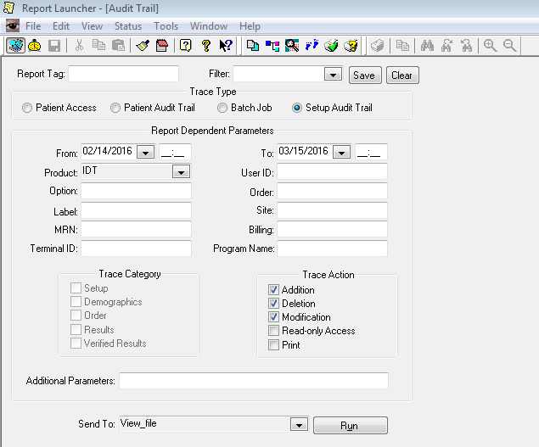
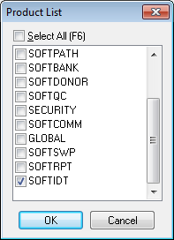
SoftID.Tx Feature review

Slide 22
SoftID.Tx Feature review

Slide 23
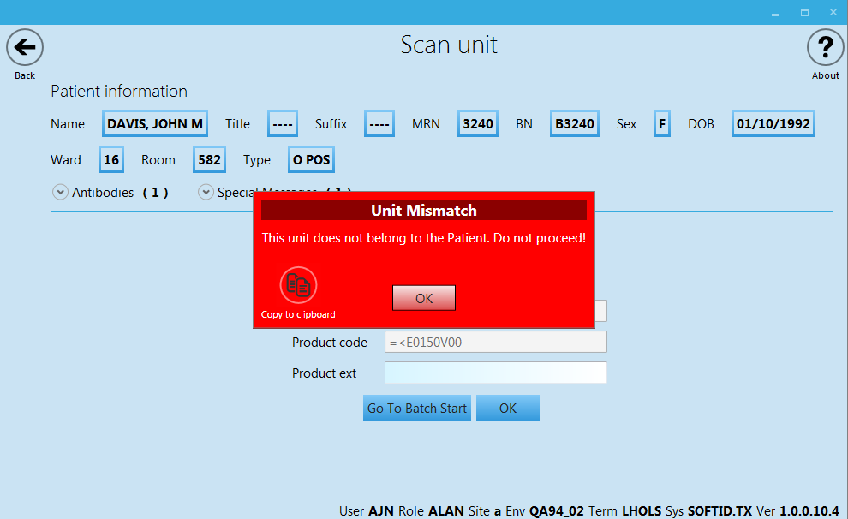
SoftID.Tx Feature review

Slide 24
SoftID.Tx Feature review

Slide 25
SoftID.Tx Feature review
Import Vitals

Slide 27
SoftID.Tx Feature review
Ease of use
3 clicks and 2 scans needed to start a Transfusion
Lets have a warm up!

Slide 29
SoftID.Tx Feature review
Auto addition of users
IT will never have to manually add a new user to Security Management nor assign a user to a role in the Admin Console
Use of Device role eliminates the need to make the assignment of user to role in the Admin consol
The first time a new user attempts to login to Tx with their network ID and password, access to Tx will be automatically granted based upon setup.
And the setup is…….

Slide 30
SoftID.Tx Feature review
Auto addition of users-Setup
Must use Domain Authentication
Must have users assigned to groups in AD
User is added to Security and assigned a role
User is assigned a Role in ID and/or Tx
Works only for a first time user
Create Template user
Go to Setting and Definitions
Go to Definitions/CSF/Security
Go to Template user’s initials….
Enter SoftID.Tx in the Setting and Setting ID fields, and in Default value field enter initials of Template user

Slide 31
SoftID.Tx Feature review
Auto addition of users-Setup Continued
Go to Settings/CSF/Security
CreatedByInitialsOnAutoImport must be set to AUTO
EnableAutoImportFromLDAP must be set to Y

Slide 32
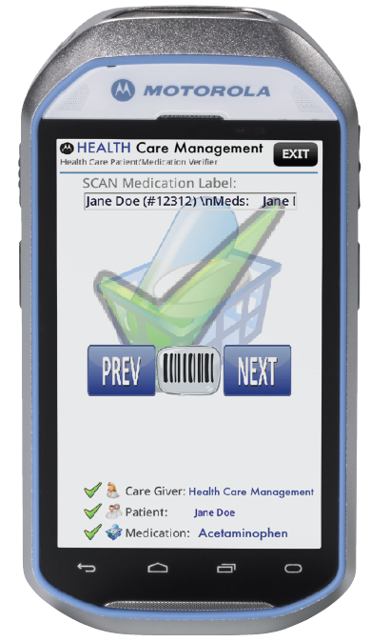
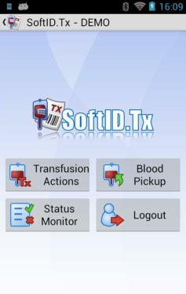
MC40 C0mpatible

Slide 33
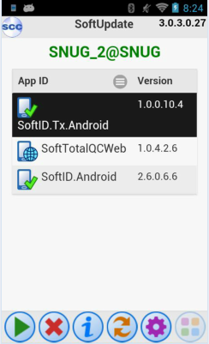
MC40 SoftUpdate

Slide 34
Ease of use in a Trauma
Start by Batch
Only have to scan two barcodes, never need to scan the expiration D/T barcode
Add Pre-vital signs to all units automatically
Add 15’ vitals without scanning
Stop units by batch
Add post vitals without scanning

Slide 36
Transfusion status monitor
Allows you to track all of your patients.
Displays information on Start/Stop/Vitals collected/Vitals due
You can look at patients on one floor
At change of shift you can assign your patient to the new nurse

Slide 38
Medal Ceremony

