Slide 1
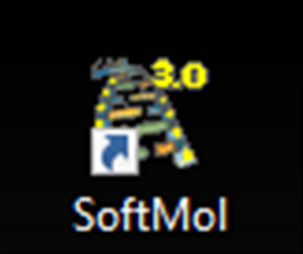
HPV in SoftMolecular
Michelle Bent-Morgan
Marcrese McDaniel
Vitalii Stadnyk, PhD.

Slide 2
Outline
What is HPV?
Importance of testing
FDA approved platforms
Configuration in SoftMolecular
Process and Reporting in SoftMolecular

Slide 3
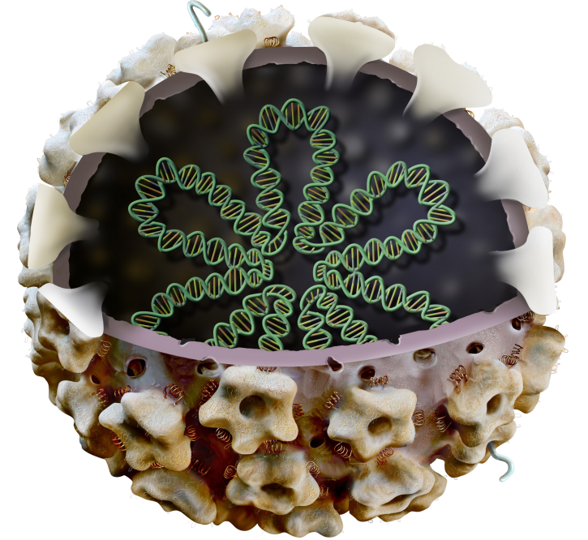
What is HPV?
HPV is a small, nonenveloped, double-stranded DNA virus
genome Size of approximately 8,000 nucleotides.
more than 118 different types of HPV
approximately 40 different HPVs that can infect the human anogenital mucosa

Slide 4
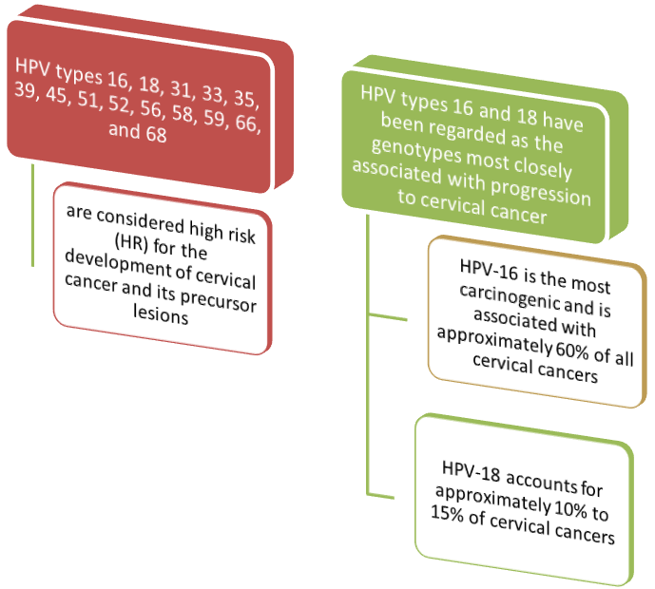
Types of HPV:
data suggests that 14 of these types are most clinically significant

Slide 6
Clinical significance and importance of HPV testing
yearly, over 27,000 women and men are affected by a cancer caused by HPV

Slide 7
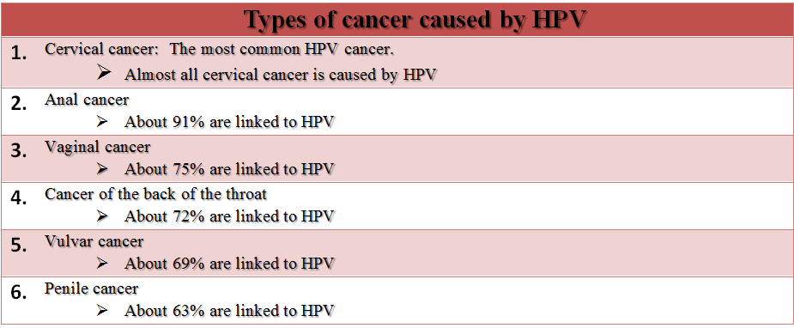
Clinical significance and importance of HPV testing
According to CDC data, Persistent HPV infection can cause cervical and other cancers
*Note: Many of these cancers may be related to tobacco and alcohol use

Slide 8
FDA Approved (IVD) platforms used for HPV testing

Slide 9
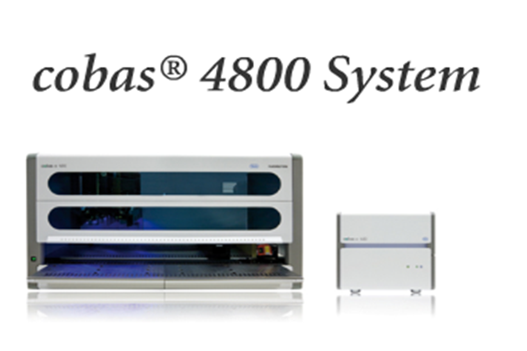
Cobas 4800 HPV test is a high-risk–HPV DNA-based PCR screening assay with capability for concurrent genotyping for HPV 16 and HPV 18 by real-time PCR.

Slide 10
Nucleic acid (DNA) testing by PCR has become a standard, noninvasive method for determining the presence of a cervical HPV infection. Proper implementation of nucleic acid testing for HPV may 1) increase the sensitivity of cervical cancer screening programs by detecting high-risk lesions earlier in women 30 years and older with normal cytology and 2) reduce the need for unnecessary colposcopy and treatment in patients 21 and older with cytology results showing atypical squamous cells of undetermined significance (ASC-US).

Slide 11
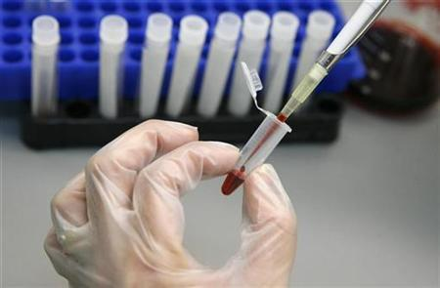
Nucleic acid (DNA) testing by PCR has become a standard, noninvasive method for determining the presence of a cervical HPV infection. Proper implementation of nucleic acid testing for HPV may
increase the sensitivity of cervical cancer screening programs by detecting high-risk lesions earlier in women 30 years and older with normal cytology and
reduce the need for unnecessary colposcopy and treatment in patients 21 and older with cytology results showing atypical squamous cells of undetermined significance (ASC-US).

Slide 12
Setting up HPV in SoftMolecular 1. Need action to create protocol 2. Create protocol 3. Create report template 4. Create test 5. Create tasklist

Slide 13
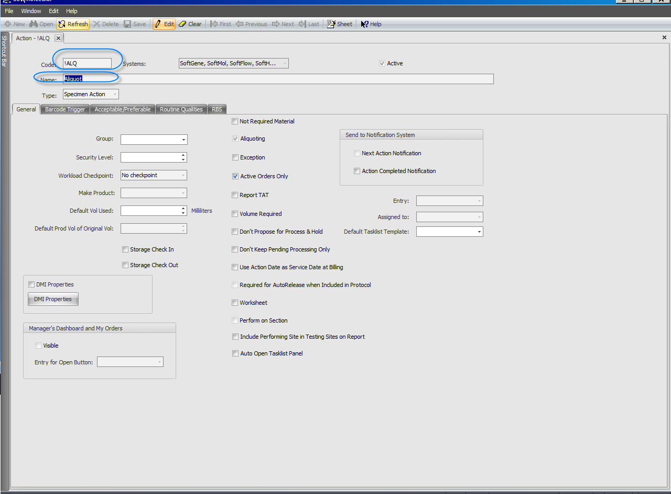
We need an Aliquot action in our protocol

Slide 14
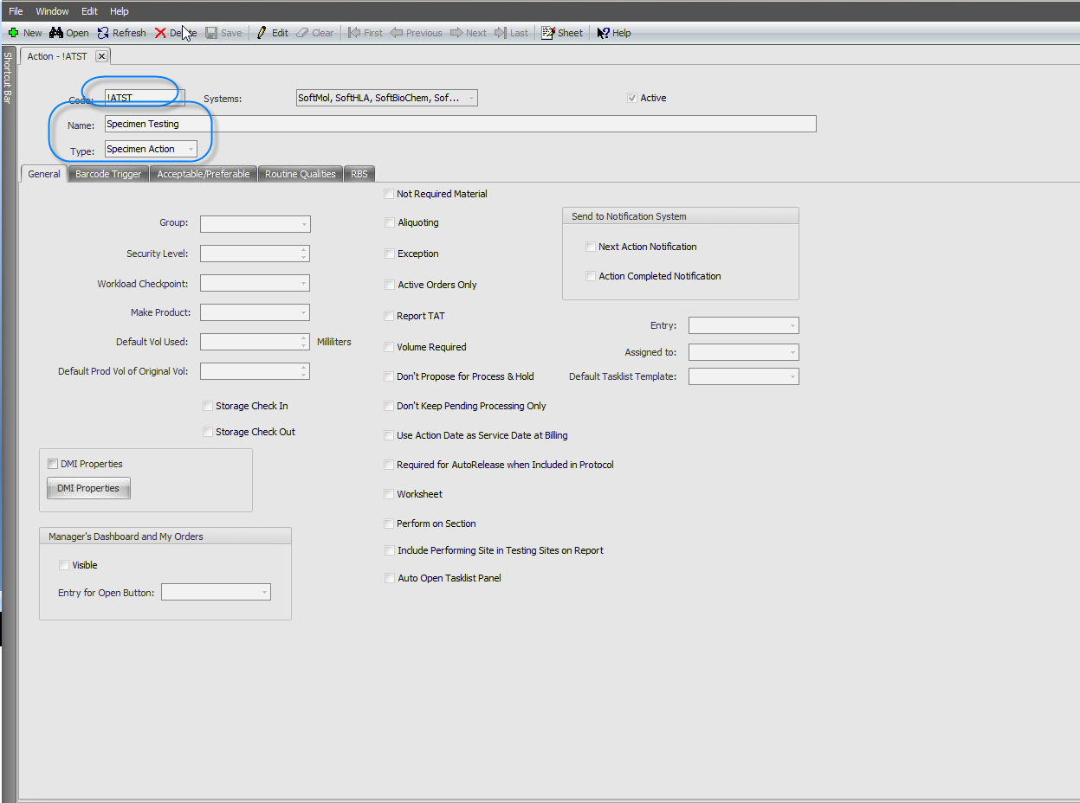

Slide 15
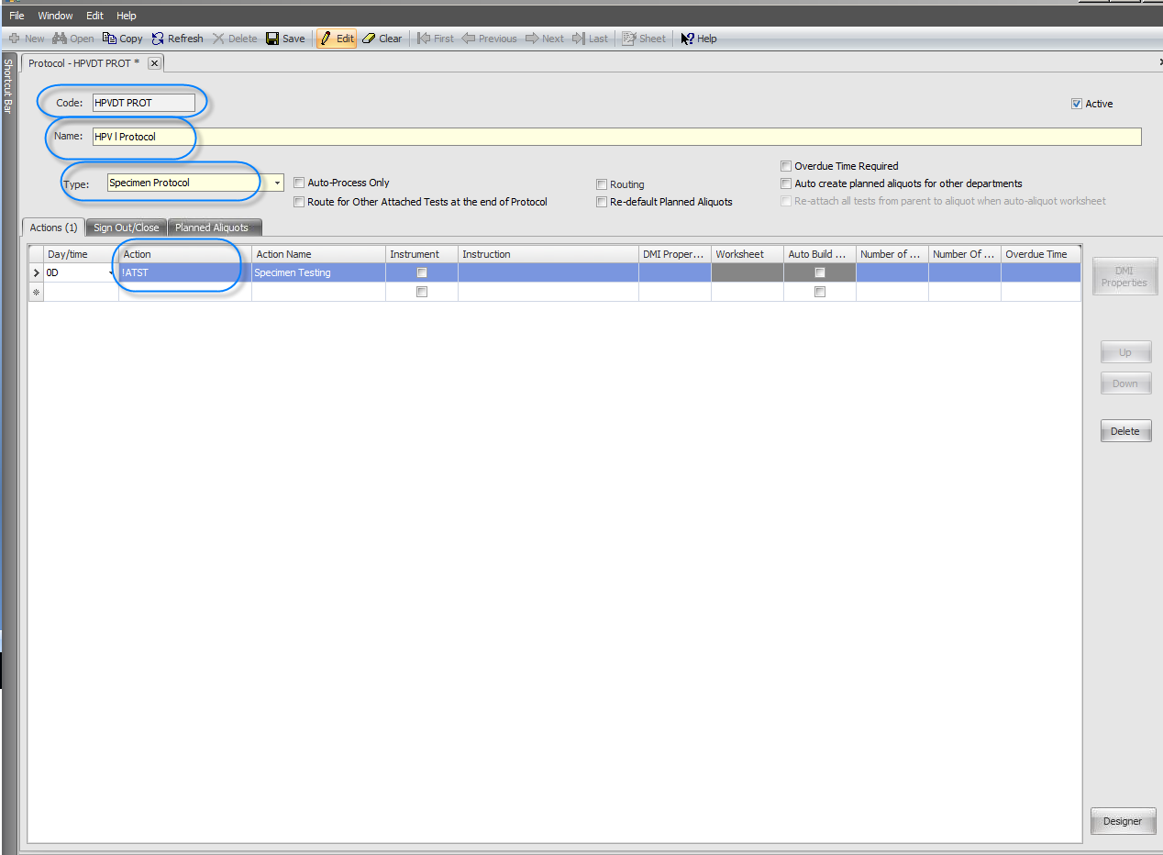
Protocol
Creation of Specimen Protocol

Slide 16
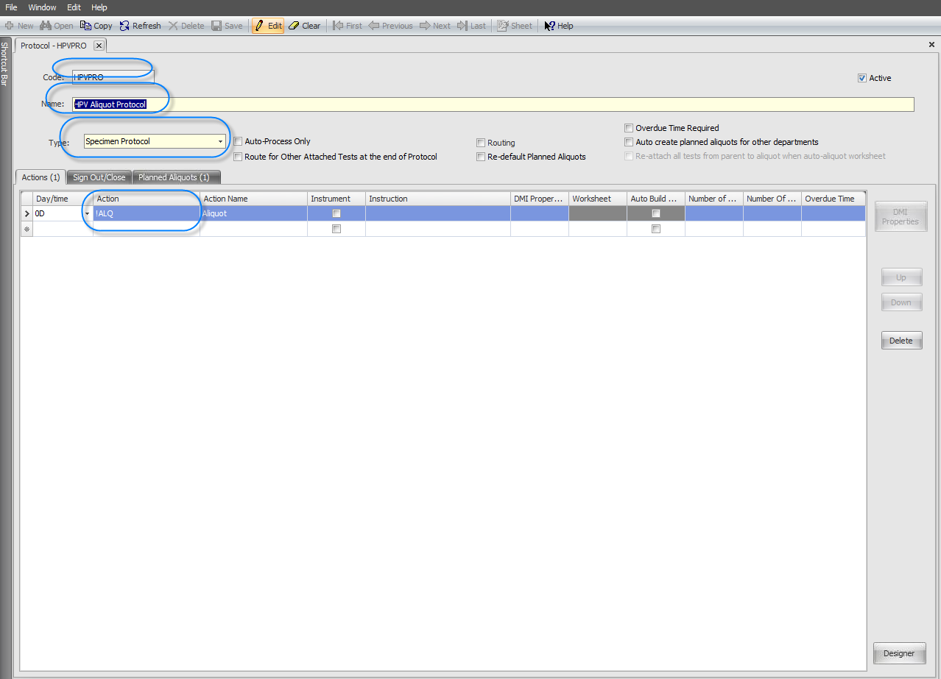

Slide 17
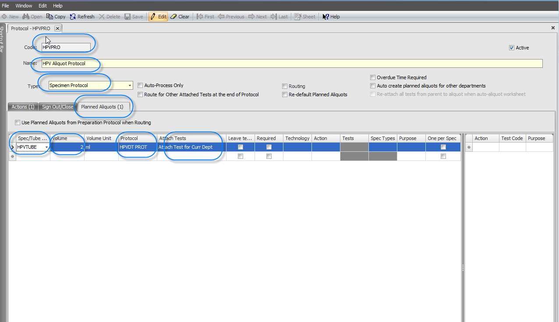

Slide 18
Create report template Create test.

Slide 19
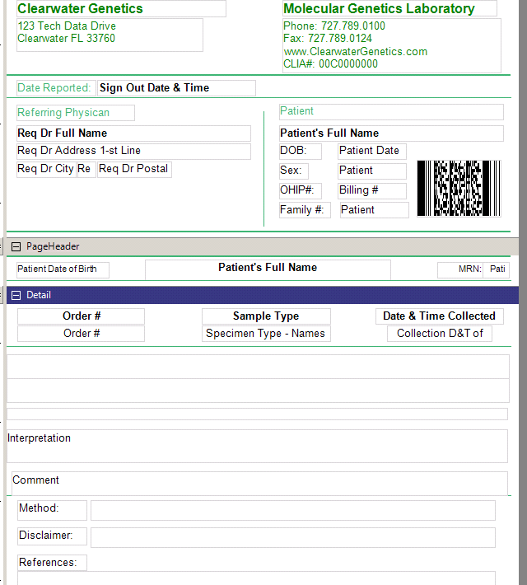
Test Specific Report Template

Slide 20
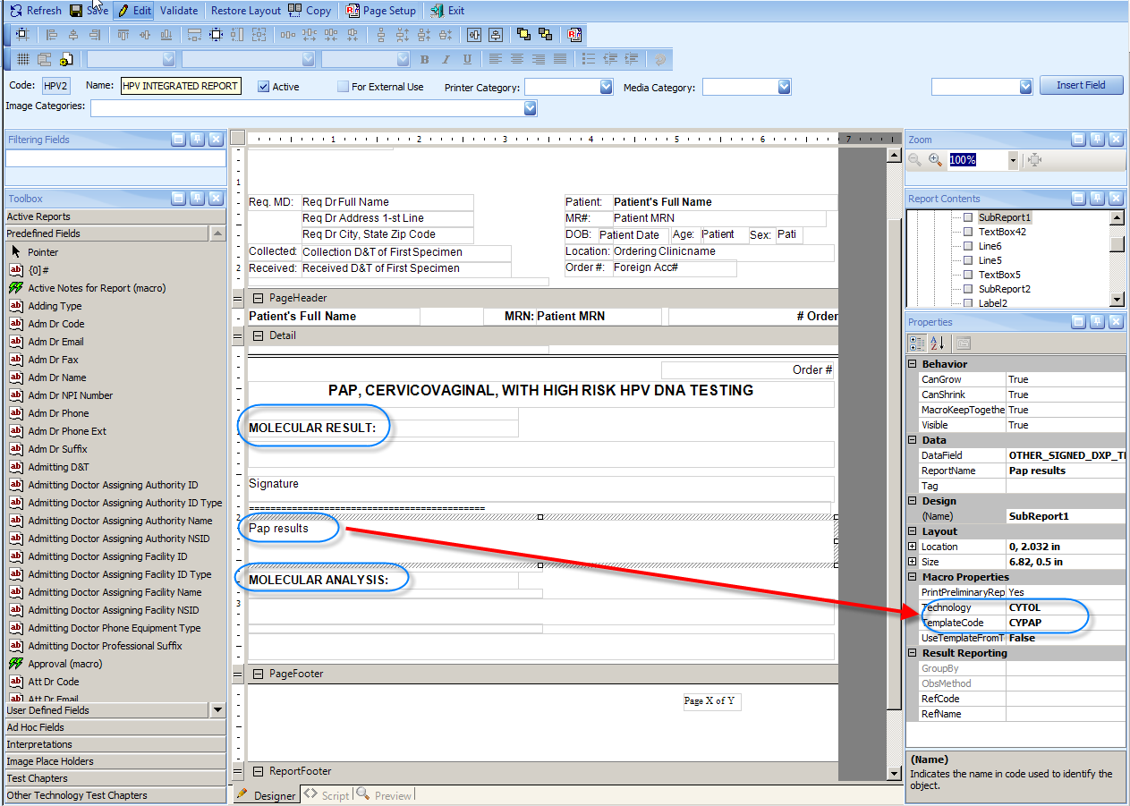
An integrated report Template

Slide 21
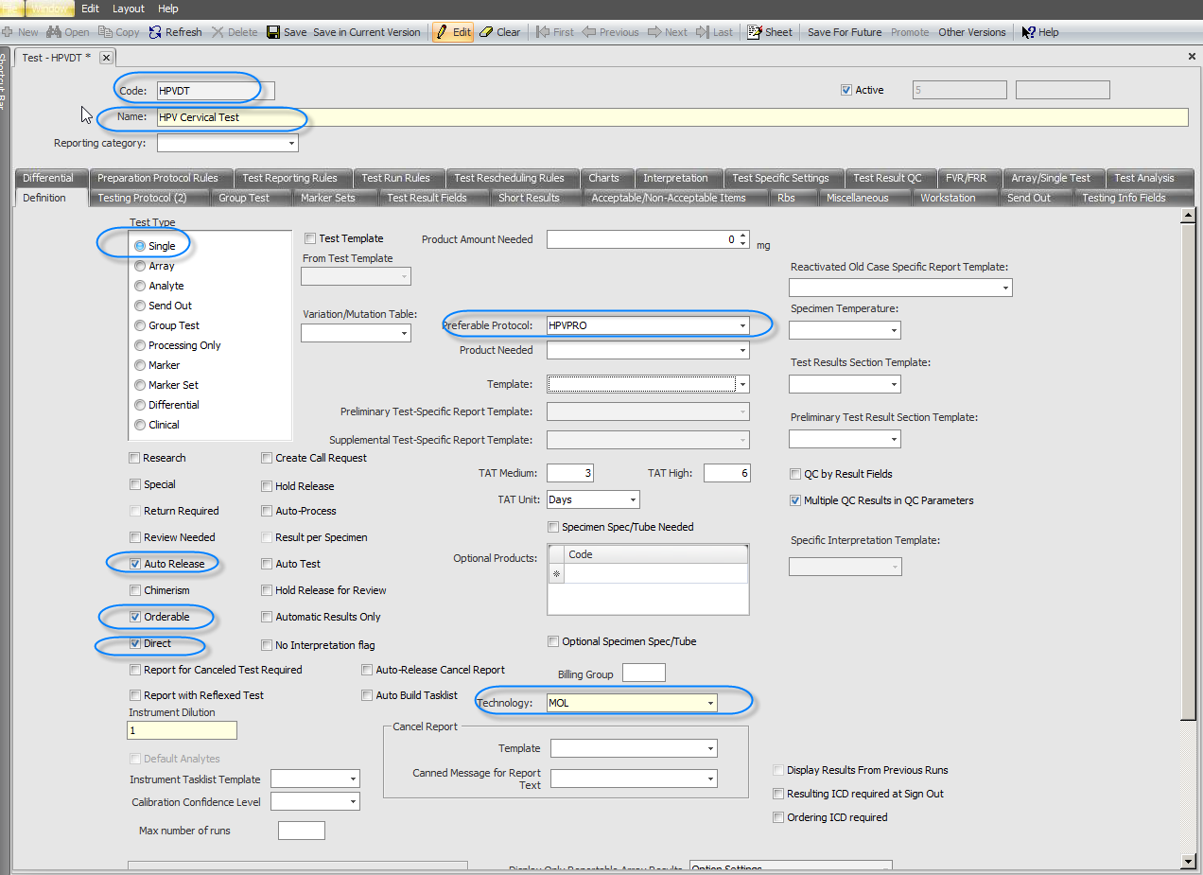
Test Definition

Slide 22
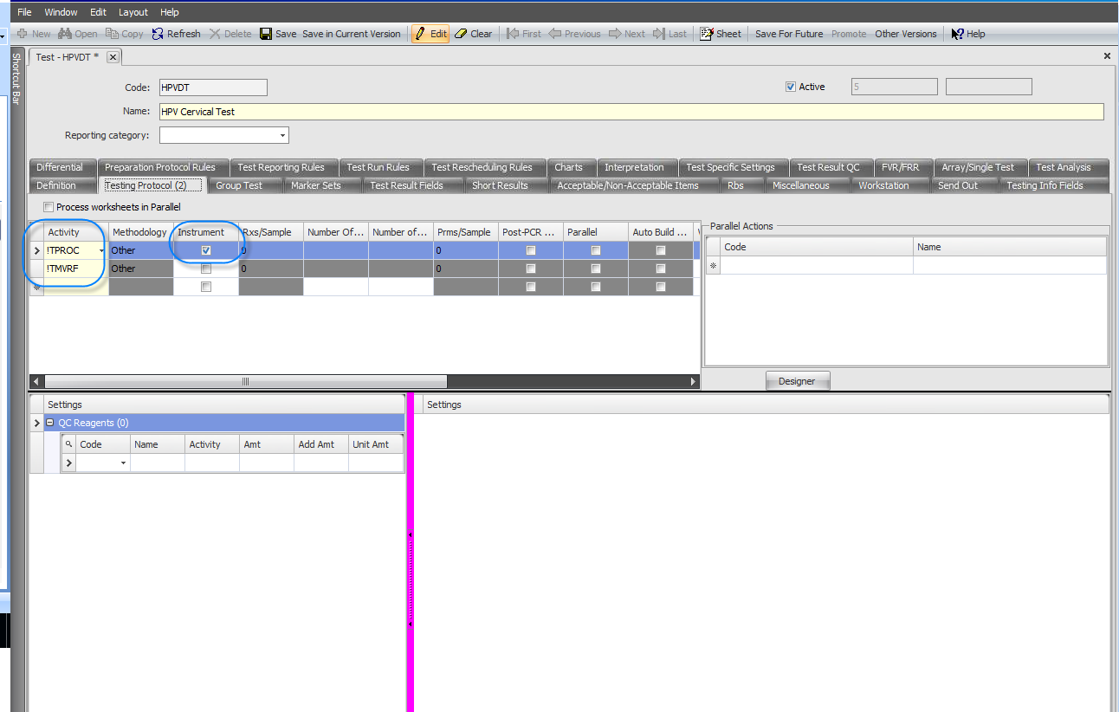
Actions to perform on test

Slide 23
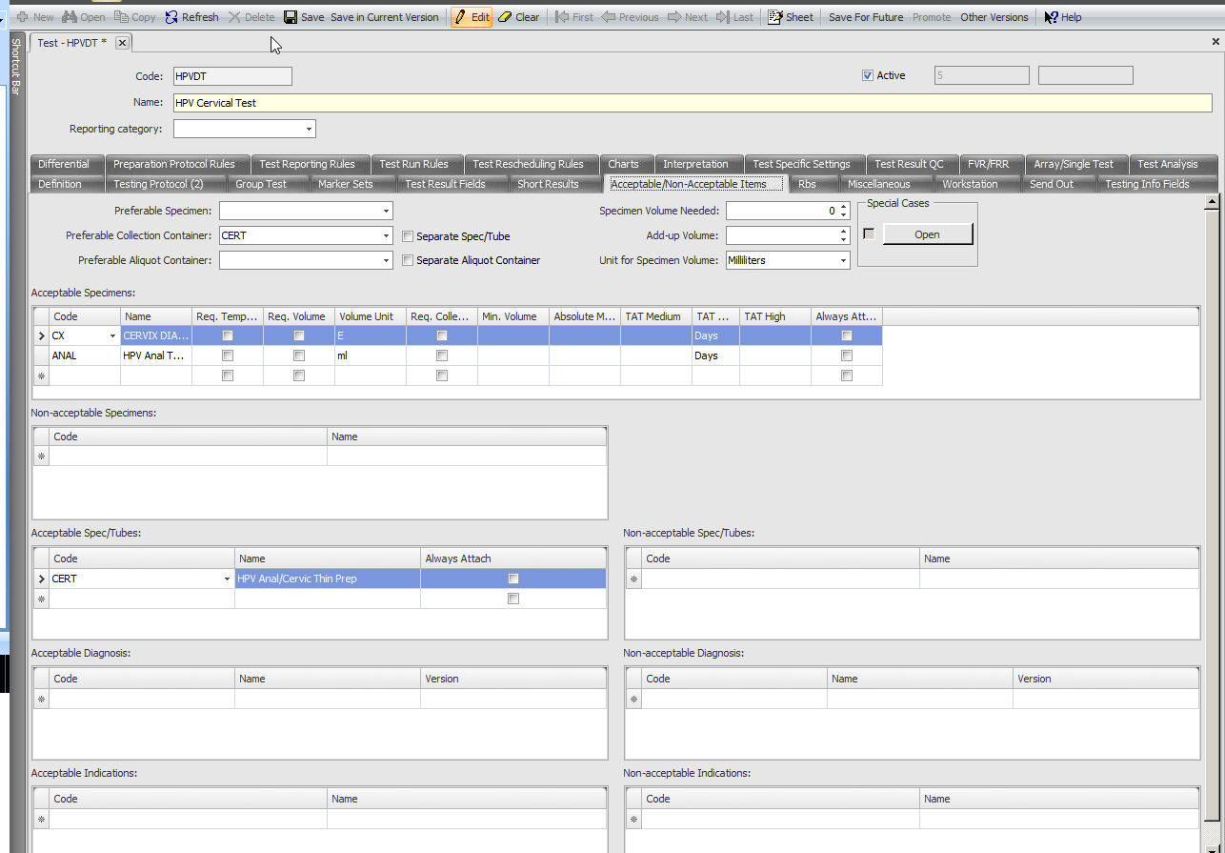
List of acceptable specimens

Slide 24
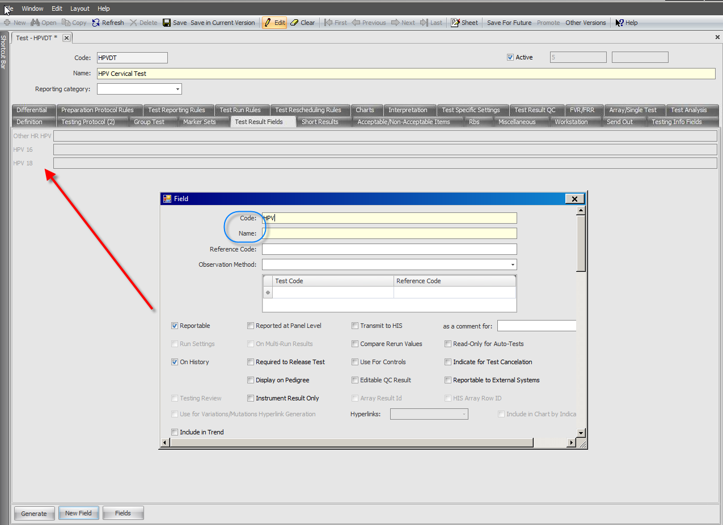
Creation of Result fields

Slide 25
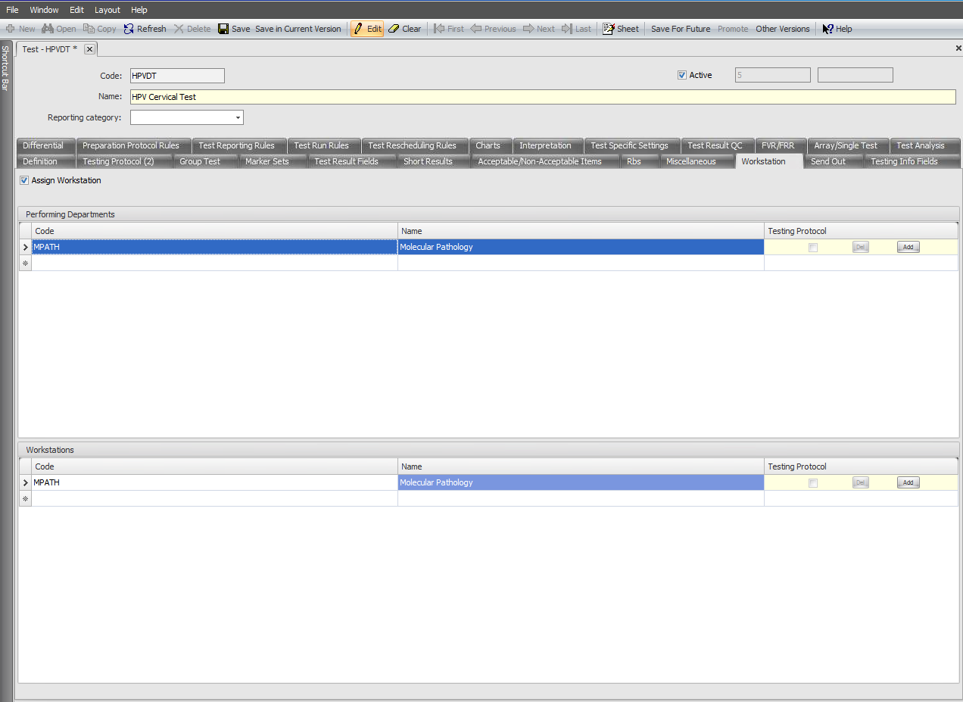
Performing department and workstation need for DMI and SoftTQC

Slide 26
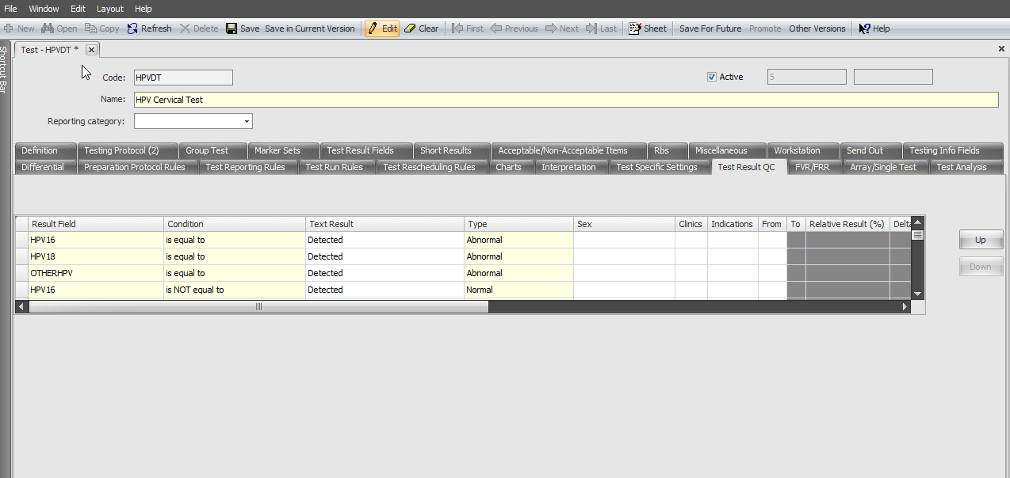
Result QC to show abnormal flagging of result on tasklist

Slide 27
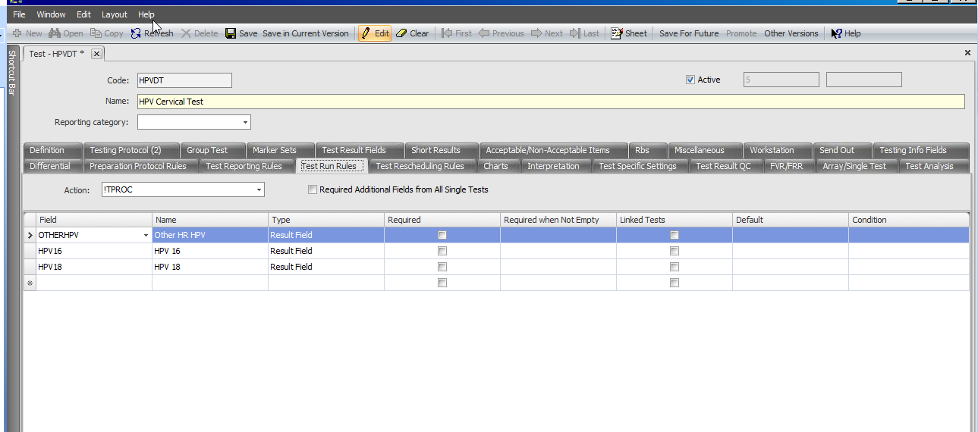
Test Run Rules need for DMI configuration to send results back to Softmolecular

Slide 28
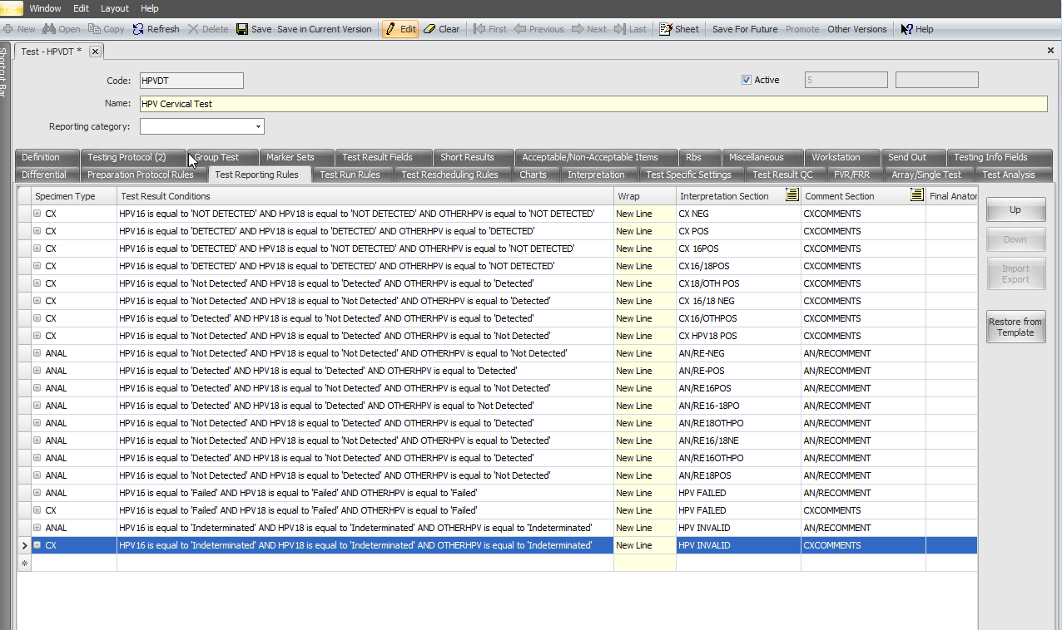
Test Reporting Rules for defaulting Interpretation on tasklist

Slide 29
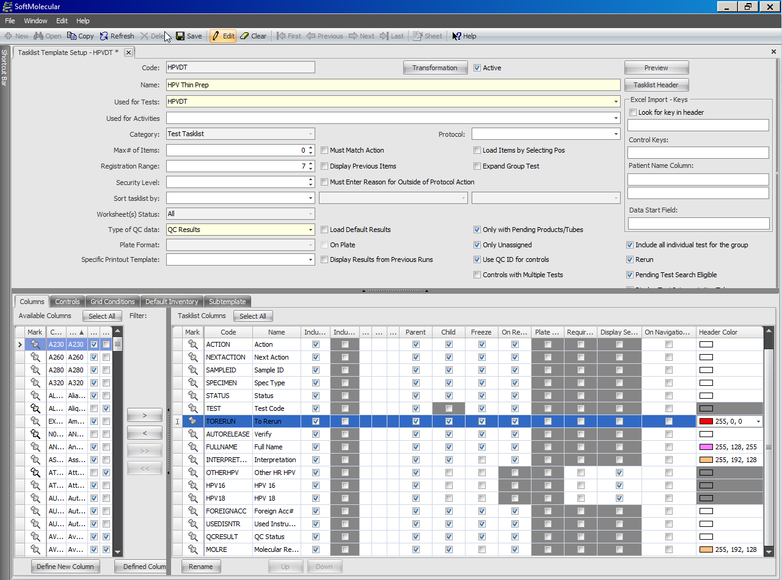
Creation of Tasklist template

Slide 30
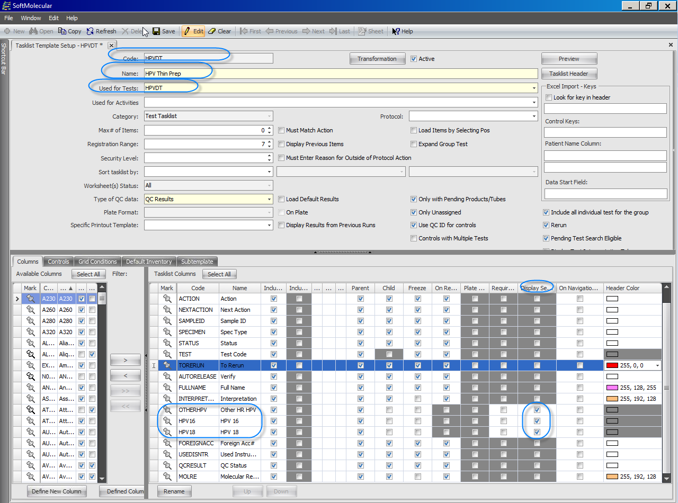

Slide 31
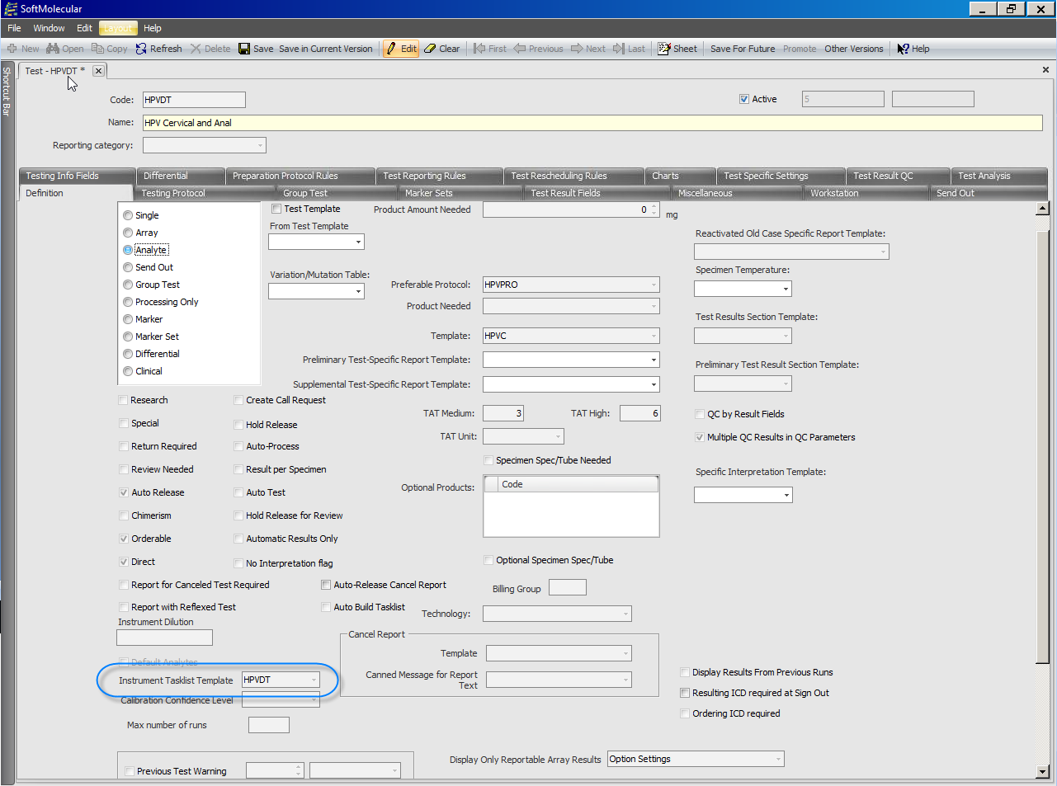
Test Setup showing Tasklist linkage for Automatic DMI tasklist build

Slide 32
Where do we get our samples
From Softlab, Directly entered into SoftMolecular or PathDXP as a reflex test. Samples can come thru Specimen receiving worklist, Dept Received or directly in Specimen Prep based on setup and integration

Slide 33
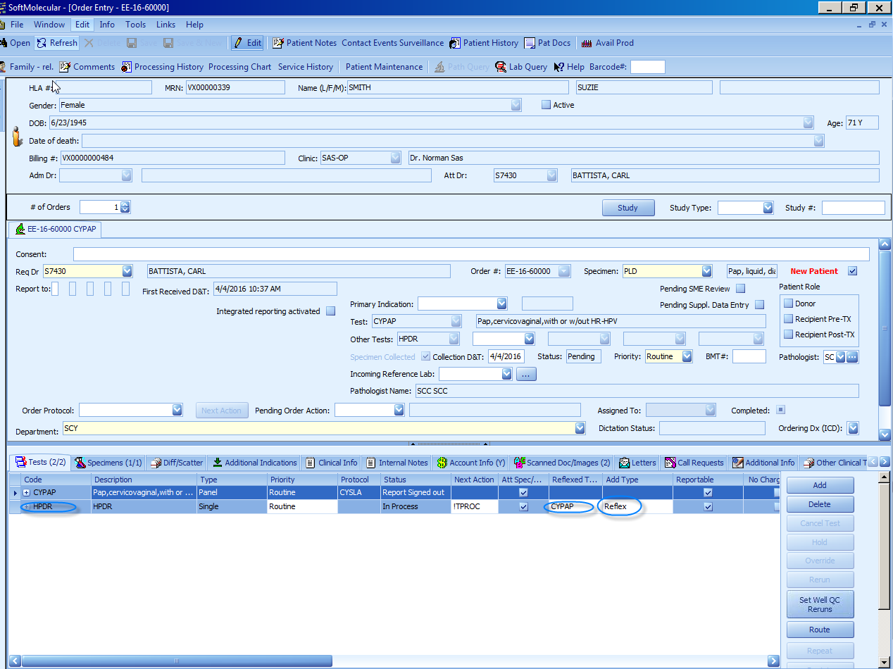
Reflex from SoftPathDX

Slide 34
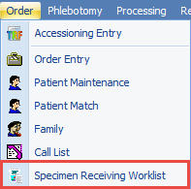

Slide 35
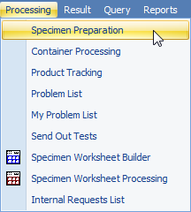
Specimen Processing in Softmolecular
In toolbar, click Processing then Specimen Preparation

Slide 36
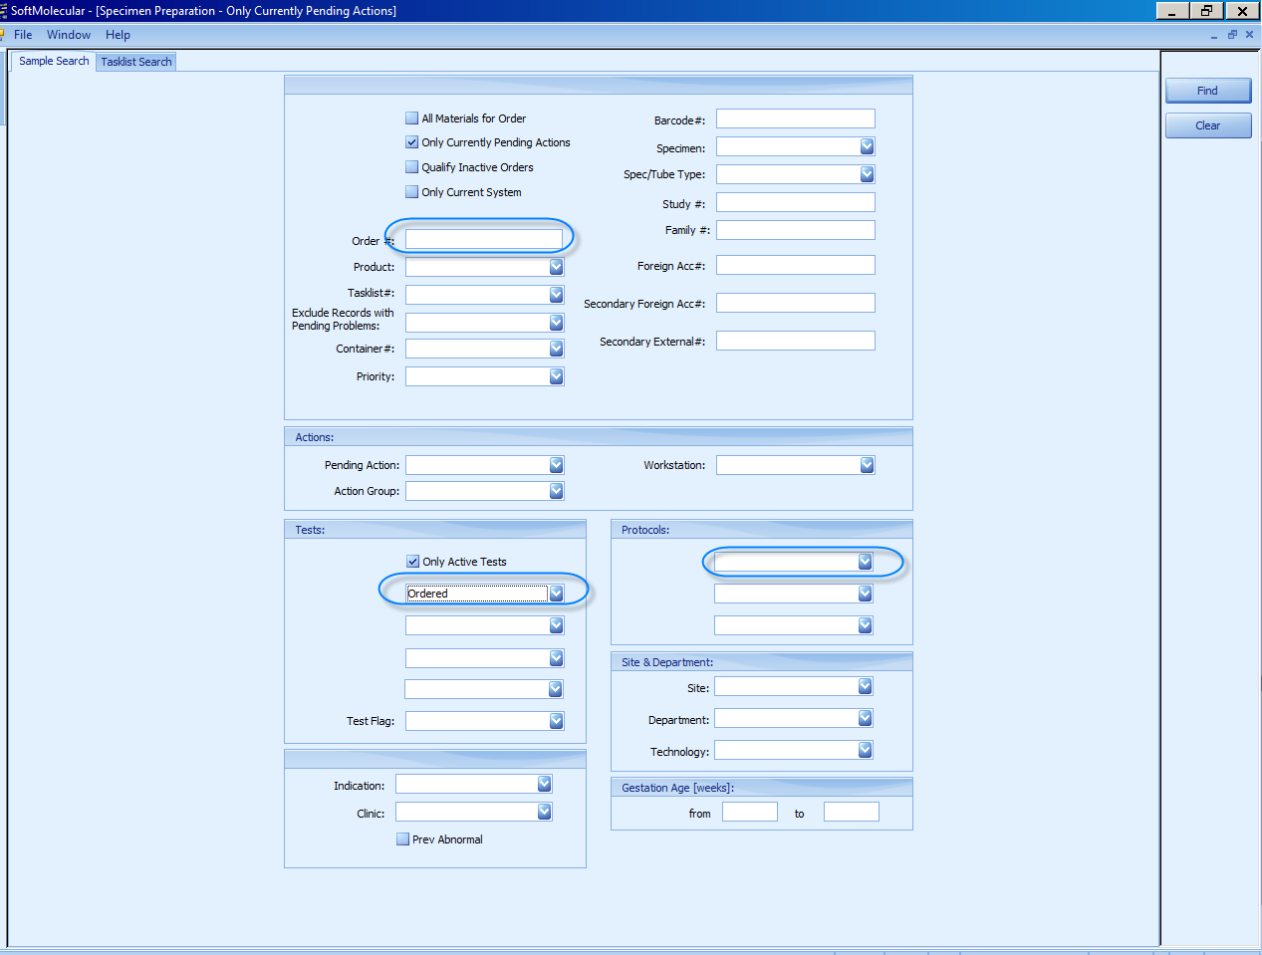
Search by Test name for list of all orders pending for that test
Or search by Order # if its one order only or Protocols

Slide 37
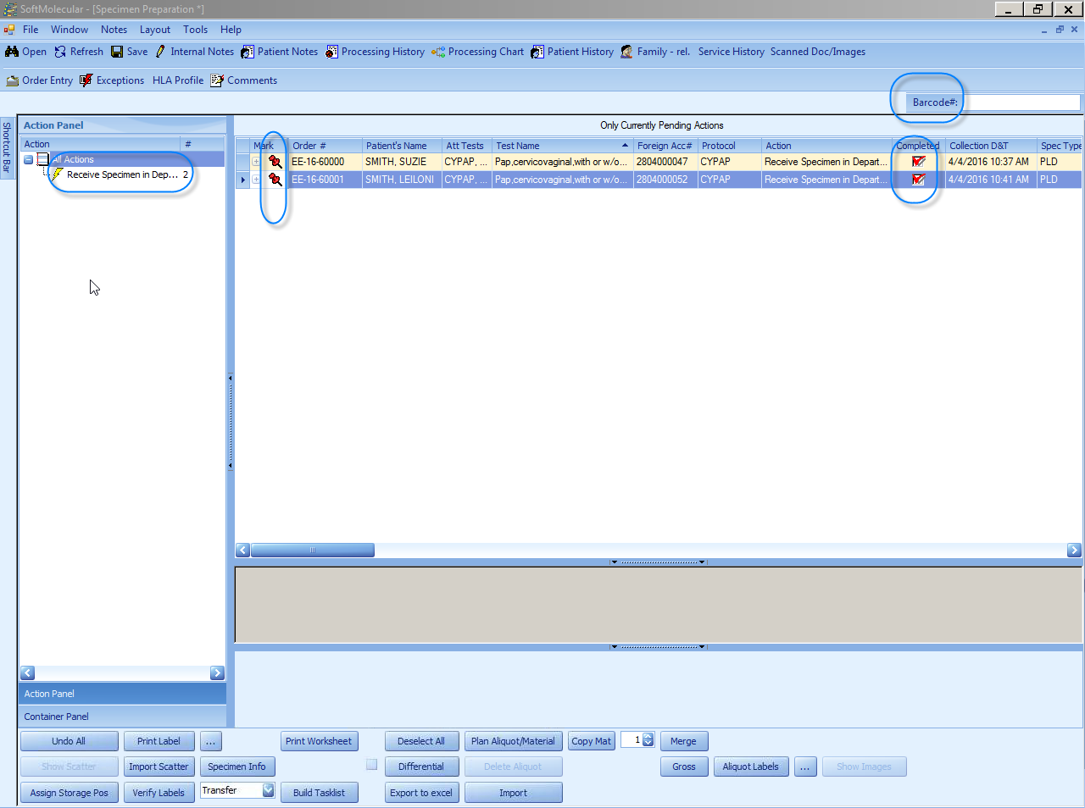

Slide 38
Processing in Cobas interface with DMI and SoftMolecular.
Load the Cobas by scanning the Specimen bar code
Once the Cobas instrument completes running the test
After the instrument finishes running click send results to LIS in the instrument

Slide 39
Open SoftMolecular main screen
In toolbar, click Result then Tasklist

Slide 40
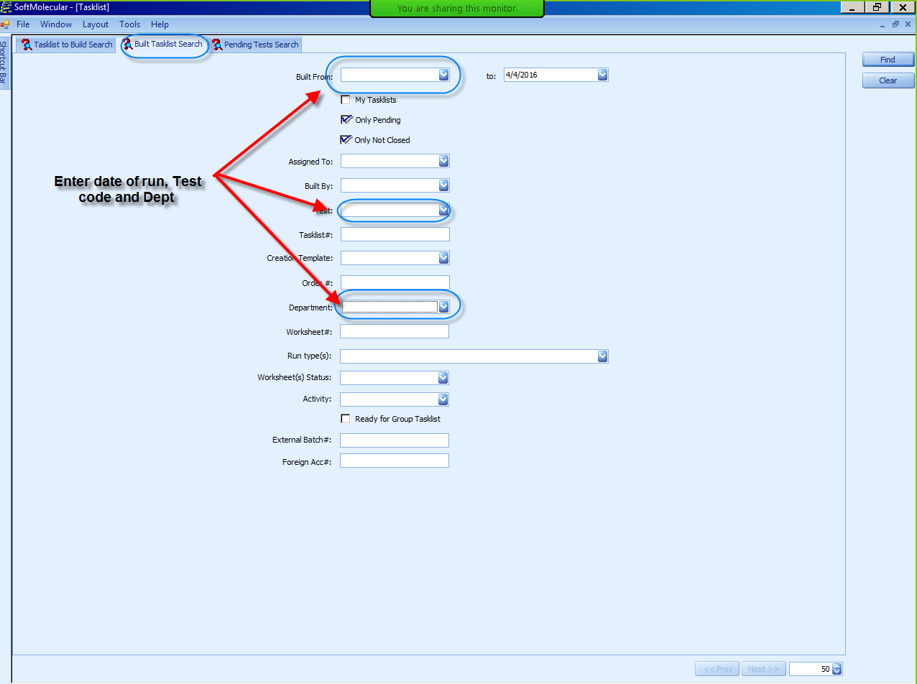
Search by Built Tasklist search and use the Date range as search criteria (RUN DATE)

Slide 41
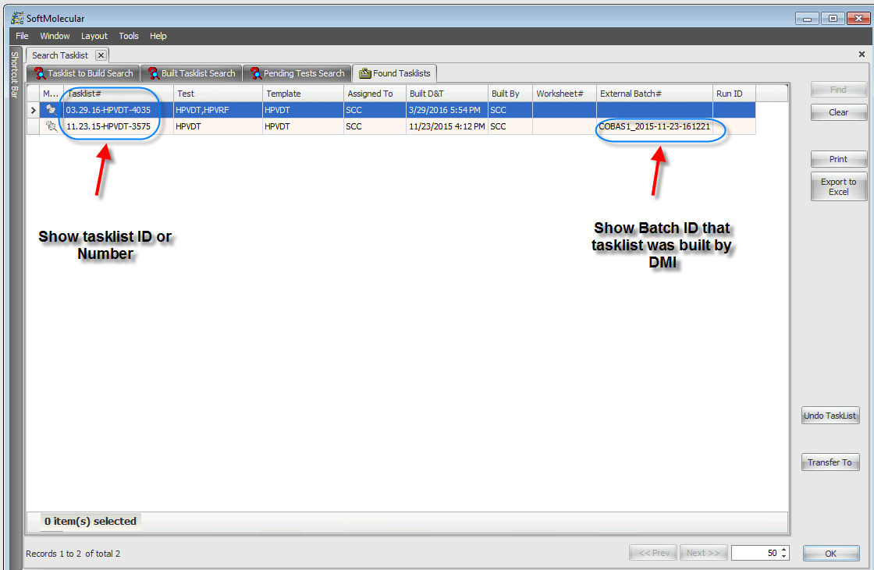
Select Tasklist# and External Batch # that matches your run

Slide 42
Results Downloaded by DMI to SoftMolecular

Slide 43
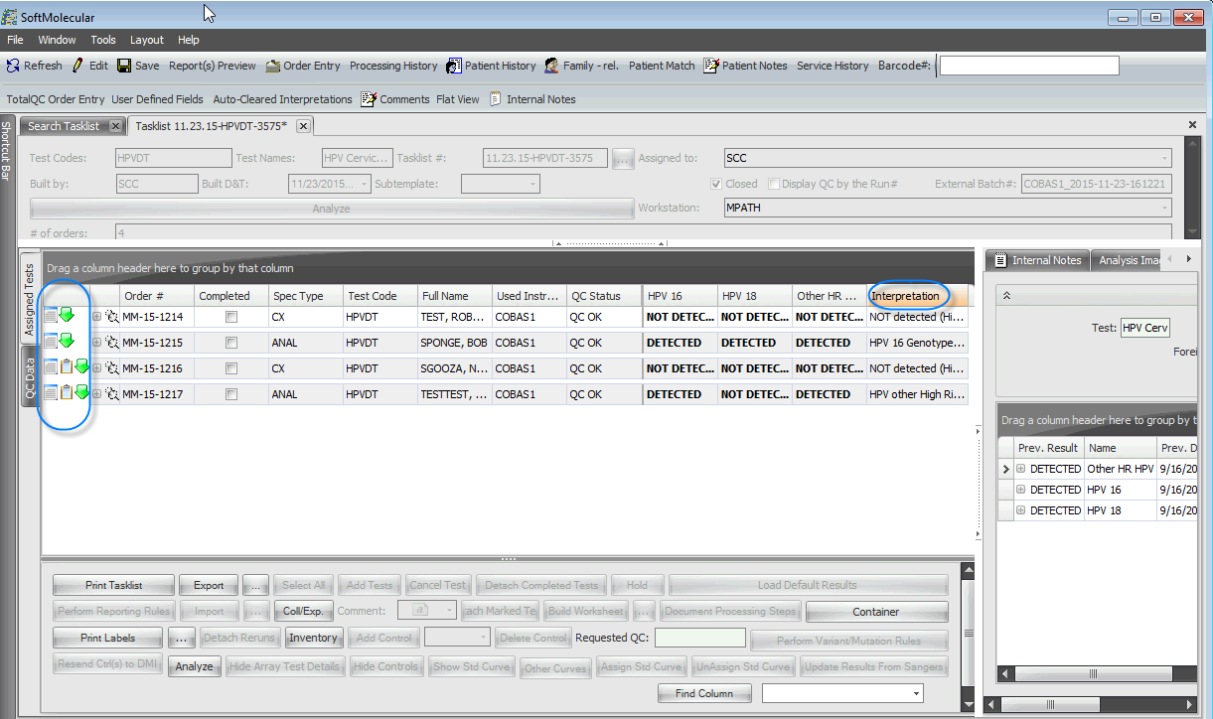
Results from Instrument are downloaded and base on RBS setup, rules are set to run to default interpretation

Slide 44
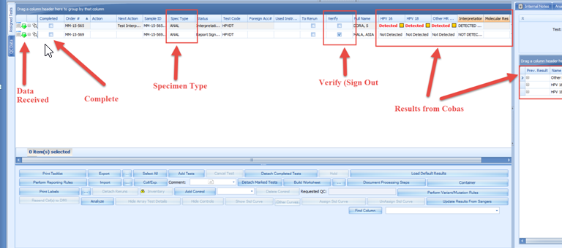
Once the tasklist open, Review imported results (Data received symbol)
Review QC Results
Check the completed box to complete Test Manual Review Action and Click Save
Click Edit, Detected Results will be highlighted in Red.

Slide 45
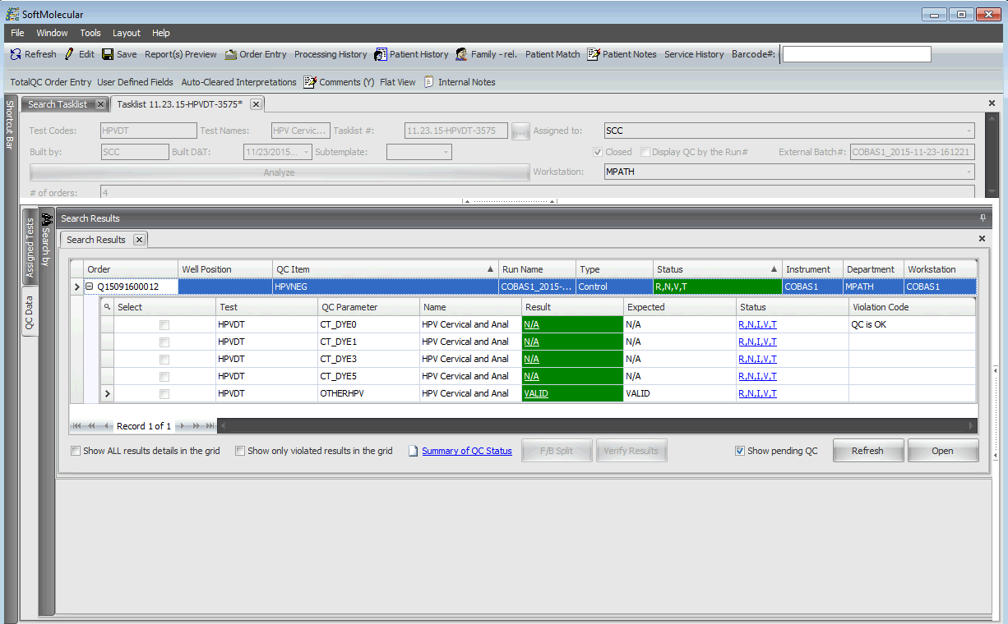
Control Results Downloaded by DMI to SoftTQC

Slide 46
Test Specific Report

Slide 47
An Integrated Report Showing Molecular and Cytology Results

Slide 49
Reference
Human Papillomavirus (HPV) and Cancer. (2016). Retrieved April 01, 2016, from http://www.cdc.gov/cancer/hpv/index.htm
MLO Staff. (n.d.). Retrieved April 01, 2016, from http://www.mlo-online.com/the-five-fda-approved-hpv-assays.php
cobas® 4800 System . (n.d.). Retrieved March 18, 2016, from http://molecular.roche.com/instruments/Pages/cobas4800System.aspx

