Slide 1
The Pathologist Review Process by Gerald M. Davis BS, MT(ASCP), MPH jdavis@med.umich.edu University of Michigan Hospitals Department of Hematopathology

Slide 2
UMMC

Slide 3
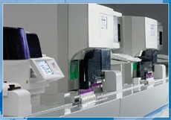
The Hematology Laboratory
Sysmex XE 5000
CBC
Automated differential – 6 part
NRBCs
Platelet count
Reticulocyte count
Body fluid counts
Jan 1, 2016 – April 1, 2016
1797/day (including week-ends)
63% case auto-validate
26% partial auto-validate
14% need a slide review

Slide 4
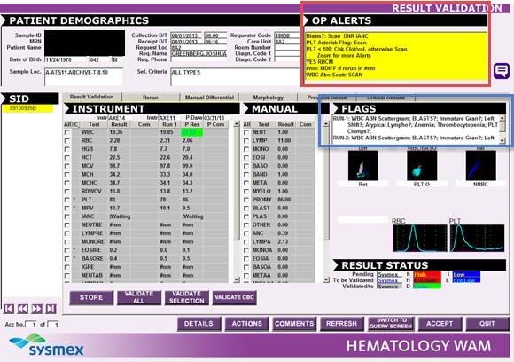
CBCD – CBC and Differential
WAM
Sysmex messages - Flags
Used-defined rules – OP Alerts
Slide is made

Slide 5
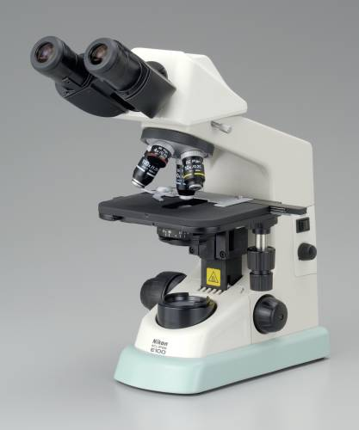
Slide WBC differential
Correlate and confirm CBC findings
Automated differential vs. the Slide differential
Scan for specific findings
Misclassification of cells by the instrument
Abnormal cells – blasts, plasma cells,
lymphoma cells, etc.
Platelet clumps
Inclusions

Slide 6
We Need What?...Path Review Criteria?

Slide 7
Objectives A Stepwise approach to….
What ducks do I need to get in a row?
How do I get from where I am now to where I want to be?
What are the pieces that I need?
How do they fit together?
What are the advantages?
What metric do I use to measure the advantages?
Is this really all there is? Where to go from here…

Slide 8
What should it be like?.....
Would it be something you can use with a microscope?
What do you need to have happen?
Should it be difficult or easy to use?
Who is going to benefit from this process?
Will it be seamless or painful?

Slide 9
It Needs To Be All Of That…
The “Pathologist Review interpretation” needs to be displayed with ordered test in the HIS.
Temporary work queues for Pathologists
One order number for everything
Embargo enabled 14 day delay (including mandiff blasts)
System Lean
No Pathologist Phantom directing user to see the CBCD test with same collection date and time.
No billing or PREVD phantom tests required
Improved and more clear display of Path Rev
Zero impact on staff (processing or training)

Slide 10
What if we …..
Used the absorption function of Soft to absorb the CBCD into CBCPR (CBCD with PR)
Streamline specimen processing
Lessen the impact of change control on staff
Commitment to continual improvement
Increase communication internally
Work with Soft and nurture the relationship
Task follow up and tracking
SCR (Software Change Request)

Slide 11
UM Pathologist Review Criteria

Slide 12
Step 1: Add The Pathologist ReviewComponent

Slide 13
Here is the Path Rev Workflow

Slide 14
Step 2: Ordering A Path Rev On The Fly in WAM or Resulting Worlist Needs to be Seamless…

Slide 15
Seamless In Resulting Worklist Too…

Slide 16
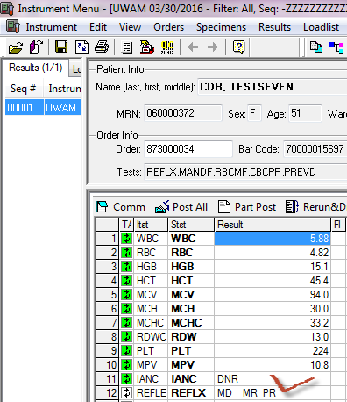
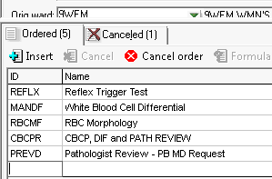
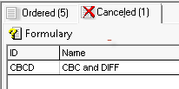
What Just Happened?...
1. CBCPR was reflexed and CBCD was canned

Slide 17
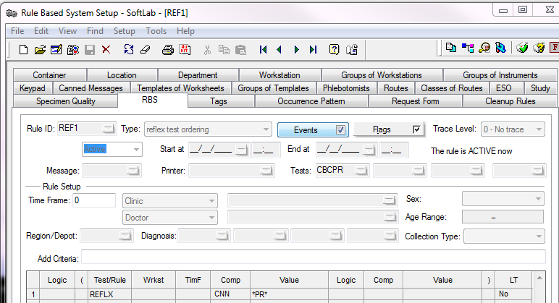
Step3: Build RBS Rule To Reflex “Path Rev” Test

Slide 18
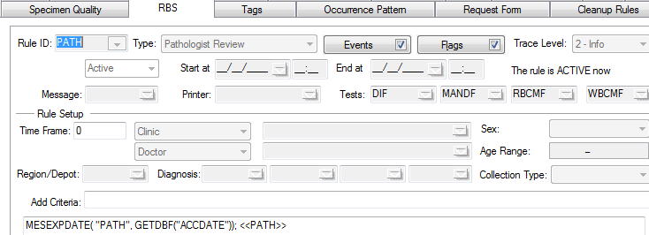
Step 4: Build Canned Message & RBS Rule To Get Those Cell Lines Marked “ + ” For Path Rev?
Check F41 in Test Setup for individual test

Slide 19
WAM Path Rev In Resulting Worklist…

Slide 20
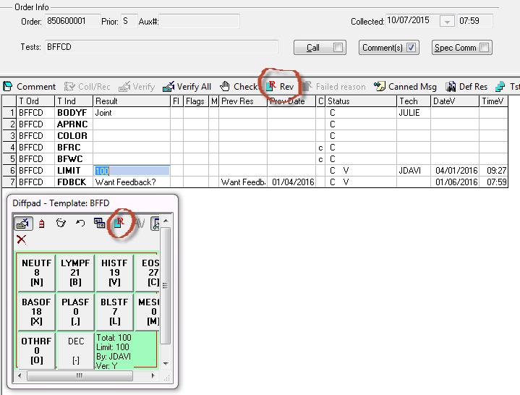
…Or…Use A Template For Reflexing Path Rev Test

Slide 21
Step 5: How To Qualify Case To “Review Worklist”

Slide 22
Step 6: Final Review

Slide 23
Pathologist Interpretation…

Slide 24
HIS – This was then…..

Slide 25
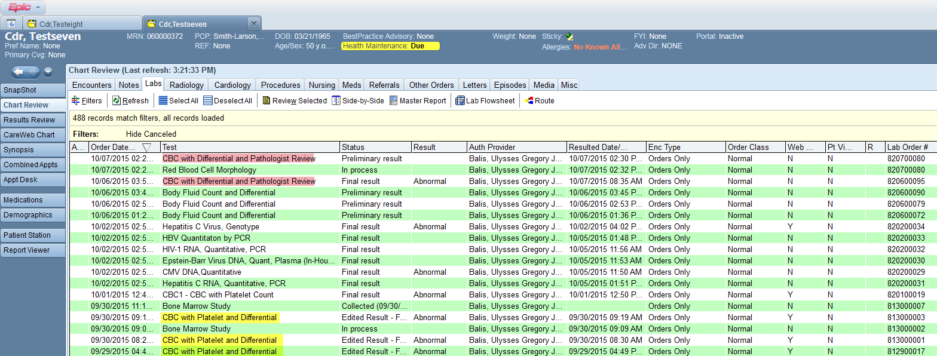
This is now…….(No Phantom)

Slide 26
Where else are you going to get the CBC, Diff, Abs. Cts., and Path Rev Interp on the same screen ?

Slide 27
Pathologist Queues ?
1. You need to manually enter as phantom test …or…. 2. Make a rule that reflexes the phantom (result =Pathologist)

Slide 28
Pathologist Personal Queue?

Slide 29
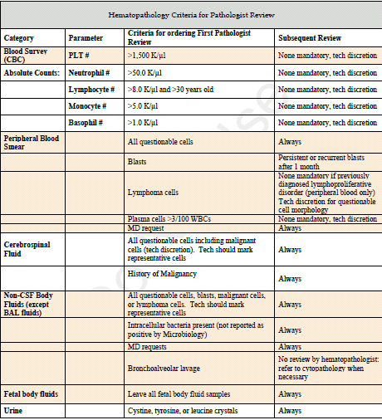
Managing the Path Rev Process

Slide 30
Tweaking The Process
We changed the Path Rev criteria…..
There were Path Review changes to
MCV
fluid crystals
NRBCs
apheresis patients not reviewed for increased WBCs and blasts, etc.

Slide 31
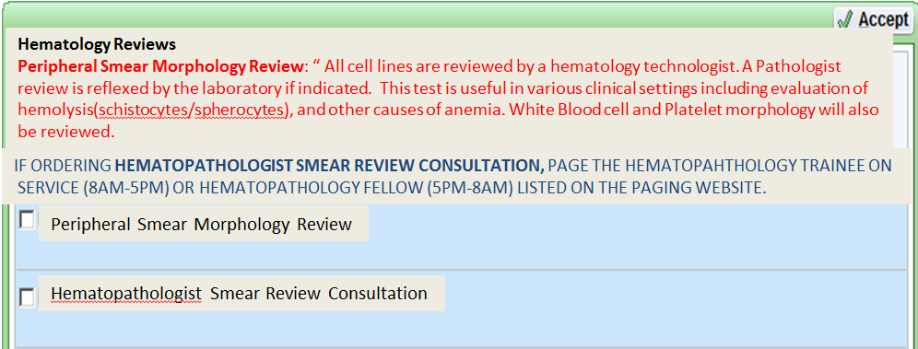
What do you mean “You want a peripheral smear”
We disabled the ability to order the Path Review as a standing order
The Hem lab staff directs the MD phone calls requesting a Path Rev, to the trainee who triages for a valid reason for the request
At the HIS level we offered the tech an alternative to the Path Rev that ensures a peripheral smear is scanned

Slide 32
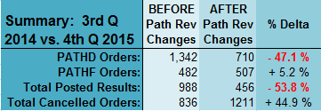
What Can Tweaking Do For You?

Slide 33
Protecting the RED line…

Slide 34
SCR Hot Items Coming….
Assign & track Path Rev cases
Defaulting Pathologist assignment
Dynamic automatic status updating per case
Sorting per Pathologist and/or per case
Mechanism for case transfer
Review Worklist screen modifications
SCR 09747
Revised report modifications (auto template)

Slide 35
Thank you.
Thank you.

