Slide 1
SoftUpdate 3.0.3
New features
and
management technique

Slide 2
Comparing 3.0.3 UMC with older 3.0.1 and 3.0.2 releases
 | 3.0.1 | 3.0.2 | 3.0.3
Native Win32 app | X
Web app |  | X | X
Supports text-based browsers (e.g. elinks) |  | X
Supports modern GUI browsers (e.g. IE10, Chrome, Firefox) |  | X | X
Supports enhanced graphical features and intuitive interactive GUI controls | X |  | X
Offers the complete access to all management functions in SoftUpdate without command line specific tools |  |  | X
Offers context sensitive help and detailed user guide |  |  | X
Enhanced security |  |  | X

Slide 3
SoftUpdate features added in 3.0.3 release
All new UMC Web application that provides access to all deployment, configuration and management functions for SoftUpdate
Introduced new “Device Types” configuration for easier linking service specific apps with corresponding devices (e.g. formatters, portal, etc)
Universal cross-platform agent for integrating UNIX server run-time environments with SoftUpdate infrastructure
Support for Android based devices
Workload management allowing to submit RUP commands to thousands devices without clogging the network or stressing the server
Flexible custom report system with data export to various formats
Consolidated management of applications and environments
Consolidated RUP commands interface for individual devices and groups
UMC built-in help system with context sensitive help and custom help builder
Monitoring of all vital SoftUpdate metrics and activities
Enhanced security with detailed audit trail

Slide 4
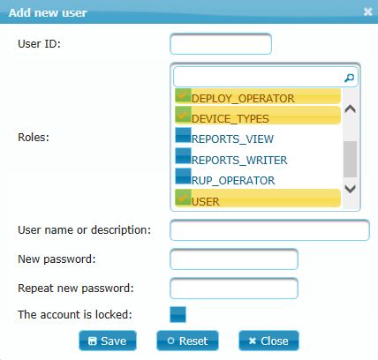
Security Tips for UMC (UMC => Setup => Users)
Never create or use shared accounts in UMC for the group of people
Always create only individual user accounts for each eligible UMC Operator
Do not assign “ADMIN” role to all newly created users in UMC
Assign multiple roles instead, if possible to minimize unwanted impact on SoftUpdate infrastructure by inexperienced Operator
Three unsuccessful login attempts to UMC will automatically lock the account
Each Operator logged into UMC can change his/her password at any time
“UMC Audit Trail” custom report keeps tracking of all activities in UMC

Slide 5
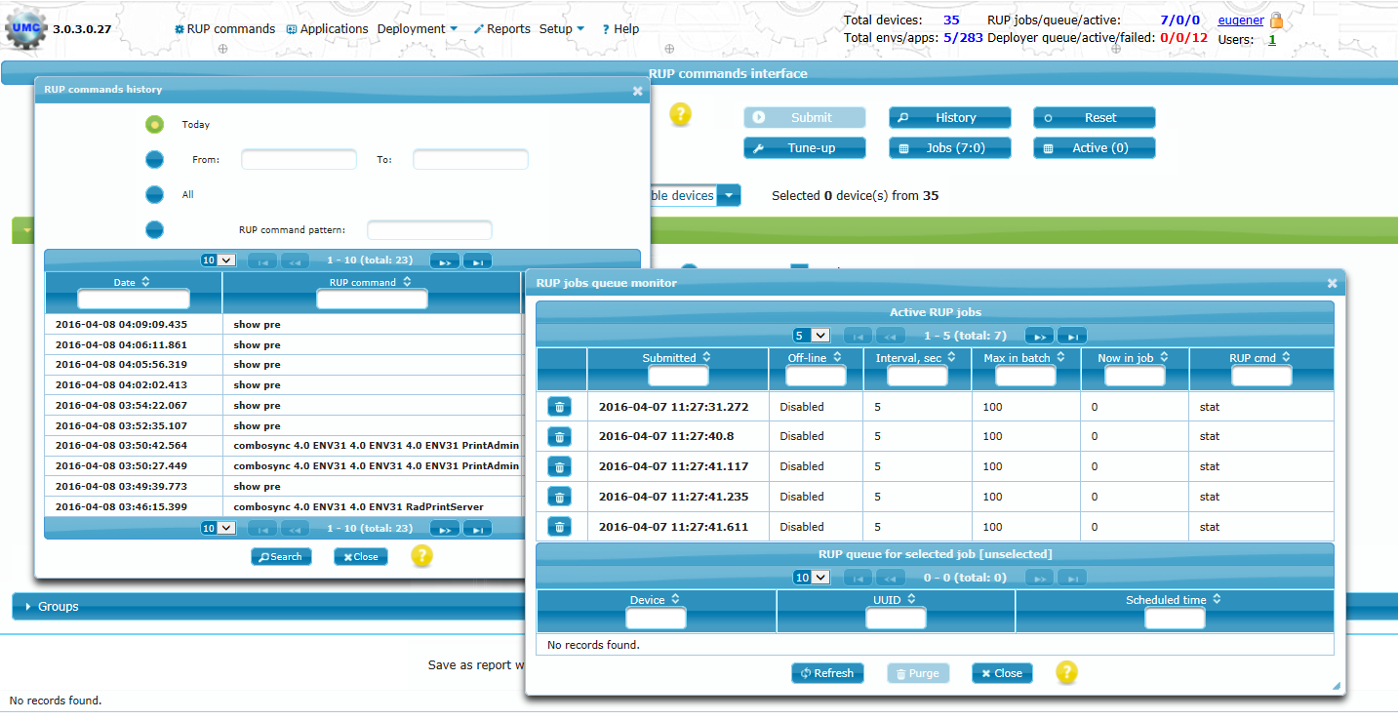
RUP: Remote Update Protocol (UMC => RUP commands)
Allows sending the command to selected individual devices, group of devices or devices that have specific software installed
Allows to monitor submitted jobs and active connections
Allows to search, display and export data for previously submitted commands (for today, from…to, all, by pattern)

Slide 6
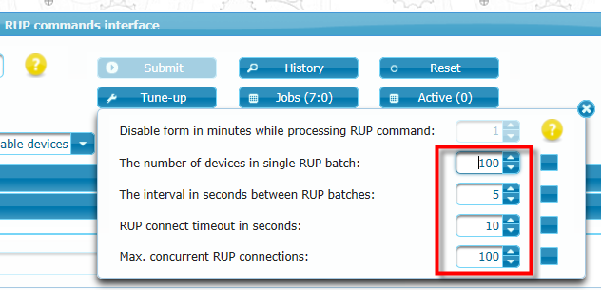
Connectivity Workload Management (UMC => RUP Commands => Tune-up)
Option #1: Sending RUP command in small batches with delays between each batch
Option #2: Limit the number of maximum concurrent connections between SoftUpdate server and remote devices

Slide 7
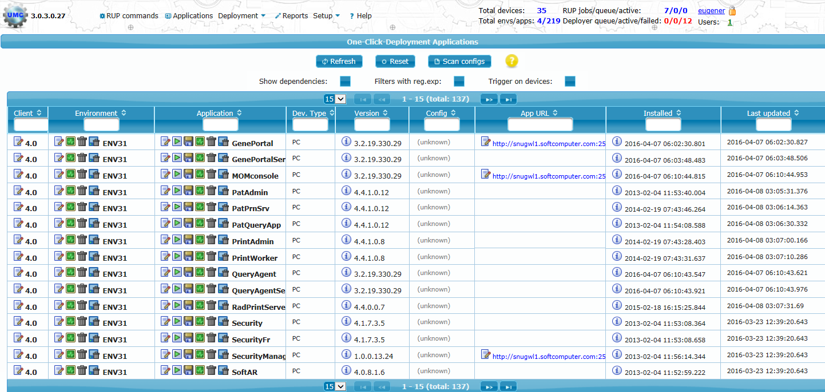
Consolidated applications and environments management (UMC => Applications)
Application startup (Web based launcher)
The modification of Client, Environment and Application specific attributes
The removal of individual applications or the whole environment from the server repository
Triggering the removal of the individual applications or the whole environment from remote devices that have specified applications installed
Checking deployment configuration consistency for individual application or for the whole environment
Creation and modification of the custom configuration in application that support it
Analyzing application dependencies and loaded updates

Slide 8
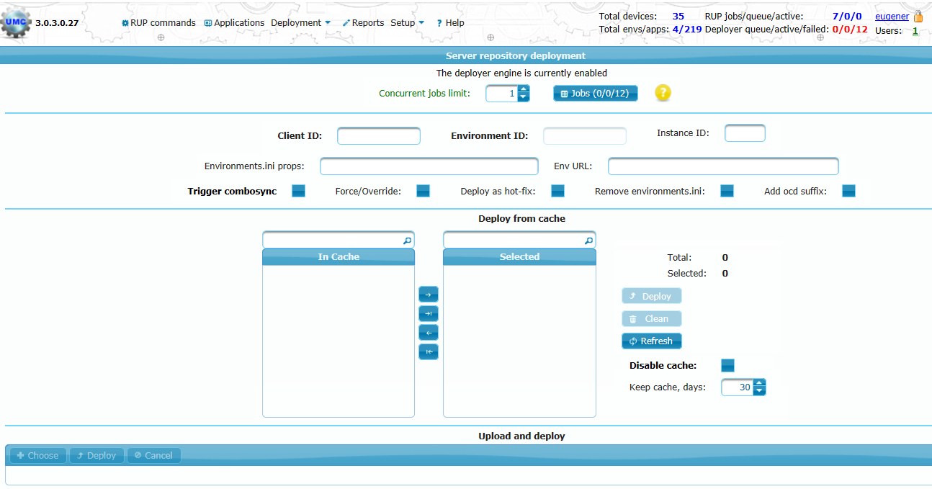
Server deployment (UMC => Deployment => Server repository)
Upload and deploy one-click-deployment packages directly in UMC (no need to access server command prompt)
Monitor active and review failed deployer’s jobs
Deploy packages using deployer’s cache
Automatically trigger app sync (push) on remote devices

Slide 9
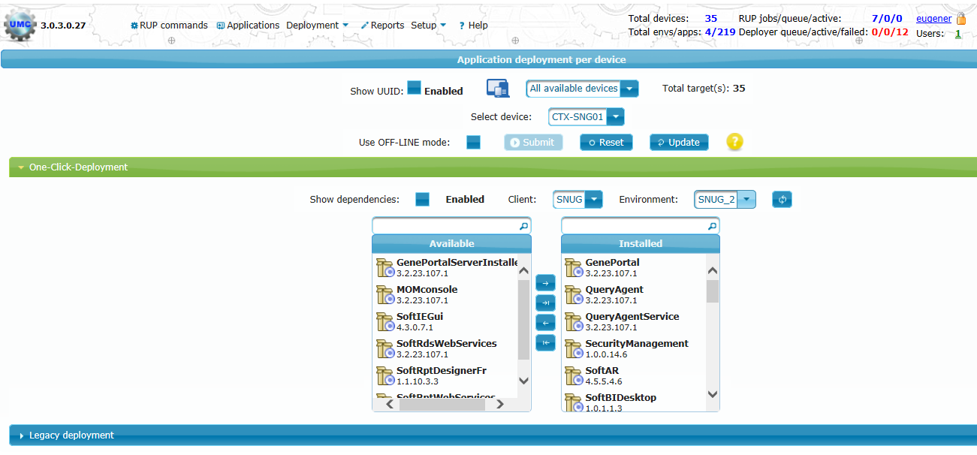
Deployment wizard for individual device (UMC => Deployment => Individual device)
Check software inventory for individually selected device
Install new or remove unwanted software for individually selected device
Supports “One-Click-Deployment” and “Legacy deployment”

Slide 10
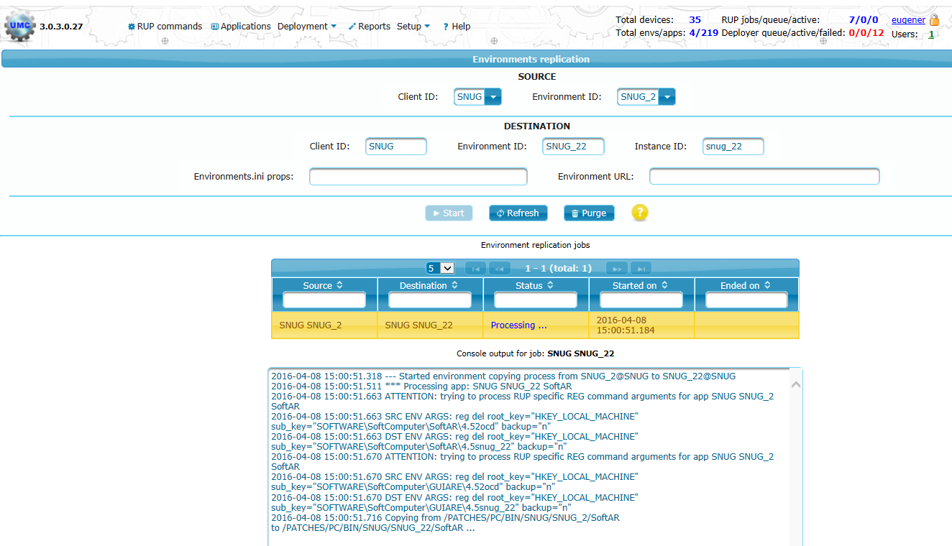
Environment replication (UMC => Deployment => Environment replication)
Helps easy to replicate the existing environments (e.g. TEST from LIVE or DEV2 from DEV1)
Supports multiple replications in parallel

Slide 11
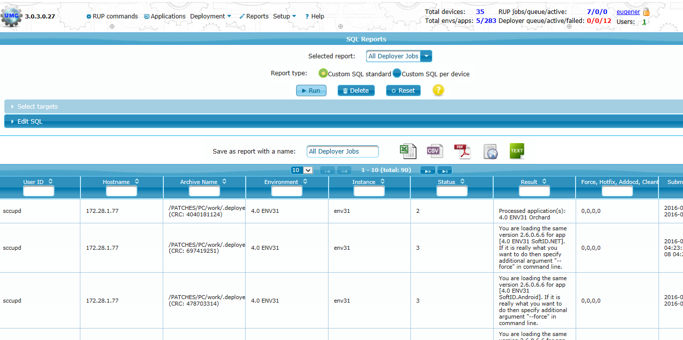
Custom reports (UMC => Reports)
Offers standard SQL custom reports with a possibility to run the same query for selected devices
Supports filtration and sorting of the result in data table
Exports filtered data using multiple formats (PDF, Excel, etc)
Allows to modify existing or create new custom reports

Slide 12
Any Questions ?

