Slide 1
UNIX basics
Run Faster, Jump Higher, Finish First, Win The Gold
Introduction to UNIX scripts that can make IT support easier, faster and more efficient.
Speedy UNIX tools for searching and formatting.
Real World problems and winning UNIX solutions
IT Support on Roids
Automated scripts do the work for you.
Corbin Ellsaesser SNUG Vice President Sr. IT Systems Engineer Christiana Care Health Systems Delaware
cde@christianacare.org

Slide 2
zz
Z
Z
Z
Z
Z
Did someone say UNIX ?
Programming??

Slide 3
Did someone say UNIX ?
Purpose of this session:
To open your eyes to new possibilities.
Demonstrate ways we use UNIX scripts to make LIS support easier.
NOT to teach you how to program in UNIX.

Slide 4
Soft Error Logs
Raise your hands If you . . .
Love that they are cumulative for a month?
Love that they are packed with such useful information?
Search the logs looking for issues to resolve before they become problems?
Go through the error logs daily?
Only go to the logs after a problem has been brought to your attention?
So the rest of you are like …

Slide 5
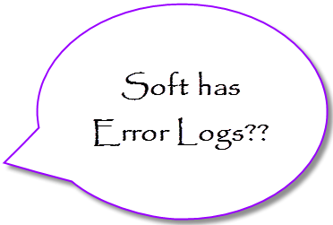
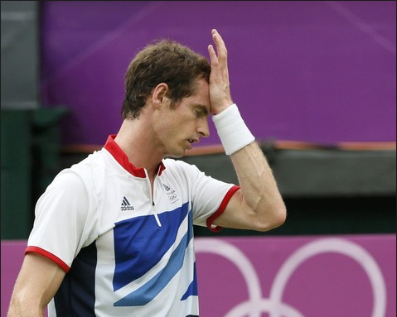
Soft Error Logs

Slide 6
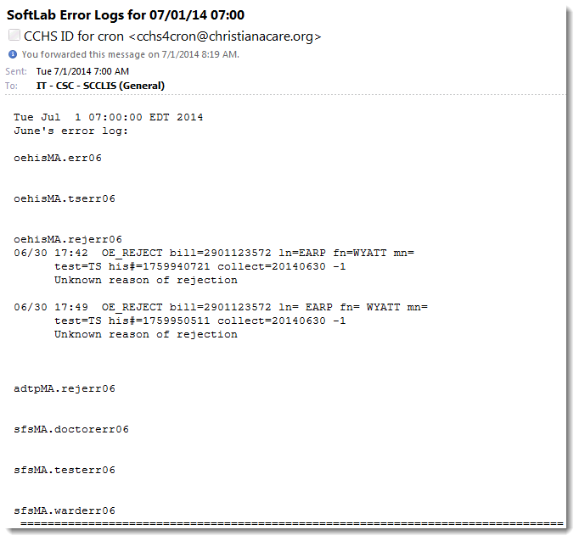
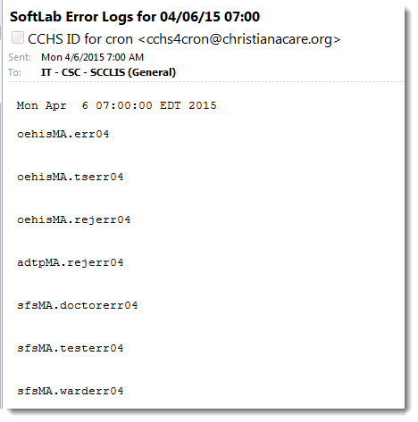
Let UNIX Run the Race. How would you like to be emailed error log reports?
Error Log Examples

Slide 7
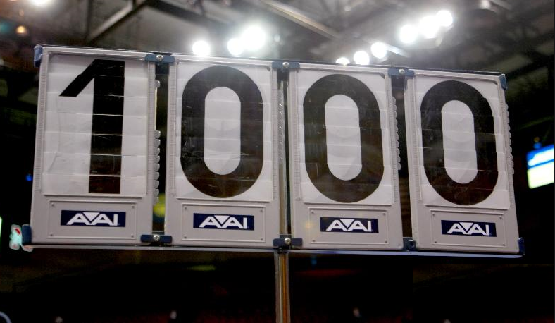
Let UNIX Carry the Torch And email you a daily report
The script only reports significant errors that were logged since the last report was sent.
UNIX emails the report our team at 0700 each day.
Monday’s report works weekends! It reports errors from Friday through Monday.
Tuesday through Friday reports cover yesterday through today.
A blank report means no errors to work up.

Slide 8
Print Queue Maintenance
How do you monitor and maintain your printer queues?
How often do you check printer queue statuses?
Do you leave it to the users to report or fix their own?
Do you print to doctor’s offices?
Autoreports?
What do you do if the office is closed on extended holiday?
Printer jobs queue up because it’s out of paper/toner?
Do their print jobs purge before they can print?
How do you know if the report actually printed?
What do you do?
Wait for doctors to call for reprints?

Slide 9
Pass the Baton to UNIX. Schedule Maintenance on Cron
Automatically check and restart stopped queues every 15 minutes
“touch” unprinted files so they won’t ever purge until they print.
touch command → changes file’s system date to “now” so Soft won’t remove it.
Email report to Lab Admin Team once an hour, during business hours, for queue problems.
Won’t ping
Running but not printing
Down queues
Sample report.

Slide 10
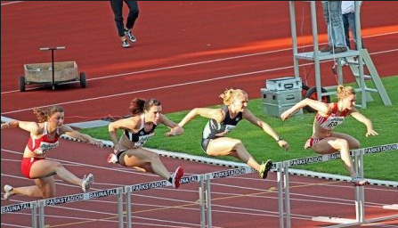
Make UNIX Jump the Hurdles. Scripts do the heavy lifting for you.
Scripts can :
Automate searching, extracting and reformatting interface trace file records.
Automate billing file searches
Scrub PHI from data to attach to Tasks
Do hosparm setting searches

Slide 11
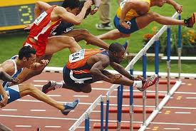
Make UNIX Jump the Hurdles.
Demonstrations
Note:
Our HIS system is Cerner PowerChart also known as HNAM
Our HIS financial system is Soarian
ADT message troubleshooting the hard way
Missing BMP troubleshooting
Scrubbing information to attach to Tasks
Billing file troubleshooting

Slide 12
So tell me more about this “UNIX” stuff.
What does it look like?
How does it work?
How hard is it to use?

Slide 13
So What does UNIX look like?
grcv script to search RCV log is only about 18 lines long!
#! /usr/bin/ksh
Rcv="$UDIR/db/dat/I/HIS/RES*/rcv.trace"
sed -e '/\([0-9]\{2\}:\)\([0-9]\{2\}:\)\([0-9]\{2\}\.[0-9]\{3\}\)\.\
Program=</,/rq_Open(<hislisMAIN>)\ OK/d' \
-e '/^.*|ACK|.*$/,/^.*\\r>$/d' \
-e '/^\ ---/d' \
-e '/r.*\.\.\.$/d' \
-e '/^\([0-9]\{2\}:\)\([0-9]\{2\}:\)\([0-9]\{2\}\.[0-9]\{3\}\)
.*len=[0-9]*$/d' \
-e '/^<.*>$/d' \
-e 's/^\([0-9]\{2\}:\)\([0-9]\{2\}:\)\([0-9]\{2\}\.[0-9]\{3\}\)
\ .*\(MSH.*$\)/<r>\\r\1\2\3\\r\\r\4/g' $Rcv |
perl -lne 'if (/<r>/){printf "\n$_"} else {printf} END{print}' |
sed 's/\\r\\28\/>\ len=[0-9]*$//g' |
grep -hE "$1" |
sed -e 's/\\r/\
/g' \
-e 's/<r>//g'
exit
sed -e '/\([0-9]\{2\}:\)\([0-9]\{2\}:\)\([0-9]\{2\}\.[0-9]\{3\}\)\.\
Program=</,/rq_Open(<hislisMAIN>)\ OK/d' \
-e '/^.*|ACK|.*$/,/^.*\\r>$/d' \
-e '/^\ ---/d' \
-e '/r.*\.\.\.$/d' \
-e '/^\([0-9]\{2\}:\)\([0-9]\{2\}:\)\([0-9]\{2\}\.[0-9]\{3\}\)
.*len=[0-9]*$/d' \
-e '/^<.*>$/d' \
-e 's/^\([0-9]\{2\}:\)\([0-9]\{2\}:\)\([0-9]\{2\}\.[0-9]\{3\}\)
\ .*\(MSH.*$\)/<r>\\r\1\2\3\\r\\r\4/g' $Rcv |

Slide 14
I know what you’re thinking . .
You’re right...
This is our top UNIX script Programmer . .

Slide 15
UNIX manipulates text like
Michael Phelps treads water..
Two basic commands and a fair knowledge of UNIX Basic Regular Expressions (BRE) are all you need.
grep – Globally search a Regular Expression
and Print.
sed – Scripting with the “ED” UNIX editor.
For the real propeller heads –
awk is a great UNIX language to learn

Slide 16
Basic/Extended Regular Expressions
A.k.a. BRE and ERE
Regular Expression Metacharacters
" ' \ | UNIX quotation marks
• | (dot) Any single character ( similar to ? In Windows)
[Ttrack] | Square Brackets: Use any single character within the brackets
[^Javelin] | Caret in brackets: NOT any single character within brackets
( ) | Three uses: 1: Used to enclose an "OR" expression sequence – (track|field) 2: Grouping for quantifiers (drunk)? (saloon girl)+ (cow)* 3: Create numbered expressions to be recalled later (see '\1' below)
? | Previous expression is optional (repeat zero or more times)
+ | One or more of the previous expression
* | Repeat Zero to Any number of the previous expression
 | NOTE: Matches as many as possible to the end of document
| | “OR” (ABC|123) matches strings "ABC" or "123"
^ | Start of line
$ | End of line
\1 (\2 \3…) | Output numbered expression created above (see '( )' above).

Slide 17
Let’s make sense of the Gym Monkey’s script
grcv script:
sed -e '/\([0-9]\{2\}:\)\([0-9]\{2\}:\)\([0-9]\{2\}\.[0-9]\{3\}\)\.\
Program=</,/rq_Open(<hislisMAIN>)\ OK/d' \
-e '/^.*|ACK|.*$/,/^.*\\r>$/d' \
-e '/^\ ---/d' \
-e '/r.*\.\.\.$/d' \
-e '/^\([0-9]\{2\}:\)\([0-9]\{2\}:\)\([0-9]\{2\}\.[0-9]\{3\}\)
.*len=[0-9]*/d' \
-e '/^<.*>$/d' \
-e 's/^\([0-9]\{2\}:\)\([0-9]\{2\}:\)\([0-9]\{2\}\.[0-9]\{3\}\)
\ .*\(MSH.*$\)/<r>\\r\1\2\3\\r\\r\4/g' $Rcv |
perl -lne 'if (/<r>/){printf "\n$_"} else {printf} END{print}' |
sed 's/\\r\\28\/>\ len=[0-9]*$//g' |
grep -hE "$1" |
sed -e 's/\\r/\
/g' \
-e 's/<r>//g'
exit

Slide 18
Now I get it!
Remember those funny numbered expressions?
sed -e '/\([0-9]\{2\}:\)\([0-9]\{2\}:\)\([0-9]\{2\}\.[0-9]\{3\}\)\.\
Program=</,/rq_Open(<hislisMAIN>)\ OK/d' \
-e '/^.*|ACK|.*$/,/^.*\\r>$/d' \
-e '/^\ ---/d' \
-e '/r.*\.\.\.$/d' \
-e '/^\([0-9]\{2\}:\)\([0-9]\{2\}:\)\([0-9]\{2\}\.[0-9]\{3\}\)
.*len=[0-9]*$/d' \
-e '/^<.*>$/d' \
-e 's/^\([0-9]\{2\}:\) \([0-9]\{2\}:\) \([0-9]\{2\}\.[0-9]\{3\}\)
\ .*\(MSH.*$\)/<r>\\r\1\2\3\\r\\r\4/g' $Rcv |
perl -lne 'if (/<r>/){printf "\n$_"} else {printf} END{print}' |
sed 's/\\r\\28\/>\ len=[0-9]*$//g' |
grep -hE "$1" |
sed -e 's/\\r/\
/g' \
-e 's/<r>//g'
exit

Slide 19
UNIX grcv script has 4 parts
sed -e '/\([0-9]\{2\}:\)\([0-9]\{2\}:\)\([0-9]\{2\}\.[0-9]\{3\}\)\.\
Program=</,/rq_Open(<hislisMAIN>)\ OK/d' \
-e '/^.*|ACK|.*$/,/^.*\\r>$/d' \
-e '/^\ ---/d' \
-e '/r.*\.\.\.$/d' \
-e '/^\([0-9]\{2\}:\)\([0-9]\{2\}:\)\([0-9]\{2\}\.[0-9]\{3\}\)
.*len=[0-9]*$/d' \
-e '/^<.*>$/d' \
-e 's/^\([0-9]\{2\}:\)\([0-9]\{2\}:\)\([0-9]\{2\}\.[0-9]\{3\}\)
\ .*\(MSH.*$\)/<r>\\r\1\2\3\\r\\r\4/g' $Rcv |
perl -lne 'if (/<r>/){printf "\n$_"} else {printf} END{print}' |
sed 's/\\r\\28\/>\ len=[0-9]*$//g' |
grep -hE "$1" |
sed -e 's/\\r/\
/g' \
-e 's/<r>//g'
exit

Slide 20
Disclaimer:
No Trace Files were harmed by running any script.
Original files are untouched.
Scripts work by reading the file into a data stream and manipulating the flow.
Scripts can output to the screen, a file, an email, a printer – anywhere you want to send them.
Step by step what the grcv script does

Slide 21
Questions?
Bring home the Gold

Slide 22
References

