Slide 1
Upgrading from SoftPath to SoftPathDx “Passing of the Torch” Presented by: Christine Comella SoftPathDx Implementation Specialist

Slide 2
Upgrading from SoftPath to SoftPathDx
Today we are here to discuss Upgrading from SoftPath to SoftPathdx
This presentation will offer an overview of what to expect during the Upgrade process, as well as many new features that will aid in optimal workflow for the Pathology department.
Our goal is to make our clients more aware so they can start to prepare in advance, save time, be more efficient and effective.

Slide 3
What can I do to Prepare now?
Workflow assessment
Hardware assessment
Data conversion
Familiarization with SoftPathDx Terminology

Slide 4
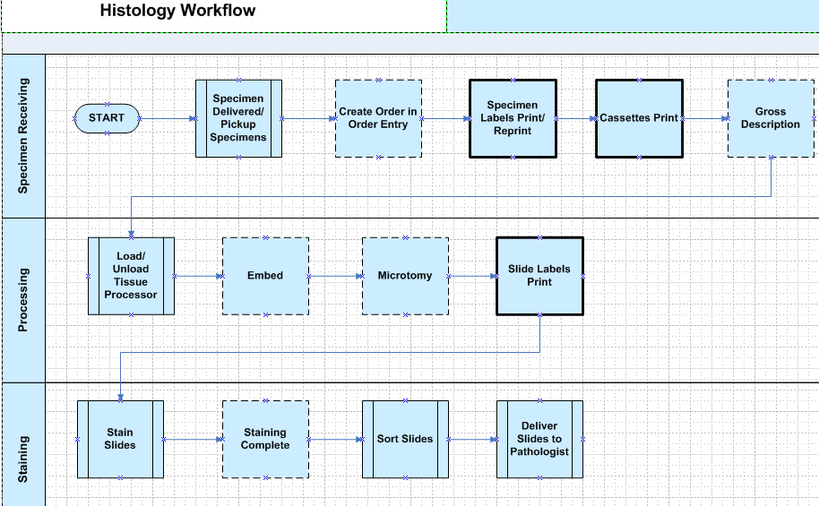
Workflow Assessment
Before the start of the project is an ideal time to go over current workflow processes. This is also an ideal time to make changes for the future.

Slide 5
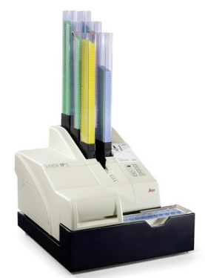
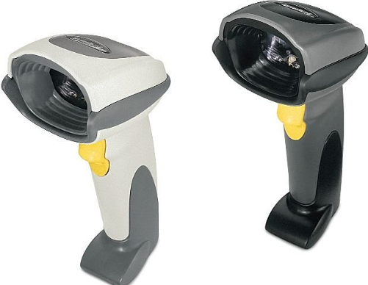
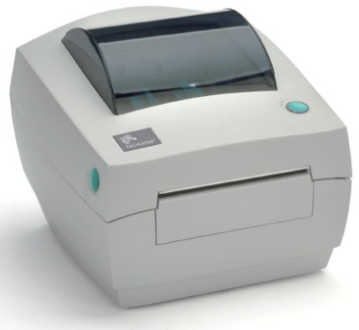
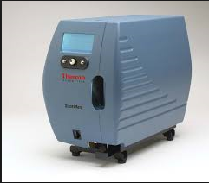
Hardware Assessment
Do we need more of the following:
Label printers at each station
Cassette printers
Slide printers
Barcode Scanners
Larger Monitors – 24”

Slide 6
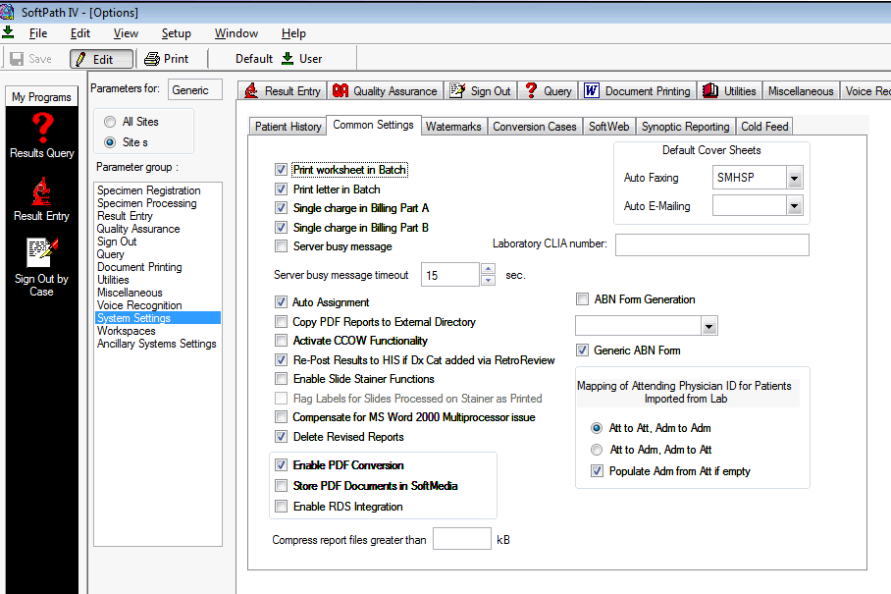
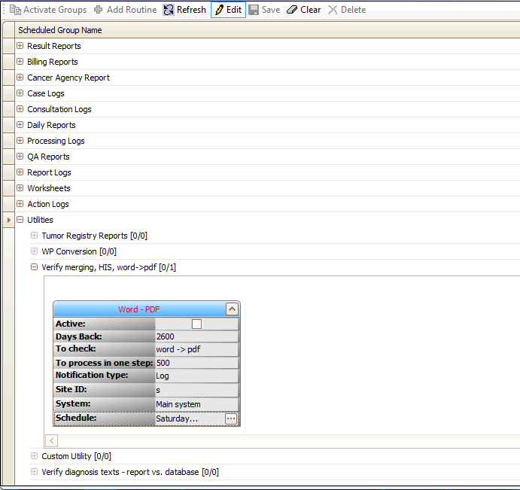
PDF Conversion
All SoftPath signed out reports need to be converted to PDF to be viewable in SoftPathDx
2nd – scheduler PDF conversion of previously s/o documents
1st – turn on option for future s/o documents

Slide 7
SoftPathDx Terminology
Tests/Panels = Stains/group of stains or group of the same stain
Specimen Preparation = Grossing / Embedding
Panel Setup = Microtomy
Panel Tracking = Slide staining
Interpretation Results Entry / Batch Reporting = Results entry
Technology – for Pathology terms this is closely related to what case types are ordered in pathology (surgical, autopsy, non gyn, gyn)
Department – most similar to the technology, as technology can only be assigned to one department
Workstation – workstation are physical PC’s that are logged into, which can control label printing. workstations can be assigned one department, but the same department can be used for more than one workstation.

Slide 8
SoftPathDx Terminology
Actions – specimen tracking milestones that get completed through the life of the specimen (example, grossing action, embedding action, microtomy action, slide creation action, staining action etc.)
Protocols – are workflow steps comprised of built actions.
Material = materials used (blocks, specimen container)
Specimen setup = source setup
New edit fields = pipes in SoftPath for canned messages
Aliquot – pouring off specimen to block, pouring off block onto slides
Cancel order (like Lab) = not deleting it from the database
Rejection blocks = instead of deleting blocks

Slide 9
Why do I want to Upgrade ?
Order Entry Customs
Processing Customs
Resulting
Setup
Integration

Slide 10
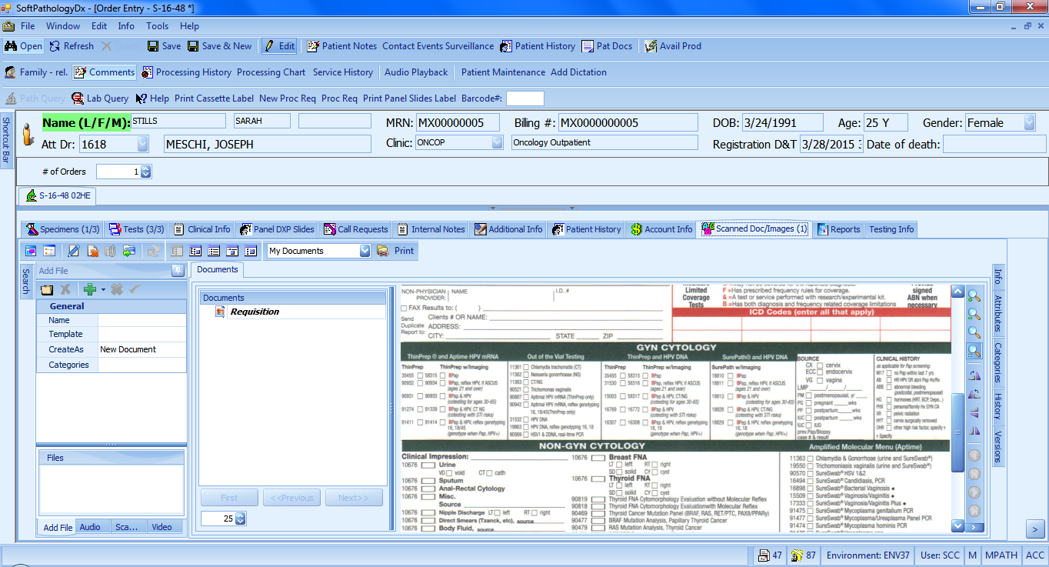
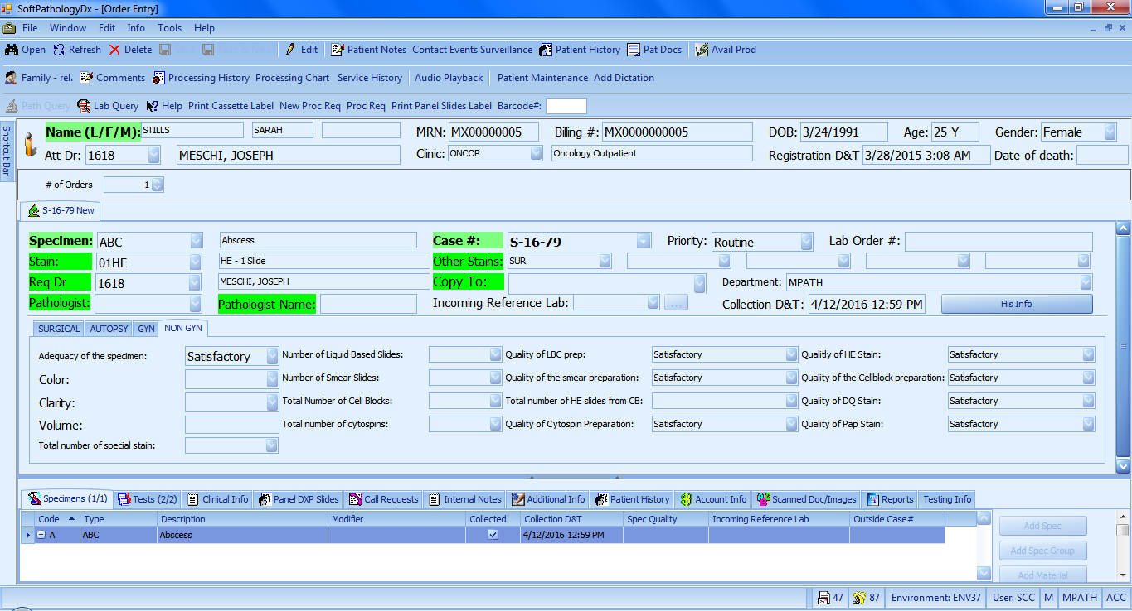
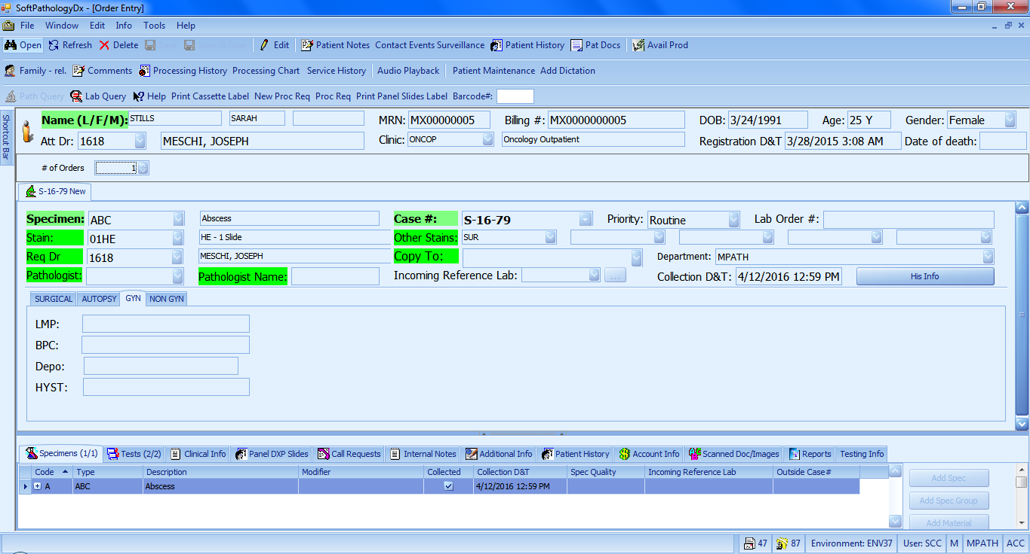
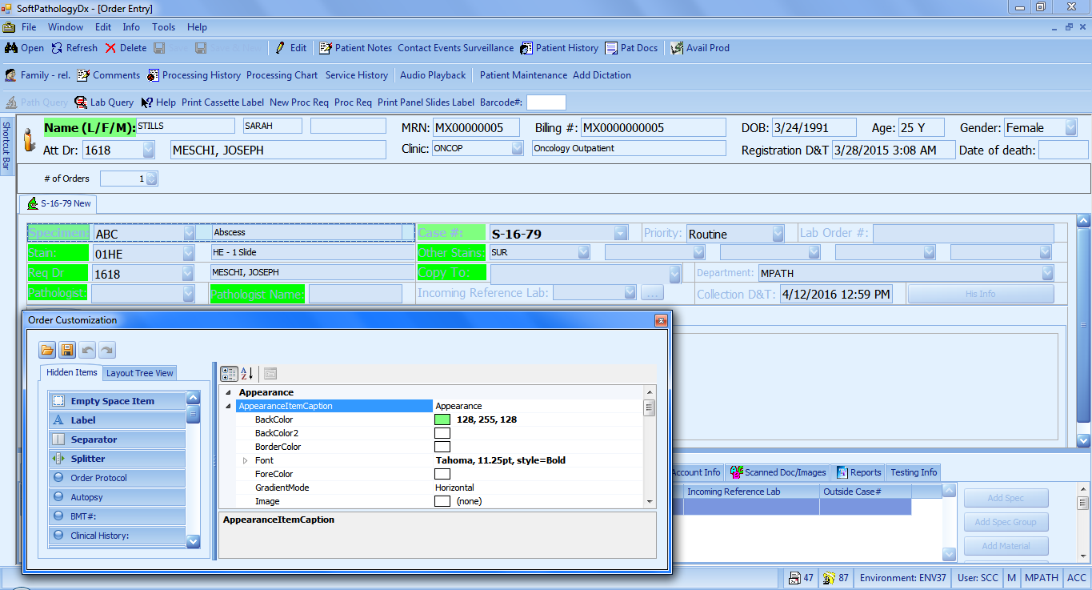
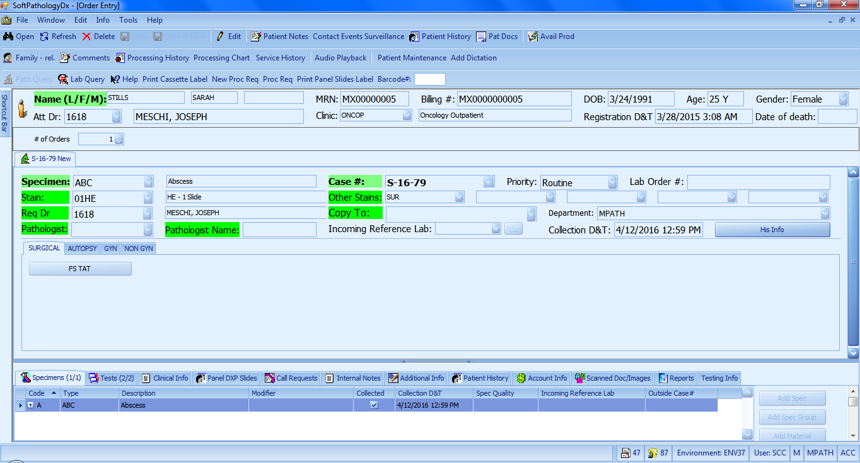
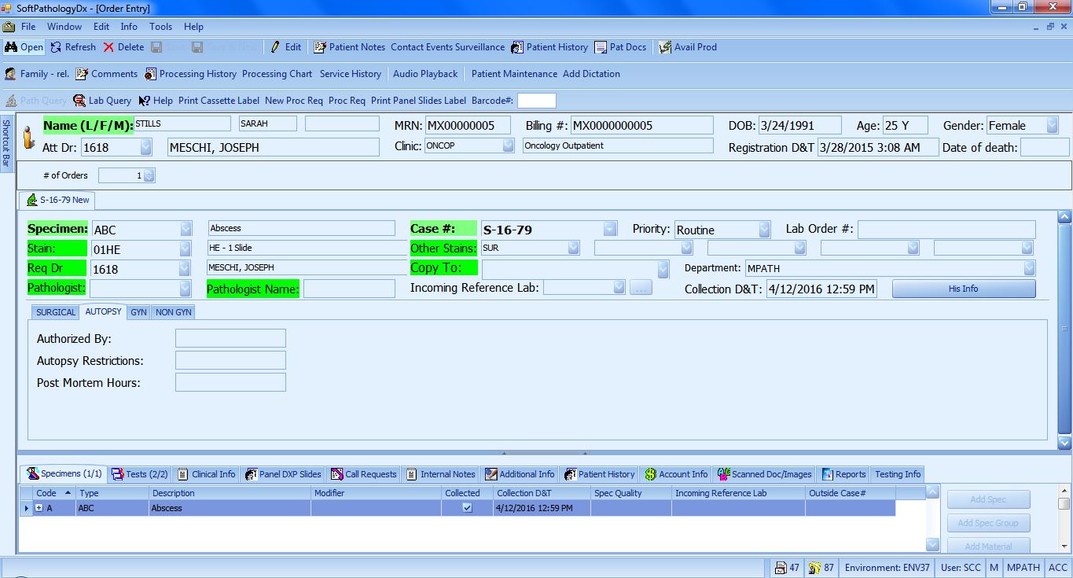
Order Entry
Screen Customizations
Surgical and Autopsy info separate pages (like GYN and NON GYN)

Slide 11
Processing
2D Barcode scanning capability
Are you fast processing currently just to get labels ??? And Requiring one user to complete all actions ??
Custom action completion checkpoints for each user to acknowledge they are performing that job function.
More PPID and Chain of custody
More Tracking of Materials

Slide 12
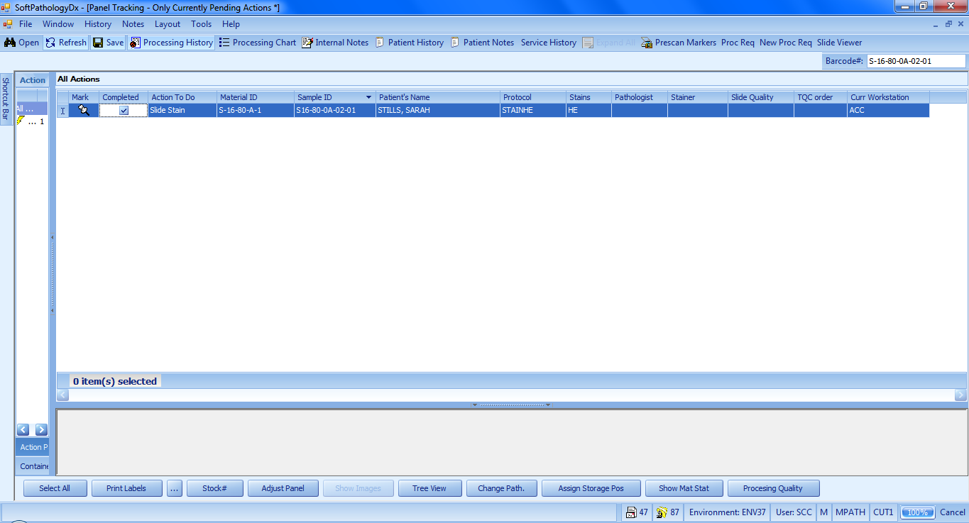
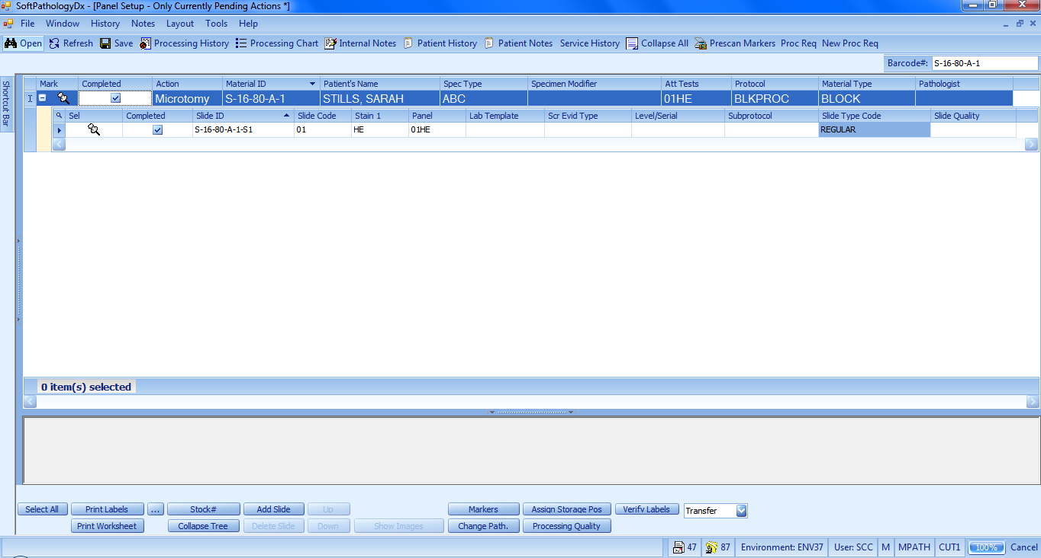
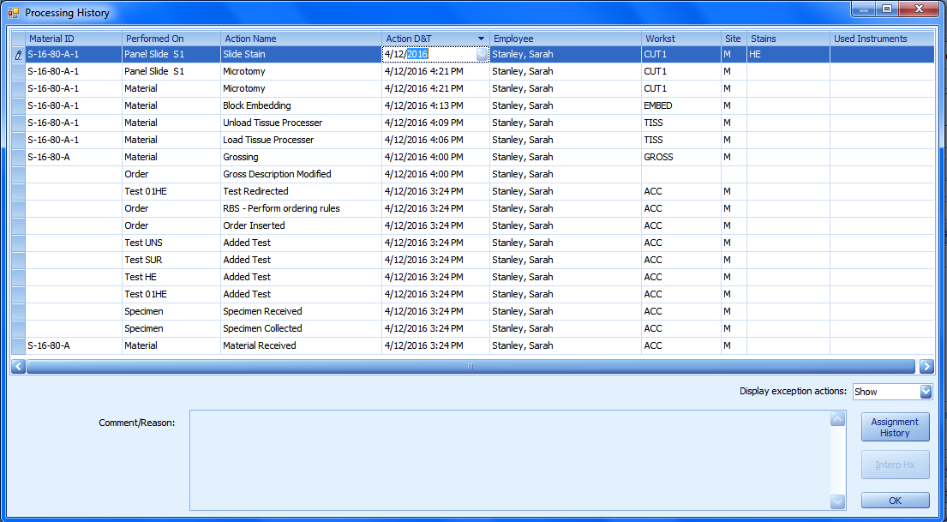
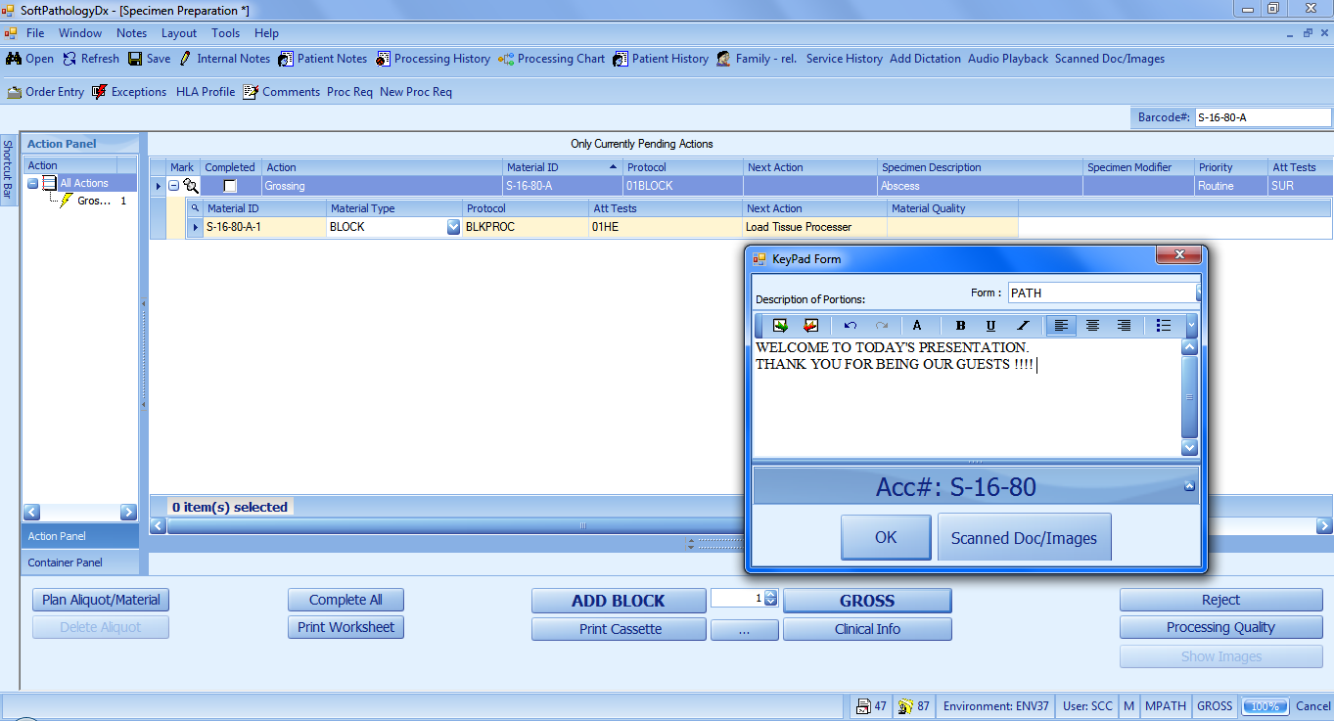
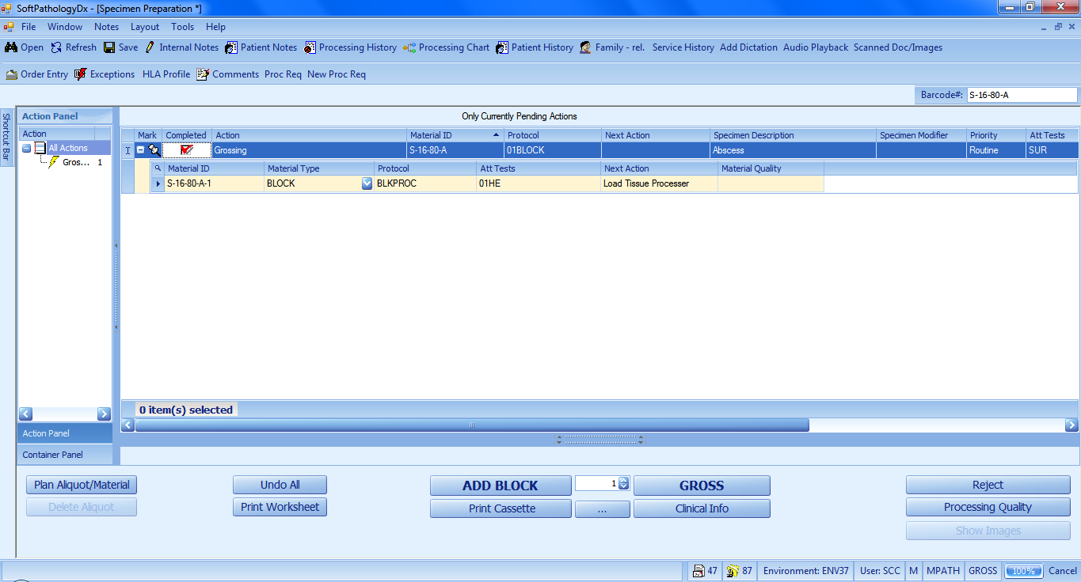
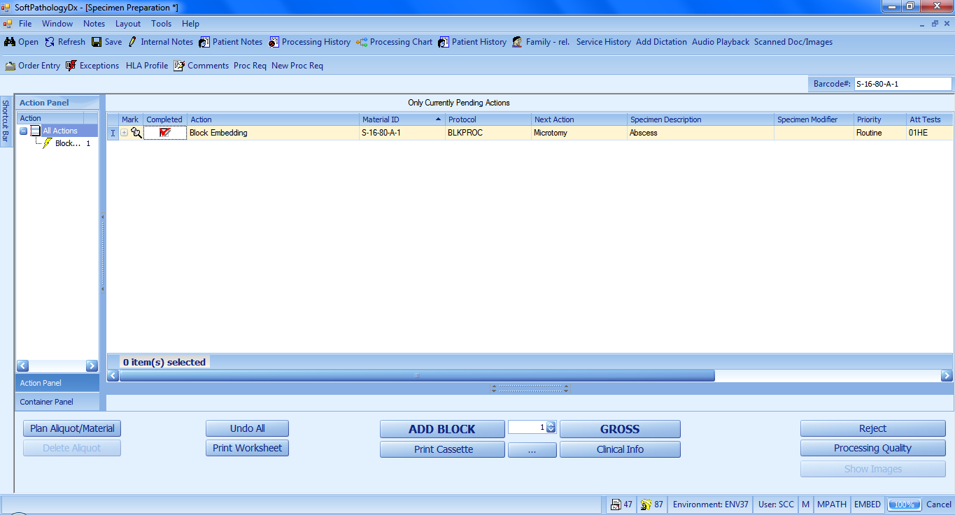
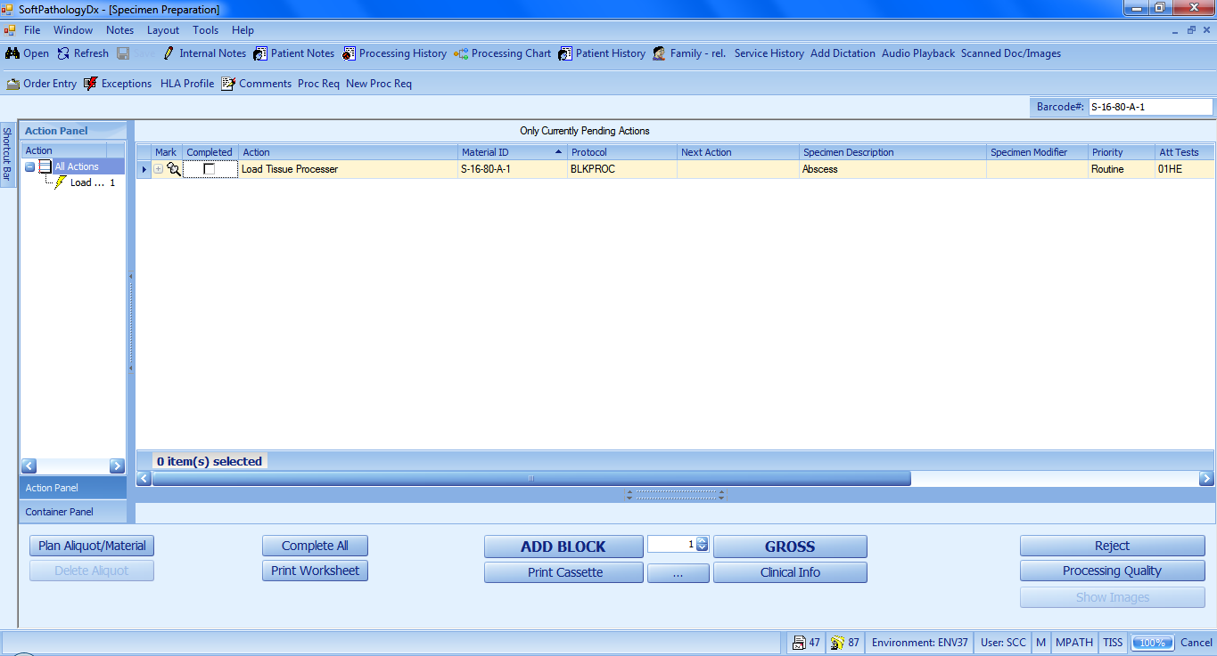
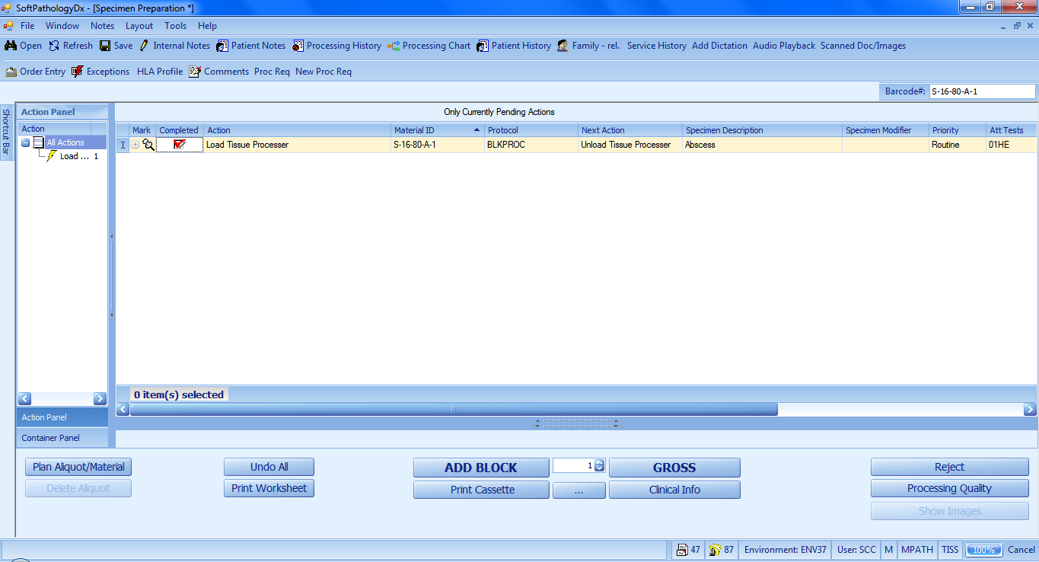
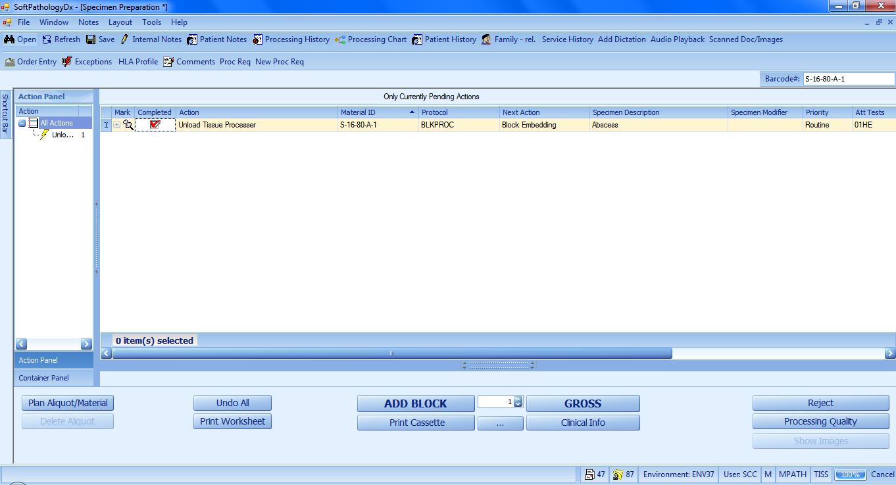
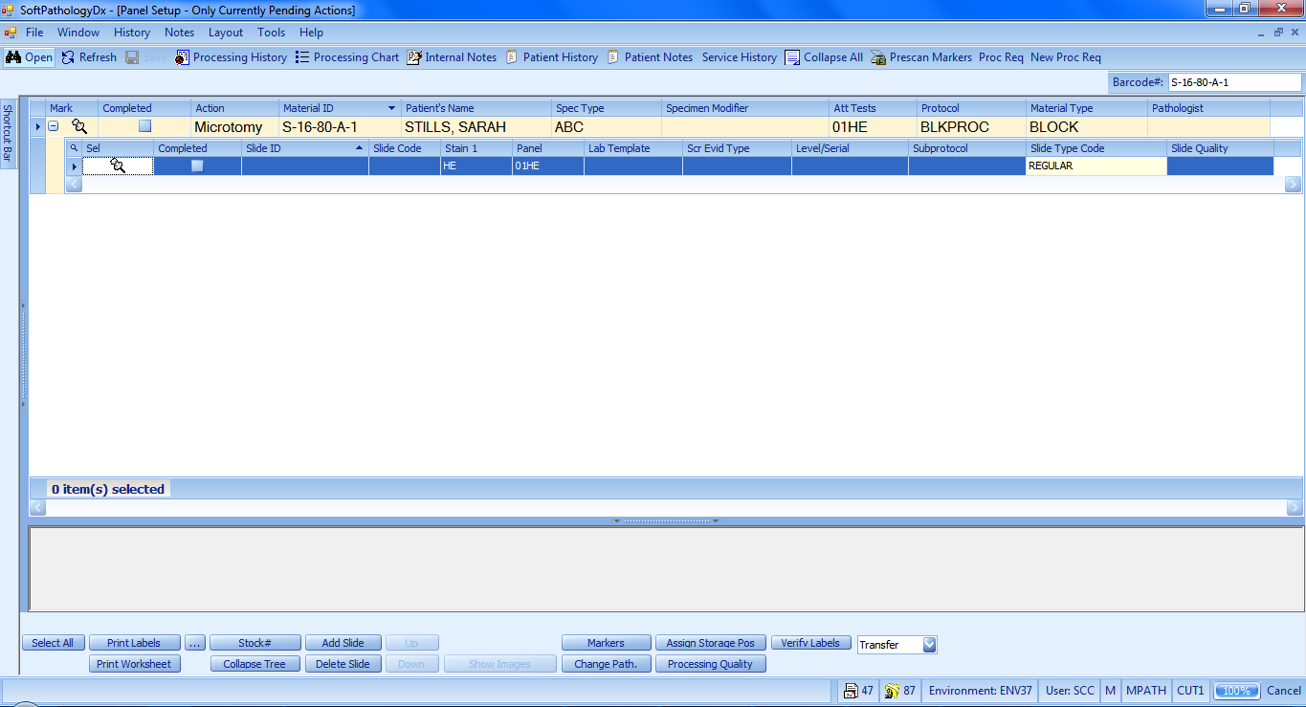
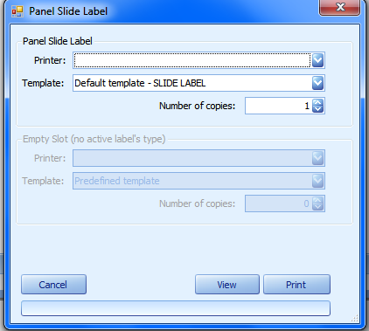
Buttons can have hot keys (for dragon)
All columns seen can be repositioned, or removed from the screen
Viewing which workstation performed the last action, this allows
For tracking of the material to better zero in on where it was last

Slide 13
Resulting
No more bookmarks ! No more MS word !!
Can create a revised Supplemental Report
Cytotechnologists can s/o Supplemental reports
Can Update the s/o order w/o creating a revised report first.
Designated area for internal notes that follows the case through all areas of the system
Can upload images and reports to append to the final, revised, or supplemental report
Send out Test Area

Slide 14
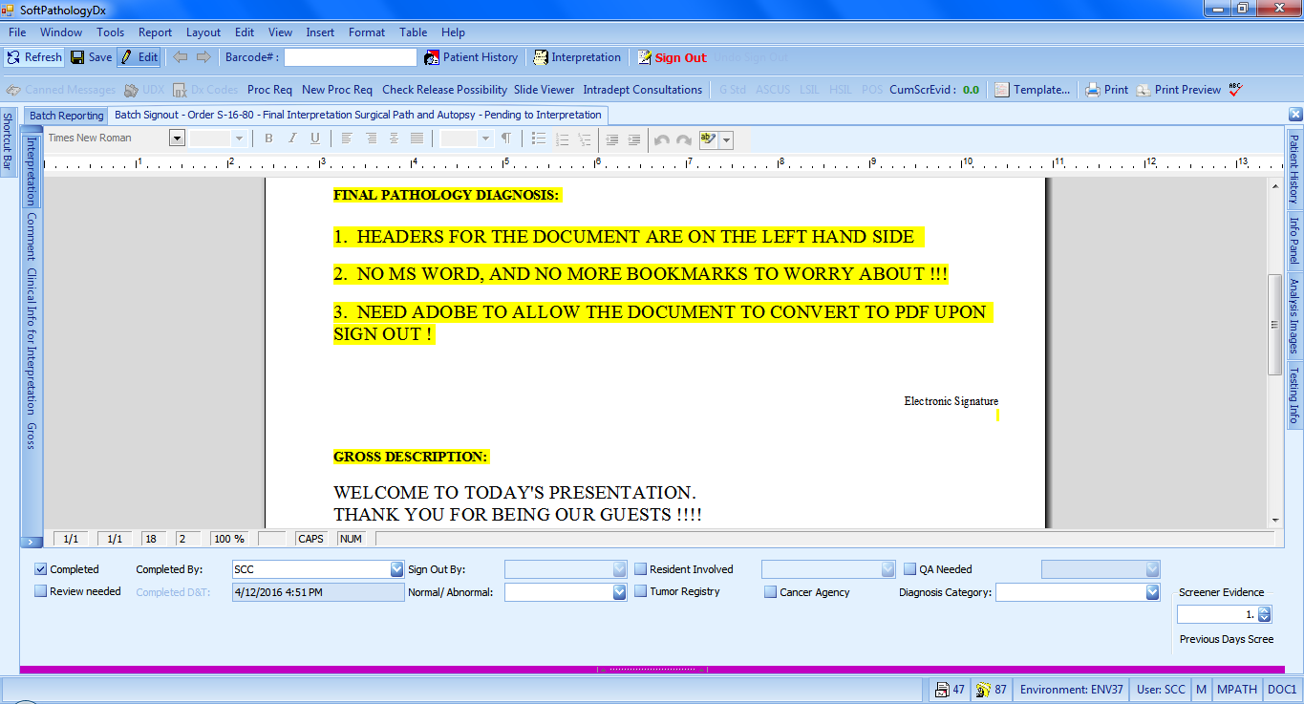

Slide 15
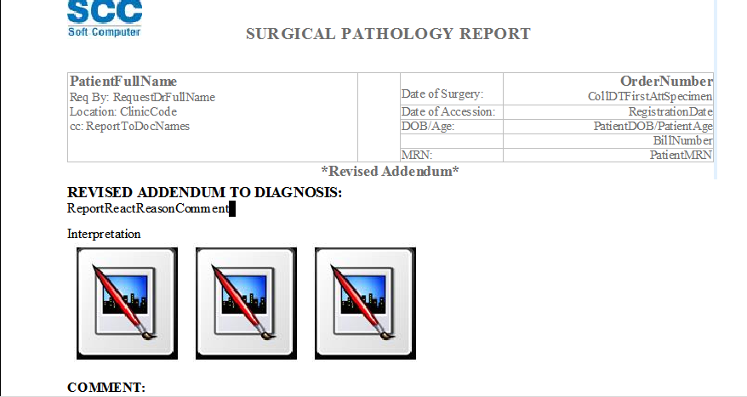
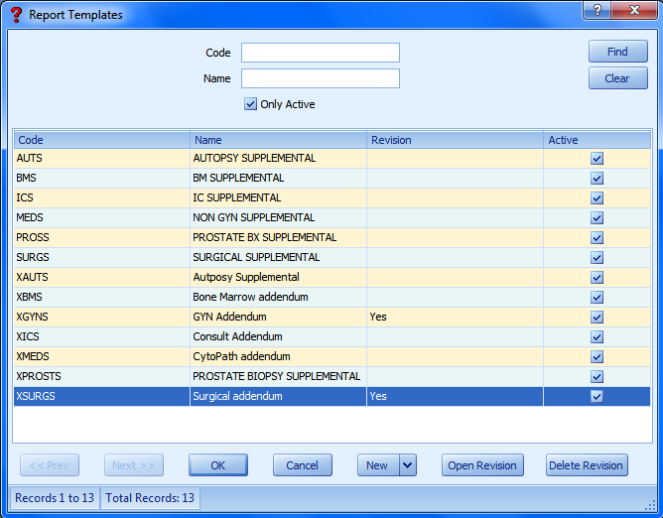
Supplemental Revised Report

Slide 16
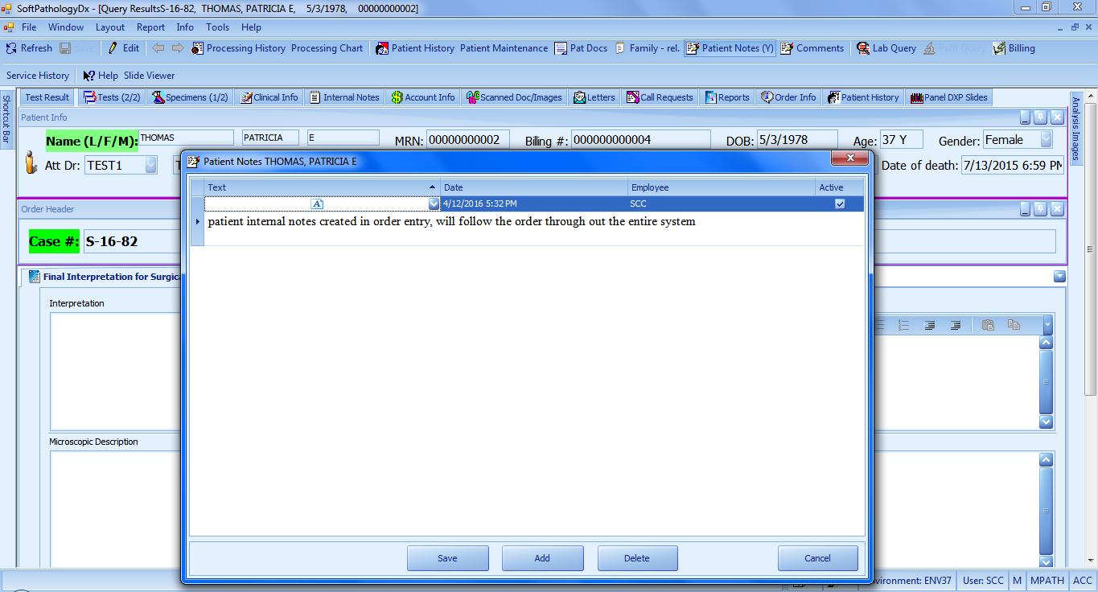
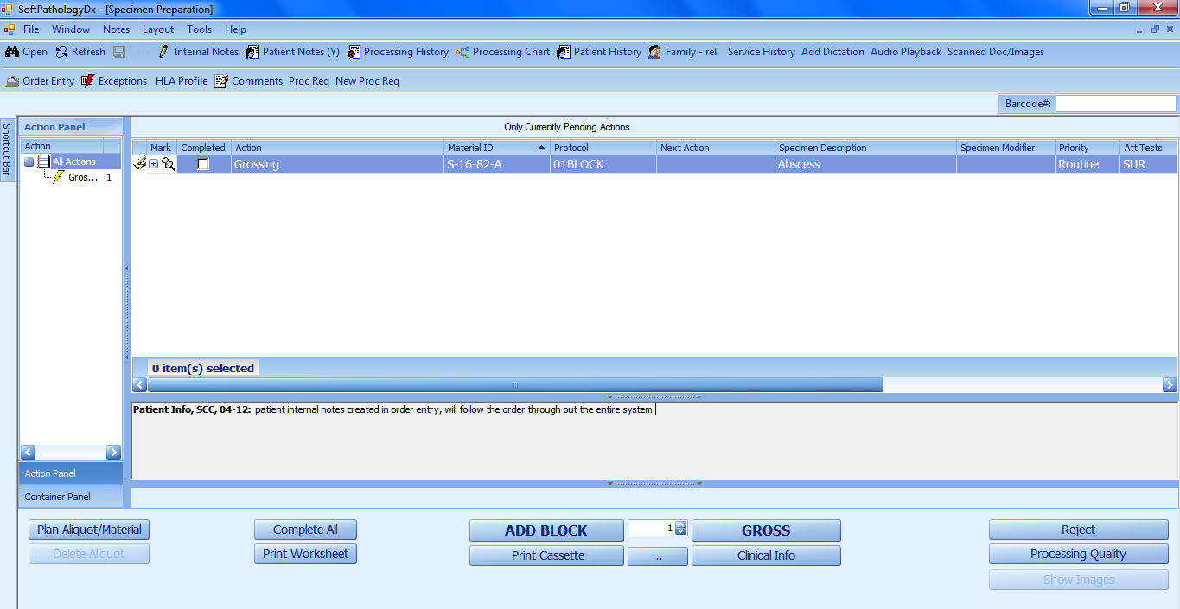
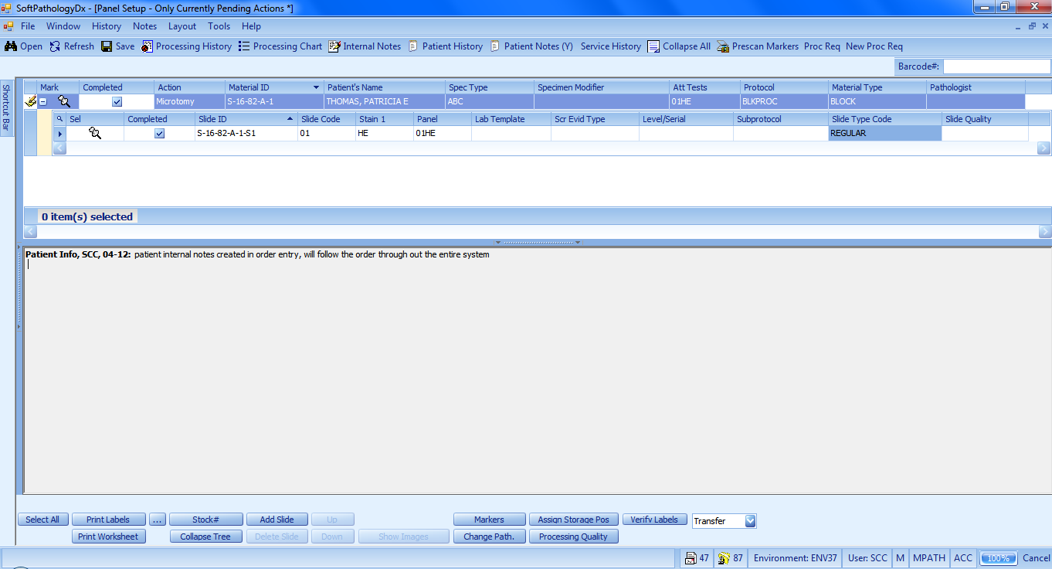
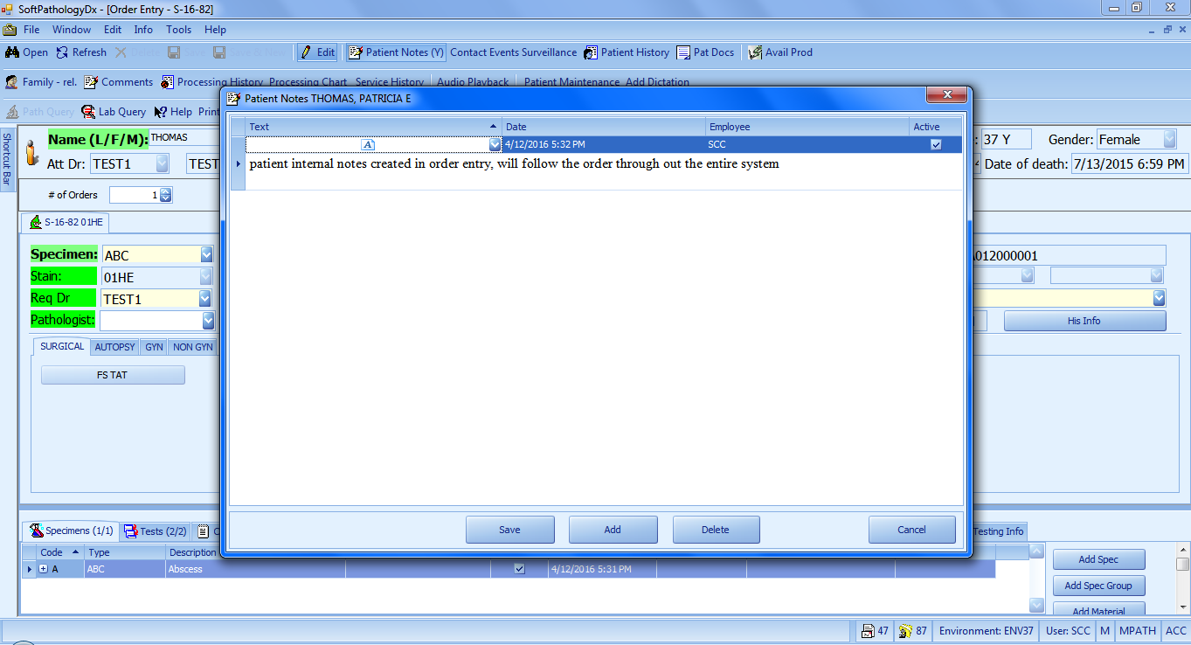
Internal Notes
Query
Microtomy
Specimen Preparation

Slide 17
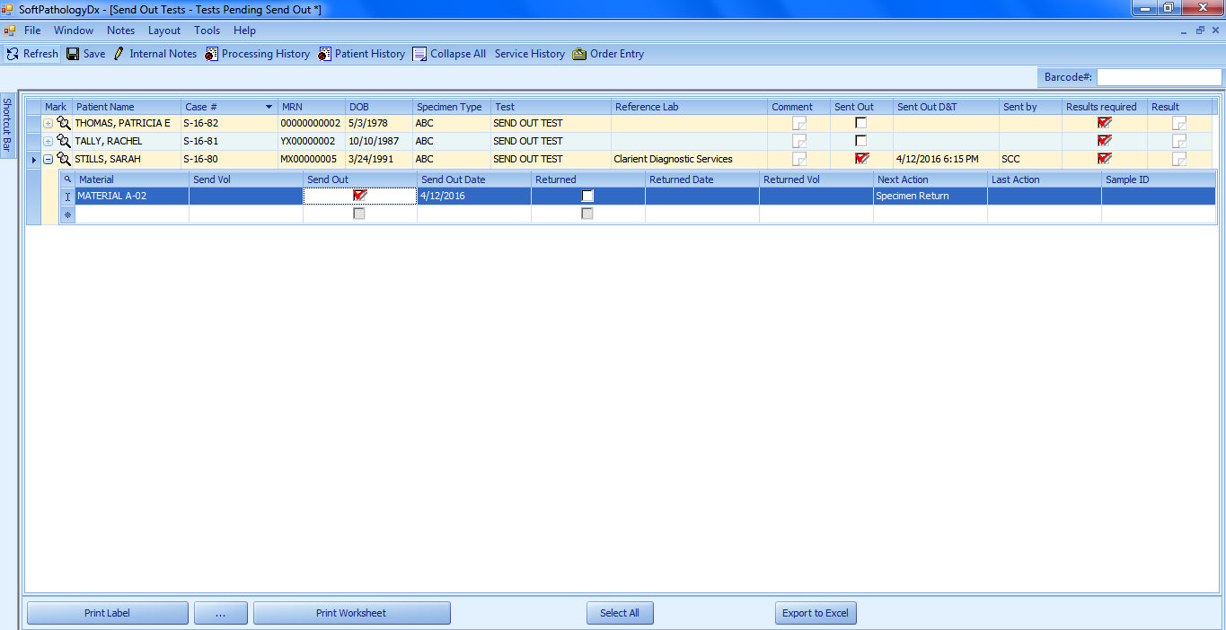
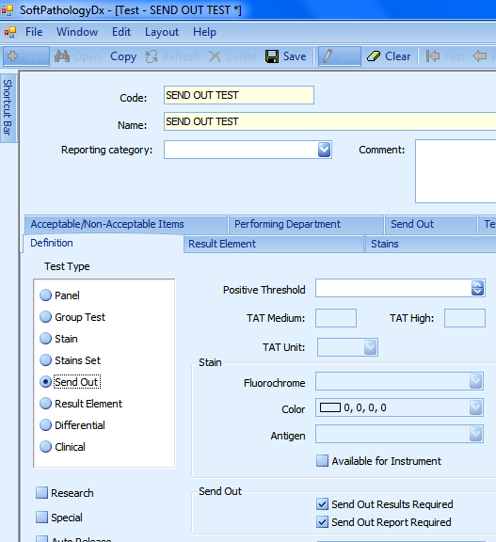
Send out Testing Area
When a test is marked as send out, there should be a send out area !!!
SoftPathDx has an area just for send out tests

Slide 18
Setup
Reports and Labels can be customized by YOU !! No more waiting on US !!
RBS Rules
More Billing Rules

Slide 19
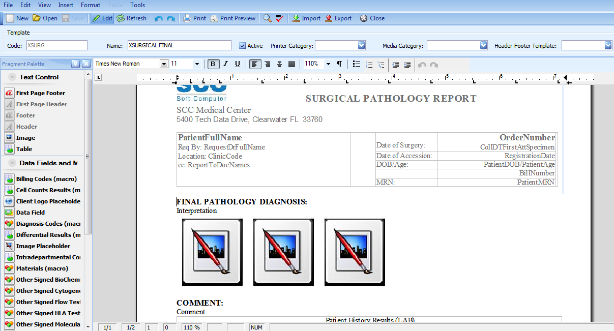
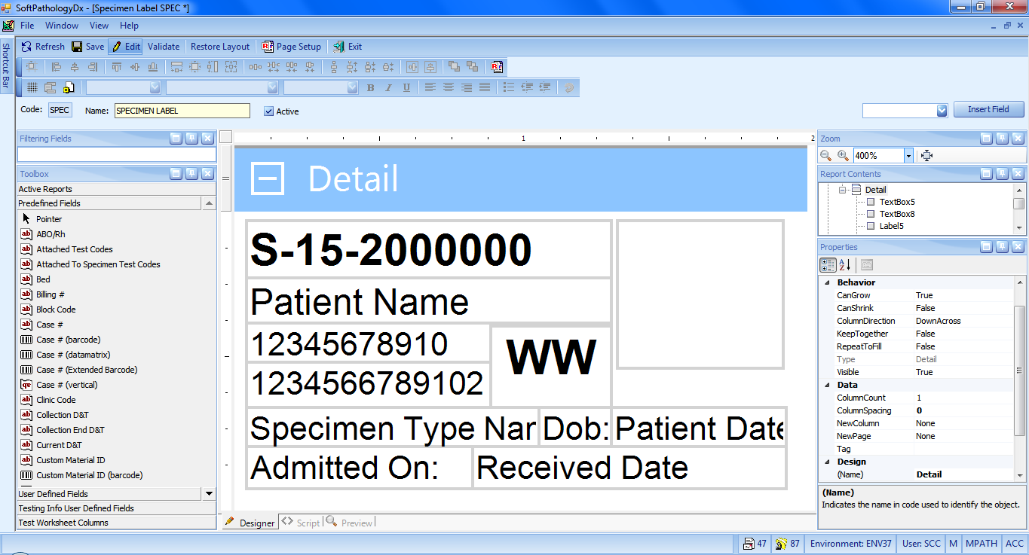
Reports and Labels
Drag and drop fields from the left to the detail section.
Configure the font, style, width properties to the right
Can also export and import to create new labels.
Header footer template
Export and import for new accessions

Slide 20
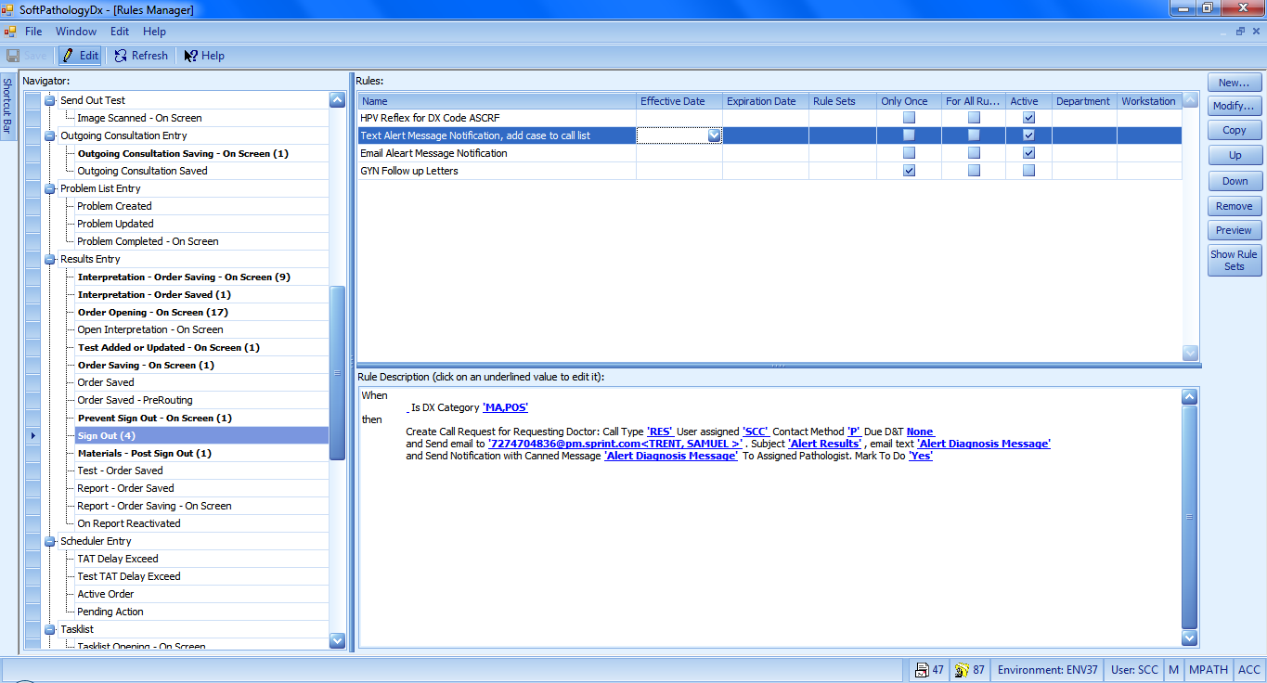
RBS Rules In Pathology
If all else fails, there will be an RBS rule.
Like lab, RBS rules drive certain functions to happen based upon logical if, then statements

Slide 21
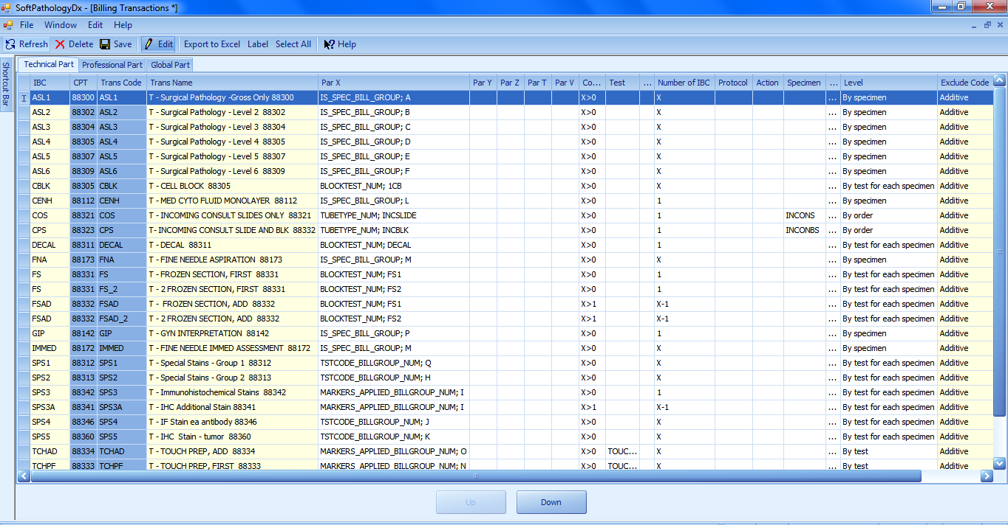
Billing Transaction Table
More Billing Parameters
Additional ways to bill
Easy to keep items in order

Slide 22
Integration
SoftPathDx is Compatible with Lab 4.0.7, 4.0.8 and Lab 4.5 (sharing of specimens, tube types, departments, exists in Lab 4.5)
SoftPathDx is Fully compatible to share tests, specimens etc and reflex tests with other genetics applications (Molecular, Flow, Cytogenetics etc.)

Slide 23
Questions ????

Slide 24
Contact Information
If you have any future questions or concerns, I can be reached at:
Christine Comella
ccomella@softcomputer.com
x 4648
If you are interested in Starting a SoftPathDx Upgrade please contact:
Ms. Ellie Vahmin
ellie@softmputer.com
x4052

Slide 25
Have a Nice Day !!

