Slide 1

Value of STEMI education
“We live in a society exquisitely dependent on science and technology…in which hardly anyone knows anything about science and technology.”
Carl Sagan,
Astronomer
Notes:
Thank you for letting us speak today.

Slide 2
Contributing to Organizational Success in a Value Based World
Using the CLIS to Impact Clinical Decision Making and Laboratory Utilization in a Value Based Environment
R Bruce Wellman, MD
Sue Ann Hedrick, MT
Notes:
Thank you for letting us speak today.

Slide 3


“So, am I only one who sees a conflict of interest here?”
Notes:
I have a lot of conflicts but nothing of interest.

Slide 4

Objectives
Health care costs are the problem.
Data can change behavior.
Our experience in developing data to create information that can lead to change using SCC basic functionality.

Slide 5
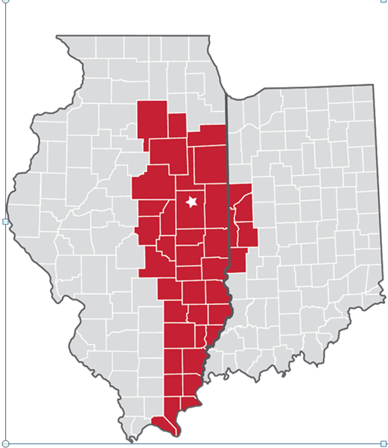
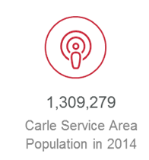
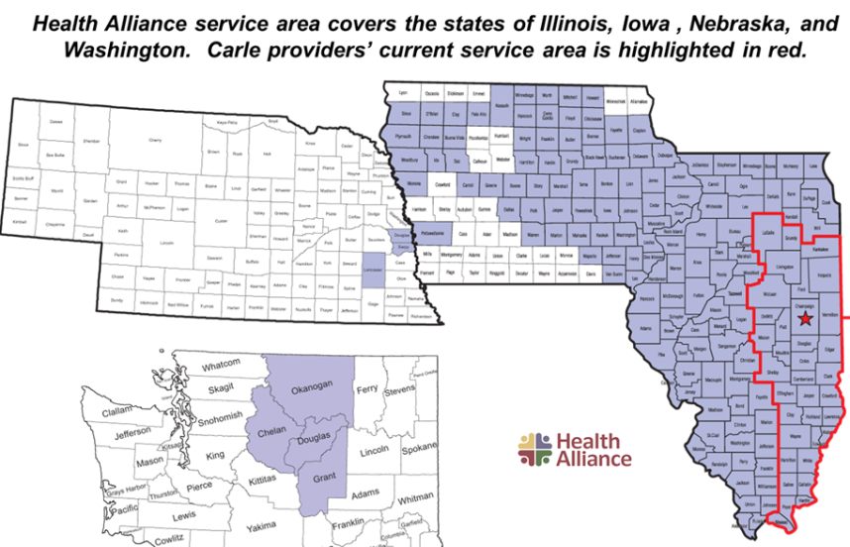
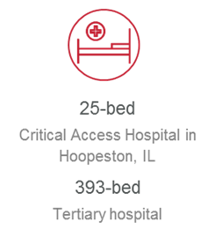

Carle Health System
Clinic founded 1931-Hospital founded 1948- Health Plan started 1980
Integration of Clinic, Health plan and Hospital- April1, 2010
Average daily census | 352
Inpatient admissions w/ newborns | 25,045
Births | 2,679
Neonatal Intensive Care Unit patients | 671
Emergency Department patients | 84,763
Trauma patients | 1,280
Outpatient visits | 1,009,137
Outpatient/inpatient/ASC surgical pts. | 19,470
Total employees | 6,871
Notes:
AIDET
31 years at Carle
Chair of Path and Lab services 7 years,
14 years as CEO of physician group, that owned a large health plan then after integration served as physician group CEO and exec VP for all medical activity in system. Served as Chairman of the Board of large medical serviced purchasing group.
Returned to Laboratory part time in 2014
Carle overview RBW
Carle Lab over view RBW

Slide 6
Carle Laboratory
160 staff
7 Pathologists
2 Path Assistants
Services-1.6 million billable events
  Surgical, Autopsy, Gyn and NON Gyn Cytology
  Blood Bank, Chemistry, Immunology, Hematology Molecular, Referral, Point of Care
32% Inpatient/68% Outpatient
Operating Budget-$ 25 million
Accreditation
  CAP, AABB, CLIA
Notes:
Overview of our lab and volumes

Slide 7
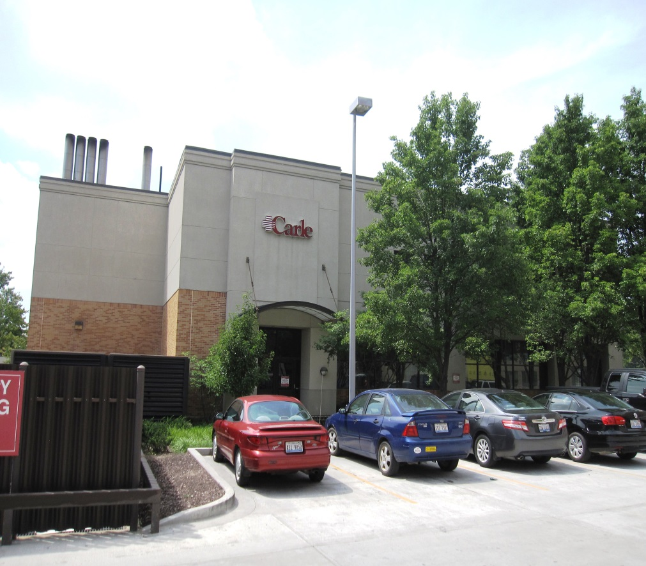

Carle Lab-Center of the Universe
Carle Lab
Hospital and Clinic
Notes:
Centrally located on the main campus, linked by tube system to all sites on the main campus.
Supervises POC across the organization and in branch sites.

Slide 8
Target rich Environment For improvement-2014
High blood use compared to peers
Repeat inpatient lab tests
Use of recommended thyroid profile algorithm
Vitamin D testing by provider and site
Test use variability between Providers
PSA Screening of men over age 70
Use/Misuse of thrombophilia testing in inpatients
Incidence of Anemia in hospital population
Ambulatory anemia management-Iron testing and Hgb levels
Impact of Hepatitis C recommendation to test baby boomer cohort(1945-1965 birth dates)
Appropriate use of referred/non-in house testing
Appropriate use of molecular testing
Notes:
After years of depending on others to do big things I had an opportunity to directly affect change.
Usable information other than actual $ activity, based on actual events is hard to come by .

Slide 9
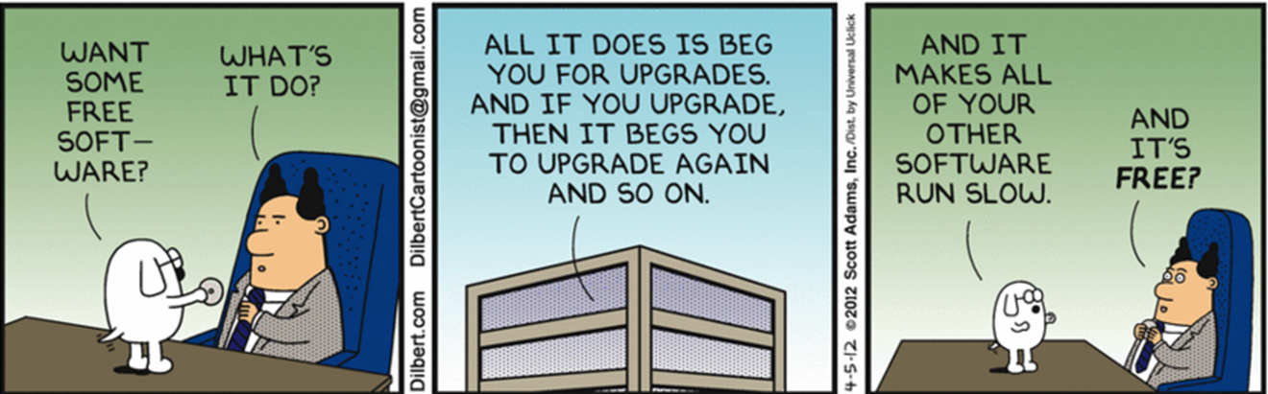

“Want some free software?”
Notes:
IT comes down to technology.
EMR does had not produced a lot of usable info.
Several expensive bolt on vendor solutions attempted but relied on EMR based data.

Slide 10
Our Electronic Setup:
Carle Electronic infrastructure:
  Epic House with most modules, excluding Beaker
  LIS:
    SCC: Lab, MIC, Bank-Live since 1994
      SoftLabMIC: 4.0.7
      Bank: 25.1.0.5.1
    SCC: Pathology-Live Since 2003
      Path: 4.4.0.1.13
Dedicated LIS staff-3.5 FTE

Slide 11
Our Starting Point
What we did not have:
  Data mining experience in relational databases
  Report modules/products of any kind
  Anything other than basic knowledge in Excel
  Dedicated Report Writer
  Money to purchase products or services
What we had:
  A provider willing to drive information to affect change
  Willingness to learn and explore what we could do with what we had available
  Partnership with our analytics group to help us assess tools and provide some answers to our questions
Notes:
Acknowledgment to all the wonderful SCC users that are producing amazing reports via ODBC, Soft Reports, Oracle SQL Tools. Your extracts that you have shared via the users groups are truly amazing and are a tremendous resource.
That is not where we are at this time but we are trying to get there.
For our Starting Point:
What we did not have:
Data mining experience in relational databases.
Report modules or data mining products of any kind.
Very basic (really basic) knowledge of Excel
Dedicated report writer
Money! Requests in the past for data mining tools had been turned down due to tight health care dollars.
We were old school LIS support staff. All we knew was how to pull the canned SCC reports and to perform some minor tweaks to the SQL reports in the system.
What we had:
Provider who had the interest and the curiosity to look into processes and utilization and try to make sense of the information we could get.
Willingness to learn-which can still be difficult. Report writing or data mining requires massive time commitments so that you can bury yourself into the process in order to make meaningful headway quickly.
Partnership with our institutional analytics group:
Our analytics group was quickly being overwhelmed with report requests from across the institution, but through a cooperative partnership we had a partner that was willing to tutor us through some of the basics of SQL report writing as well as help us troubleshoot problems when we got stuck on a particular data type or syntax problem.
In return, we were a ready resource for that group to consult on specifics for report requests for lab data by other users outside of the lab.
No one knows the lab data like the lab and we are available to assist with some of the nuances of our data such as considering cascading tests, all the places you would find a hemoglobin result from the main lab to point of care.
Also had the luxury of no upgrades or new products for the lab for the past year which freed up time to learn.

Slide 12
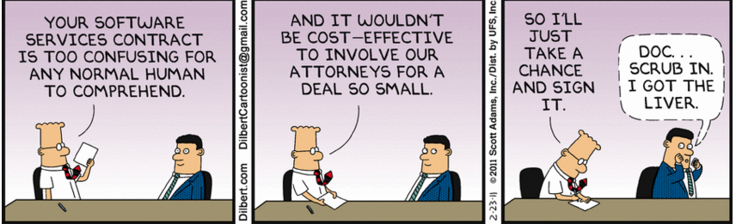
“Your software contract is too confusing ....”
Notes:
We live in a complicated environment, in what is called the United States health care system today.

Slide 13
Health Care-
It’s Complicated……
Health care costs are the problem
  What is covered?
  Who is covered?
  Who is going to pay?
  Who is going to provide the services?

Slide 14
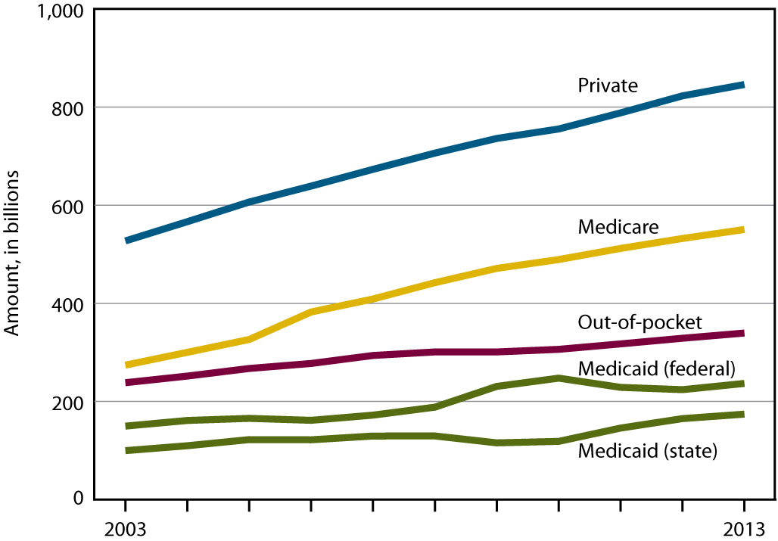

US personal health care expenditures rising……
2014 $3 Trillion
SOURCE: CDC/NCHS, Health, United States, 2014, Figure 19 and Table 104. Data from the Centers for Medicare & Medicaid Services, National Health Expenditure Accounts (NHEA).
Notes:
Cost increases 2-4 times inflation
Medicaid Medicare lower because of fee schedule.
Private fee schedules payments higher because of cost shifting.

Slide 15
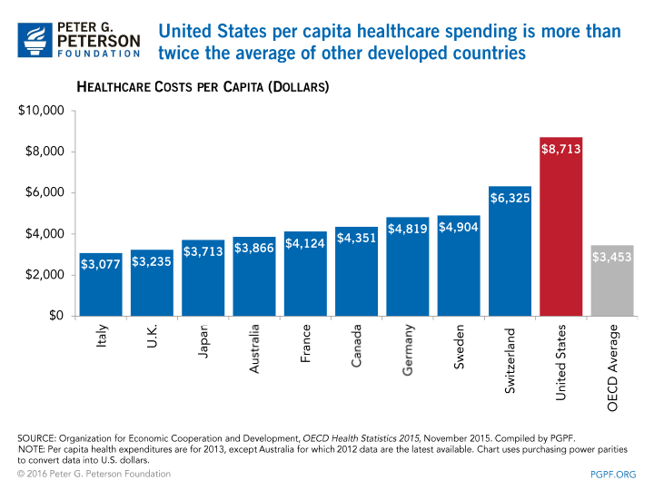
US Healthcare Costs are high.. Not new information..
Notes:
Costs are increasing in every country
price
aging
culture
Technology
access

Slide 16
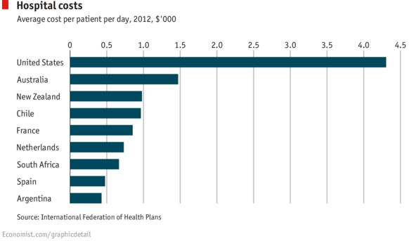
Difference driven by hospital costs..
And…..
Notes:
The major difference in US spending is the intensity of hospital use, rescue care and post hospital care
Expensive
People
Technology
access

Slide 17
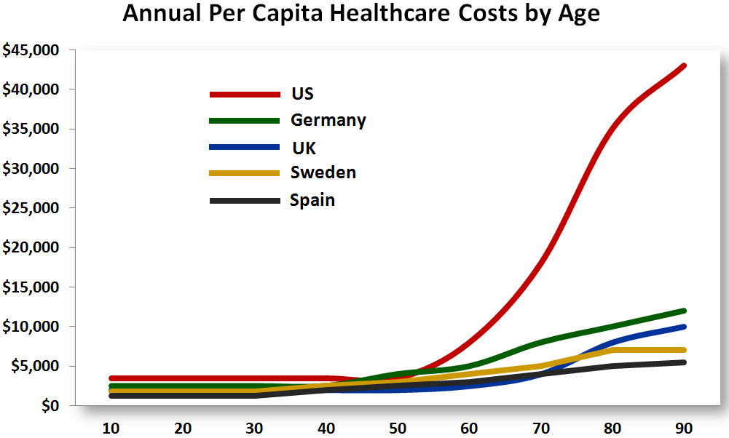

The major difference driver between US and other countries of the national spending per capita is
50 + years of Medicare FFS benefit
THANK YOU!
Notes:
Benefit design
What’s covered
Who’s covered
Who’s going to pay

Slide 18
Not just USA has issues….
National Health Service Reports that Most UK Hospitals Operating in Deficit Situations
The National Health Service of England (NHS) ended 2014 with a budget overrun of £800 million, placing financial stress on the entire UK health system
“The major cause of the financial crisis stems from overspending on wages for outsourced staff and management consultants, according to the report.”
Dark Report-April 4, 2016

Slide 19

The Problem- Health Care Cost TOO High…
  Cost= # of events X cost per event
  Health care cost (depends who is paying)
    Individual
      Insurance premium, deductible, copays, time, inconvenience
    Insurers/payers
      Benefit Cost versus premium/copays/deductibles
      Claims paid- per event /per bundle/per life
      Operations-people, contracting, marketing, compliance, etc.
    Providers-what we spend to deliver services
      People, facilities, supplies, compliance, insurance, recruiting, training, technology, turnover, etc.
      Different payment rates for the same service

Slide 20
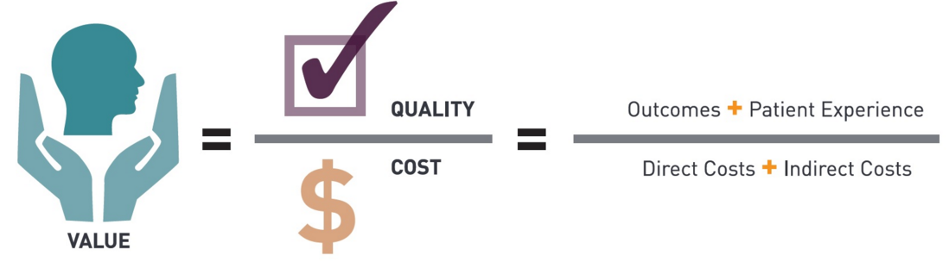
Moving from event based payment to value based payment
Everyone’s goal is increased or same QUALITY for LOWER COST
PLEASE DEFINE QUALITY! COST!
This is an equation!
We have not proven increased quality reduces long term cost.
If you change one variable it will theoretically effect the Value.
Definitions are important!
Only Cost can be directly measured.
Notes:
Our main issues revolve around the definition of the terms in this equation

Slide 21
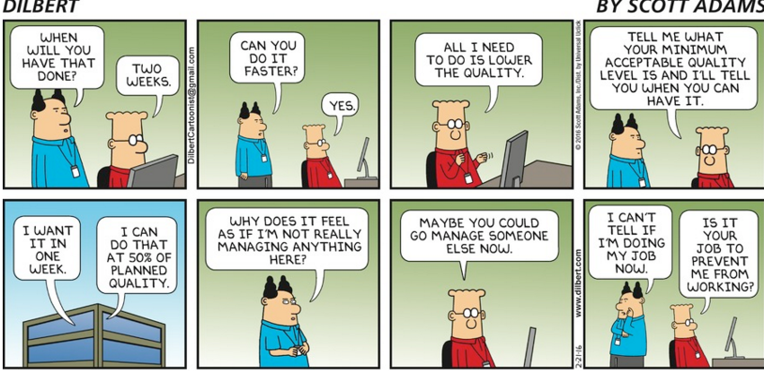

Everyone’s goal:
INCREASED QUALITY (at lower cost)

Slide 22
No worries- The Government will solve it!
They are redefining what an event is….
MACRA=MIPS, APMs, CEG, PRC, PCG
Medicare Access and CHIP Reauthorization Act of 2015 (MACRA).
  Merit-Based Incentive Payment System (MIPS)
  Metrics: Average cost per patient, patient satisfaction, patient use of EMR, mortality, infection rates, readmissions, access, etc
  Alternative Payment Models (APMs)
-New Section of MACRA:
  "Collaborating with the Physician, Practitioner, and Other Stakeholder Communities to Improve Resource Use Measurement”
  In one year (2016) this requires creation of new metrics:
    Care Episode Groups
    Patient Relationship Categories
    Patient Condition Groups
    For masochists I have attached a definition of these new “events” in slide deck
Notes:
First they “gave” us Medicare
Part A
Part B
Part C
Part D
Then Medicaid
Then uncountable additions and modification
Then HITECH,
Then ACA
Now …..
Rather paying, by event-visit, image, lab test
Payment will be by events modified by metrics of an attributed population.
Each metric will drive its own regulatory bureaucracy, politics,
Data is 12-24 moths delayed and subject to appeal
Hoped for outcome is that the total cost and outcome will be what is ultimately measured.
VALUE
Stay tuned.

Slide 23

Hanlon’s Razor:
“Never attribute to malice that which is adequately explained by stupidity.”

Slide 24
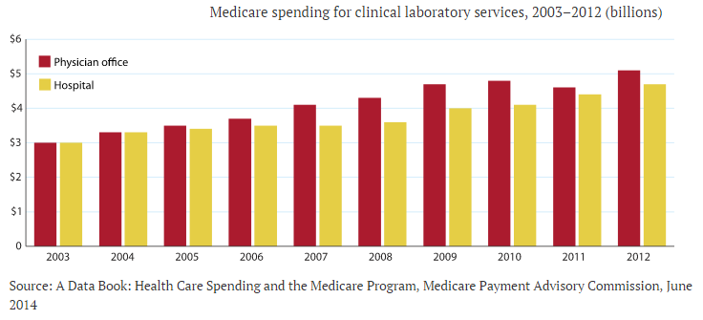
Lab costs in 2012 accounted for only 1.7% total Medicare costs (but Lab events and intensity increasing rapidly)
Medicare Lab Spend 2003-2012
Bottom line….
Avg. increase of 5.6%
Increase in 2012 was 9.1%
As price schedule is fixed increases reflect increased volume or increased use of high cost tests
Managed Care - October 2014

Slide 25
How can the Lab positively effect this equation?
Notes:
Looked at the rising costs of healthcare services delivered in the US and world.
Events drive a lot of the cost but also the costs of each event.
Lab costs as a % of total costs to the payers is rising probably because of increased access and high cost testing.
Value is an equation of multiple moving pieces we are trying to define and measure.
Our roll then is to focus on appropriate use delivered by the lowest cost.
Redefine the lab event s more than just the test.

Slide 26
15 year meta-analysis of published lab utilization studies (1997-2012)
Overall rate of inappropriate (overutilization) testing 20.6%
  Overall rate of underutilization 44.8% (based on fewer studies)
  Rate of inappropriate initial testing 43.9%
  Rate of inappropriate repeat testing 7.4%
  Inappropriate use by restrictive criteria 44.2%
  Inappropriate use by permissive criteria 12.0%
•10-40% lab tests are unnecessary (using objective criteria)
•Underutilization is bigger problem than overutilization
Reducing test volume is not the only answer!
Focus should be on how lab use adds/reduces the cost of the outcome, not just the cost of testing.
Findings from Zhi et al. PLoS ONE 8(11):e78962, 2013

Slide 27
DATA matters….more than $ incentives
Quality = reduction in variation
You can do this with SCC LIS
From 2003 through last year, tests per 100 well visits dropped from 2.5 to 0.43 for the 14 chemistry tests; 2.5 to 0.91 for CBCs; and 1.7 to 0.3 for TSH, she reported.
“To manage utilization, Riddell developed a report card for each family physician showing who orders medical laboratory tests inappropriately. The effort focused on the most-ordered tests, such as chemistry panels, the thyroid stimulating hormone test, and the complete blood count. “Then we did a deeper dive to see how many of these were ordered and by whom,” Riddell said. “Just by creating awareness about the overuse of testing, we saw a drop in utilization. Then when the report cards came out, we saw another drop in utilization because a lot of physicians quit ordering inappropriate tests entirely.”
Kim Riddell, M.D., Service Line Chief-Clinical Laboratory at Group Health Cooperative in Seattle, Washington
As Medical Laboratory Test Utilization Grows, Health Insurers Develop Programs to Manage Rising Costs | Dark Daily http://www.darkdaily.com/as-medical-laboratory-test-utilization-grows-health-insurers-develop-programs-to-manage-rising-costs-306#ixzz41b5VU9Pi
Notes:
HEDIS story

Slide 28
Why CHANGE?????
“Faced with the choice between changing one's mind and proving that there is no need to do so, almost everyone gets busy on the proof.”
John Kenneth Galbraith,
Canadian-American Economist
Notes:
Sue next

Slide 29
Identifying Resources:
SCC Canned reports in the LIS
  Transfusion Report, Verified Results Report, Tests per Month and anything else canned in the system.
    Preconfigured SQL reports available in Soft with some minor changes
Online and Community College courses
  http://www.wiseowl.co.uk/blog/s217/sql_server_tutorial.htm
Online searches (thank you, Google!)
Notes:
We were in a position where we had to use the resources that were already available or those that might be free or relatively inexpensive.
SCC Canned Reports were the only place we knew to start.
Transfusion Report, Verified Results Report, Tests per Month.
When these did not give us what we needed we turned to the canned SQL reports in SoftLab and opened tasks with SCC to make some minor revisions.
Online and Community College courses:
Community College-started with a couple of 2 day Excel courses because the SCC Canned Reports required so much manipulation we needed to find shortcuts where ever we could.
We discovered we would definitely need to move to the SQL tools so we started with the Wise Owl tutorials on line.
Wise Owl was a great way to understand what a relational database was, the basics of syntax and manipulating data.
Online searches:
SO MANY resources on line.

Slide 30
Roadblocks:
There was never one SCC canned report that had everything we needed.
Sometimes you need data from the EMR integrated into your reports.
The complexity of the data requests quickly outstripped our abilities.
  Not only our expertise, but sometimes the data structure did not allow us to easily pull the information needed.
Massive amounts of time trying to manipulate and display data.
Notes:
SCC canned reports rarely had enough information!
Not always formatted in a way that makes the report Excel friendly.
In order to make effective use of the information in one system sometimes we needed information from our Epic EMR system (OR procedures, admission information, medical service data, etc.)
This is where we had to turn to our Analytics Team-they taught us how to pull some of our data from the Epic Clarity databases, but when we needed to integrate data from the LIS with data from the EMR we needed the experts.
The complexity of our data requests quickly outstripped our abilities
We initially were overwhelmed by complex requests that exceeded our expertise but as we continued to evaluate more requests and explore new tools this is becoming less of an issue for one of our users.
Regarding the Time Constraints:
Requires that you always be exploring and evaluating new options and tricks to getting the data in a workable format. We have found it often took less time to research a solution and play than it would take to manually manipulate any large data dump.

Slide 31
Evolution of our progress:
SCC canned reports were reformatted and additional fields were added via tasks.
  Originally started with the canned reports and adding additional information manually-this can never be maintained.
Became more Excel savvy.
Became familiar with relational databases and how to pull data via the Oracle/SQL Tools.
Still learning!
Notes:
We have requested many changes to different canned reports in the SoftLab and Bank systems.
Transfusion Report: Staff were initially adding the HGB results MANUALLY so when the LIS became involved the first thing we did was open a task to see if additional needed data could be added to the report.
For Example: We defined parameters for which the HGB results would display.
If one of your options is to sort by and that data does not display in a column-ask!
Excel:
Incorporating pivot tables and graphs, we are better at consolidating data from multiple reports.
Learning SQL/Oracle was really the turning point for us.
We have a user that has been able to devote the time to learn and develop skills using these tools.
New preferred way to get information.

Slide 32
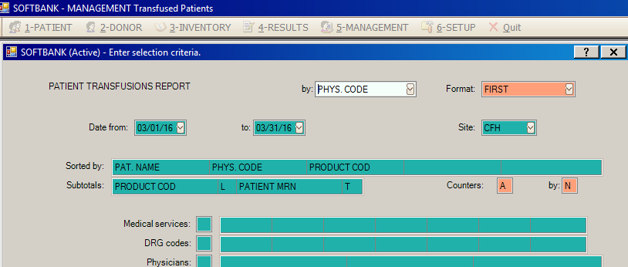

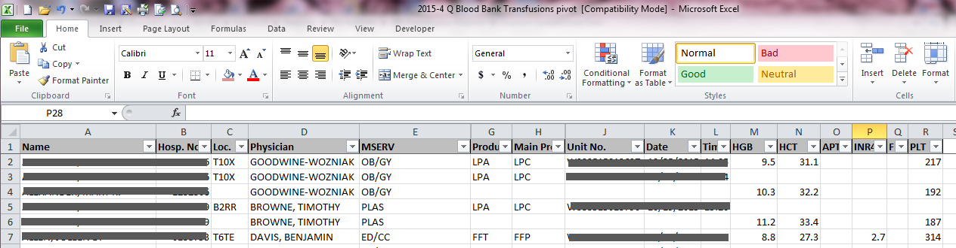
Data can change behavior
Clinical Challenge
  High Blood utilization compared to Premier peer group- no single reason
  Created SCC based report exported to Excel, tracking use of every transfused component, with pre-order labs.
Notes:
Started with the SoftBank Transfusion Report-many enhancements to the report – HGB, INR, Platelet counts for pre and post transfusion events. We were able to define the parameters of what qualified as pre and post transfusion via time frames.
Task CARLE 9315

Slide 33
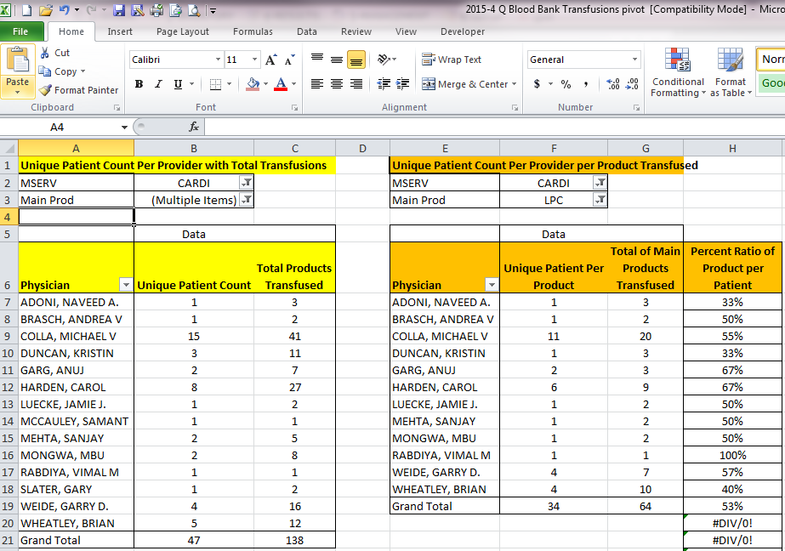
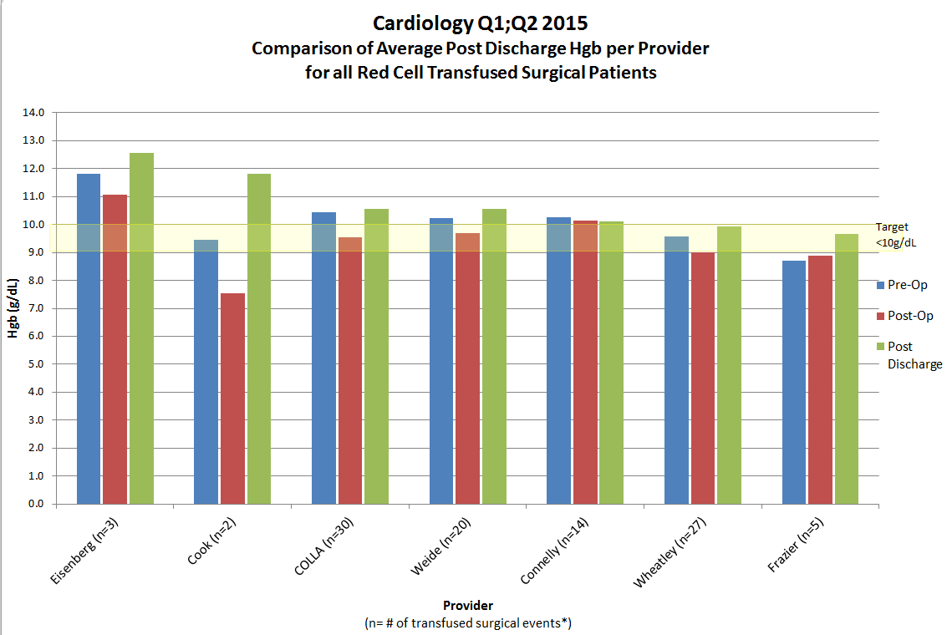
Data can change behavior
This data can then be pivoted or charted for further analysis and distribution:

Slide 34
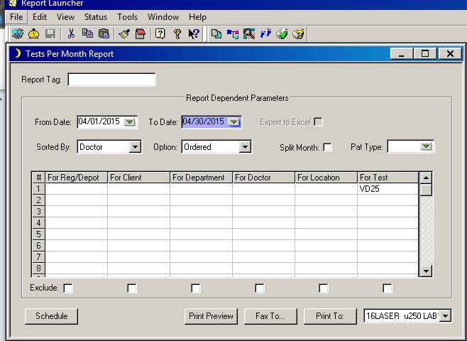
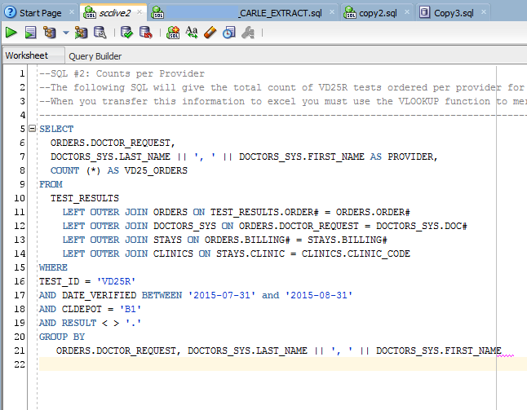

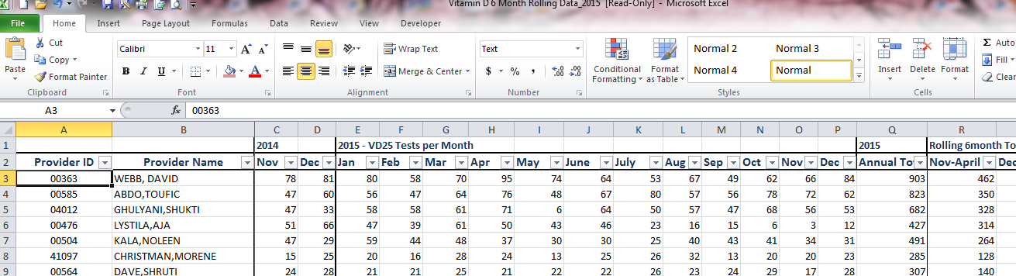
Data can change behavior
Clinical Challenge
  Routine Vitamin D testing is of no clinical value
Notes:
Began with the canned Tests Per Month but transitioned to an SQL.

Slide 35
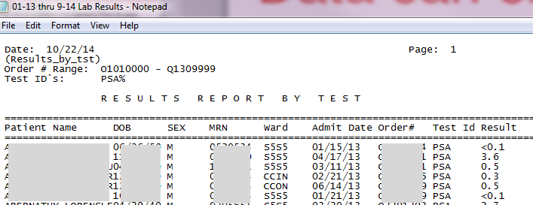
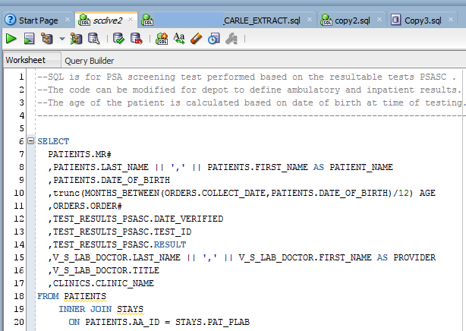

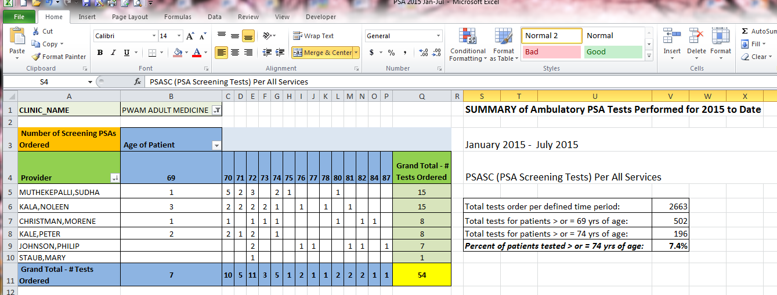
Data can change behavior
Clinical challenge
  PSA not routinely recommended for men over 70
Notes:
Used the Result Report by Test but had to move to the SQL for Date of Birth information.

Slide 36
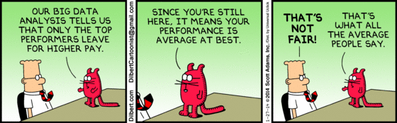
BIG Data

Slide 37
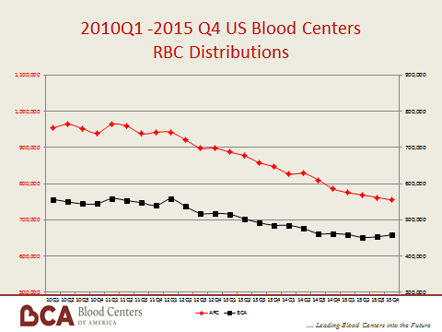
20% decrease in RBC use across the country in 6 years

Slide 38
Data can change behavior
Clinical Challenge
  High Blood utilization compared to Premier peer group- no single reason
    2012-over 10% of adult admissions received RBC
    National trend showed decreasing use
  Created SCC based Excel report tracking use of every transfused component, with pre order labs.
    Profile by specialty, site, ordering provider, where components used, pre Hgb, platelet count, INR, use of special products, single unit events, dosing of FFP.
    Review by quarter
  IP OR blood use report
    By case number, record number, provider, specialty, procedure, order, date and time of component use, pre and post lab values,
  Provided customized reports to main users
    Oncology, Surgery, Hospitalists
    Resulted in discussion of criteria, coagulation reversal order set, new best practice guidelines and new Epic indication driven order set .

Slide 39
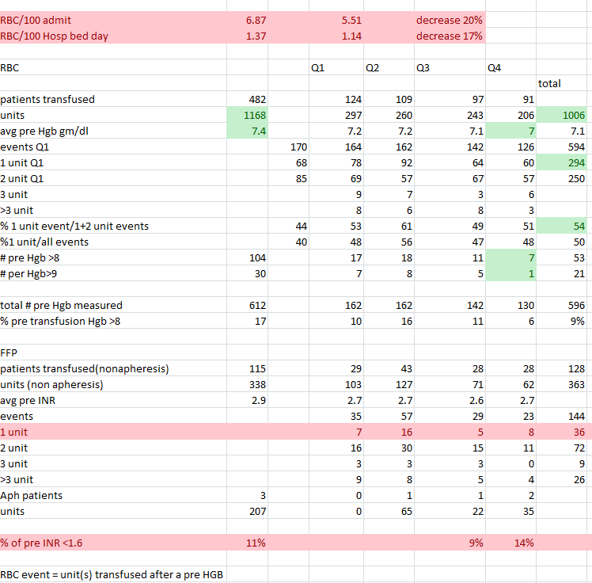
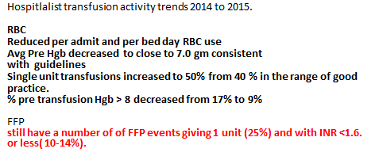
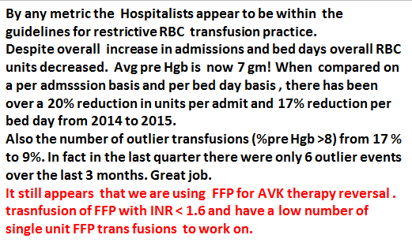
Hospitalist Transfusion Summary 2014-2015

Slide 40
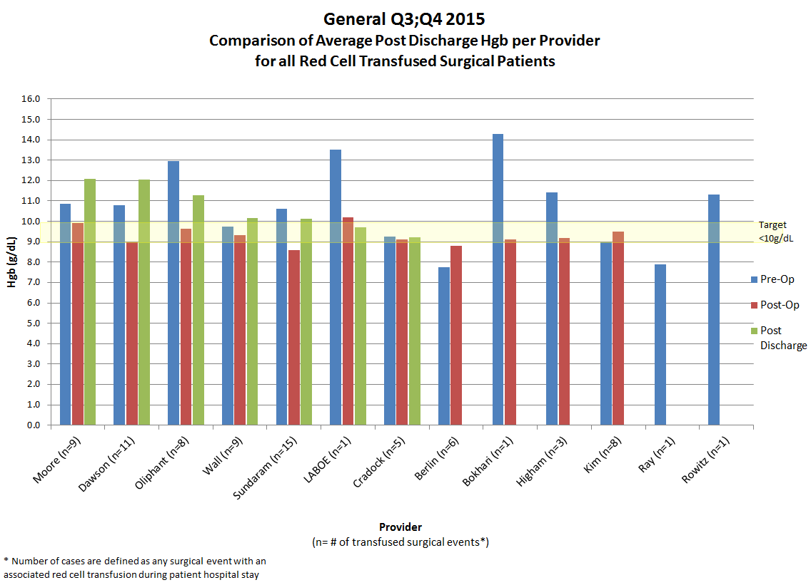
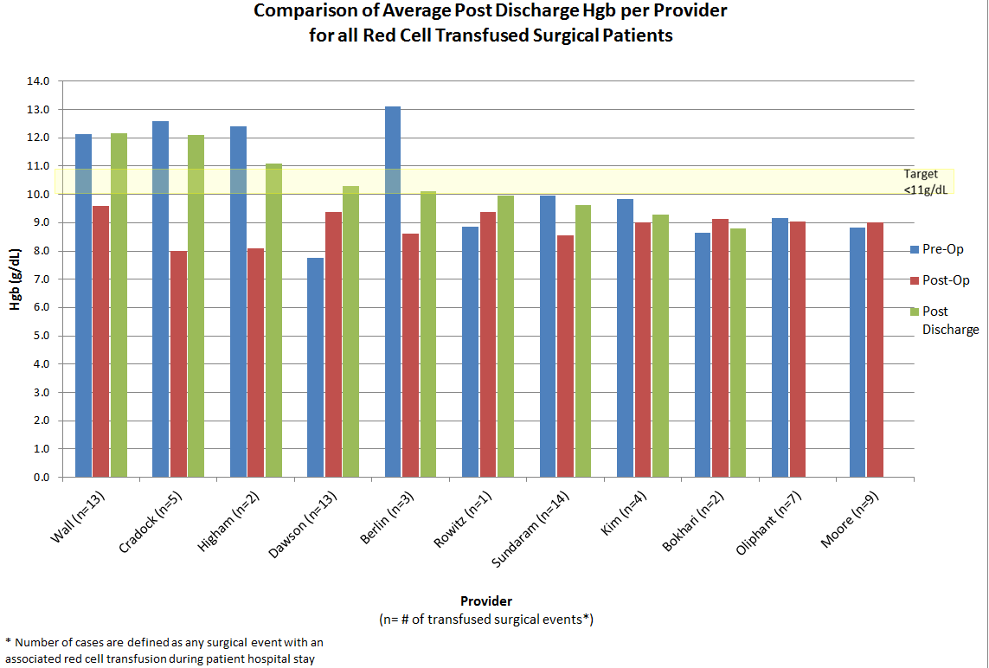
% Avg. Post Discharge HGB <10.0 g/dL by Surgeon, 2015
Q1=39% Q2= 55% Q3= 43% Q4=54%
General Q1:Q2 2015

Slide 41
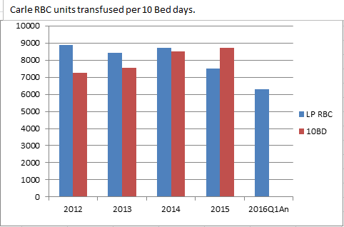
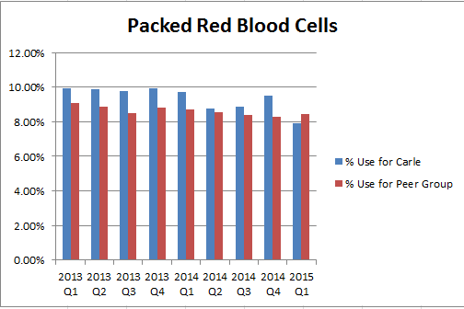
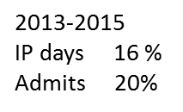

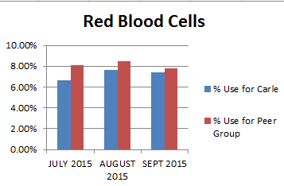
System activity up
RBC use down 1300 units
Premier Peer Group Comparison
2013-2015
IP days 16 %
Admits 20%
Decreased RBC units transfused, fewer transfusions events per admission, fewer units per patient, lower pre Hgb levels, more 1 unit transfusions

Slide 42
Data can change behavior
Clinical Challenge
  Routine Vitamin D testing is of no clinical value.
    Carle performed over 16,000 tests in 2014.
    Mostly ordered in primary care, significant variation in volumes and adjusted for patient panel size.
  Initiated best practices recommendation
  Primary care leadership rolling out as part of medical home process.

Slide 43
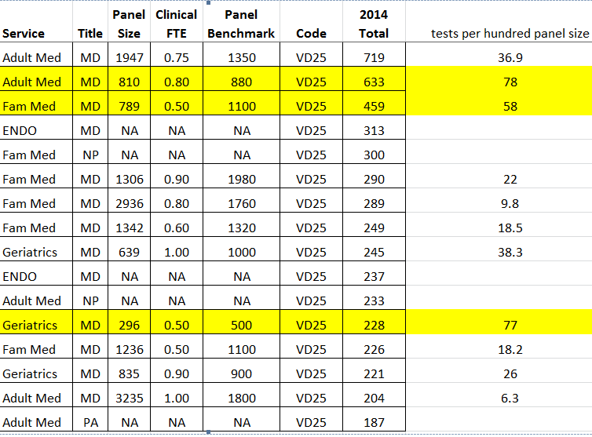
Practice ordering variation

Slide 44
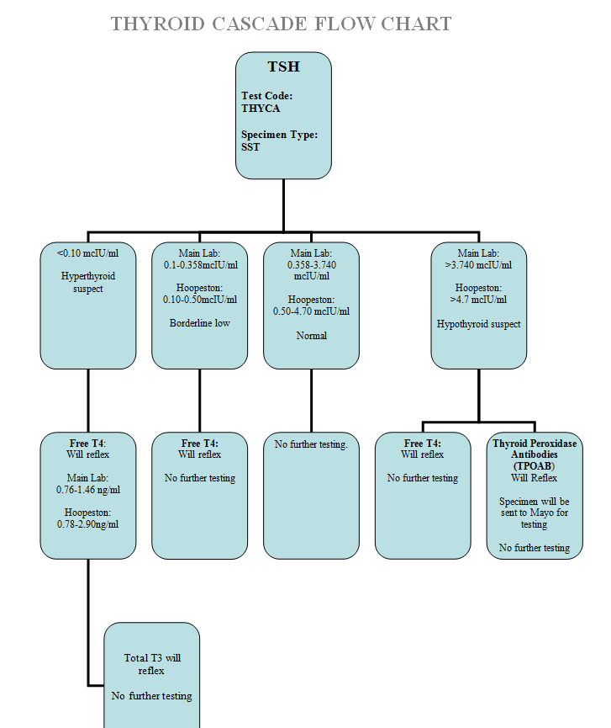
Concern over thyroid testing led to thyroid cascade.
We tested this and provided feed back to best practices.
Found conflicting order sets in primary care and fee schedule issues.
NOTE to Best Practices Committee:
“We have folks ordering both TSH and T4, or ordering TSH and then a second draw for the T4.
Most are ordering way more TSH, than Thyroid Cascade Panels which starts with a TSH and then reflexes to a T4 if TSH is abnormal.
We do 13,100 TSH separately orders annually from the 4000+ Thyroid Cascade Panel TSH tests followed by 2800 T4 ordered. I doubt we have 25% incidence of low TSH but am looking at that now.
Or we have a lot of folks on therapy for hypothyroidism.”

Slide 45
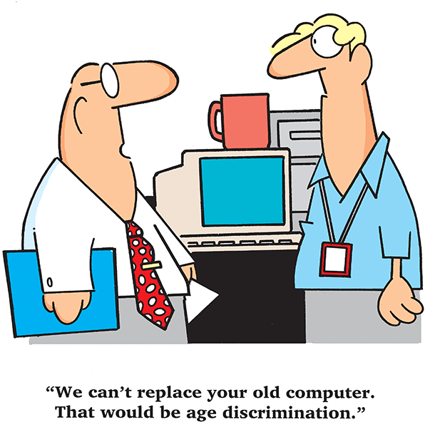
“We can’t replace your old computer. That would be age discrimination”

Slide 46
Lessons Learned:
You may be able to produce meaningful data working with what you have.
Presenting data in a relevant way does not necessarily require more than basic skills.
Consider all reports a “work in progress”.
  Surprisingly, you may find what you originally thought you wanted can be reshaped by what your data shows.
  Don’t worry about perfection (except for the validity of the data!).
  As reports change practice, the needed information may evolve.
Results may show inconsistencies.
  Reports have shown us opportunities to identify variances and tighten processes.
Notes:
You can producing meaningful data working with what you have:
Those first reports from the SCC canned reports and consolidation of different reports together may not have been pretty but the data was there and it was clean.
Each time we were asked to pull data we explored ways to increase efficiencies.
We learned to look at our data in a different way-thinking of the end goal and determining the best way to approach a report before we started writing the report.
Allowed us to evolve in the way we look at our system, our data and our report requests.
We now know we need to ask more probing questions with our report requests-we got burned early on by giving people what they requested-literally-without understanding what the data would be used for. You need to be the data expert and help users understand the nuances of the data they want to gather.
Presenting data in a relevant way can be done with simple Basic Excel formulas will often get you the data you need.
As you learn and explore you will come to a better understanding how to present data in a way that adds meaning and understanding.
You should always consider highly complex reports a “work in progress”:
Initially we would pull data, look at it and determine we either were looking at the needs the wrong way, using the wrong data points, or we would need additional data to make the initial targeted more meaningful.
Sometimes you need to get the data out there before you perfect the report-just always make sure you are giving the correct data.
Surprisingly we found Inconsistencies:
Variances were found in SOPs-the data clearly showed this and, therefore can be rendered meaningless if you do not correct processes or SOPs are not being followed consistently. (Ex: TAT’s)
Reports have shown us opportunities to identify those variances and make positive changes to standardize practices.

Slide 47
Where do we go from here?
As we become more data driven from the provider side and the business side we need to consider how to manage the required resources for obtaining the necessary data.
  We need dedicated products for lab specific analytics such as Soft Reports, or additional personnel with the expertise to pull this data via other methods.
    Timely reports are the most effective so we will need to emphasize how we can best meet the needs quickly.
  Development of SCC Canned Reports for those one time ASAP or low complexity extracts needed.
Notes:
The demand for data is only going to increase.
The demand is such that we will need better balance resources-prioritizing requests in order to try to effect changes for patient safety, efficiencies in the Lab and better utilization practices for the organization.
We will need to explore getting a dedicated product or a report writer.
Example: We have requests for daily reports since timely reports are the most effective. You cannot change behavior unless you can move more towards timely reporting and you cannot explore deviations easily months after they occur.
This is where I think SCC can help:
SIG request show other users are trying to utilize the canned reports and not able to pull all the needed data. There is usually something missing and the formats do not lend themselves to be easily exported to Excel and manipulated.
The one time ASAP requests for data need to be easily pulled by the supervisors and managers. Even if you have SoftReports, writing reports takes time and if there are reports that the front end staff can run to satisfy their needs, you can free up your experts to do the heavy lifting with the complex reports.

Slide 48

We are always resource challenged..
“Do not let what you cannot do interfere with what you can do.”
John Wooden,
Basketball Coach

Slide 49
Data can change behavior
Volume –is there a problem or opportunity?
  Unexplained variation between providers
  Variation from guidelines
  Care deficiencies, overuse?
Advantages of organizational LIS over Payer Data
  Can quantify direct cost savings for organization
  Not segmented by payer, shows whole picture
  Distinguishes ordered tests and performed tests
  Can easily identify abnormal subsets
  Can help set priorities
  Can customize to your organization needs
Helps define value of data that drives change and guide software and staffing decisions

Slide 50
Using the LIS to Impact Clinical Decision Making and Laboratory Utilization in a Value Based world
Physicians focus on an individual care episode or patient
  Without outcome data presented in a meaningful way they do not know if they are doing more or less than others. They attribute differences to their unique population.
  Organizations rarely aggregate population data. They get reports from different payers but not a picture of a whole practice pattern.
  LIS data allows customize answers to organizational specific problems without having to invest in new software.
The LIS data is all payer…..this is a big deal!

Slide 51
Value Based Care
Goal is to align incentives to lower cost and maintain/improve Quality
  Payments/penalties for events modified by metrics
  Payment by patient per year modified by metrics
Both Federal and Commercial payment models evolving
SCC LIS can support and drive the Value based organizational strategies
Notes:
Value based payment?
Currently no standard definition
The provider has some or a lot of risk for performance ? Consequences, limited control over cost drivers
What is performance?
Total cost of service for individual, group, population?
Per individual per year=capitation
Metrics- could not find one metric related to specific lab testing pattern, other than overall cost of care for attributed population

Slide 52
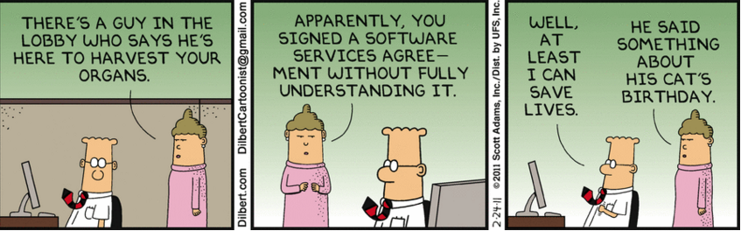
It is all about outcomes

Slide 53

Questions?
Where’s the Coffee?

Slide 54
Extra credit
Harvard Conference on Lab utilization and Laboratory Developed Tests
  https://theforum.sph.harvard.edu/events/medical-tests/

Slide 55
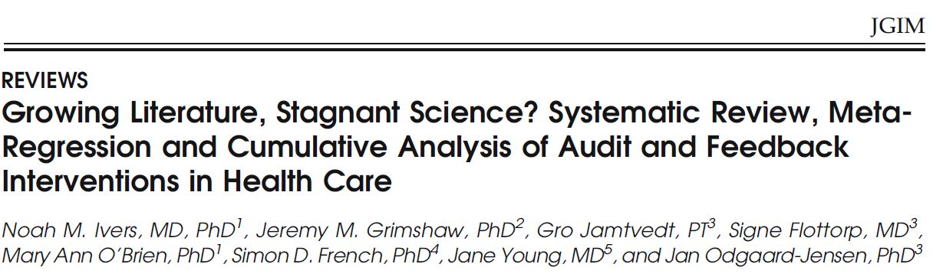
Discusses importance of audit and feedback in the success of any clinical intervention
  Characteristics of most effective interventions
    Format: Verbal and written feed back
    Source: Trusted colleague or supervisor
    Frequency: More frequent better than less frequent
    Instructions for improvement: Explicit and measurable target and action plan
    Nature of behavior change: Decreased activity > increased activity
    Profession of recipient: Non physicians change greater than Physician
      J Gen Intern Med 29(11):1534–41, 2014

Slide 56
In 2014, U.S. health care spending increased 5.3 percent following growth of 2.9 percent in 2013 to reach
$3.0 trillion, or $9,523 per person. The faster growth experienced in 2014 was primarily due to the major coverage expansions under the Affordable Care Act, particularly for Medicaid and private health insurance. The share of the economy devoted to health care spending was 17.5 percent, up from 17.3 percent in 2013. https://www.cms.gov/research-statistics-data-and-systems/statistics-trends-and-reports/nationalhealthexpenddata/downloads/highlights.pdf
Hospital Care: Spending for hospital care increased 4.1 percent to $971.8 billion in 2014 compared to 3.5% growth in 2013. The fastest growth in 2014 was influenced by a resurgence of growth in non-price factors such as use and intensity of services.
  In addition, hospital services experienced faster growth in Medicaid, private health insurance, and Medicare spending compared to 2013.
  Lastly, ACA-related coverage expansion contributed to increased hospital spending for both Medicaid and private health insurance.
Physician and Clinical Services: Spending on physician and clinical services increased 4.6% in 2014 to $603.7 billion from 2.5 % growth in 2013 when spending was at a historical low. Faster growth in both price and non-price factors contributed to the acceleration in overall spending for physician and clinical services.
  Medicaid, private health insurance, and Medicare spending for physician and clinical services all accelerated in 2014.
Other Professional Services: Spending for other professional services reached $84.4 billion in 2014, an increase of 5.2%, which is an acceleration from 3.5%in 2013. Spending in this category includes establishments of independent health practitioners (except physicians and dentists) that primarily provide services such as physical therapy, optometry, podiatry, or chiropractic medicine.

Slide 57
In 2014, U.S. health care spending increased 5.3 percent following growth of 2.9 percent in 2013 to reach
$3.0 trillion, or $9,523 per person. The faster growth experienced in 2014 was primarily due to the major coverage expansions under the Affordable Care Act, particularly for Medicaid and private health insurance. The share of the economy devoted to health care spending was 17.5 percent, up from 17.3 percent in 2013.
Dental Services: Spending for dental services increased 2.8% in 2014 to $113.5 billion, faster than in 2013 when growth was 1.5%. Private health insurance (which accounted for almost half of dental spending in 2014) increased 3.4% after growing 1.3% in 2013.
  Out-of-pocket spending for dental services (which accounted for 40% of spending in 2014) increased slightly at 0.2%in 2014, following growth of 1.0% in 2013.
Other Health, Residential, and Personal Care Services: Spending for other health, residential, and personal care services grew 4.1% in 2014 to $150.4 billion, which was a slowdown compared to 4.7% growth in 2013. This category includes expenditures for medical services that are generally delivered by providers in non-traditional settings such as schools, community centers, and the workplace; as well as by ambulance providers and residential mental health and substance abuse facilities.
Home Health Care: Spending growth for freestanding home health care agencies accelerated in 2014, increasing 4.8% to $83.2 billion following growth of 3.3% in 2013. The faster growth in 2014 was attributable to increased spending by the two largest payers of home health, Medicare, with growth of 3.3%, and Medicaid, with growth of 3.5%. Combined, both payers of home health care represented 77% of total home health spending.
Nursing Care Facilities and Continuing Care Retirement Communities: Spending for freestanding nursing care facilities and continuing care retirement communities increased 3.6% in 2014 to $155.6 billion, an acceleration from growth of 1.3% in 2013. The faster growth in 2014 was due to the increased spending in Medicare, with 4.1% growth, and Medicaid, with 3.1% growth.

Slide 58
Health Spending by Major Sources of Funds:
Medicare: Medicare spending grew 5.5% to $618.7 billion in 2014, an acceleration from 3.0% growth in 2013. This increase was primarily attributable to faster growth in spending for prescription drugs, physician and clinical services, and government administration and the net cost of insurance. Medicare accounted for 20% of total health care spending.
Medicaid: Total Medicaid spending, which accounted for 16% of total national health expenditures, increased 11.0% in 2014 after growing 5.9% in 2013. State and local Medicaid expenditures only grew 0.9%, while federal Medicaid expenditures increased 18.4% in 2014. The increased spending by the federal government was largely driven by the newly eligible enrollees under the ACA, which were fully financed by the federal government.
Private Health Insurance: Total private health insurance expenditures increased 4.4% (33% of total health care spending) to $991.0 billion in 2014, faster than the 1.6% growth in 2013 which was the slowest rate since 1967. The faster rate of growth reflected the impacts of the ACA, including the introduction of Marketplace plans, health insurance premium tax credits, health insurance industry fees, and mandated benefit design changes. Average monthly marketplace enrollment was 5.4 million in 2014.
Out-of-Pocket: Out-of-pocket spending grew 1.3% in 2014 to $329.8 billion which was slightly slower than annual growth of 2.1% in 2013. The slowdown in 2014 was influenced by the expansion of insurance coverage and the corresponding drop in the number of individuals without health insurance.

Slide 59

MACRA, MIPS, APMs
Extracredit

Slide 60
Primary Care Physicians' Challenges in Ordering Clinical Laboratory Tests and Interpreting Results
John Hickner, MD, MSc, Pamela J. Thompson, MS, Tom Wilkinson, MPH, Paul Epner, MBA, MEd, Megan Shaheen, MPH, Anne M. Pollock, BA, Jim Lee, MS, Christopher C. Duke, PhD, Brian R. Jackson, MD, MS and Julie R. Taylor, PhD, MS
+ Author Affiliations
JABFM March–April 2014 Vol. 27 No. 2
1768 physicians (5.6%) responded to the survey
They reported uncertainty about ordering tests in 14.7% and uncertainty in interpreting results in 8.3% of these diagnostic encounters.
The most common problematic challenges in interpreting and using test results were not receiving the results and confusing report formats.
Physicians infrequently sought assistance or consultation from laboratory professionals but valued these consultations when they occurred.
With more than 500 million primary care patient visits per year, the level of uncertainty reported in this study potentially affects 23 million patients per year and raises significant concerns about the safe and efficient use of laboratory testing resources.
From the Department of Family Medicine, University of Illinois College of Medicine, Chicago (JH); the Centers for Disease Control and Prevention, Atlanta, GA (PJT, AMP, JRT); the Altarum Institute, Ann Arbor, MI (TW, MS, JL, CCD); Paul Epner LLC, Evanston, IL (PE); and the Department of Pathology, University of Utah, Salt Lake City (BRJ); and ARUP Laboratories, Salt Lake City, UT (BRJ).
Corresponding author: John Hickner, MD, MSc, Department of Family Medicine, University of Illinois Chicago, 1919 W. Taylor, MC 663, Chicago, IL 60612 (E-mail: hickner@uic.edu).

Slide 61
Primary Care Physicians' Challenges in Ordering Clinical Laboratory Tests and Interpreting Results
John Hickner, MD, MSc, Pamela J. Thompson, MS, Tom Wilkinson, MPH, Paul Epner, MBA, MEd, Megan Shaheen, MPH, Anne M. Pollock, BA, Jim Lee, MS, Christopher C. Duke, PhD, Brian R. Jackson, MD, MS and Julie R. Taylor, PhD, MS
+ Author Affiliations
JABFM March–April 2014 Vol. 27 No. 2
Conclusions:
  Improvement in information technology and clinical decision support systems and quick access to laboratory consultations may reduce physicians' uncertainty and mitigate these challenges.

Slide 62
Where do we spend the commercial health care dollar(2012)?
Source: IMS LIFELINK Health Plan Claims
74 Million unique patients in >80 US Health Plans
Spending per year
(N=over 15 million patients)
Outpatient costs
$ Avg. $ mean
Total (100%) 3955 709
Outpt. (54%) 139 506
Inpatient (25%) 972 0
Drugs (21%) 845 30
$ Avg. $ mean
  ASC, Dialysis, 781 23 PT, Chemo etc.
  Office visit 462 218
  Surg. Phy. fees 278 0
  Radiology 271 0
  ED 177 0
  Lab/Path 170 12
  Lab Costs=4.2% of spending
“What Contributes Most to High Health Care Costs?” Prichard, D et al
J of Managed Care and Specialty Pharmacy vol. 22, no.2

Slide 63
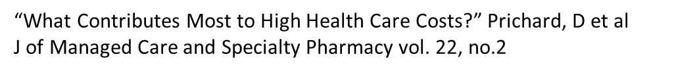
Commercial Payer Costs to Lab and Pathology Services Increasing
Around $190 avg./person/year in 2012
  5% of total cost
For High Risk Patients(5% of total) 4% of total costs can be attributed to lab and pathology costs
  $2000 avg.
  5% are High Resource Patients..
  (used to just be called sick)

Slide 64
Using the LIS to Impact Clinical Decision Making and Laboratory Utilization in a Value based world
How can the cost of a clinical event be influenced by lab use?
  Direct cost - make or buy
  How does the test effect the outcome?
  Cost of managing the Clinical Cost of patient-lab interaction
    Decision to order, Patient education on need and value of test, Effect of Turnaround time
    Managing access, specimen acquisition, managing result, dealing with abnormal results, integrating result into data base, providing access to result, follow-up of abnormal or normal.
    Liability to perform or not perform?

Slide 65
All of these interventions require data
  Four Types of Algorithms:
    Pathologist-driven: Review of pathology findings determine next steps in testing algorithms; cancel or add appropriate next steps
    Genetic Counselor-driven: Review of genetic test requests require genetic experts with laboratory knowledge; make phone calls to add or cancel testing
    Laboratory-driven: Laboratory results drive subsequent test selection. Testing is performed by laboratories using available specimens; specimens are shared between labs
    IT-driven: Clinical input and information drive what testing gets ordered or not.
  From Mayo Clinic Lab utilization presentation available on line at Mayo Lab web site

Slide 66
Midwest Provider Owned Health Plan:
Clinical lab 2012-2015 spending trends show
Lab costs 5+% and rising…
Commercial
  % change in premium +17%
  % change in Hosp lab claims +30%
  % change in Clinic lab claims +18%
% Total Change in Lab claims +26%
Medicare Advantage
  %change in premium +12%
  % change in Hosp lab claims -28%
  % change in Clinic lab claims +12%
% Total Change in Lab claims -5%
Rapid increase over the past 4 years compared to historical trends.

