Slide 1
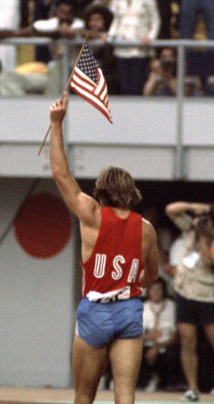
Decathlon of Epic integration:
NurSE COLLECTION USING PPID and BEYOND THE Next event!
p. Michael Huppenthal
Director of pathology I.T. – Johns Hopkins
Gregory Rex
i.t. Manager – SCC Soft lis

Slide 2
Learning Objectives
Understand how Epic’s PPID specimen collection workflow can be implemented with the 3rd party SCC Soft LIS.
Learn details of the PPID workflow, our partnership with scc and epic, implementation challenges, and ultimately our success.
Understand how we measure success and monitor nursing collections.

Slide 3

Johns Hopkins Health System (JHHS)
Johns Hopkins Hospital (1140 Beds)
Bayview Medical Center (545 Beds)
Howard Co. General Hospital (271)
Suburban Hospital (236 Beds)
Sibley Memorial Hospital (318 Beds)
All Children’s (St. Petersburg)
Epic Ambulatory 2013
Epic Inpatient 2013 thru 2016
LIS: SCC Soft / STTx / Telcor (2012 thru 2016)

Slide 4
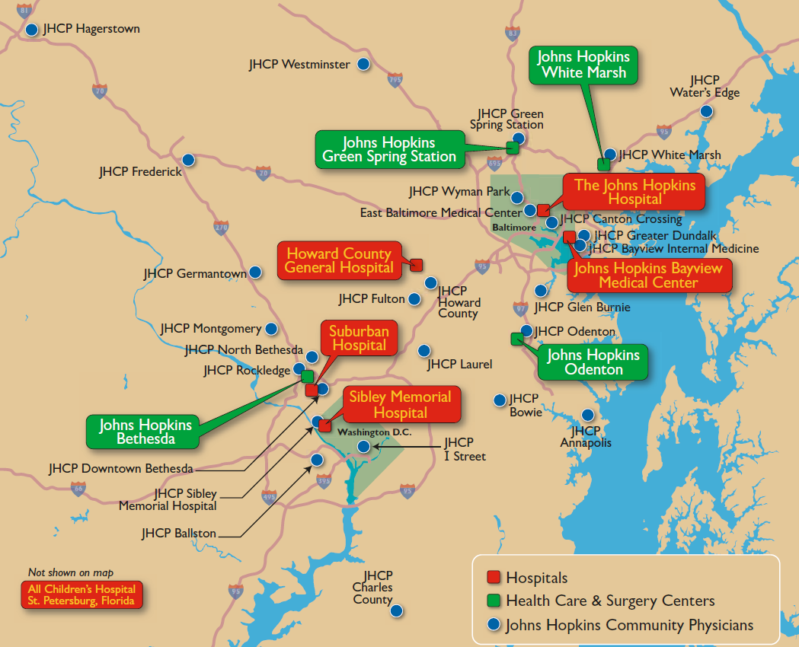
Johns Hopkins Health System
6 Hospitals / 4 Surgery Centers / Community Physicians (30)

Slide 5
J.H.M. Laboratory Statistics
Average clinical Orders/Day: 22,500
Volume Distribution:
  40% Inpatient
  30% Outpatient Main Campus
  30% Outreach (Primary Care Sites)
Anatomic Pathology
  Surgical Pathology: 93,000 cases
  Cytopathology 33,000 cases
  A.P. Consults: 35,000 cases

Slide 6

J.H.M. - Information Technology
State of the union
J.H.M. has implemented the Epic H.I.S. and its suite of applications at all five Hospitals.
Other 3rd party applications must achieve tight integrated workflows that fulfill the strategic missions of the institution.
Nursing uses “one application”.
Our scc soft LIS suite of applications have fulfilled our laboratory Clinical needs but integration is a challenge!

Slide 7
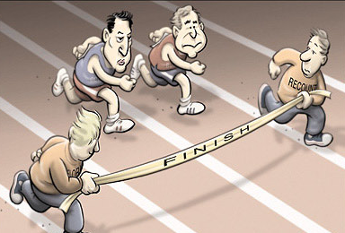
Where is the finish line!
Epic

Slide 8

Is it Friday?
Epic

Slide 9

Specimen Collection Standard of Care
Positive Patient Identification (PPID)
Long History with PPID workflows:
  10 years at Howard co. general Hospital (Mobilab)
  8 years at Bayview Medical Center (Mobilab)
  5 years at Johns Hopkins Hospital (Carefusion)
Forced documented scanning of wristband
specimen Label Printing at the Bedside
Electronic Collection at the Bedside
Well documented Patient Safety Record

Slide 10
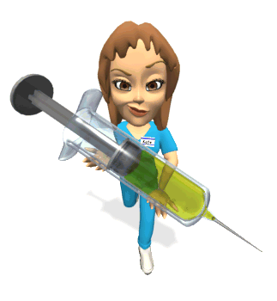
Epic Nursing Specimen Collection Workflow before New Development.
Nursing printed Lab labels to one shared printer for each DEP at most sites.
Specimen collection in a variety of workflows; in room, in Nursing Station, auto-collect at label print. Varies by site and Application.
Significant “potential” for patient identification mistakes, workarounds, and invalid collection times.

Slide 11
J.H.M. goals:
Develop an Integrated Epic PPID workflow.
Nursing uses one Application = Epic.
Lab Rounding Phlebotomy = SCC Soft ID.
Goals
  Simple Intuitive Streamlined Workflow.
  JHM Nurses work in epic.
  Meet Existing Patient Safety Objectives.

Slide 12

Development timeline
UGM 2014 – Strategic decision to develop an integrated epic PPID Workflow.
Epic delivery of Software July 2015.
SCC Soft delivery of changes (Oct 2015).
Gene upgrade and MOM changes.
December 1st go-live.

Slide 13
Nursing Workflow basics (12/1):
Specimen Label Print Request
The Epic Nursing “Work List Tasks” shows all active lab orders.
After selecting [Request Label], the “Specimen to Collect” list appears.
Nursing Work Lists Tasks
 | Time | Task
 | 1450 | Request Lab Label for Urinalysis | Request Label
 | 1450 | Request Lab Label for CBC | Request Label
 | 1500 | Request Lab Label for Amylase | Request Label
Specimens To Collect List
 | CBC
 | Amylase
 | Urinalysis
 | Magnesium
 | Gentamicin Level, Peak
 | Label Printer:

Slide 14
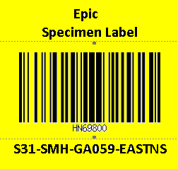
Select the Lab tests and Printer
Selected the desired tests for label printing (aod).
The local printer may default automatically, select by clicking on the printer search command, or scan the barcode on the printer.
Click on [Request Label] to initiate the printing task.
Specimens To Collect List
 | CBC
 | Amylase
 | Urinalysis
 | Magnesuim
 | Gentamicin Level, Peak
 | Label Printer:
REQUEST LABEL(S)

Slide 15
The labels have now printed to the selected printer.
The Work List immediately updates to allow for specimen Collection.
You can REPRINT any labels that are still pending for collection.
Nursing Work Lists Tasks
 | Time | Task
 | 1450 | Reprint Label for Urinalysis | Request Label
 | 1450 | Collect Urinalysis | Collect
 | 1450 | Reprint Label for CBC | Request Label
 | 1450 | Collect CBC | Collect
 | 1500 | Reprint Label for Amylase | Request Label
 | 1500 | Collect Amylase | Collect

Slide 16
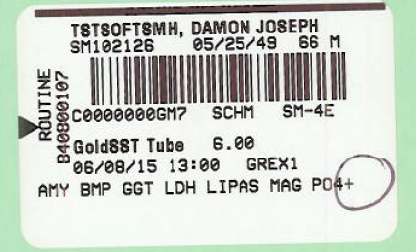
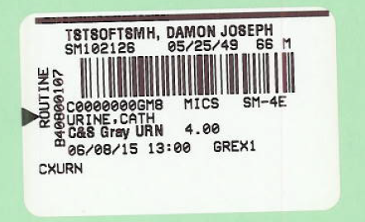
Typical Specimen Label
Printer quality check bar; (if there are any white gaps in this bar, a printer quality issue exists).
Patient Last, First Name.
Patient MRN, DOB, Age, Sex.
Lab Specimen Barcode.
Specimen #, Workstation, Location.
Micro Specimen Source and Site.
Specimen container and Volume.
Label print date/time / JHED ID.
Tests being collected.
Special Collection Conditions.

Slide 17
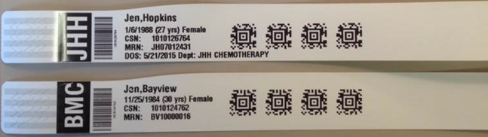
Scan the Patients Wristband - ppid
Nurses can scan the wristband at any point but it is forced before Specimen Collection, Another problem.
If your scanner is broken you can proceed but users must document the override reason.
Enter the Reason that you were unable to Scan the Patient Wristband?

Slide 18
Key Points of the Workflow
Ability to request label printing for any lab order to a selected printer at the bedside.
Real time accessioning on demand (AOD) by the LIS to the least number of containers and tube volume.
Ability to reprint labels as needed.
Ability to scan labels at the bedside for real time collection (now) or in the past.

Slide 19

go live issues

Slide 20

Challenges at Go-Live event = hurdles
Under-estimated label printing complexity.
Nurse Training did not match workflow.
Nursing forced to work in “survival” mode - workarounds.
Regression of previous Safety Standards.

Slide 21
Working Partnership
All day on-site summit to collectively define the issues and plan for corrections.
Weekly meetings
Tuesday – Epic Verona
Wednesday – steering committee
Thursday – scc soft
Epic: Deanna Hanisch, jeff Wolanin, kevin hermsen, tom Hammond, Vinaya Shenoy, josh newman, Navin Pathak, ryan griffin, Jacob Robinson, lucas Sherman, joe Acosta.
SCC: lisa perkins, don Gilpin, catherine Schulz, mykola Kukushkin, yury Kornilov, safwan makar, olexiy tyurin, michelle Musgrove, pavlo dyedov, alan nicols.
Jhm central: Kelly cavallio, Andrew frake, Stephanie poe, Barbie Bryant, carrie stein, kim Foltz, omar abarca, rich kowalweski, brian balch
jHH lab: mike Huppenthal, greg rex, brian glanz, Teanya walker, saba jawhar.

Slide 22
five Key Issues Identified
End to End Timing - Label Print Speed.
Unwanted Reprint Labels.
Device Infrastructure – Label Printers.
Multi-container scanning – Soft 4.0 vs 4.5
Auto-generation of Epic Collection task.

Slide 23
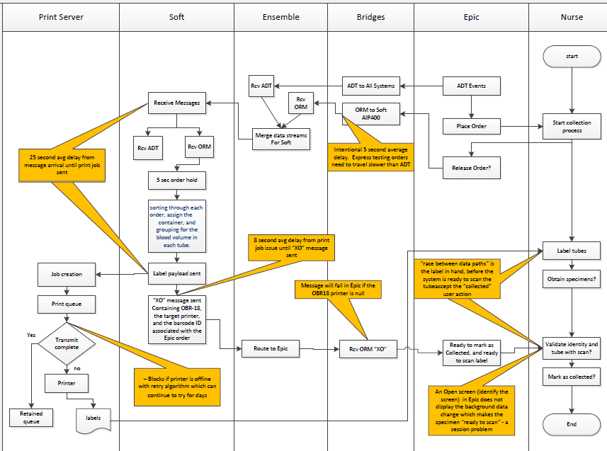
Complex Workflow

Slide 24
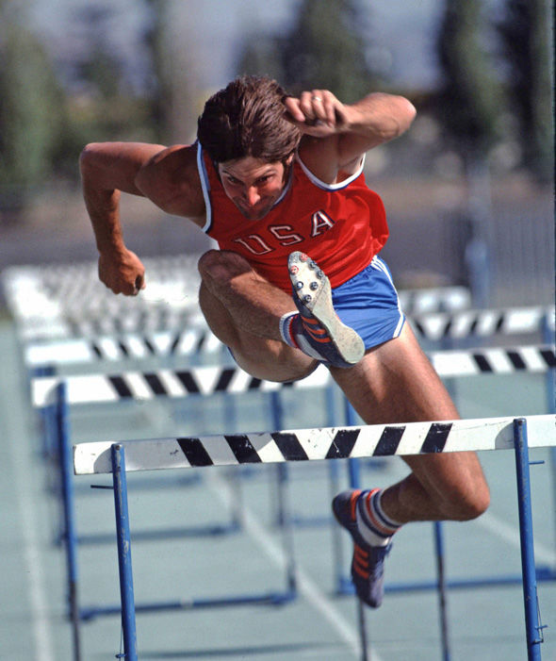
Issue 1- Label Print Speed
“many hurdles to jump”
Label printing took 12 sec to 7 minutes.
  Label messages backed up behind released order messages. ERCV to EFSS to HISOE.
  Added 9 additional hisoe processor instances.
  OEHIS merge look back moved from 15 days to 1=same day.

Slide 25
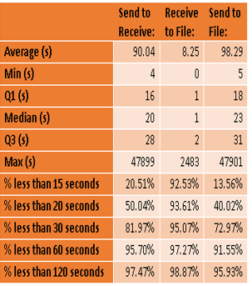
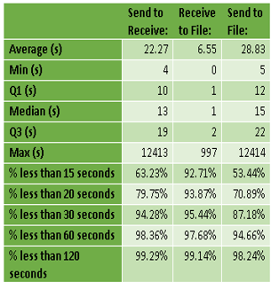
End to End Label Timing
Pre and Post first fix
Timing 12-1-15 thru 2-2-16
Timing 2-2-16 thru 2-8-16

Slide 26
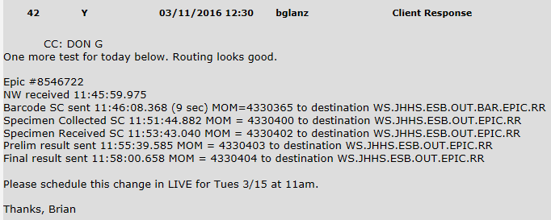
MOM Delays in Processing second round of fixes
Adjust db inbound timer interval 5 sec to 1 sec
Adjust timer interval from 1sec to 400ms
Handle Specimen Barcode messages on a separate processor. Was OUT.EPIC.RR moved to BAR.EPIC.RR
To Production: 3-15-16

Slide 27
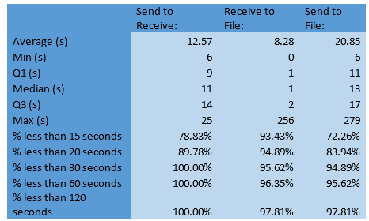
Gold Medal timing!!! nursing is happy = lab is happy.
Timing 2-2-16 thru 2-8-16
Timing 2-15-16 thru 2-19-16

Slide 28
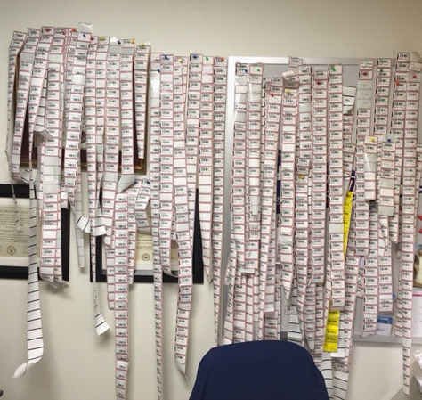
Issue #2
Label Reprint out of control
reprint message in Epic would send multiple RP’s for a series of tests in one tube.
CMP, MG, AMY, PO4, GGT, LIPID into 1 tube = 6 RP messages for the reprint of the Soft Order = 24 labels on reprint.
Nurse wants ONE label not 108 !

Slide 29

Label Reprint Fix: 3-7-16
Saving the Planet one label at a Time!
SCC Soft reprogrammed message so that reprint is to a specific test or specimen barcode (not the entire order).
Epic changed message format to send single RP message with multiple OBR segments (prevent duplicates).
Eliminated the need to incorporate SPM messages into the RP workflow.

Slide 30

Issue #3
Epic Race Condition
When a nurse prints specimen labels, the epic system immediately generates a collection task in advance of Soft providing the barcode information for each container.
the nurse has no indication that they cannot scan for specimen collection – epic moved to fast.
if the nurse starts the collection process prior to the barcode being received, epic will lock the orders, preventing the scc soft barcode details from being filed into epic.
Another delay – total confusion – uncollected specimens.

Slide 31
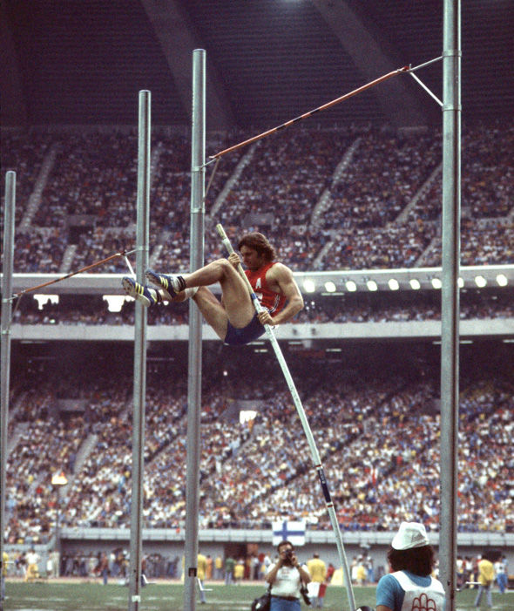

Race condition
Epic fixed this condition by not updating the collect task until the soft barcode identifiers have filed in epic.

Slide 32

Next event toggle (task 9814)
ability to toggle or move orders back and forth between unit collect and lab collect and back again.
Used by nursing with central line status changes.
Action can only be initiated in Epic.

Slide 33

Toggle
without toggle the nurse is forced to cancel the orders released to lab and place new nurse collect orders.
one rule – if lab has printed the label (accessioned), the order cannot be released back.

Slide 34

When does the race end?
Scc soft has finished the race but epic still has not made it to the finish line if you are a 4.5 site.
Anticipating a june 3rd delivery of multi-container specimen collection better suited to scc soft 4.5.X
SCC Soft

Slide 35
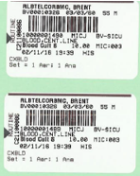
Blood Culture = Two Containers
As each barcode label is scanned, the corresponding barcode ID changes from RED to GREEN.
Collection Date | 4/7/2016 |  | Collection Time | 14:15
Collected by: | PHUPPEN1
 |  |  | Bacterial/Yeast Culture, Blood
 |  |  | 10000001489
 |  |  | 10000001490
Collection Date | 4/7/2016 |  | Collection Time | 14:15
Collected by: | PHUPPEN1
 |  |  | Bacterial/Yeast Culture, Blood
 |  |  | 10000001088
 |  |  | 10000001089

Slide 36
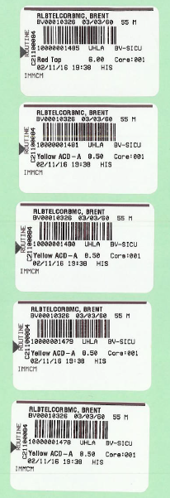
Multi-container Collections
Immunogenetics Crossmatch (5 tubes)
This single order requires the collection of five tubes. The user must collect and scan one Red Top and four Yellow ACD tubes to fulfill the lab test volume requirements.
Collection Date | 4/7/2016 |  |  | Collection Time | 14:15
Collected by: | PHUPPEN1
 |  |  |  | Immunogenetics Crossmatch
 |  |  |  | 1000001485
 |  |  |  | 1000001481
 |  |  |  | 1000001480
 |  |  |  | 1000001479
 |  |  |  | 1000001478

Slide 37
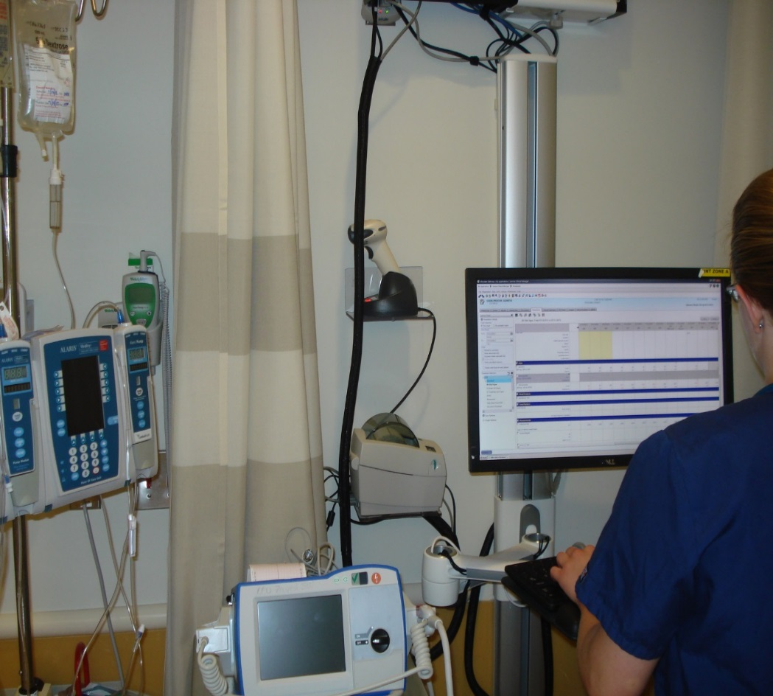
Outcomes: patient safety is #one!
Labels printed in the patient room after ppid.
Containers labeled in the presence of the patient.
Electronic specimen collection at the bedside before leaving the room.
1900 plus active Lab Label printers @jhh.

Slide 38
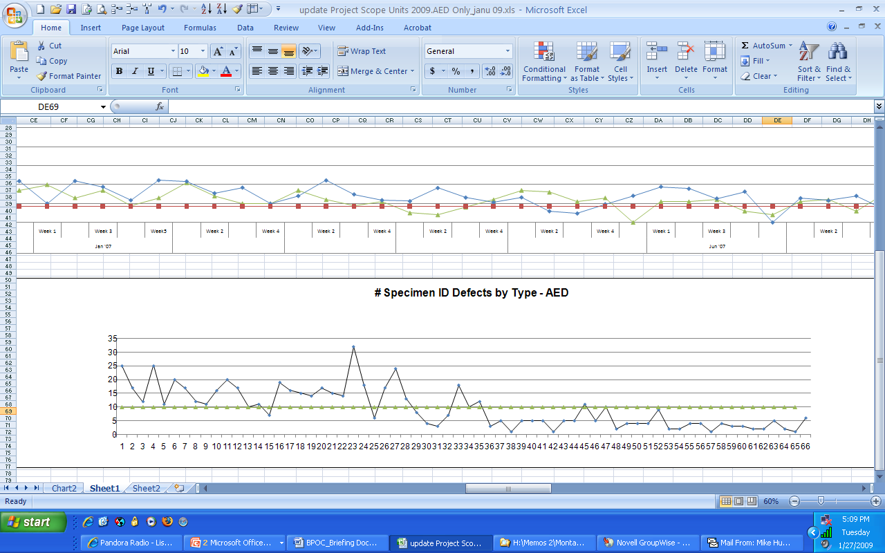
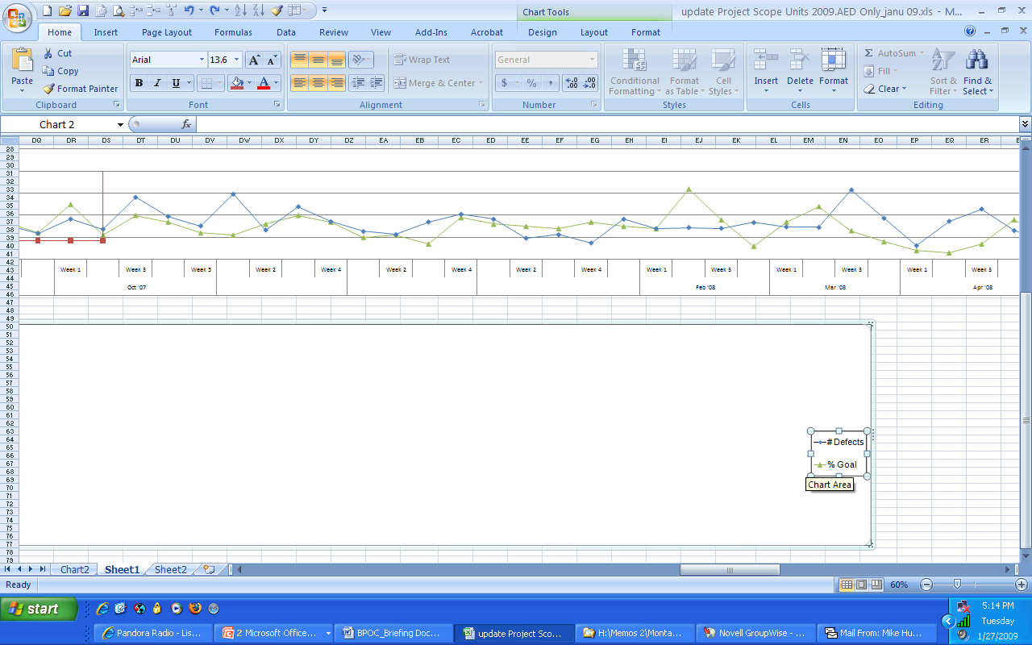
Reduction in Mislabeled Specimens
Adult Emergency Department
360 fewer specimen defects*
64% reduction
# Defects
*Comparison of 36 weeks post deployment to 36 weeks prior
BPOC not used on Trauma Patients and John Doe’s

Slide 39
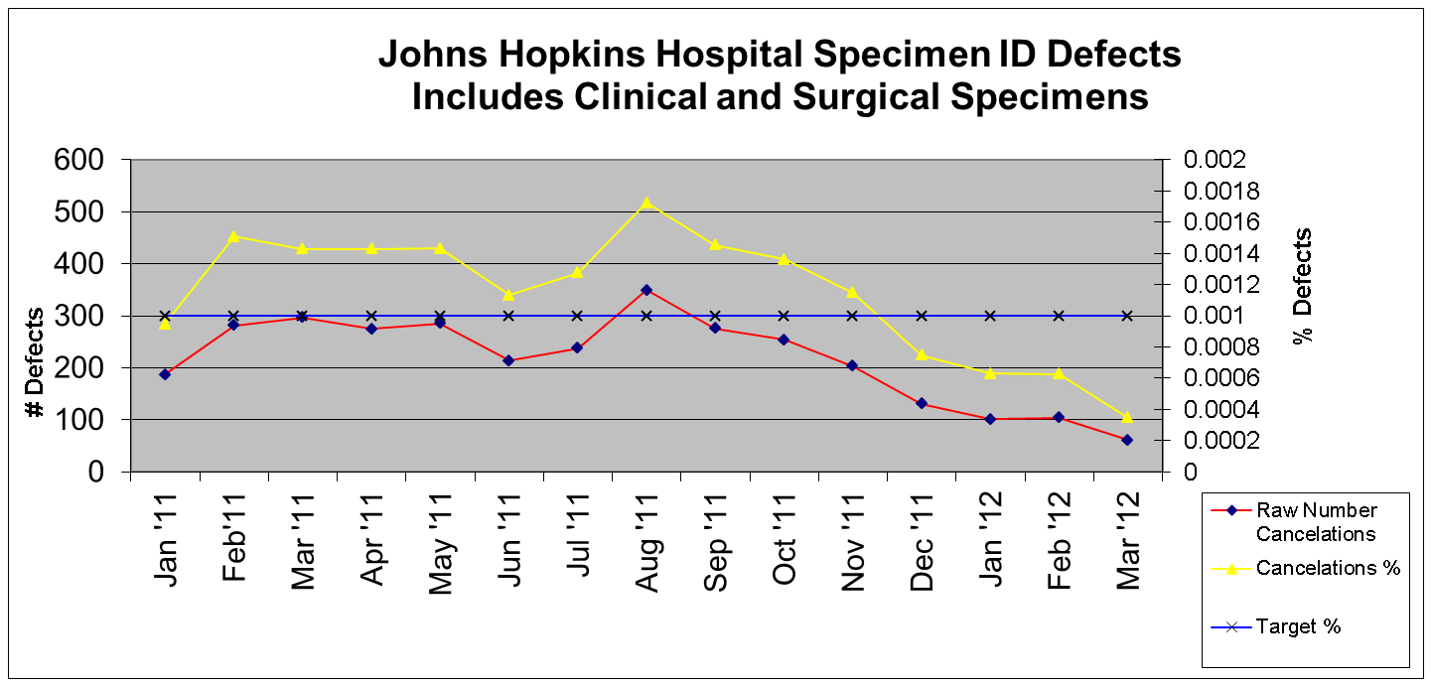
Cancellation of Unlabeled /
Mislabeled Specimens

Slide 40
Outcome Summary
A focus on reducing pre-analytic errors has been an ongoing Quality Improvement Process at jhm since 2006.
Despite weak interventions (education, training, data reporting, etc.) an irreducible specimen error rate persisted.
With the introduction of technologic interventions (ppid), we were able to reduce basic human error and achieve P.I. metrics that support our patient safety goals.

Slide 41

Epic and SCC soft
The saga continues…

Slide 42

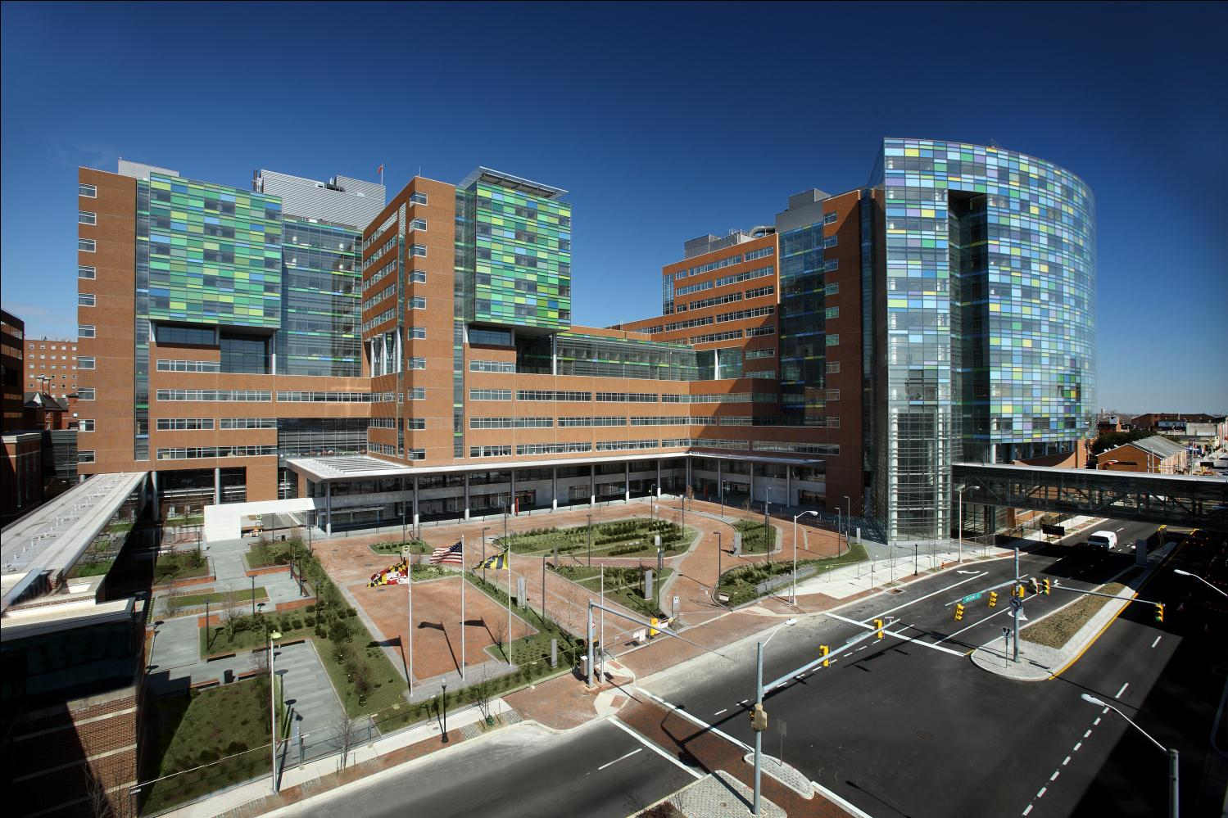
1889 to 2012
Thank You.

