Slide 1
Foreign Barcode

Slide 2
Definitions
Foreign Barcode (FBC), also known as Instrument Ready Foreign Barcode (IRBC) – a barcoded specimen label produced by a laboratory ordering system other than any Soft LIS application that has the capability within Soft to be linked to an order and recognized by the laboratory instruments interfaced to the Soft system.

Slide 3
What is Foreign Barcode?
FBC is a process that allows clients to generate a specimen label from a Foreign EMR system.
The labels print and are applied in the client office.
This label contains a bar code (FBC) that can be read by instrumentation.
Specimens arrive instrument-ready at processing and do not need to be relabeled.

Slide 4
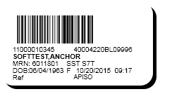

How is the Foreign Barcode generated?
A unique eleven digit foreign barcode for each specimen is generated from the foreign system.

Slide 5
Container name and tube type code
In the Foreign EMR the tube type containers had to be stored in a certain way that would allow the specimen to come into Soft.
The Foreign EMR had to store the soft tube type code per container name.
SST S7T
Gray T0C

Slide 6
Add up volume logic
The Specimen container, specimen type and the tube type code is used in the calculation for add-up volume logic.

Slide 7
Example of HL7 message coming from Foreign EMR.
In the below order 1 barcode label barcode is created in the Foreign EMR.
OBR.18.
OBR|3|40004259BL0999603||LAB5211^aPTT|R|201511180715|201511180715|||Henderson,Karri LIS||||||3262^BOYANTON JR,BOBBY L^^^^^^PHYID||11000010609^Plasma^Blue Na Cit BOU|||||||||||||||||Routine||||

Slide 8
SCC updated specs Foreign Barcode Requirements
The Foreign EMR sends the data we need in Soft but does not format the way it is needed by Soft.
SCC updated specs Foreign Barcode Requirements
The placer system will send the Foreign Specimen ID in OBR[18.1], the Foreign Barcode Number in OBR[18.2], and the foreign tube type in OBR[18.7]. The interface (SoftIE) shall create a custom segment "ZSP" following the OBR segment. SoftIE shall copy the Foreign Specimen ID OBR[18.1] to ZSP[2], copy the Foreign Barcode Number OBR[18.2] to ZSP[3], and copy the Specimen Tube Type OBR[18.7] to ZSP[1].
Segment name: “ZPS” will be produced by Soft
ZPS seq# 1: Specimen Type D/T =”ST” R/O= optional field, LN=“10”
ZPS seq# 2: Foreign Specimen ID D/T =”ST” R/O= optional field, LN=“31”
ZPS seq# 3: Foreign Barcode ID D/T =”ST” R/O= optional field, LN=“31”

Slide 9
HL7 message coming into soft
rOBR|3|A40004259BL0999603||LAB5211^aPTT|R|201511180715|201511180715|||COLLA||||||3262^BOYANTON JR,BOBBY L^^^^^^PHYID||40004259
BL0999603^11000010609^^^^^BOU|||||||||^^^^^Routine||

Slide 10
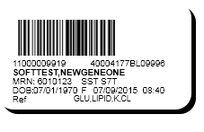
A single tube can be used for multiple tests.
Add up volume logic
Commonly used for Chemistry testing.

Slide 11
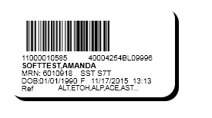
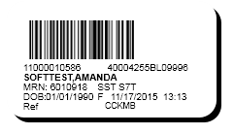
Multiple Specimens with same tube type and tube type code.

Slide 12
Foreign Barcode and Force print logic
Force print is when the test ordered requires more than one tube and the tube cannot be collapsed down.
The below order would create 5 barcode labels in the Foreign EMR.
OBR|1|40004261BL0999601||LAB5058^Glucose Tolerance Test, 6 hr (75g glucola)|R|201511181032|201511181032|||Henderson,Karri LIS||||||3262^BOYANTON JR,BOBBY L^^^^^^PHYID||11000010650^Plasma^Gray T0C~11000010651^Plasma^Gray T1C~11000010652^Plasma^Gray T2C~11000010653^Plasma^Gray T3C~11000010654^Plasma^Gray T4C~11000010655^Plasma^Gray T5C~11000010656^Plasma^Gray T6C|||||||||||||||||Routine||||

Slide 13
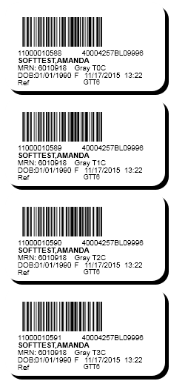
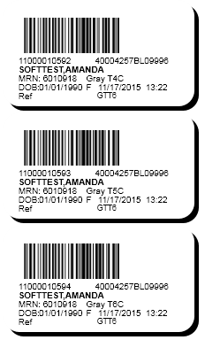
Multiple specimens with same tube type but different tube type codes.

Slide 14
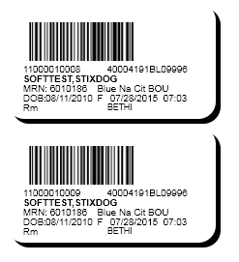
Multiple Specimen with same tube type codes

Slide 15

Multiple Labels with different tube types and different tube type codes.

Slide 16
Challenges
Force print labels needed for one test cannot be shared.

Slide 17
Settings in Soft lab
Hosparam needed to be set in soft lab.
Lab Params needed to be set in soft lab.

Slide 18
Hosparams
Hosparam set “foreign_barcode”=Y.

Slide 19
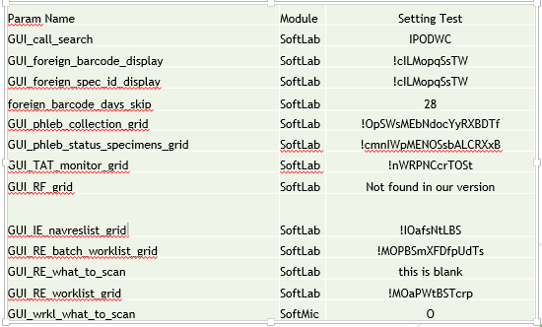
Lab Params
Several Lab Params had to be set to see the foreign barcode display within the soft lab application.

Slide 20
SCRS
SCR Foreign Barcode enhancements were submitted for the ability to see the foreign barcode in the Soft lab, Soft Bank, Soft Mic and the Gene modules.

Slide 21
Where can you see the FB in Soft lab?
Order Entry
Phlebotomy
Pending Order Report
Specimen Tracking List
Lab Query
Call List
Instrument Menu
Lab Resulting Worklist
Task list
Micro worklist

Slide 22
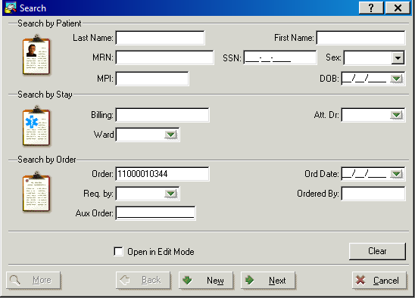
Soft Lab Order Entry Search
Scan or type FB number and enter to view order.

Slide 23
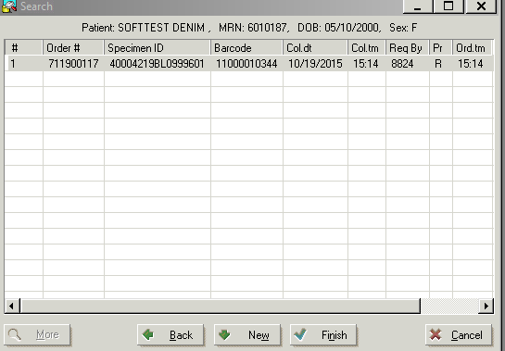
Soft Lab Order Entry
Found the order from the search.

Slide 24
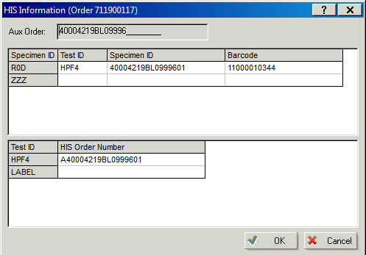
Soft Lab Order Entry
HIS Information with foreign barcode number.

Slide 25
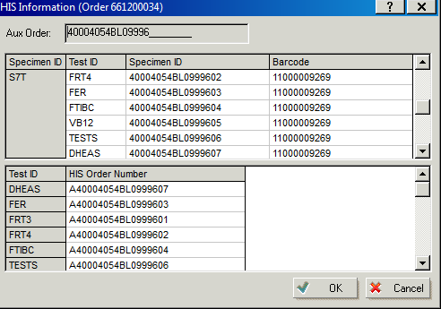
Soft lab Order Entry
HIS information with foreign barcode numbers.

Slide 26
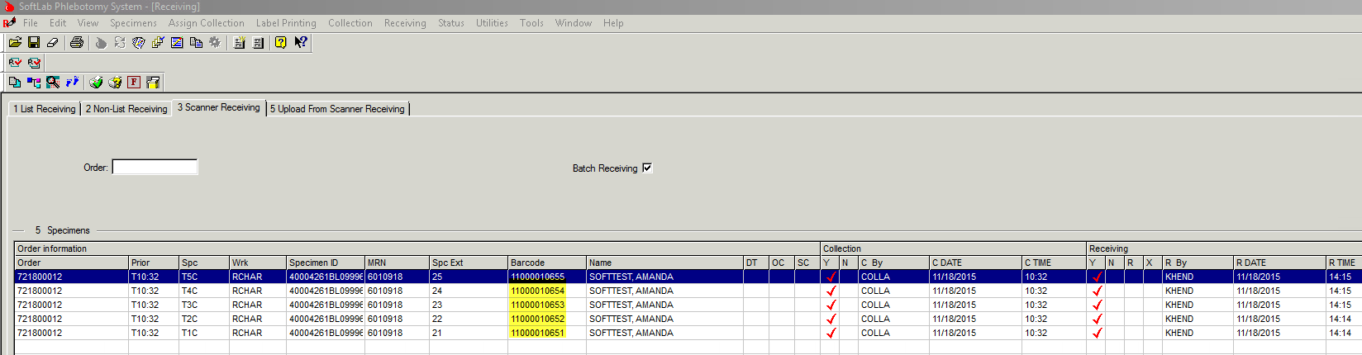
Phlebotomy Receiving
Scan or type FB number in the Order Field.
Each test with associated FB numbers are received on one line.

Slide 27
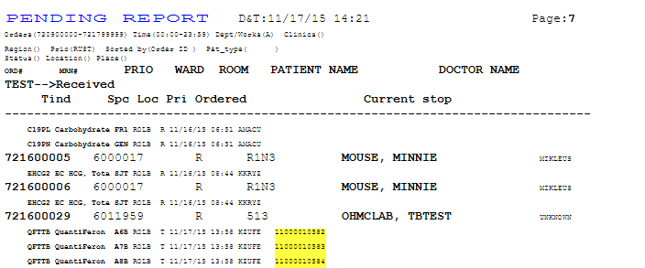
Pending Order Report
Listed are the FB numbers associated to each test.

Slide 28
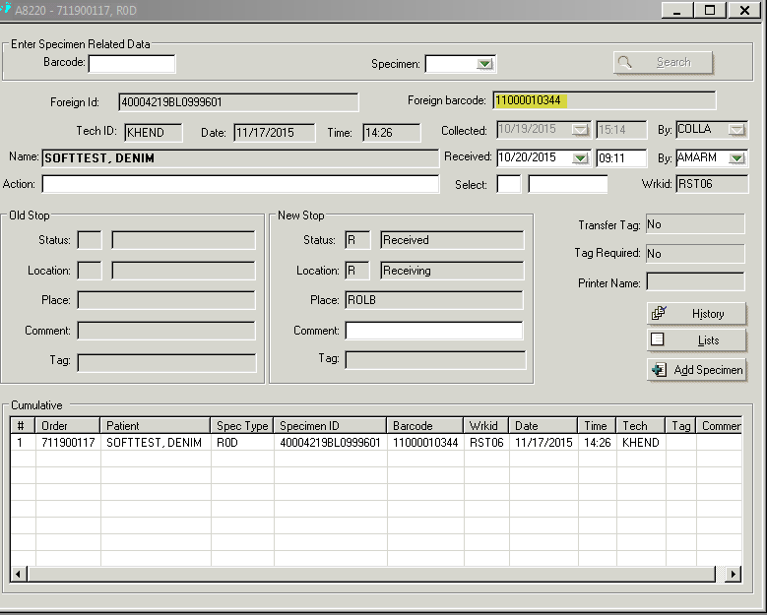
Specimen Tracking
FB can be seen each time the specimen is tracked to a location.

Slide 29
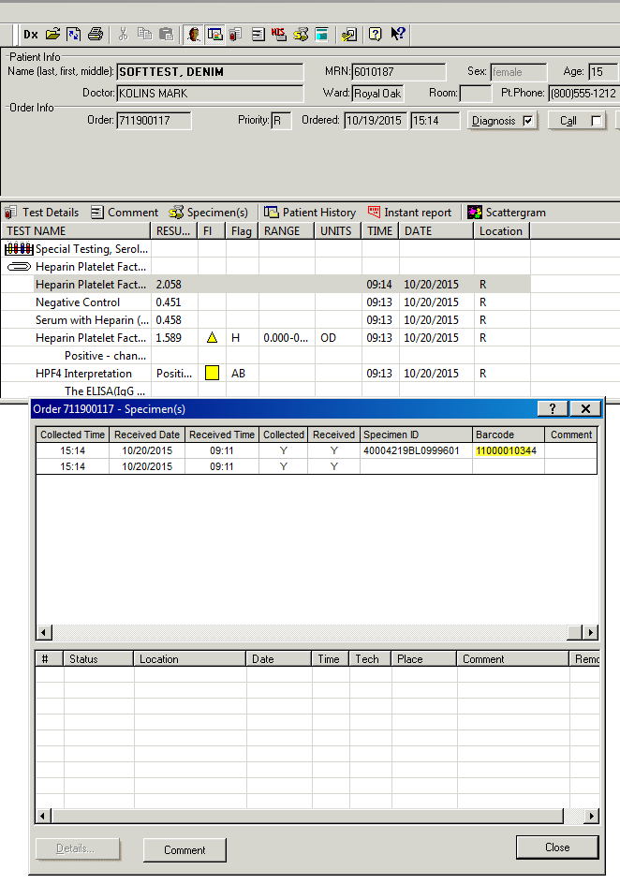
Lab Query
FB can be seen by clicking on the Specimen tab.

Slide 30
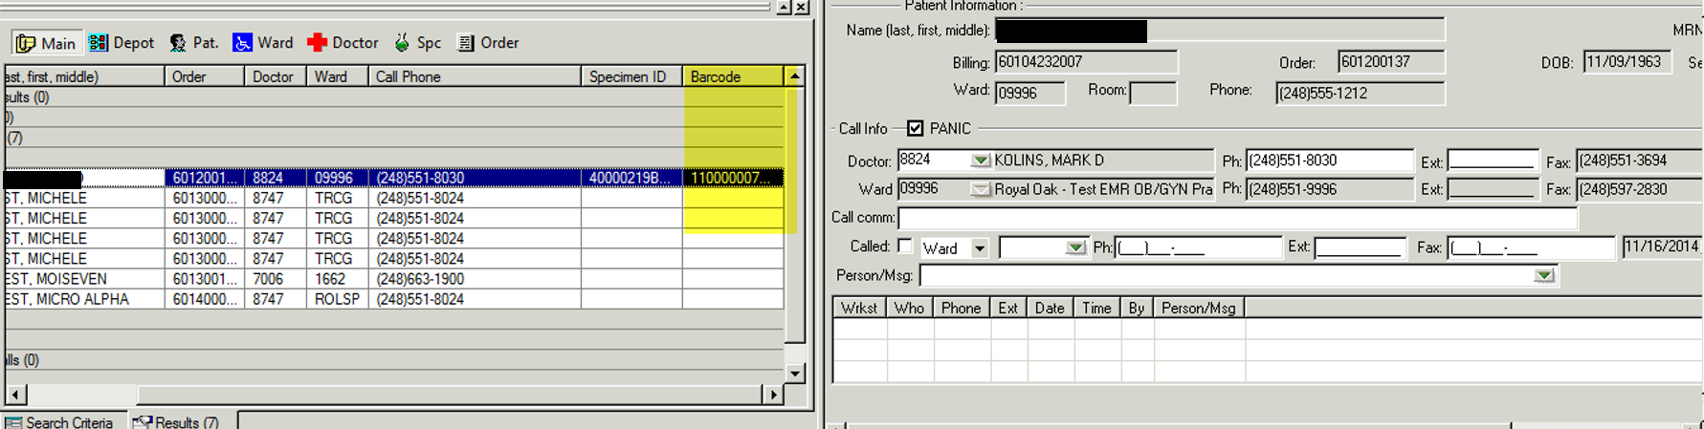
Call List

Slide 31
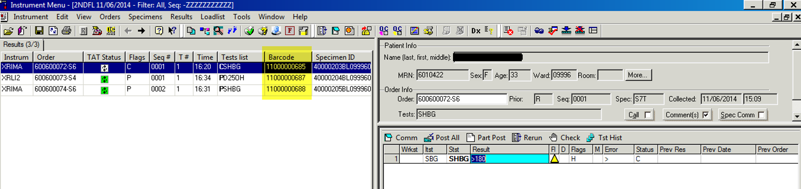
Instrument Menu

Slide 32
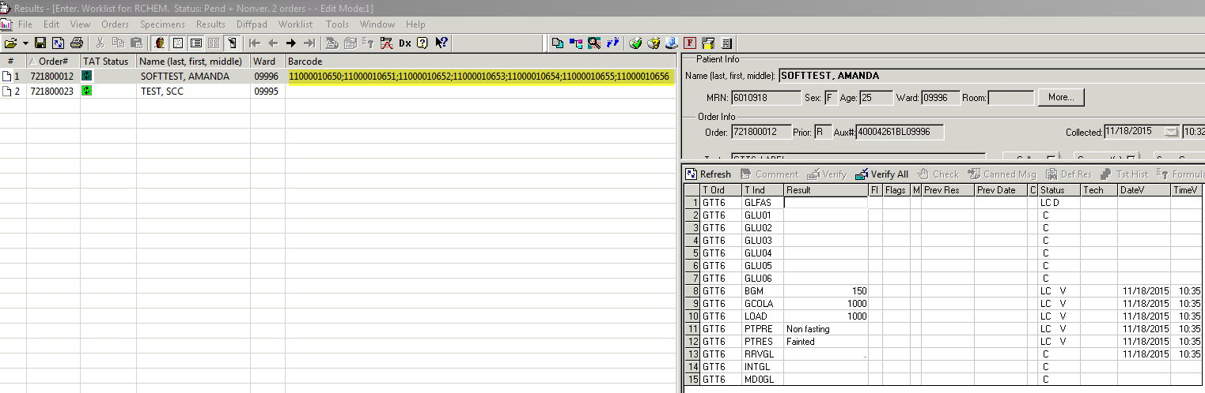
Lab Resulting Worklist

Slide 33
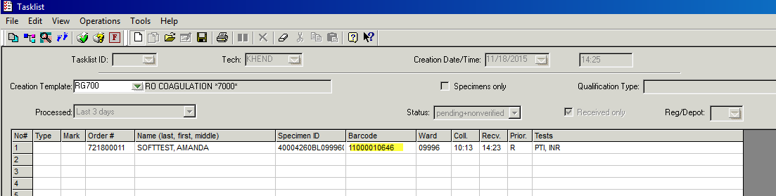
Task list

Slide 34
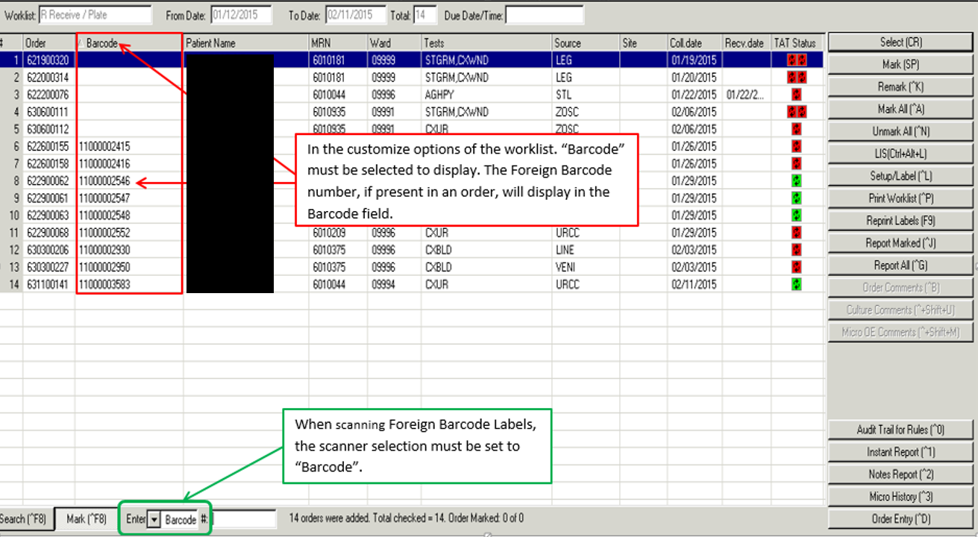
Micro worklist

Slide 35
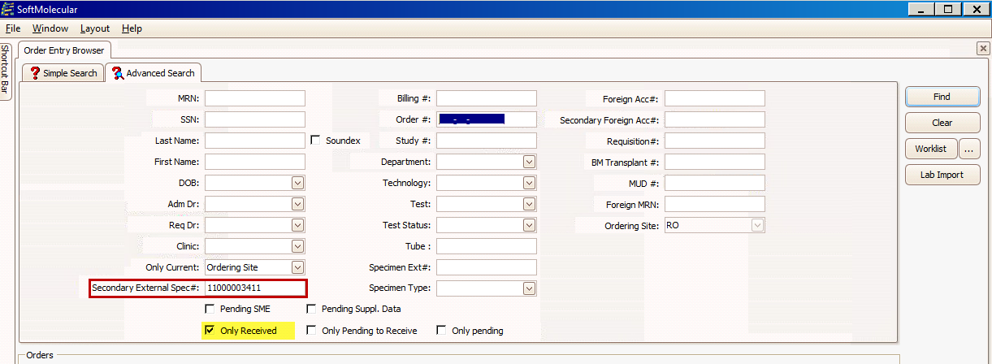
Foreign Barcode in the Gene Modules

Slide 36
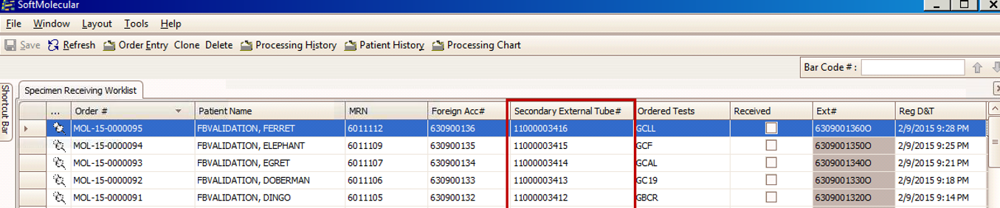
Gene Specimen Receiving Worklist

Slide 37
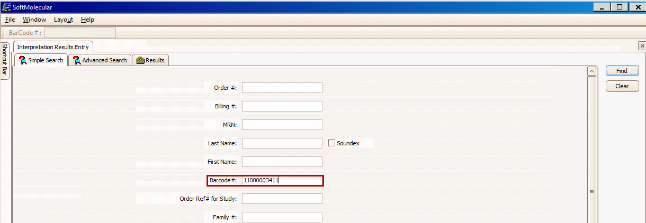
Gene Result Entry

Slide 38
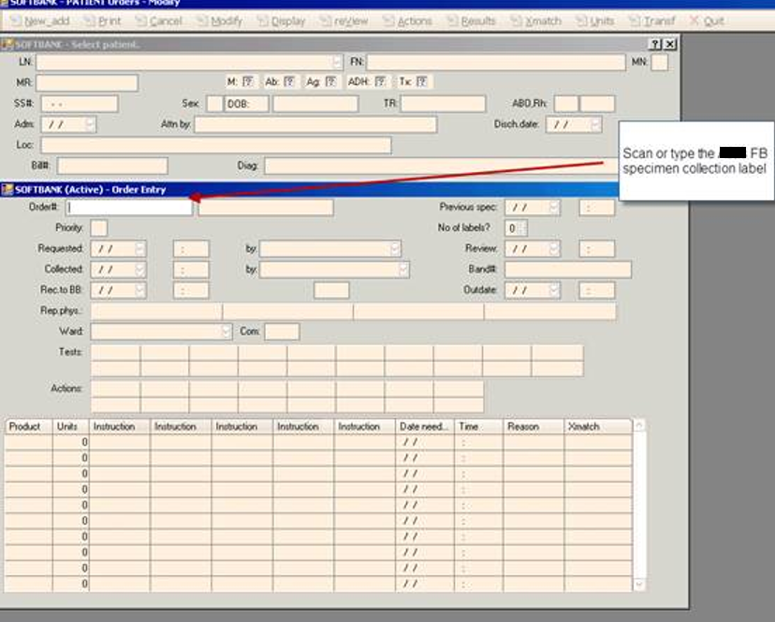
Soft Bank

Slide 39
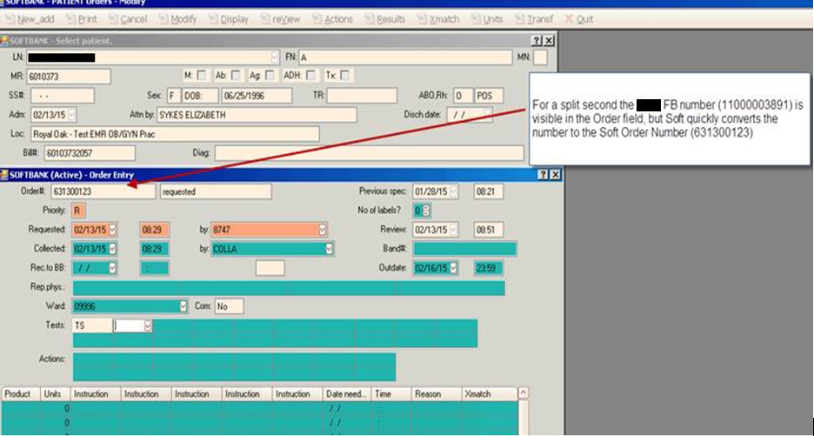
Soft Bank Order Entry

Slide 40
Reprint Foreign Barcode in Soft Lab

Slide 41
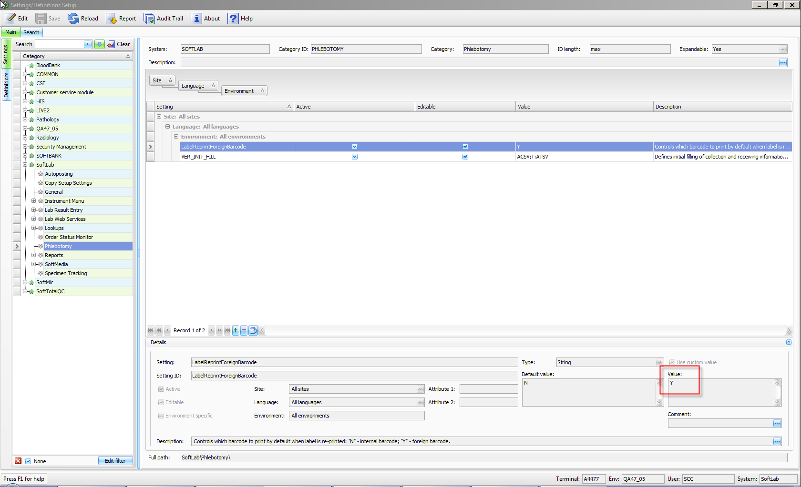
Soft Lab Settings and Definitions
SSM param Label Reprint Foreign Barcode set to “Y”

Slide 42
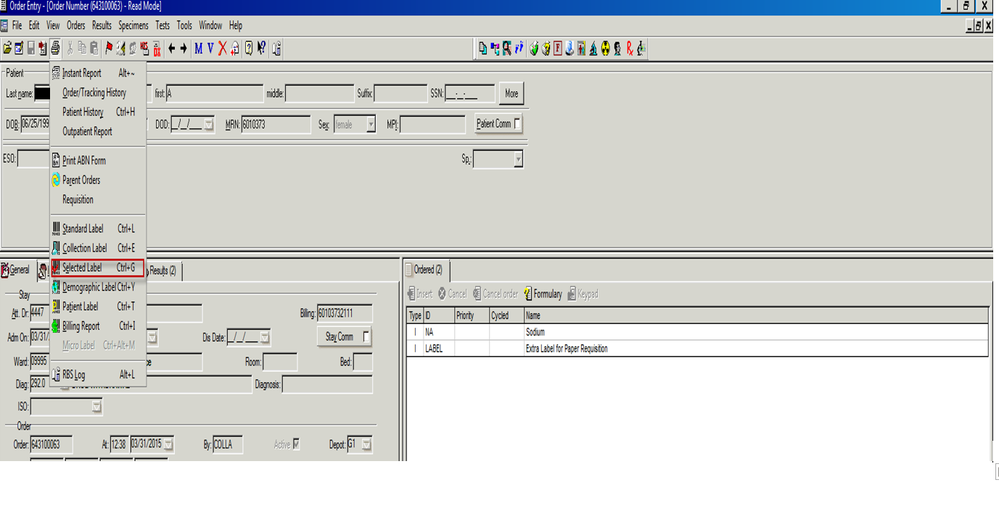
Selected labels
Order Entry under printer pick Selected Labels.

Slide 43
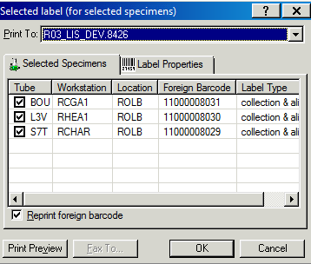
Reprint FB Label
Reprint FB Label will be defaulted.
Tube Types will be defaulted.

Slide 44
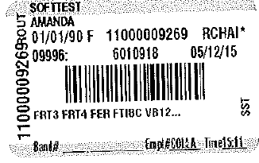
Reprinted Foreign Barcode from Soft Lab

Slide 45
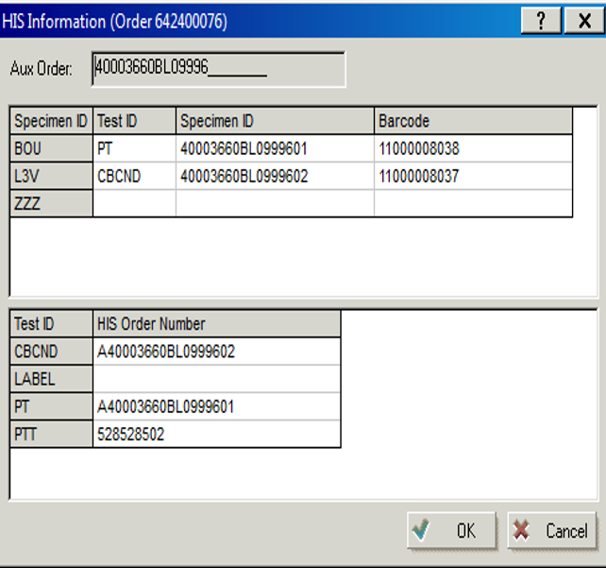
Add on Test in Soft with same Tube Type Code
Add on PTT test to an order with same tube type code BOU.
PTT and PT will be on the same FB number.

Slide 46
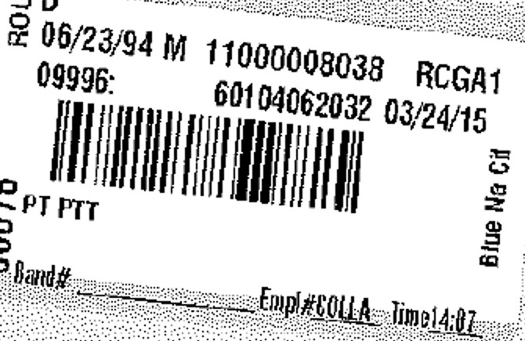
Reprinted Selected Label with add on Test.

Slide 47
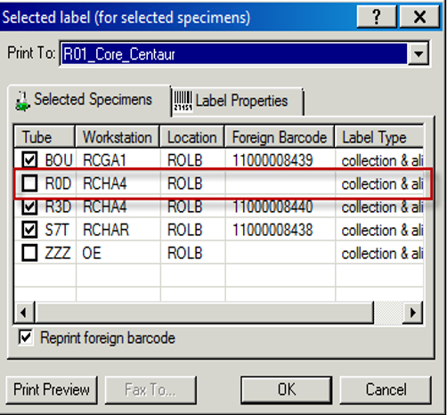
Add on Test with same container but different tube type code.
Add on Test with same container but different tube type code.

Slide 48
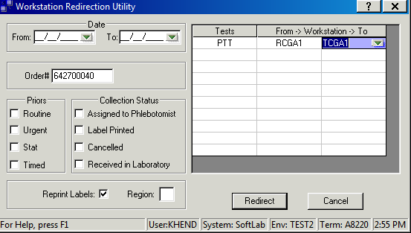
Workstation Redirection
Workstation redirection uses the soft order number.

Slide 49
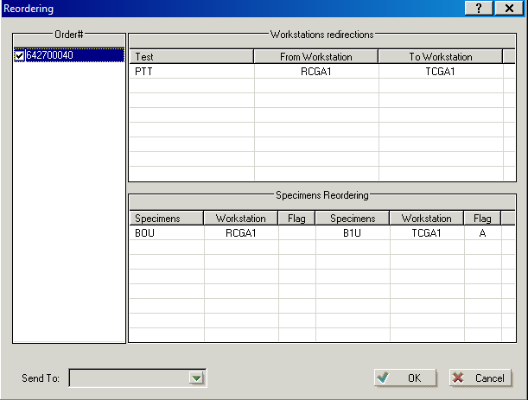
Workstation Redirection
The BOU specimen from RCGA1 workstation was redirected to B1U specimen and TCGA1 workstation.

Slide 50
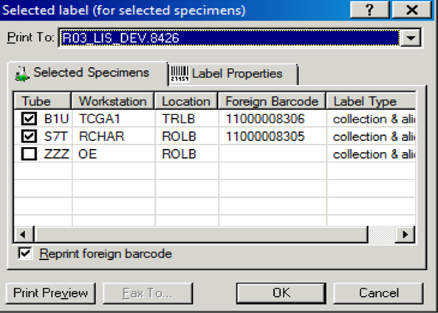
Workstation Redirection
PTT has been redirected to TCGA1.

Slide 51
Instruments
Soft lab Instrument interfaces are set up to receive the Foreign Barcode.

Slide 52
Foreign Barcode Instrument Validation
Grouped Instruments by instrument Character, Auto Download and translation table
From the grouping tested each type of instrument.
Created testing plans for each instrument.
Performed validation testing for each instrument.

Slide 53
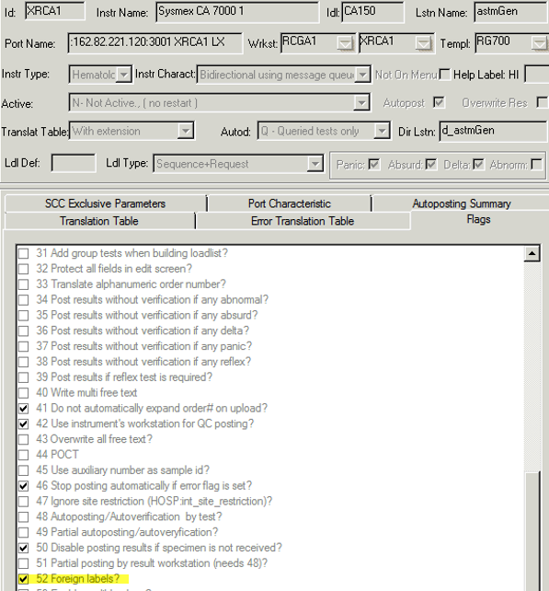
Instrument FB set up Flag 52

Slide 54
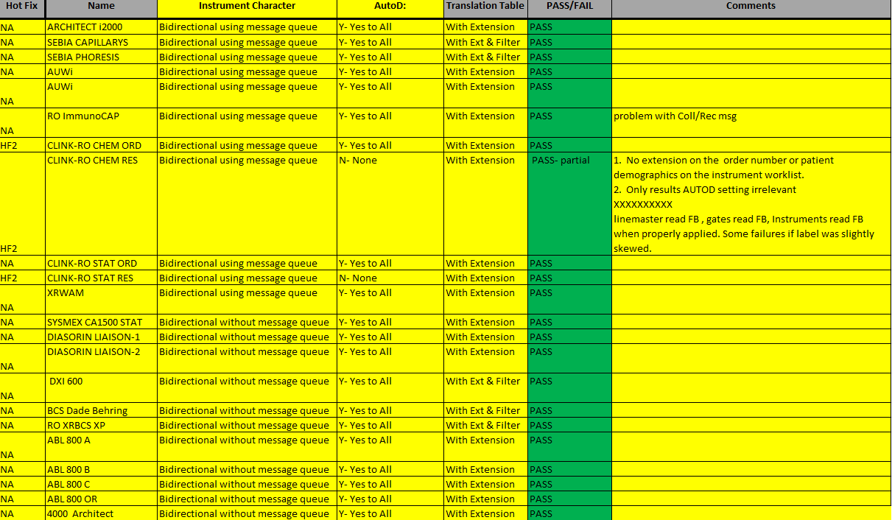
Grouped Instruments by Interface Setup

Slide 55
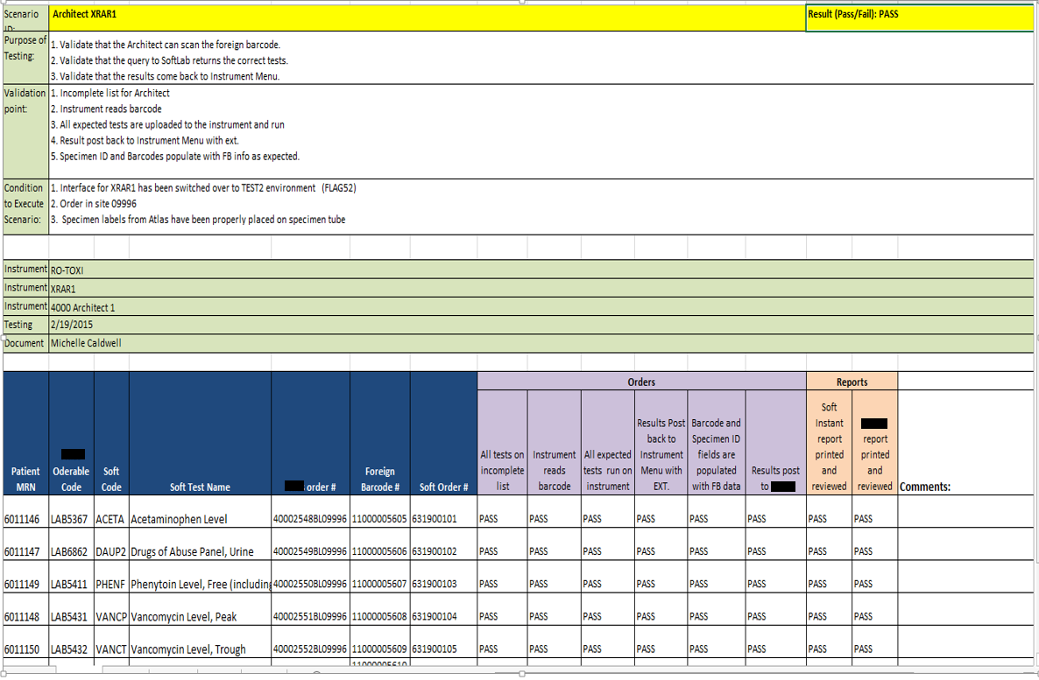
Example of a Test Plan for a instrument.

Slide 56
P612 pre-analytical system
Validated that the instrument would sort the specimens using the foreign barcode.
Validated that aliquoting from the primary tubes would created the foreign barcode number on the aliquot tube.

Slide 57
Challenges
Reflex testing on automation lines need to use the foreign barcode number instead of the soft order number.
Needed the ability to run soft order number barcodes with flag 52 set for foreign barcode.

Slide 58
Set up of tube types for Multiple Locations
In the interface table a test that is run at multiple sites has a different tube type extension.
The same tube type extension cannot be used at multiple locations because you would lose the ability to track the specimens.
The tube type codes needed to be converted in the OEHIS table to be able to run the foreign barcode at all sites.

Slide 59
OE HIS changes
Translation table
FB_ERROR error logs

Slide 60
All sites can run the Foreign Barcode
Royal Oak Hospital is primary site for running tests.
In the Foreign EMR only the RO tube type codes are stored.
OE HIS translation table will convert the test/tube type received into Soft, using the ordering depot for routing specimen.

Slide 61
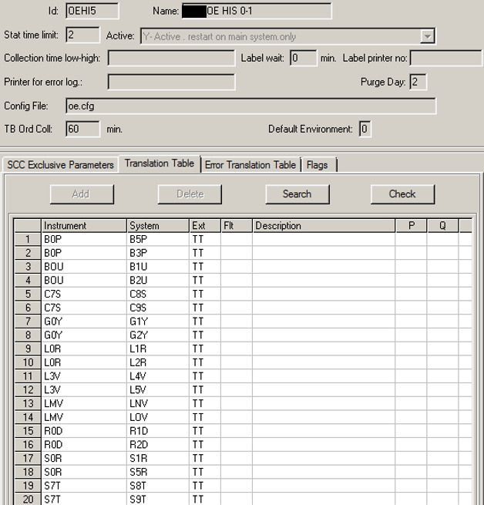
OEHIS Translation Table

Slide 62
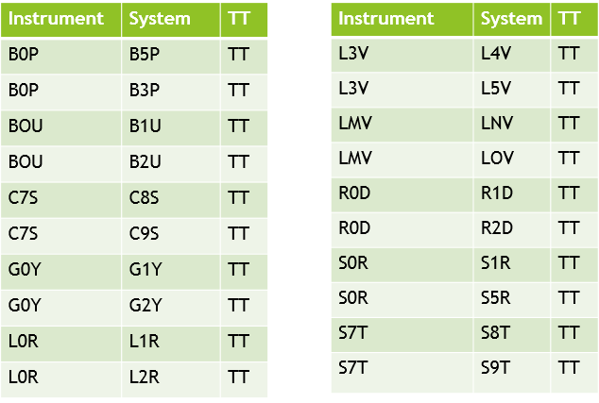
OE HIS Translation Table

Slide 63
Challenges
Only one tube type code can be converted to another code per depot.
Example
S7T (RO code) is converted to S8T (TR code)
S7T (RO code) is converted to S9T (GP code)

Slide 64
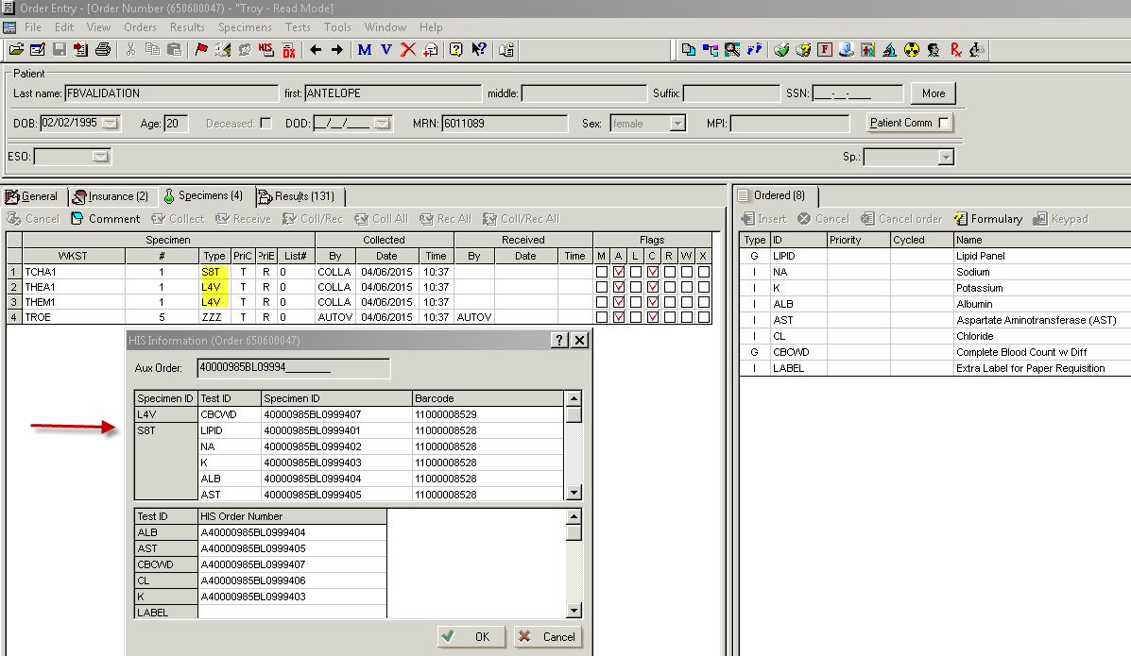
Troy code changed
The code S7T changed to be S8T and L3V changed to L4V.

Slide 65
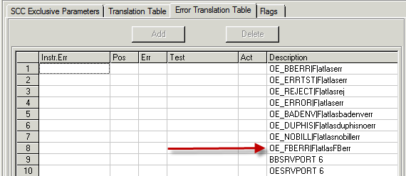
OEHIS Interfaces Error Translation Table

Slide 66
Monitoring the FB err interface
A soft lab report can be set up to monitor the Foreign Barcode errors.

Slide 67
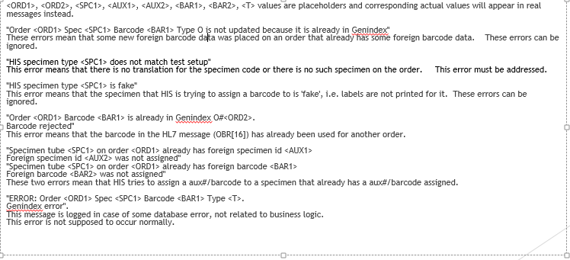
OE_FBERR errors from Soft

Slide 68

Tube does not match Soft
  04/03 08:48 OE_FBERR biln=60103732114 ln=BARCODE fn=A mn= test=XCBA his#=A40003807BL0999601 aux#=40003807BL09996 HIS specimen type ZHF does not match test setup Foreign barcode 11000008506 was not assigned to order Foreign specimen# 40003807BL0999601 was not assigned to order

Slide 69
False messages
Some messages do not need to be acted upon.
"Order <ORD1> Spec <SPC1> Barcode <BAR1> Type O is not updated because it is already in Genindex"
These errors mean that some new foreign barcode data was placed on an order that already has some foreign barcode data. These errors can be ignored.
HIS specimen type <SPC1> is fake"
This error means that the specimen that HIS is trying to assign a barcode to is 'fake', i.e. labels are not printed for it. These errors can be ignored.
Order <ORD1> Barcode <BAR1> is already in Genindex O#<ORD2>.
Barcode rejected"
This error means that the barcode in the HL7 message (OBR[16]) has already been used for another order.

Slide 70
False messages cont.
"Specimen tube <SPC1> on order <ORD1> already has foreign specimen id <AUX1>
Foreign specimen id <AUX2> was not assigned"
"Specimen tube <SPC1> on order <ORD1> already has foreign barcode <BAR1>
Foreign barcode <BAR2> was not assigned"
These two errors mean that HIS tries to assign a aux#/barcode to a specimen that already has a aux#/barcode assigned
ERROR: Order <ORD1> Spec <SPC1> Barcode <BAR1> Type <T>.
Genindex error".
This message is logged in case of some database error, not related to business logic.
This error is not supposed to occur normally.

Slide 71
Staff Education Objectives
Understand how foreign barcode utilization impacts operations within Soft LIS applications
Be able to recognize when a specimen is labeled with a foreign barcode
Recognize where foreign barcode information can be found within the Soft LIS applications
Understand workflow differences with foreign barcode labeled specimens
Educate staff that they would no longer have the barcode suffix on the order number.

Slide 72
We met all our Goals.
We achieved our goal of reducing the rate of relabeling specimens and reduced turn-around time for specimen processing.
Over 100 hotfixes were needed!
The foreign barcode can be read by all the instruments in the laboratory.
Supervisors and lead techs that were involved in the instrumentation testing were please with how well the foreign barcode was read on the instruments.
This project was very successful with no noted problems during the go-live.

