Slide 1
MOM Basics and Traces
Tracking Messages Through MOM

Slide 2
What is MOM?
Message Oriented Middleware (MOM) used in v4.5 HIS Interfaces, or limited v4.0.7
Think of it as the SCC event processor and viewer.
Main Message screen: a user can investigate how an action in one application did not produce the expected outcome in another application or external system.
High level flow of messages.
RCV > MOM > DC > OE > WS > MOM > SND
Enterprise Service Bus Result Reporting (ESB-RR) interaction

Slide 3
MOM Integrated Diagram
Notes:
Software infrastructure focused on sending and receiving messages between distributed systems.
The MoM service is an accumulating point for trigger messages which include SoftLab, SoftMic, SoftBank, SoftGenetics and other SCC Soft Computer applications.

Slide 4
What are MOM Events?
Every external (e.g. HIS orders) and internal action (e.g. SPECIMEN_RECEIVED)..
Any process that produces a change within SCC modules.
Includes the final processing and translation before a message gets sent out (e.g. old SND interface).
Includes Data Collectors and calls to various Web Services
Notes:
This also includes Data Collectors and calls to different web services.

Slide 5
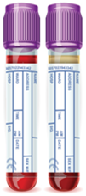
MOM Order Entry Events
Specimen Events
  SPECIMEN_ADDED
  SPECIMEN_BARCODED
  SPECIMEN_COLLECTED
  SPECIMEN_RECEIVED
Test Events
  TEST_ADDED
  TEST_CALLED
  TEST_CANCELED
  TEST_RELEASED
  TEST_CALLED_MODIFIED (XO)-New
Order Events
  ORDER_ADDED
  ORDER_MODIFIED
  ORDER_RECEIVED
  ORDER_RESEND

Slide 6

MOM Patient Events
Patient Events
  PATIENT_ADDED
  PATIENT_DELETED
  PATIENT_MERGED
  PATIENT_MODIFIED
Visit Events
  VISIT_ADDED
  VISIT_DELETED
  VISIT_MODIFIED
  VISIT_NUM_CHANGED
DMI Events
  DMI_ACTION_RESULTED
  DMI_CONTAINER_ACTION
  DMI_TEST_CANCELLED
  DMI_TEST_RESULTED

Slide 7
MOM Event Processing
PARENT EVENT
LAB
PARENT EVENT
MOM - routing
CHILD EVENT
ESB - Data Collector
CHILD EVENT
MOM - routing
HL7 message
GENE
BB
ESB – formatter
(EMR, ELR)

Slide 8
Parent > Child Event flow
parent event
e.g. [SPECIMEN_RECEIVED]
child event
e.g. [SPECIMEN_RECEIVED]
GENE
HIS-1
Application
e.g. LAB
Data Collector
e.g. TDC
(Test Data Collector)
Destination
SWP
AR
HIS-2
HIS-3

Slide 9

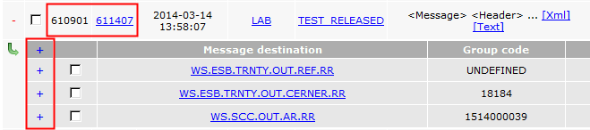
MOM Parent & Child Message
Parent Message
Child Message
Notes:
Top search bar has ID, Parent, Send date, Sender Code, Event Code, Message, Attributes, Total Status

Slide 10
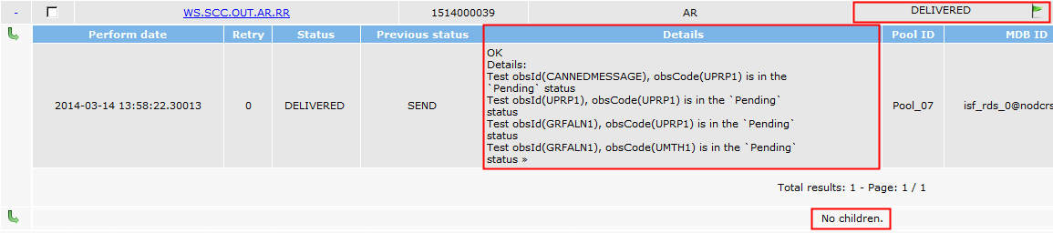
MOM Sub-Child Messages
Information from each destination.
Notes:
Child header: Message destination, Group code, Destination Group Code, Status, Status date, Retries, Show Group, What’s blocking
Destination Header: Perform date, Retry, Status, Previous states, Details, Pool ID, MOB ID, Result code, Processing code, Processing time (ms), ESB Instance

Slide 11
Processing MOM Events

Slide 12
Services
LAB Patient Service
LAB Requisition Service
GENE Patient Service
G`ENE Requisition Service
CSM Services
Translation Service
… and more

Slide 13
Data Collectors
CMN_SIN_ADC – changes patient level notification to order level notification (XO)
CMN_SIN_NSDC – data collector for specimen data
CMN_SIN_PDC – data collector for patient data
CMN_SIN_QDC – process results messages for whole order ORDER_RESEND, REPORT_REACTIVATED, creates child for each orderable test
CMN_SIN_RDC – data collector for results
CMN_SIN_TDC – data collector for test data
CMN_SIN_VDC – data collector for stay / visit data

Slide 14
Using MOM
Best point to gather data for STAR or TMS tickets.
Multitude of search criteria, additional options, dropdowns, etc.
Track internal processing (verification, collection, receipt, etc.)
To intelligently track processes and you need to know the basics
Remember to use the “+” red plus and “+” blue plus

Slide 15
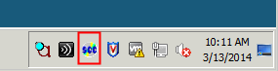
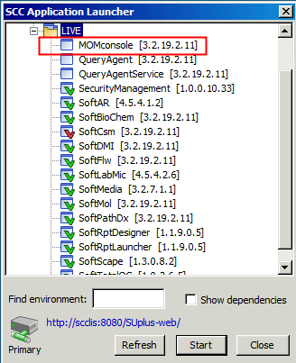
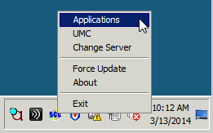
MOM Application Location #1
SoftUpdate>Right Click>Applications

Slide 16
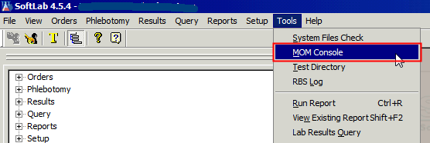

MOM Application Location #2
Notes:
Log in to SoftLab. Go to Tools>MOM Console. This option

Slide 17
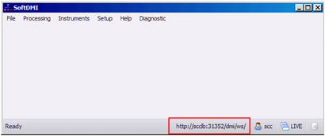
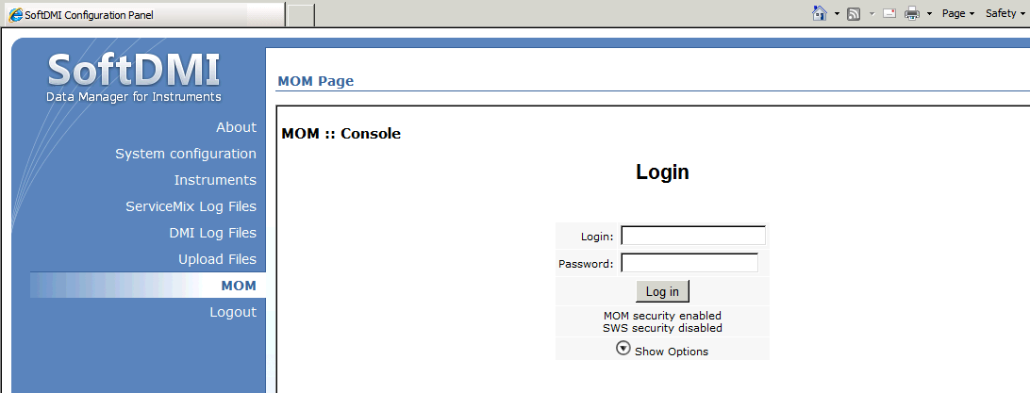
MOM Application Location #3
Notes:
Log in to DMI. Bottom right is a web address. Left click on the web address and the SoftDMI web console comes up. The 7th option down is the MOM web console. Click on it and you will see the login screen.

Slide 18
MOM Application Shortcut Pathways
http://nbaixlab001a.net.$client.org:7700/gcm/console/
http://nbaixlab001a.net.$client.org:7700/mom/console/
http://nbaixlab001a.net.$client.org:7700/csf/translation/

Slide 19
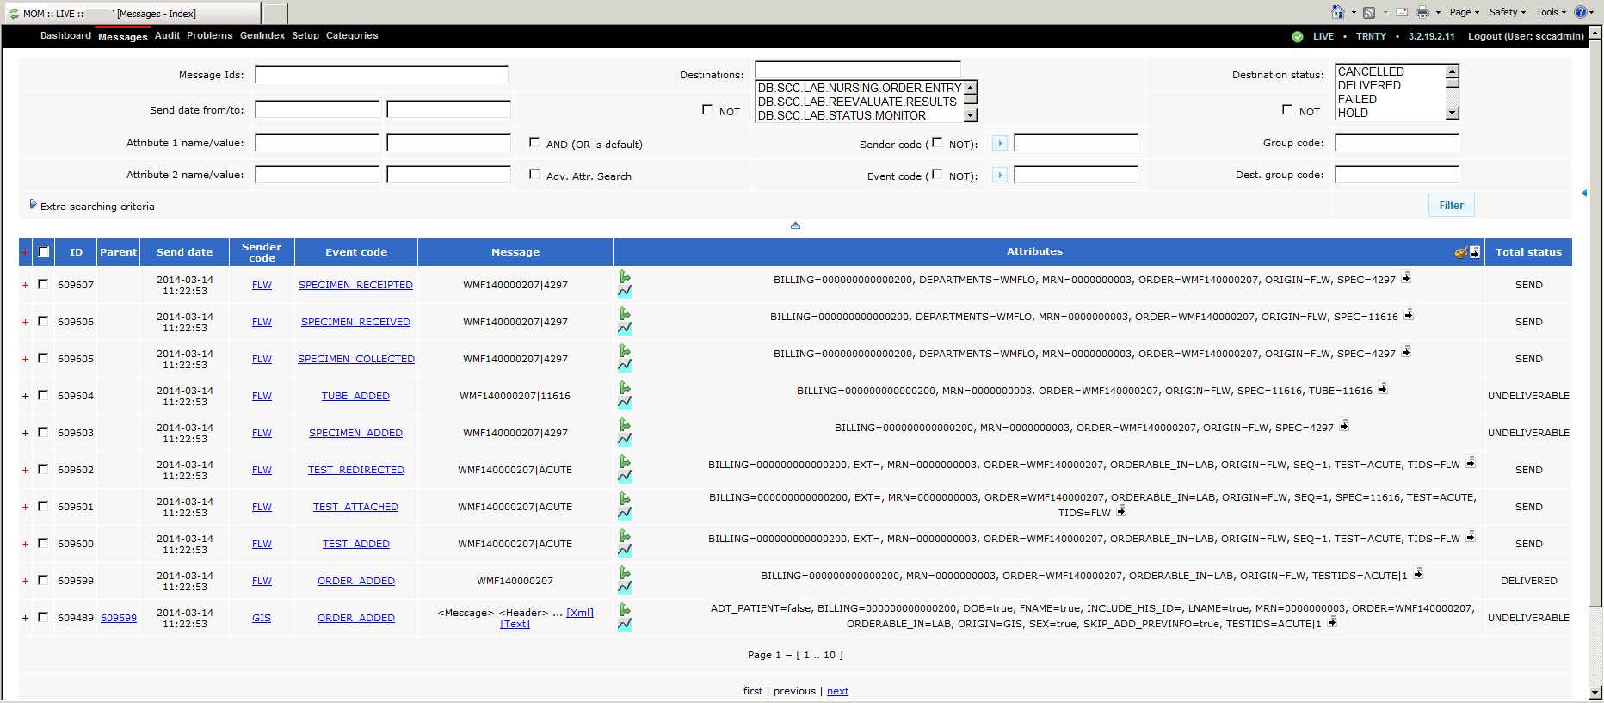
MOM Main Screen

Slide 20
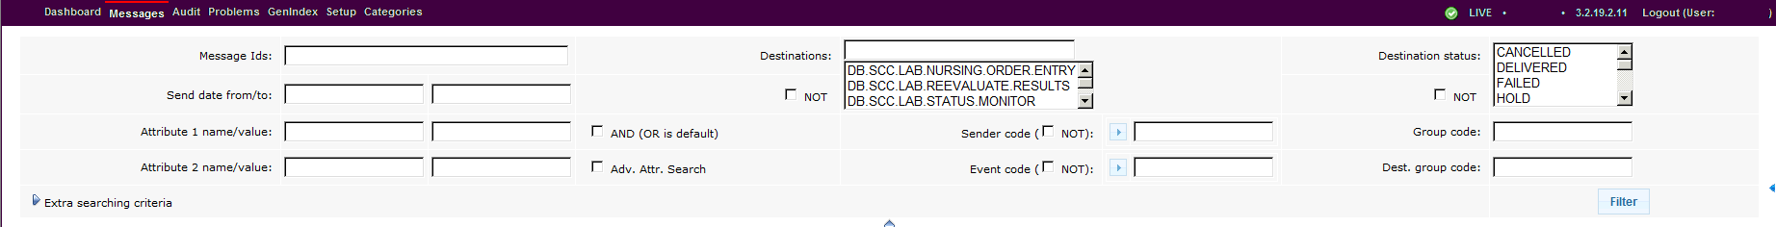
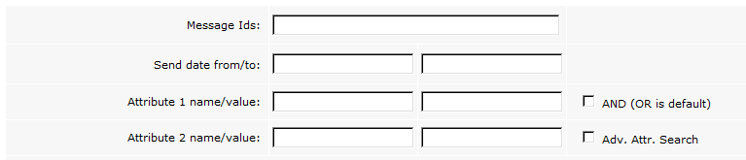
MOM Search Dates, Attributes

Slide 21
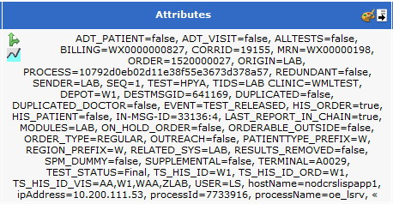
MOM Attributes Example 1/2

Slide 22
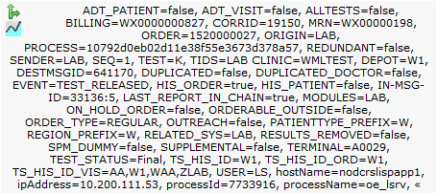
MOM Attributes Example 2/2

Slide 23
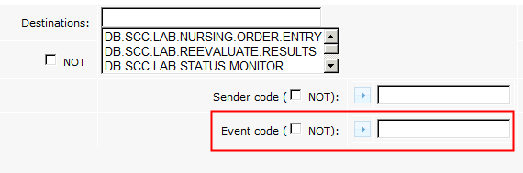
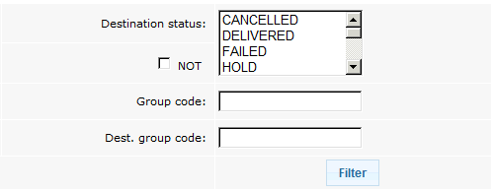
MOM Event codes, etc.
Notes:
TEST_ADDED, TEST_RELEASED

Slide 24
Destination status
DELIVERED (0) - delivery succeeded
DATA_ERROR (1) - indicates wrong data in message
TRANSPORT_ERROR (2) - indicates some temporary connection problems
INTERNAL_DATA_ERROR (3) - as above, however it can indicate that some internal requirements are not met
WAIT_ACK (4) - delivery status will be confirmed later
REPLACED (5) - destination together with delivery status published some other messages (replaced main message by another)
IN_PROCESS (6) - this is MOM internal status – means only that message is currently processed
UNDELIVERABLE (7) - status is set whenever MOM is not able to route message – there is no appropriate mapping in MOM setup or there is no routing defined in Delivery Result response
SKIPPED (8) - status indicates that MOM has skipped message processing (there was no WS call for this message on destination)
SKIPPED_BY_DEST (9) - status informs about skipping of message done on destination (so the WS call has been done but destination has skipped further message processing – usually in the ‘details’ section in MOM the user should find the reason of skipping)
RESOURCE_BUSY (10) - status similar to TRANSPORT_ERROR – indicates temporary application (not connection) problems like (record locks)
TIMEOUT_ERROR (11) - this is subtype of TRANSPORT_ERROR – indicates problem with lack of response by destination after timeout period
SKIPPED_FAILED (12) - this is result code that works like a WARNING - e.g. there is some setup problem that needs to be fixed (the difference between SKIP_FAILED

Slide 25
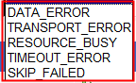

MOM Extra Search Criteria
Result Code list

Slide 26
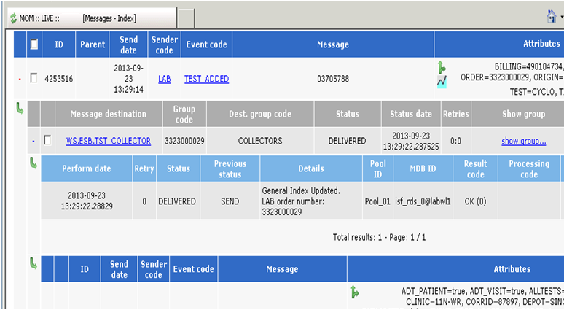
MOM Parent Messages
Notes:
Top search bar has ID, Parent, Send date, Sender Code, Event Code, Message, Attributes, Total Status

Slide 27
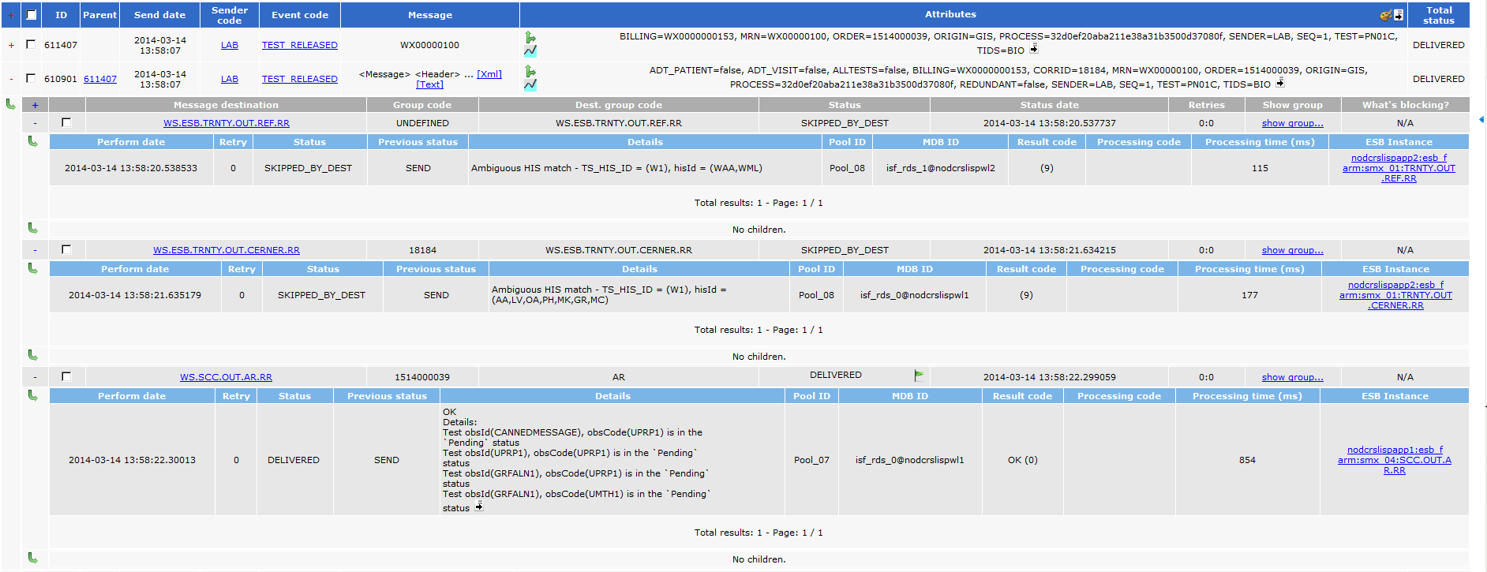
MOM Child Messages
Notes:
Child header: Message destination, Group code, Destination Group Code, Status, Status date, Retries, Show Group, What’s blocking
Destination Header: Perform date, Retry, Status, Previous states, Details, Pool ID, MOB ID, Result code, Processing code, Processing time (ms), ESB Instance

Slide 28

Delivery troubleshooting
MOM Console – Messages Tab
  Link to Routing review
  GenIndex preview
  HL7 message created indicator

Slide 29
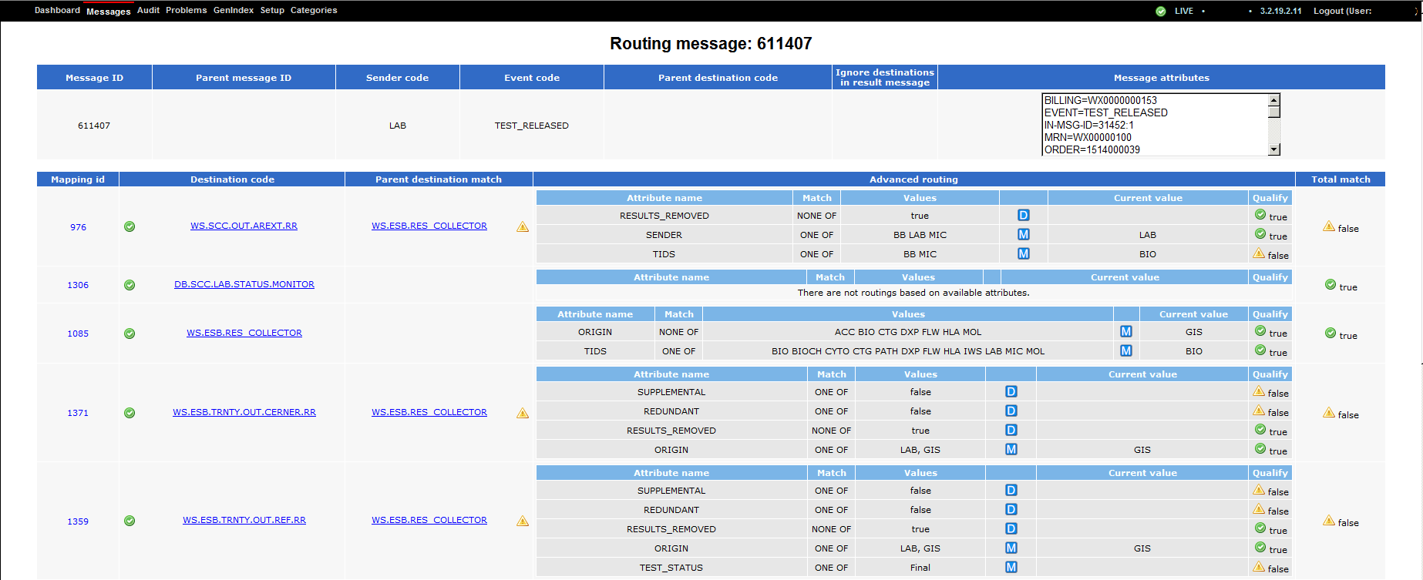
MOM Routing Review

Slide 30
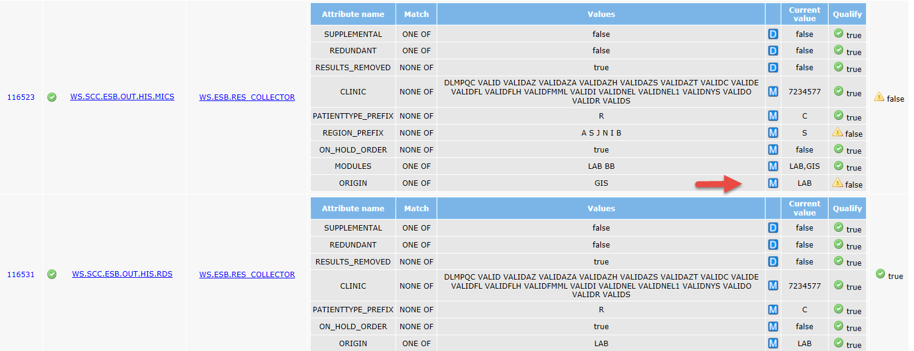
MOM Routing Review

Slide 31
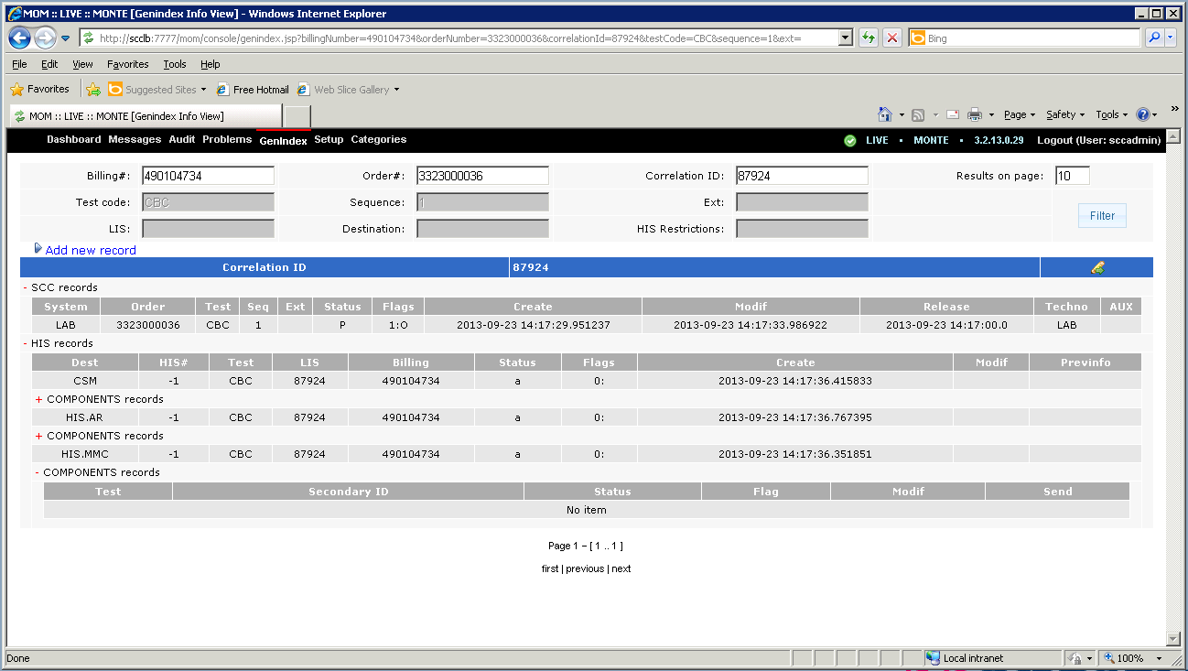
MOM GenIndex view

Slide 32
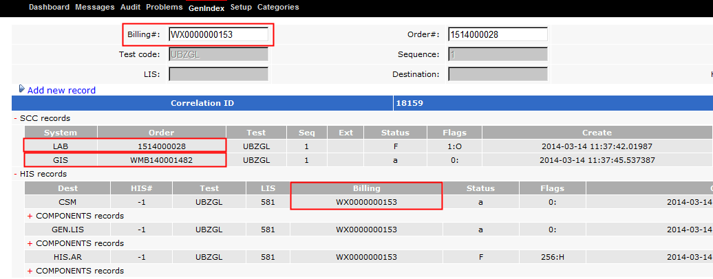
Information in GenIndex

Slide 33
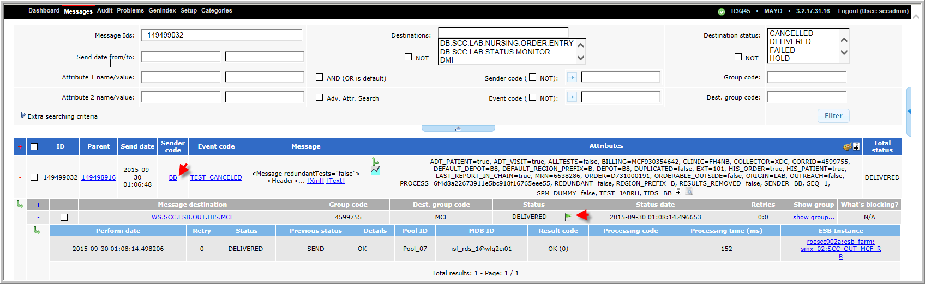
MOM Console

Slide 34
BB Sender
HL7 message: 149499032
Sender code: BB, Event code: TEST_CANCELED, Destination: WS.SCC.ESB.OUT.HIS.MCF
Queue path: $UDIR/db/dat/I/HIS/mcf_out/
MSH|^~\&|LAB|SCC|MCAOIFOUT|MCA|201509300208||ORM^O01|149499032-2015093001|D|2.4
PID|||6638286||CERTPT^TIFFANY^^^MRS.||19901204|F||W||||||||MCF930354642
PV1|||FH4NB^437^A||||12281093^PRESUTTI^RICHARD^JOHN||||||||||12281093^PRESUTTI^RICHARD^JOHN|R
ORC|OC|2124944553|D731000191:72|D731000191|||^^^201508311333^^R||201508311333|||12281093^PRESUTTI^RICHARD^JOHN|FH4NB^B8||201509300206
OBR|1|2124944553|D731000191:72|JABRH^ABORH||||||||||||12281093^PRESUTTI^RICHARD^JOHN||||||201509300206||JHBB|X||^^^201508311333^^R
NTE|1||ABORH was cancelled on 09/30/2015 at 02:06; Auto-cancellation by Newshift|TCANC

Slide 35
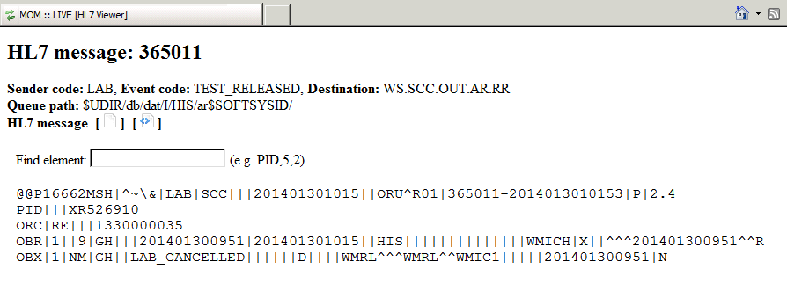
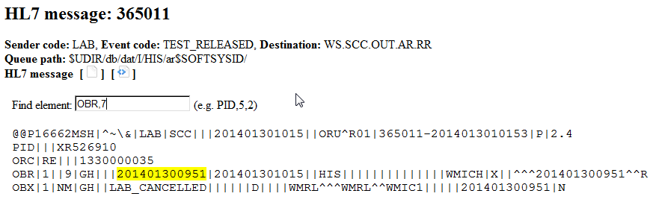
HL7 Message View

Slide 36
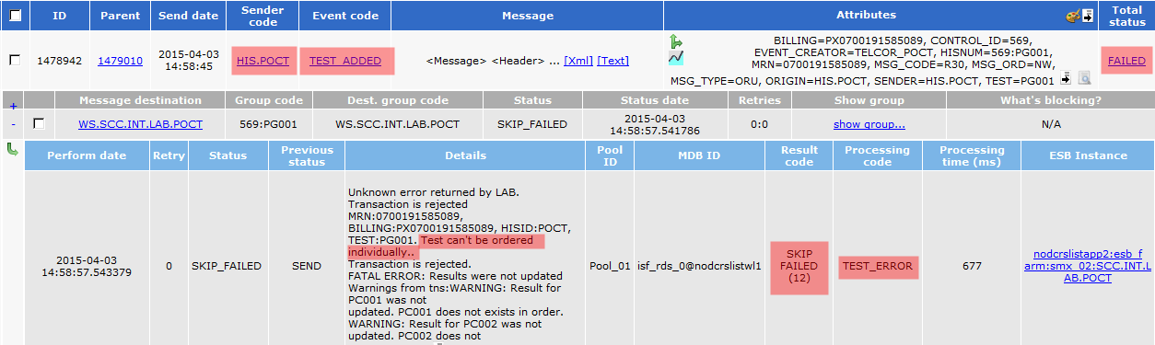
Message Scenarios
Inbound: Not Happy Day Scenario
A message does not post due to a unexpected setup issue

Slide 37
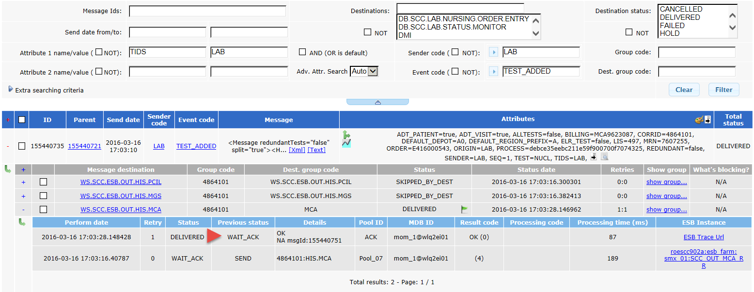
Send Number
Wait Ack

Slide 38
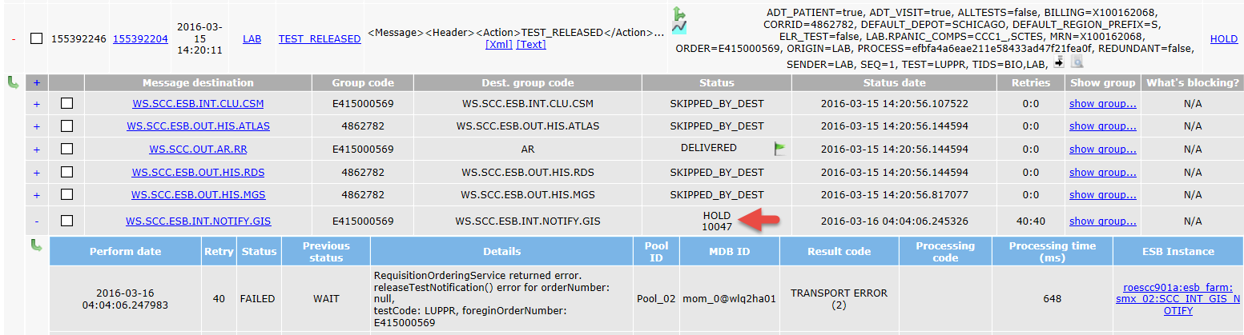
HOLD Status

Slide 39
Summary
MOM is Message Oriented Middleware that routes various Events to Services and Destinations.
MOM is where you want to go when looking for outbound traces.
There is a lot of information and searches possible so – practice, practice, practice!

Slide 40
MOM Basics and Traces
The Browser Based Trace Viewer

Slide 41
Introducing: The Trace Viewer
Designed to speed up searches
Allows searches through very large traces.
Don’t forget! The best way to do any search is to gather information first (e.g. MRN, Order #, etc.)
Ready? Set... Let’s go!

Slide 42
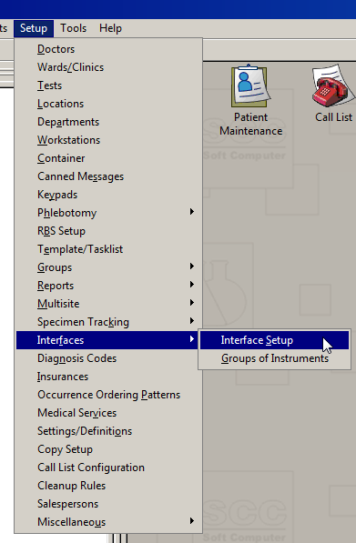
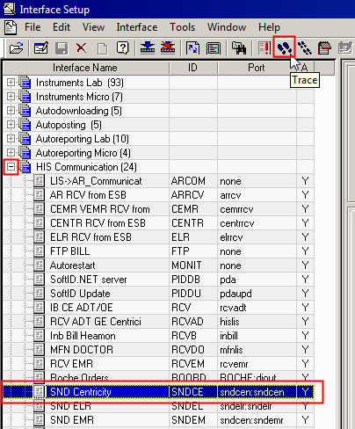
Searching Interface Traces

Slide 43
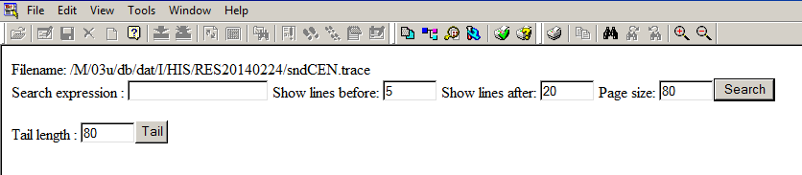
The Trace Viewer Screen
Rather surprising isn’t it?
Plain but powerful!

Slide 44
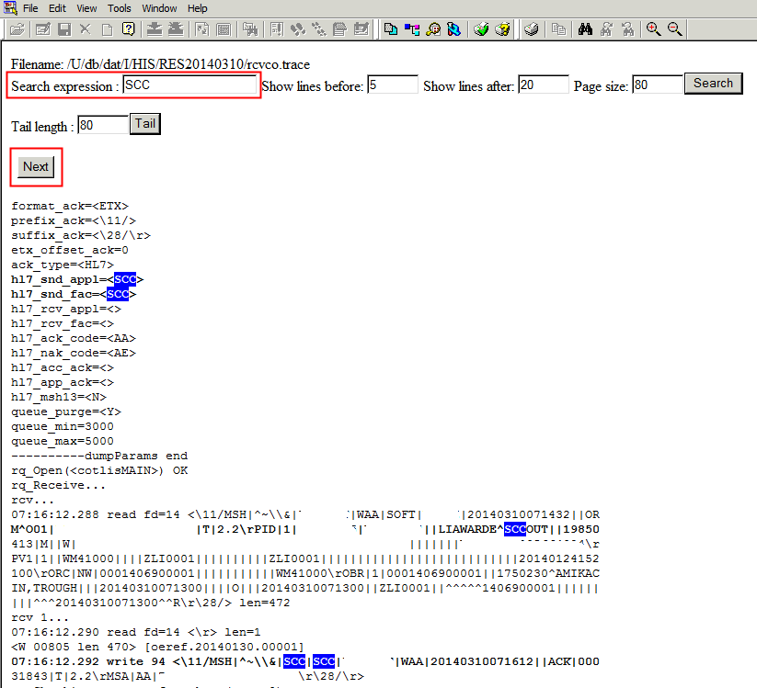
Search Example

Slide 45
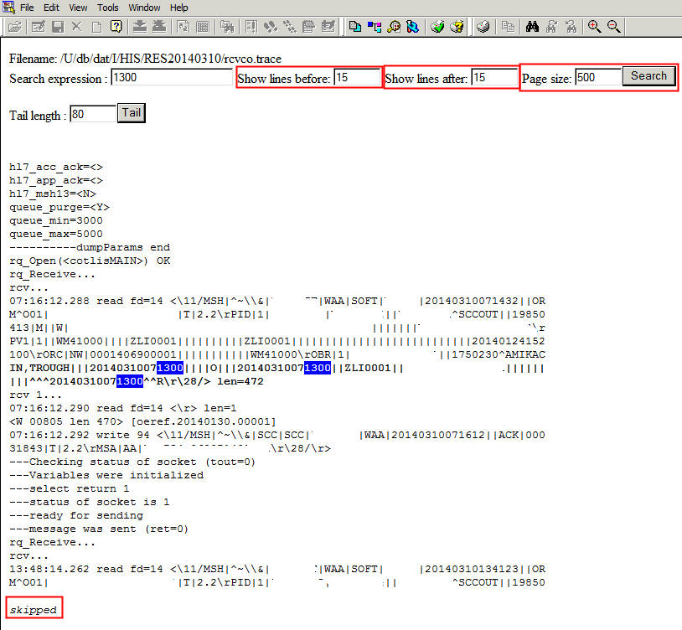
Search Example

Slide 46

Tail Search
Tail search is not specific
Don’t do this...
Searches based on two criteria only
  Searches from the bottom of the trace
  Searches up the number of lines in the Tail Search box.

Slide 47
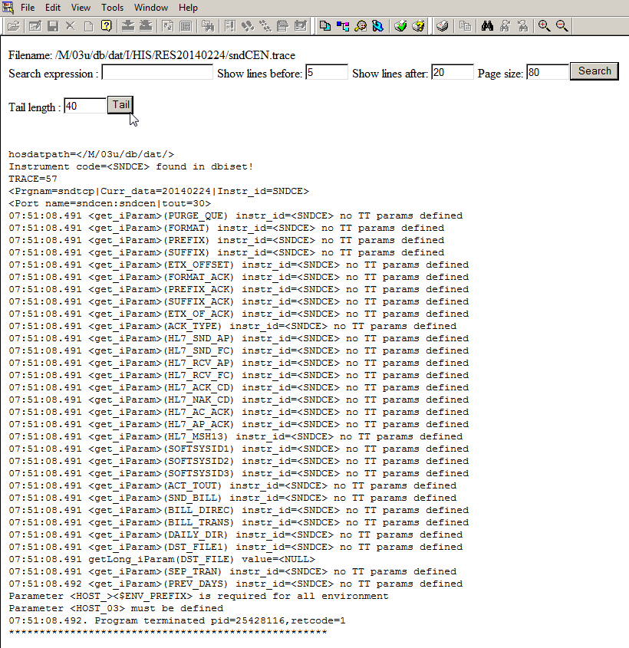
Tail Search – 40 Line Example
Bottom Up

Slide 48
Modifying Default Values
You can adjust the Trace Viewer!
Default field values are:
  Lines After = 20 (50-100 prefer)
  Lines before = 5 (15 prefer)
  Page size (Tail Search) = 80 (800 prefer)
  HTTP Show = Y
  (This means the HTTP trace viewer is on.)

Slide 49
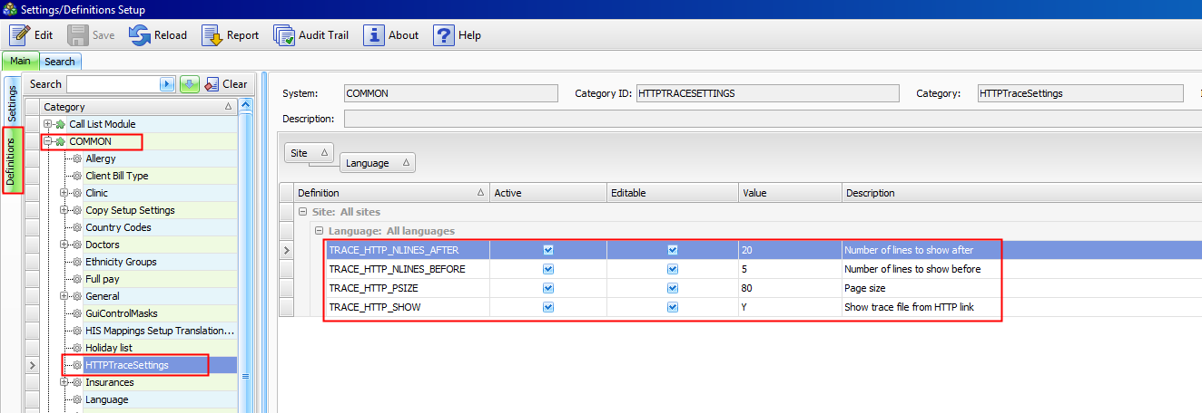
Default Settings Location
Setup>Settings/Definitions>Definitions tab>COMMON>HTTPTraceSettings

Slide 50
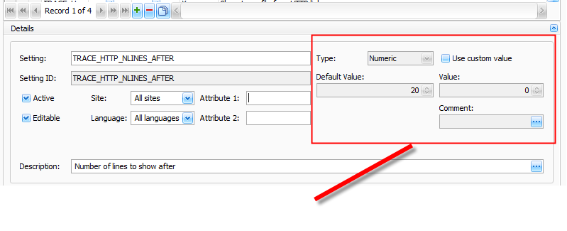
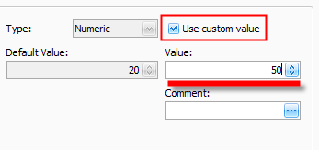
How To Adjust Default Values

Slide 51
Summary – New Trace Search
Best way to search traces is to gather information first (e.g. MRN, Order #, etc.)
Remember - the ‘Search’ box is CASE sensitive.
Tail search is not specific, bottoms-up!
Adjusting default value fields for the New Trace Viewer is easy!

