Slide 1

Printerc and Print Queue Setup
Background:
SCC utilizes AIX printing subsystem to handle majority of the application printing needs. Exceptions are:
  Pathology printing through Pathology Print servers;
  PathDX and Genetic module label printing are through RDS formatters;
  A few sites with large printer population, utilize CUPS printing subsystem.
Print queue must be setup in Application servers/LPARs, it is not necessary to setup print queues (and printerc file) in dedicated Oracle LPARs, since we do not print directly from Oracle LPARs.
Printerc file ties together the print queues and our application, like a cross reference table.

Slide 2
Printerc and Print Queue Setup
Information to obtain:
  Printer IP and/or DNS name
  Printer Type – Report or Label
  Printer make and model
  Location and Description
  Queue name
  Soft Name – Name to be used in printerc file
  Purpose:
    Reports
      Must support PCL5 and higher printer language.
      Impact printer – support Epson Emulation
    Label printing
      Regular labels for lab, micro, etc, 203 DPI
      Regular labels for lab, micro, etc, 300 DPI
      ISBT labels – 300 DPI, Zebra printers

Slide 3
Printerc and Print Queue Setup
A word about DNS name resolution
What does this mean to you? IP address = 216.58.219.174
scc1:/user/davew> nslookup google.com
Server: 10.100.64.120
Address: 10.100.64.120#53
Non-authoritative answer:
Name: google.com
Address: 216.58.219.174
For me at least, its easier to remember the name, than numbers.
<continue to next page>

Slide 4
Printerc and Print Queue Setup
Whenever possible, SCC would like to setup printers using DNS name, rather than creating an alias mapped to the IP address in /etc/hosts file.
Correct information for your DNS server:
#> cat /etc/resolv.conf
nameserver 10.1.8.83
domain bhcs.pvt
You have the printer IP address: 10.92.32.224, in UNIX, or from your PC, you can run the command nslookup to identify the domain name of that printer:
#/usr/spool/lpd/pio/@local/custom> nslookup 10.92.32.224 ← IP address of the device you are checking
Server: 10.1.8.83 ← it queries DNS server 10.1.8.83
Address: 10.1.8.83#53 ← DNS works on port 53
Name: PRT000131.bhcs.pvt ← this is the fully qualified domain name (FQDN)
Address: 10.92.32.224
#/usr/spool/lpd/pio/@local/custom> ls –l *PRT00131*
-rw-rw-r-- 1 root printq 11630 Jan 26 2015 w31:hp@PRT000131
<continue to next page>

Slide 5
Printerc and Print Queue Setup
If IP is not resolvable, you will see the following:
#> labapp1:/usr/spool/lpd/pio/@local/custom> nslookup 10.51.72.65
Server: 10.1.8.83
Address: 10.1.8.83#53
** server can't find 65.72.51.10.in-addr.arpa: SERVFAIL
Few possible causes:
  Device IP is not valid
  Entry has not been added to DNS servers
  Reverse lookup is not supported.
  Printers are not added to DNS servers
  Printers belong to another domain, not included in /etc/resolv.conf file.
It DNS server is not able to resolve this IP, but IP address is valid, we will add an entry to /etc/hosts file, associate it with a dummy alias.
10.51.72.65 w31 # HP 4350 in ICU
Is it necessary to add IP address to /etc/hosts file? No, it’s not, you can setup printers using IP address. This comes in handy when printer has been replaced with a new device, then you just need to edit the /etc/hosts file with new IP, without the need to recreate the print queue.

Slide 6
Printerc and Print Queue Setup
Requirement:
  UNIX account – review internal approval process.
  UNIX knowledge
  Text Editor – such as vi.
    You may have to edit /etc/hosts file, or virtual printer file,
    You will edit printerc file
  File structure
  Network printer setup and configuration
      DNS server name resolution
      Edit /etc/hosts file
  Request SCC to provide “Printer Info Template” spreadsheet, this will assist with printer addition process

Slide 7
Printerc and Print Queue Setup
Breakdown of printerc file:
A01_Label !LZ1:201:lp -c –dA01 >printer.trace 2>&1
^^^^^^^^^ ^^^ ^^^ ^^^^^^^^^^^
||||||||| ||| ||| unix command to print to label printer lp2
||||||||| ||| |||
||||||||| ||| security number, this MUST be unique! ! !
||||||||| |||
||||||||| Type of printer. This indicates this is a label printer, Zebra to
||||||||| be precise. See chart below.
|||||||||
Name of printer to be seen by users. First 3 characters must be unique,
and should be upper case. The limit here is 29 characters (6/9/2008).
For queue name, let’s use upper case also, it has something to do with new process.
P Laser or dot matrix printers used in Lab, Micro and BB modules.
F File, saves the report(s), labels to a file located in $UDIR/softprint dir.
If you would like to save certain label format, the second letter after
F should be just like one of the following example. Ex. FZ1 will save
the label file in Zebra format. FT1 will save the label in UBI Easycoder
91 format. This will not affect reports.
V View, used to display a report on screen. Same principle applies here.
You can use different letter designations to represent different label
formats.

Slide 8
Printerc and Print Queue Setup
Types of Label Printers:
LA1 TermaBar label printer for Alverno "BIG PRINTER"
LB1 BARCODE BLASTER label printer
LC1 CITOH T4 Terminator label printer
LB1 BARCODE BLASTER label printer
LC1 CITOH T4 Terminator label printer
LD1 DOTMATRIX printer
LE1 format for zebra print but different form STFFS00239
LF1 FACIT label printer
LL1 DataMax M-Class DPL language.
LI1 Intermec printer (IPL)
LP1 PT650 label printer
LT1 UBI 'ELTRON' label printer FIRST FORMAT (Zebra TLP2844 without –Z)
LU1 UBI 'ELTRON' label printer SECOND FORMAT – Contains small slide label
LW1 301\501 UBI 'ELTRON' label printer
LZ1 ZEBRA-203 DPI label printer FIRST FORMAT
LG1 ZEBRA-300 DPI label printer FIRST FORMAT
LS1 ZEBRA-203 DPI label printer SECOND FORMAT – contains small slide label
LH1 ZEBRA-300 DPI label printer SECOND FORMAT – contains small slide label
LN1 ZEBRA-300 DPI ISBT label format, for Bloodbank Only
LX1 ZEBRA label printer for 6 dots/mm printhead

Slide 9
Printerc and Print Queue Setup
Sample printerc file:
View_file !VD1:30:
Save,file !FZ1:31:
Dummy !P:17:cat >/dev/null 2>&1
T01_BHPRT24690 !LZ1:201:lp -c -dT01 >/dev/null 2>&1
T02_BHPRT12603 !LZ2:202:lp -c -dT02 >/dev/null 2>&1
T03_BHPRT24689 !LN1:203:lp -c -dT03 >/dev/null 2>&1
## B Printers
B01_BHPRT00341 !LZ1:301:lp -c -dB01 >/dev/null 2>&1
B02_BHPRT03127 !P :302:lp -m -dB02 >/dev/null 2>&1
B03_BHPRT07004 !LN1:303:lp -c -dB03 >/dev/null 2>&1
Above example is my preferred setup. First letter is site identifier, then # will be from 01-99, if greater than 99, then go to A0, A1, to Z0-Z9. The combination should allow for greater coverage to meet the unique first 3 character requirement.
The description following the underscore, in this case, is how each printer is labeled for this client. This is fairly important identifier, as your user and IT/MIS team will be using this name for reference, in this case, this is also the hostname for the printer device, so when we setup the print queue, we used it in the setup:
labapp1:/usr/spool/lpd/pio/@local/custom> ls -l t01*
-rw-rw-r-- 1 root printq 5308 Mar 6 2014 T01:hp@BHPRT24690

Slide 10
Printerc and Print Queue Setup
Limitation with security numbers:
Up to 4044 printers can be assigned in the security number.
Reserved numbers are:
17 – Dummy
30 -View file
31 -Save file
245 – 260, 700 – 702
*** PLEASE NOTE – 4044 is the highest # as security for printers ***

Slide 11
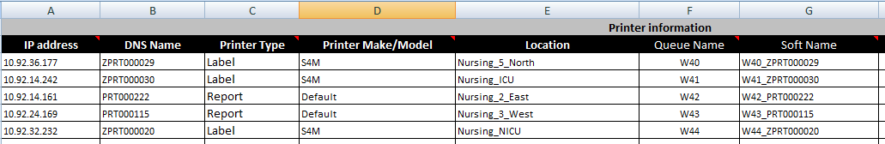
Printerc and Print Queue Setup
Using the Printer Info Template spreadsheet to maintain your printer setup process.
You still have to fill in the information, here’s a short list of first tab.
Since the DNS Name field is populated, the AIX command to setup the queue will rely on this column. If this column is empty, then it will utilize the Queue Name column entries to build the commands.

Slide 12
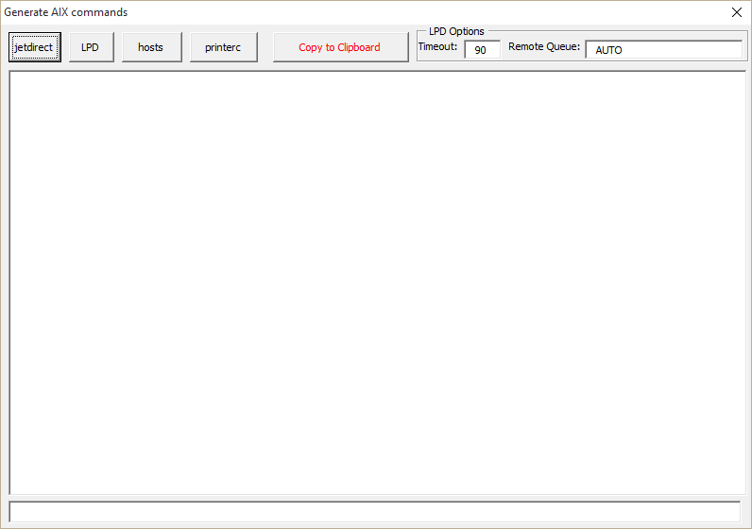
Printerc and Print Queue Setup
When I have entered all the information, click on Generate AIX Commands button, the following will display:

Slide 13
Printerc and Print Queue Setup
Click on jetdirect button, it will display all of the commands system uses to create these queues, in the HP Jetdirect format.
You see the –h `ZPRT000029`, which shows the system is using DNS name to build the commands.
/usr/lib/lpd/pio/etc/piomkjetd mkpq_jetdirect -p 'scc_label' -D 'asc' -q ‘W40' -h 'ZPRT000029' -x '9100'
/usr/lib/lpd/pio/etc/piomkjetd mkpq_jetdirect -p 'scc_label' -D 'asc' -q ‘W41' -h 'ZPRT000030' -x '9100'
/usr/lib/lpd/pio/etc/piomkjetd mkpq_jetdirect -p 'SCC_hp' -D 'pcl' -q ‘W42' -h 'PRT000222' -x '9100'
/usr/lib/lpd/pio/etc/piomkjetd mkpq_jetdirect -p 'SCC_hp' -D 'pcl' -q ‘W43' -h 'PRT000115' -x '9100'
/usr/lib/lpd/pio/etc/piomkjetd mkpq_jetdirect -p 'scc_label' -D 'asc' -q ‘W44' -h 'ZPRT000020' -x '9100'

Slide 14
Printerc and Print Queue Setup
Click on jetdirect button, it will display all of the commands system uses to create these queues, in the HP Jetdirect format.
I emptied out the DNS name column here, and you can see that –h (host) is the queue name:
/usr/lib/lpd/pio/etc/piomkjetd mkpq_jetdirect -p 'scc_label' -D 'asc' -q ‘W40' -h ‘W40' -x '9100'
/usr/lib/lpd/pio/etc/piomkjetd mkpq_jetdirect -p 'scc_label' -D 'asc' -q ‘W41' -h ‘W41' -x '9100'
/usr/lib/lpd/pio/etc/piomkjetd mkpq_jetdirect -p 'SCC_hp' -D 'pcl' -q ‘W42' -h ‘W42' -x '9100'
/usr/lib/lpd/pio/etc/piomkjetd mkpq_jetdirect -p 'SCC_hp' -D 'pcl' -q ‘W43' -h ‘W43' -x '9100'
/usr/lib/lpd/pio/etc/piomkjetd mkpq_jetdirect -p 'scc_label' -D 'asc' -q ‘W44' -h ‘W44' -x '9100'

Slide 15
Printerc and Print Queue Setup
Click on the hosts button, you can see the entries you can add to /etc/hosts file.
This is only needed if your printers do not have a DNS name.
10.92.36.177 W40 #S4M
10.92.14.242 W41 #S4M
10.92.14.161 W42 #Default
10.92.24.169 W43 #Default
10.92.32.232 W44 #S4M
When building the /etc/hosts file, we just map the IP address to the queue name you provided.

Slide 16
Printerc and Print Queue Setup
Click on the printerc button, it will create the correct entries for printerc file, that you can append to the printerc file.
W40_ZPRT000029 !LZ1:540:lp -c -dW40 > /dev/null 2>&1
W41_ZPRT000030 !LZ1:541:lp -c -dW41 > /dev/null 2>&1
W42_PRT000222 !P :542:lp -m -dW42 > /dev/null 2>&1
W43_PRT000115 !P :543:lp -m -dW43 > /dev/null 2>&1
W44_ZPRT000020 !LZ1:544:lp -c -dW44 > /dev/null 2>&1
Comments at the end of each line:
LAB_LabServices_CR1_RY73 !P :0196:P:lp -dLAB >/dev/null 2>&1:733-3615 LA3_LabServices_CR2_RVF5 !P :0393:P:lp -dLA3 >/dev/null 2>&1:733-3615
RXF_LabServices_CR_RXF8 !P :0451:P:lp -dRXF >/dev/null 2>&1:733-3615
A lesser known feature, is the ability to add a comment at the end of each line. Above is the format. Add :######## to the end of each line. This is useful to place contact information for each printer.
We are looking at adding this as a feature to the spreadsheet.

Slide 17
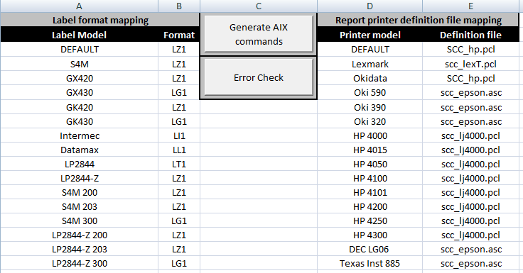
Printerc and Print Queue Setup
Here’s a listing of available printer type that you can enter in Column D of Printer Data Tab.

Slide 18
Printerc and Print Queue Setup
Once the spreadsheet has been fully populated, let’s try to execute this on the system now. Remember, print queues must be added to Application and Weblogic LPARs, there’s no need to add printers to the Oracle LPAR.
First thing first, if the printer IP are not resolvable through your DNS server, then you must update the /etc/hosts file first.
** Backup the /etc/hosts file first, before you edit the file.
I copied the entries found under “hosts” button, and I will append this information to the /etc/hosts file on Application/Weblogic LPARs:
10.92.36.177 W40 #S4M
10.92.14.242 W41 #S4M
10.92.14.161 W42 #Default
10.92.24.169 W43 #Default
10.92.32.232 W44 #S4M
The command to create print queues will fail, if the host name entry is invalid.

Slide 19
Printerc and Print Queue Setup
Execute the script to create the print queues:
Login to system, be sure you have privileges to add print queues (if you can edit /etc/hosts file, then you can add print queues):
/usr/lib/lpd/pio/etc/piomkjetd mkpq_jetdirect -p 'scc_label' -D 'asc' -q ‘W40' -h 'ZPRT000029' -x '9100'
/usr/lib/lpd/pio/etc/piomkjetd mkpq_jetdirect -p 'scc_label' -D 'asc' -q ‘W41' -h 'ZPRT000030' -x '9100'
/usr/lib/lpd/pio/etc/piomkjetd mkpq_jetdirect -p 'SCC_hp' -D 'pcl' -q ‘W42' -h 'PRT000222' -x '9100'
/usr/lib/lpd/pio/etc/piomkjetd mkpq_jetdirect -p 'SCC_hp' -D 'pcl' -q ‘W43' -h 'PRT000115' -x '9100'
/usr/lib/lpd/pio/etc/piomkjetd mkpq_jetdirect -p 'scc_label' -D 'asc' -q ‘W44' -h 'ZPRT000020' -x '9100'
If hostname is not valid, you will receive an error like the following:
scc1:/user/davew> /usr/lib/lpd/pio/etc/piomkjetd mkpq_jetdirect -p 'scc_label' -D 'asc' -q ‘W40' -h 'ZPRT000029' -x '9100'
Host name ZPRT000029 does not exist. A valid host name is required!
scc1:/user/davew>

Slide 20
Printerc and Print Queue Setup
Now, you can add the entries to printerc file.
Printerc file is located in /usr/lib directory. Make a backup copy of the file before you edit the file.

Slide 21
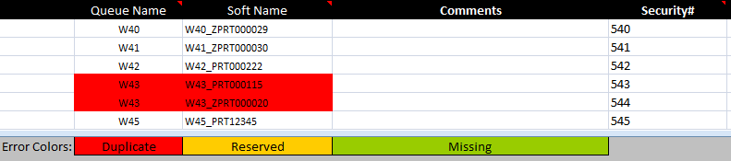
Printerc and Print Queue Setup
Error checking capability:
Only a few area that really matters:

Slide 22
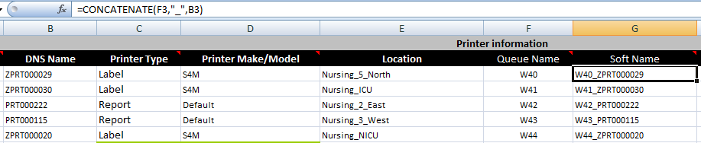
Printerc and Print Queue Setup
Cell manipulation within Printer Info Template spreadsheet:
To make your life easier, you can combine the cells together, so you don’t have to type too many fields – therefore, lowers the chances for typo.
In this example, I combine column F and B, to form Column G, which will be the first entries found in printerc file.
The formula is displayed.

Slide 23
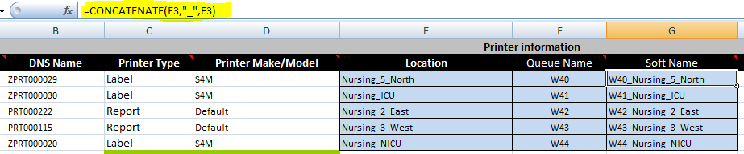
Printerc and Print Queue Setup
This next example is to use the location column as part of the description.
Simply change your formula to accomplish this.

Slide 24
Printerc and Print Queue Setup
Troubleshooting:
Jobs are not printing:
  Is this isolated to a specific printer, or the problem is system wide?
  Is the problem affecting label printing, or report printing, or both?
  Is the system able to generate the softprint jobs (reports only), can you view the content of these softprint jobs?
Check printer status from your all of your application servers. If you have weblogic servers, make sure to check printer status from them too!
If printer jobs are queuing up, try to ping the printer in question.
Most print servers have built-in web browsers, enter the printer IP or hostname (http://printerhostname/) in your web browser’s URL link, and you may be able to find additional information, such as printer status, toner, etc, see next slide for sample screen shot.
Receiving extra page: was the printer changed recently? If it was changed, was it from one brand to another? This would suggest a print driver issue.
<Continue in 2 slides>

Slide 25
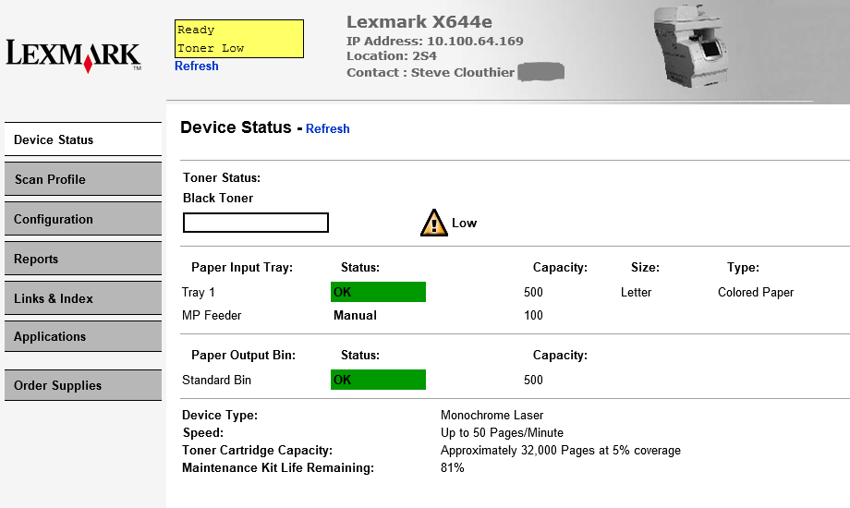
Printerc and Print Queue Setup
This example is from a Lexmark printer.

Slide 26
Printerc and Print Queue Setup
6. When checking printer status from application, check process is hanging. There are 2 causes for this, let me give you the background first:
AIX print queues can be setup in 2 ways. HPJetdirect or Remote queues. Most of the printers are setup using the HPJetdirect style queues. In certain situations, the queues are setup using remote print queue setup, that utilizes the LPD protocol.
When checking print queues with lpstat command in AIX, the check process is different between HPJetdirect and remote printer queues.
labapp1:/usr/spool/lpd/pio/@local/custom> lpstat -vw16
Queue Dev Status Job Files User PP % Blks Cp Rnk
------- ----- --------- --- ------------------ ---------- ---- -- ----- --- ---
w16 hp@BH READY
For Remote print queue:
labapp1:/usr/spool/lpd/pio/@local/custom> lpstat -vc01
Queue Dev Status Job Files User PP % Blks Cp Rnk
------- ----- --------- --- ------------------ ---------- ---- -- ----- --- ---
c01 @BHPR READY
c01: JetDirect lpd: no jobs queued on the port Auto
In this case, lpstat command actually queries the print server to get an update from it. If the print server is offline, it will wait for a reply, until it times out. <Next Slide>

Slide 27
Printerc and Print Queue Setup
labapp1:/SCC/user/scc> timex lpstat -vw16r
Queue Dev Status Job Files User PP % Blks Cp Rnk
------- ----- --------- --- ------------------ ---------- ---- -- ----- --- ---
w16r @BHPR READY
: (WARNING) Connection to server failed.
rembak: errno = 4: Interrupted system call
w16r MPS_2 HOST_DOWN
real 90.03 the timeout is set to 90 seconds before it gives up
user 0.01
sys 0.01
In the old days, SCC application used lpstat command to check printer status, if you have multiple printers offline, the check printer process will take forever to complete! So we asked our programmer to change the check process with another command: enq –isA, it will only care for AIX queue status, and not worrying about print server’s status:
labapp1:/SCC/user/scc timex enq -isA
real 0.05
user 0.00
sys 0.01
<continue to next slide>

Slide 28
Printerc and Print Queue Setup
For application checking process, we don’t care about print server status, but for some reason, the old checking process (utilizing the lpstat command instead of enq command) keeps reviving itself into different releases.
Please test the check printer status function as part of your validation process for new release of software.
7. Label print out looks smaller than normal.
Check and see if printer type has changed. Zebra printers support 203 and 300DPI. A site purchased new printer that is 300 DPI, but all the in-house printers were 203 DPI. By simply swapping out an existing printer to this new 300 DPI printer will not work correctly, as labels will look smaller than what they should be. SCC provides another label type that works with 300 DPI printers (based on printerc file). But my recommendation with this is to keep your printers to the same DPI if you can.

Slide 29
Printerc and Print Queue Setup
8. Pull paper from specific tray:
Question? Why does SCC have to make the adjustment? ☺
This will need to be done by SCC staff. Before we can change the printer setting, we have to find out the correct PCL (Printer Control Language) code to pull the paper from the correct paper tray. We will need someone standing by the printer, then we send out a test page to the printer with the tray selection command embedded in the print job. The person by the printer should alert us when the paper is pulled from correct tray. This may take multiple tries, and once we have the right code, please make sure to test this out by printing a report from application. Don’t forget, turn off tray linking function from the printer. In printers now a day, this is by defining a different paper type in each tray.

Slide 30
Printerc and Print Queue Setup
Any additional questions?
Thank you all for attending this session.

