Slide 1
Rule Based System
Presented by:
Peggy Steele and Jane Blackmar
Lab Implementation

Slide 2
Let’s Look At…
Examples of each type of Rule
  12 types (14 if you are on 4.5)
Calculations in RBS
New Features for 4.0.4 and 4.5

Slide 3
12 Types of Rules
(14 if you’re on 4.5)
Order Entry | Autoposting Server | RBS Server
D- Test Ordering Restricton | H-Stop Autoverification | R-Reflex
W- Test Ordering Warning | S- Stop Autoposting | V- Pathologist Review
A- OE Add On |  | M-Send Message
U-OE Update |  | I-Print Instant Report
 |  | C- Test Call Request
 |  | P-Posting
 |  | G-Draw Charge
 |  | B- Positive for Epi
Evaluated before the order is saved | Evaluated for every result from autoposting instruments | Evaluated as an order is saved or results are posted/verified.
Notes:
It is important to know where and when each type of rule is evaluated so that you can write them to fire where and when you need them to.
The Test Ordering Restriction, Test Ordering Warning, OE Add On and OE Update rules are evaluated by the OE Server every time an order is saved.
The Stop Autoposting and Stop Autoverification rules are evaluated by the Autoposting Server every time a result from an autoposting instrument is evaluated.
The rest of the RBS’s are evaluated by the RBS server every time an order is saved OR results are posted/verified.
Note each rule is evaluated EVERY time- not just the one time the rule addresses.
The two additional rules found in 4.5 are circled in purple and will be discussed in the section about new features.
We’ll look at how to construct each of these rules in turn.

Slide 4
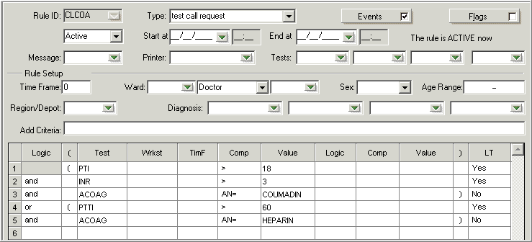
C – Test Call Request
Send results to the Call List
Life Threatening
Notes:
Before we look at this kind of rule, let’s look at the general construction of a rule. You get to this screen from Main Menu/Setup/RBS Setup.
Enter up to five characters which will be the Rule ID.
Select the type of rule from the dropdown. Use the rest of the fields to add granularity to your rule as needed.
Select the event(s) at which you want this rule to fire. Which Event(s) may be used is dependent on the type of rule.
Set flags as necessary. We will talk about some of them during this presentation.
Enter a canned message ID in the Message field to print the message to a printer or terminal.
Select the printer to which the message should print or enter >T to send the message to a terminal.
The use of the four boxes to the right of the label Tests: varies by the type of rule.
Time frame is VERY important. It tells the system how far back should it go to find the conditions set forth in the rule. 0 (the current order) is the most frequently used time frame. If no time frame is added, the system will evaluate every order that ever there was and make it fire if the conditions are met.
The rest of the criteria in the Rule Setup section is pretty self explanatory. Note if you are going to use diagnosis, you need to get them in the patient order consistently. The Addition Criteria field can be used to add additional granularity to your rule. A complete list of the available attributes and how to write them can be found in the Lab Design 2 book or the online help manuals or by emailing me at peggy@softcomputer.com
I will point out highlights of the Logic grid as we go along.

Slide 5
C – Test Call Request
Send results to the Call List
Life Threatening
Notes:
Results can be sent to the call list under very specific but broad conditions like panic, stat, pre-op etc. This is accomplished using hosparams in the 4.0 versions and Call List Configuration in 4.5. However, you can also write Test Call Request rules to make results go to the call list conditionally. In this example, the results of the PTI, INR, ACOAG and PTTI tests will go to the call list if (the value of the test PTI is greater than 18 AND the value of the INR is greater than 3 AND if the value of ACOAG equals COUMADIN- just like that) OR if the value of PTTI is greater than 60 AND the value of ACOAG equals HEPARIN- just like that).
If only certain tests should go to the call list, list them in the Tests: boxes. Otherwise all tests in the rule will go to the call list.
Note each line is one or two conditions about one test. Each line subsequent to the first has to be joined with either and or or. The complete list of possible entries in the Comp column can be found in the same places as before.
Life Threatening (LT) is a category upon which the Call List can be sorted (like panic). Test Call Request rules are the only rules that have this the ability to determine if a call request will go to that category. It does not necessarily mean the result is life threatening.

Slide 6
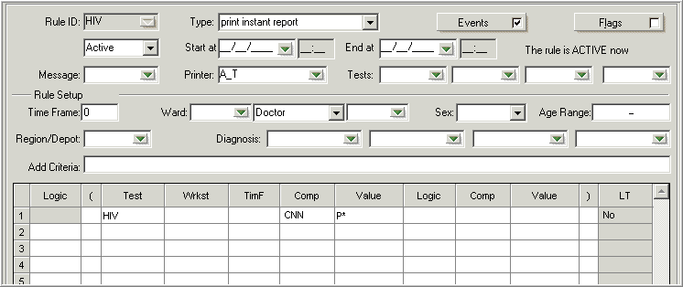
I – Print Instant Report
Print Instant Report
Prints entire order
  Use !F as Additional Criteria
Notes:
The next type of rule is Print Instant report. It is useful in printing a report outside of autoprinting or reports from the Scheduler. An example would be printing a report to Infection Control in addition to the regular patient reporting channels. Note the entry in the Printer: field- this is the 3-character printer ID. The Logic grid contains the conditions under which a report will print to A_T- whenever the HIV result starts with P. CNN in the Comp column is used for alphanumeric results and means basically ‘close to’. It allows the use of the wildcard * in the Value column. Note, written this way, a result of Positive, POSITIVE, or Perky would qualify- so you’d want to control potential results, perhaps with a keypad. Notice also this type of rule will print the whole report to printer A_T. This can be controlled by using an alternative format that only contains the tests you want to print. You would indicate the other format in the Add Criteria field as !, F, space, the three character format code. For example- !F RR2.

Slide 7
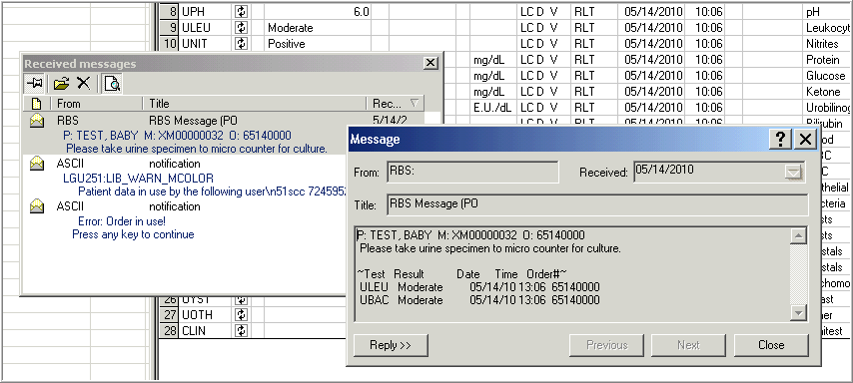
M – Send Message/Warning
Send message to terminal, printer or log
Order Entry or Result Entry
Notes:
The Send Message/Warning Rule can send predefined canned messages to either a printer or the terminal under the defined conditions. The canned message does NOT print to the HIS or other downstream systems. For this rule, you would enter the ID of the canned message which will print in the Message: field and the printer ID or >T for terminal in the Printer: field. The two examples here are the same message showing but one contains the results while the other one doesn’t. If it is NOT important the results show with the message, you can click on the Flag: box and select the Do Not Show Results with the Message Flag. If you do print the results with the message, make sure the message doesn’t print to someplace results should not.

Slide 8
P – Post Result
Posts a result to a designated test
  Attach interpretive comment to a result
Use only when can’t use Ind. Test calculation field.
  Doctor, ward, region specific rules
  Multiple time frames
View->Switch to Textual Formula
Notes:
Post Result Rules are used to enter a particular result under certain conditions. Only one of the four Test: field are used- the first field contains the test to which the result is being posted. This is the kind of rule you use when you want to use RBS for calculations. To enter the calculation, you can either fill in the logic grid or go to View-> Switch to Textual Formula and type the calculation in. There are two flags used only for Posting type rules- the Do NOT create RMOD for Canned Messages and the Verification Flag. When checked, the former causes the system NOT to create an RMOD when the rule adds an interpretive comment to the result. For the latter, there are four options:
Calculate the verification flag- system calculates flag off of component tests
Always verified
Always unverified
Keep the previous verification state — The verification status of the results will be what they were before the RBS rule was triggered.

Slide 9
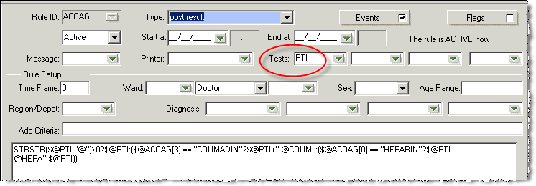
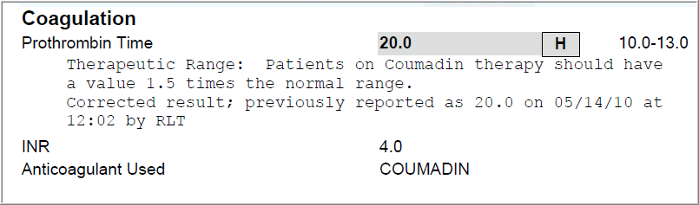
P – Post Result
Notes:
Note the logic grid is gone and has been switched to Textual Formula. Technically, all rules could look like this but are generally only switched to textual formula if the rule involves timeframe or workstation differences. Once a rule has been switched to textual formula and saved, it cannot be changed back to a grid.
Note the RMOD in the report. This can be controlled by setting the Do NOT Create RMOD for Canned Messages flag.

Slide 10
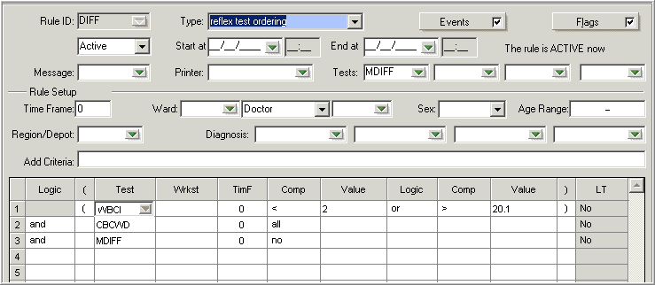
R- Reflex
Automatically adds up to 4 tests to an order when specified criteria are met
Notes:
Enter up to 4 tests in the Tests: fields to add up to 4 tests under certain conditions.
Note there are a total of 4 conditions in this rule. Line 1 contains two conditions for the same test (WBCI). Note too that each condition has to be joined with either or OR and denoting if it is necessary ALL conditions be met or only some.
This example shows different entries in the Comp field. Numeric tests can use < or > and an entry in the Value Column. All denotes a test is on an order while No denotes it is not.

Slide 11
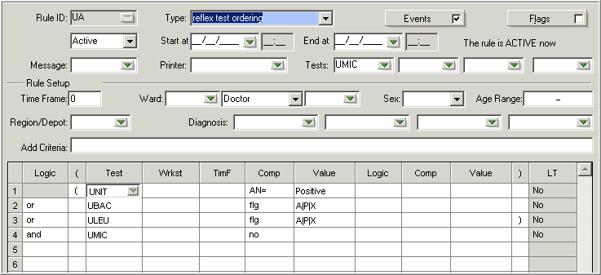
R- Reflex
Notes:
More entries in the Comp column. AN= Alphanumerically equal to the entry in the Value column. Note this means exactly equal to, including case. Flg- the system will look for results with the flag noted in the Value column. In this example, the flags used are abnormal, panic, and absurd (these tests are alphanumeric). Each flag is separated by a pipe (|). A complete list of flags can be found in the Lab Design 2 book, online help screens or by emailing peggy@softcomputer.com

Slide 12
R - Reflex
Ability to have label print when Reflex test is added
Additional Criteria line
  !LB XXX where XXX is the printer ID
  !LBL XXXX where XXXX is the desired label layout

Slide 13
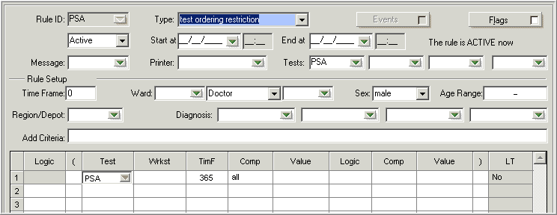
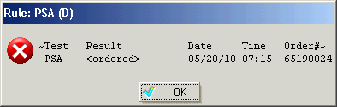
D – Test Ordering Restriction
Not orderable!
4 tests
Notes:
For Test Ordering Restriction Rules, use the Tests: fields to indicate up to four tests which can’t be ordered under certain conditions. When the conditions are met, the test(s) cannot be ordered and the LIS user will see a message describing the order which is causing the restriction. Note- these rules apply to both HIS and LIS orders but the HIS user will not see the message nor know about the restriction. They will think they have a good order.
Also note the conditions used in this example. The Sex: field has an entry as does the TimF (Timeframe) column. Any timeframe written in this column overrides that written above. In this case, the rule is looking back 365 days (including the current order) for any ordered PSA test.

Slide 14
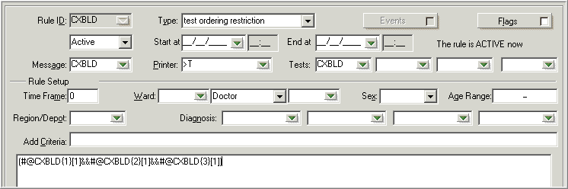
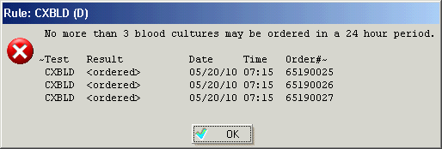
D – Test Ordering Restriction
(#@CXBLD{1}[1]&&#@CXBLD{2}[1]&&#@CXBLD{3}[1])
Notes:
This example shows a canned message ID can be entered in the Message: field and a 3-character printer ID (or >T for terminal) can be entered in the Printer: field to denote to where the canned message should print. Also note that the Logic grid has been switched to textual formula. Lastly note the use of indexing- the numbers included within the braces ({}). This annotates how many orders back the system should look within the days back included within the brackets ([]). This calculation is telling the system to look back 1 day for 3 blood culture orders.

Slide 15
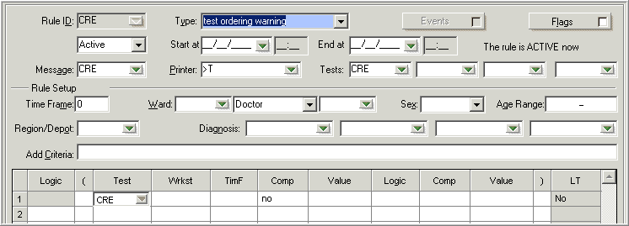
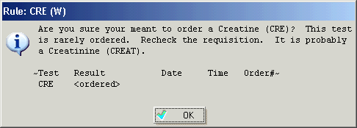
W – Test Ordering Warning
4 tests
Still orderable!!
Notes:
Similar to the Restriction Rule except the 4 tests listed in the Tests: fields will still be orderable. Applies to both LIS and HIS placed orders, but HIS users will not see the warning.

Slide 16
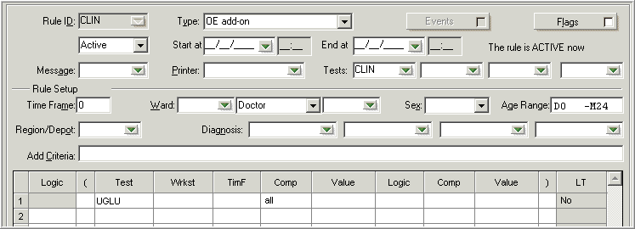
A – Order Entry Add On
LIS and HIS placed orders
Before order number is created
Add on up to four tests
HIS “NW” message
Notes:
The difference between OE Add On and Reflex rules is when the rule fires. OE Add On rules fire BEFORE the order is created while Reflex rules fire AS the order is created. The system will send back a new order (NW) message to the HIS. Up to 4 tests to be added on can be listed in the Tests: fields.
Note the use of the Age Range: field in this example.

Slide 17
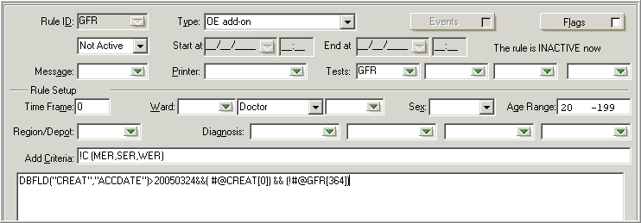
A – Order Entry Add On
GFR
Order created after 3/24/2005
CREAT on order and no GFR for past year
Age range >20
Notes:
Lots of good stuff included in this example. In addition to the items listed on the slide, note that this rule is NOT active and the entries in the Add Criteria field. This entry is saying all clinics except MER, SER, WER.

Slide 18
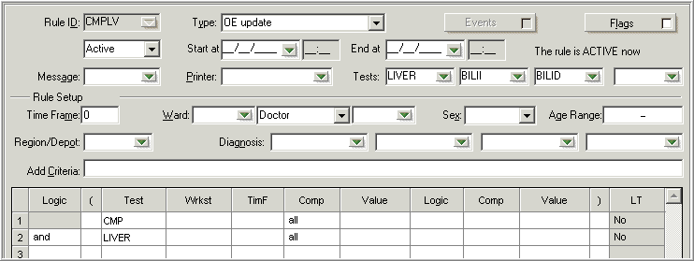
U – Order Entry Update
Cancel one test
Order up to three tests
Useful for panels with some duplicate tests
HIS “CA” and “NW” messages
Notes:
This rule will cancel the test listed in the first Tests: field and add up to 3 tests listed in Tests: fields listed in 2-4. Cancellation (CA) for the cancelled test and new order (NW) for the added test messages will be sent to the HIS.

Slide 19
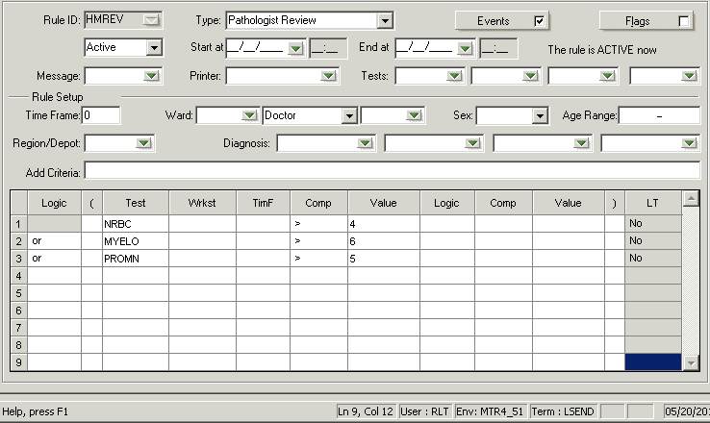
V – Pathologist Review
Test qualifies for Path Review template
Tests field not used
Notes:
There are three ways to add on a Path Review if using the Lab Module’s Path Review functionality:
Test flags
Ad hoc
RBS

Slide 20
Stop Autoposting and Autoverification
Looks only current instrument databases
  Set timeframe to 0
Prevents autoposting or autoverification of Individual tests
Enter up to 4 tests
May need more than one rule to stop all needed
Notes:
Stop Autoposting and Autoverification rules are very similar- the only difference between them is where will the results be stopped on the continuum of results going from an analyzer to Soft via interface. If a Stop Autoposting rule is used, the results will be seen in Instrument Menu. If a Stop Autoverification Rule is use, the results will post but not verify and will have to be accessed from a Manual Result Entry worklist.
Note system stops the posting/verification of individual tests, but could also be setup to hold many tests (including groups) if one test fails autoposting.

Slide 21
Stop Autoposting and Autoverification
Requirements
  Instrument Interface setup flag 48 checked (Autoposting/Autoverification by test?)
  RBS flag “Effective for not verified results?” set to Y.
  Hosparam RBS_send_not_ver must be set to "Y".
  Hosparam RBS_instr must be set to “Y”
Notes:
In addition to these requirements, the flag Effective for not verified results must also be set.

Slide 22
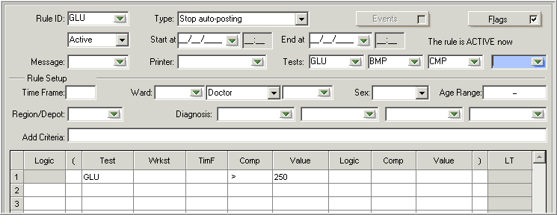
S – Stop Autoposting
Notes:
List up to four tests in the Tests: fields that will stop autoposting based on the defined criteria. Note that is a group test is entered here- all individual tests within that group will stop posting/verifying regardless of whether they were ordered individually or as a group. Therefore, GLU and BMP were not needed in this rule as all tests within the BMP (including the GLU) are covered by the CMP and so only CMP was actually necessary for this rule.

Slide 23
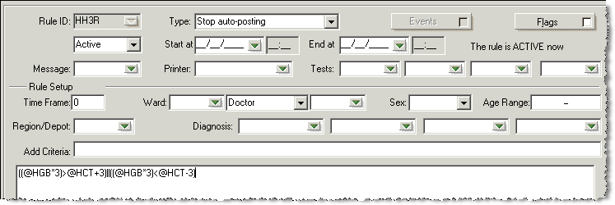
S – Stop Autoposting
Notes:
You can use a calculated value to stop autoposting/verifying. However, you would need to use the calculation- not the test to stop. For example, if you want to use the anion gap (ANGAP) to stop autoposting, the logic cannot be @ANGAP>12 (for example). You would have to say @NA-(@CL+@CO2)>12. This is because ANGAP is not valued until the NA, CL and CO2 values are posted. So by the time you have the ANGAP value, it is too late to stop autoposting/verifying the NA, CL and CO2 results unless you express the ANGAP value as a calculation.

Slide 24
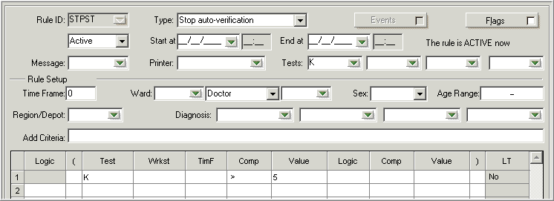
H – Stop Autoverification
Notes:
Same rules and logic as stop autoposting rules applies here.

Slide 25
Calculations in RBS
Used most often with the Posting rule
Rarely used with Call rules (must designate test)
Can view any RBS as calculation
  Ctrl+f in ASCII
  View>Switch to Textual Formula in GUI
Used when:
  multiple time frames
  multiple workstations
  Need the top criteria

Slide 26
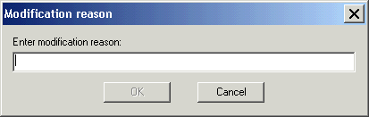
New Features (4.0.4)
RBS_change_reason
  Ask reason for modification
Notes:
On to New Features in 4.0. 4. This Hosparam can be shut off while you are in Implementation. It is very annoying then but very useful afterwards.

Slide 27
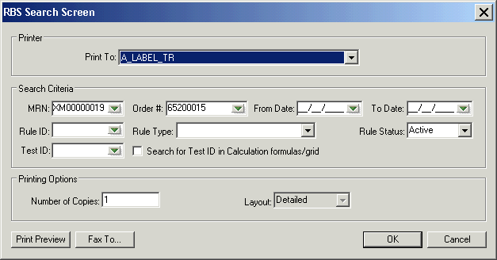
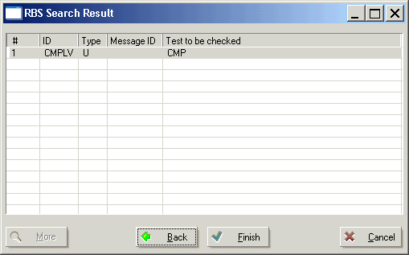
New Features (4.0.4)
RBS Log
  A report that shows successful rules applied to an order/patient
  Access from OE

Slide 28
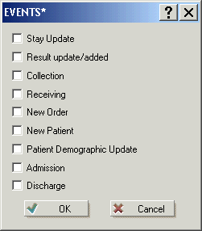
New Features (4.0.4)
Events
  When event occurs -> message is sent to RBS
  RBS searches for rules with matching events
  Only certain rules
    R, C, M, I, P and V
Notes:
Can control when a rule will trigger by selecting an event(s). Which events are available depends on what kind of rule you are creating. If an event is not available for a particular rule, it is dithered.

Slide 29

New Features 4.5
Trace Level
Notes:
And new features for 4.5. The RBS server trace file is enormous in 4.5 and so it is important that only rules being implemented have any detail in the trace file. Therefore, each rule had a Trace Level assigned. The default is 0-No trace. The rule will appear in the trace as having fired, but won’t give any more details. There are a choice of 3 other levels- each providing more detail in the trace. Only when troubleshooting- set the trace to the lowest level necessary to troubleshoot. Make sure to set to 0 once the rule is working the way you want.

Slide 30
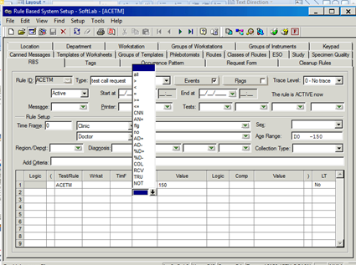
New Features 4.5-
New Comp Options
Notes:
The Comp column has 4 additional comparisons:
COL
RCV
TRU
NOT
The COL and RCV comparisons look to see if the specimen has been collected/received or not. Do not confuse with the Events Collected or Received. The Events describe when the rule will fire, the Comp column describes the condition of the specimen when the rule fires.
TRU and NOT refer to other RBS’s. Notice the Test column in the logic grid now has Test/Rule. Enter a rule ID here to indicate another rule this rule should evaluate. The system will evaluate if the rule is True or Not (note not necessarily THAT the rule has already fired).

Slide 31
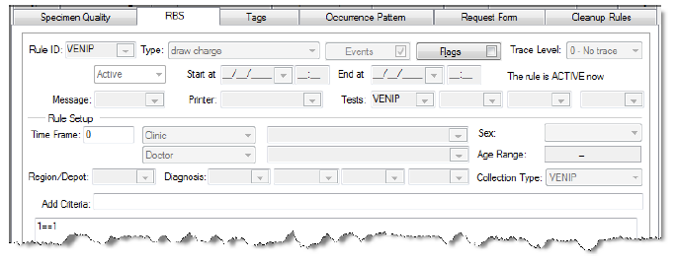
New Features 4.5
G – Draw Charge – adds on billing test automatically. Must make an entry in the Collection Type field . No information is required in the logic fields
Notes:
The first of the two new rules available in 4.5- Draw charge. All Draw charges are added via RBS in 4.5- this is no longer controlled by hosparam as it was in 4.0.

Slide 32
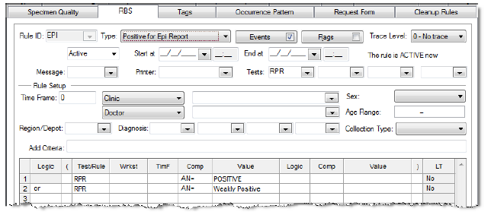
New Features 4.5
B - Positive for Epi Report defines lab tests to qualify for the Infection Control and Integrated Statistics type reports under Micro Epidemiology Reports.
Notes:
The second of the two new rules in 4.5.

