Slide 1
Overcoming The Hurdles Of EQ
By
Tom Larson
SoftReports Implementation Support Specialist
And
Kim Schroeder
SoftReports Team Lead Implementation/Support

Slide 2
Objectives
Introduce you to EQ (EQ, Easy Query, EQ SQL Generator)
We will show you how to get to the EQ Application
You will learn how to Create and Edit a new report
We will demonstrate how to add Criteria and Parameters
We will show you how to Run and Print Reports
You will learn how to customize the Screen and Form
We will demonstrate how setup your report to export to Excel
We will review some common Issues/Errors that you might encounter and give you suggestions on how to resolve them

Slide 3
What is EQ?
EQ allows it’s users the ability to put together quick and efficient reports with minimal effort.
What modules use EQ
Lab/Mic
BB
AP (Path)
AR
Donor
SEC
QC

Slide 4
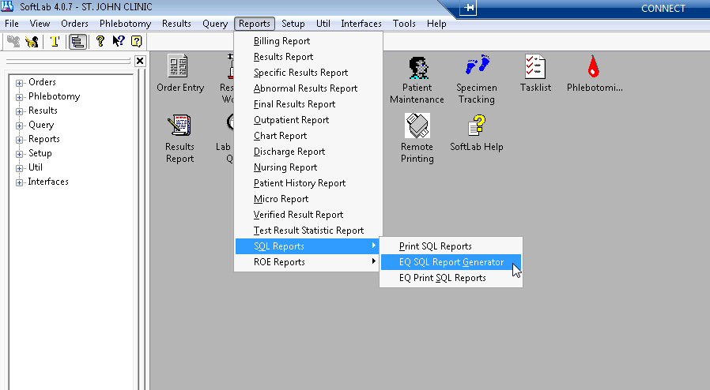
Loading EQ From Lab 4.0.7
This presentation is being done on an Oracle environment. There are some slight differences in functionality when using DBVista vs Oracle.

Slide 5
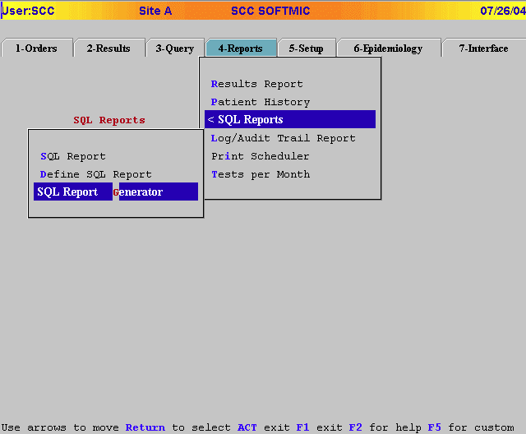
Loading EQ From Mic ASCII

Slide 6
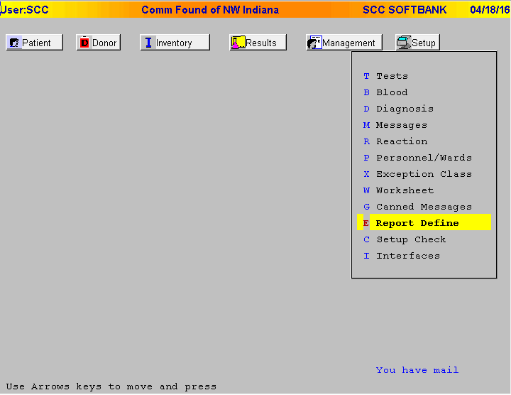
Loading EQ From BB ASCII

Slide 7
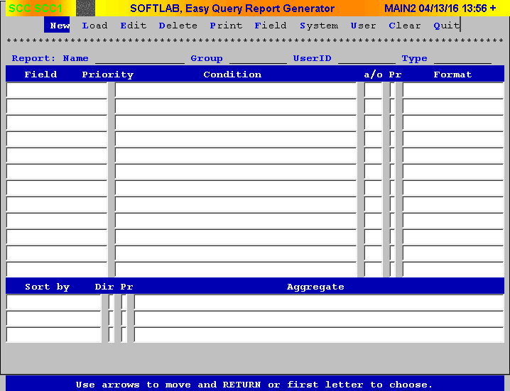
Welcome To EQ

Slide 8
This presentation will provide instructions first, followed by screenshots to represent the instructions

Slide 9
How to Create a new report….

Slide 10
How to Create a new report….
Press N (for New) or navigate to New using your arrow keys on your keyboard until New is highlighted Blue and press Enter
After you have selected New, type in the desired name of your report and press Enter
Proper report naming – No Spaces! Instead use __ (New_Report)
Use of Letters (both capital and lowercase), numbers, and only __ are allowed
You should now be in Edit mode, at this point lets Save by pressing F12 and press Enter for the highlighted Save option

Slide 11
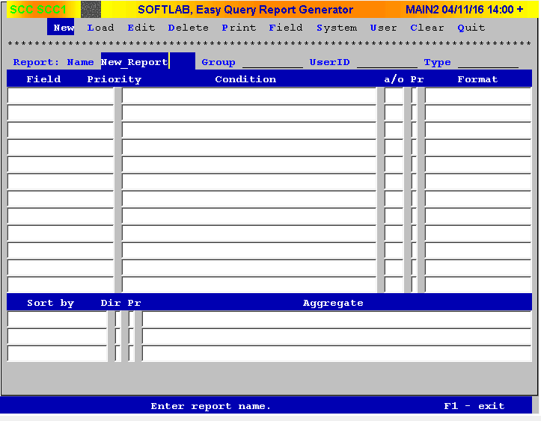
How to Create a new report….Continued

Slide 12
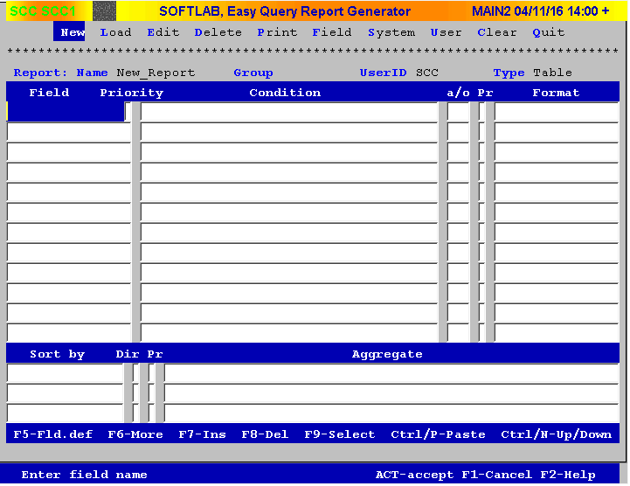
How to Create a new report….Continued

Slide 13
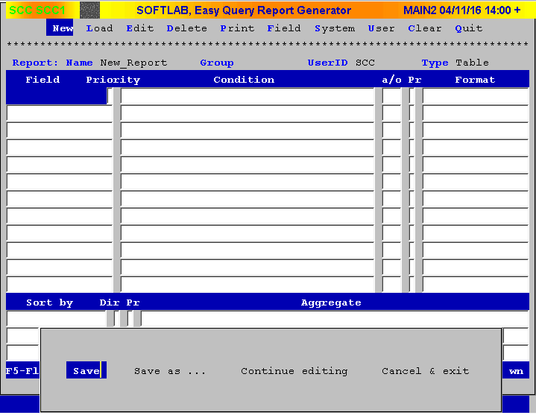
How to Create a new report….Continued

Slide 14
How to Edit a new report….

Slide 15
How to Edit a new report…
Adding fields to a report
Press E for Edit, or navigate to Edit using your arrow keys on your keyboard until Edit is highlighted Blue and press Enter
Press F9 to begin adding fields
Using existing report(s) fields
Using the database
Select From database
Select the database you wish to use… In our example we will use hosplab
Select the table you wish to use… In our example we will use lab_active
Select the fields you wish to use… In our example we will use acord, aodate, aotime, acward, acdepot, Panic_low, Panic_high, Abnormal_low, Abnormal_high
Notice how a * is placed next to the field(s) you select and they are highlighted Blue
After you have selected your desired fields, Press F12 to save your selection and back out to the previous screen. You will need to do this 3 times.
If you make a mistake, you can press F1 to back out without saving any selections
Alternatively you can manually type in your fields instead of using the database
Please note that this is the oracle table name. DBVista does not contain the lab_

Slide 16
How to Edit a new report …Continued
Attempt to SAVE! Press F12 to save
A blue screen should appear that lets you know that you have added/deleted fields and that the Form should be edited to match the changes
Editing the default Form
In edit mode, Press F6
This screen allows you to edit the View Path, the Form, and the Screen
Navigate down to Form
Press Enter to view the current Form
Notice how it is blank and has no fields shown on it
Back out with F1
Press F7 to Create Default Form
Press Enter to view the updated Form
Notice how it now shows all your fields in the order that you selected them
Press F12 two times to save the edits and return to the edit screen
Now SAVE! Press F12 to save
If you successfully saved, EQ has taken you out of Edit mode

Slide 17
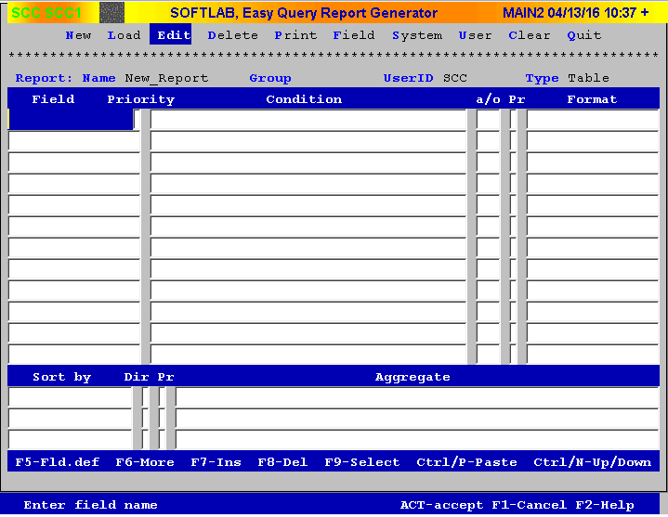
How to Edit a new report …Continued

Slide 18
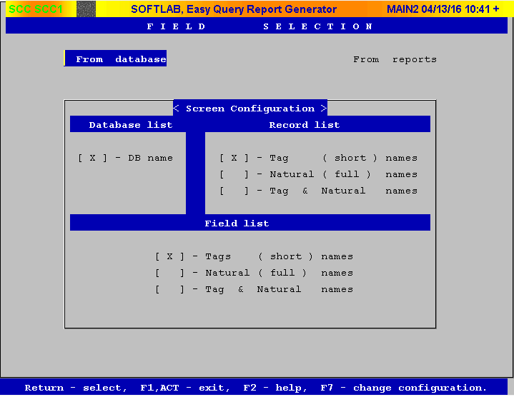
How to Edit a new report …Continued

Slide 19
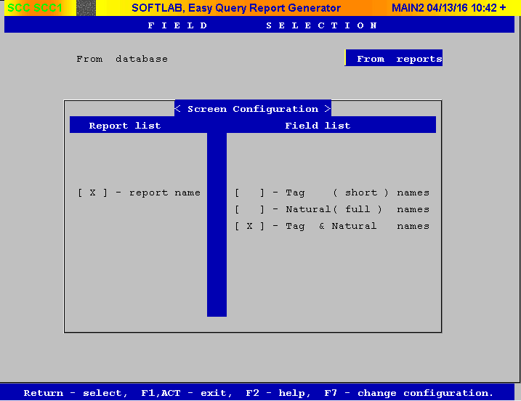
How to Edit a new report…Continued

Slide 20
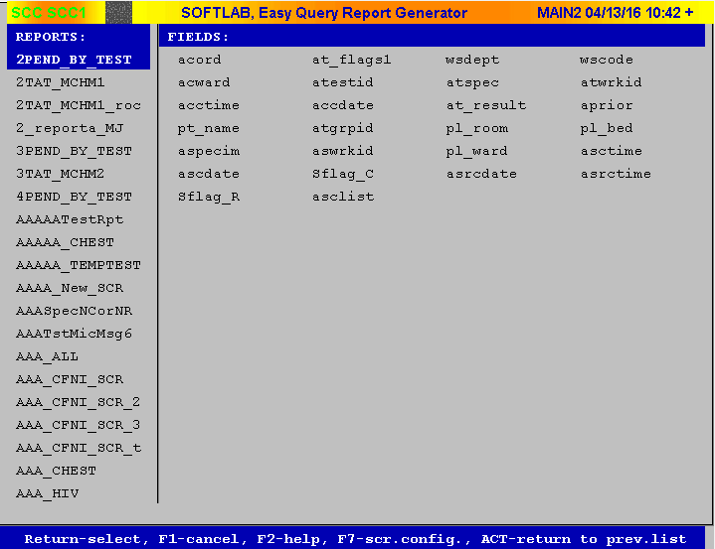
How to Edit a new report…Continued

Slide 21
How to Edit a new report…Continued

Slide 22
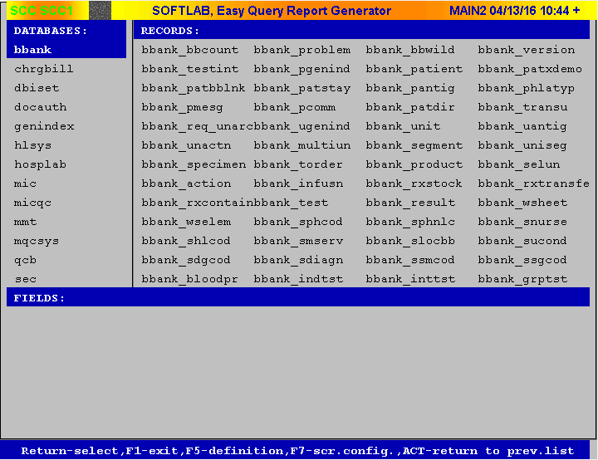
How to Edit a new report…Continued

Slide 23
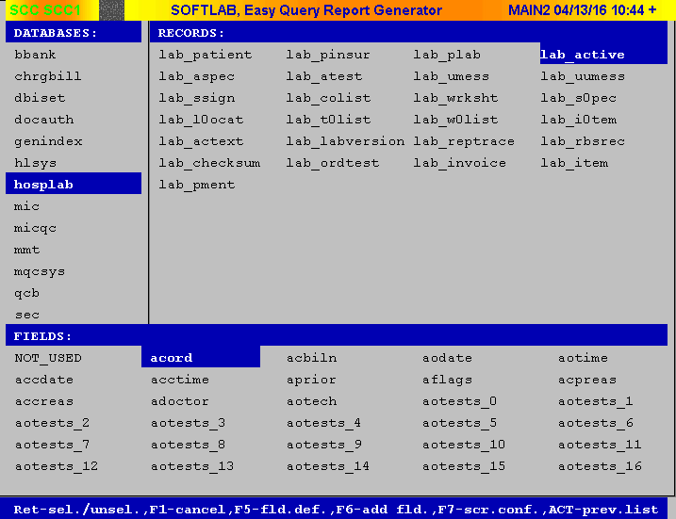
How to Edit a new report…Continued

Slide 24
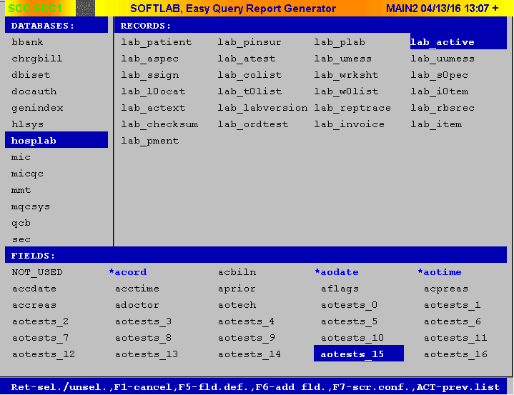
How to Edit a new report…Continued

Slide 25
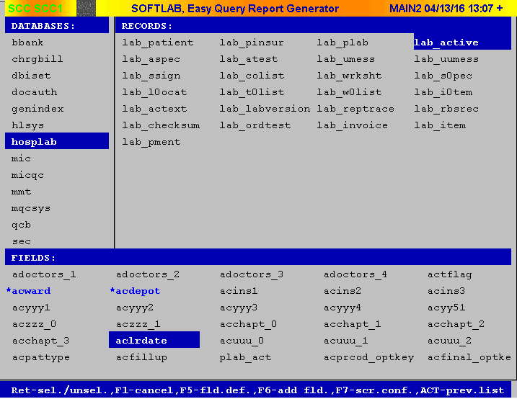
How to Edit a new report…Continued

Slide 26
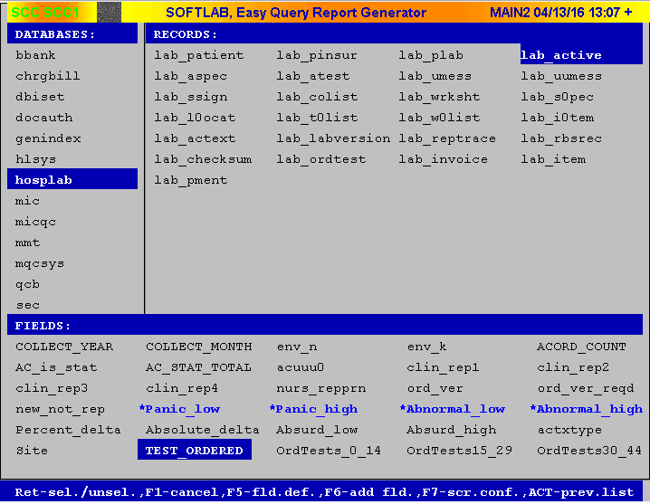
How to Edit a new report…Continued

Slide 27
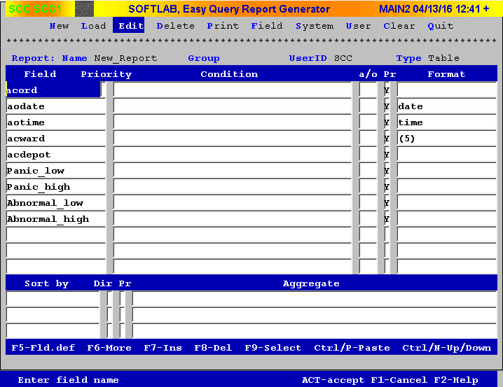
How to Edit a new report…Continued

Slide 28
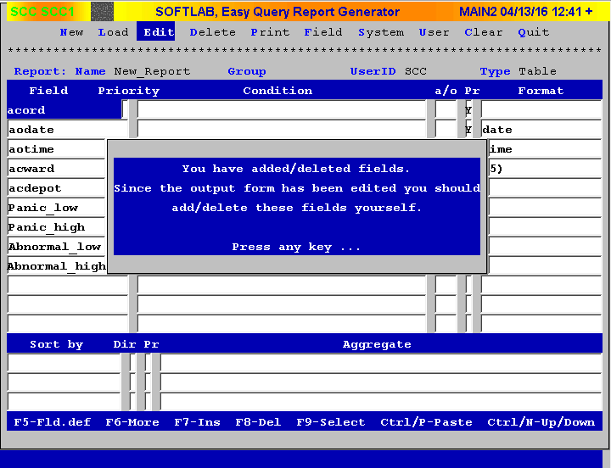
How to Edit a new report…Continued

Slide 29
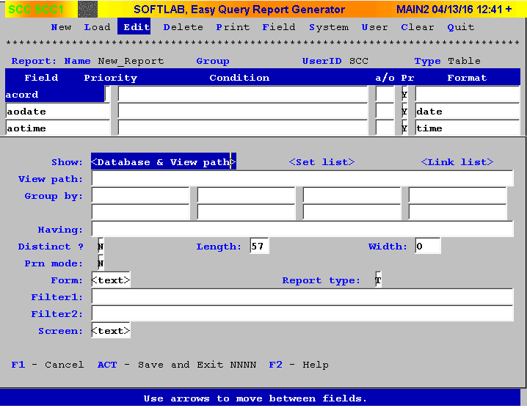
How to Edit a new report…Continued

Slide 30
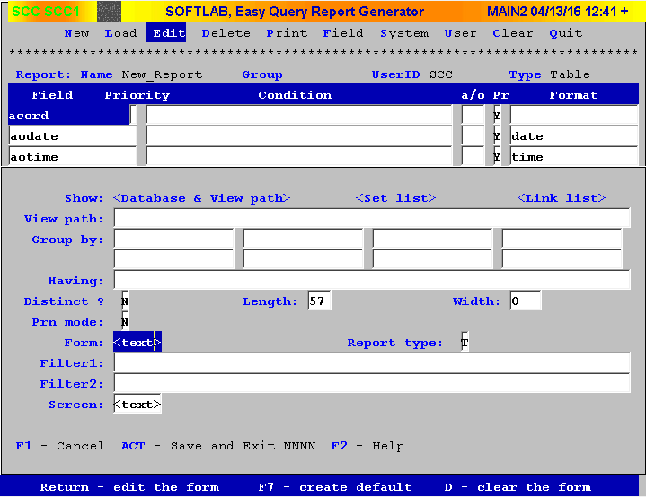
How to Edit a new report…Continued

Slide 31
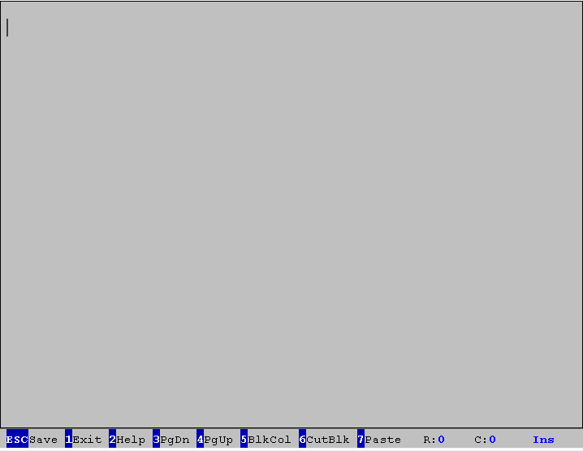
How to Edit a new report…Continued

Slide 32
How to Edit a new report…Continued

Slide 33
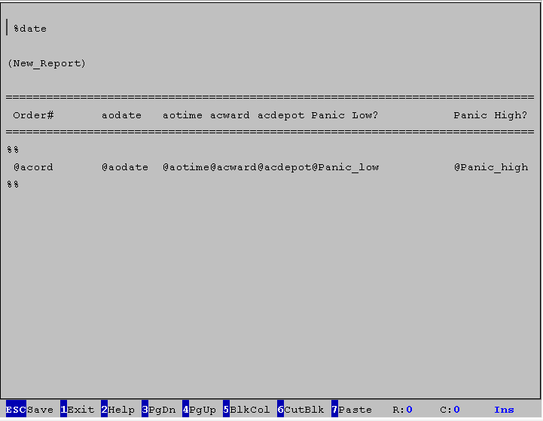
How to Edit a new report…Continued

Slide 34
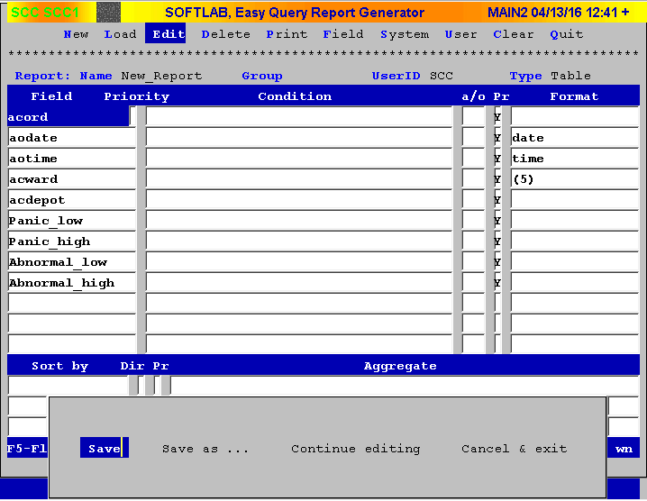
How to Edit a new report…Continued

Slide 35
How to Edit a new report…Continued
DON’T RUN IT YET!
At this point you have successfully edited the report. However,
Running a report like this could cause issues because there currently
Is no criteria for the query to search by, so it will attempt to pull all
The information that applies to your request. As you can imagine, the
Query could be working quite a long time to pull all your Order #’s,
and that will cause the query to hog all your systems resources.
So lets add some CRITERIA and PARAMETERS to search by!

Slide 36
How to add Criteria and Parameters…

Slide 37
How to add Criteria and Parameters
In order to add criteria and parameters we will first need to evaluate how we are building this report. We are going to setup a report that will gather information based on a specific Order Range. So what we need now is the ability to search based on a desired Order Range.
Lets start by adding in another acord field (acord = order ID)
To do this we will go into Edit mode and make sure the first field is highlighted
Then using the menu items at the bottom we will use F7 (F7 = Ins)
This will create a blank field between your other fields
Then type in acord and use the -> arrow key or press Enter to accept it
Now that we have two acord fields, navigate to the first Condition row using your keyboard
We will now begin adding conditions and parameters to the report

Slide 38
How to add Criteria and Parameters
Begin typing “ >= [ORDSFROM] “ for the first acord row
Next press Enter and your cursor will appear under the a/o column
Right now we have one condition however it is not a complete range so we will want to add a second condition so we can accurately look for information in a specific range.
In the a/o column type “ and “ and then press Enter four times
You should now be the Condition of the second acord row
Begin typing “ <= [ORDSTOTO] “ for the first acord row
You have just created a standard Between statement that allows the user to run a report to get information between an order range

Slide 39
How to add Criteria and Parameters
Attempt to SAVE! Press F12 to save
A blue screen should appear that lets you know that you have added/deleted fields and that the Form should be edited to match the changes
Editing the default Screen
In edit mode, Press F6
This screen allows you to edit the View Path, the Form, and the Screen
Navigate down to Screen
Press Enter to view the current Screen
Notice how it only displays the report name
Back out with F1
Press F7 to Create Default Screen
Press Enter to view the updated Screen
Notice how it now shows all your parameters in the order that you have them on the report
Press F12 two times to save the edits and return to the edit screen
Now SAVE! Press F12 to save
If you successfully saved, EQ has taken you out of Edit mode

Slide 40
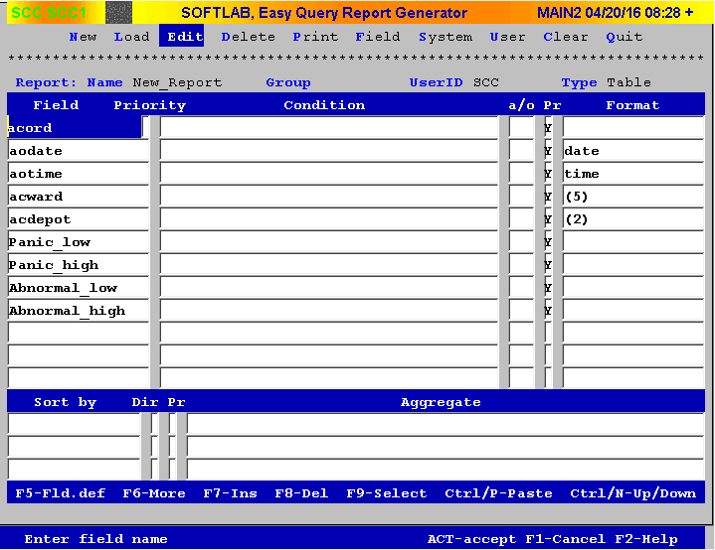
How to add Criteria and Parameters

Slide 41
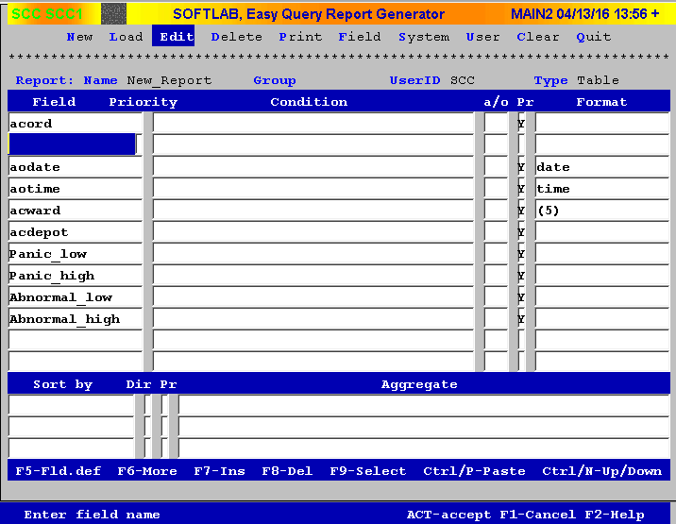
How to add Criteria and Parameters

Slide 42
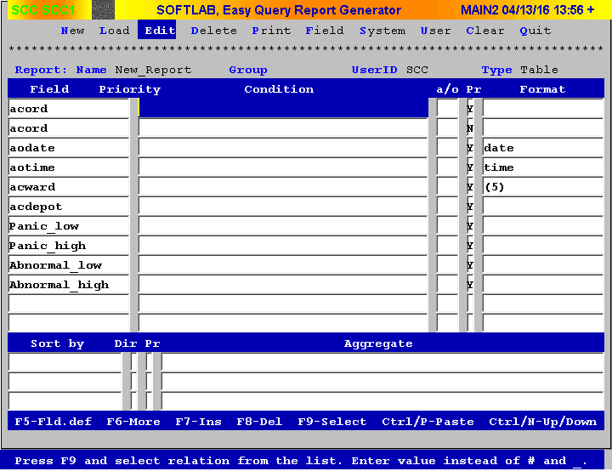
How to add Criteria and Parameters

Slide 43
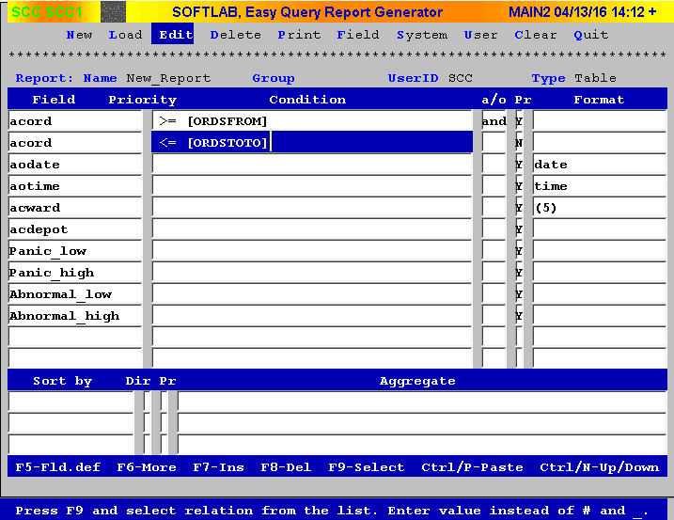
How to add Criteria and Parameters

Slide 44
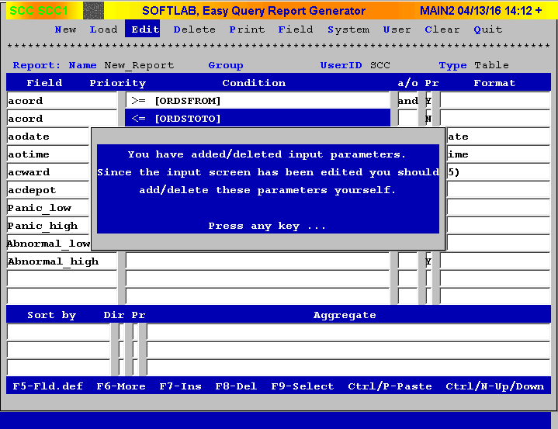
How to add Criteria and Parameters

Slide 45
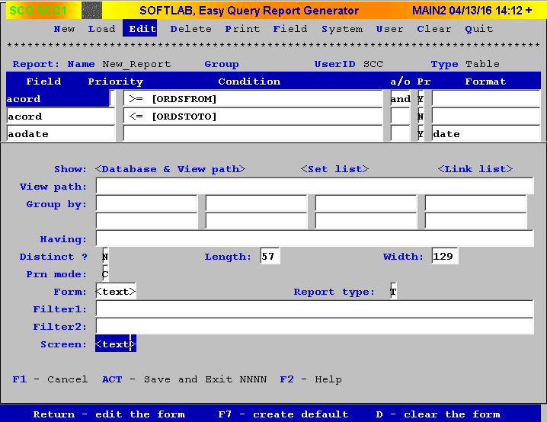
How to add Criteria and Parameters

Slide 46
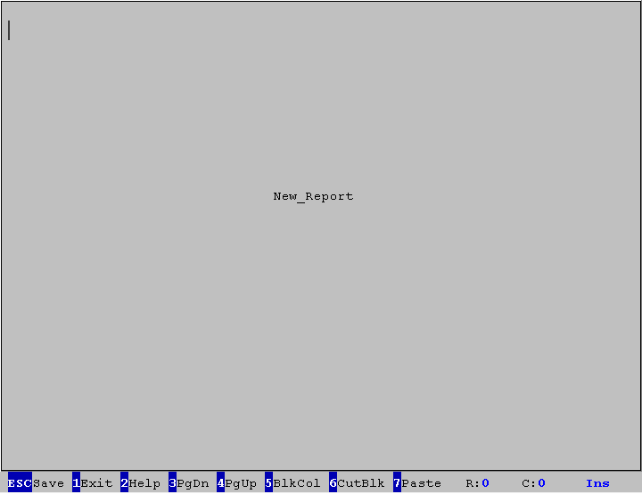
How to add Criteria and Parameters

Slide 47
How to add Criteria and Parameters

Slide 48
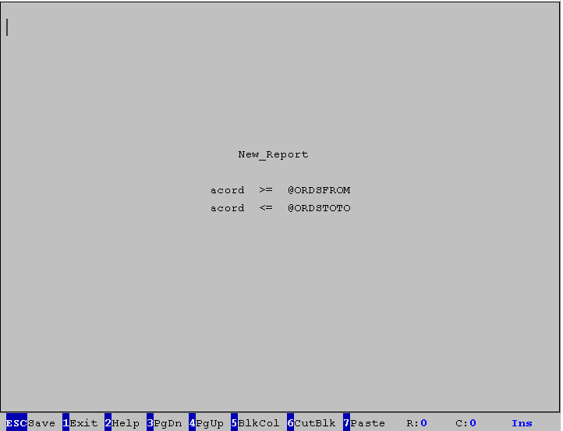
How to add Criteria and Parameters

Slide 49
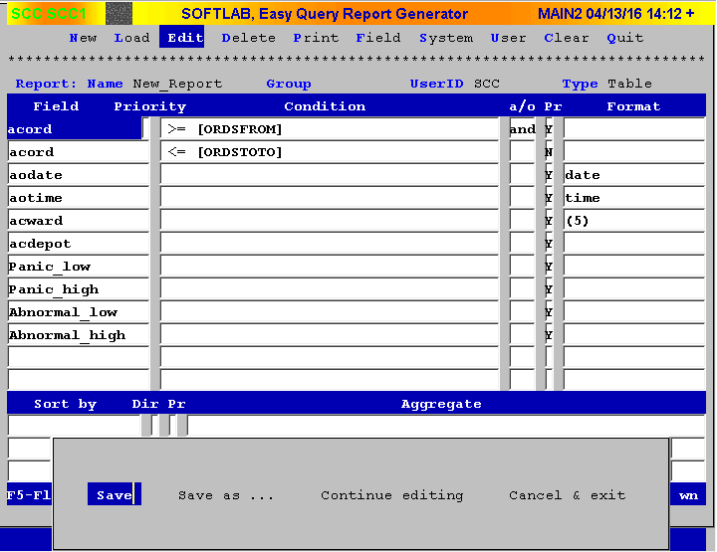
How to add Criteria and Parameters

Slide 50
How to Run and Print a report…

Slide 51
How to Run and Print a report
To run the report, press P or navigate to Print with the arrow keys on your keyboard
Press Enter, here you will see the parameter Screen and its where you will enter any search parameters or conditions the query will search by… in our example we will use an Order ID number range
After you have entered your desired Order ID range, press Enter
The report will run and return data (if data is available)
From here you can use the menu items at the bottom to Search for a specific order number or data, navigate through the report, and Print the report
All these options are available with the use of the hotkeys in blue

Slide 52
How to Run and Print a report
Press P to print this report
You can either select a printer available on the list or select Save, file to name your file to pull it up in lab later. You can use View Existing Reports to find it
In our example we will use Save, file and name the file April_04_13
Press Enter to accept the name and press Y for make this file permanent
Please note that this doesn’t actually make the file permanent, it will be erased like every other file after your major weekly restart
Now lets try to find our report in Lab using View Existing Reports
In LAB, open View Existing Reports and type in the name of your report and press Find
After the report is found, click View to open it and your done!

Slide 53
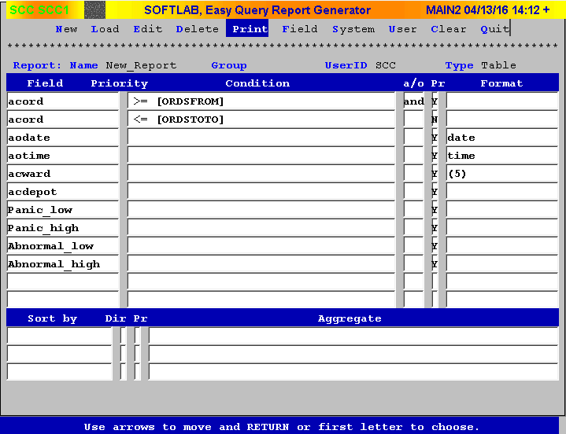
How to Run and Print a report…Continued

Slide 54
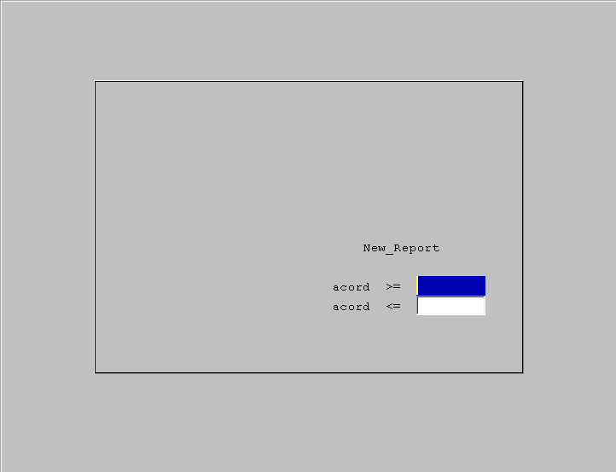
How to Run and Print a report…Continued

Slide 55
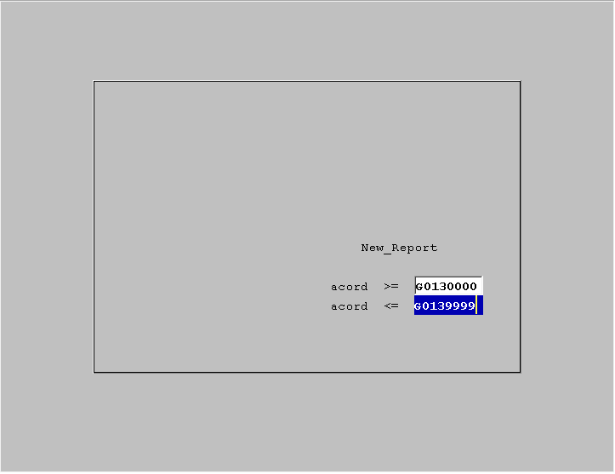
How to Run and Print a report…Continued

Slide 56
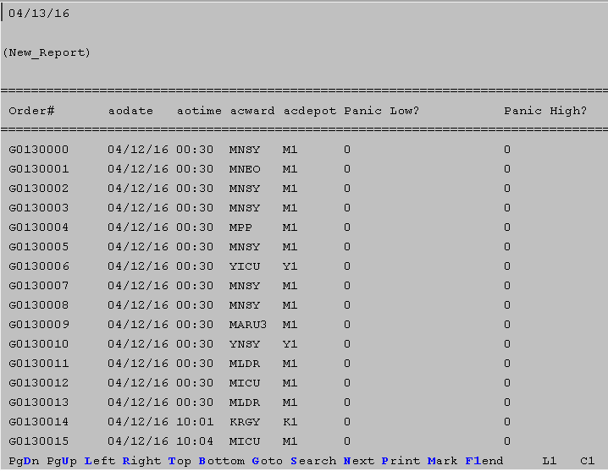
How to Run and Print a report…Continued

Slide 57
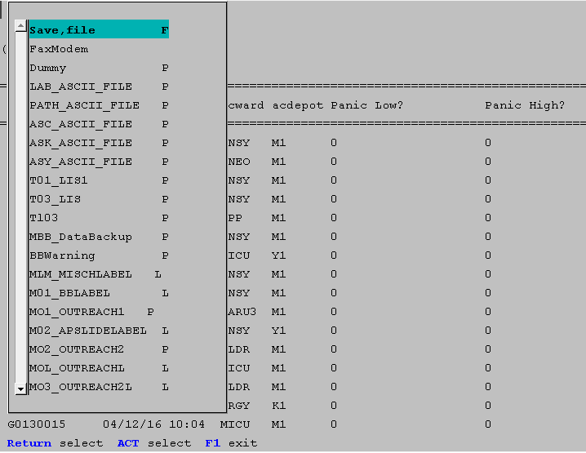
How to Run and Print a report…Continued

Slide 58
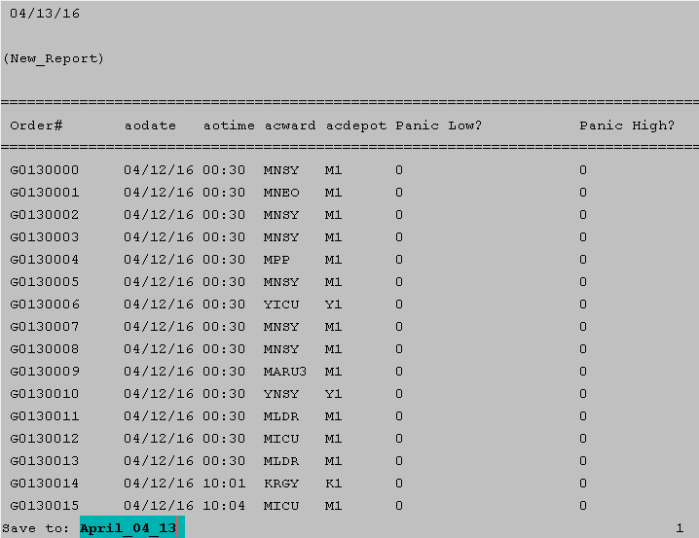
How to Run and Print a report…Continued

Slide 59
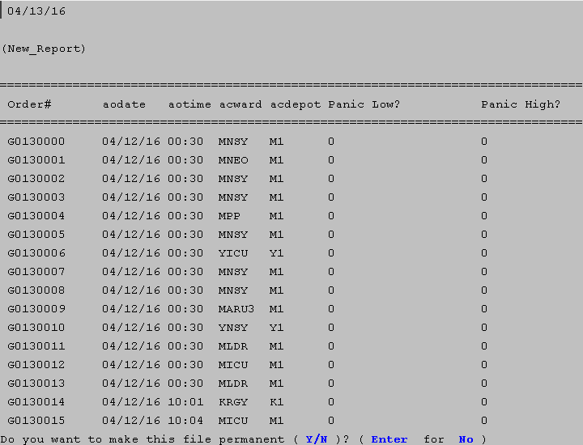
How to Run and Print a report…Continued

Slide 60
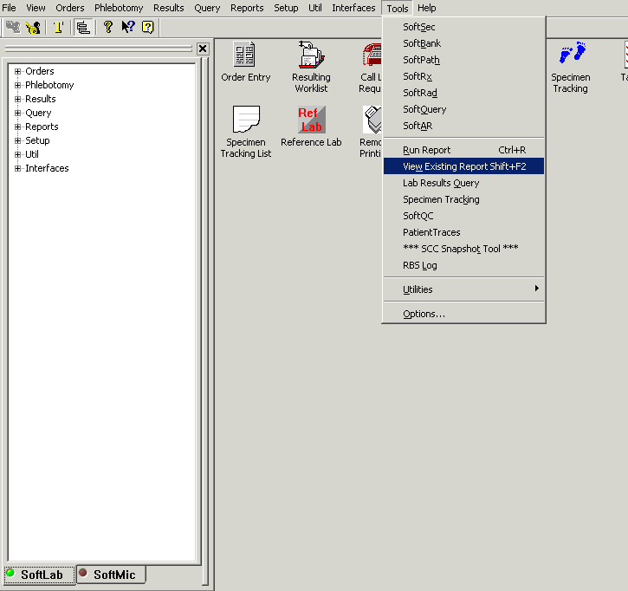
How to Run and Print a report…Continued

Slide 61
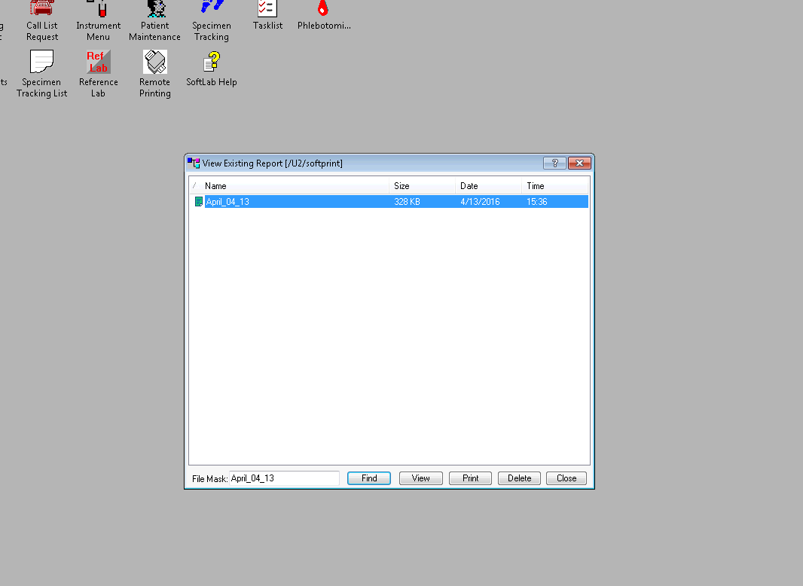
How to Run and Print a report…Continued

Slide 62
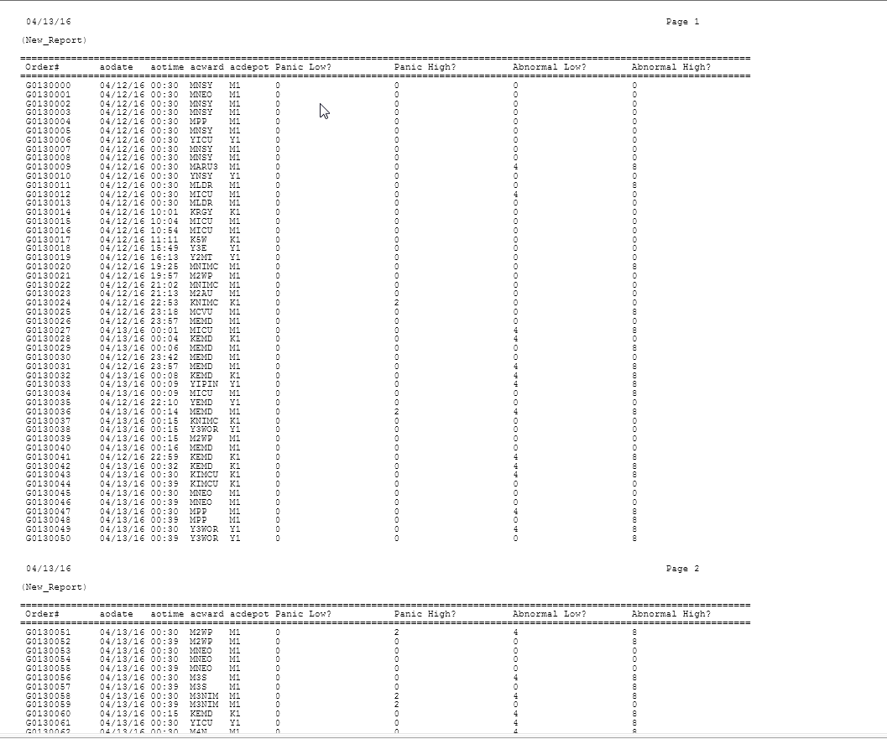
How to Run and Print a report…Continued

Slide 63
How to customize the Screen…

Slide 64
How to customize the Screen…
To customize the Screen, you must first be in Edit mode
Once in Edit mode, press F6 and navigate down to the Screen
Press Enter, and observe how you would like to change the display
All navigation is done with your arrow keys.
If you remember from running the report, the display is slightly off center. When modifying the Screen, you will need to adjust its position accordingly. This can be done by simply backspacing/deleting rows and spaces till the items are in the desired position. You can also change any of the text to display the exact wording of what you want.
The @ symbol is used for your parameters. When editing or adding new parameters, always make sure to use @ at the beginning of the parameter(s) and always type the parameter name exactly how you typed it on the report.

Slide 65
How to customize the Screen…Continued

Slide 66
How to customize the Screen…Continued

Slide 67
How to customize the Screen…Continued

Slide 68
How to customize the Screen…Continued

Slide 69
How to customize the Screen…Continued

Slide 70
How to customize the Screen…Continued

Slide 71
How to customize the Screen…Continued

Slide 72
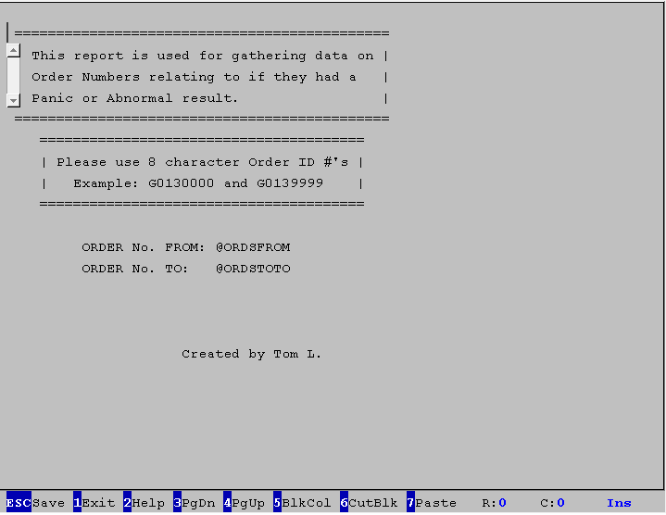
How to customize the Screen…Continued

Slide 73
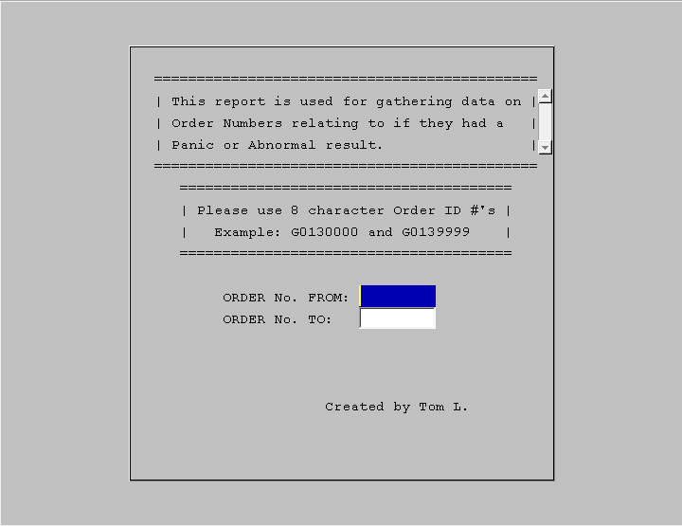
How to customize the Screen…Continued

Slide 74
How to customize the Form…

Slide 75
How to customize the Form…
To customize the Form, you must first be in Edit mode
Once in Edit mode, press F6 and navigate down to the Form
Press Enter, and observe how you would like to change the display
All navigation is done with your arrow keys.
When modifying the Form, you can adjust the position of headers, fields, and the detail sections. This can be done by simply backspacing/deleting rows and spaces till the items are in the desired position. You can also change any of the text to display the exact wording of what you want.
The @ symbol is used for your field details. When editing or adding new field(s), always make sure to use @ at the beginning of the field(s) and always type the field(s) name exactly how you typed it on the report.

Slide 76
How to customize the Form…Continued
While editing your Form you will notice that sometimes you want to squeeze all your fields into a small area. Sometimes the field names make that difficult because they are too long. Well there is a solution to this issue.
You can reference fields by their ordinal position (the order it is in on the report) instead of its name. For example acord is field # 1. So to display that on the report we will type it as such: @1
Ordinal positions skip duplicate fields like our acord #1 and acord #2
For our example, we will use the ordinal position of Panic_low, Panic_high, Abnormal_low and Abnormal_high due to their excessively long field name
Remember that Ordinal position ignores duplicate fields
Panic_low = @6, Panic_high = @7, Abnormal_low = @8 and Abnormal_high = @9
After your done with your changes, Always SAVE!

Slide 77
How to customize the Screen…Continued

Slide 78
How to Edit a new report…Continued

Slide 79
How to customize the Form…Continued

Slide 80
How to customize the Form…Continued

Slide 81
How to customize the Form…Continued

Slide 82
How to customize the Form…Continued
Ordinal Position #1
No Ordinal Position
Because it’s a duplicate
Ordinal Position #6 even though its actual position is #7, this is because of the duplicate acord

Slide 83
How to Edit a new report…Continued

Slide 84
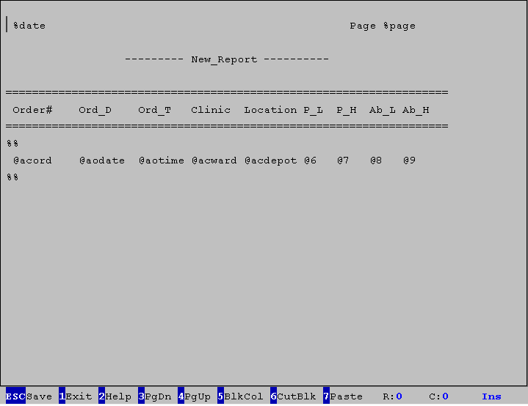
How to customize the Form…Continued

Slide 85
How to customize the Form…Continued

Slide 86
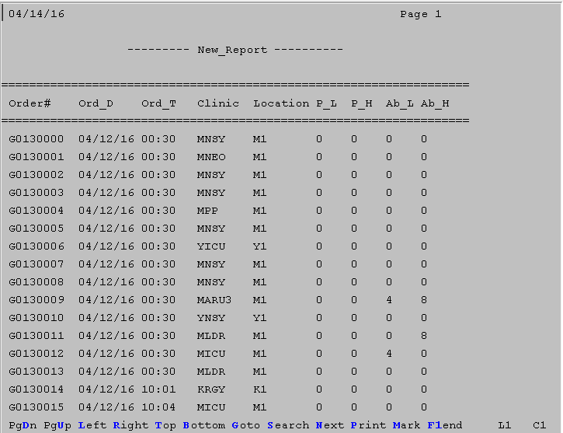
How to customize the Form…Continued

Slide 87
How to export to Excel...

Slide 88
How to export to Excel...
To export an EQ report to excel, there are a few steps to take first to prepare your EQ to be exportable.
The first thing you need to do is follow the steps to customize the Output Form as this requires us to remove all excess headers and leave the Output Form with just the initial headers and the fields.
Next you will need to add a delimiters at the end of every field but with enough space that the entire field will display. Generally you put the delimiters at the end of the NEXT field to give the space needed.
Delimiters can be commas, semicolons, periods, however I generally use semicolons.
After that you need to save the reports updates and follow the Run/Print steps and SAVE the file to be viewable in LAB.
Once in LAB, use view existing report to view the report and then proceed to click, File > Export to Excel.
Next set the delimiter to use your specific delimiter(s) and then click Export.

Slide 89
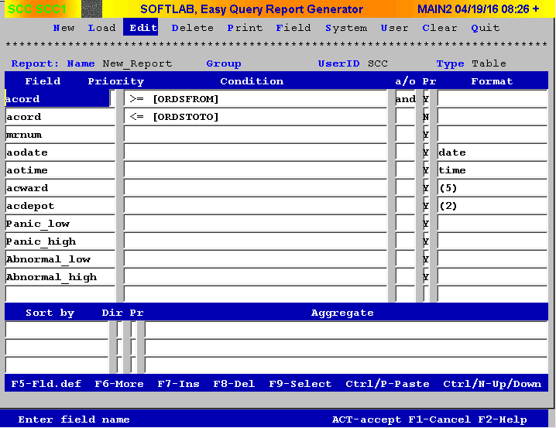
How to export to Excel...Continued

Slide 90
How to Edit a new report…Continued

Slide 91
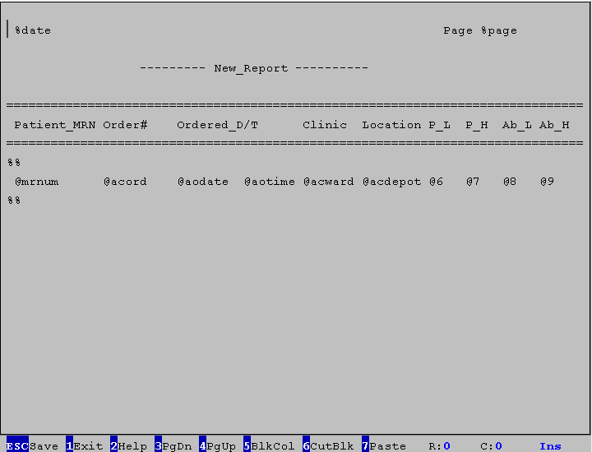
How to export to Excel...Continued

Slide 92

How to export to Excel...Continued

Slide 93
How to customize the Form…Continued

Slide 94
How to customize the Screen…Continued

Slide 95
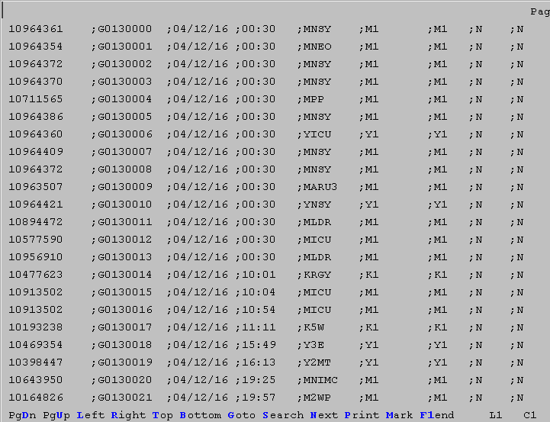
How to export to Excel...Continued

Slide 96
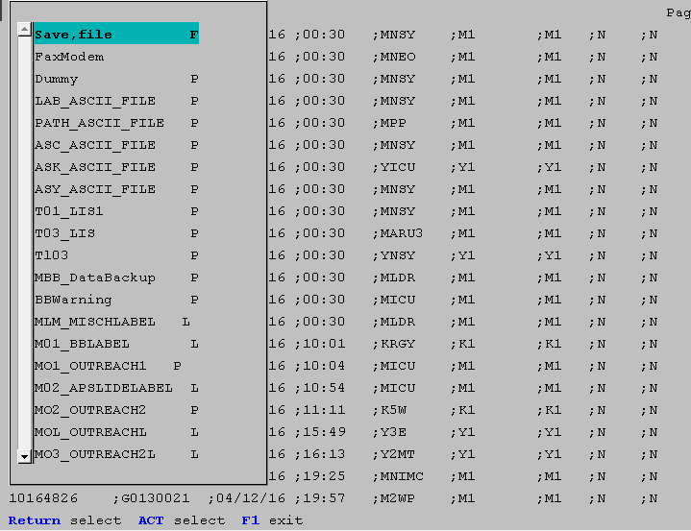
How to export to Excel...Continued

Slide 97

How to export to Excel...Continued

Slide 98
How to Run and Print a report…Continued

Slide 99
How to export to Excel...Continued

Slide 100
Common Issues/Errors You might encounter..

Slide 101
Common Issues/Errors
When receiving an error “SQL command not properly ended,” this usually means that a condition operator is missing such as ‘And’, ‘Or’ and ‘Con’ or that your missing a beginning or end ( )
To correct an issue like this, first identify the potential location(s) of where the error is and then simple correct it and re-save the report.
The next five screenshots represent this issue and how to identify and correct it.

Slide 102

Common Issues/Errors

Slide 103

Common Issues/Errors
Missing ‘and’

Slide 104

Common Issues/Errors

Slide 105

Common Issues/Errors

Slide 106

Common Issues/Errors

Slide 107
Common Issues/Errors
When receiving an error “table or view does not exist,” this usually means that the view path needs to be updated, or the database needs to be added for one of fields being used, or the database needs to be converted from DBVista to Oracle.
To correct an issue like this, put in a support task and make sure the product is RPT (NOT LAB) and mention the error as well as the fact that you are using EQ (EQ, Easy Query, etc..)

Slide 108

Common Issues/Errors

Slide 109
Common Issues/Errors
When receiving an error “invalid identifier,” this usually means that the field being used does not exist in the database or it’s a custom field that a user created that is not referencing a proper field.
To correct an issue like this, you can either put in a support task and send it to N/REPORTS and mention the error as well as the fact that you are using EQ (EQ, Easy Query, etc..) or investigate the field on your report and check what field is being referenced, if any, and then identify if this field is still in the database by using the Field menu option outside of Edit mode.

Slide 110

Common Issues/Errors

Slide 111

Common Issues/Errors

Slide 112

Common Issues/Errors

Slide 113
Any Questions?

Slide 114
Common EQ Hotkeys
Universal Hotkeys
When in Edit mode in EQ
F1 – Cancel Action or to go back to the previous screen
F12 – Save Action or Save Changes and navigate back to previous pages
Field Details – F5
Report Details (More) – F6
F8 – Delete Field
F9 – Select Field from DB
Ctrl/N – Navigate between the fields section and Aggregate section

