Slide 1
SoftBank Version 25.5
New Features
Presented By:
Laurie Sapp
Blood Services Product Analyst

Slide 2
Software innovation, like almost every other kind of innovation, requires the ability to collaborate and share ideas with other people, and to sit down and talk with customers and get their feedback and understand their needs.
~Bill Gates

Slide 3
SoftBank Version 25.5 New Features
Describe some of the new features available
Benefits of the new features
Consider features for upgrade

Slide 4
Expired QC Exception

Slide 5
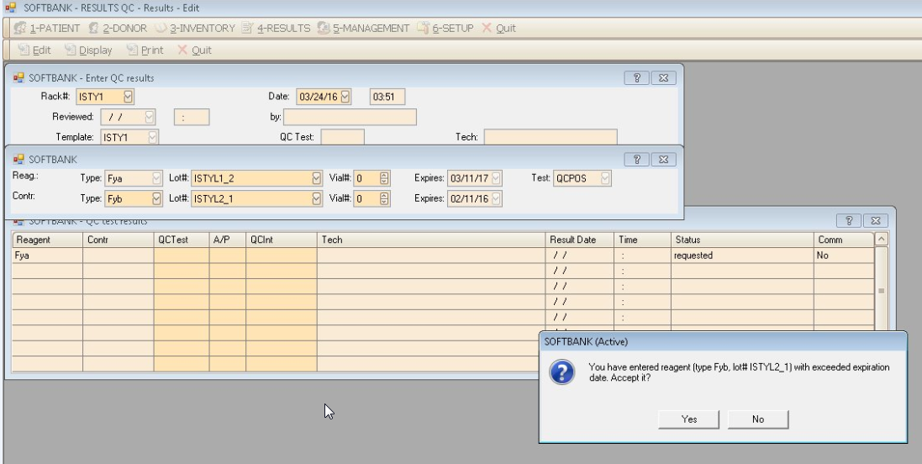
Expired QC Reagent-Exception

Slide 6
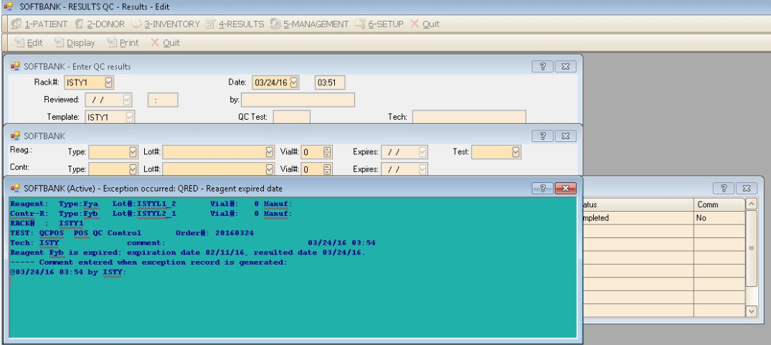
Expired QC Reagent-Exception
The system can be setup to generate an exception for supervisor review when expired QC reagents are used.
Notes:
Based on parameter: hos_QCResReagExp

Slide 7
Unit Expiration Date-Issue confirmation screen.

Slide 8
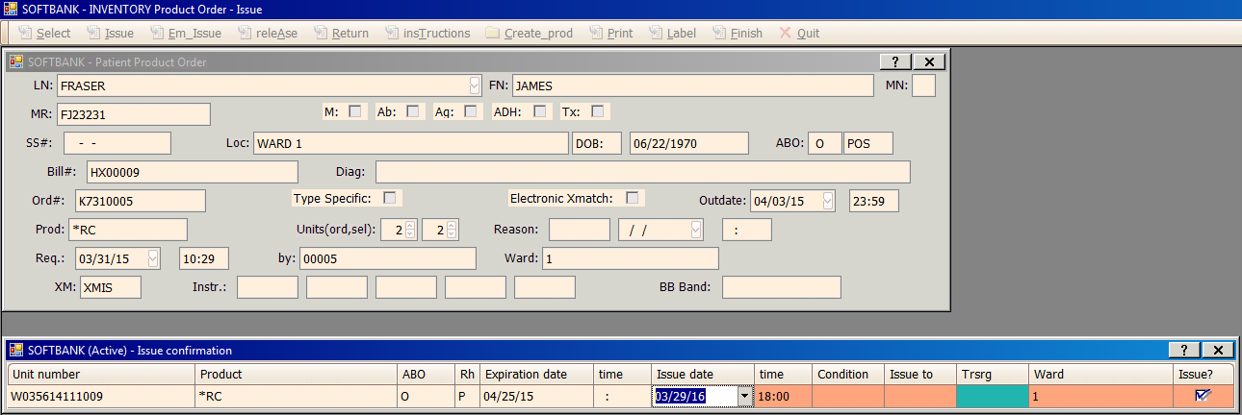
Unit Expiration Date-Issue/Emergency Issue
Notes:
Product Orders Service>Issue and Emergency Issue- The unit expiration date can be displayed instead of the Product Name based on parameter setting hos_IssConfirmdispExp

Slide 9
Patient>Transfusion Options-Unit ABO/Rh

Slide 10
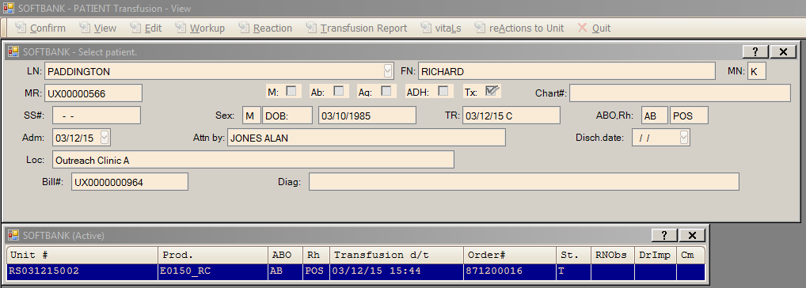
Unit ABO/Rh
Notes:
Unit ABO/Rh added in Patient>Transfusion options, Patient>Display>Transfusion, and Inventory>Product Orders Service>Presumed Transfused

Slide 11
ABO/Rh Phase Report

Slide 12
ABO/Rh Phase Report
New report added , Control +D
Parameter driven
Adds the ability to see if ABO/Rh phases are increases or decreasing in strength.

Slide 13
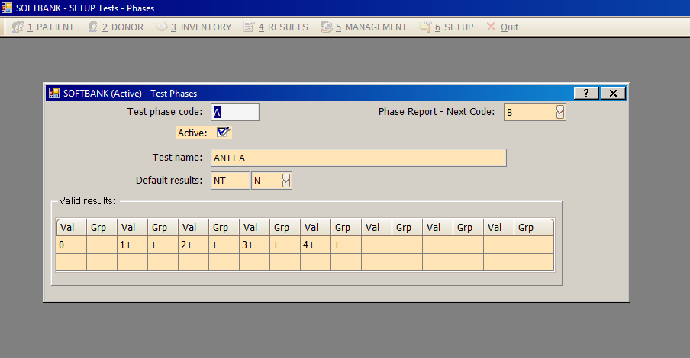
Setup>Test>Test Phase
Notes:
New parameter-hos_ABORh_phasereport set to “Y” for phase report

Slide 14
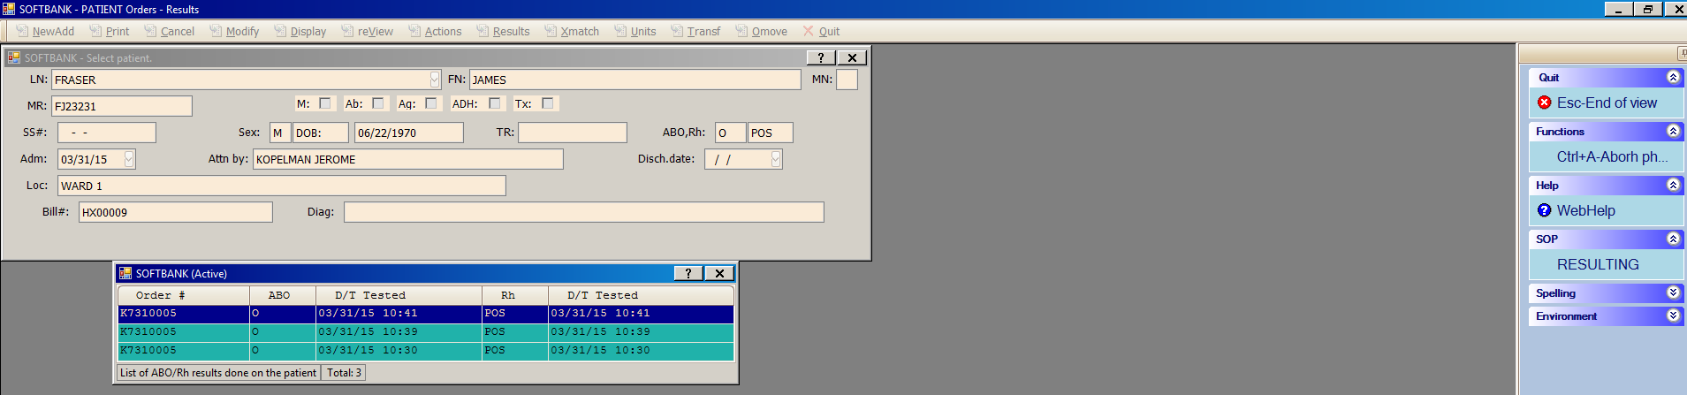
Control+D, New function key

Slide 15
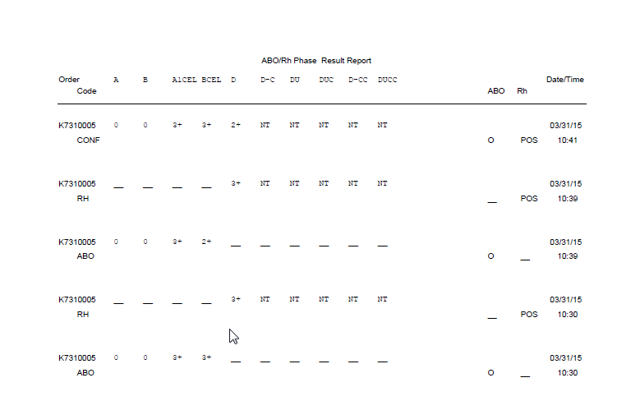
ABO/Rh Phase Report

Slide 16
Result Reporting-New elements for transfusion administration

Slide 17
Transfusion Administration Elements
The following information can be sent to HIS using result reporting:
Unit Expiration
Transfused Volume
Transfusion Start Time
Transfusion Stop Time

Slide 18
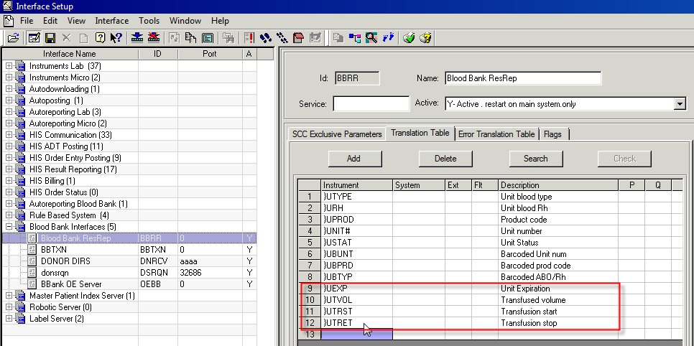
Interface Setup-BBRR
Resulting Reporting with Lab 4.5-the transfusion administration elements are configured by the programming team.

Slide 19
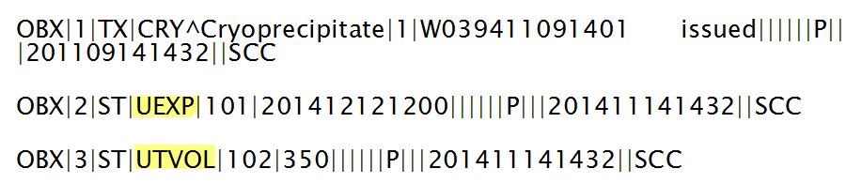
Interface Trace Example
Trace example from Blood Bank Result Reporting (BBRR)

Slide 20
Result Reporting-Electronic Crossmatch Eligibility

Slide 21
Electronic Crossmatch Eligibility
New feature-send Electronic Crossmatch eligibility to HIS
Provides physicians and nursing staff information that the patient is eligible for electronic crossmatch, red cell product can be made available quickly.

Slide 22
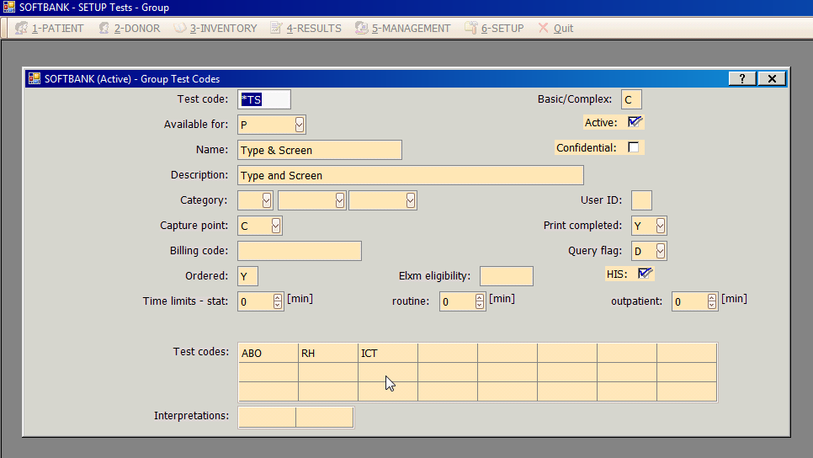
Setup>Tests>Group Tests
New field added to define the tests to determine eligibility
Can be defined for basic or complex tests
Five character unique code can be entered in the Elxm Eligibility field

Slide 23
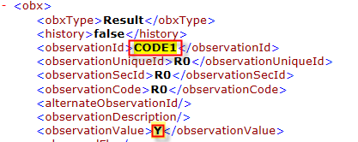
Result Reporting
CODE1 was defined as the Elxm eligibility code.
Note: This feature is available using new result reporting in Lab 4.5

Slide 24
Phase results and electronic crossmatch

Slide 25
Phase results and electronic crossmatch
When typing discrepancies exist such as mixed field results, this new functionality will automatically prevent electronic crossmatch.
The FDA Guidance for Electronic Crossmatch mentions that mixed field reactivity, missing results, or change in blood type compatibility testing should be performed with serological crossmatch methods.
Setup and parameter driven

Slide 26
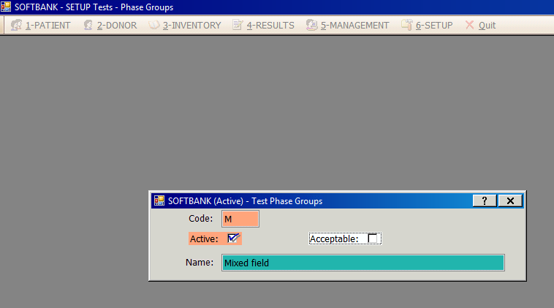
Setup>Tests>Test Phase Groups
New field-Acceptable Flag
Determines if this phase result is acceptable for electronic crossmatch.

Slide 27
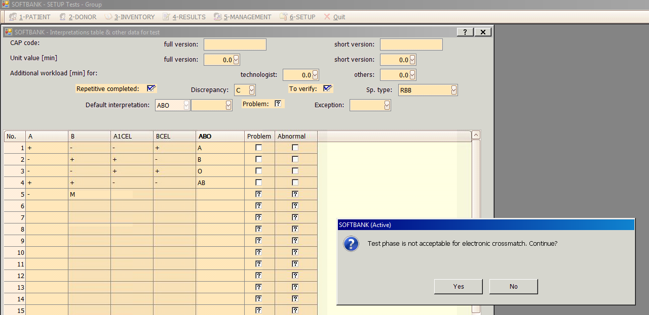
Setup>Tests>Group
When entering a phase that is not acceptable for electronic crossmatch on the interpretation table the system displays a warning.

Slide 28
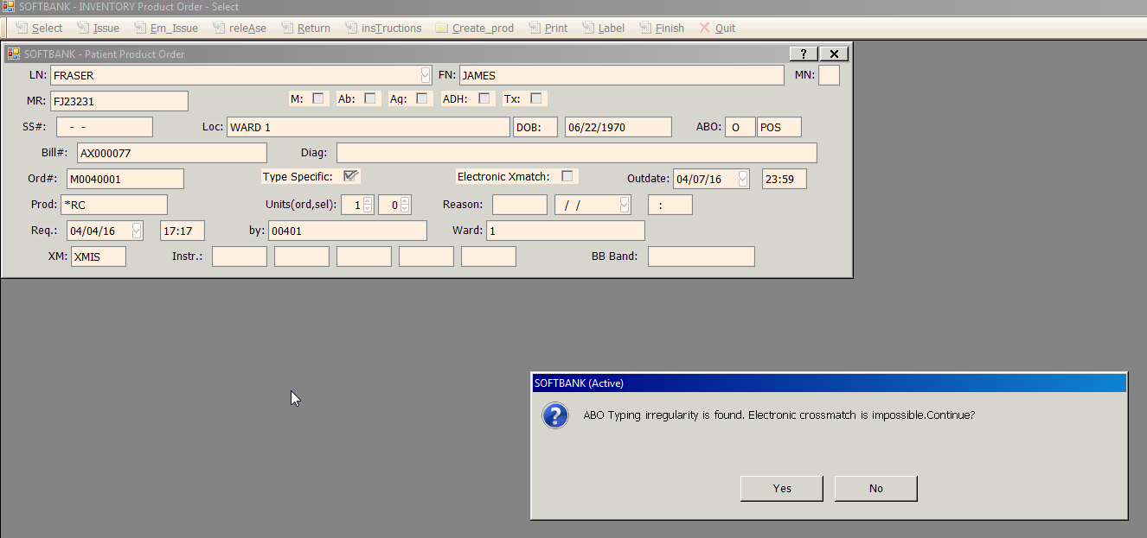
Inventory>Product Orders Service>Select
In Inventory>Product Orders Service>Select the system displays a warning letting the user know why the patient/order does not qualify for electronic crossmatch.
Notes:
New parameter-hos_Tpacceptelxm determines if this functionality is used.

Slide 29
Site Specific Reagents

Slide 30
Site Specific Reagents
Ability to define reagents per site
Adds flexibility for multi-site facilities
New feature is setup driven

Slide 31
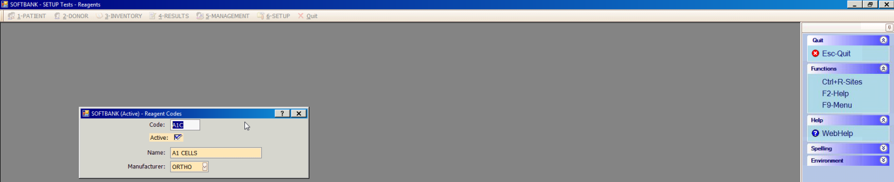
Setup>Tests>Reagents
Setup>Tests>Reagents to define site for selected reagents
Ctrl+R Sites -new function key

Slide 32
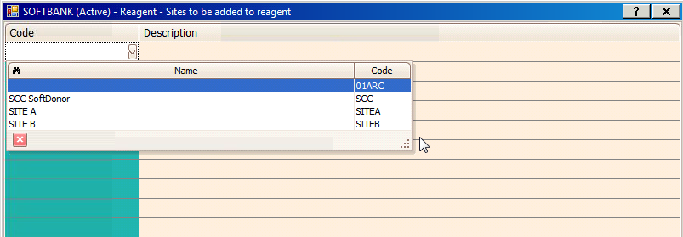
Setup>Tests>Reagents
Drop down displayed to select site

Slide 33
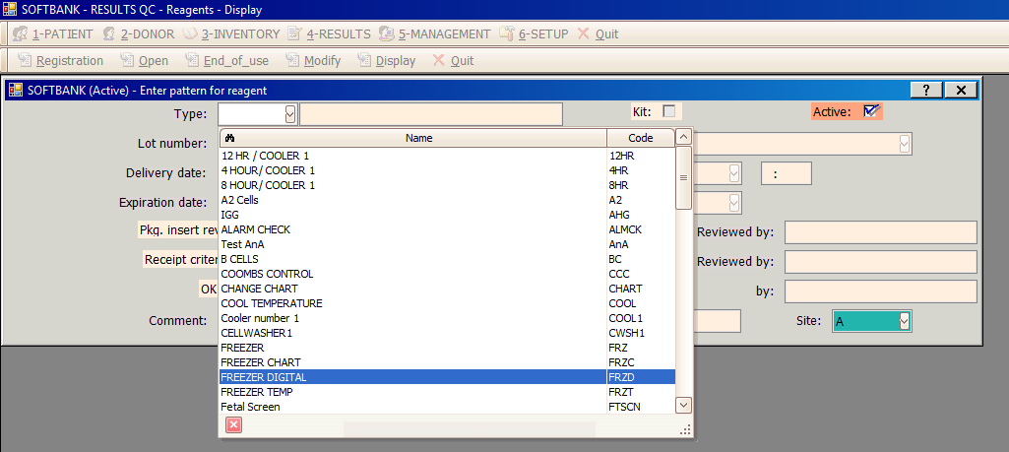
Quality Control>Reagents>Display
A1c is not displayed in the drop down list, defined in Setup for Site B.
Notes:
Paramater hos_InvSite needs to be set.

Slide 34
Site Specific Tests

Slide 35
Site Specific Tests
Ability to define patient tests per site
Adds flexibility for multi-site facilities
New feature is driven by test/workstation setup in SoftLab

Slide 36
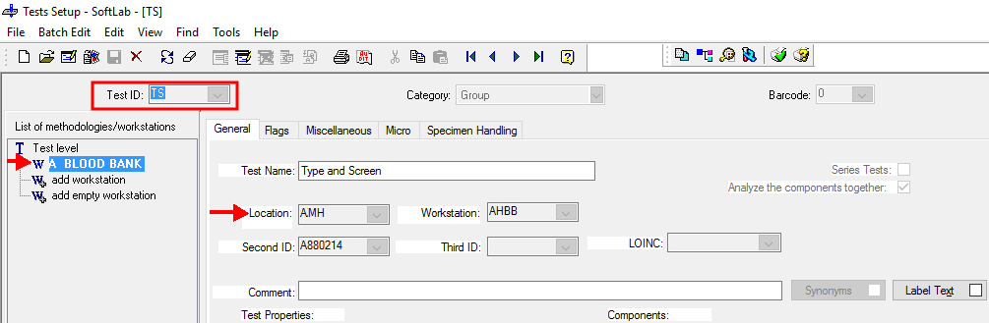
Test Setup in SoftLab (Site A)
Test setup in SoftLab-TS test for Site A

Slide 37
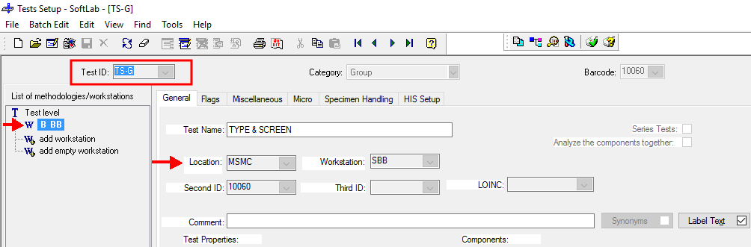
Test Setup in SoftLab (Site B)
Test setup in SoftLab-TS-G test for Site B

Slide 38
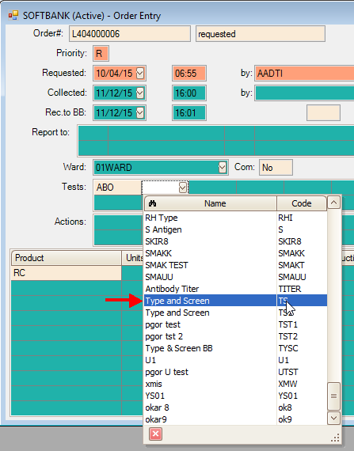
Order Entry (Site A)
Only the Type and Screen test (TS) defined for Site A displays in the drop drown list of tests

Slide 39
Questions?

Slide 40
Software is a great combination between artistry and engineering.
~Bill Gates

Slide 41


