Slide 1
SoftID the Collection Choice of Champions
Michelle Musgrove MT, CSP SoftLab/SoftID Implementation Specialist
michelmu@softcomputer.com

Slide 2
SCC Soft Computer: SoftID Positive Patient Identification Module
SCC Soft Computer's SoftID.NET provides enhanced functionality as a bi-directional solution in specimen collection; data is transmitted both to and from SoftID. Collection lists are downloaded directly to SoftID and used to print collection labels at the patient’s bedside after the patient is positively identified. The enduser draws the specimen (s), scans tubes with bar-coded labels, submits collecction and all collection information is transferred back to the LIS instantly.
Security Management adds the creation of SoftID user profiles and Administrator roles, to better manage the information, collection, and management process. Profiles and administrator roles can help tailor system features to workflow changes related to morning, afternoon, and night phlebotomy collections.
SoftID .PC is designed to support hospitals using COWS (computer on wheels) WOWS (workstation on wheels) or tablet PCs, SoftID.PC runs on PCs or laptops using Microsoft® Windows
SoftID.NET is designed to function with mobile HW such as MC55, MC40 Android and iOS PDA’s bonded with zebra mobile printers QLn220, QLn320 and QLn420 printers.

Slide 3

2016 National Patient Safety Goals
Goal #1: Improve the accuracy of patient identification
NPSG.01.01.01: Use at least two patient identifiers when providing care, treatment and services.
NPSG.01.03.01: Eliminate transfusion errors related to patient misidentification
Applies to: Ambulatory, Behavioral Health Care, Critical Access Hospital, Home Care, Hospital, Laboratory, Nursing Care Center, Office-Based Surgery

Slide 4

2016 National Patient Safety Goals continued
Goal #2: Improve the effectiveness of communication among caregivers.
NPSG.02.03.01: Report critical results of tests and diagnostic procedures on a timely basis.
Applies to: Critical Access Hospital, Hospital, Laboratory

Slide 5

2016 National Patient Safety Goals continued
The National Patient Safety Goals for each program and more information are available on The Joint Commission website at www.jointcommission.org
Questions can be sent to the Standards Interpretation Group at 630-792-5900 or via the Standards Online Question Form

Slide 6

Picking Your Team and adding them to Security Management
Team Leads-Builders
Super Users
End Users
Game Plan

Slide 7
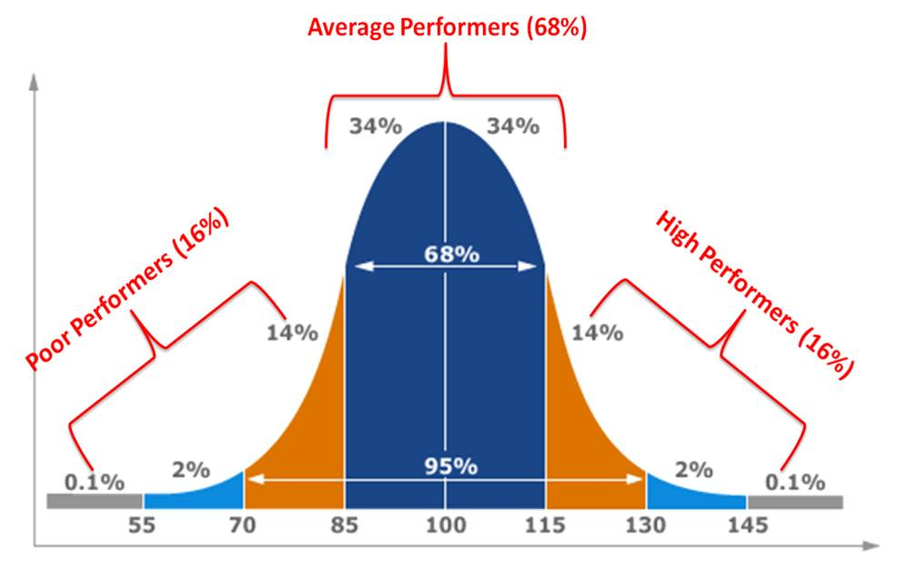
Prisoners*Passengers*Pioneers

Slide 8

Team Leaders* Pioneers

Slide 9


Passengers: Will follow the practice set

Slide 10



Prisoners will resist the new process

Slide 11
Do I have what it takes to try out for Auto Creation of Users?
Security Management
Minimum Version:
Sec. Management 1.0.0.10 with HF 15277 and CSF 1.0.1.31
SoftID
Minimum version:
2.6.0.4.18

Slide 12
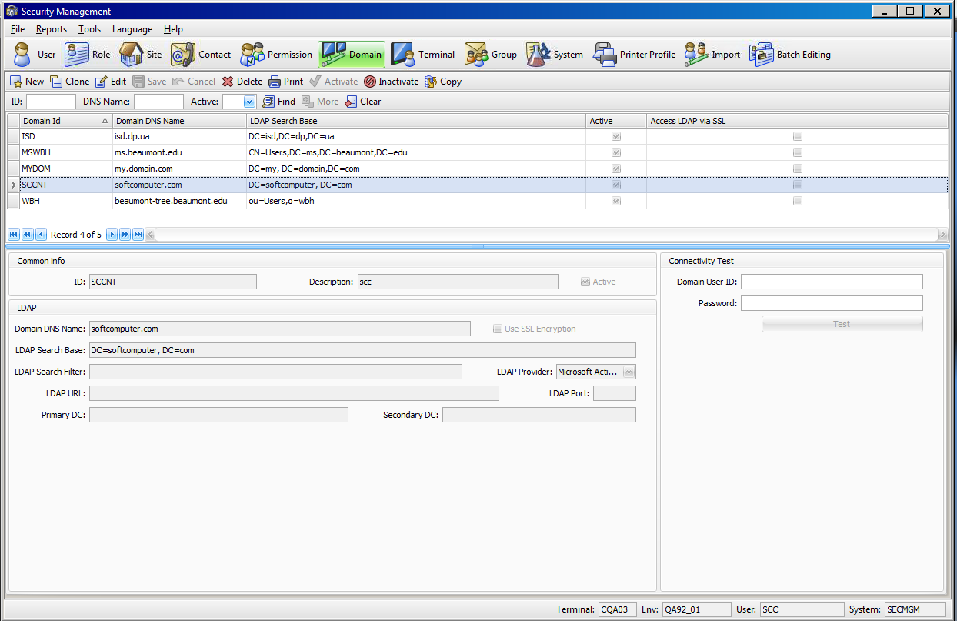
Security Management Define the domain(s) in Security Management

Slide 13
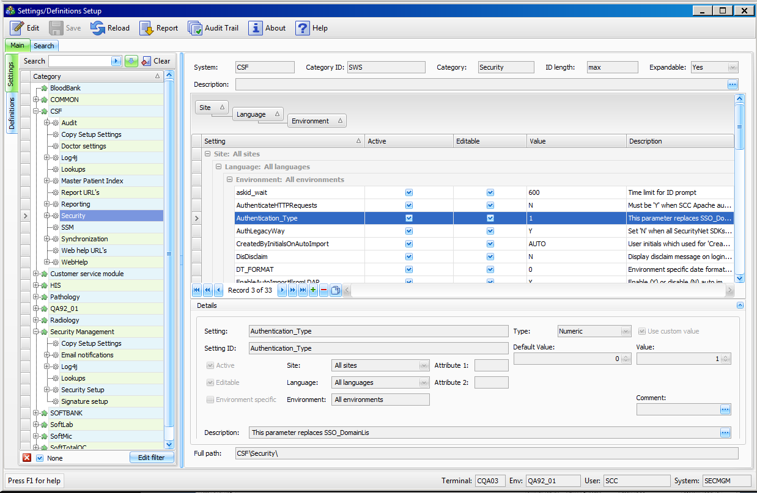
SoftLab SSM Set Authentication Type “1” (Hospraram for SCC to set)

Slide 14
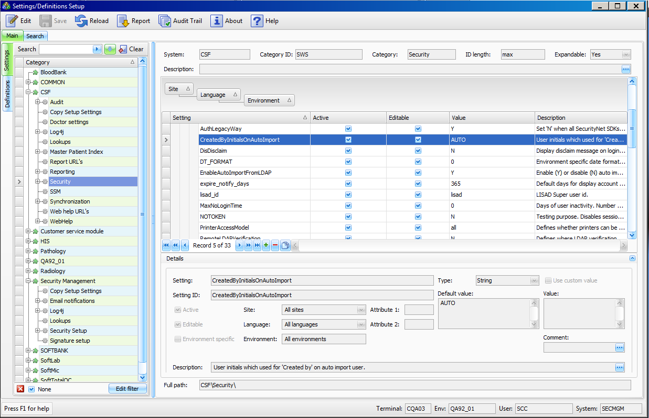
SSM: Created by Initials on AutoImport

Slide 15
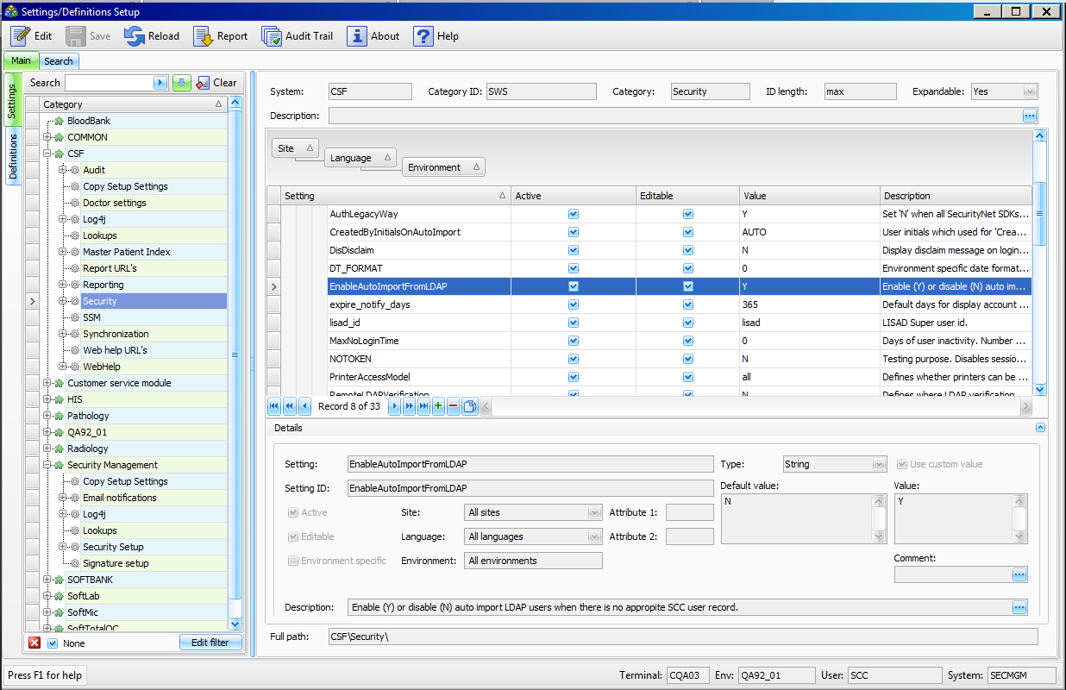
SSM: Enable AutoImport from LDAP

Slide 16
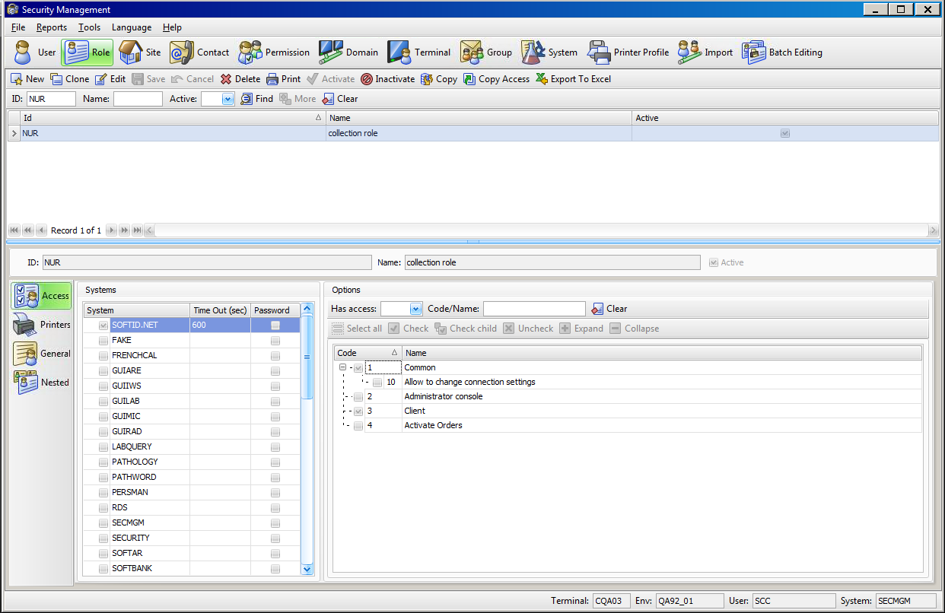
Create a role in Security Management which contains the SoftID system
A role with access to SoftID should be created.

Slide 17
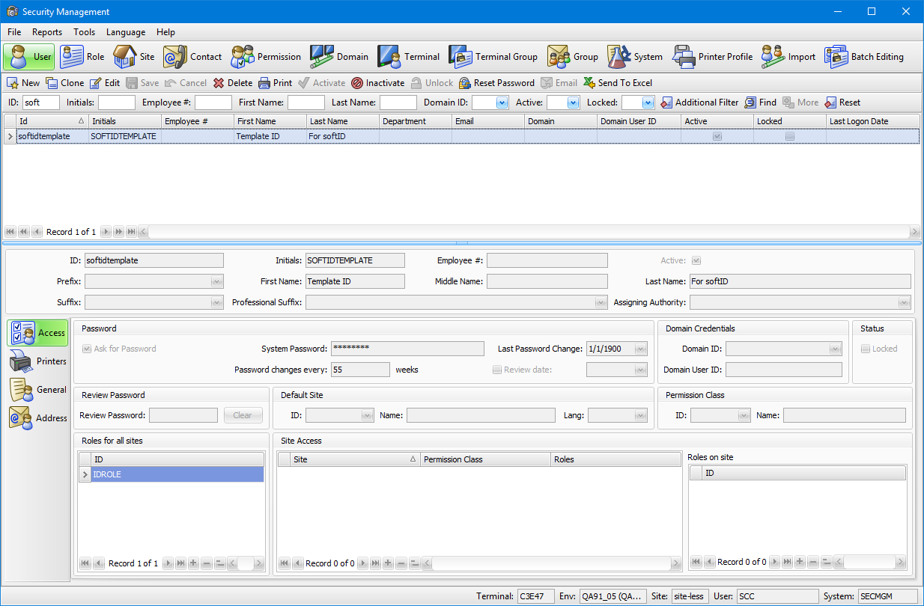
There must be a default user template for the system to assign when valid users log on. This one is called softidtemplate and has a role containing the SoftID system assigned to it.

Slide 18
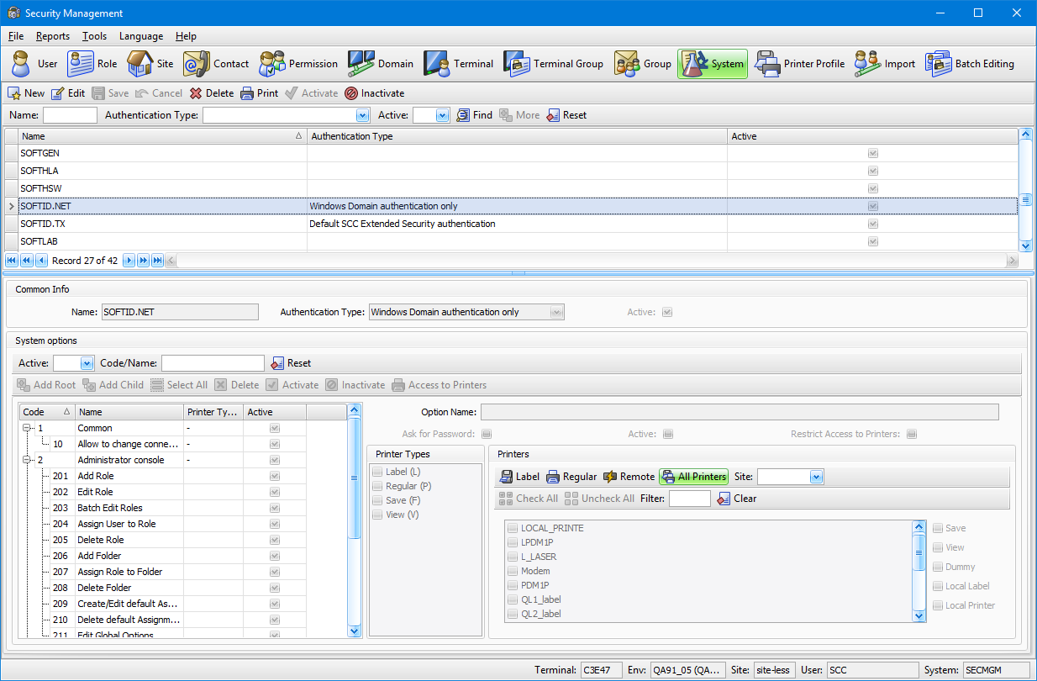
Security Management Adding Access to System
System access to SoftID

Slide 19
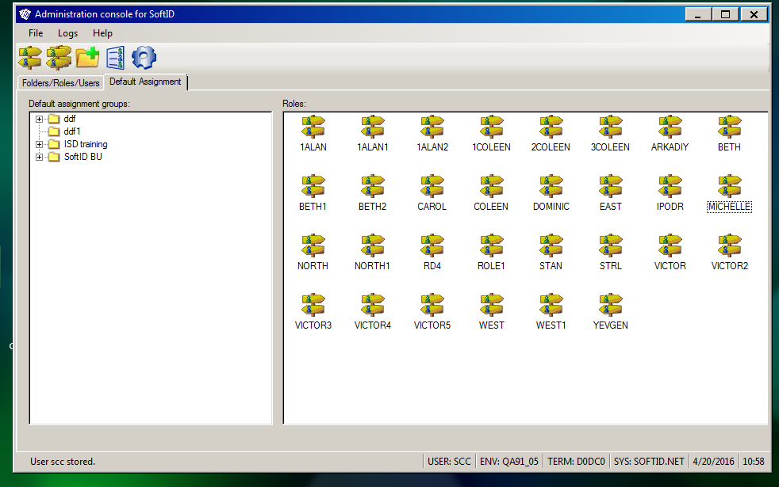
Default Assignment after LDAP setup

Slide 20
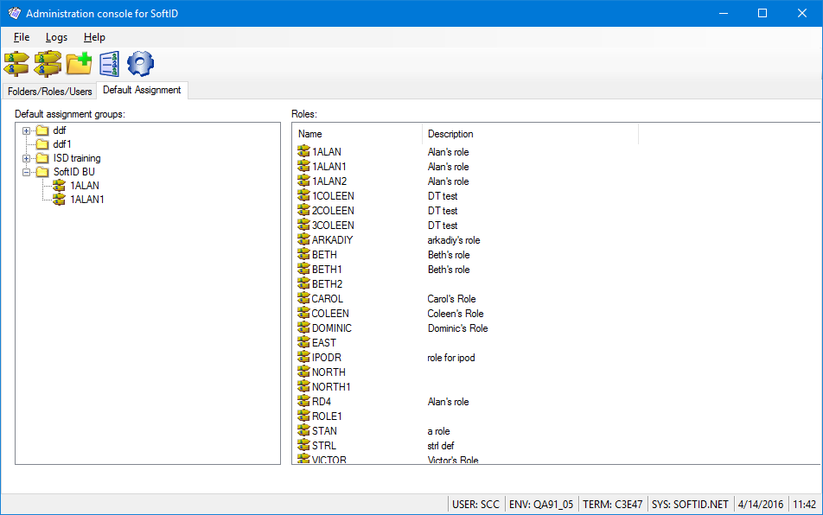
SoftID AC after LDAP setup: Default Assignment expanded

Slide 21
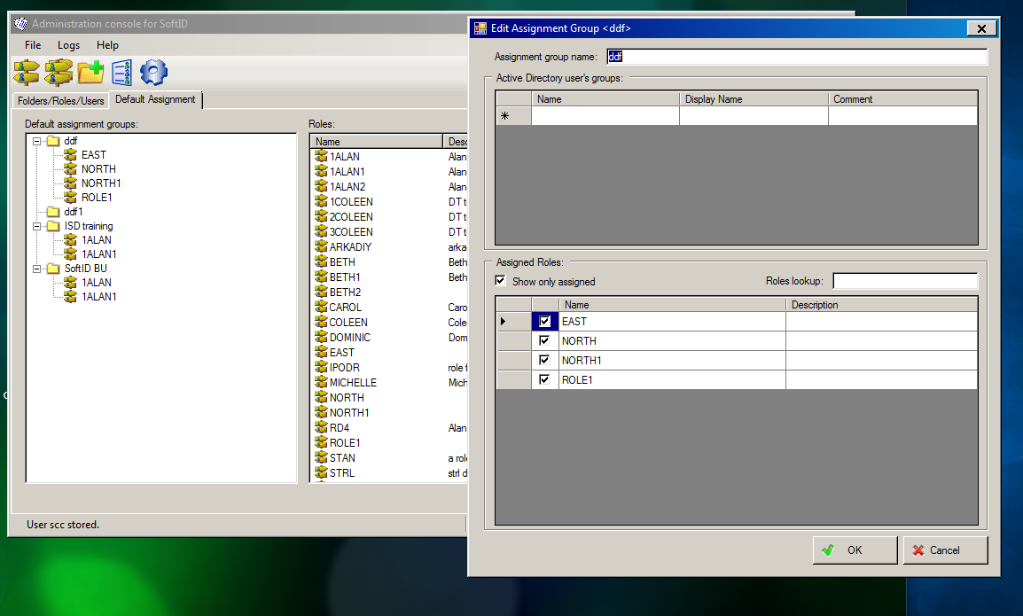
EDIT Assignment Group

Slide 22
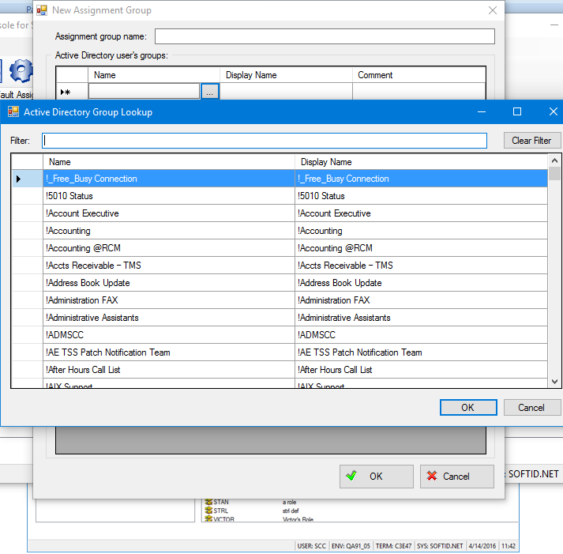
SoftID Admin Console pulling AD groups from Sec. Man.

Slide 23

Lab Setups to Address
Multisite Label Printing Table 4.5 (OEHIS 4.0)
Collection areas
(IP, ED, OP)
Designate Ward (collection area)
Defined Network printer
Draw Type/Specimen such as Nurse collect, etc
Ward/Clinic
Phlebotomy Route
Phlebotomy Class of Route

Slide 24
Lab Setups continued
Container Setup (4.5)
Tube Setup (4.0)
Print Scheduler
for Downtimes
Review all proper Blood/Phlebotomy collection containers
Review all proper Non-Blood collection containers
Phlebotomy Assignment
Phlebotomy Status

Slide 25



Excellence and Quality

Slide 26
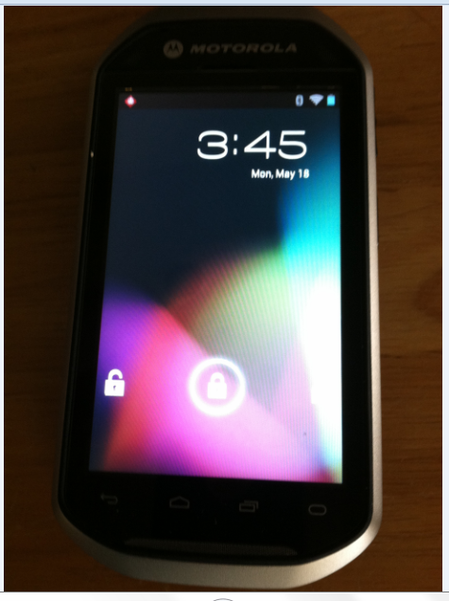
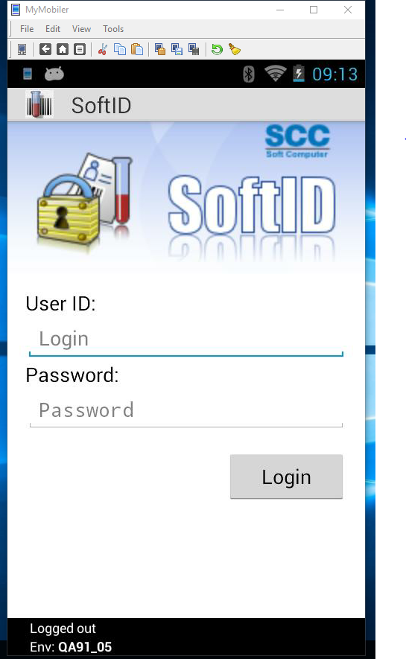
SoftID.NET MC40
Lock Screen
Login Screen

Slide 27
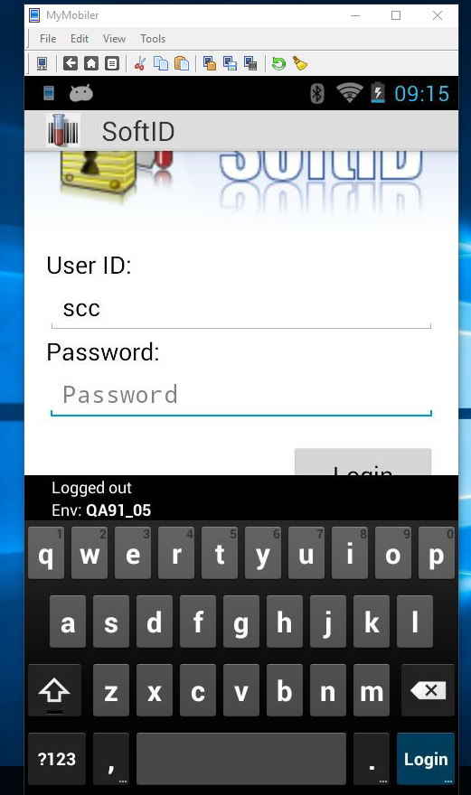
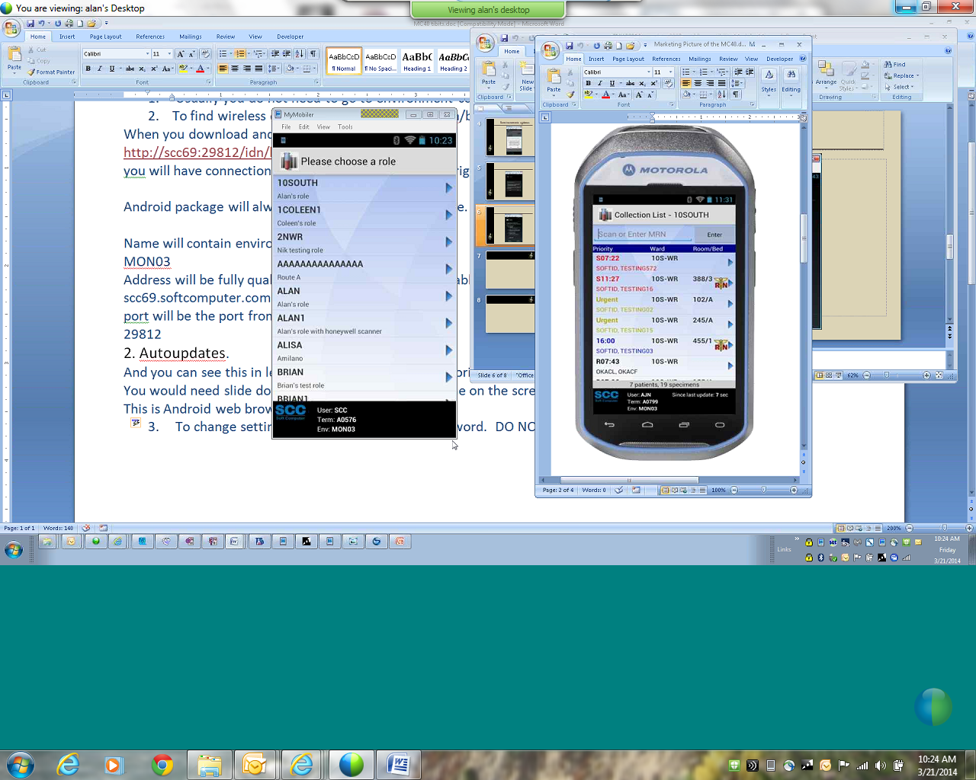
User Login and selection of Assignment
User
Choose Assignment

Slide 28
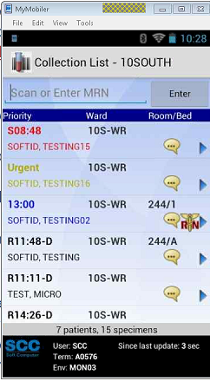
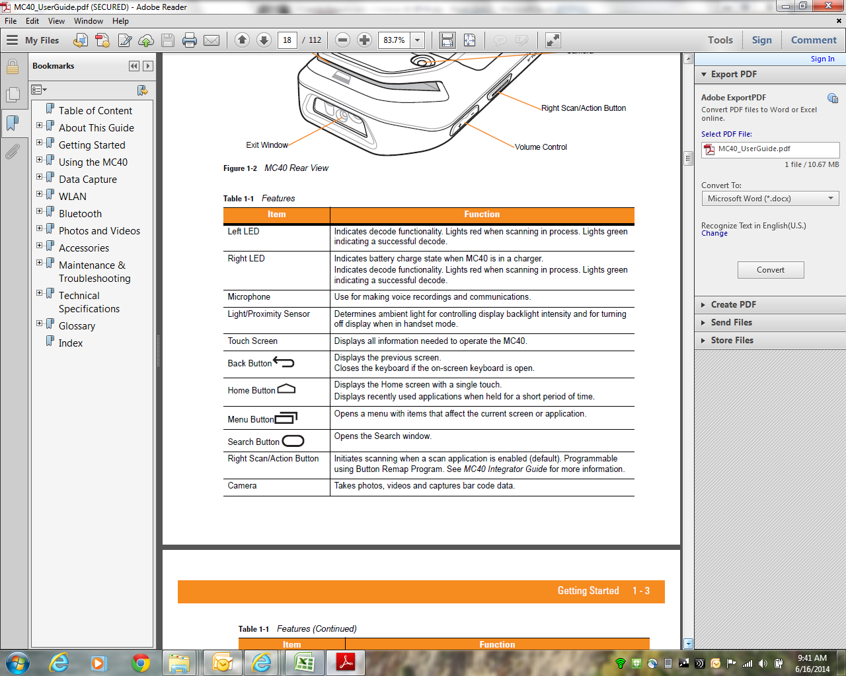
MC40 Icons and Dynamic collection list
Toolbar Icons

Slide 29
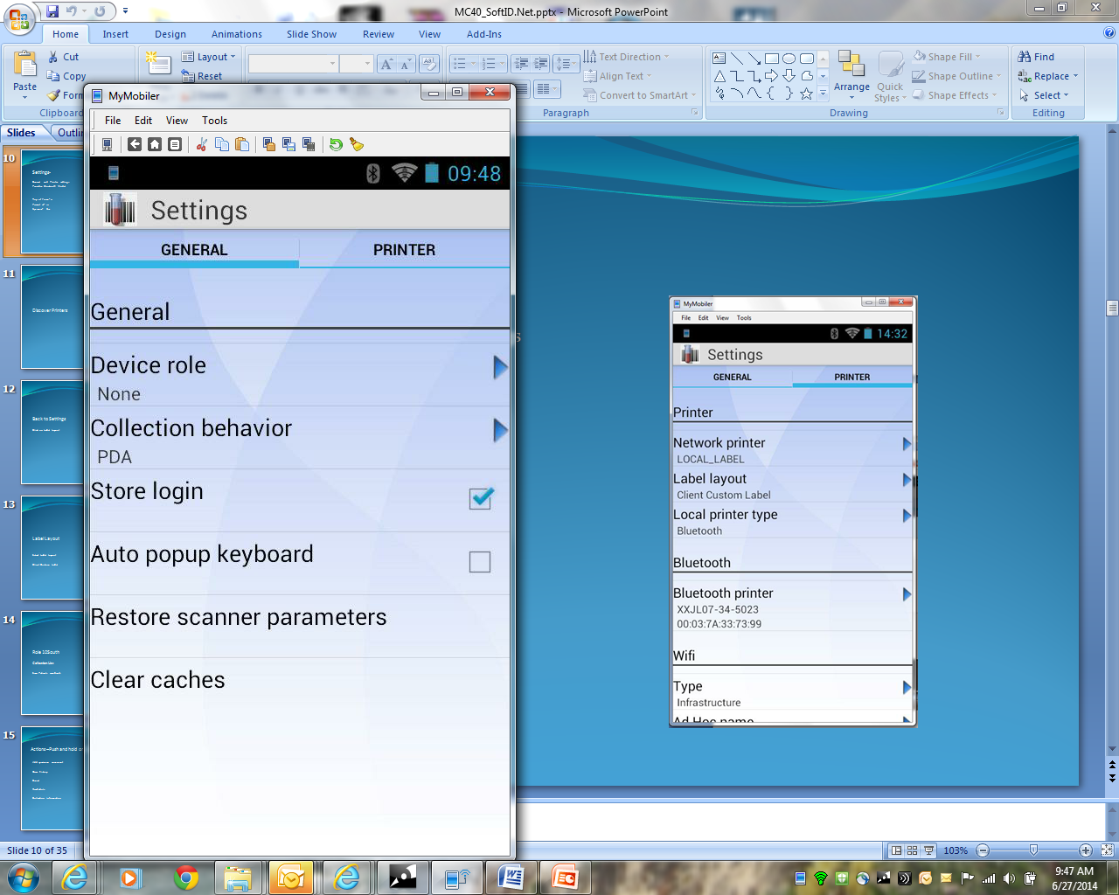
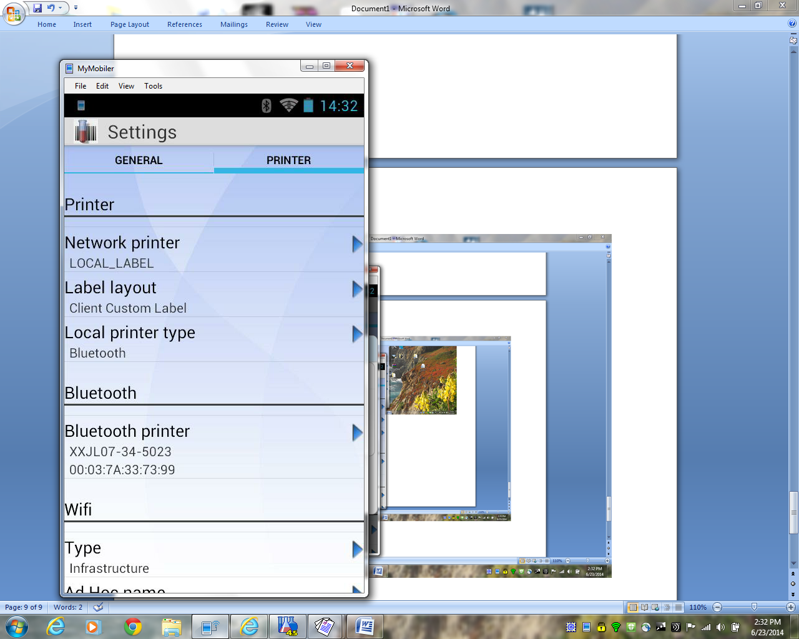
MC40 Settings
General
Printer

Slide 30
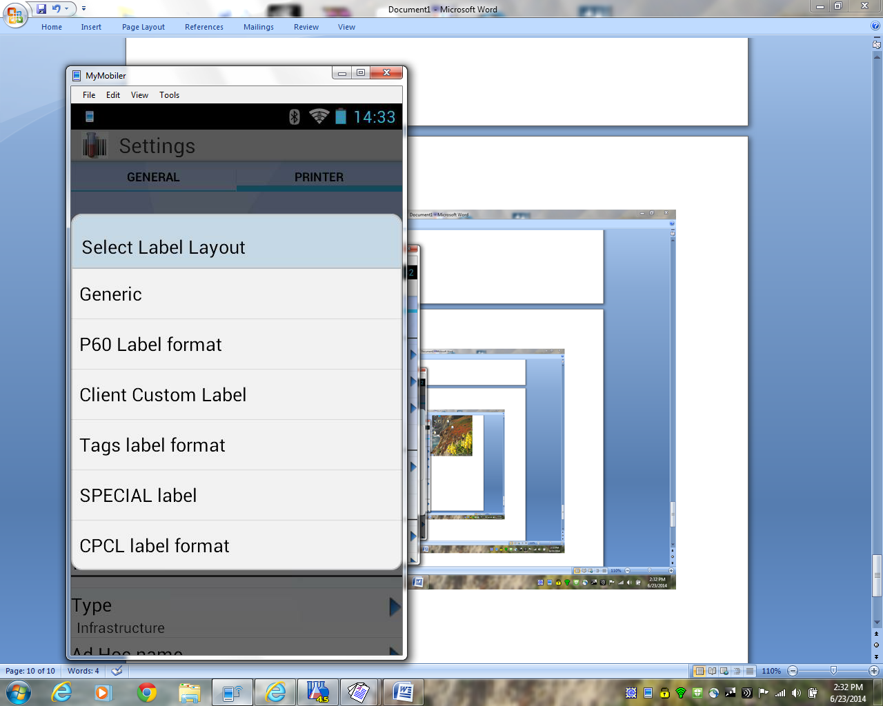
Setups for Printing
Label Layout
Label selection
Select Label Layout
Client Custom Label

Slide 31
Bluetooth printing
Bluetooth setup
Click on Bluetooth printer

Slide 32
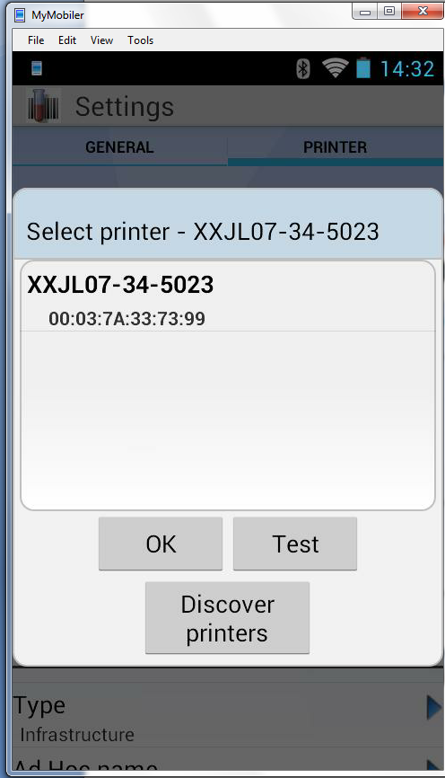
BT Printer setup Continued
Printers
List of BT Printers ON
Touch Discover printers tile.
Touch the Serial number or IP of printer of choice.
Then touch Test-> a test label will print.
Touch OK to save settings.

Slide 33
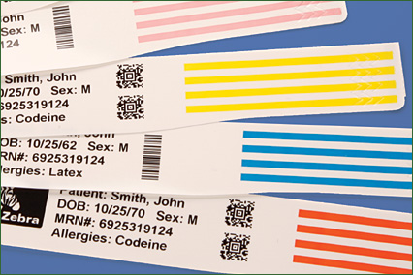
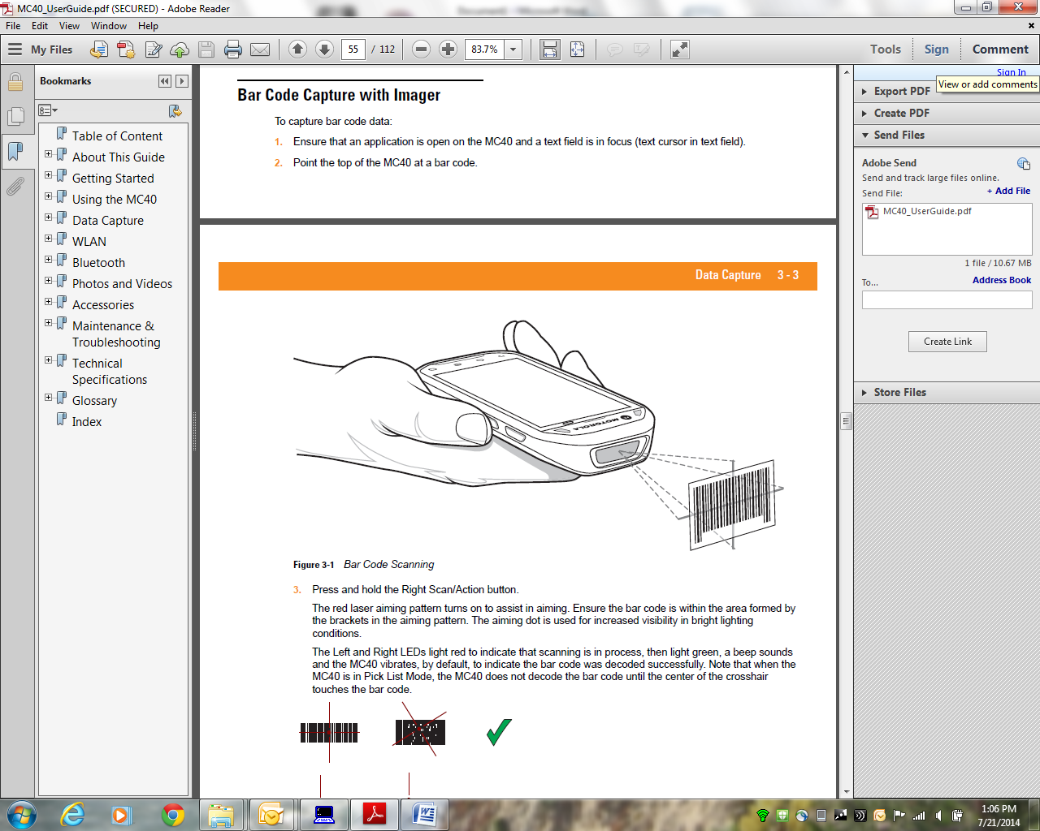
Scan Patient HIS wristband *Billing Number or MRN* *Linear or 2D*
Scanning HIS wristband

Slide 34
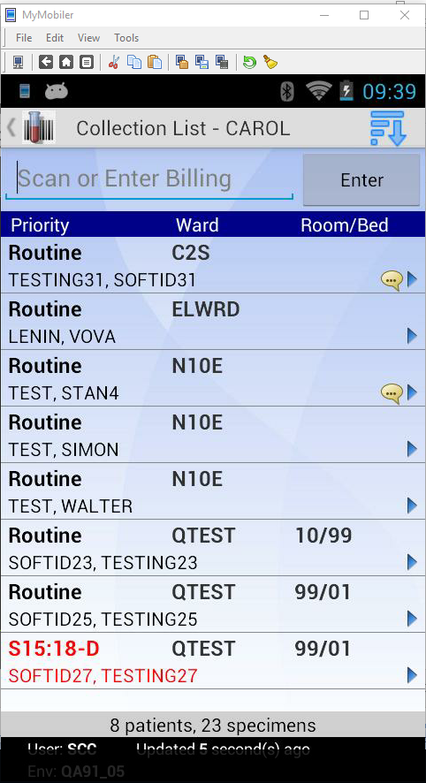
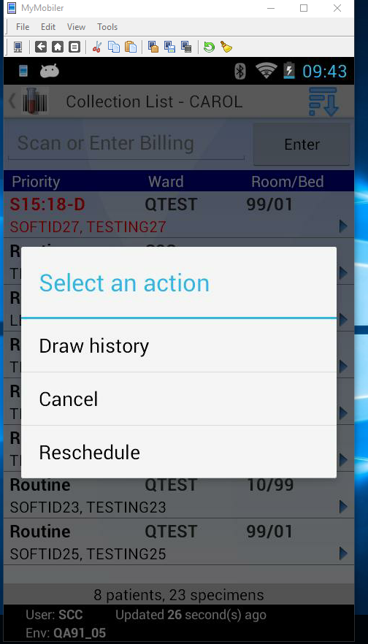
Actions prior to scan–Push and hold on patient name
MC40 Menu
MC40 Patient prior to Scan
Draw history
Cancel
Reschedule

Slide 35
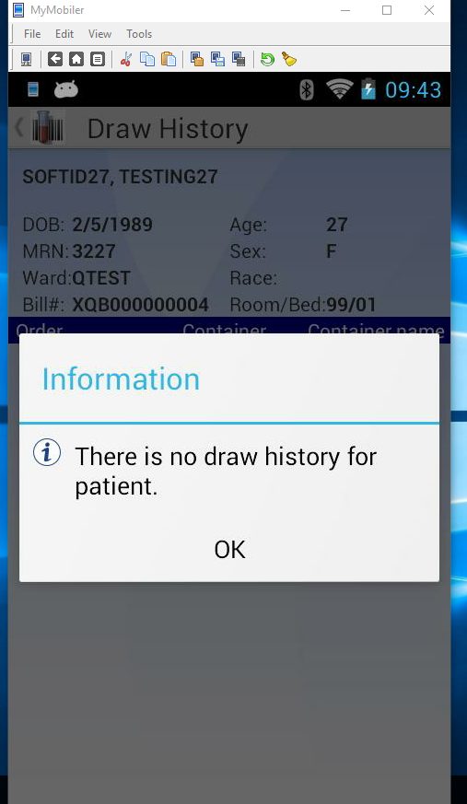
Draw History
Set in SoftID Admin Console
at assignment level
to look back
24, 48, 72 hrs etc….

Slide 36
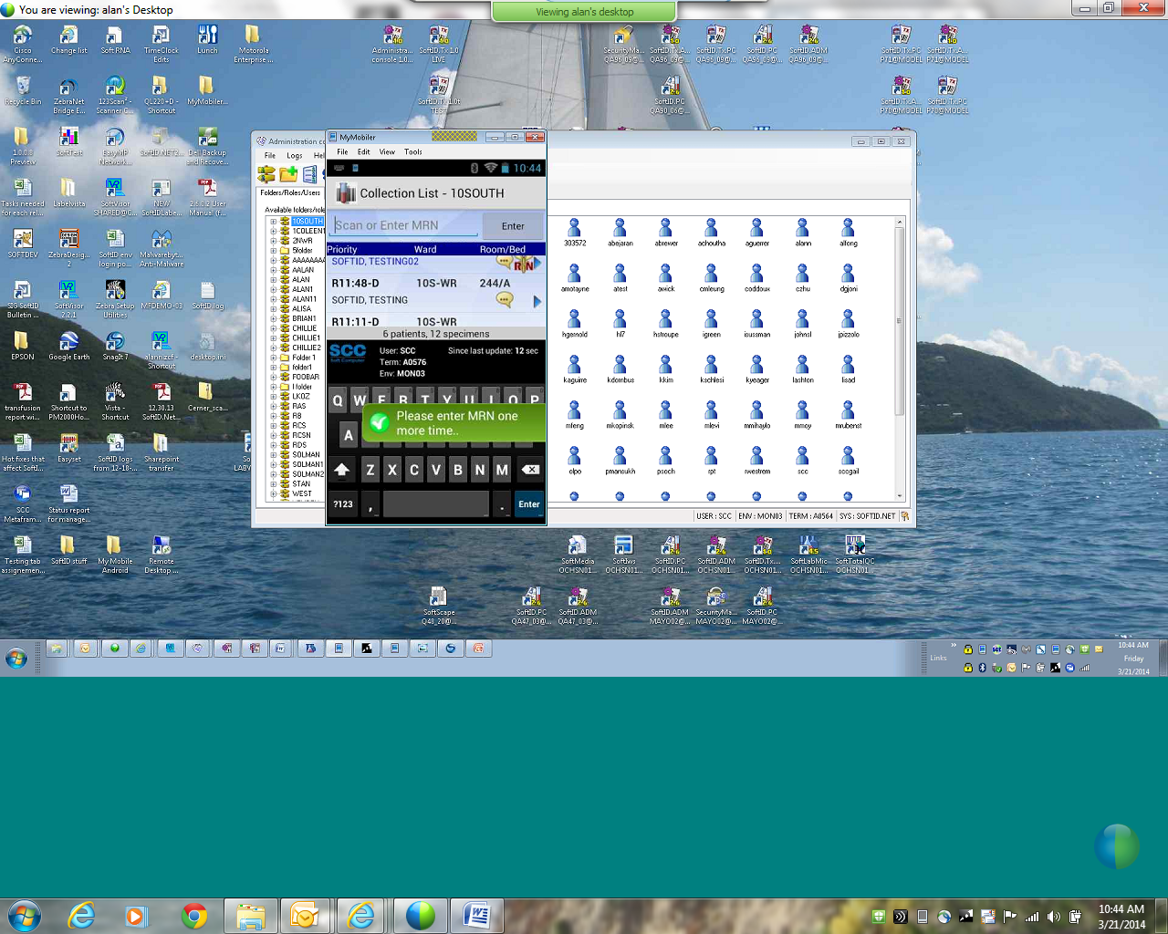
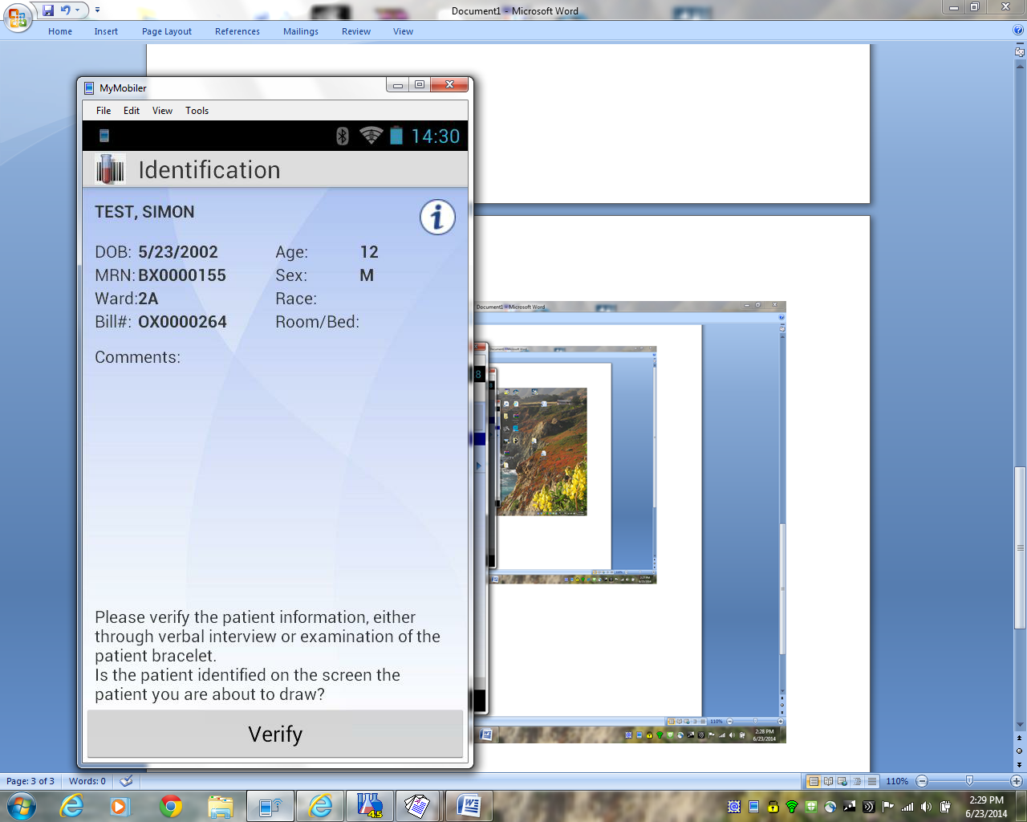
Manual Entry Patient BN/MRN
Required 2 entry’s
Verify Patient Info

Slide 37
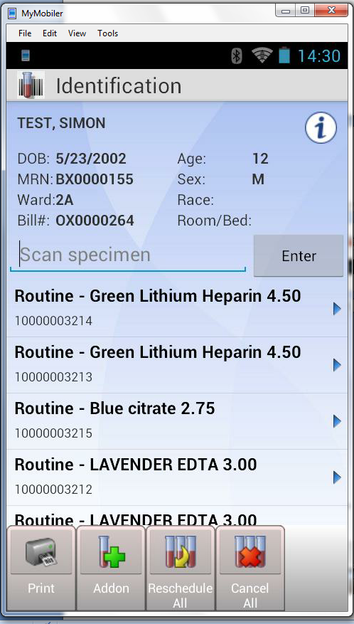
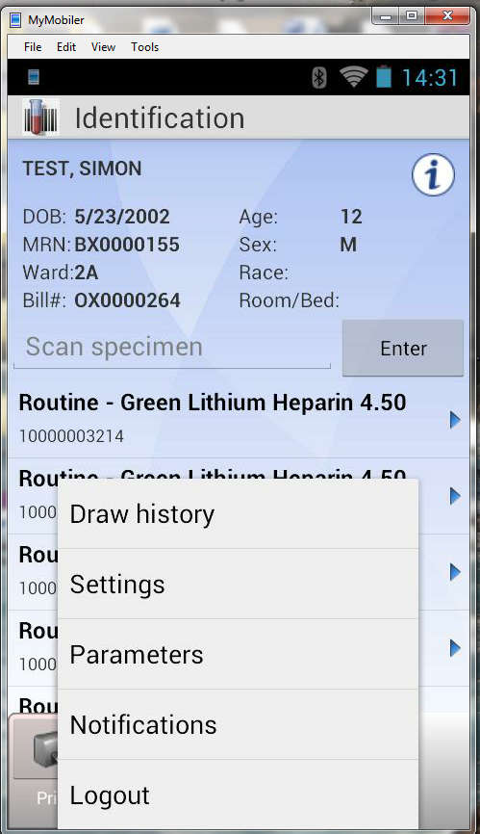
Patient Tests and Information

Slide 38
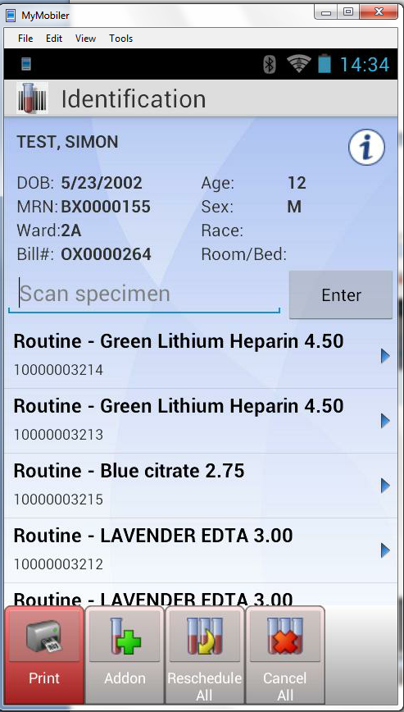
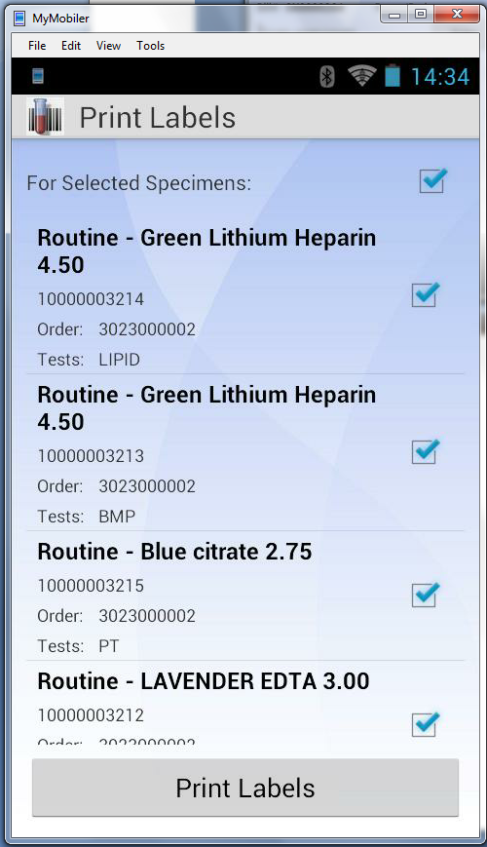
Printing/Draw/Label

Slide 39
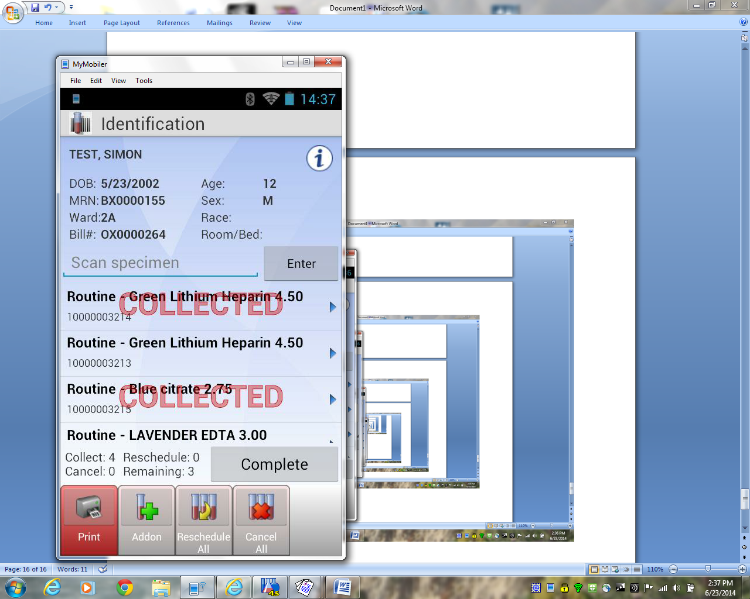
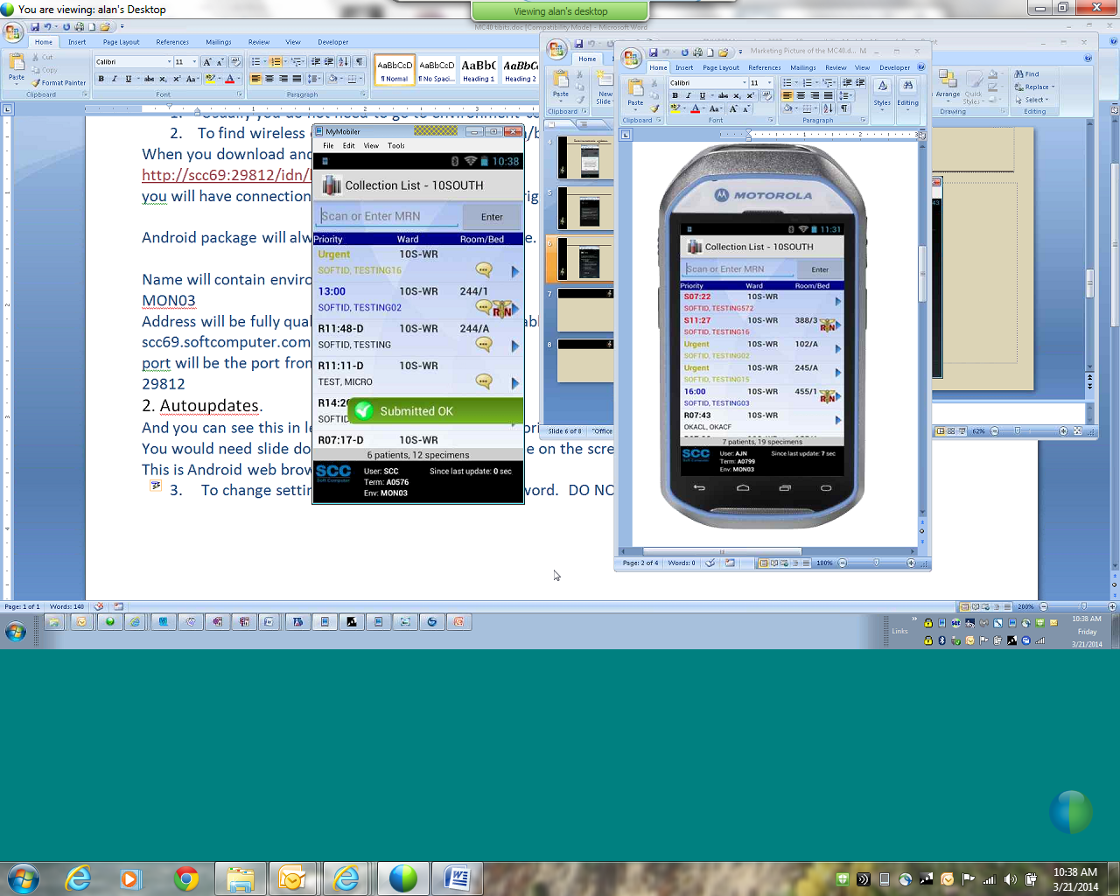
Collection/Submit to Lab

Slide 40
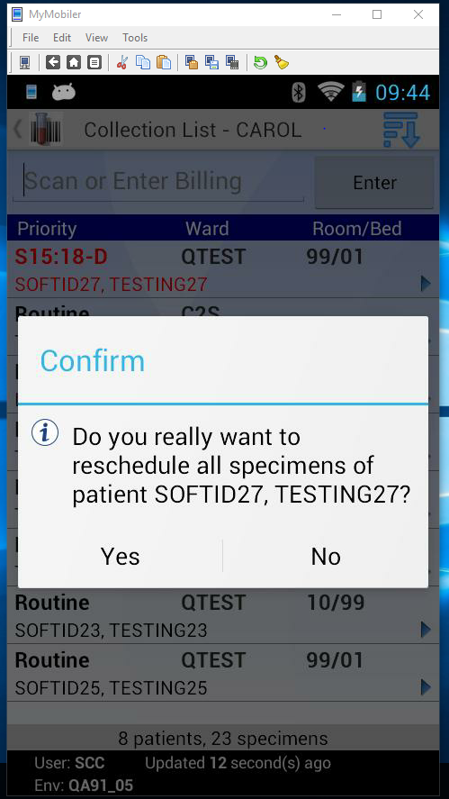
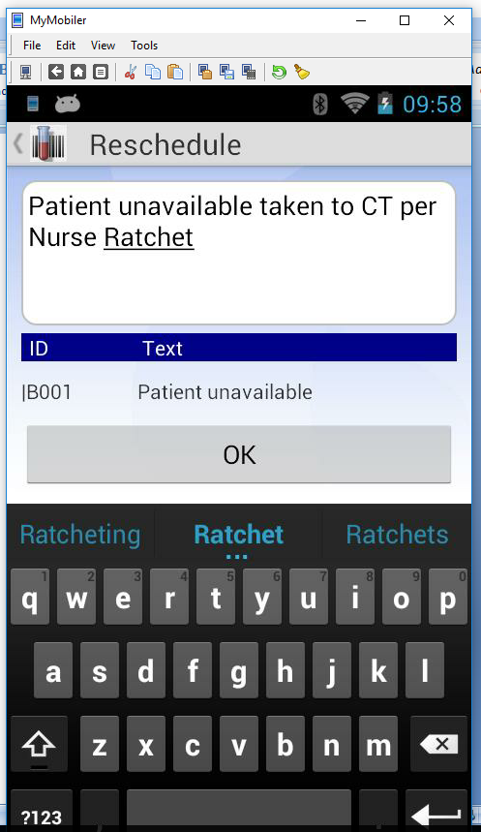
Rescheduling prior to scan

Slide 41
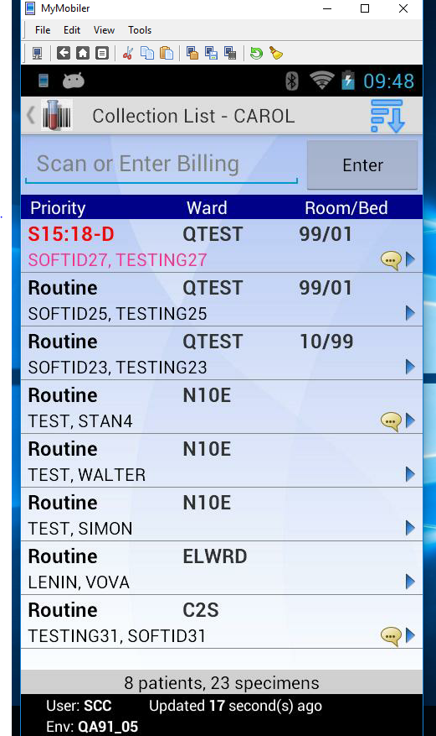
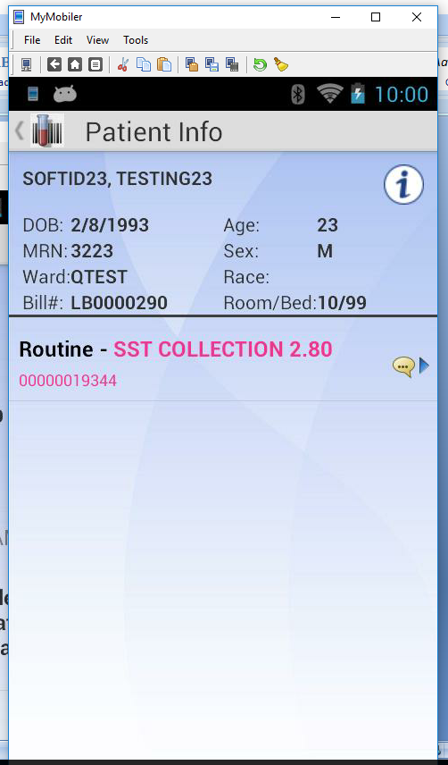
After Reschedule is submitted
Return to dynamic collection list
Check Info on reschedule

Slide 42
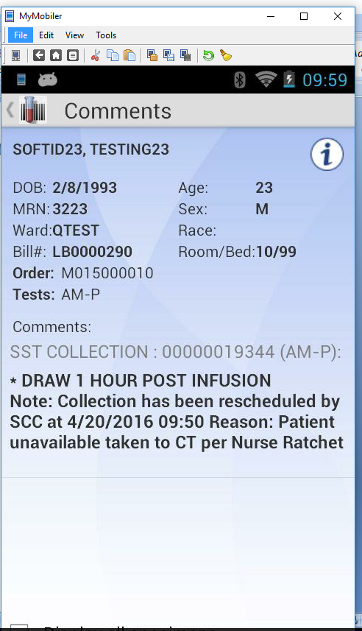
Reschedule message for coworkers

Slide 43
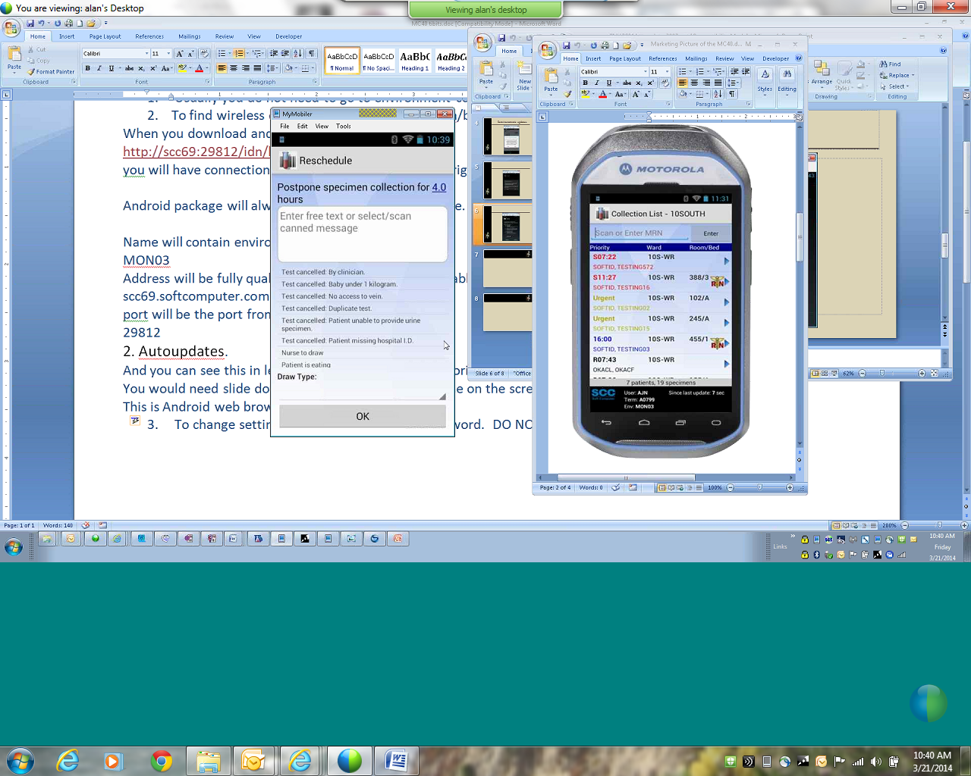
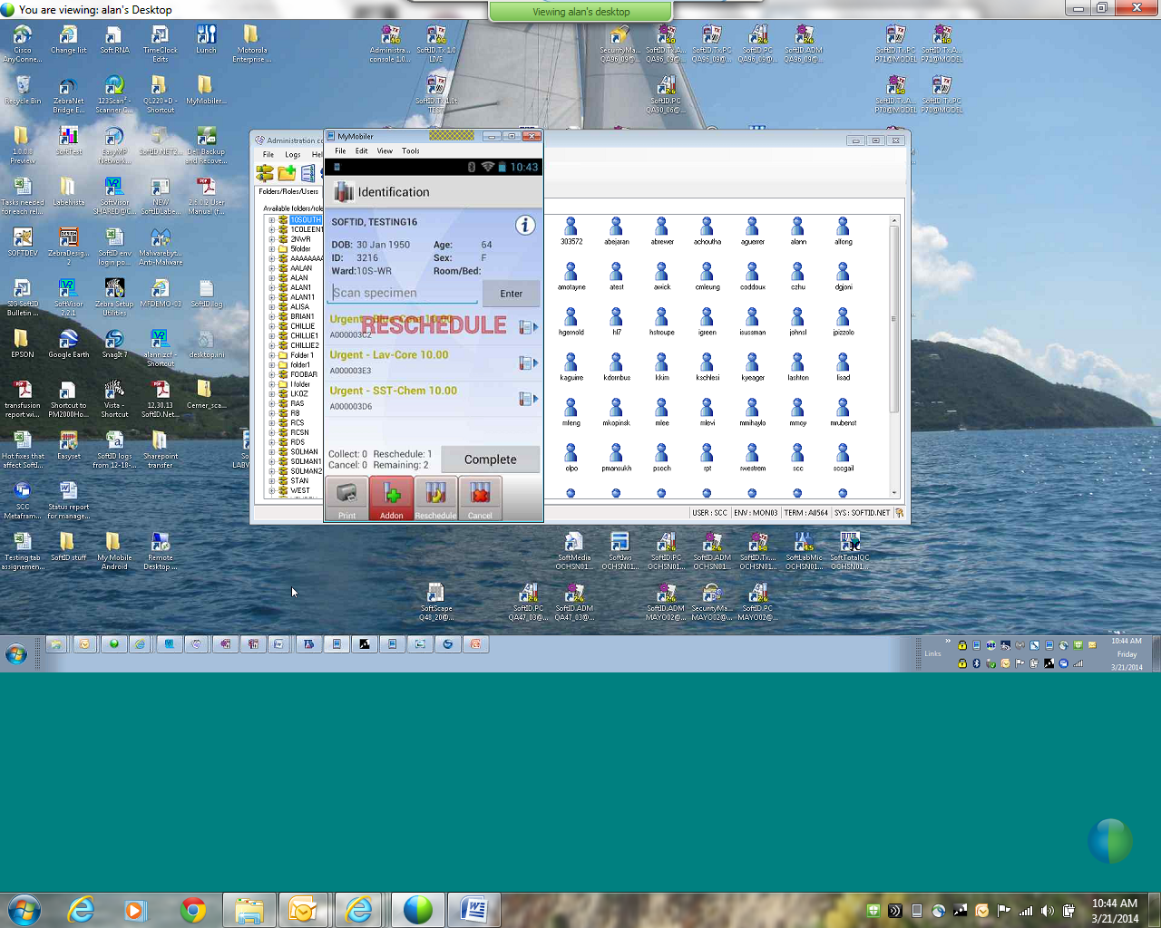
Rescheduling a Collection after scanning HIS wristband

Slide 44
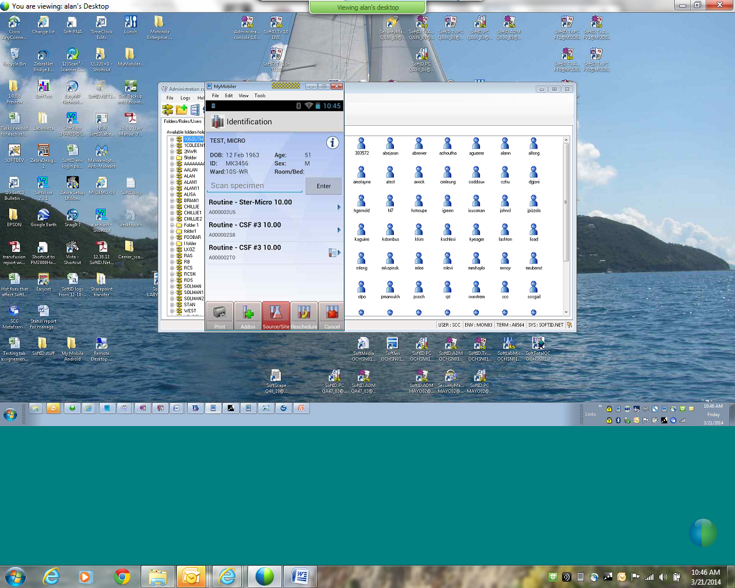
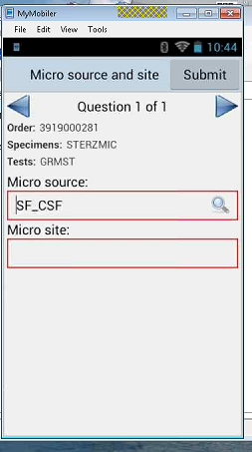
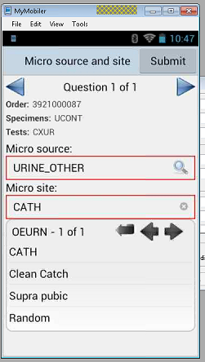
Micro Source Site collections

Slide 45
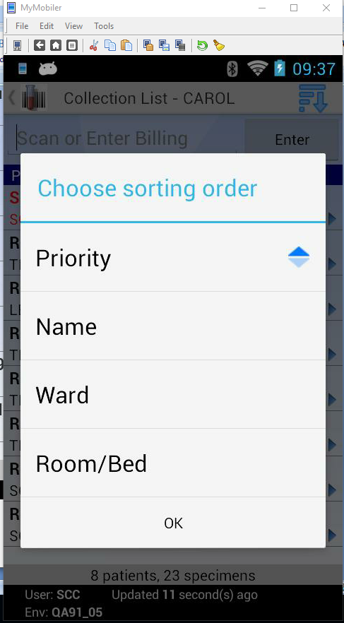
Change collection sort on PDA or WOW

Slide 46
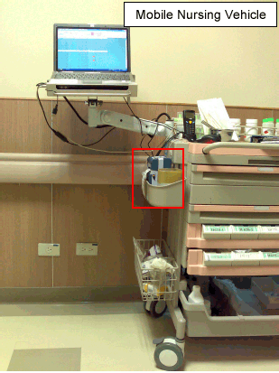
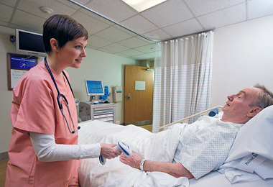
WOW SoftID.PC
Nurse logs into SoftID on PC and can minimize as needed for other applications and use while staying on one device/workstation.

Slide 47
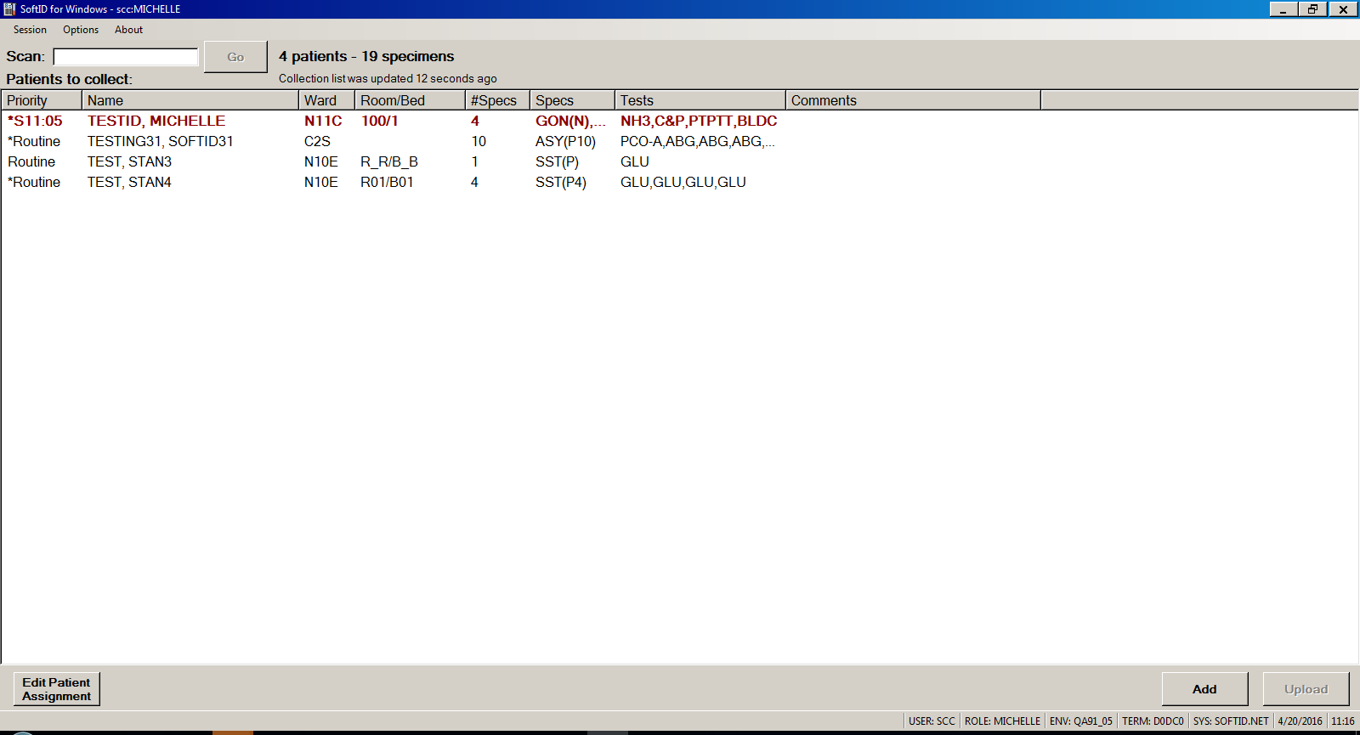
SoftID.PC on WOW

Slide 48
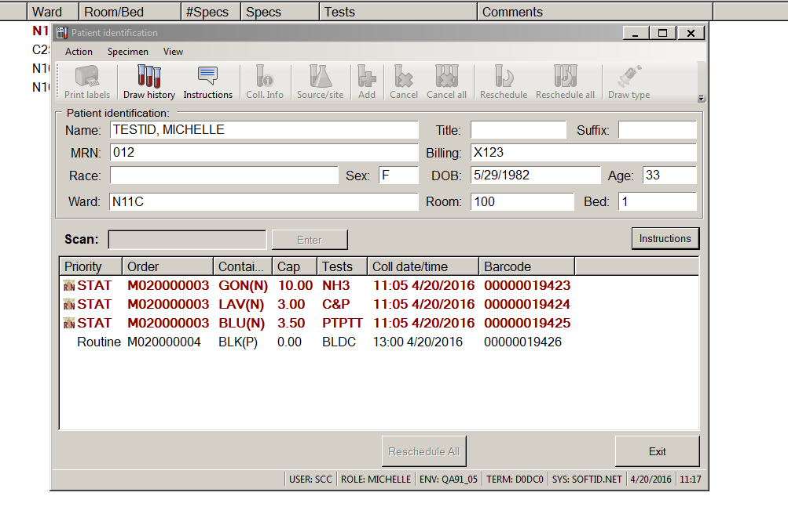
Check Patient info prior to scan

Slide 49

Patient Information Tab

Slide 50

Scan patient HIS wristband

Slide 51

Verify Patient Information

Slide 52

Collection (with Text Help Message)

Slide 53

Collecting Micro (without keypad)

Slide 54

Free Text Micro Site

Slide 55

Print Labels

Slide 56

Change Draw Type

Slide 57

Collection Complete

Slide 58



Laboratory Specimen Processing

Slide 59

SoftID Phlebotomy Status Monitor
Dedicated PC with SoftID module loaded
Default Phlebotomist User defined in Sec. Man.
Monitor dedicated to SoftID PC version. (PC and User setup to not log out).
If a Flat screen Monitor is unavailable, a dedicated PC can also be used.
This is very similar to the Lab system OSM Order Status Monitor

Slide 60

New Features to 2.6.0.6
SoftUpdate will be added to Android devices
Removal of PIDDB and PIDDU
SoftLab Assignment Tool
Custom message setup

Slide 61

Additional Printing setup functionality

Slide 62


Teamwork and Conditioning
End-user training documents
Validation Plans for Software and Hardware

Slide 63


Event Preparation (Go-Live)
Additional scheduling during
Go-Live for Super Users
Hardware charged
additional batteries available

Slide 64

Go-Live Success Story with SoftID

Slide 65
Thank you for choosing SoftID for your patients Any Questions????
Michelle Musgrove MT, CSP
SoftID Implementation Specialist
michelmu@softcomputer.com

