Slide 1

SoftTotalQC® :
Sporting New Features and Taking the Gold with Stronger Standards and Higher Performance!
Presented by: Isis Smith, MLS(ASCP)
SCC SoftTotalQC Product Specialist
isis@softcomputer.com
Notes:
Sochi 2014 Olympic Gold Medal

Slide 2
Presentation Outline
New features for Setups and Lot Records
  Batch Edit Function
  Export/Import Templates
  Lot Record Reviews
Optimized QC review capabilities
  Quick Order/Result Reviews
Enancements made to the integration with SoftLab®
  Pre-posting QC Validation
  QC Result Graph
Completely new application designed
  SoftTotalQC® Web Mobile Application

Slide 3

With the lighting of the Olympic cauldron,
we’ll begin!
Notes:
Lighting of the torch in Athens for the 2004 Winter Olympics

Slide 4


Batch Editing Setups
Designed to allow for updating a batch of Setup records simultaneously
Notes:
London 2012 Olympic Gold Medal

Slide 5
Batch Edit Function
Provides the ability to batch edit Setup records of the same Type
The changes made to the first record act as a pattern for what changes will be applied to other records
Available for most Types of Setup records
Not available for: Locations, Keypads, Holidays, Worklists, Reports, Export/Import Templates, Scheduler, and RBS Setups
Qualifying fields for batch editing are:
  Profile section fields
  Additional Information > Flags
  Other Additional Information window fields
Notes:
Available Setup records for batch edits are: Setups: Departments, Workstations, Manufacturers, Tests, Instruments, QC Parameters, Frequencies, Actions, Methods, Equipments, Controls, Drugs, Reagents, Media, Panels, and Consumables.
Not Available for: Locations, Keypads, Holidays, Worklists, Reports, Export/Import Templates, Scheduler and RBS.
Fields unavailable for batch editing are: ID, Name, Location, Department, Workstation, Subtype, parameters information in the grid, Components, ILCP info, Performing Workstation, QC Identifiers, Sample Run, Related LIS items, Inventory, Result Entry, Worklists and Reports.

Slide 6
Batch Edit Process
Open a Setup record in Edit mode
Make one or more changes to the record, which enables the Batch Edit function
Click the Batch Edit button
Save the changes to the current record and proceed with Batch Editing
Select other Setup records of the same QC Item Type
Review the selected records in the Batch Edit tab
Click Save to apply the edit(s) to the selected records
Observe the Processed column to ensure batch editing was completed successfully
Notes:
Implemented in 1.0.4.0 (PCC-61127)
Release Note:
SoftTotalQC edit functionality was enhanced. The Batch Edit button now provides ability to edit multiple records of the same type.
Benefit Note:
Batch edit functionality enables user to apply edit changes to multiple records at the same time.
Implementation Note:
N/A

Slide 7
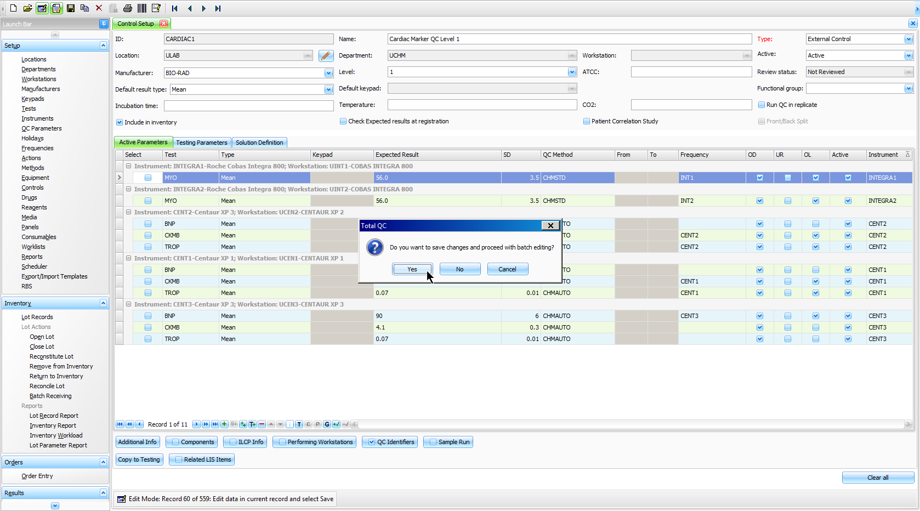
Batch Edit Process
Notes:
Prompt to save the changes displays after the user clicks the Batch Edit button.

Slide 8
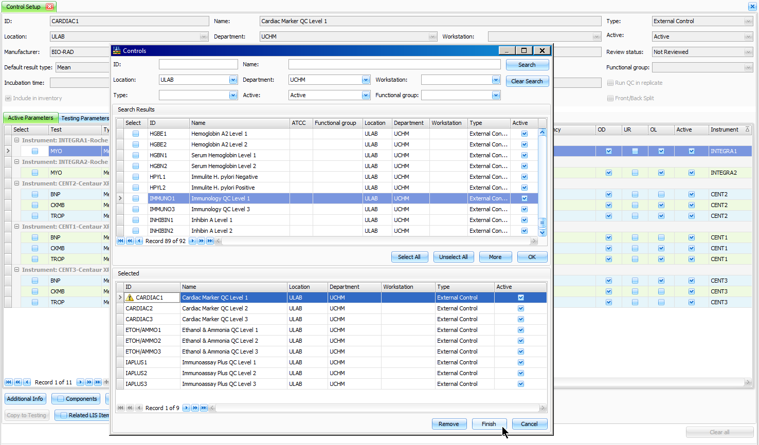
Batch Edit Process
Notes:
After the changes are saved, the system opens a record selection window to allow the user to select other records of the same Type to include in the batch.

Slide 9
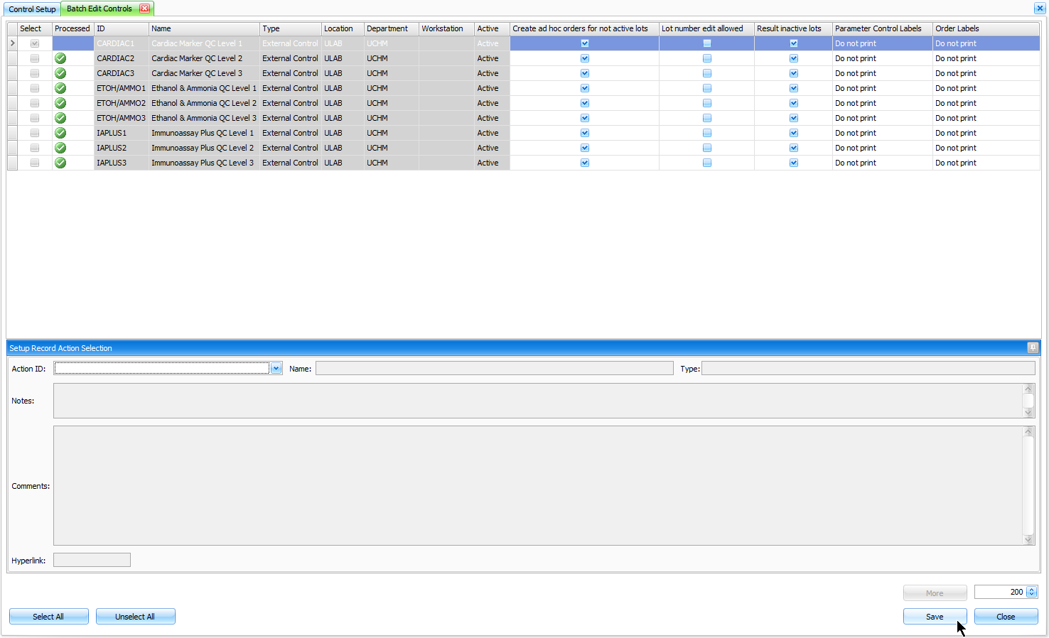
Batch Edit Process
Notes:
Next the Batch Edit Controls tab displays with all of the selected records to which the changes will be applied. The user has the ability to unselect records that should not be included in the batch at this point. After the Save button is pressed, the system displays an indicator for all selected records to visually alert the user whether changes were successfully applied, or not.

Slide 10


Excel Export/Import Templates
Designed for importing to and exporting from QC Items and Lot Records using Excel spreadsheets
Notes:
Vancouver 2010 Olympic Gold Medal

Slide 11
Export/Import Templates Setup
Provides the ability to:
Import Parameter data for QC Item Setups and Lot Records from an Excel Spreadsheet
Export QC Items and Lot Records to an Excel Spreadsheet for maintaining records of items built in SoftTotalQC®
Create custom Export/Import Templates for routine use
Update Lot Record Ranges/Expected Results
Could be utilized during file building if Manufacturers provide lot information in an Excel spreadsheet (must be saved in .xls or .xlsx format)
Notes:
Implemented in 1.0.3.10 (PCC-58551)
Release Note:
The Export/Import Template setups were enhanced. The Setup > Export/Import Templates now provide the ability to export and import QC parameter data of Setups and Lot Records to and from Excel spread sheets. The templates of Lot and QC item types now include the defined parameter data found in the Setup and Lot Records for mapping to and from Excel spread sheets. Included are the required fields such as the lot number, expiration date, number received and the units. Also included are the additional user defined fields of the parameters including the expected results, result types, ranges To and From, mean, frequency, and method data.
Benefit Note:
Using Excel spread sheets and SoftTotalQC Export/Import Templates saves time and improves accuracy by transferring the lot and setup records of many items at once with less manual input by the user.
Implementation Note:
N/A

Slide 12
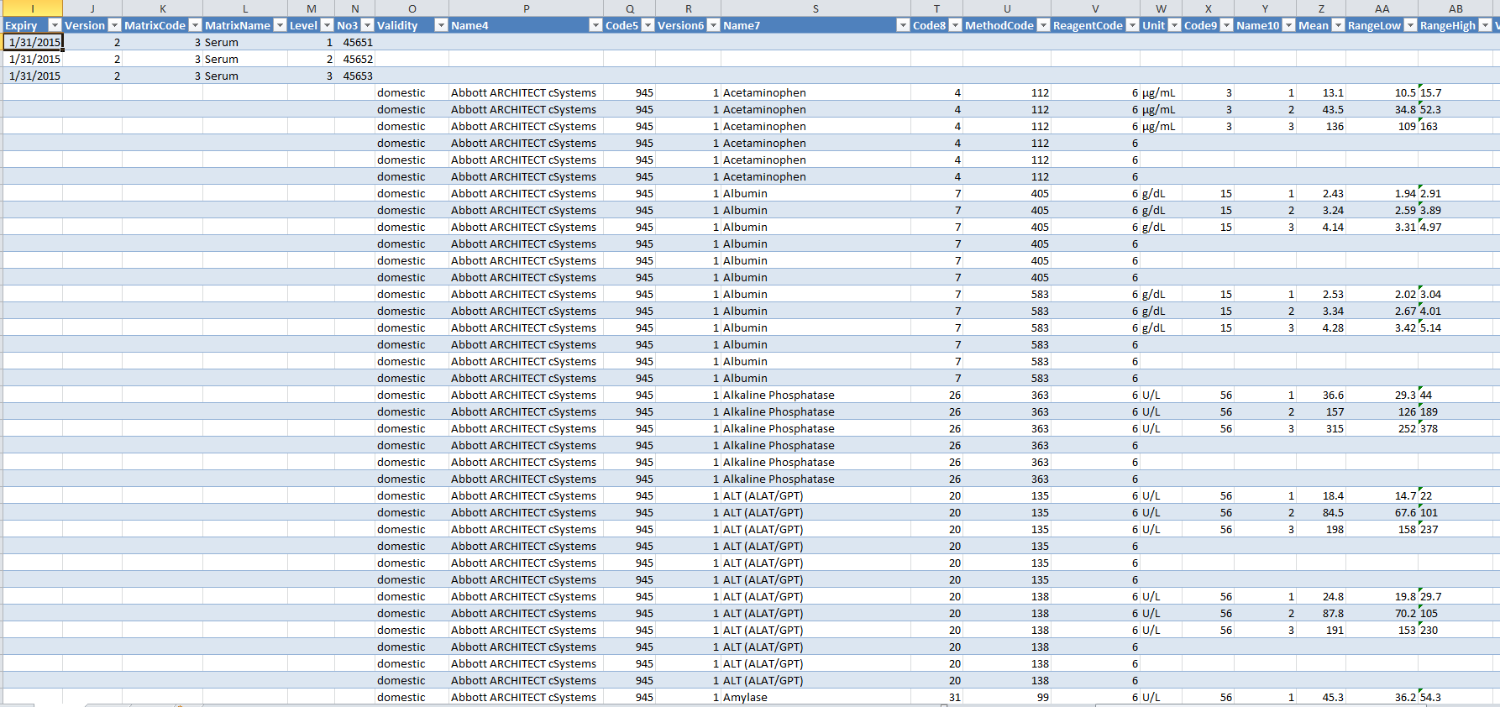
Manufacturer Provided Excel Spreadsheet
Notes:
Example of a Manufacturer supplied spreadsheet with various lot information. Columns do not have to be in any particular order in the spreadsheet. Column order does not have to match that of the Export/Import Template.

Slide 13
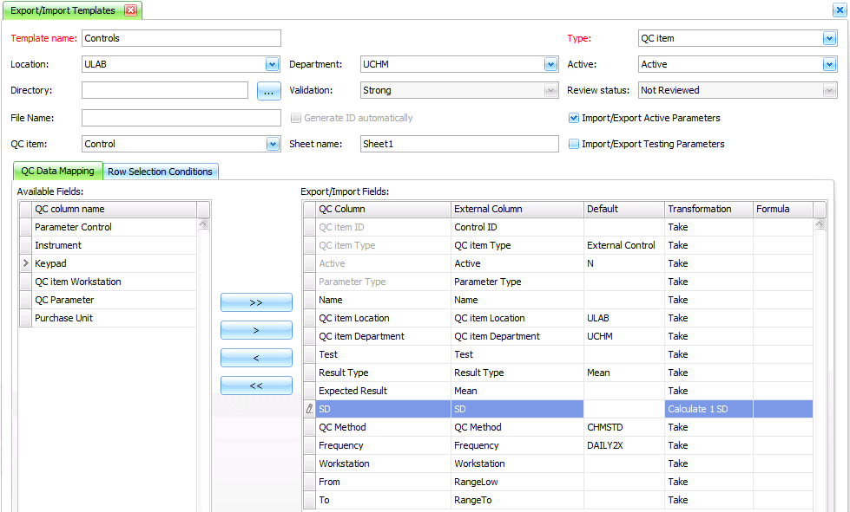
Export/Import Template Setup
Completely redesigned for improved usability
User Tip:
Build for Department
Notes:
Create Export/Import template under Setup>Export/Import Templates:
-Select QC item template type
-Select Department
-Select QC item type Control
-Check checkboxes to Import/Export Active and/or Testing Parameters for importing corresponding parameters
-Add fields for Test and expected result: Test, Result Type, Expected Result, SD, QC Method, From, To, QC item Location, QC item Department for importing corresponding parameters

Slide 14
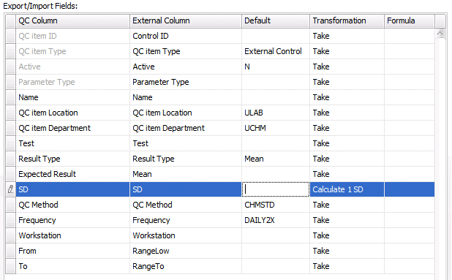
Export/Import Template Setup
Select and map TotalQC fields to desired Spreadsheet fields:
User Tip:
Use Default values as much as possible
User Tip:
Select Transformation type to calculate SD from Expected Range
Notes:
QC Column – name of column/filed in TotalQC
External Column – name of column in XLS Spreadsheet. External Column fields are editable in order to define name of column to spreadsheet
There are 2 ways to map columns:
Define how columns are called in XLS in Template
Adjust column names in XLS template to match TotalQC column names
Grey QC Column fields are required, all other fields are optional
QC Item ID > Control ID – unique ID of control
QC item Type – Subtype of control (External Control, Calibrator, etc.)
Active – status of imported record: set N to import records in Not Active status or Y to import records in Active status
Parameter Type: Active or Testing
QC item Location and QC item Department: set defaults if template defined for Department, field with default value is not required in Excel
Test – Test ID
Result Type: Mean, Range, Keypad, etc.
Expected Result
SD – set Calculate 1 SD in order to calculate this value from Range, From and To are required for calculation. SD could be calculated from assumption that 1, 2 or 3SD were used to define Range
QC Method, Frequency: Set defaults if the same method/frequency used for all parameters
Workstation – Test Workstation
From/To – Expected Range

Slide 15
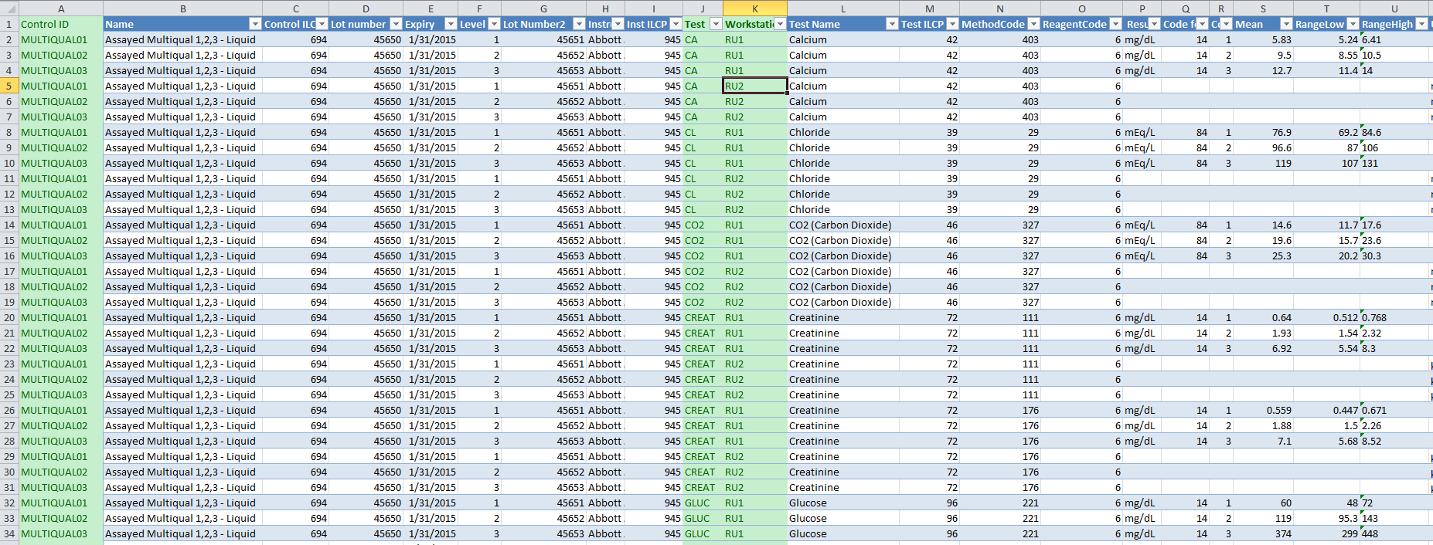
Adjust XLS Spreadsheet
Add missing columns from the Template and fill required values
Rename columns to match template
Check that all setups are present in SoftTotalQC: Location, Department, Tests, QC Method, Frequency
Tip 5:
Columns with Defaults are not required in XLS file
User Tip:
Use the same spreadsheet for creating Lot Records
Notes:
-Columns in XLS spreadsheet could be in any order
-Extra column in XLS spreadsheet are allowed

Slide 16
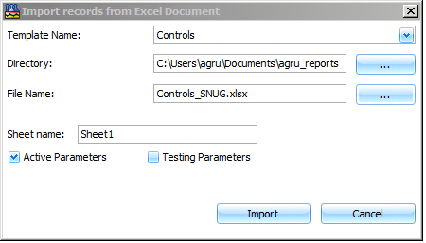
Import Controls
Go to Setup > Controls > Tools > Import Records from Excel
Select Template and File
User Tip:
Check the Sheet name
Notes:
One document with multiple sheets can be used for importing/exporting information from and to.

Slide 17
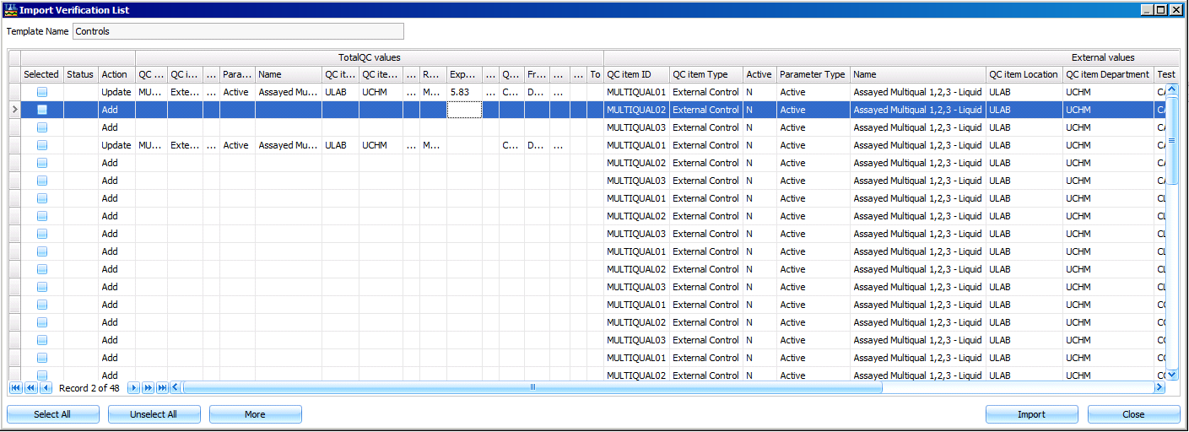
Import Verification List
TotalQC values: filled if following QC item/Parameter is already present in SoftTotalQC®
Add and Update Actions are available
External values: filled from XLS document according to the Template
User Tip:
Select and Import!
Notes:
Verification list has following columns:
Selected: No, by default
Status: Green checkbox for successful import and Red Cross for fails or errors
Action: Add: if QC item is not present in TotalQC and Update: if QC Item is present in TotalQC
Please note: When creating

Slide 18
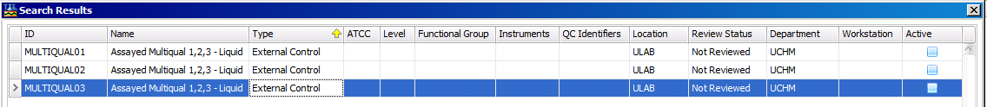
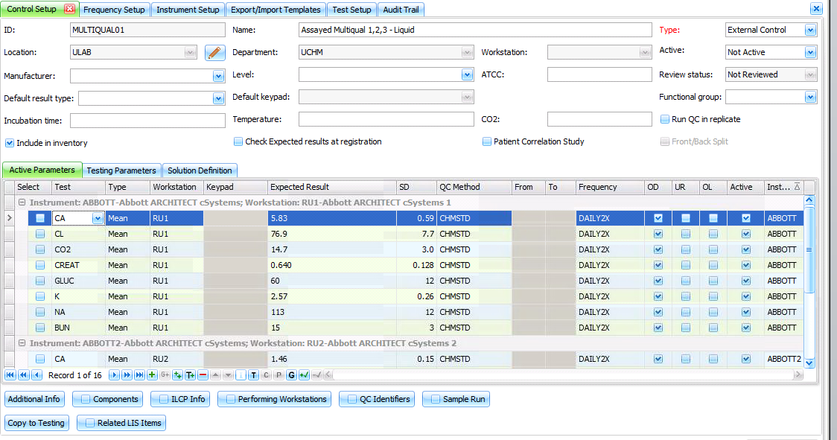
Imported Records
User Tip:
Review and Activate
Notes:
It is highly recommended to import records as Not Active and to utilize the Setup and/or Lot Record Review options before activating them.

Slide 19
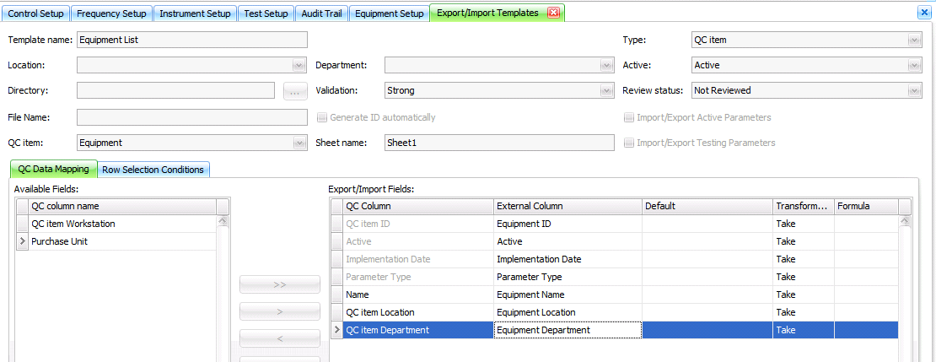
Create an Equipment List
User Tip:
Use Export records to Excel tool
Create Export/Import Template
Type: QC item
QC item: Equipment

Slide 20
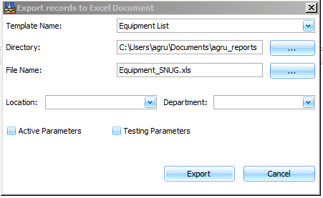
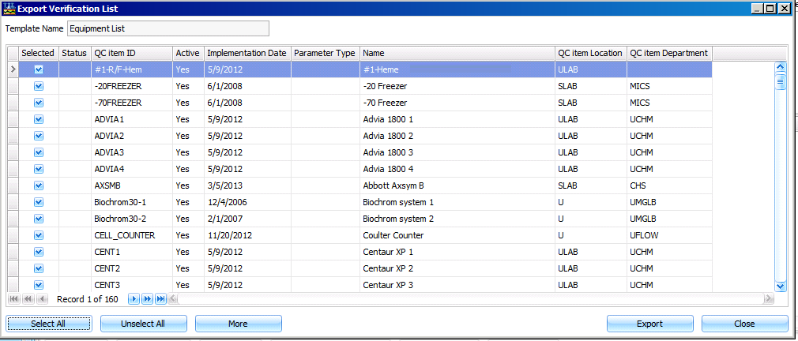
Export Records to Excel
Go to Equipment Setup > Tools > Export records to Excel
Notes:
For Exporting records to Excel, in the Export records to Excel Document window, you must select the desired Directory and create or select the File Name including the .xls or .xlsx extension.

Slide 21
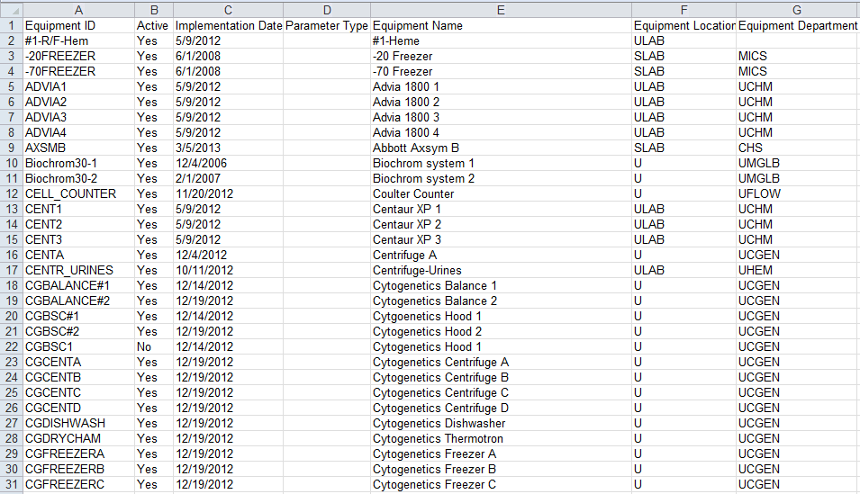
Equipment List

Slide 22
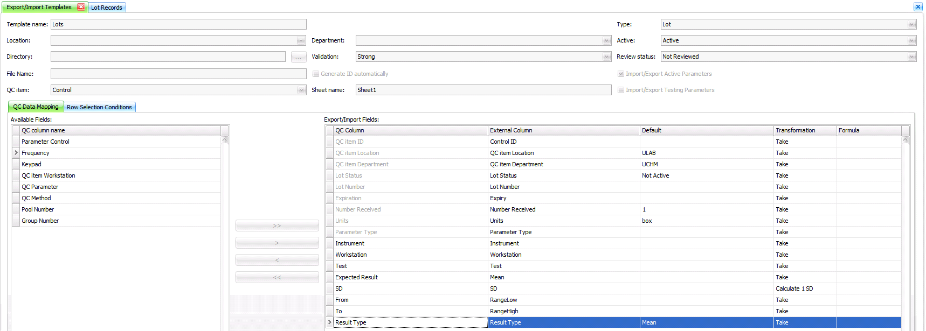
Updating Lot Records
Create Export/Import Template
Type: Lot
QC Item: Control

Slide 23
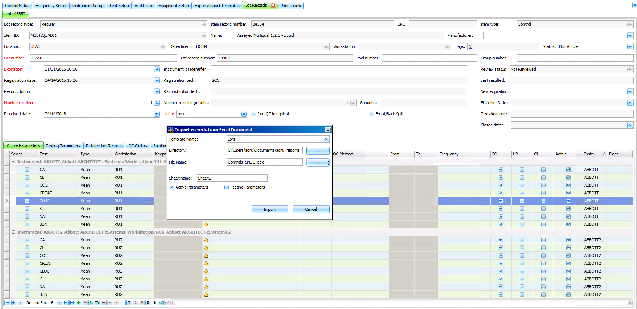
Update Selected Lot
Open Lot and select Tools > Import from Excel to update selected lot
User Tip:
Process similar to importing QC Items

Slide 24
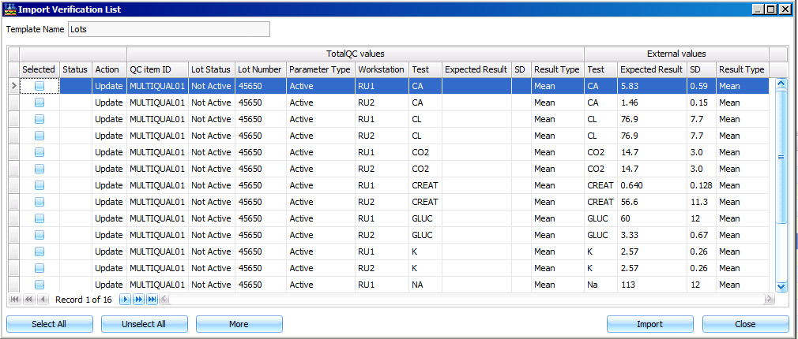
Update Lot Expected Results
User Tip:
Remove unnecessary columns for a better view

Slide 25
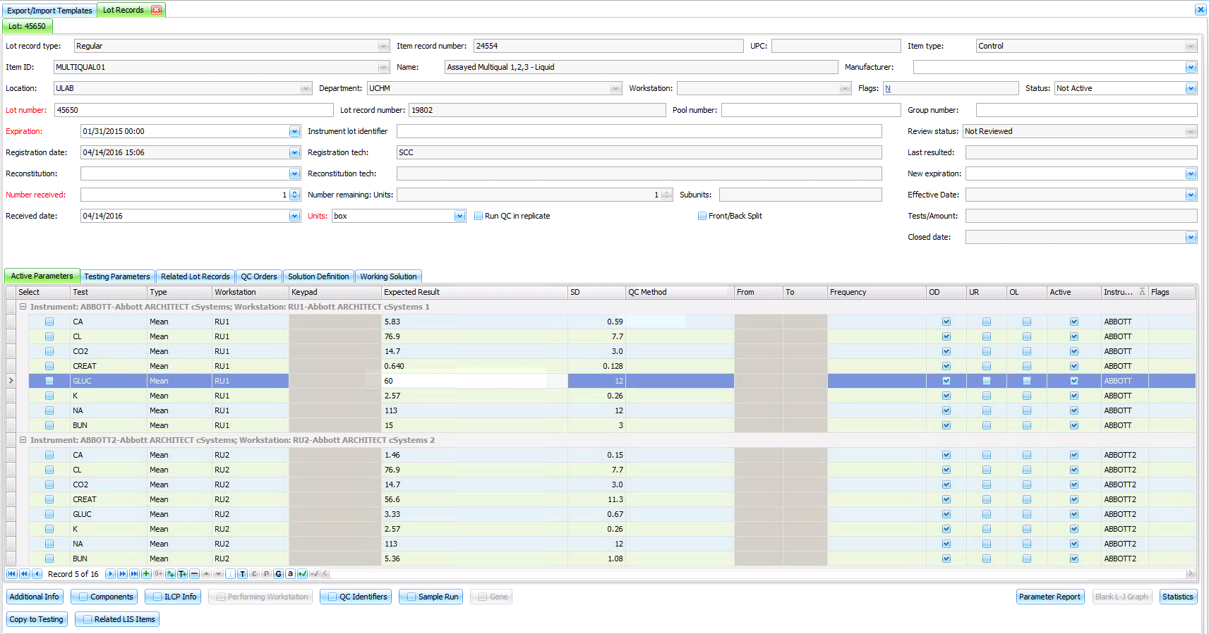
Updated Lot Expected Results

Slide 26


Lot Record Reviews
Designed to allow for the review of a Lot Record before the lot is put into use
Notes:
Beijing 2008 Olympic Gold Medal

Slide 27
Lot Record Review Option
Provides the ability to flag a lot record as acceptable indicating all testing is complete and lot can be placed into use
Similar functionality to that of Setup record reviews
User with access to Security Option 2000 is able to review Lot Records using the Review button
Review status is printed on applicable reports
Recommended for use when importing Lot Records with Parameter information into SoftTotalQC®, or updating a lot’s expected results using an Excel Spreadsheet
Notes:
Implemented in 1.0.4.0 (PCC-61158)
Release Note:
Inventory > Lot Records was enhanced. The system now provides the ability to set a Review status on a
Lot Record prior to placing the lot in active use, and can prevent the user from opening the Lot Record if it
has not been reviewed.
Benefit Note:
The addition of the flag "Prevent opening lot when not reviewed" to the Additional Information window >
Flags tab for QC Item setup records provides the ability to require a Lot Record Review prior to the Lot
Record being opened and put into active use.
Implementation Note:
The following field in QC Item Setup > Additional Information > Flags > Prevent opening lot when
not reviewed was added. When the flag is checked, the system requires users to enter a Review
Action for the Lot Record prior to an Open Lot action. If checked, the system will prevent the user
from setting the Status field in the Lot Record to Active without the Review Action documented. If
the flag is unchecked, the system will not require a Lot Record Review Action prior to opening the
Lot Record.

Slide 28
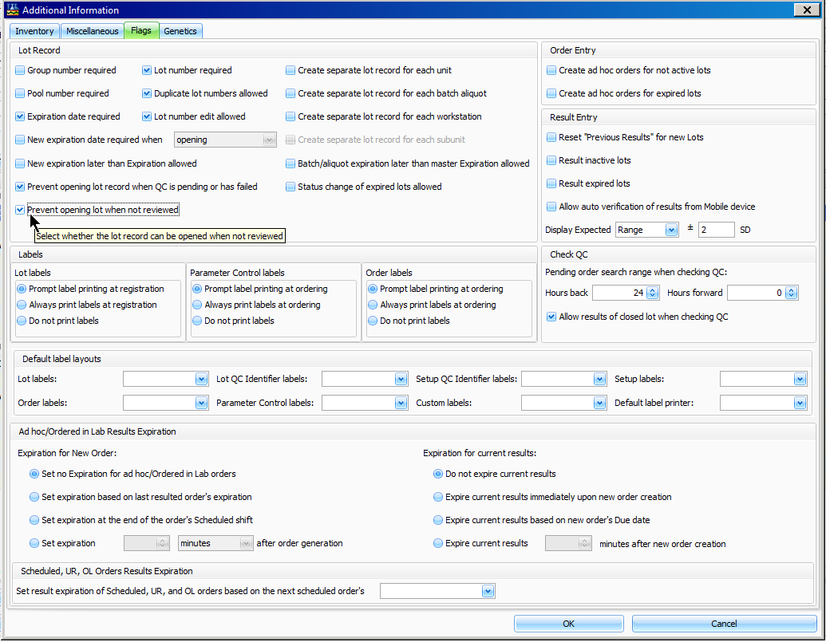
Lot Record Review Flag
In the Flags tab of the Additional Information window, the flag for ‘Prevent opening lot when not reviewed’ must be selected within the QC Item Setup record.
Notes:
Related/Required Security Options for the role assigned to users who will be permitted to perform Lot Record reviews:
2 - Inventory
270 Inventory - Override Lot Opening Restriction
1) If user has access to this option, the user shall be able to activate lots from Lot Records window, that have pending or failed results. The user is prohibited to activate the Lot Record that has pending or failed results via Lot Actions and Open Lot from launch bar.
2) If user has access to this option, the user shall be able to change status of the Lot Records from Not Active to Active or from Testing to Active, which are in Not Reviewed or Rework status and have 'Prevent opening lot when not reviewed' flag set in the Additional Info > Flags.
The user is prohibited to activate not reviewed Lot Record via Lot Actions and Open Lot from launch bar.
3) If user has no access to this option, the user shall be prohibited to activate lots from Lot Records window, that have pending or failed results.
4) If user has no access to this option, the user shall be prohibited to change status of the Lot Records from Not Active to Active or from Testing to Active, which are in Not Reviewed or Rework status and have 'Prevent opening lot when not reviewed' flag set in the Additional Info > Flags.
2000 Inventory - Lot Record Review
When user has access to this option, the system shall allow the user to review Lot Records.
When user has no access to this option, the user shall be prohibited to review Lot Records. When user attempts to review a Lot Record without access to this option, the system shall display the message 'Sorry, you do not have access to this option'.

Slide 29
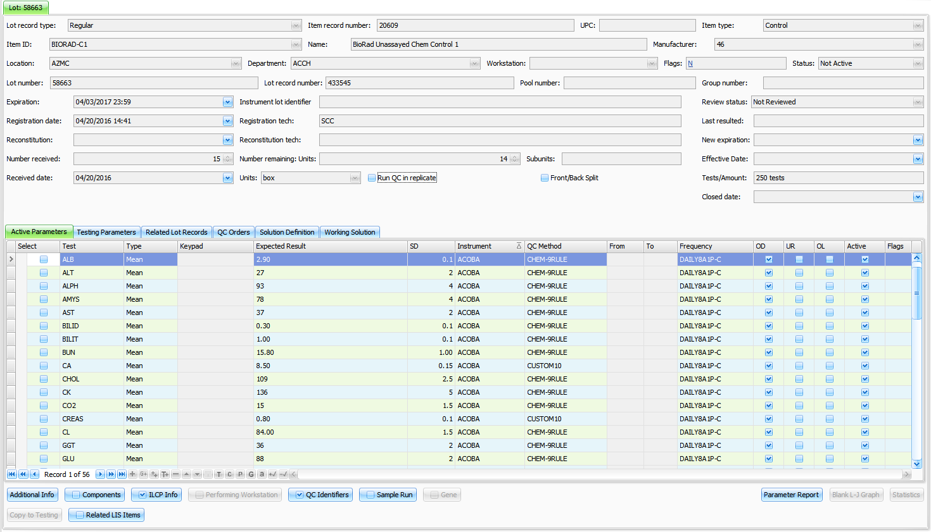
Lot Record Review Functionality
Reviewed status field now displays in the profile section

Slide 30
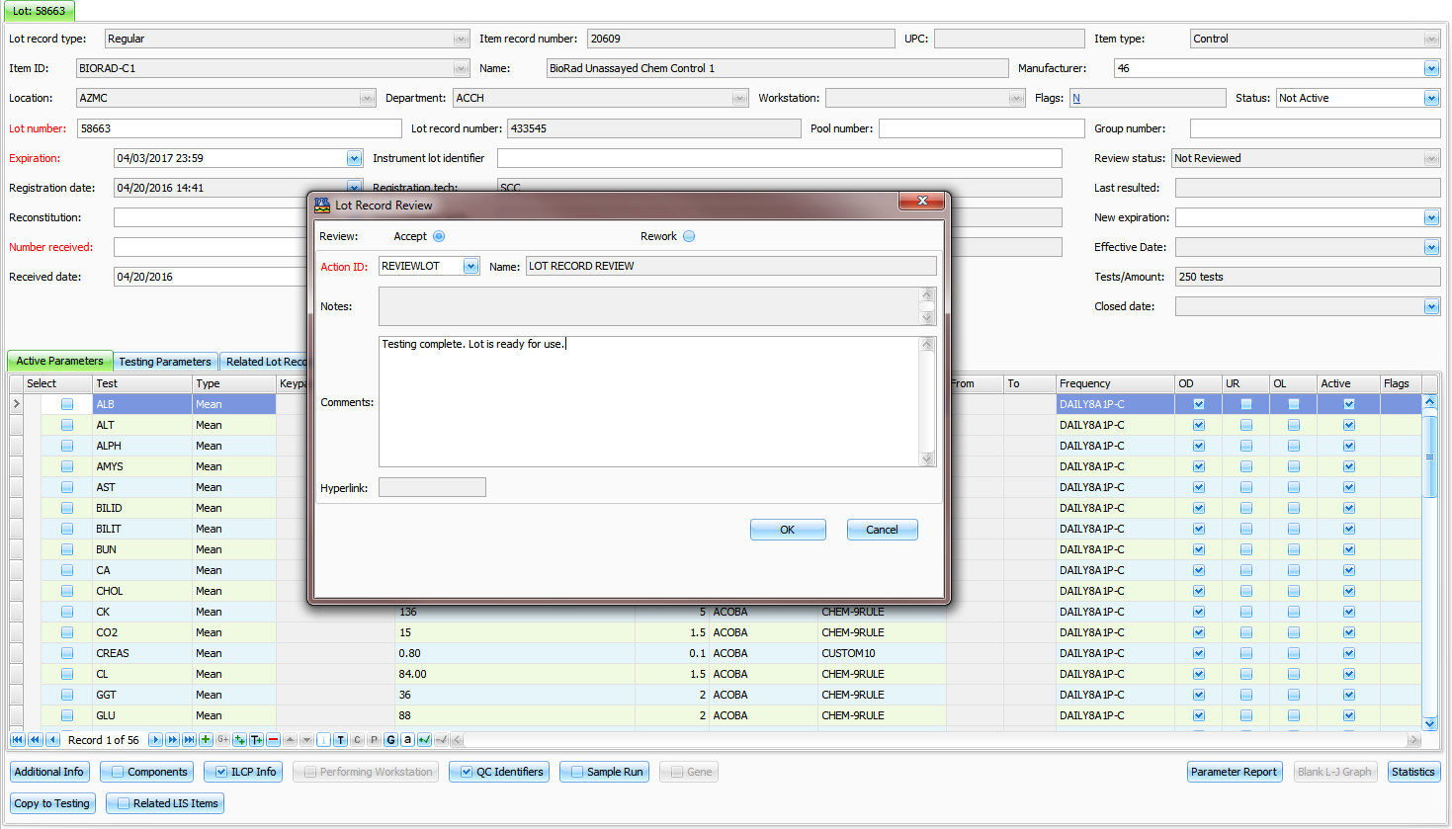
Lot Record Review Functionality
Lot Record Review window

Slide 31
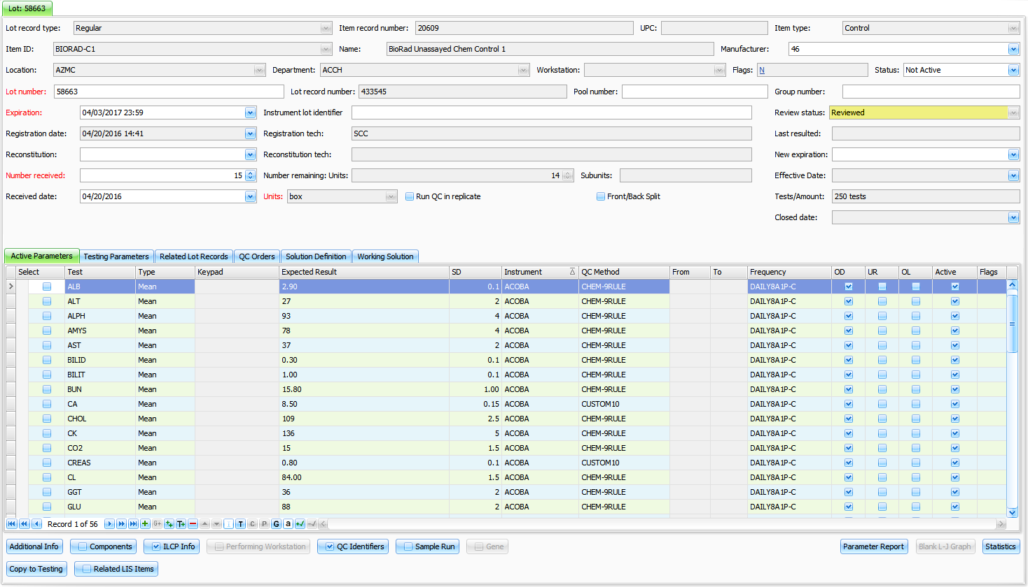
Lot Record Review Functionality
Lot Record Review status changes to Reviewed

Slide 32
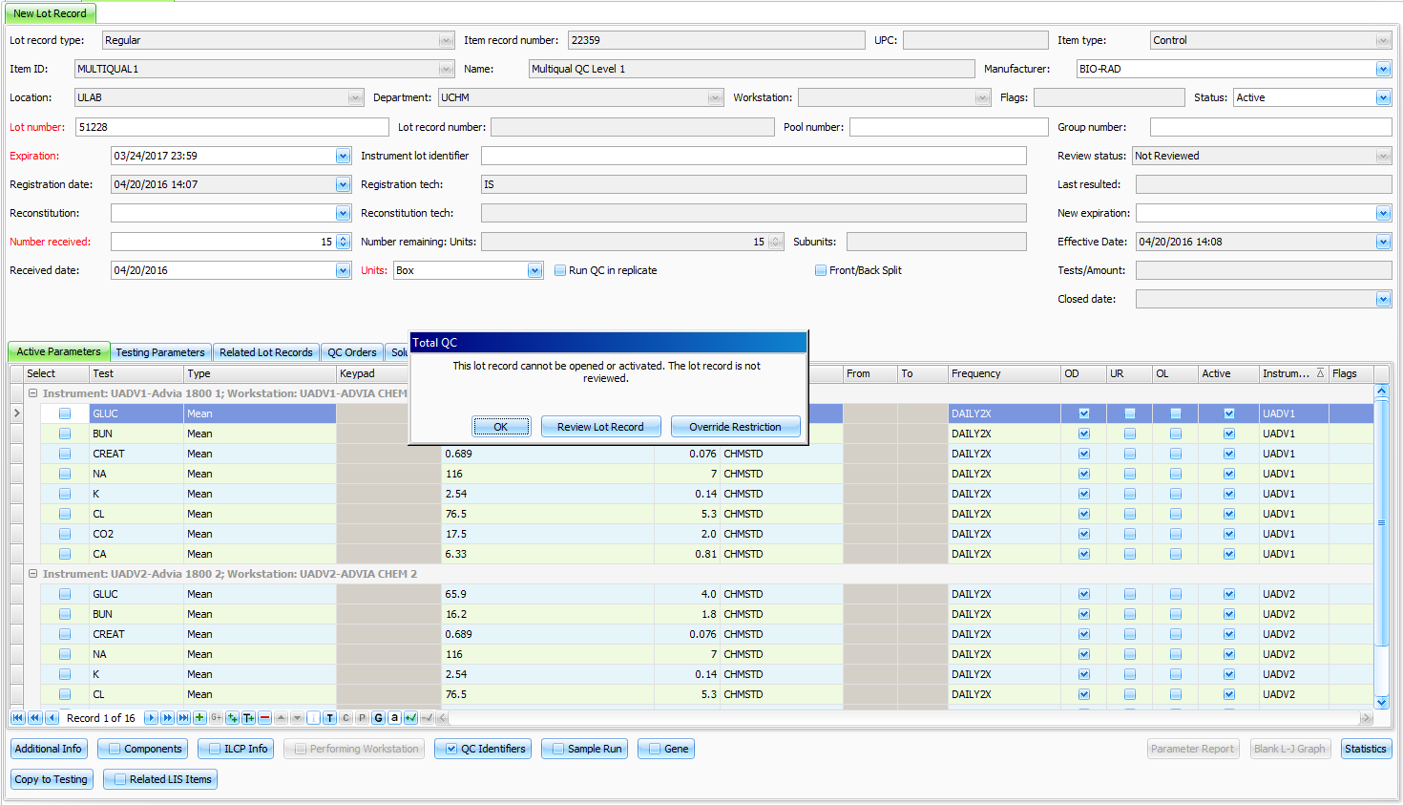
Lot Record Review Functionality
Change Lot Status to Active within the Lot Record
Notes:
TotalQC message displays if the user attempts to open or activate a lot record without the record being reviewed.

Slide 33
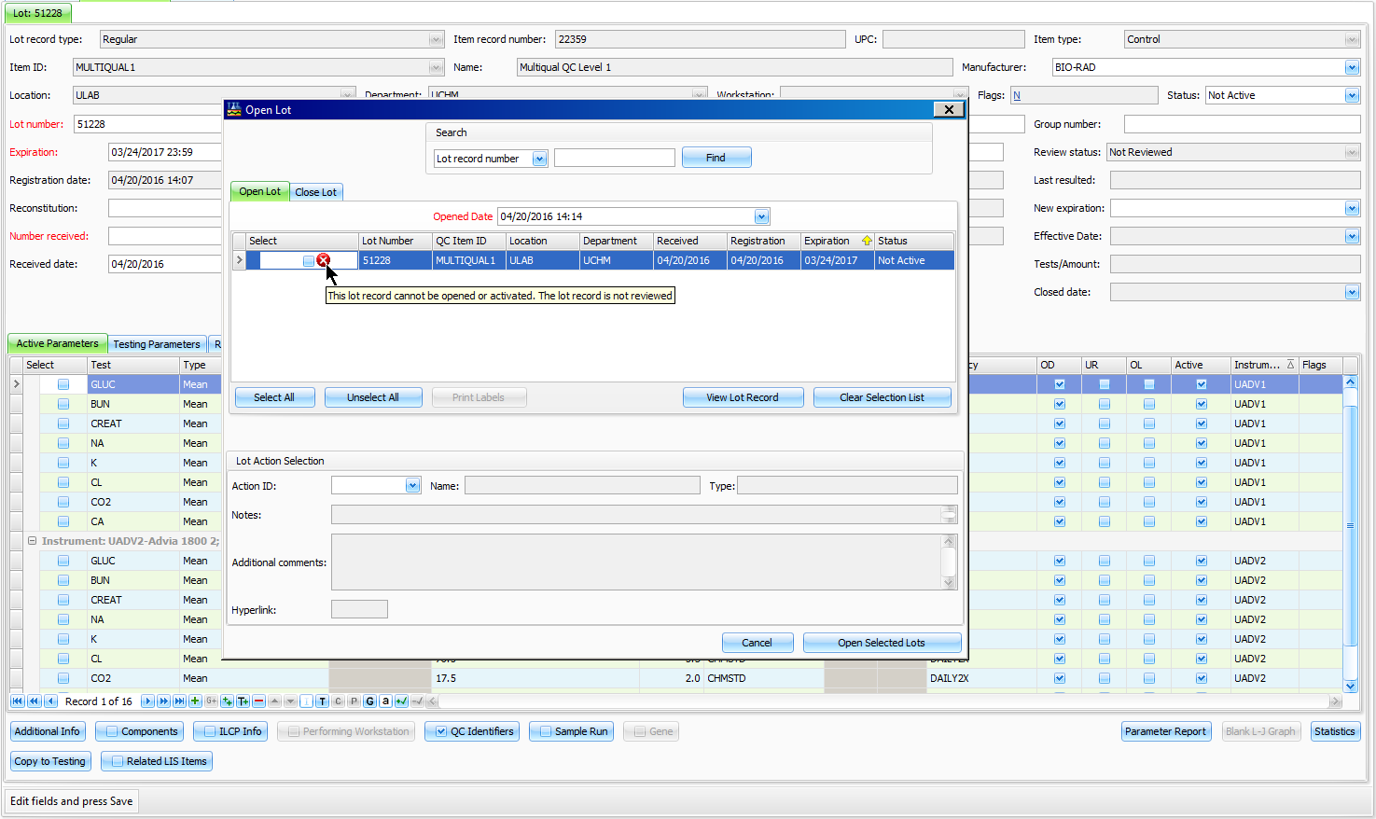
Lot Record Review Functionality
Open the lot via Lot Actions > Open Lot
Notes:
If the user attempts to open the lot using the Open Lot option, the system prohibits a user without access to Security Options 270 and 2000 from opening a lot with the Review status of Not Reviewed.

Slide 34

Quick Reviews
Designed to optimize performance when reviewing QC orders and results
Notes:
Turin (Italy - Torino) 2006 Olympic Gold Medal

Slide 35
Quick Review: Overview
Benefits
  Improved performance when reviewing a large number of records
  Eliminates RBS rule-checking
  Review Results and Review Order options available along with the Quick Review options
Available within:
Review Worklist
  Quick Review Orders
  Quick Review Results
Interactive Graph Report
  Quick Review Result
Notes:
Implemented in 1.0.4.0 (PCC-60446)
Release Note:
The Review > Review Worklist and Reports > Interactive Graph Report > Review was enhanced. The added Quick Review Results/Quick Review Orders buttons now provides the options to perform a faster save function for large numbers of records when reviewing orders and results by batch entry during the
Save process.
Benefit Note:
Quick Review process enables the system to reduce the time required to complete a Review and Save. Users are now able to choose the Quick Review, or original Review process.
Implementation Note:
This functionality requires that the user has access to existing Security review options 1201 - Review Worklist with one or more of the following options 12011 - Review Worklist - Review Level 1, 12012 - Review Worklist - Review Level 2, and 12013 - Review Worklist - Review Level 3 in SoftSecurity/User Management
for the ability to perform a Quick Review Results.

Slide 36
Review Worklist
Quick Review Process:
Select at least one qualified order to enable the buttons
Quick Review Orders or Results
For Results – select parameters to review
Enter a Review Action
Review flags are set
No other checks are performed in the background
No RBS rules checked – no notifications will be sent if using the Quick Review function

Slide 37
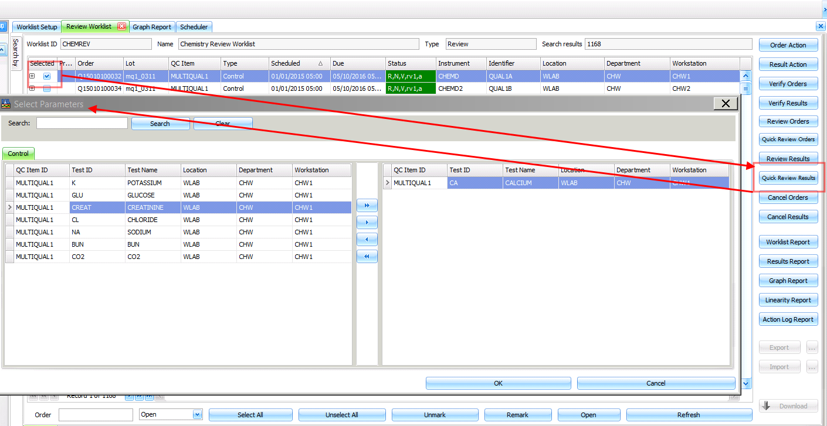
Quick Review Results

Slide 38
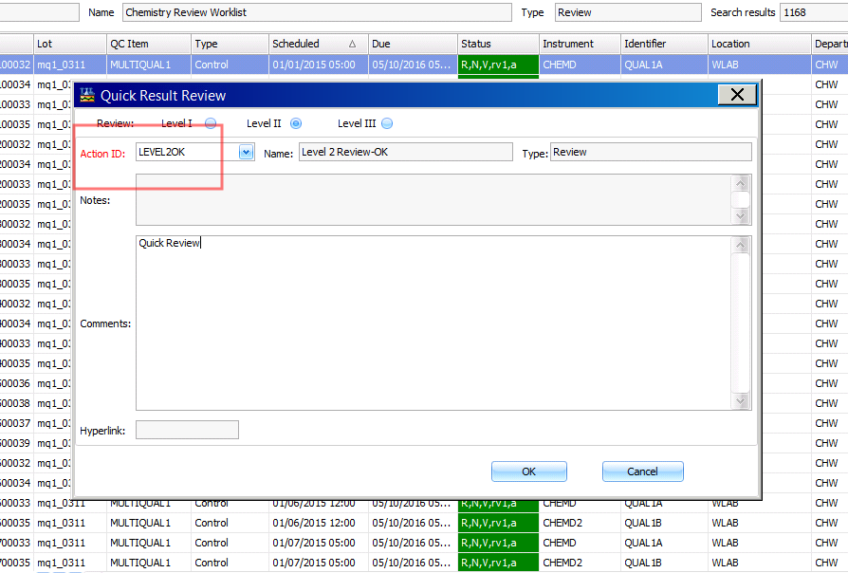
Quick Review Results

Slide 39
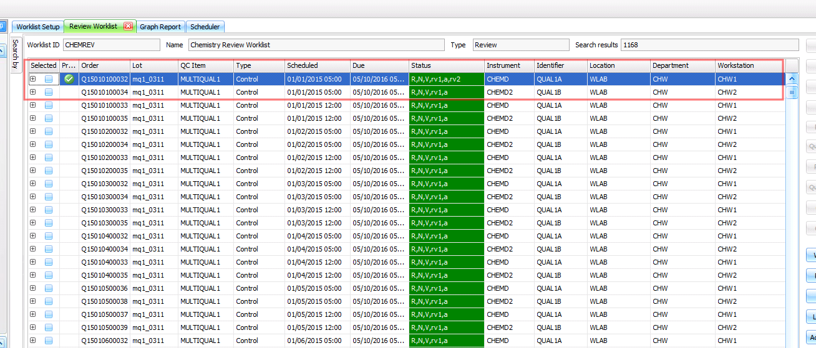
Quick Review Results

Slide 40
Interactive Graph Report: Quick Review Results
Quick Review Process:
Run an Interactive Graph Report
Select records from the Result Points grid
Click the Quick Review Result button
Add Review Action
Save changes

Slide 41
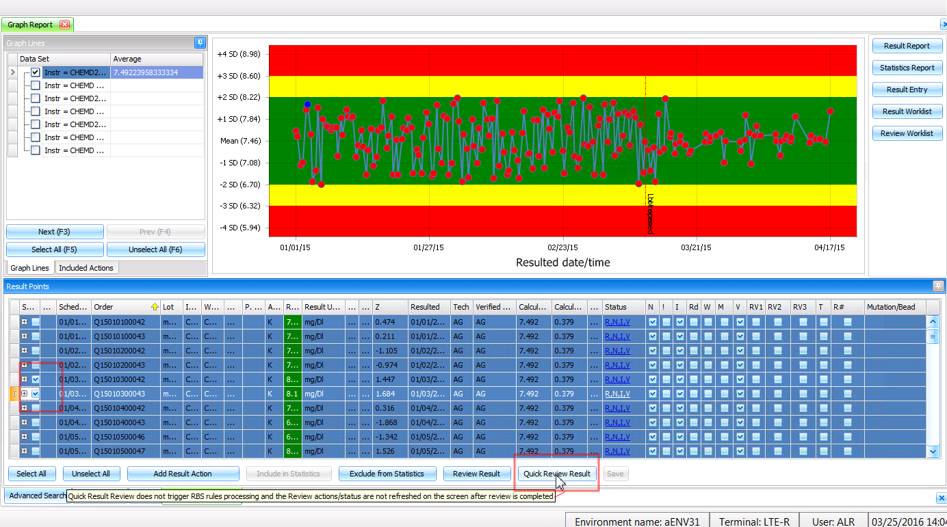
Interactive Graph Report: Quick Review Results

Slide 42
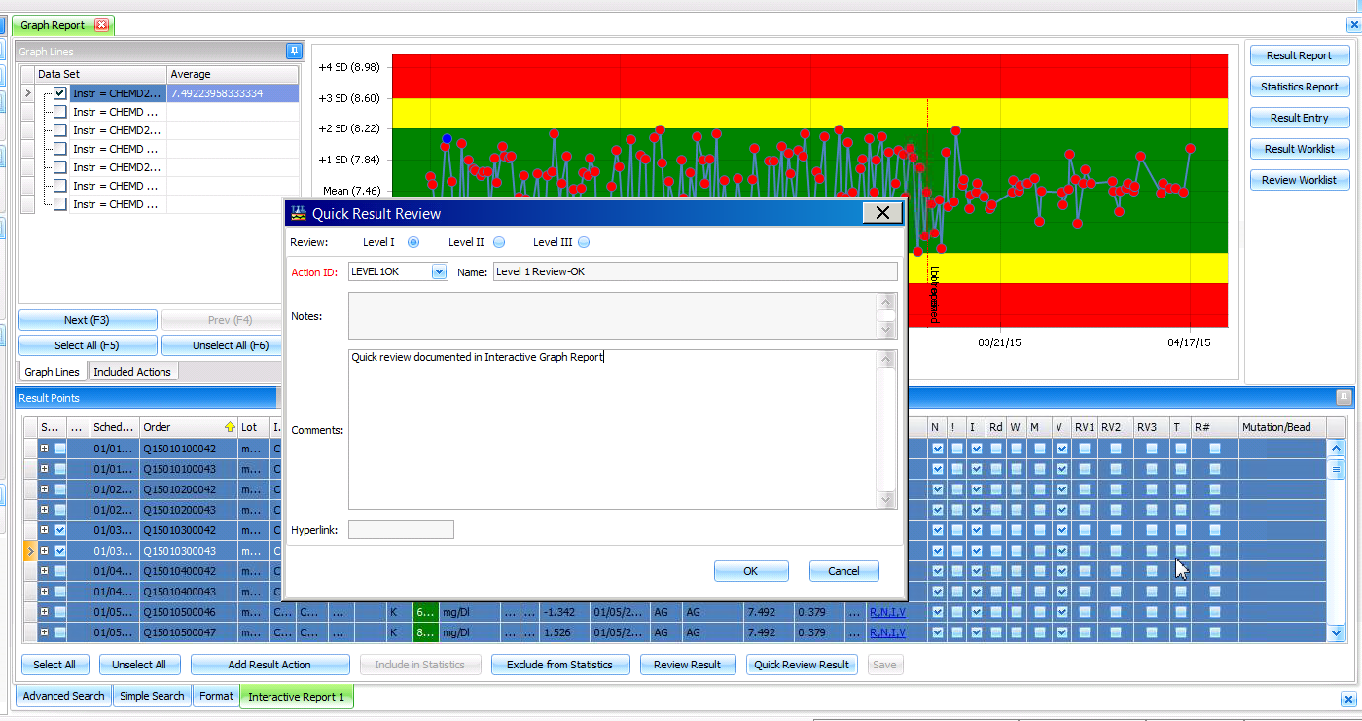
Interactive Graph Report: Quick Review Results

Slide 43
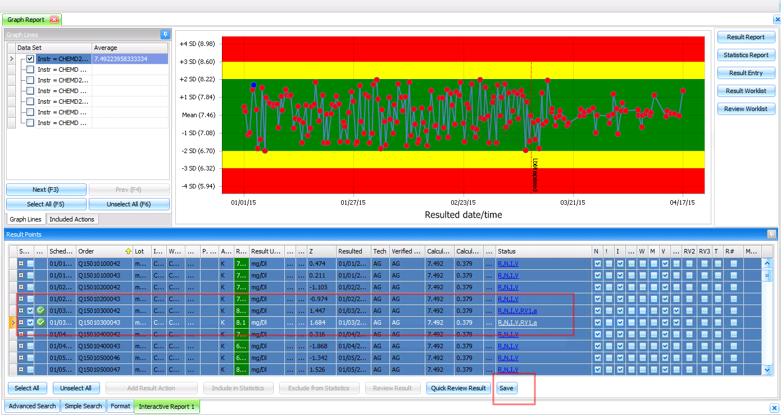
Save to Complete

Slide 44


Pre-Posting QC Validation
Designed to provide the ability for the user to view a color flag, the expected results, and the QC status before posting results from the SoftLab Instrument Menu
Notes:
Athens 2004 Olympic Gold Medal

Slide 45
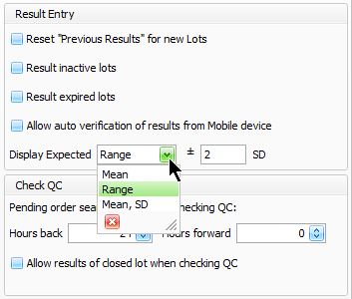
Pre-posting QC Validation
Provides the ability for the system to display a color flag, the QC status, and the expected results for unposted QC results in the Lab Instrument Menu
The Expected Results are displayed in the format defined in the QC Item Setup record > Additional Information window > Flags tab > Result Entry section:
  Mean, only
  Range +/- defined SD range
  Mean and SD
SoftLab Hosparam: GUI_IE_result_grid
  Controls what columns display in the
  Instrument Menu grid by default
Notes:
Changes for Lab were done in 4.5 only. This functionality does not apply when SoftTotalQC is run on an environment with Lab 4.0.
Before posting, when the user opens the Instrument and selects a QC order in the order list, the system queries SoftTotalQC lot records for the QC identifier, test/workstation, resulting D/T and temporarily validates the QC result against the Expected result. Based on the validation, the system will display a green, yellow, or red icon in the Flags column field.

Slide 46
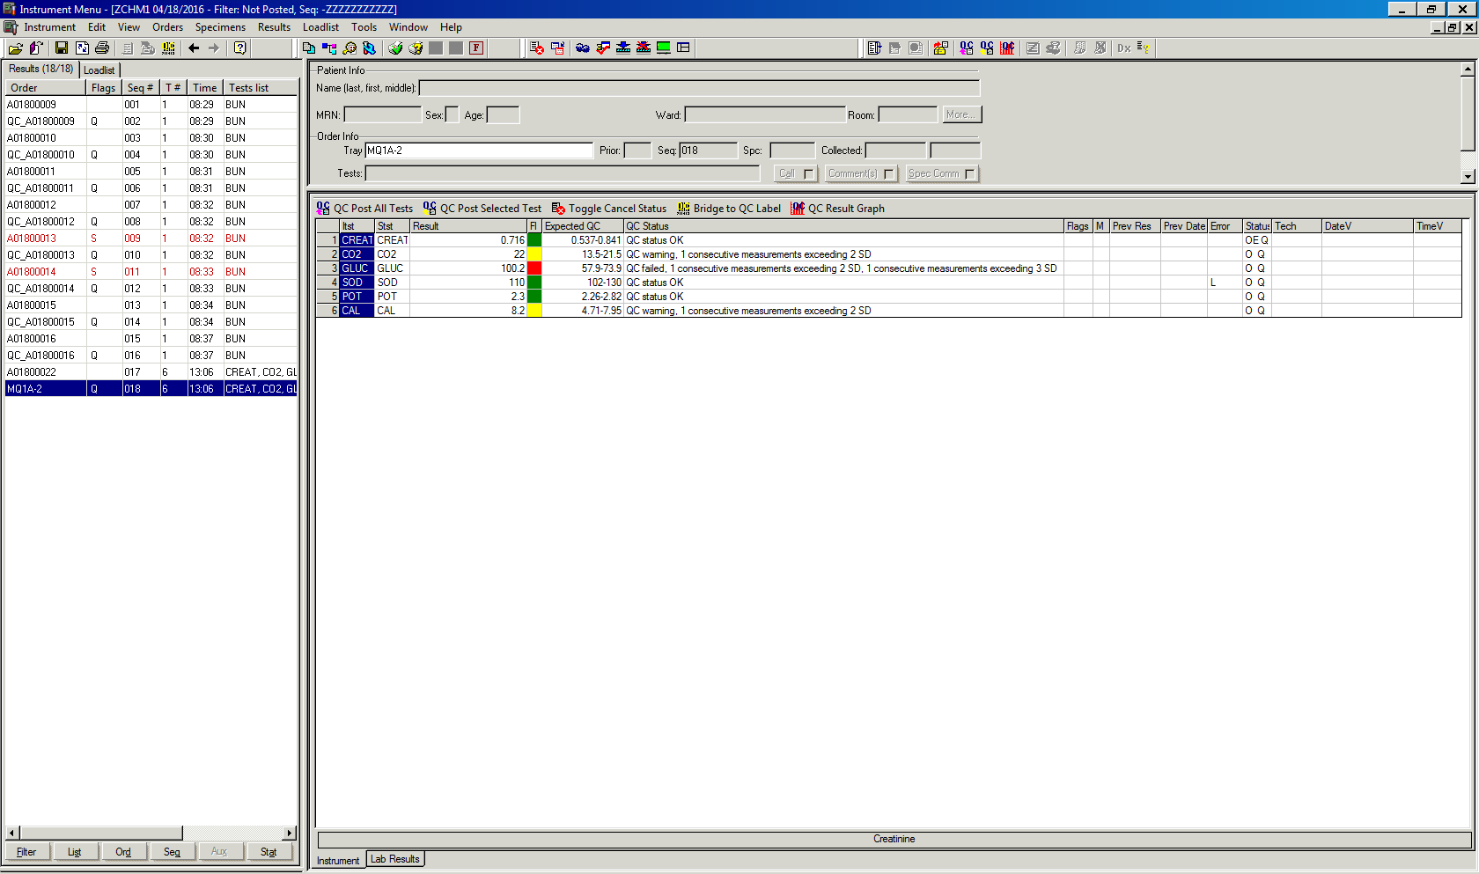
Pre-posting QC Validation
Notes:
Implemented in 1.0.3.9 (PCC-58973)
Release Note:
The SoftLab > Instrument Menu functionality was enhanced. The Instrument Menu now provides the ability to view the expected QC results and result validation color flags.
Benefit Note:
The addition of the "Expected" and "Fl" columns to the available columns within the SoftLab Instrument Menu enable the user to view more complete information about the QC results while entering, posting, and verifying QC results as part of their normal workflow.
Implementation Note:
This functionality requires that the user add the "Expected" and "Fl" columns to the Instrument Menu grid via the Column Chooser, accessed via the Context Menu. They may not display in the grid by default.

Slide 47
PrevalidateInstrumentQC System Setting
Provides the ability to control whether the system performs the pre-posting QC validation.
Accepted values:
  Empty value – disable the Please Wait message while the system is performing the pre-posting QC validation to speed performance during the QC result validation (system default)
  PleaseWait – display a Please Wait message while the system is performing the pre-posting QC validation
  Disabled – disable the pre-posting QC validation within the SoftLab Instrument Menu, altogether
System Setting: SoftTotalQC\LabIntegration\PrevalidateInstrumentQC

Slide 48
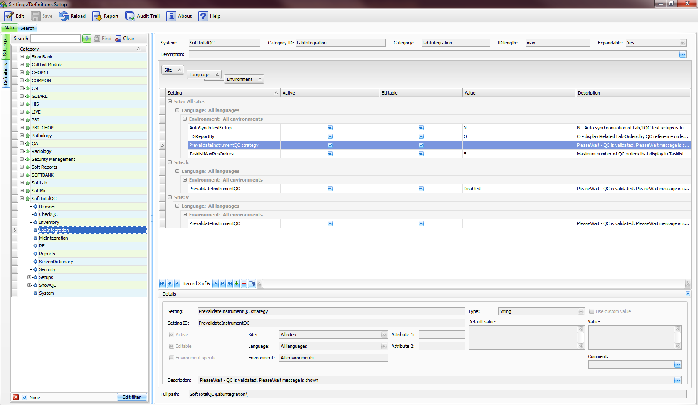
PrevalidateInstrumentQC System Setting

Slide 49
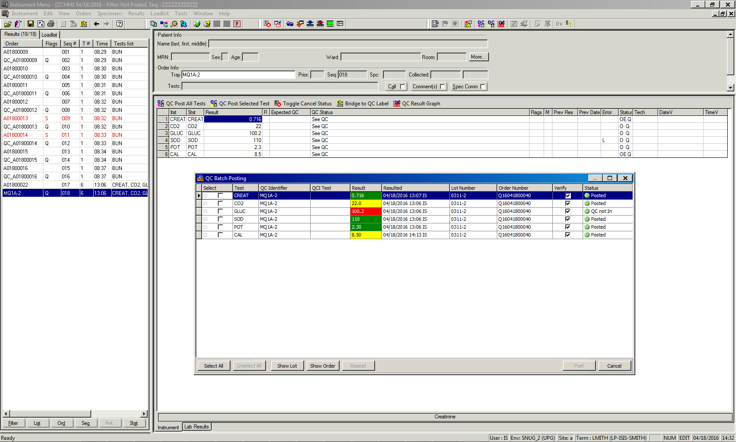
QC Results Graph
Provides the ability to display the Result Graph for all tests on a QC order from the SoftLab Instrument Menu
Available for Mean and Range type results
Last 30 result points are displayed, including the current results that are not yet posted
Result value, date and time of resulting, and Tech initials are displayed in a tooltip when the user hovers the mouse pointer over a result point
Cross icon is displayed in the QC Result Graph for an unposted QC result
Results are displayed by the Resulted date/time
Includes a Result Points section that is hidden by default
Notes:
Please note: The system will display an empty Results Graph window if the user invokes the QC Result Graph for orders with any other inappropriate result types.

Slide 50
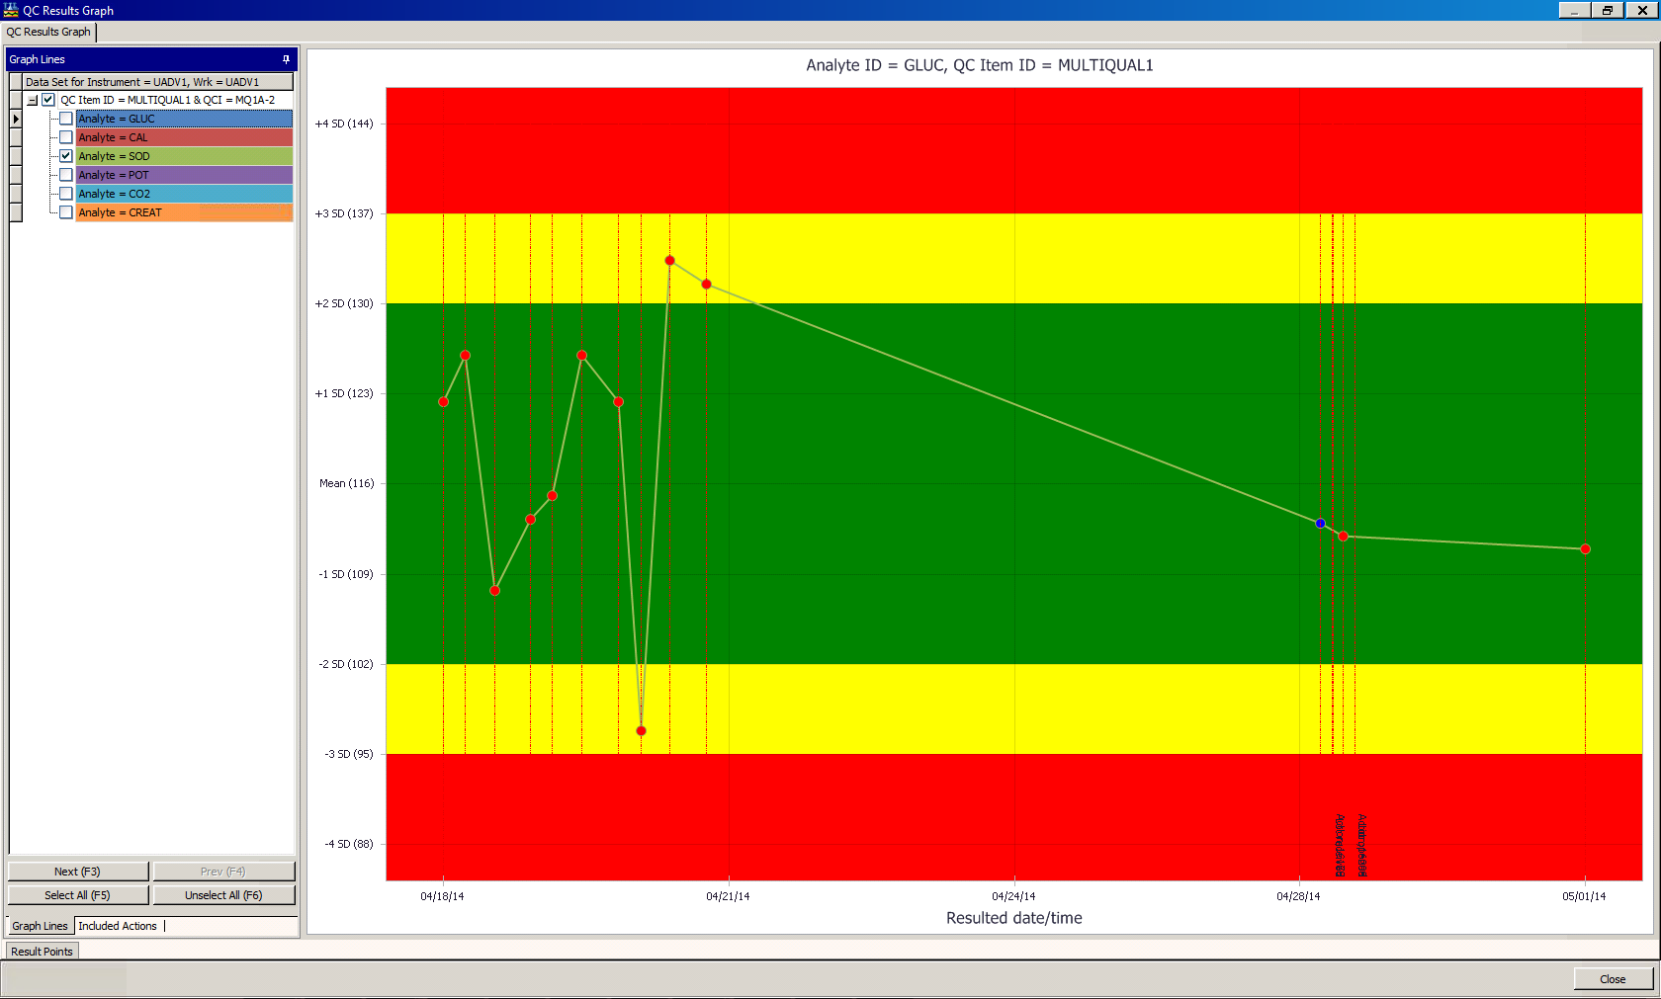
QC Results Graph
Default view of QC Result Graph
Notes:
Default view

Slide 51
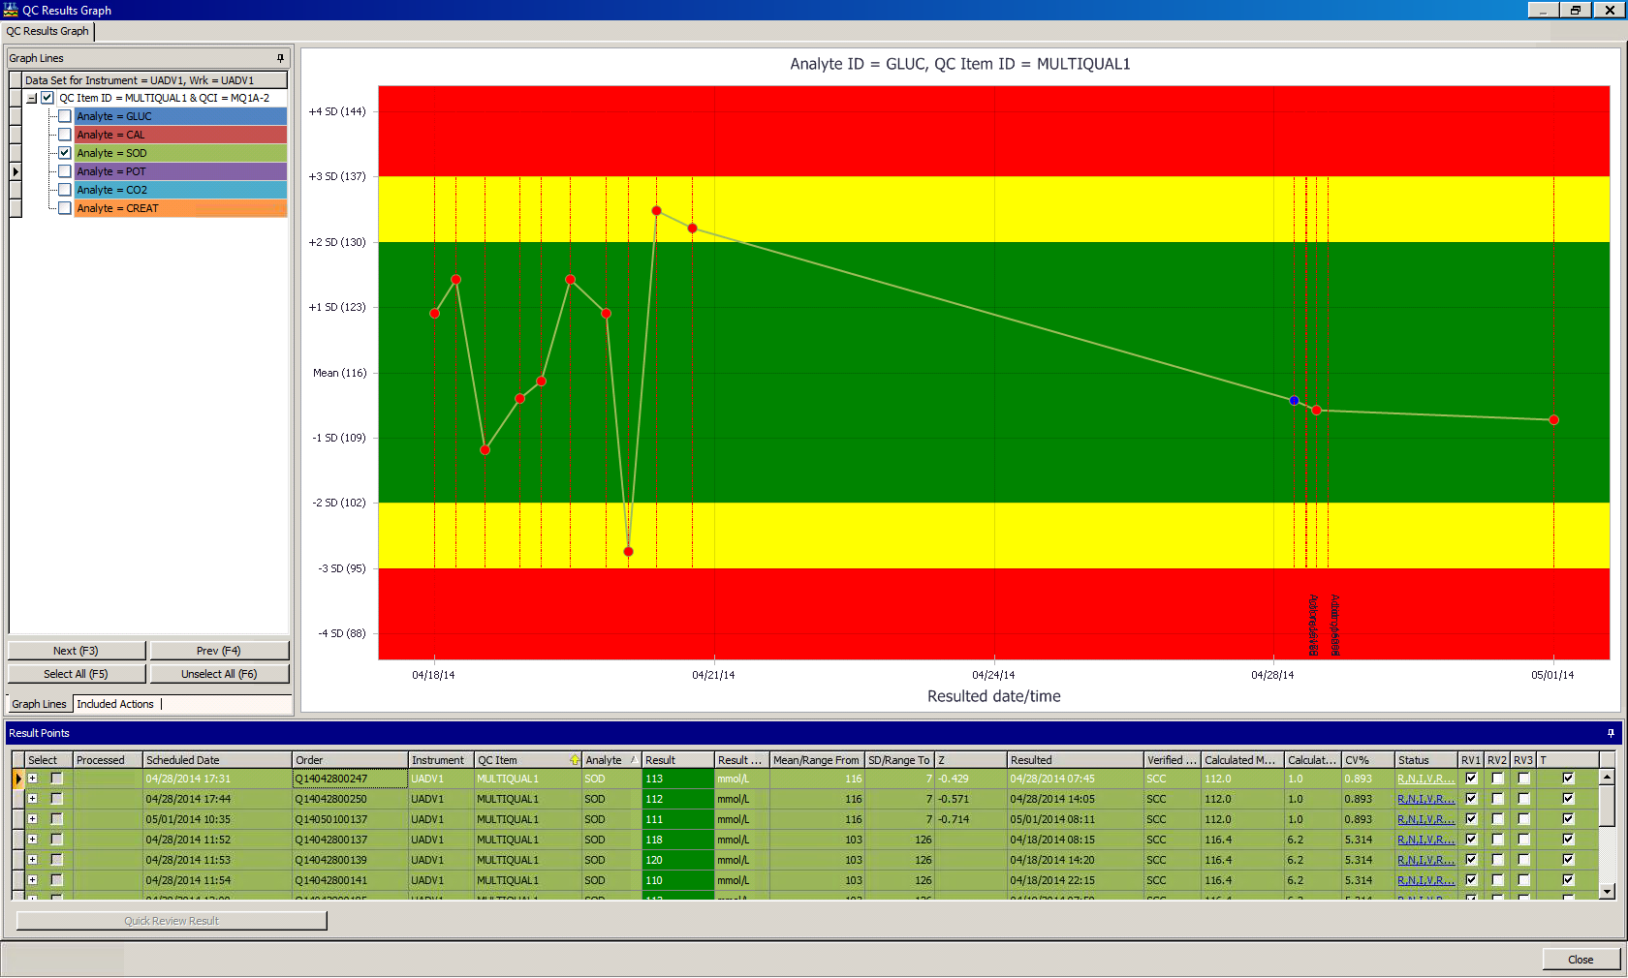
QC Results Graph
QC Result Graph with Result Points tab opened
Notes:
View with Result Points grid opened and pinned.

Slide 52

SoftTotalQC®
Web Mobile Application
Designed for the Motorola MC40 Mobile Computer
Notes:
Salt Lake 2002 Olympic Gold Medal – Medals were made in the shape of river rocks, like those found in Salt Lake streams and rivers

Slide 53
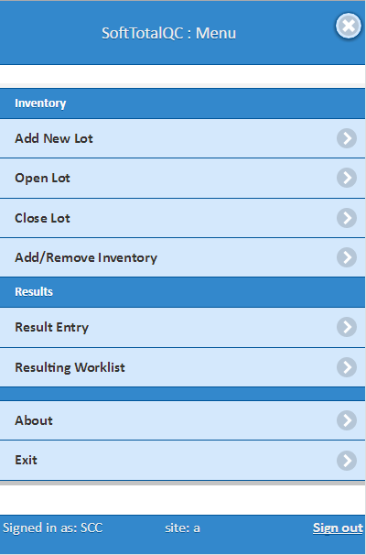
General Information
Designed for Motorola MC40 and Android OS
Supports touch screen, barcode scanner, and landscape mode
Installed from Soft Update
Provides Inventory and Resulting functionality
Controlled by Security Options
Notes:
SoftTotalQC Web Mobile Application has functionality similar to SoftTotalQC for PDA Motorola MC55, MC70, MC75 models.
SoftTotalQC Web Mobile Application was designed to work via Internet Browser and on Android OS.
Security options for SoftTotalQC Web Mobile:
9 - Mobile
This option will allow user access to SoftTotalQC functionality from Mobile client (Web application and PDA).
90 - Inventory - This option will allow user access to the Inventory database from the PDA/ Web mobile application.
900 - Mobile Inventory - Add New Lots. This option will allow user access to adding new lots through the PDA/Web mobile application.
901 - Mobile Inventory - Open Lots. This option will allow the user access to opening new lots through the PDA/Web mobile application.
902 - Mobile Inventory - Close Lots. This option will allow the user access to closing existing lots through the PDA/Web mobile application.
91 - Worklist.
This option shall control ability to select 'Resulting Worklist' option from the mobile device.
9110 - Result Worklist - Enter Results.
This option shall control entering results in the order (both: in control and out of control) from Resulting Worklist module.
9111 - Result Worklist - Verify Order/Results.
This option shall control Verification of entered results.
9113 - Result Worklist - Action Results.
This option shall control entering of corrective action.
92 - Result Entry
This option shall control entering results in the order (both: in control and out of control) from Result Entry module.
9232 - Result Entry - Results - Verify All.
This option shall control Verification of entered results.
9235 - Result Entry - Corrective Action Window
This option shall control entering of corrective action.

Slide 54
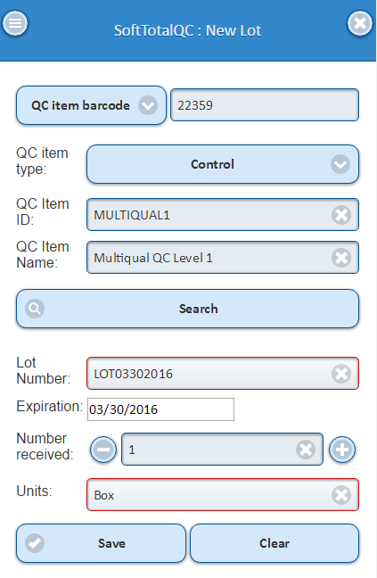
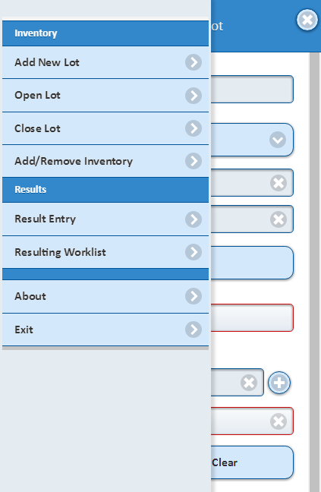
Inventory: Register Lots
Pop-up Menu button
Find QC item (accepts UPC)
Enter required information
Click Save
User Tip:
Use the Pop-up Menu for quick navigation!
Notes:
QC item barcode/UPC lookup allows user to search QC item by scanning QC item setup or UPC label
QC Item ID and QC Item Name fields allow user to search QC item by entering ID or Name
User is able to define QC item type for narrowing search by QC item ID or Name
Convenient pop-up Menu

Slide 55
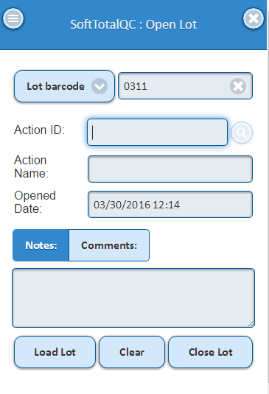
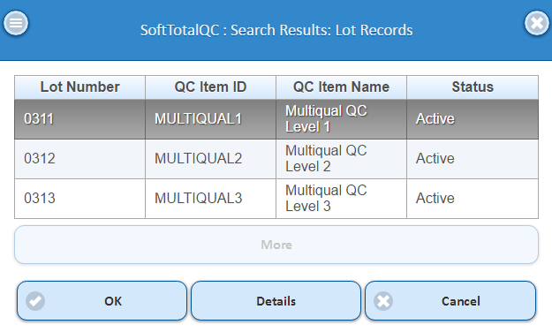
Inventory: Open/Close Lots
Scan Lot label or Lot Number
Load Lot
Open/Close Lot
User Tip:
Double-tap the screen to select an item.
Notes:
Lot Barcode/Lot Number field allows user to search lot by scanning Lot label or entering Lot number
To enable Landscape Mode set corresponding setting on MC40 and enable auto-rotate

Slide 56
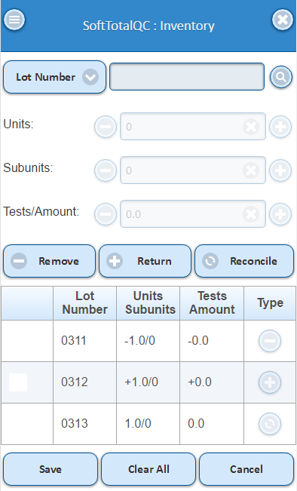
Inventory: Add/Remove
Scan Lot label or Lot Number
Use spin controls to select the number of Units, Subunits, or Tests/Amount
Remove/Return/Reconcile
Save
User Tip:
Process a few lots at a time!

Slide 57
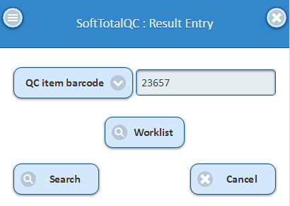
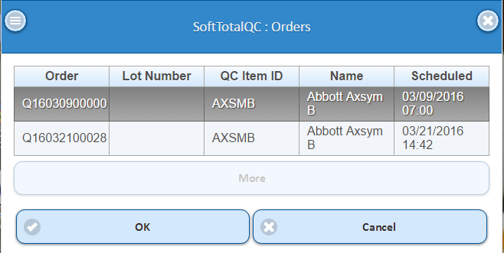
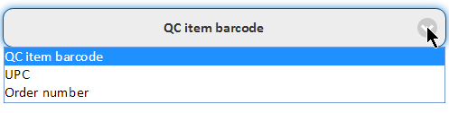
Result Entry: Search
Scan QC Item label, UPC barcode, Order label, or use a Mobile Resulting Worklist for an orders search
Select Order from search results (double-tap screen)
Notes:
QC item barcode/UPC/Order lookup enables search by QC item barcode, UPC barcode or Order number

Slide 58
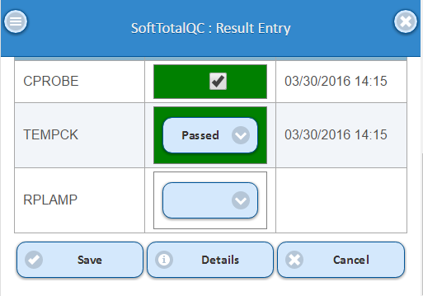
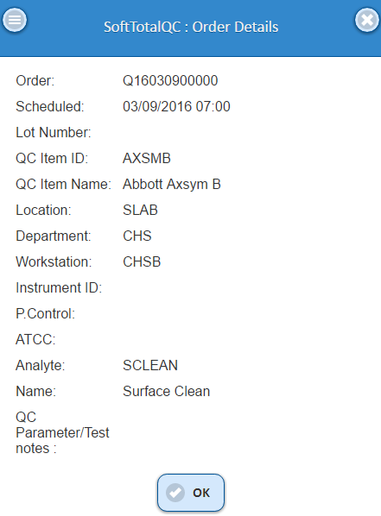
Result Entry: Enter Results
User Tip:
Click Details to view Order info

Slide 59
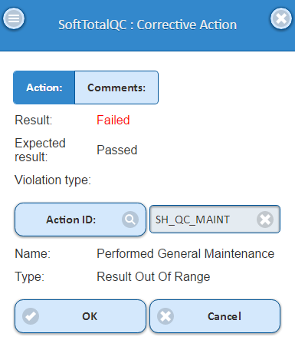
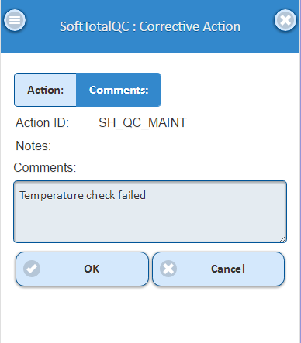
Result Entry: Corrective Action
Corrective Action window
Tap on Comments
User Tip:
Click Comments to enter additional information
Notes:
Select an Action and enter a Comment

Slide 60

Mobile Worklist: Setup of Template
Select Mobile: Yes

