Slide 1
SCC SoftUpdate
Automated
Update
System

Slide 2
SoftUpdate is SCC proprietary deployment system for MS Windows platforms and mobile devices (e.g. PDA, Android) that …
Automatically discovers and loads new software patches and incremental hot-fixes.
Easy performs initial deployment from scratch, uninstalls or removes obsolete software modules from update targets.
Provides consolidated management console that helps SoftUpdate administrator easy to manage and interact with individual update targets and groups.
Keeps software and hardware inventory for every single update target.
Has built-in scheduler, interactive messenger, off-line commands, troubleshooting facility and other useful features that help with daily desktop support tasks.
Offers new deployment strategy called “One-Click-Deployment” (AKA: OCD) or “Soft Update Plus”.
Note: SoftUpdate 3.0.3.x is backward compatible with all previously released Soft Update versions 3.0.1.x and 3.0.2.x, which means it can be used with any SCC software release or deployment configuration.

Slide 3
SCC “One-Click-Deployment”
Virtually eliminates software deployment on PC. Installation package is installed only one time on update server and there is no need to have it installed on every single PC.
User, network and resource friendly that checks and automatically updates application on startup.
Efficient “dependency update” mechanism that supports recursion and shared dependencies.
Offers GUI application jumpstart directly from URL (e.g. Web page, email or messenger).
Offers flexible customization rules to publish One-Click-Deployment application per selected target or group of targets.
Does not depend on the usage of existing third party installers (e.g. as MS Installer) or packaging frameworks (e.g. InstallShield). As a result SCC One-Click-Deployment approach does not inherit well-known third party deployment problems and issues we facing in the past in the context of old installations we now call “Legacy” deployment approach.

Slide 4
Comparing “One-Click” with “Legacy” deployment
Description | One-Click | Legacy
The possibility to check software discrepancy on application start-up and automatically perform update if it's needed | Yes | No
Possible problems to automatically reload multiple hot-fixes in the different order | No | Yes
Possible problems to rollback individual hot-fix | No | Yes
Sporadic unsolvable problems with Microsoft Installer on selected PC | No | Yes
Possible problems with Major Upgrade | No | Yes
Possible deployment impact between different instances for the same product | No | Yes
Multi-Instance limitation and redundant packaging per instance | No | Yes
The possibility to automatically rollback software patch, service pack or release | Yes | No
High efficient nested dependencies automated update | Yes | No
Application JumpStart from URL (Web page or E-mail) | Yes | No
Consolidated and intuitive application launcher on PC for all available applications and environments with customizable content per individual PC | Yes | No

Slide 5
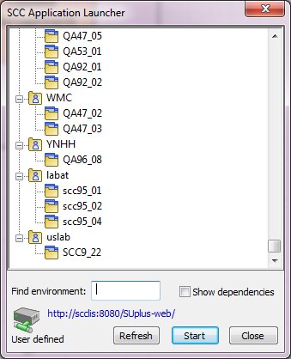
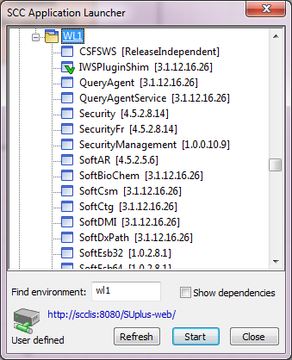
Application Launcher on PC

Slide 6
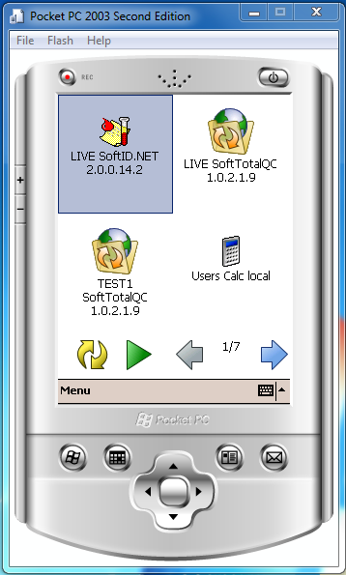
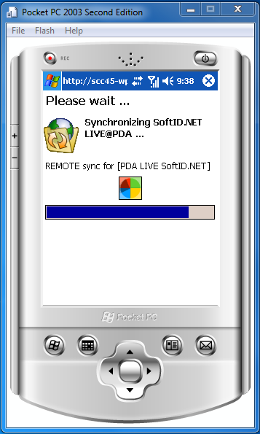
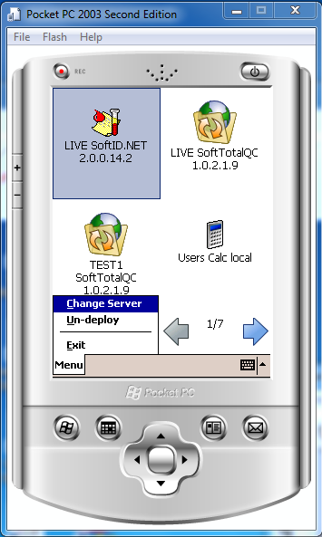
Application Launcher on PDA

Slide 7
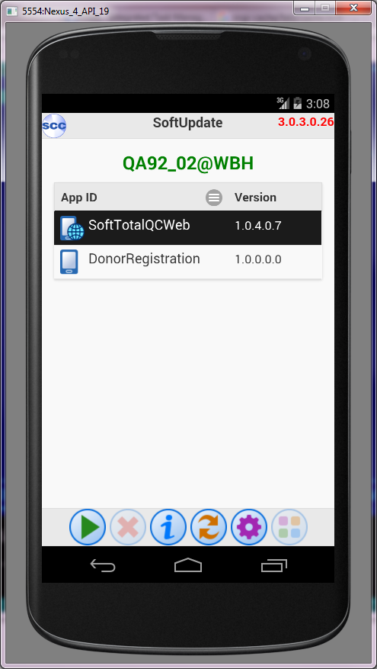
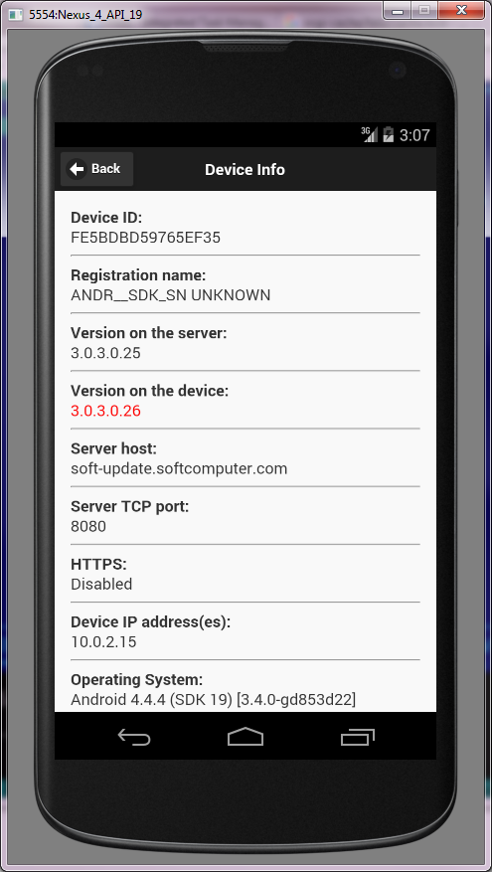
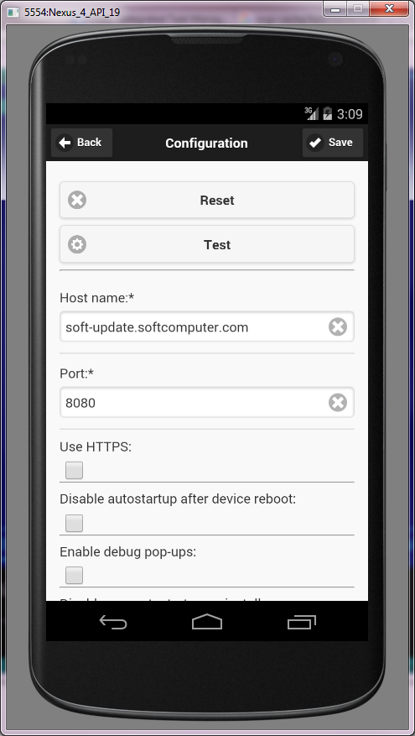
Application Launcher on Android

Slide 8
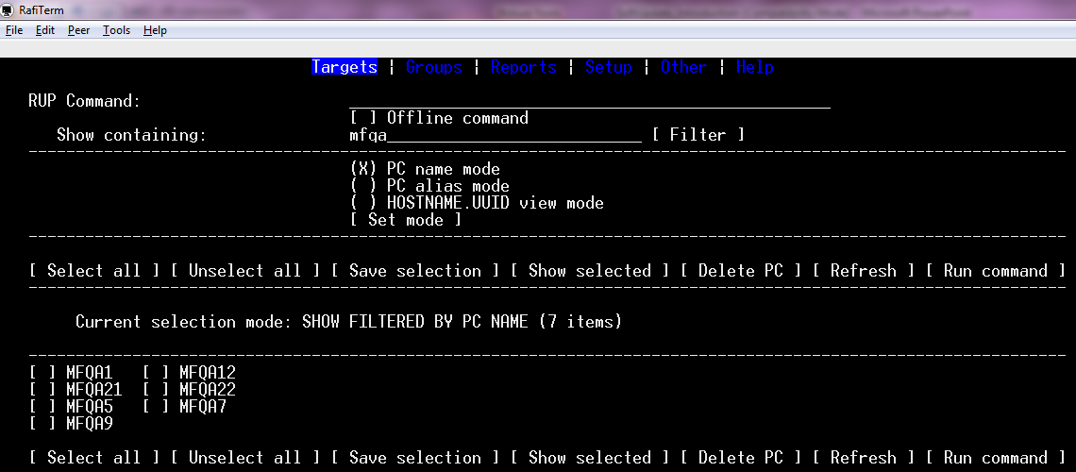
Old Web-based UMC 3.0.2 client
(Console Web browser)

Slide 9
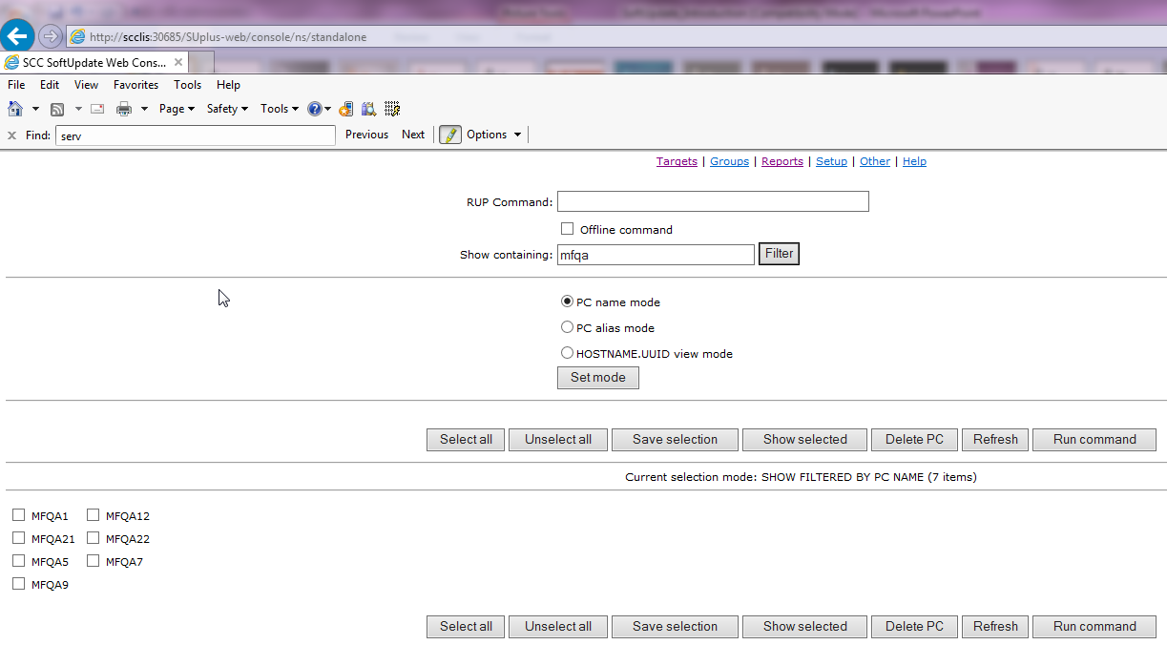
Old Web-based UMC 3.0.2 client
(GUI Web browser)

Slide 10
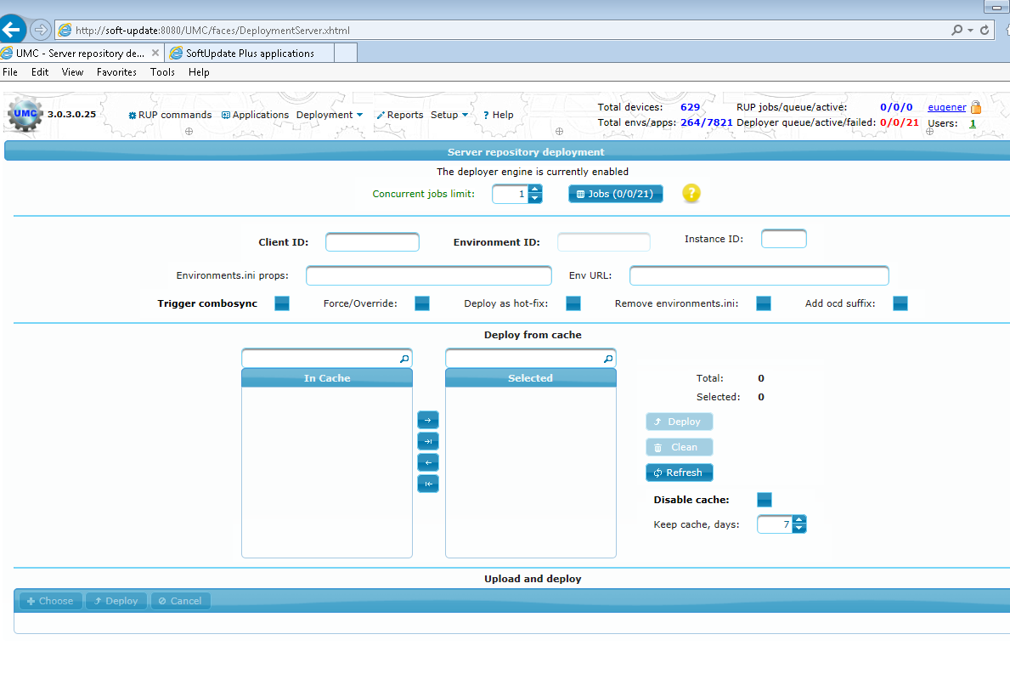
New Web-based UMC 3.0.3 client
(GUI Web browser)

Slide 11
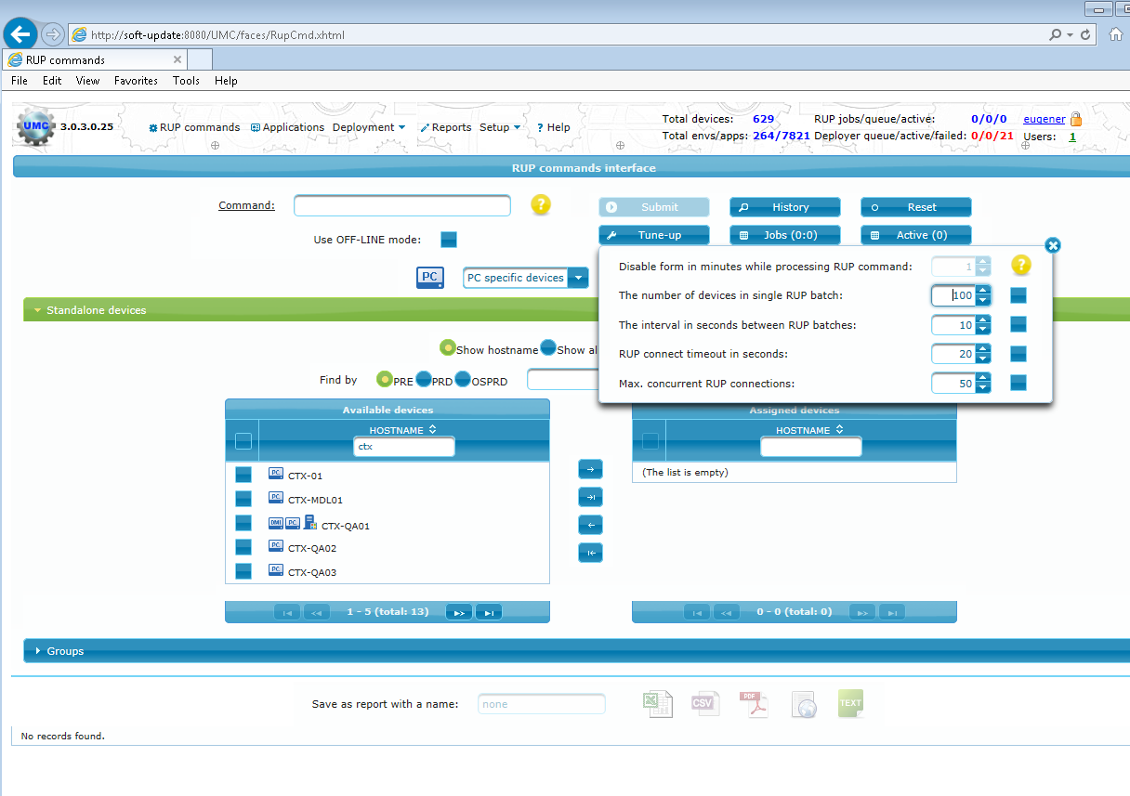
New Web-based UMC 3.0.3 client
(GUI Web browser)

Slide 12
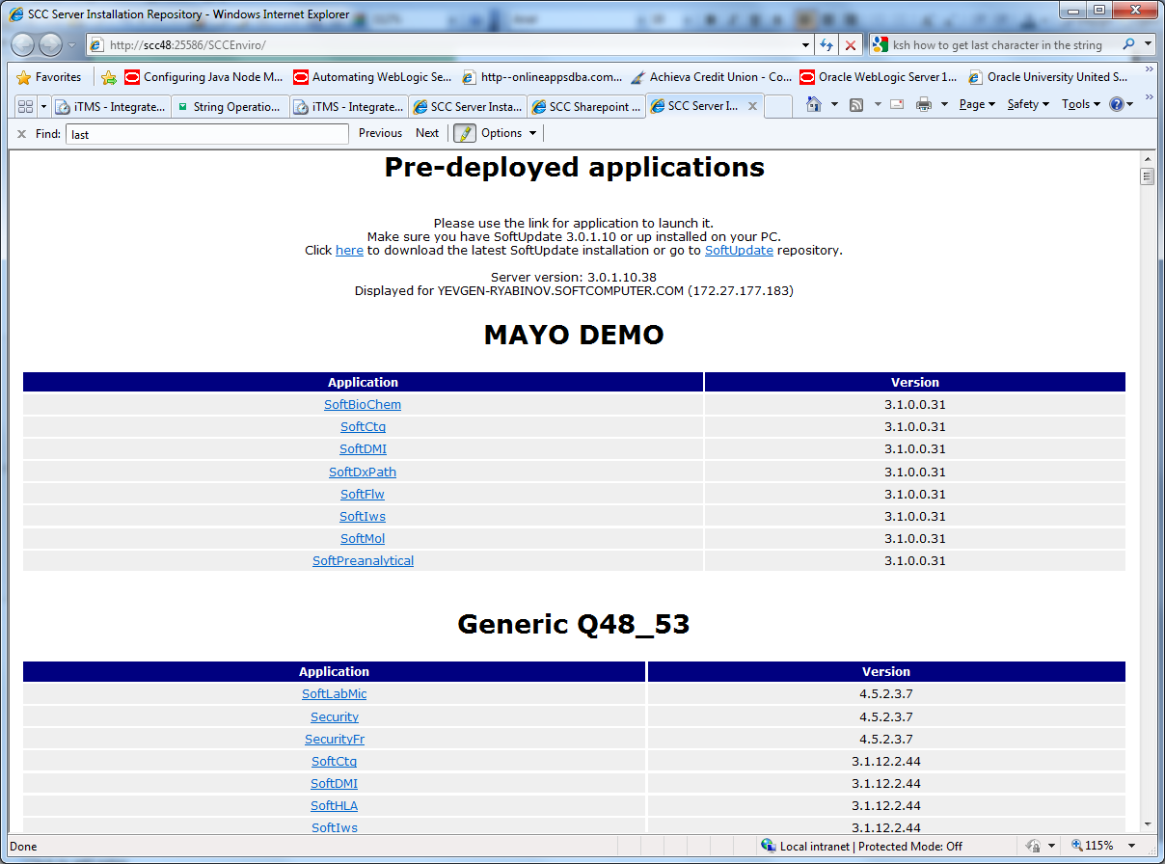
Internet Browser Launcher
Old SoftUpdate 3.0.2

Slide 13
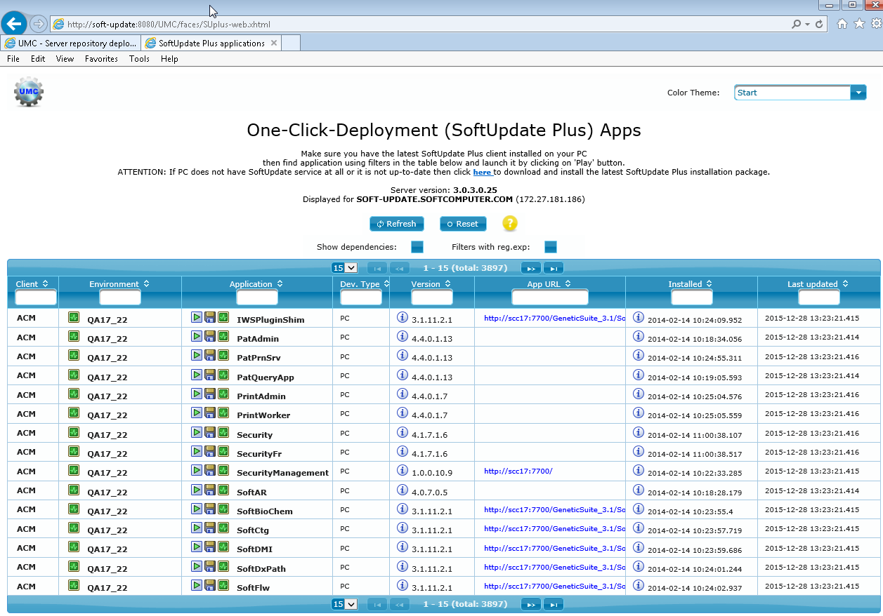
Internet Browser Launcher
New SoftUpdate 3.0.3

Slide 14
Any Questions ?

