Slide 1
Tips on implementing a new HIS interface
Interface Project Strategies
Presented by
Richard newton

Slide 2

Discussion Topics
The questionnaire
Functionality
Customizations
The SCR process
Order entry
Results reporting
Test plans
Erorr logging
Mu2 Objectives
Switch plans
Go-live
The future is esb

Slide 3

introduction
In this session, we will discuss the interface implementation process and items to consider and watch for. Adding a new interface is a multi-phase process that requires some planning and predeterminations. Starting off on the right foot will reduce implementation time and ensure a successful go-live. A handout covering the discussion topics will accompany this presentation.

Slide 4
The Questionnaire
The interface implementation process starts with the questionnaire. Your timely return of the questionnaire is key to staying on target with any predetermined go-live date. Careful consideration of each questionnaire section is crucial in guiding SCC in the specification writing process. Business rules are declared at this point and will be used in the development of your new interface.

Slide 5

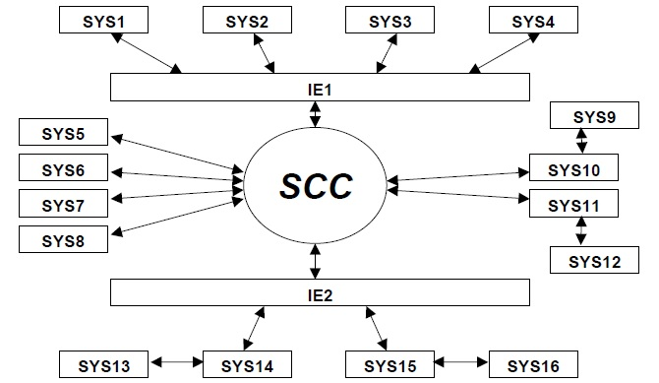
System Configuration
Identifying systems to be interfaced
The questionnaire has a section for detailing the scope and systems included in the interface project. An editable graphic is included for this purpose.

Slide 6
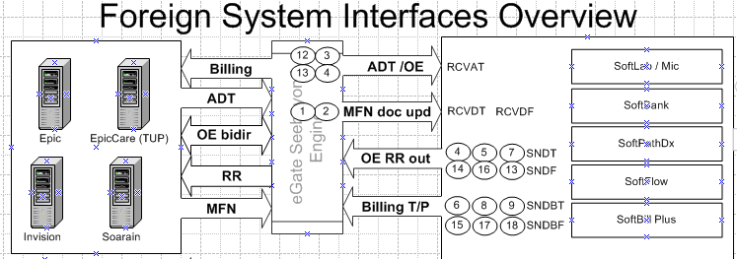
Interfaces Diagram
SCC HIS Specialist creates a client specific interfaces diagram
A detailed diagram is created to illustrate the overall system architecture showing all foreign system interfaces. Both new and existing interfaces shall be depicted.

Slide 7

Key Identifiers
MRN – length, re-use, prefixing, merging…
Billing Number – length, changing, prefixing…
Location Codes – length, uniqueness…
Physician Codes – length, uniqueness, non-staff…
Ordered Test Codes – length, translation…
Individual Result Tests Codes – length, translation…
Race Codes – length…
Discharge Codes – length…
Priority Codes – length…
Source Codes – length…

Slide 8

Determining MRN / Billing Number Prefixing Requirements Up Front
If you have an enterprise that has multiple patient pools that will use SoftLab, you may need to consider MRN and Billing number prefixing to keep these key values from overlapping. Inadvertent overlapping can cause unintended patient and order merges. Assess the potential for overlapping patient identifiers and discuss this with your SCC HIS interface specialist.
Prefixing of MRN and/or Billing numbers is usually done by adding a site specific region character to the number. This will force the site specific patient pools to use globally unique values thus preventing overlap in SCC.

Slide 9

ADT
ADT to SoftBank – updating SoftBank with HIS ADT…
Systems – how many systems send ADT to SCC?
Textual Comment– what comment types will be sent?
Merges – What merge events will be sent?
Ordered Test Codes – length, translation…
NOK information – will next-of-kin be sent?
Admitting diagnosis – will DG1 segments be sent?
Patient Types – receive and pass pat type to billing…
Patient Insurances– will insurance data be sent?

Slide 10
Stay Merges
If your HIS system has the ability to merge stays under the same MRN, chances are it will send an A41 event to SCC. In such cases, the SCC GENINDEX database needs to be configured to assign globally unique filler numbers per test.
The default is to assign filler numbers unique per billing number. When this happens and a stay merge is effected, the filler numbers will clash and be refactored (merged tests will get new filler numbers). This can cause issues in the HIS if the HIS is expecting the originally assigned filler numbers with results. Be sure to advise your SCC interface specialist of the need to merge patient stays under the same MRN.

Slide 11

Order Entry
Bidirectional – Do orders flow both ways?
Unidirectional – Do orders flow only in one direction?
Placer number – Do systems exchange order numbers?
Consider all events that the ordering system can initiate. Both ordering and reflexing scenarios will help determine the interface specification order entry workflow options.

Slide 12
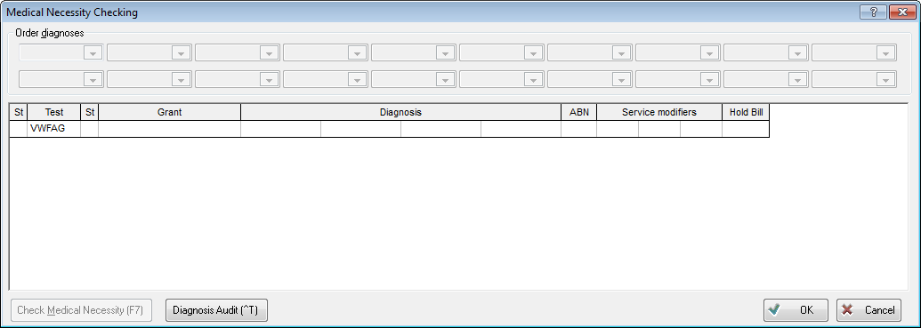
Order vs Test Level Diagnosis
If your HIS will send diagnosis in DG1 segments with order messages, the need to send them at the order or test level will need to be evaluated. The decision will depend on the need to use Medical Necessity Checking in SoftLab.

Slide 13
Order Merging
Think about what criteria will need to be considered to allow orders to merge in SoftLab. This functionality is mostly parameter driven and will need to be assessed before or during unit testing. Some criteria to consider:
Time between orders.
Merging of orders with different priorities.
Merging of Lab and Micro orders on the same accession.
Tests that should always be split to separate orders.
Tests that should be orderable as redundant.
Nurse collect and Lab collect orders.

Slide 14
Interface Business Rules
Each SCC interface is configurable to adhere to a single set of business rules. If you are using the same interface to accommodate multiple foreign systems, the SCC interface will need to be configured to a consensus set of rules that apply to all involved foreign systems. If there is a foreign system that falls outside of the set rules and cannot be adapted using the interface engine, a separate interface must be implemented to accommodate it separately.

Slide 15
Miscellaneous Fields
Occasionally, there is the need to receive, store, and return an HIS specific custom value. In such cases, SCC has several fields at three levels (patient, stay, and order) that may be leveraged to accommodate the requirement. Miscellaneous fields can be activated and added to the interface specifications as ‘Z’ segment fields. The values will be visible in SoftLab but will not have any function in SoftLab.

Slide 16

Billing
Charge generation (SoftLab / AR billing reports)
Charges per module (Mic, BB, Pat)
Technical and professional charges
Method of transmission (FTP or simulated real time)
Batch file characteristics (Naming convention, number of charges per batch…)
Coded values (location codes, doc codes, test codes…)

Slide 17

Results Reporting
Placer numbers – Is placer order number required?
Systems – What systems will SCC send results to?
Result Formats – select formats required for each system…
Discrete (SoftLab)
Display (all)
OBX Report (all)
Discrete Type I (SoftMic)
Discrete Type II (SoftMic)
Hybrid (SoftLab/SoftMic)
Discrete Short Text (SoftBank)
Discrete Long Text (SoftBank)

Slide 18
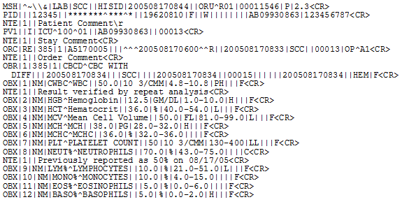
SoftLab Discrete
In the discrete format, data elements are sent field-by-field as a non-human readable results report.
Most Common

Slide 19
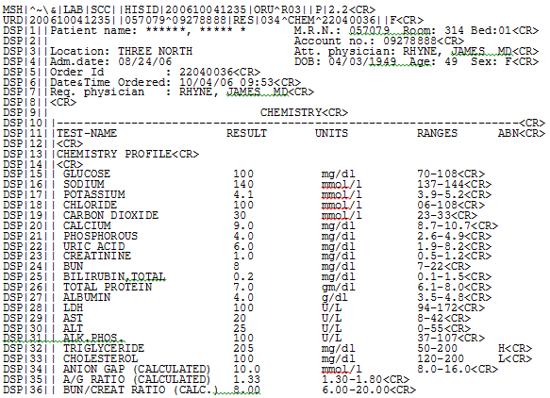
SoftLab Display
In the display format, lines of a human readable report are sent in DSP segments (one line per segment).

Slide 20
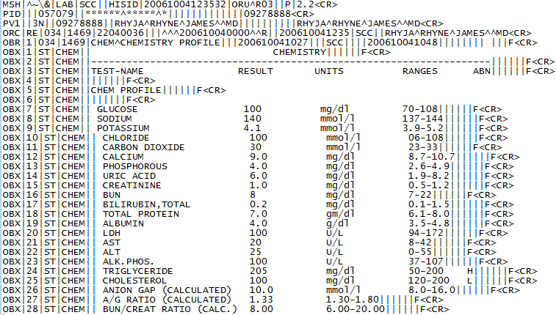
OBX Report Format
In the report format, lines of a human readable report are sent in more conventional OBX segments. OBX[5] contains a single line of a human readable report.

Slide 21
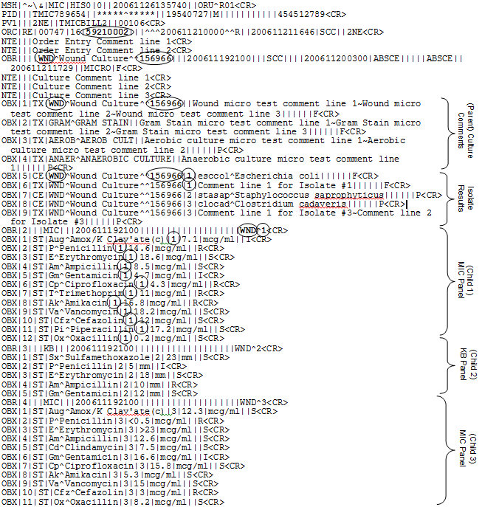
Micro
Discrete Type I
Most Common

Slide 22
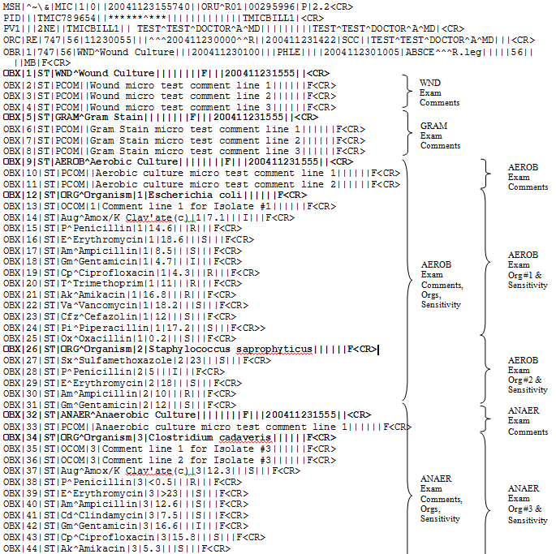
Micro
Discrete Type II

Slide 23
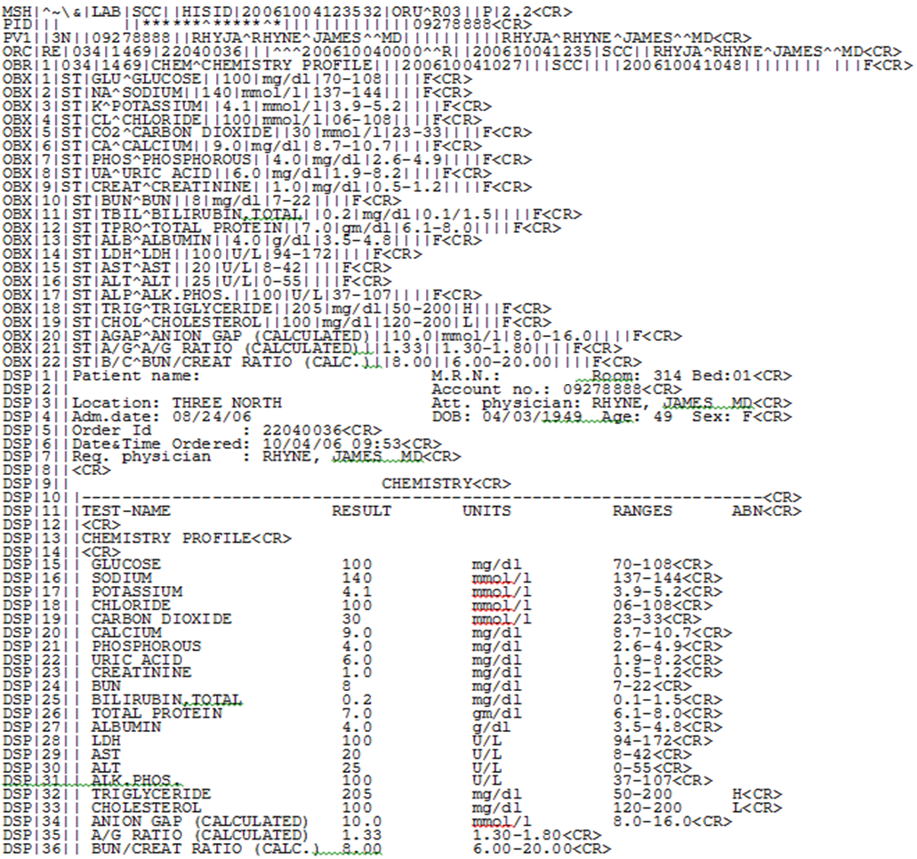
Hybrid
Discrete/Display

Slide 24
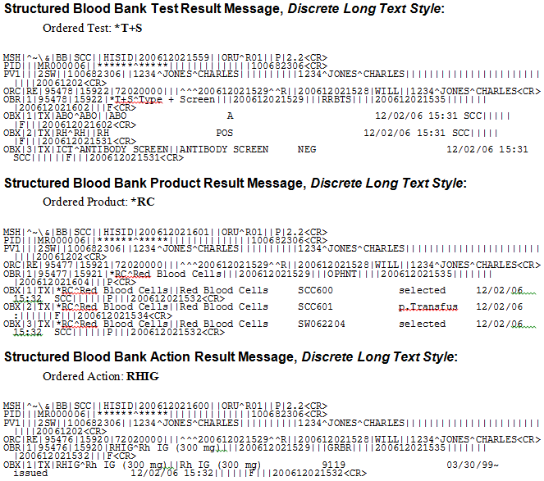
Softbank Discrete Long Text

Slide 25
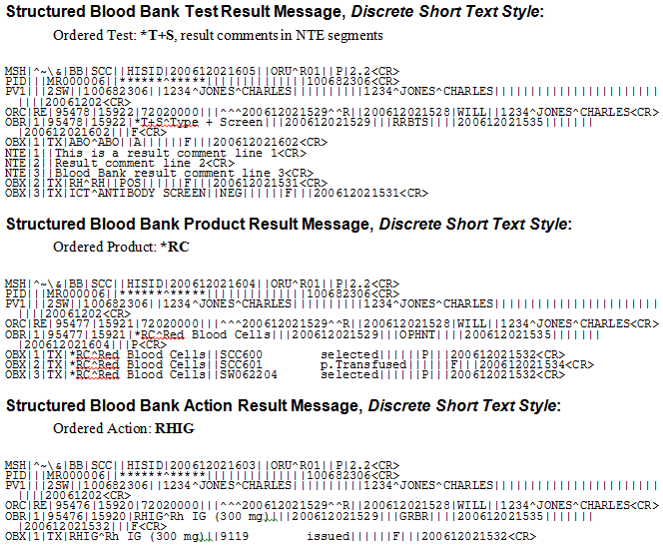
Softbank Discrete short Text
Most Common

Slide 26
Determining the Best Format
Ask your his vendor for example messages of results that they can receive and process successfully for the different technologies (general lab, micro, bank, genetics).
Predetermine HIS requirements that aren’t reflected in the standard SCC interface specifications. Special data fields that may be required by the HIS but not shown as required by SCC. These elements will need to be addressed early in the implementation process.
Send example SCC HL7 messages to the HIS vendor to assist with the selection of the most compatible formats.

Slide 27
Testing
The testing process is one of the most important parts of implementing a new interface. Vendor to vendor testing takes place by both you and your SCC interface specialist. Test plans are formulated and used to ensure all critical points are covered.

Slide 28


Developing Test Plans
Items to include in your test plan
ADT – Include any event that can be triggered ie admits, updates, merges, transfers, and discharges that can be initiated by the sending system. Note: New Order events can also create patient records in SCC.
Order entry – Order entry events include new orders, add-on orders, order merges (controlled by parameters and conditions), order cancellations, and change orders. Consider the different order entry scenarios for each module or technology.
Results reporting – Include module specific result sections. Each module/technology is different and resulting scenarios for each will need to be considered.
Billing – Successful billing interface testing is highly dependent on the completion of SoftLab setups. It is best to defer billing interface testing until after the required setup dependencies are met.

Slide 29

When to Prepare Your Test Plans
The time between the specification acceptance and the delivery of the interface is usually 4 weeks. This is the best time to draft your test plans. If you are ready with a test plan when the interface is delivered, you will keep the project moving and stay on target for the planned go-live date. Keep things moving along. Idle time degrades efficiency and poses a timeline risk.

Slide 30

Testing the unexpected
Downtime – It is critical to test an validate a downtime plan. Things to consider in a downtime situation:
How are orders going to be entered? Is there a reserved pool of key identifiers (MRN, Billing numbers) that will be used?
How are downtime patient records and orders going to be updated once the interfaces come back online?

Slide 31

Testing Reference Labs
Items to include in your test plan
Proper translation of abnormal flags with Ref Lab results sent to the HIS.
Proper performing site code sent with the results to the HIS.
Properly formatted discrete micro results.
Proper handling of prompt tests. Assess any need for separate order messages for some tests.

Slide 32


Compare Printed Reports to HL7
It is critical to make sure that the HL7 result message contains the same result information that is shown in the printed report. The HIS system should receive and post the same information as shown in the printed report.

Slide 33

Error Logging
Various error logs can be setup to report errors encountered in various internal interfaces. Consult with your SCC interface specialist to identify the need for specific error logs.

Slide 34
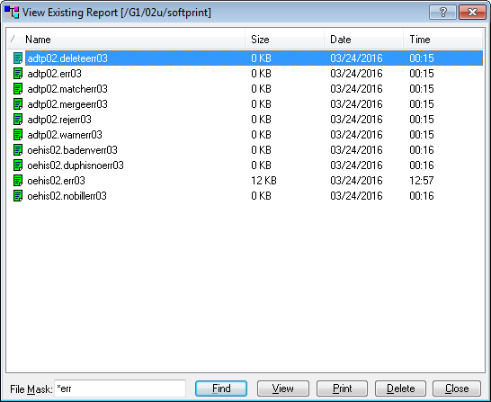
Searching Error Logs
All error logs are stored in the UNIX U/softprint directory. Error logs can be accessed through the SoftLab ‘Reports Viewer’. Filter by “*err”.

Slide 35
Decide on the need for Error Log Email Notifications
SCC has some ability for reporting certain error log events to a designated email address. If you have a need for this type of setup, discuss it early on with your SCC Interface Specialist. This functionality should be reserved for the most important of error types.

Slide 36
Interface Standardization
SCC sells and implements standard interfaces with configurable and parameter driven functional options. Work with your SCC interface specialist to identify all configuration and parameter options that best fit your enterprise needs.

Slide 37
Customizations
SCC strongly recommends working with the interface standard functionality to accommodate any non-standard foreign system or workflow need. You should review any perceived special requirement with your SCC interface specialist to work out how to setup and/or configure the interface to support that requirement.

Slide 38
The SCR Process
Occasionally, there may be a requirement that cannot be accommodated through setup, configuration, or parameters. In such cases an SCR (Software Change Request) may be submitted for consideration. SCC strongly advises that the SCR process should only be used as a last resort when all other options have been exhausted. SCC will evaluate the change request for is viability and cost. Not all SCR’s are accepted.

Slide 39
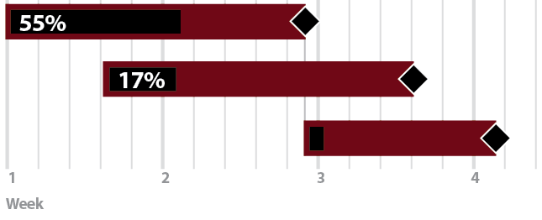
Stick to a Project Timeline
Any project should always start with the end in mind. A firm go-live date should be established and everyone should work toward meeting that date. Slippage not only causes delays, it adds resource allocation to the over-all project. Time is money…

Slide 40
Meaningful Use MU2

Slide 41

HL7 2.5.1
Meaningful Use
There are some new requirements to consider when implementing a new interface. The advent of Meaningful Use requirements has led to major changes in HL7. Meaningful Use Stage 2 is now in effect. Most new interfaces will be implemented as HL7 2.5.1 which has introduced many new data fields for sending and receiving UID (universal identifiers) and assigning authority/facility values. There are new setups in SoftLab that are used to support sending MU2 2.5.1 specific fields in the HL7 format.

Slide 42

Determining MU2 Attestation Requirements
There are some Meaningful Use core objectives to consider when deciding if an interface is to be used for attestation for Meaningful Use compliance. SCC recommends that your Meaningful Use Compliance Officer evaluate the menu objectives (see handout) and make this determination for the interface to be implemented.

Slide 43
MU2 Setup in SoftLab
Your SCC HIS interface specialist and SoftLab implementation specialist can help you determine all setups required to support MU2 data elements. Establishing all required Universal Identifiers and translated data elements are key to success in setting up an MU2 compliant system.

Slide 44

Going Live

Slide 45

Drafting a Switch Plan
Your SCC HIS interface specialist will draft a switch plan. This is a document that outlines all of the components that need to be copied from the TEST environment to the LIVE environment upon go-live of the new interface. It is an itemized list with a responsible person assigned to each item. The switch plan is sent for client review and approval ahead of the go-live date.

Slide 46

Drafting a Cutover Plan
A cutover plan is drafted by the client. A cutover plan consists of a list of activities that take place in a timeline. Each activity is assigned an execution time and a responsible person.

Slide 47

Cutover Coordinator
There should be one person designated as the cutover plan coordinator. This person would be responsible for ensuring that each responsible party executes his or her items in the cutover plan on time. The coordinator also ensures that all items in a block (time frame) are executed before moving into the next block.

Slide 48



The Future is ESB

Slide 49
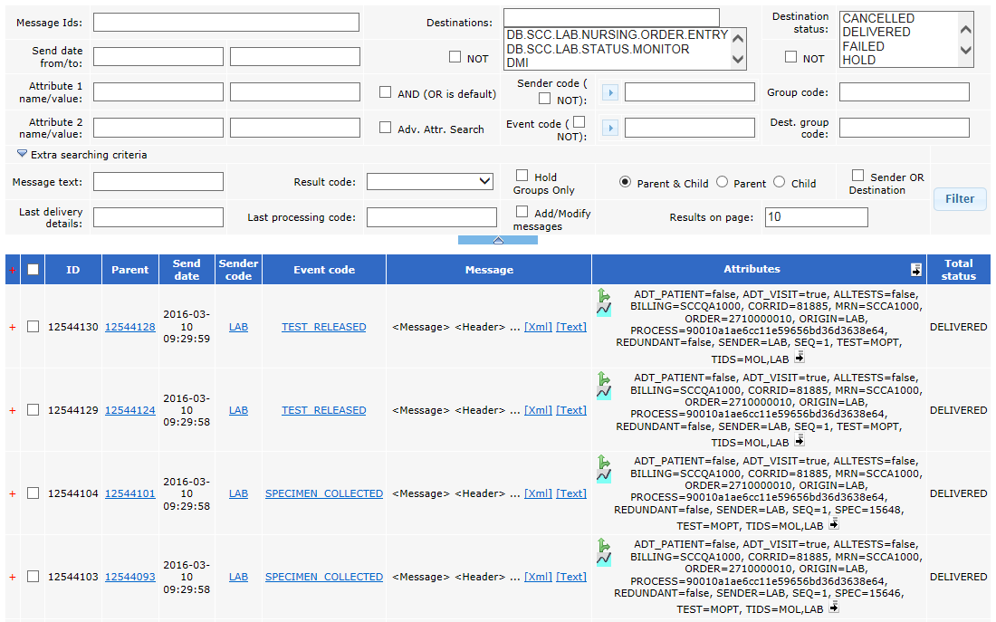
ESB – The MoM Console
MoM (Message Oriented Middleware)

Slide 50
Using MoM
Organize a Webex session with your SCC HIS interface specialist to demonstrate the filtering and functions of the MoM console. Establish point person for your organization who will learn and train others on the use of the MoM console.

Slide 51

Conclusion
Take the opportunity to make an interface project a learning experience. Take joy and pride in your efforts. The results of this approach will be evident.

