Slide 1


UNIX Advanced
Run Faster, Jump Higher, Finish First, Win The Gold
More advanced look into UNIX scripts.
grep for Speedy UNIX searching.
sed for Heavy Lifting and reformatting
awk for Jumping from one field to an other
Regular Expressions – the Baton carried throughout the race
Real World problems and winning UNIX solutions
Corbin Ellsaesser
SNUG Vice President
Sr. IT Systems Engineer
Christiana Care Health Systems
Delaware
cde@christianacare.org

Slide 2

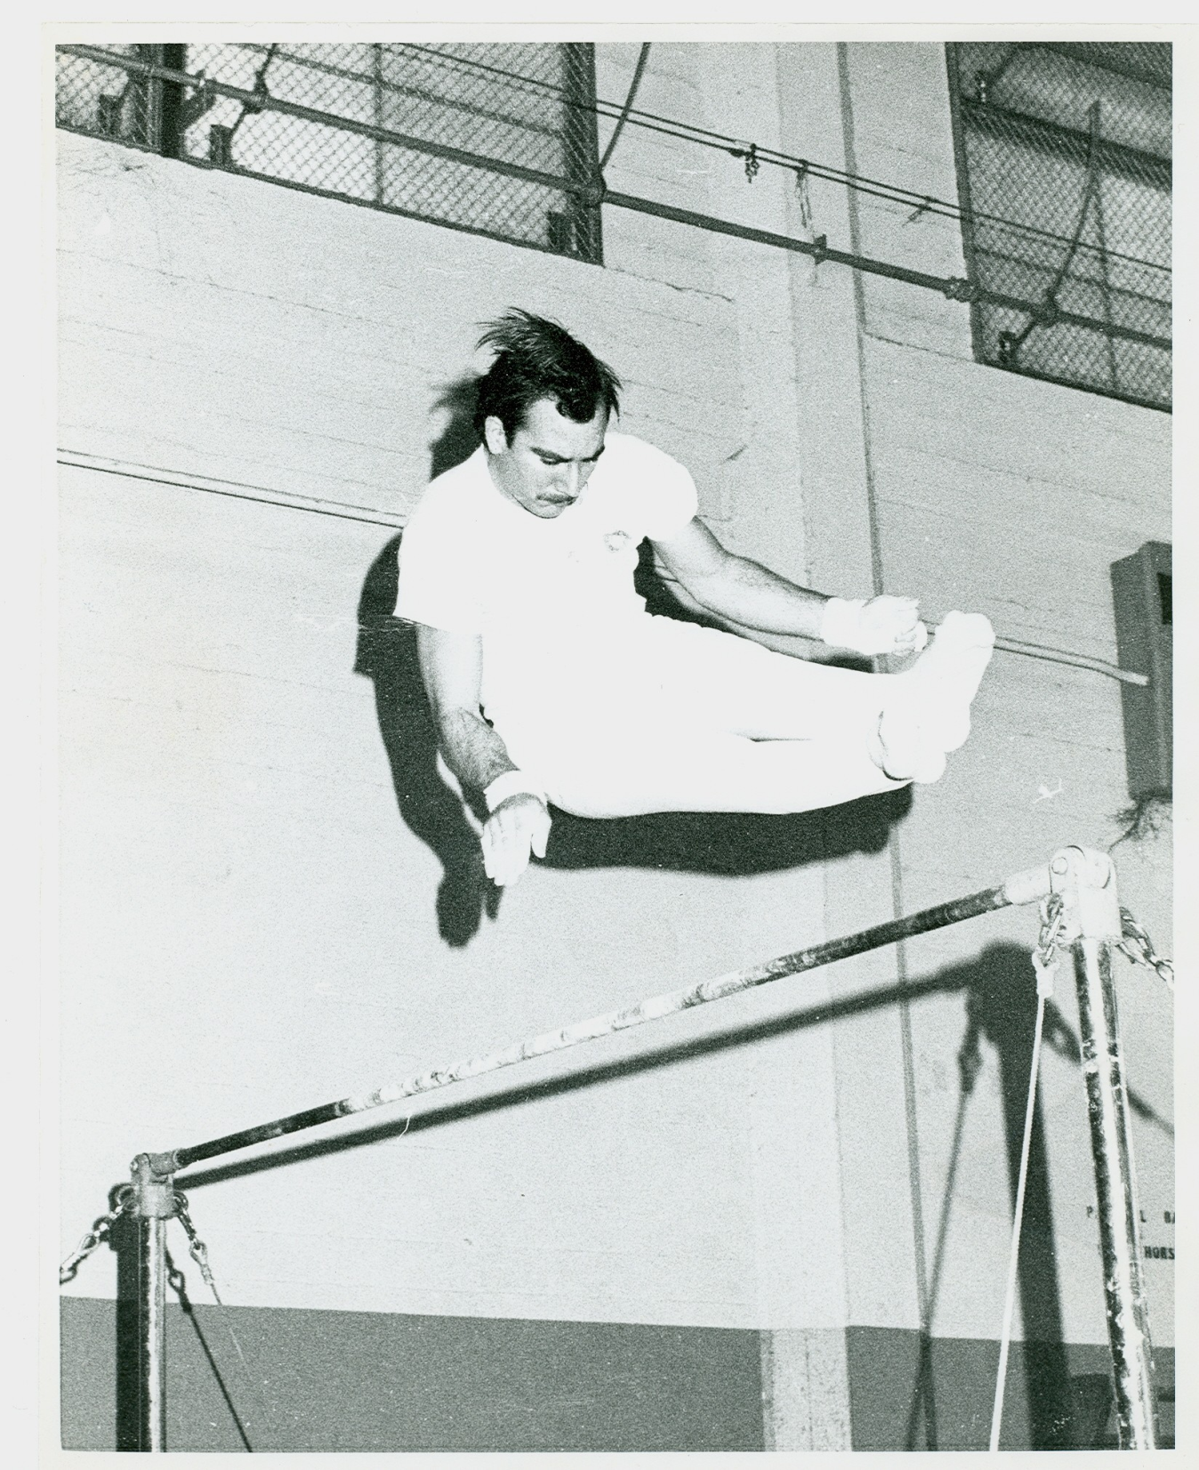
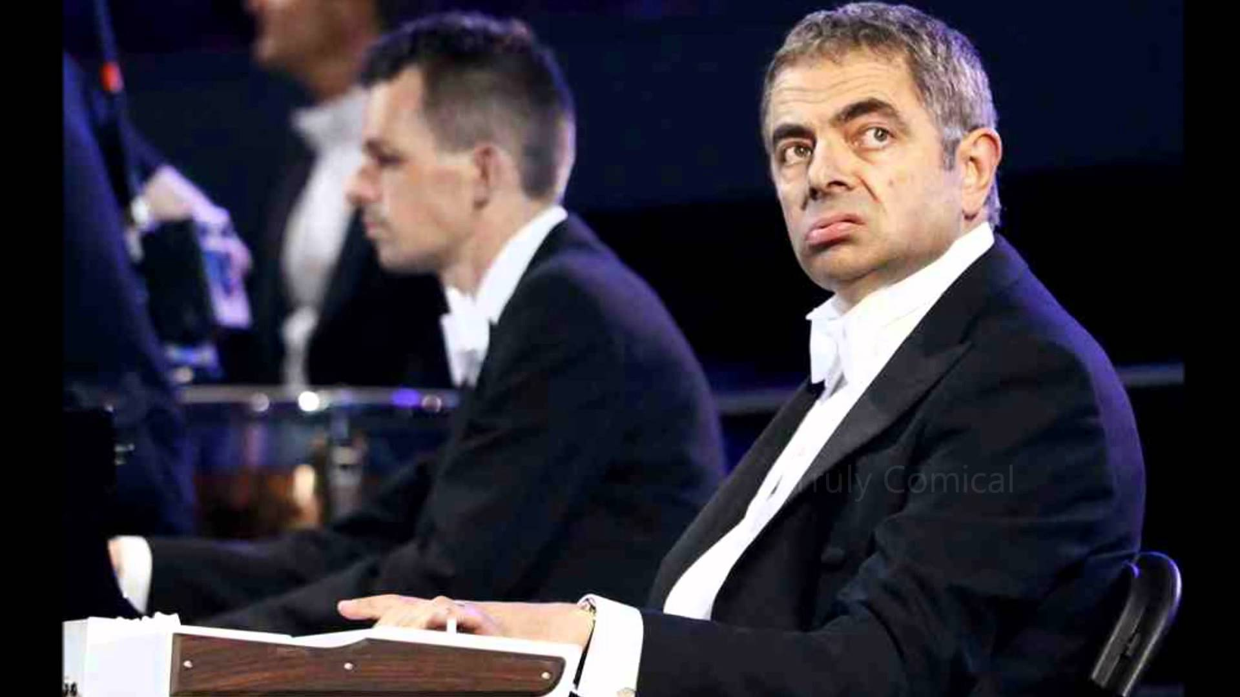

Slide 3

Regular Expressions
Normal Regular Expressions (NRE) and Extended Regular Expressions (ERE) determine what is changed, what you search for, and how programs act.
They are the heart of your programs.
Master Regular Expressions and you’ll finish in front instead of being lost in the crowd.

Slide 4
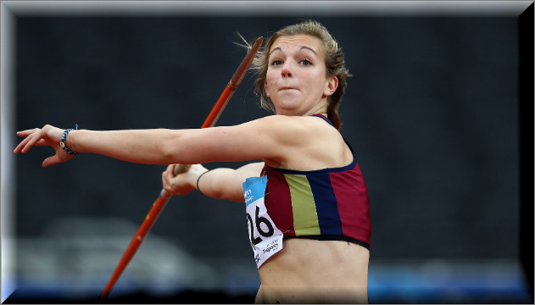
Regular Expressions
Extended Regular Expressions may not be supported by all UNIX commands or systems.
  grep for NREs
  grep -E or egrep for EREs
You may need to test to see if your system supports them.

Slide 5
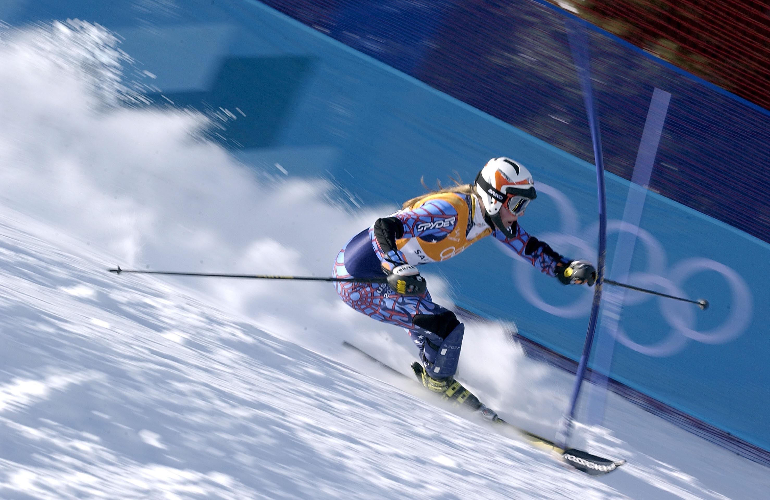
Metacharacters
Two flavors
Character substitutes “wild cards”
• Dot : Any single character or white space.
[] Brackets: Any character inside the brackets
[aeiou] [24680] [Olympics] ← note: any single character, NOT the “word”
[a-z] Bracket set: Range of characters/series designated by a dash.
[a-z] [0-9] [a-zA-Z] [2-8] [[:alnum:]] ← special POSIX character classes too
[^ ] Not brackets: NOT any one character in the bracket following the caret.
[^loser] [^13579] [^Corbin]
( ) Parenthesis Group: Any word or RE inside the parenthesis.
(Gymnast)+ ^(Ice S.*te) (Wrestler)$
( | ) Or set: Any word or the other word or RE in the parenthesis.
(Win|Lose) (2468|13579)
\( \) Numbered Expression: Any word or RE saved as a numbered expression
whatever qualifies later.
\(C.*bin\) \(El+saes+er\) . . . . \2 \1

Slide 6
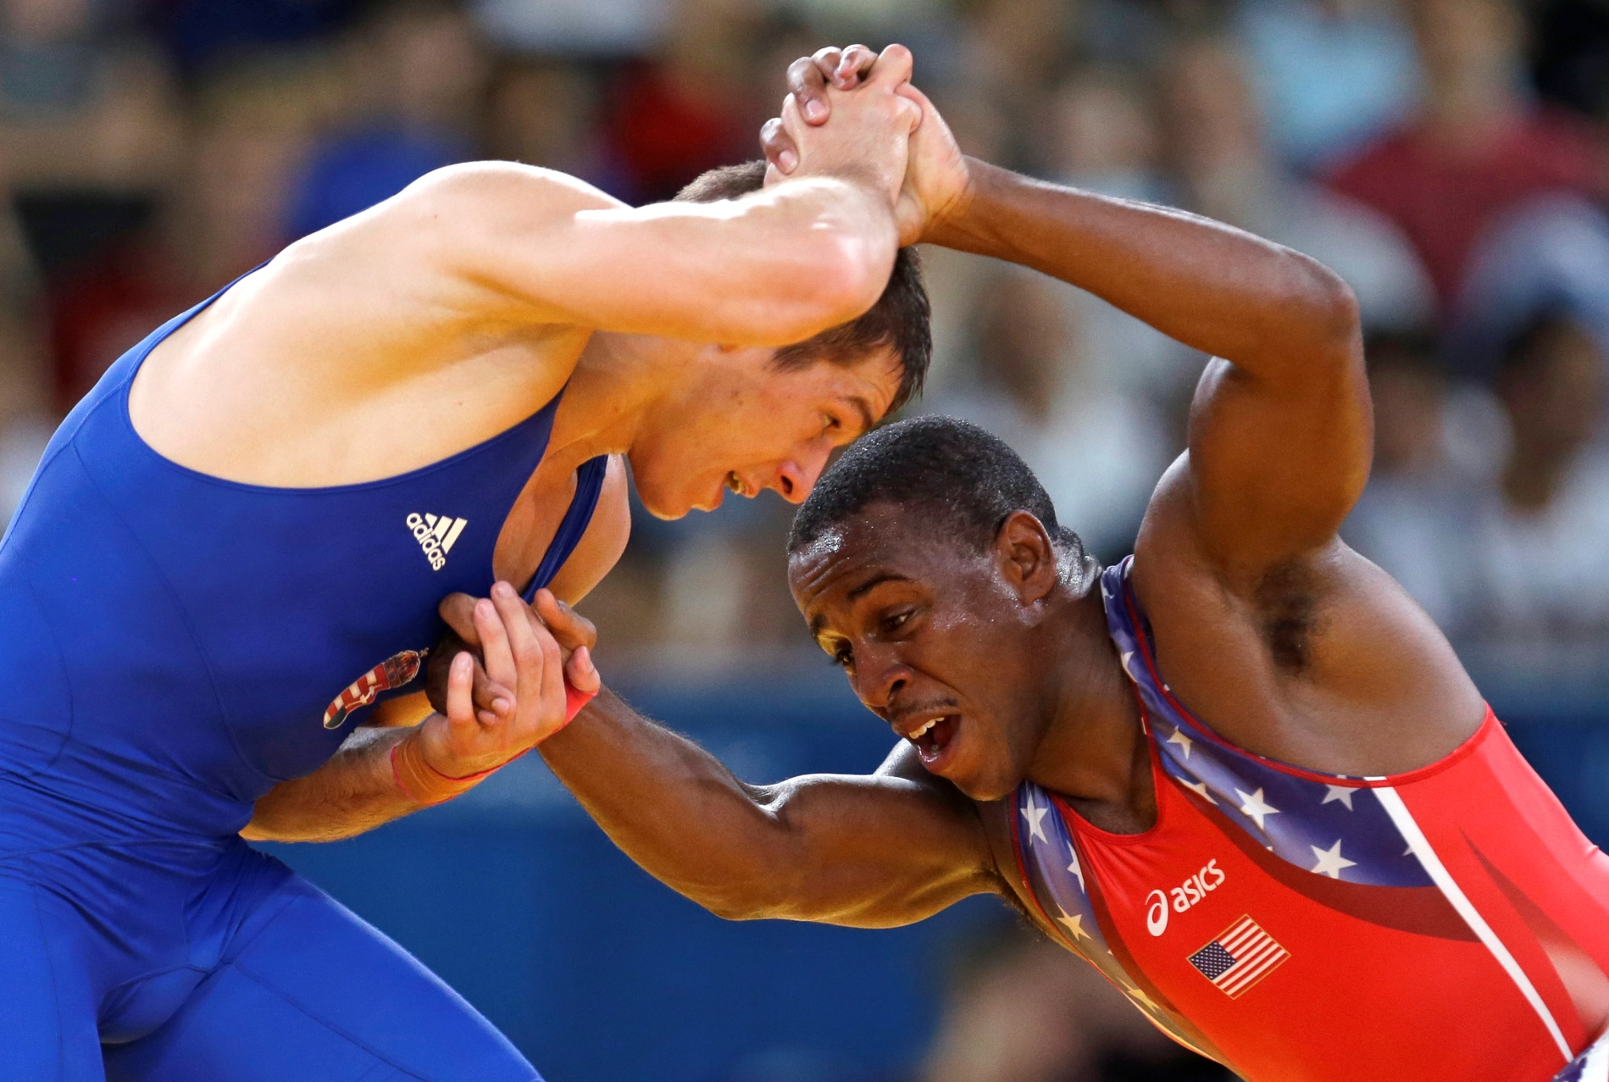
Metacharacters
Two flavors
Expression modifiers
These precede or follow expressions to modify them.
? Question Mark: We don’t care if the expression is there or not. (0 or 1 times)
  ‘Win (or lose)? it’s how you play the game’
+ Plus: Repeat expression 1 or more times (once is required)
  ‘(Gold Medal)+’ ← Bring home at least one Gold
* Asterisk (splat): Repeat expression 0 or more times.
  Bugs* ← Bug Bugs Bugss Bugssssssssssssss
^ Caret: Expression is at the beginning of the line (would precede the expression).
  Don’t confuse with NOT bracket [^loser]
  ‘^How do I begin…’
$ Dollar sign: Expression is at the end of the line (would follow expression).
  ‘…this is the end$’
\{0,5 \} Curly Bracket: match a range of occurrences
  (Gold Medal)\{2,10\} ← 2 to 10 Gold Medals

Slide 7
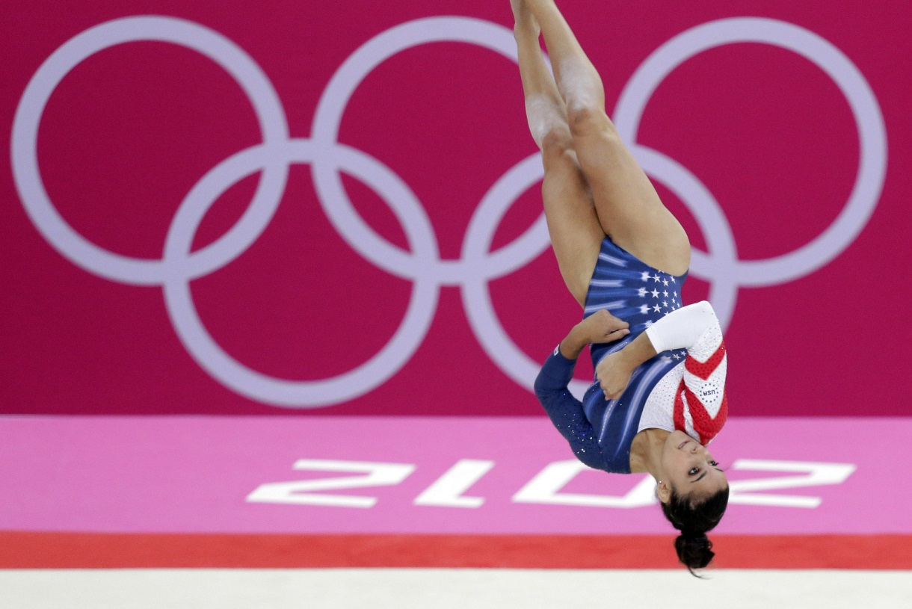
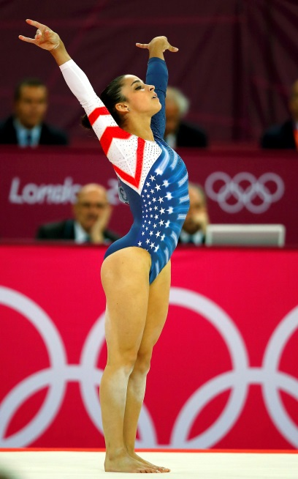
Metacharacters
Quotations
UNIX has 3 ways to “quote”
“ “
‘ ‘
\
Never copy paste from Email, Word, Notepad or PowerPoint into UNIX.
They use curved paired quotations
“ ” ‘ ’
which will break your program

Slide 8

Metacharacters
Quotations
\ Back slash removes the special meaning of characters.
  ^ means at the beginning of a line
  \^ literally means the caret character ^
  \\ means a literal back slash mark \
" " Double quoting makes the string literal
  Although one of the UNIX shells can process/replace the contents.
  X="Gold" "Bring home the $X"
  Becomes "Bring home the Gold" after the shell
' ' Single quoting protects your string from Shells
  X="Gold" 'Bring home the $X'
  Stays 'Bring home the $X' after the shell
  ' " ' is a way to quote a literal quotation mark "
  Another way is \ '

Slide 9

Regular Expressions
The Race is on…
Regular Expression Quiz
R E Q
A ce
Alice went back to the table, half hoping she might find another key on
it, or at any rate, a book of rules for shutting people up like
telescopes. This time she found a little bottle on it ("which certainly
was not here before," said Alice), and tied 'round the neck of the
bottle was a paper label, with the words "DRINK ME" beautifully printed
on it in large letters.
ru shutting p
e bottle
b d
'^A.*ce'
'ru.*shut+..g.*p'
'(Imbibe|Swallow|Guzzle|Drink)*.[me]+ bottle'
'^b.*d$'
'^[Rr].*(ate)?.*[^rules].*[sgE].*(book|of|Q)'

Slide 10

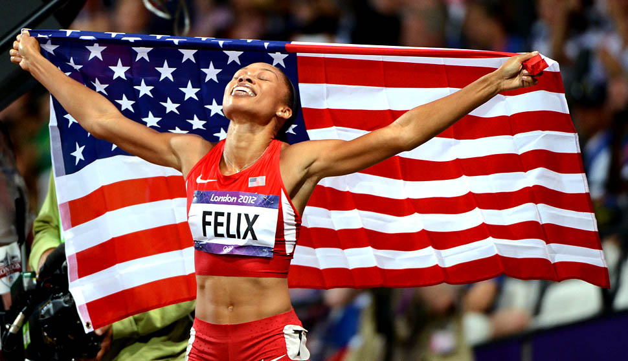

Regular Expressions
Proof..
grep in action

Slide 11
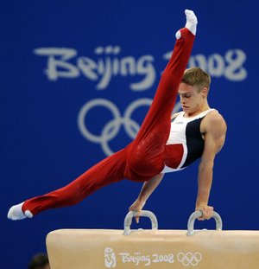
‘nuff sed
sed - Scripting with the “ED” UNIX editor.
sed is used to non-destructively
  reformat,
  replace
  delete text.

Slide 12


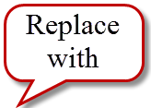
sed
Alice went back to the table, half hoping she might find another key on
it, or at any rate, a book of rules for shutting people up like
telescopes. This time she found a little bottle on it ("which certainly
was not here before," said Alice), and tied 'round the neck of the
bottle was a paper label, with the words "DRINK ME" beautifully printed
on it in large letters.
Substitute Text
$ sed 's/Alice/Corbin/g' Alice
Corbin went back to the table, half hoping she might find another key on
it, or at any rate, a book of rules for shutting people up like
telescopes. This time she found a little bottle on it ("which certainly
was not here before," said Corbin), and tied 'round the neck of the
bottle was a paper label, with the words "DRINK ME" beautifully printed
on it in large letters.

Slide 13
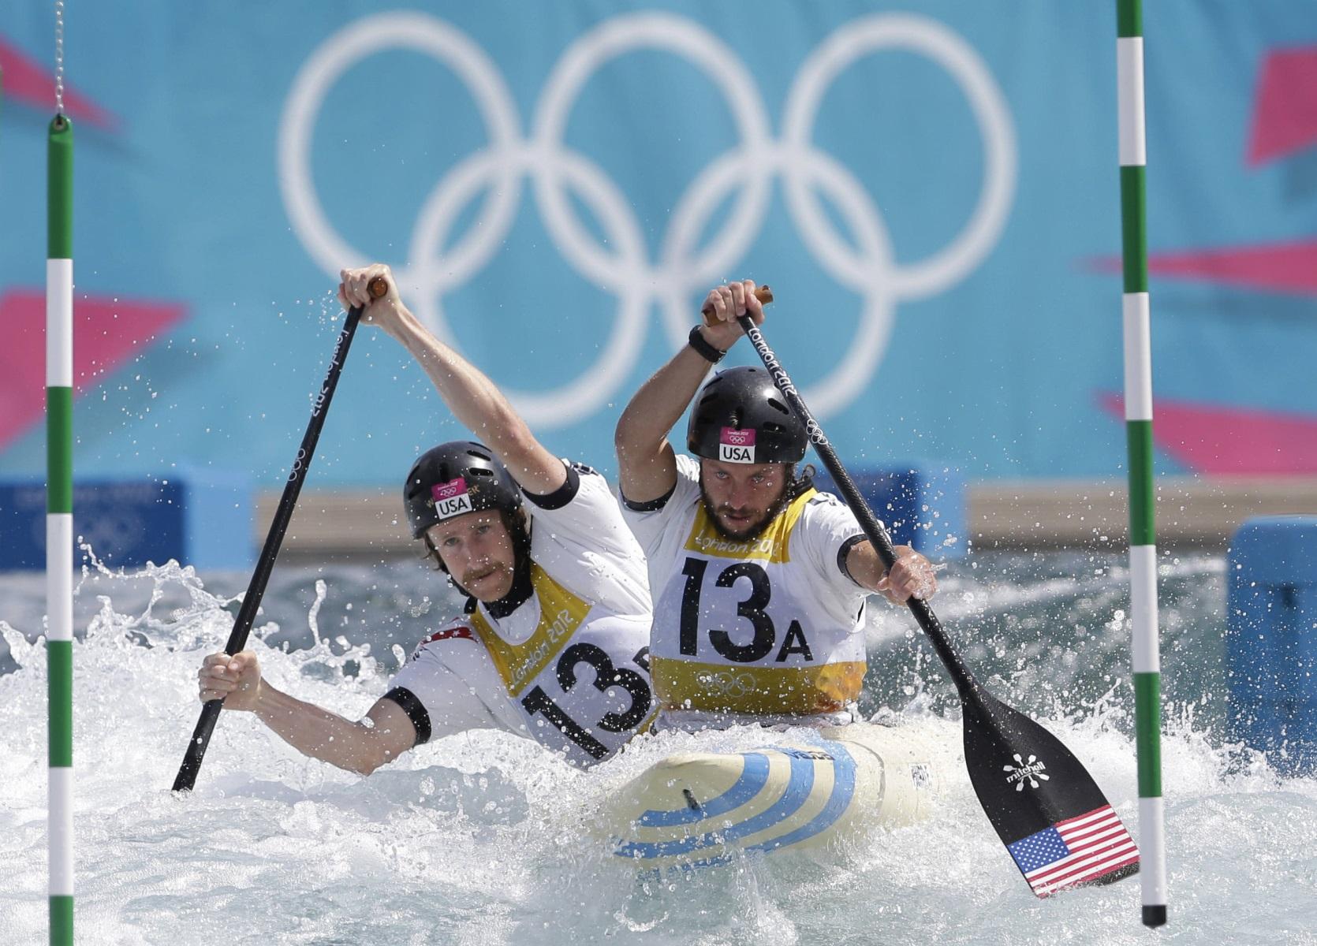

sed
Alice went back to the table, half hoping she might find another key on
it, or at any rate, a book of rules for shutting people up like
telescopes. This time she found a little bottle on it ("which certainly
was not here before," said Alice), and tied 'round the neck of the
bottle was a paper label, with the words "DRINK ME" beautifully printed
on it in large letters.
Alice went back to the table, half hoping she might find another key on
it, or at any rate, a book of rules for shutting people up like
telescopes. This time she found a little bottle on it ("which certainly
was not here before," said Alice), and tied 'round the neck of the
bottle was a paper label, with the words "DRINK ME" beautifully printed
on it in large letters.
Delete Text
$ sed '/^it,.*like$/d' Alice
Alice went back to the table, half hoping she might find another key on
telescopes. This time she found a little bottle on it ("which certainly
was not here before," said Alice), and tied 'round the neck of the
bottle was a paper label, with the words "DRINK ME" beautifully printed
on it in large letters.

Slide 14
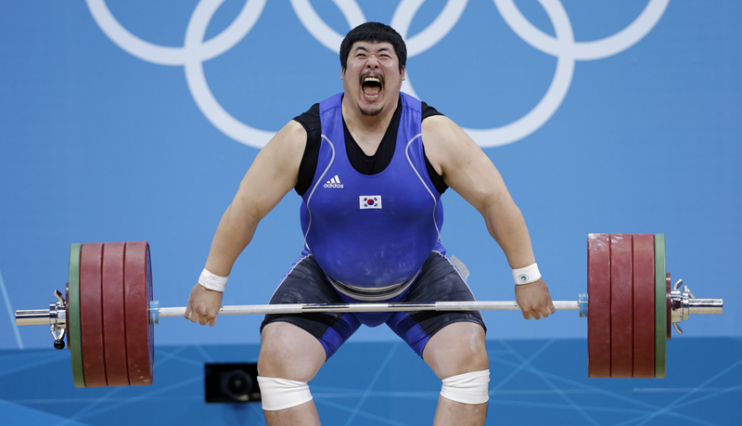
sed
Alice went back to the table, half hoping she might find another key on
it, or at any rate, a book of rules for shutting people up like
telescopes. This time she found a little bottle on it ("which certainly
was not here before," said Alice), and tied 'round the neck of the
bottle was a paper label, with the words "DRINK ME" beautifully printed
on it in large letters.
sed Program
sed -e 's/Alice/Corbin/g' \
-e 's/she/he/g' \
-e 's/at any rate, /a beer or shot of tequila/' \
-e 's/shut.*ke$/making people dance./' \
-e 's/^tel.*es\. //' \
-e 's/a\ boo.*les//' \
-e 's/\" bea.*lly.*d$/ and dance and sing \
karaoke all night!\" on it in large letters/' \
-e '/^on.*rs\.$/d' Alice
Corbin went back to the table, half hoping he might find another key on
it, or a beer or shot of tequila for making people dance.
This time he found a little bottle on it ("which certainly
was not here before," said Corbin), and tied 'round the neck of the
bottle was a paper label, with the words "DRINK ME and dance and sing
karaoke all night!" on it in large letters

Slide 15
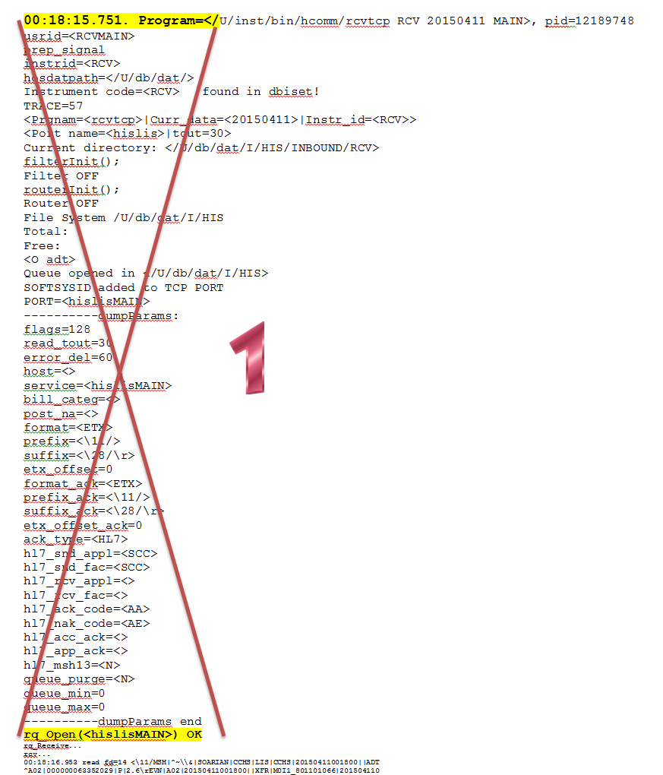
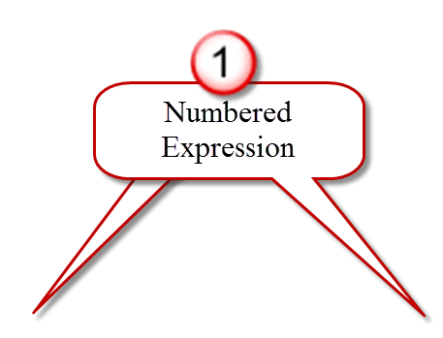
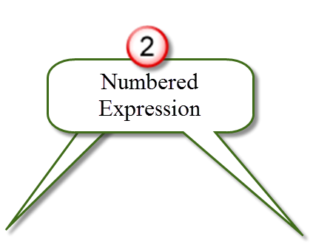

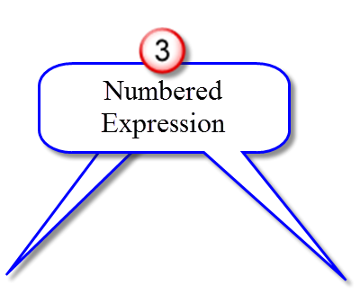
gRCV Script
Rcv="$UDIR/db/dat/I/HIS/RES*/rcv.trace"
sed -e '/\([0-9]\{2\}:\)\([0-9]\{2\}:\)\([0-9]\{2\}\.[0-9]\{3\}\)\.\ Program=</,/rq_Open(<hislisMAIN>)\ OK/d' \
-e '/^.*|ACK|.*$/,/^.*\\r>$/d' \
-e '/^\ ---/d' \
-e '/rq_Receive\.*$/d' \
-e '/^rcv\.*$/d' \
-e '/^\([0-9]\{2\}:\)\([0-9]\{2\}:\)\([0-9]\{2\}\.[0-9]\{3\}\).*len=[0-9]*$/d' \
-e '/^<.*>$/d' \
-e '/^rcv\ 1\.*$/d' \
-e 's/^\([0-9]\{2\}:\)\([0-9]\{2\}:\)\([0-9]\{2\}\.[0-9]\{3\}\)\ .*\(MSH.*$\)/<r>\\r\1\2\3\\r\\r\4/g' $Rcv |
perl -lne 'if (/<r>/){printf "\n$_"} else {printf} END{print}' |
sed 's/\\r\\28\/>\ len=[0-9]*$//g' |
grep -hE "$1" |
sed -e 's/\\r/\
/g' \
-e 's/<r>//g'
\{2\}
\([0-9]\{2\}:\)\([0-9]\{2\}:\)\([0-9]\{2\}\)
[0-9]\{2\}:[0-9]\{2\}:[0-9]\{2\}.[0-9]\{3\}

Slide 16
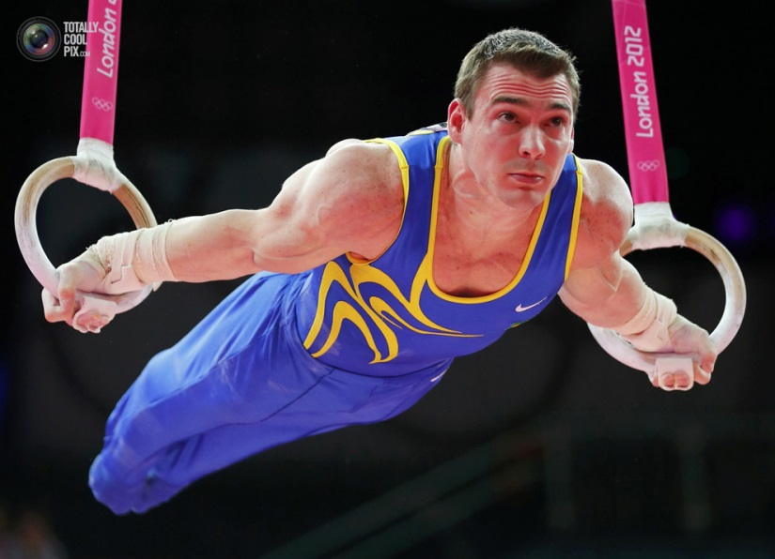
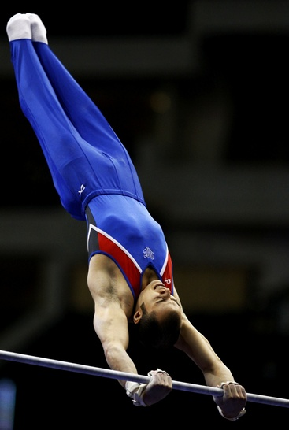
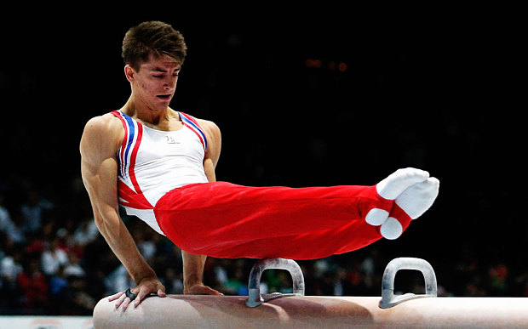
awk (aaaack!)
awk :
Aho, Weinberger, and Kernighan.
The awk scripting language was named by its authors after themselves!
Al Aho, Peter Weinberger, and Brian Kernighan.
awk is a very powerful programming language
It can separate fields from text
  White space is the default separator
  Use –F to define your own separator
Is very useful manipulating HL7 messages

Slide 17

awk
Seeing is understanding:
MSH|^~\\&|HNAM|CCHS|LIS|CCHS|20160405072817||ORM^O01|Q837771178T863570453|P|2.3||||||
PID|1||XXXXXXXXX||XXXXXXXXX^XXXXXXXX||XXXXXXXX|X||X|||(XXX)XXX-XXXX||X|X|X|7200064586
PV1|1|I|CTSU^2B01^A^CHR^^Bed(s)^CHR_HOSP|E|||22339^Brebbia^John^S.^^Dr.|||SUT|CTSU^^^
ORC|NW|2851330419^HNAM_ORDERI|||IP||||20160405072817|HNAM|||||20160405072817|||Writte
OBR|1|2851330419^HNAM_ORDERI||2000224^CBC without diff|||||||L||||BLOOD|||||||2016040
OBR|1|2851330419^HNAM_ORDERI||2000224^CBC without diff|||||||L||||BLOOD|||||||2016040
OBR|1|2851330419^HNAM_ORDERI||2000224^CBC without diff|||||||L||||BLOOD|||||||2016040
OBR|1|2851330419^HNAM_ORDERI||2000224^CBC without diff|||||||L||||BLOOD|||||||2016040
OBR|1|2851330419^HNAM_ORDERI||2000224^CBC without diff|||||||L||||BLOOD|||||||2016040
OBR|1|2851330419^HNAM_ORDERI||2000224^CBC without diff|||||||L||||BLOOD|||||||2016040
$ grep 'OBR\|' | awk -F\| '{print $5}'|awk -F\^ '{print $2}'
$ grep 'OBR\|' | awk -F\| '{print $5}'|awk -F\^ '{print $2}'

Slide 18
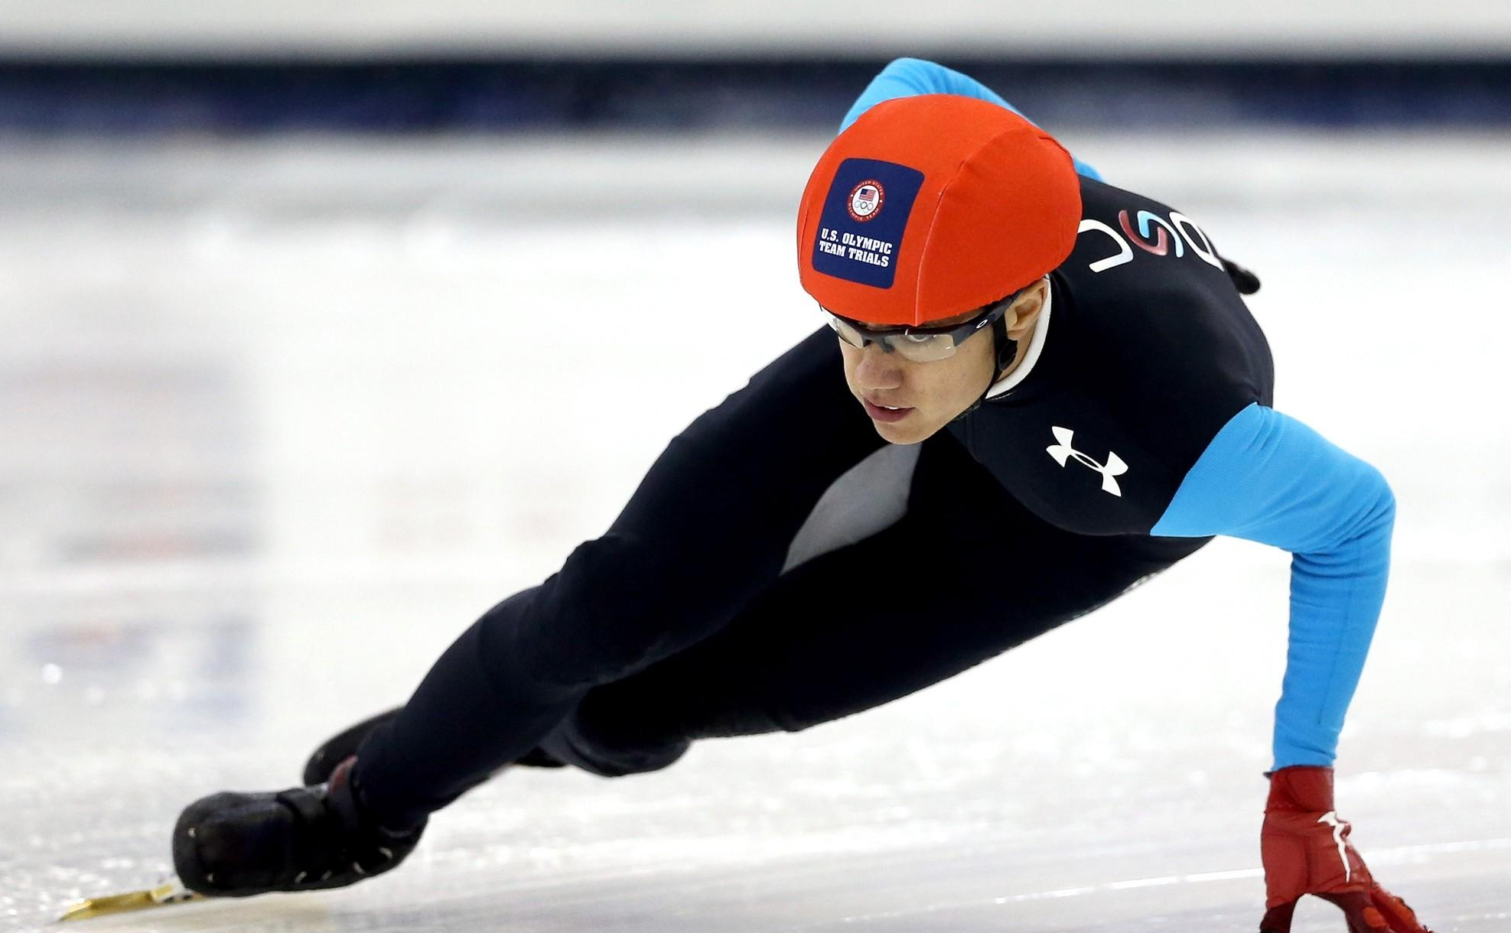
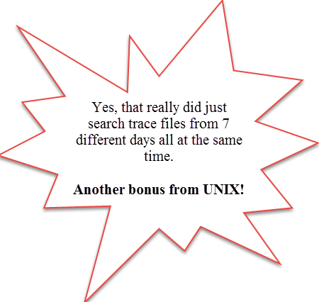
Chain your commands and scripts
I needed to search for all the "Plateletpheresis Give" orders from HIS on a patient to troubleshoot an issue with the scheduled collection times.
I wanted to report the HIS order number, when the order was placed and when it was scheduled for collection.
By "piping", using the "|" pipe symbol to chain your commands you can stream the output of one command or script, into another, and another…
You can condense and compile your output.
I started with my gRCV script.
$ gRCV 'PID\|.*\|900215841\|.*\|2901234567.*ORC\|NW\|.*4080130
\^Plateletpheresis Give'
As you saw, this returned a couple of pages of HL7 messages
All I really wanted was in the OBR segment so I piped the output into another grep
$ gRCV 'PID\|.*\|900215841\|.*\|2901234567.*ORC\|NW\|.*4080130
\^Plateletpheresis Give' | egrep 'OBR\|'
That returned about 19 OBR segments over 7 days.
Still all I wanted were a few fields in the OBR so I piped it again.
This time into awk so I could just print those fields

Slide 19
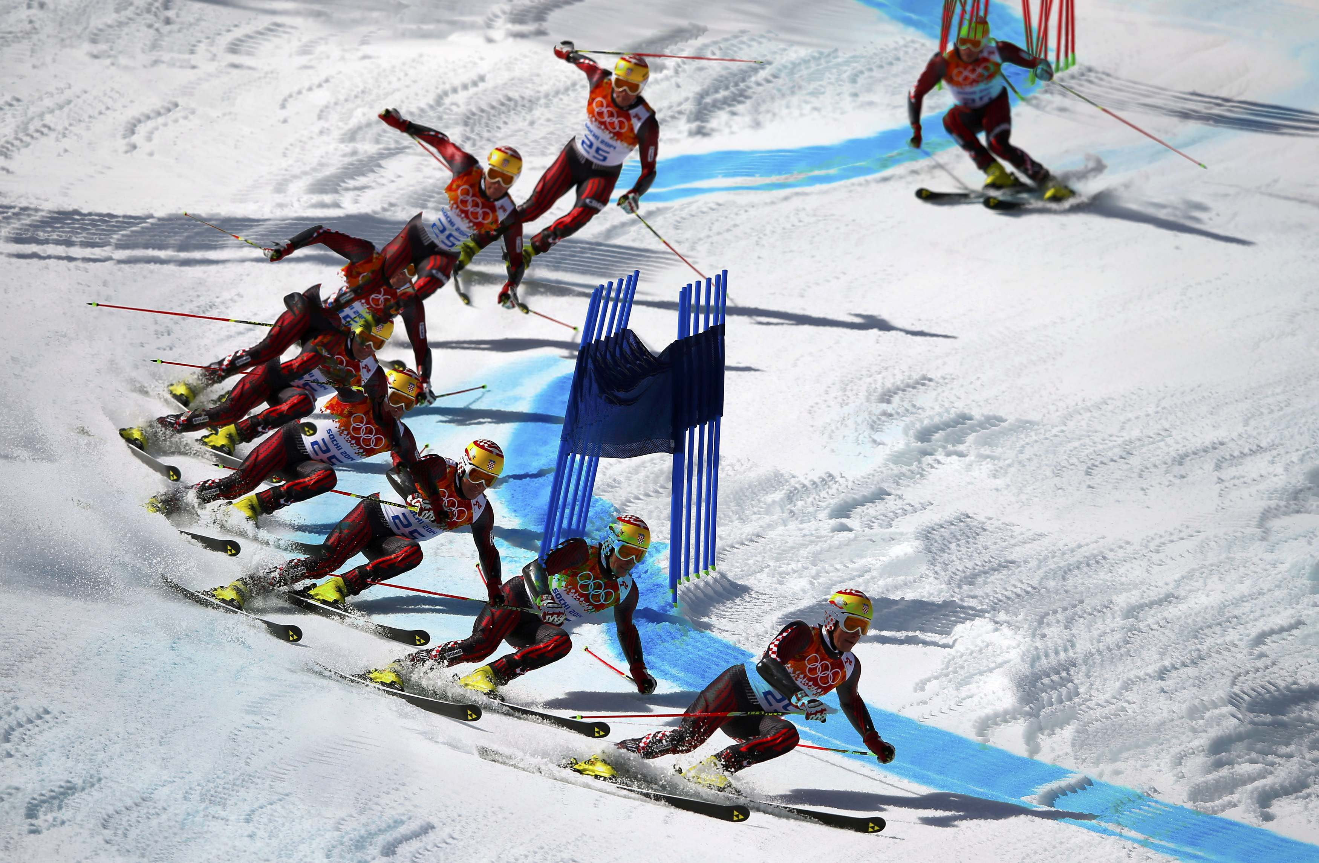
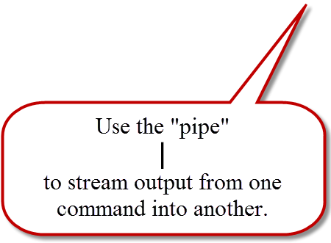
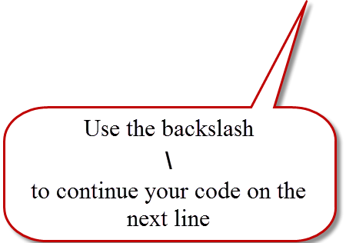
Chain your commands and scripts
grcv 'PID\|.*\|2800107792\|.*\|3800110971.*ORC\|NW\|.*Plateletpheresis Give'| \
egrep 'OBR\|' | \
awk -F\| '{print "OrdDT:",$23," | HIS#",substr($3,1,10)," | Alias/Test:",$5, \
" | CollDate:",substr($28,6,11)," | SchdDT:",substr($28,20,12)}' |
This ouput was them piped into sed to replace a "^" with a space
| sed 's/\^/\ /g'
So the code line actually looks like this:
grcv 'PID\|.*\|2800107792\|.*\|3800110971.*ORC\|NW\|.*Plateletpheresis Give'| \
egrep 'OBR\|' | \
awk -F\| '{print "OrdDT:",$23," | HIS#",substr($3,1,10)," | Alias/Test:",$5, \
" | CollDate:",substr($28,6,11)," | SchdDT:",substr($28,20,12)}' | \
sed 's/\^/ /g'

Slide 20
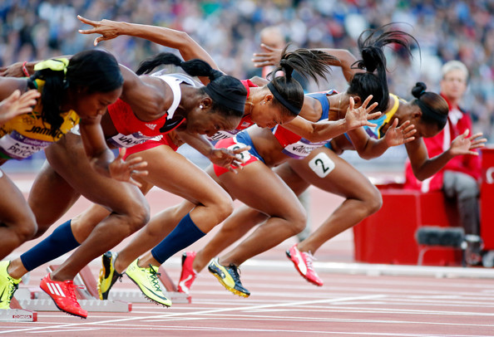
Chain your commands and scripts
Who can tell me what these scripts might do??
More Examples:
MSH|^~\\&|HNAM|CCHS|LIS|CCHS|20160405013725||ORM^O01|Q837724728T863517019|P|2.3||||
PID|1||XXXXXXXXX||XXXXXX^XXXXXX^X||XXXXXXXX|X||||||||||2902831483
PV1|1|I|C5E^5E05^A^CHR^^Bed(s)^CHR_HOSP|E|||50961^IPC^Hospitalists Company INC|||ME
ORC|NW|2851108659^HNAM_ORDERI|||IP||||20160405013724|HNAM||23946^Chowdhury^Farhana^
OBR|1|2851108659^HNAM_ORDERI||1000820^Ferritin Blood Level|||||||L||||BLOOD|23946^C Chowdhury^Farhana^A.^^Dr.||||||20160405013723||LA|||1^Once^0^20160405^^S|||||||||20160405013500
MSH|^~\\&|SOARIAN|CCHS|LIS|CCHS|20160405100600||ADT^A02|000000074628443|P|2.6
EVN|A02|20160405100600||XFR||20160405100600
PID|1||XXXXXXXXX||XXXXXXXXX^XXXXXXXX||XXXXXXXX|X||X|||(XXX)XXX-XXXX||X|X|X|29025
PV1|1|I|C4B^4B39^A^CHRHOSP|C||CLBR^HR02^A^CHRHOSP|21786^RASHID^ZUBDA^H^^DR.^MD||
DG1|1|||LARGE FIBROID||A
$ gRCV 'SOARIAN.*A02'|egrep 'PV1\|'|awk -F\| '{print $4}'|
awk 'F\^ '{print $1} | sort | uniq -c
$ gRCV 'PV1\|1\|I\|.*ORC\|NW\|.*OBR\|.*\^\^S\|' | egrep 'ORC\|NW\|' | awk -F\| '{print $5}'|awk -F\^ '{print $2}|sort|uniq -c

Slide 21

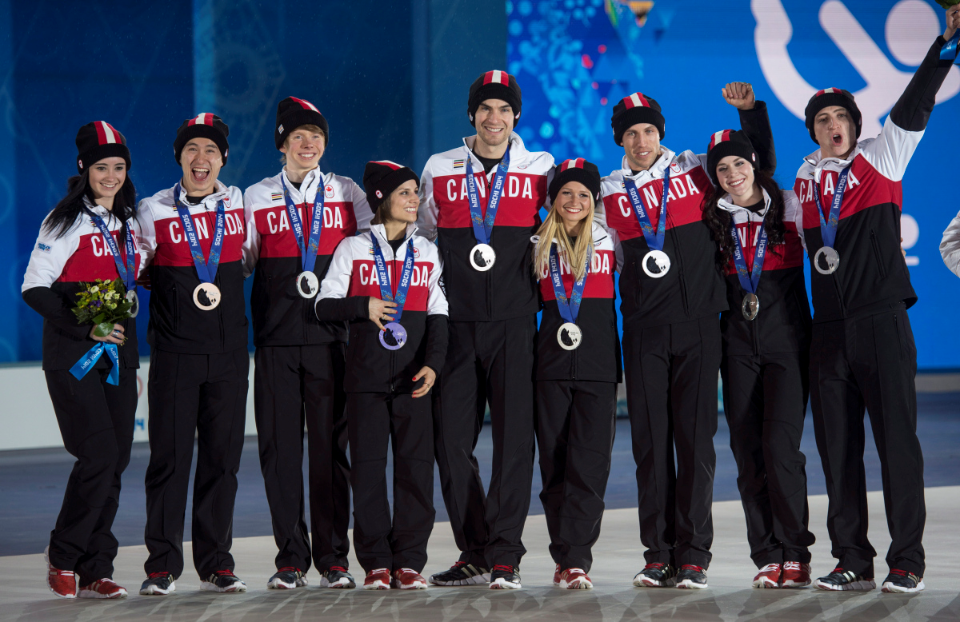

Slide 22

Bonus project
HIPAA fax number validation audit
SCC will have to grant you permissions to use their /$UDIR/bin/printfile script for this to work

Slide 23
HIPAA Fax Number Validatoin
Step 1:
  Create "pipe" delimited DrDatabase file (Doctor database)
    Fax Number
    Remote Printer Queue (CHPR)
    Provider Name and Title
    NPI
Step 2:
  Write form letter for your doctors HIPAATemplate
  Use form field labels
    <date>
    <DueDate>
    <FaxNumber>

Slide 24
HIPAA Fax Number Validatoin
Step 3:
  Split your form letter into two sections as files
    HIPAATemplate
    HIPAATemplateFooter
Step 4:
  Create script HIPAAFax
Note:
  Programs write log of emails sent to your /HOME directory named by the CHPR queue they were sent to.
  Program also writes a summary report of how many faxes were sent. You may choose to email or print this to your team.

Slide 25
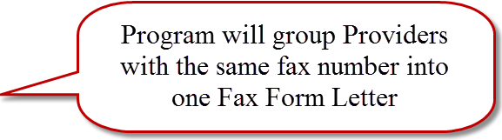
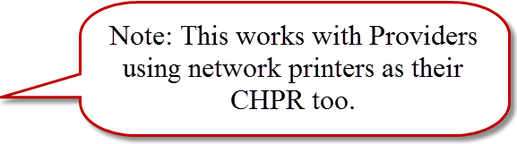
HIPAA Fax Number Validatoin
Sample of our DRDatabase:
(302)555-1200|060|Pedro Q Dayrit MD||
(302)555-1213|1VB|James K Aikins ||
(302)555-1213|1TA|Carlo Valencia |1851543862|
(302)555-1225|1TA|Maria Ana Valencia |1073765905|
(302)555-1225|0C4|Marie Pinizzotto MD, MBA|Admin-Only|
(302)555-1225|24F|Stephen F Penny |1881691236|
(302)555-1275|257|Cimy S Jacob |1912293184|
(302)555-1212|Y00|Muhammad S Smith MD|1679598387|
(302)555-1212|Y1R|Raymond S Mclaughlin MD||
(302)555-1212|0M2|Stanley R Wiercinski DO|1912944638|
LP90|GRU|Eric Martin MD|1932178050|
LP90|GRU|Jennifer R Pugh FNP|1164757118|
LP90|GRU|Mary E Zimny ANP|1366777500|
RVF5|LA3|Alfonso Ciarlo MD|1043372857|
RVF5|LA3|Armand N Desanctis MD|1558463299|

Slide 26
HIPAA Fax Number Validatoin
Examples:
  HIPAATemplate
  HIPAATemplateFooter
  HIPAAFax (script)
  HIPAA Fax Form Letter

Slide 27
References:
Klus, Agnieszka/Bambenek John (2009) grep kurz & gut O'Reilly Press
Dougherty, Dale/Robbins, Arnold (1997) sed & awk, 2nd Edition O'Reilly Press
Robbins, Arnold (1989) awk Programming, 3rd Edition O’Reilly Press
Fitzgerald, Michael (2012) Introducing Regular Expressions O'Reilly Press
Friedl, Jeffrey E.F. (2006) Mastering Regular Expressions O'Reilly Press
Goyvaerts, Jan/Levithan, Steven (2012) Regular Expressions Cookbook, 2nd Edition O'Reilly Press
Robbins, Arnold/Beebe, Nelson H.F. (2005) Classic Shell Scripting O’Reilly Press
Albing, Carl/Bossen, JP/Newham, Cameron (2007) bash Cookbook O'Reilly Press
Michael, Randal K. (2008) Mastering Unix Shell Scripting, 2nd Edition Wiley Press.
Robbins, Arnold (2006) Unix in a Nutshell, 4th Edition O’Reilly Press
For another $5 O’Reilly press
will sell you a searchable pdf soft copy of your book AND
you can download subsequent updates and
new Editions for free!

