Slide 1
Basics of Security Management
By
Kirby R. Solomon Jr.

Slide 2
What is Security Management?
Security Management is a user-access management system to be used in a medical research or clinical laboratory by knowledgeable, trained, and experienced personnel. Security Management enables the system administrator to confirm authenticity of users attempting to access secured systems, edit a group of users as well as grant and restrict permissions, for the
purpose of allowing only specified users to
access certain functions.

Slide 3

Logging on to Security Management

Slide 4
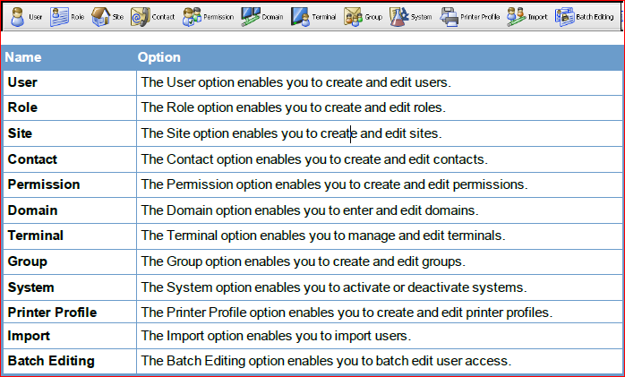
Main Program Options Overview
Notes:
Explain each option in detail. Also, discuss which options you plan on discussing during your PowerPoint.

Slide 5
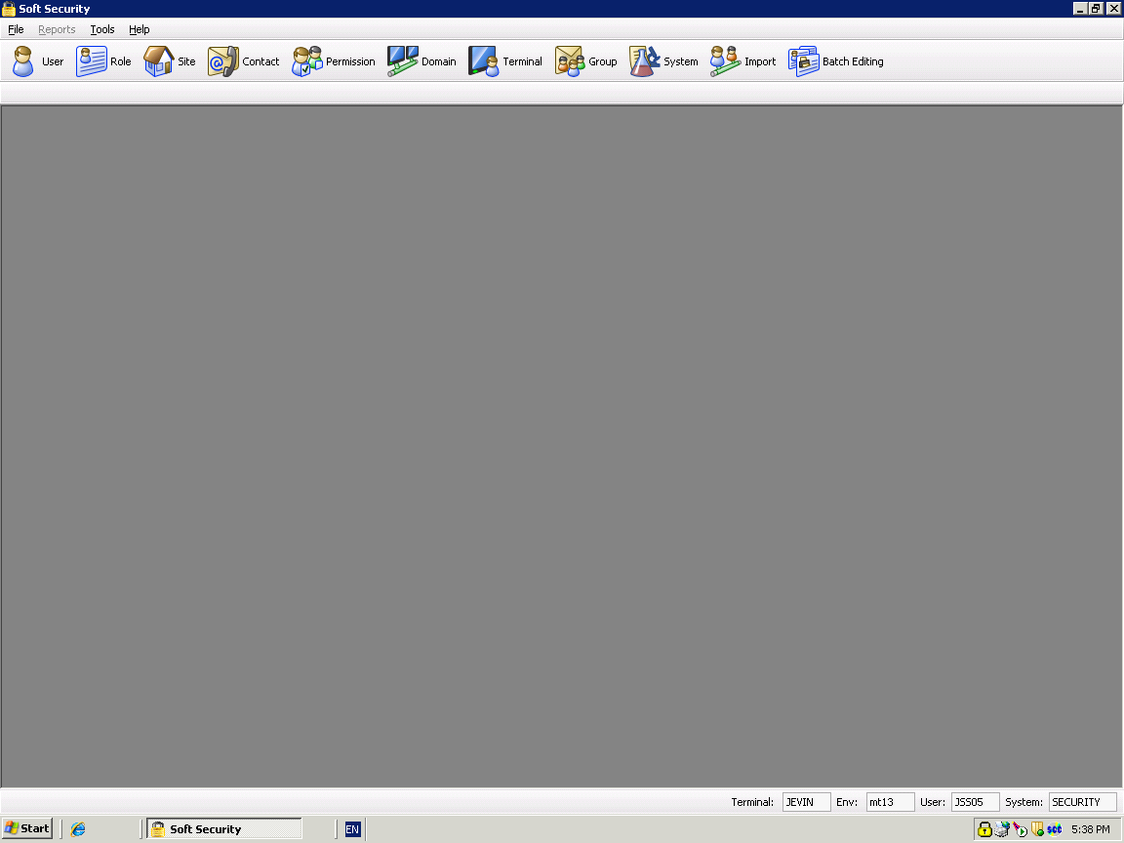
Security Management

Slide 6
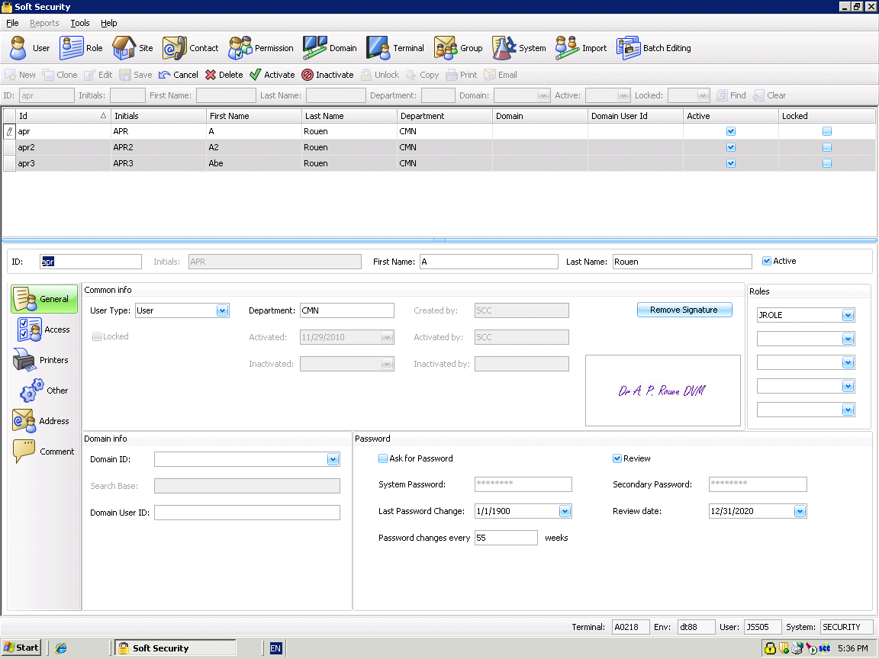
Security Management
Notes:
Discuss the amplified toolbar.

Slide 7
User Tab

Slide 8
User - General
Notes:
Discuss the General Tab.

Slide 9
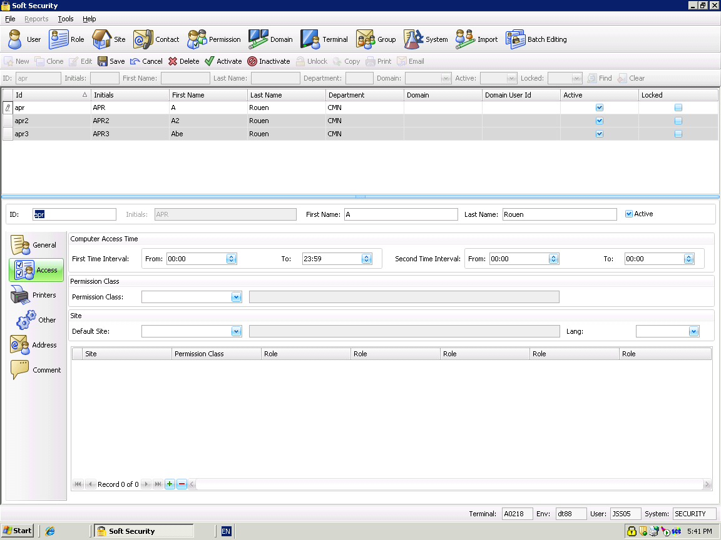
User - Access
Notes:
Discuss the User Access Tab.

Slide 10
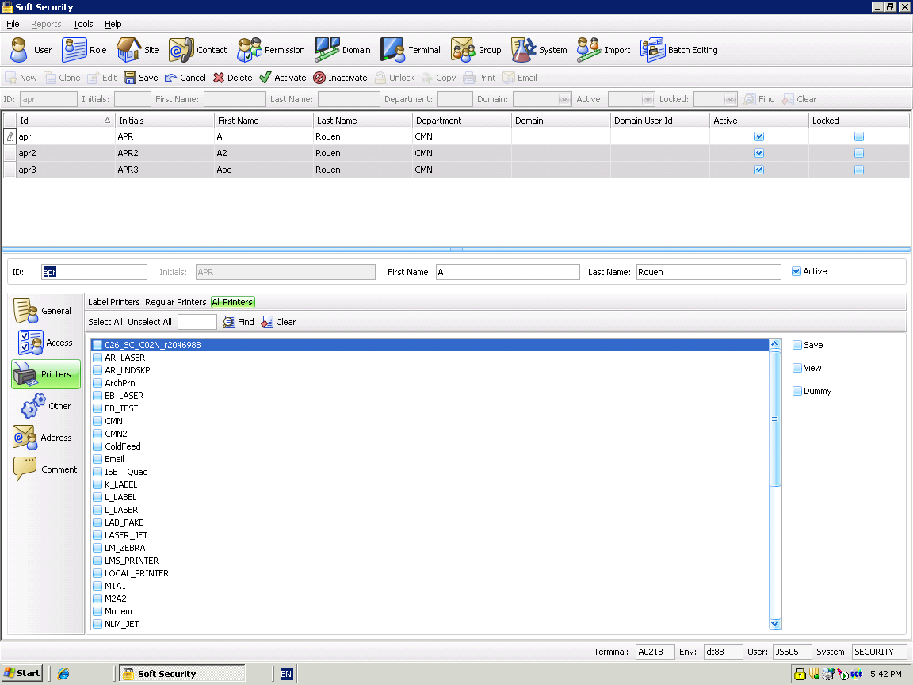

User - Printers
Notes:
Printers can be assigned to a user.
Printers can be sorted by Label, Regular or by All
Printers can be filtered by printer ID
Save, View and Dummy printers are now on the right.

Slide 11
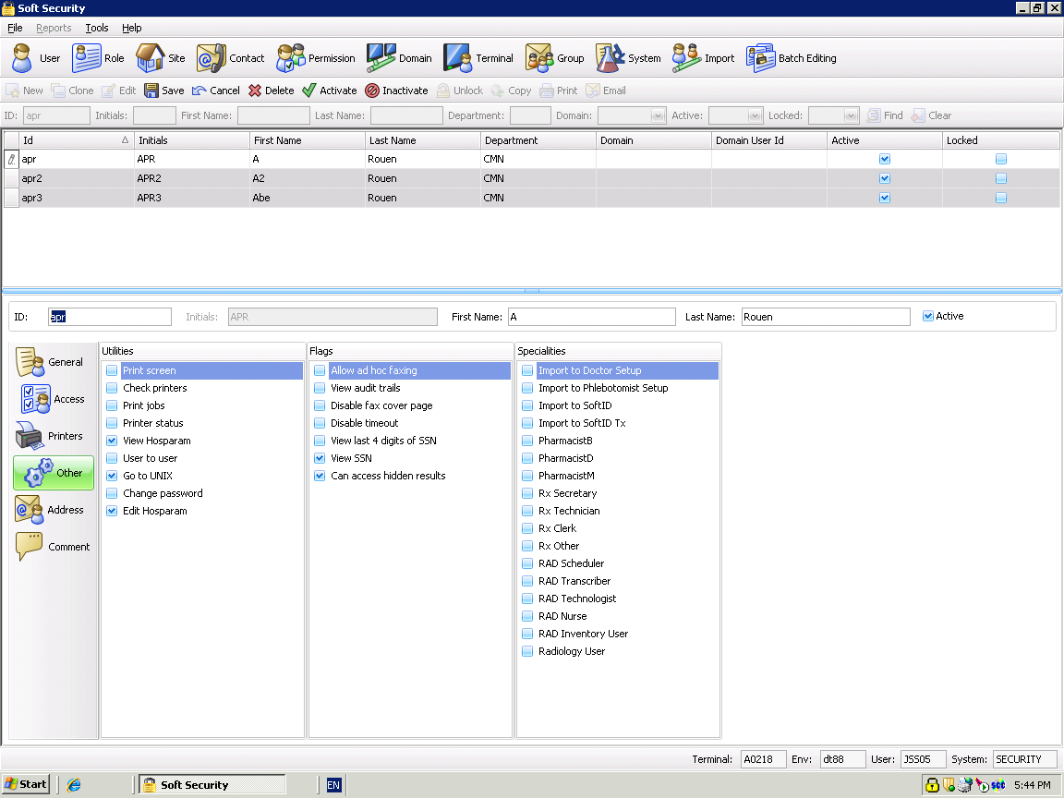
User - Other
Notes:
Utilities and Flags can be found under the Other tab.

Slide 12
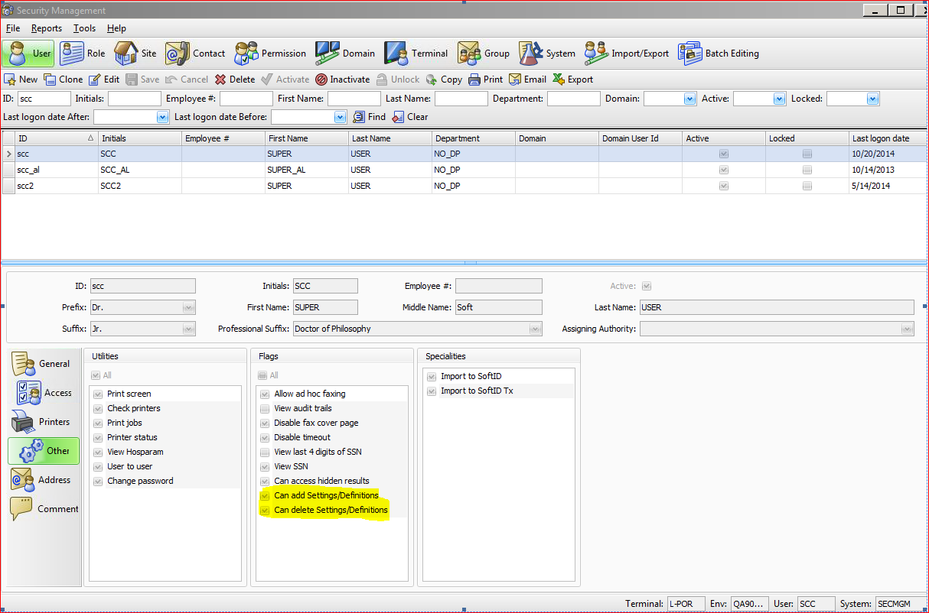
User – Other
Notes:
1.0.0.11

Slide 13
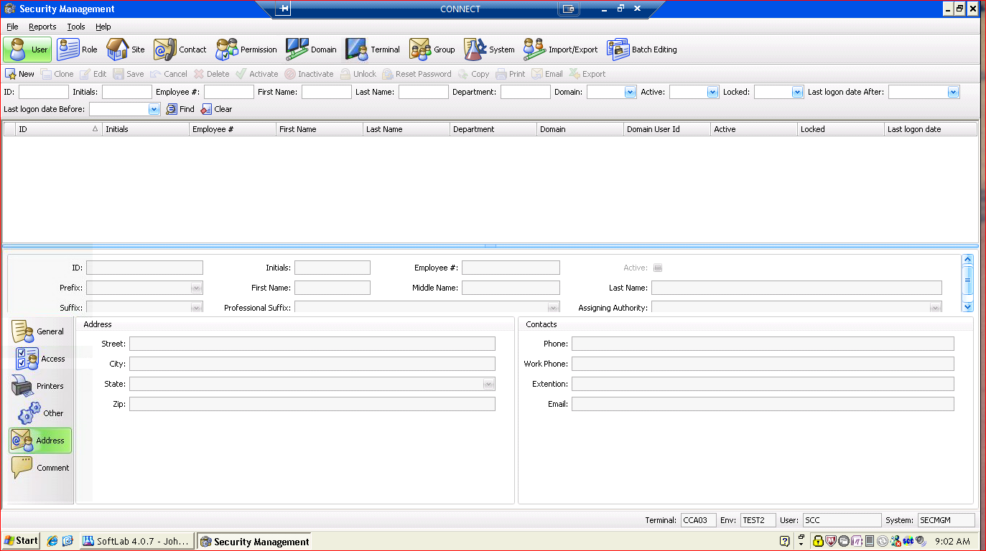
User – Address
Notes:
User information can be entered on this tab. Street, City, State, and Zip code.

Slide 14
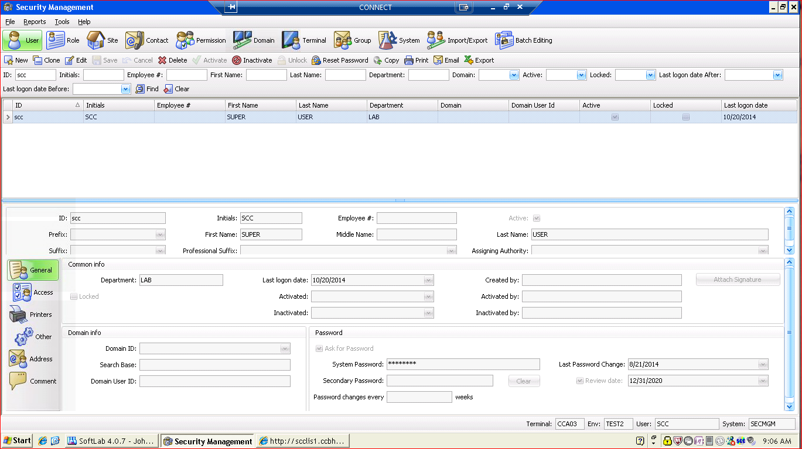
User - Reports
Notes:
User
Reports – It will open a separate window showing all of the security reports.

Slide 15
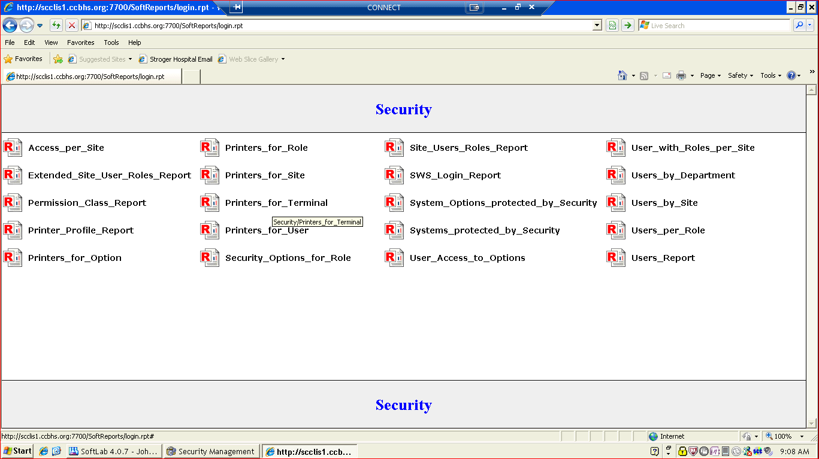
Security Reports
Notes:
Security Reports will display

Slide 16
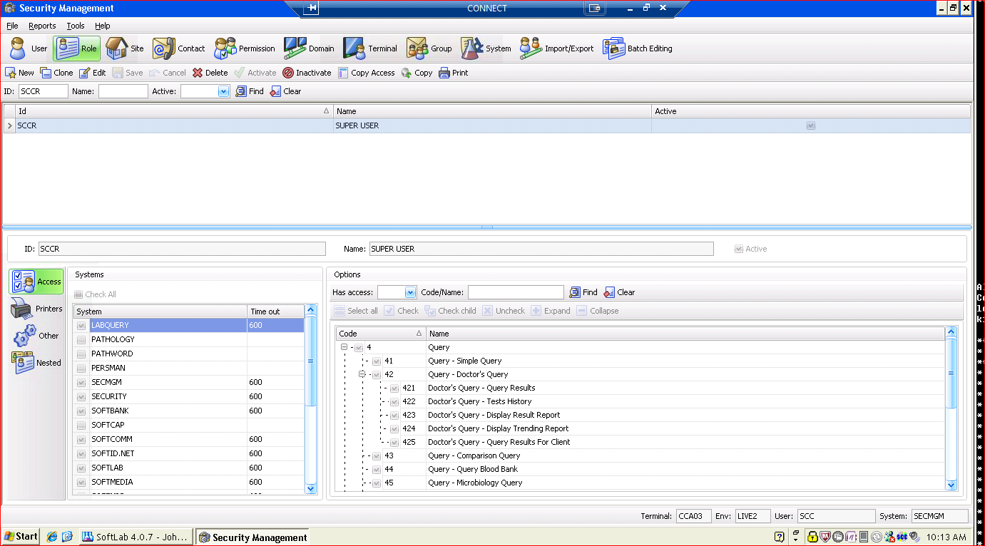
Roles
Notes:
Explain each field within Roles.

Slide 17
Roles - Access
Notes:
Displays all available access for this particular role.

Slide 18
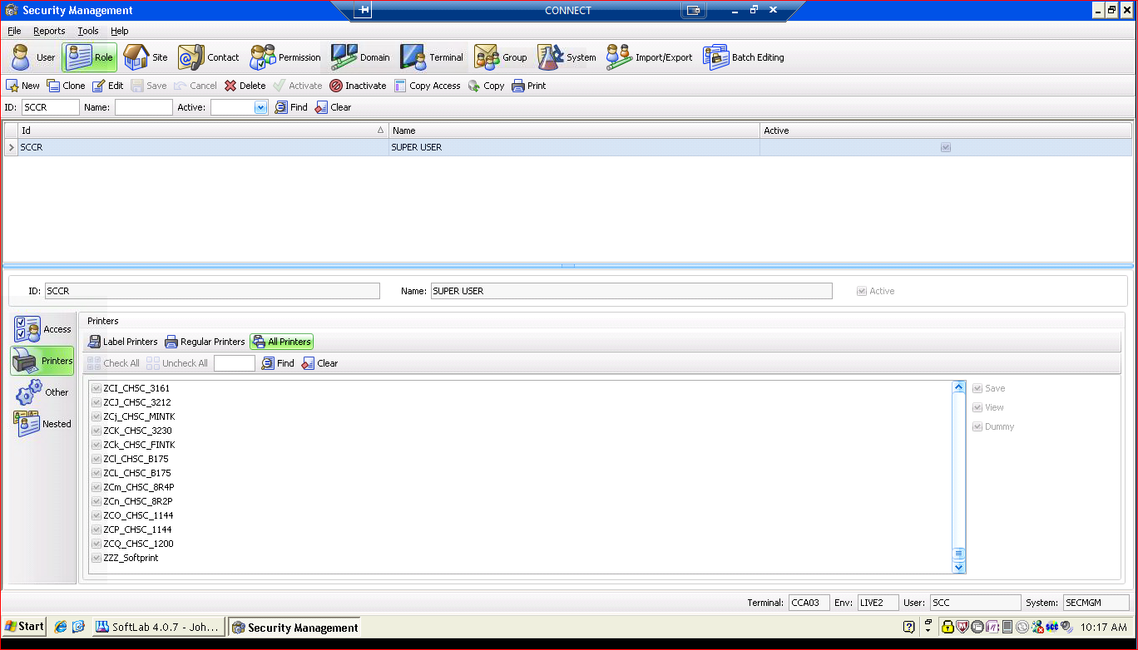
Roles - Printers
Notes:
Displays all printers available for this particular role.

Slide 19
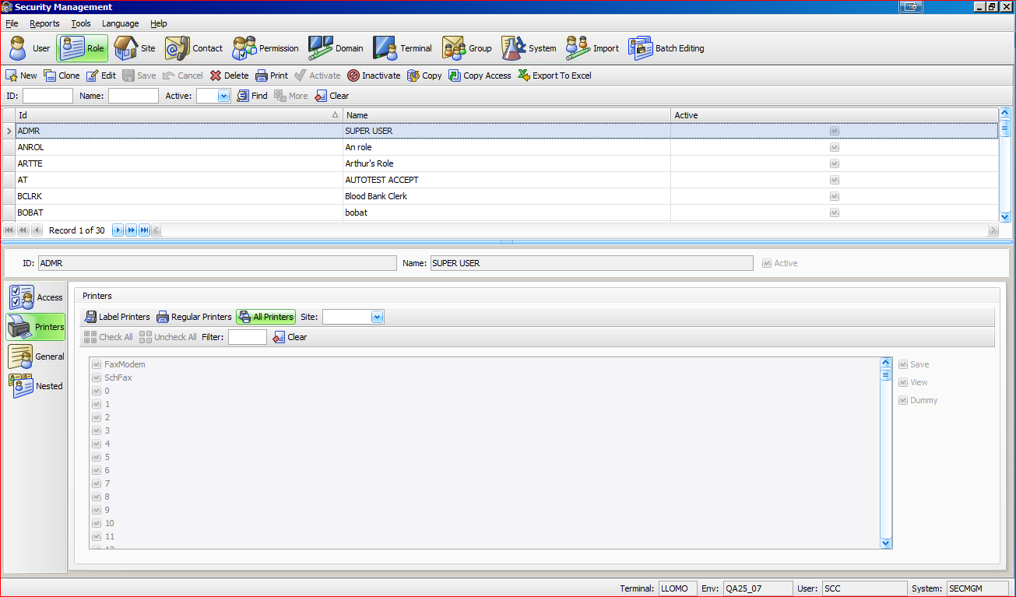
Adding Printers to a Role
Notes:
1. I selected role ADMR for my example.

Slide 20
Adding printers to a Role
Notes:
Select Printers

Slide 21
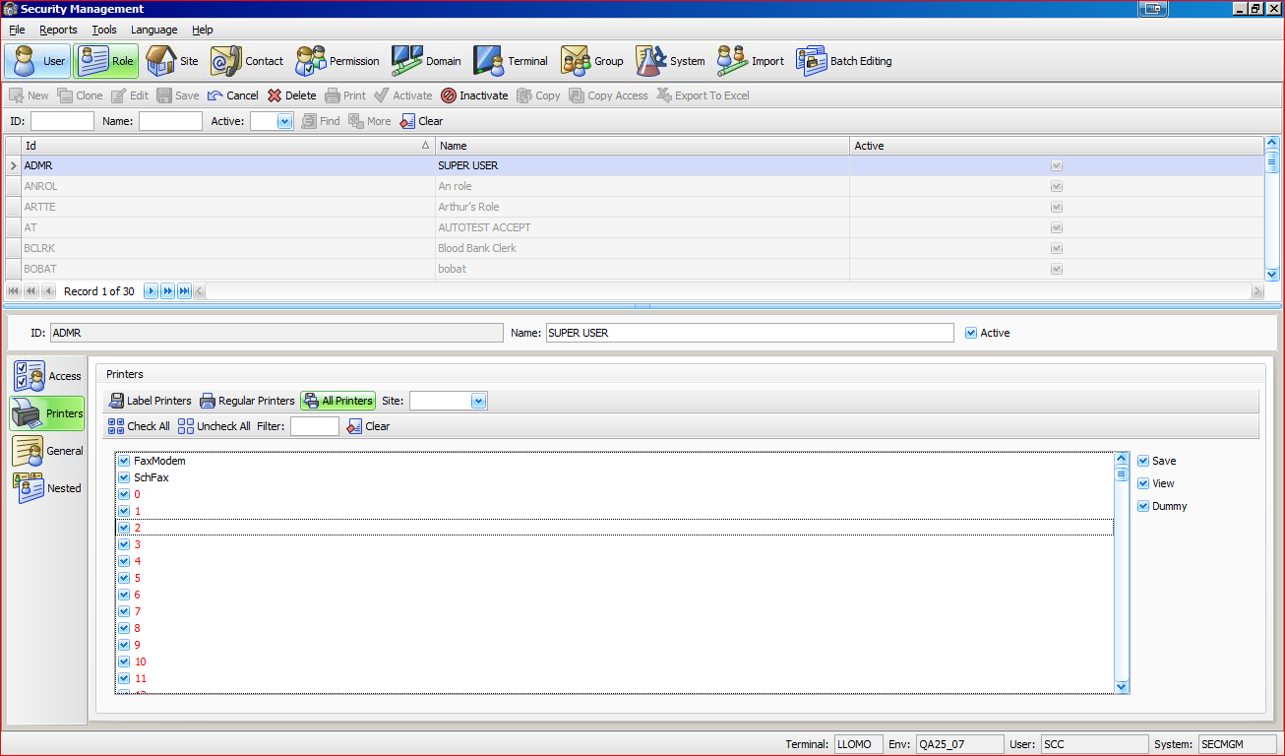
Adding printers to a Role
Notes:
You can choose Label, Regular or All Printers.

Slide 22
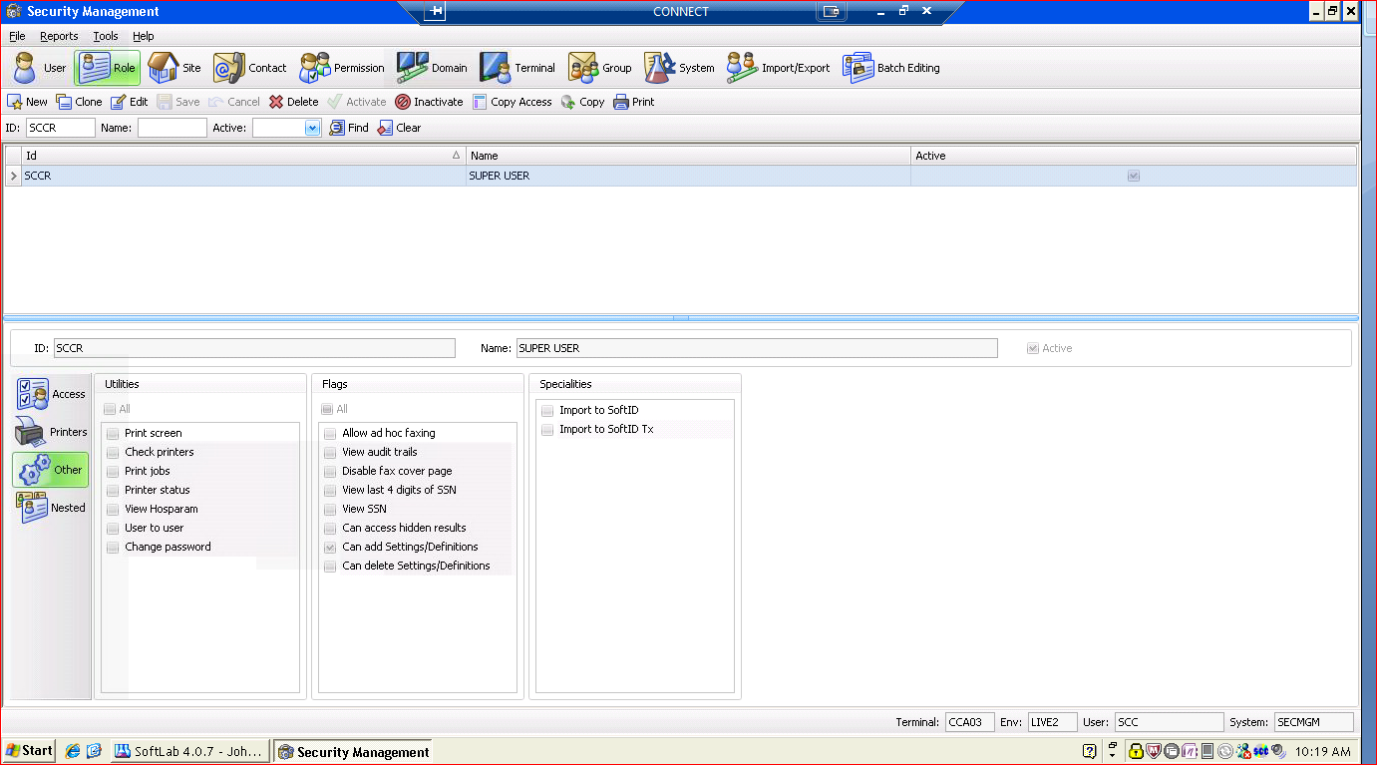
Roles - Other
Notes:
Displays all available utilities. Explain each utility and Flag

Slide 23
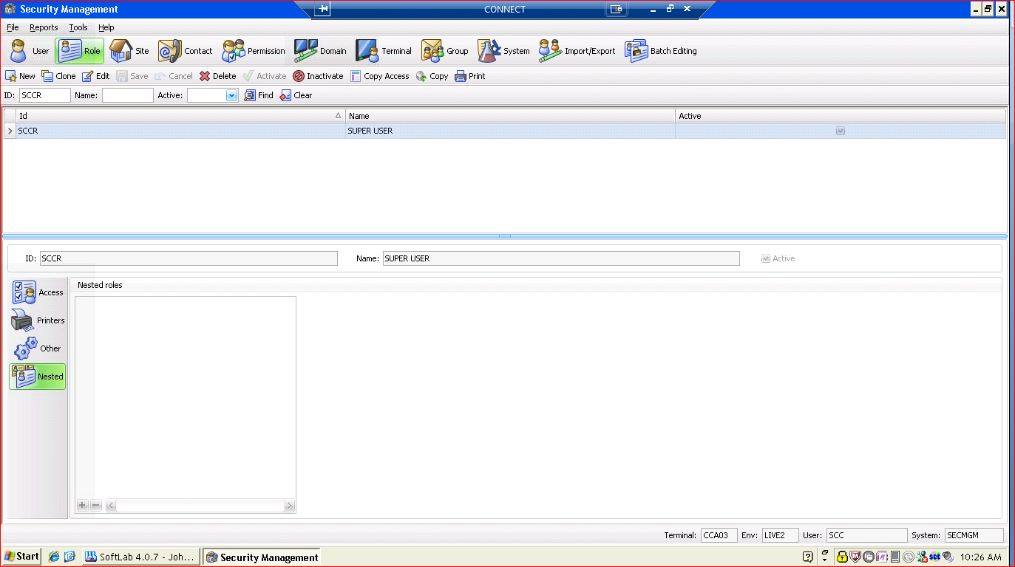
Role - Nested
Notes:
Nested Roles would be displayed here.
4.0 - Nested Roles
4.5 – No Nested Roles but you will have unlimited Roles to add to each user.

Slide 24
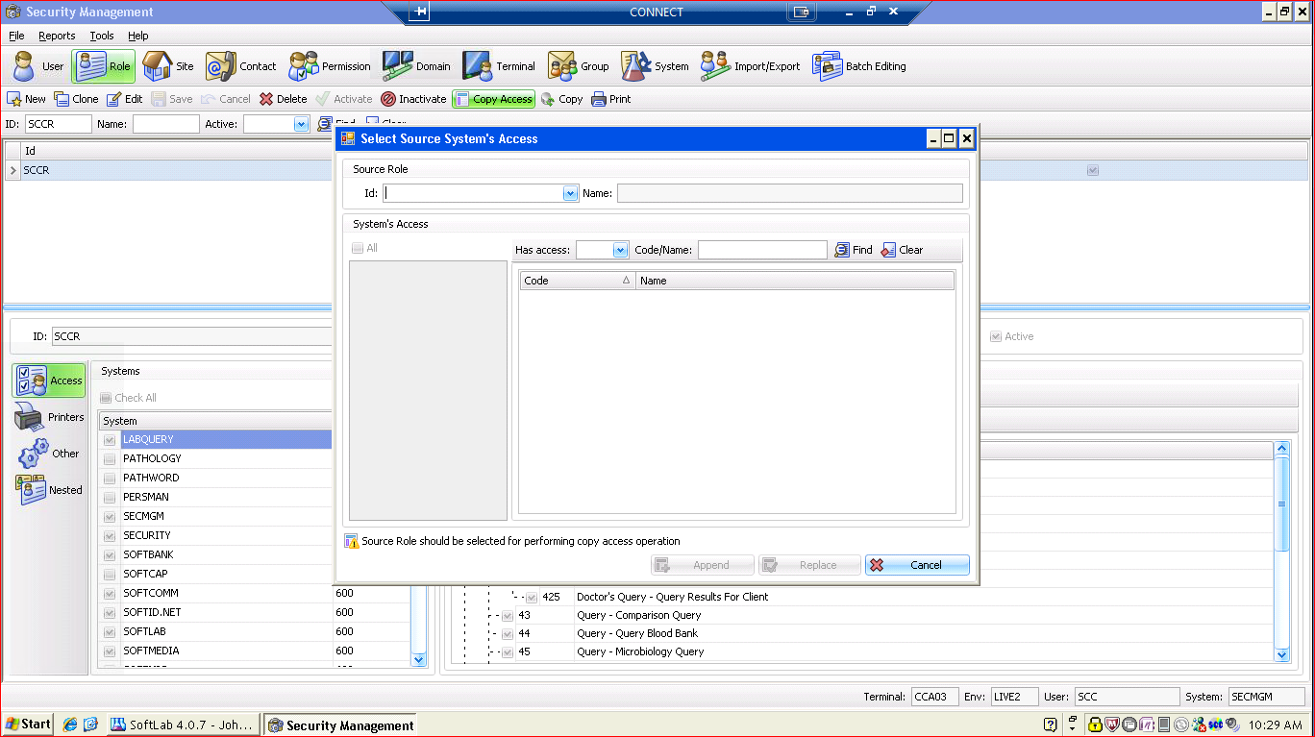
Copying Roles
Notes:
Select your role.
Select Copy Access
Copy Access screen will appear.

Slide 25
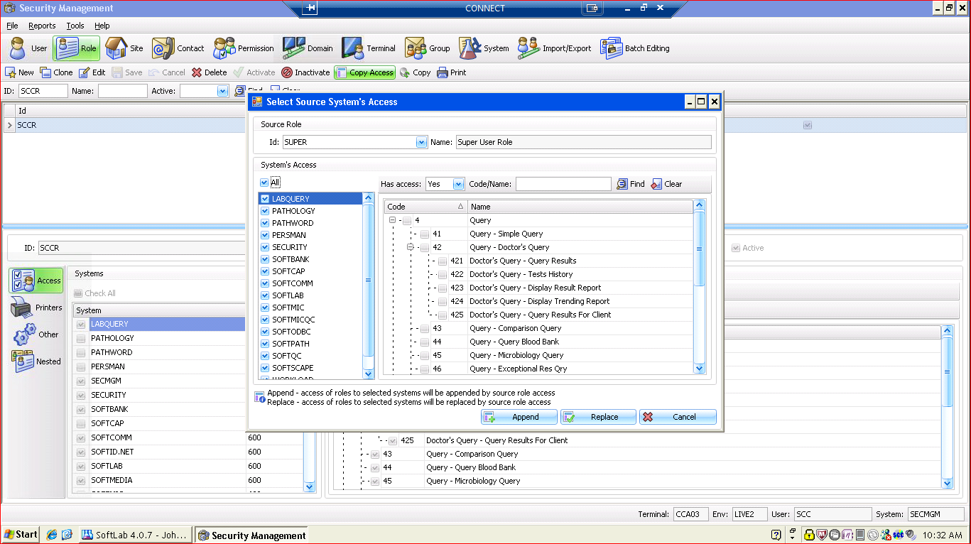
Copy Access Screen
Notes:
The user would then select the role he would like to copy. I selected role SUPER.

Slide 26
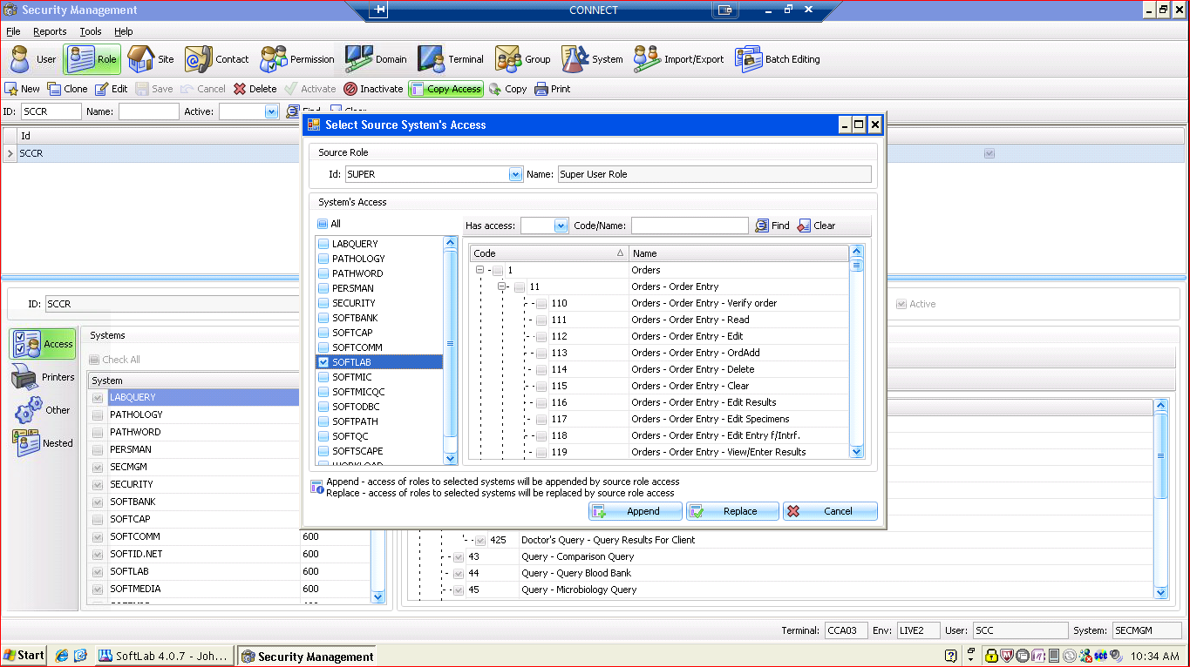
Copy Access Screen
Notes:
The user would then select which system they would like to copy access from or you can select all to add everything defined for that role. I selected SoftLab.

Slide 27
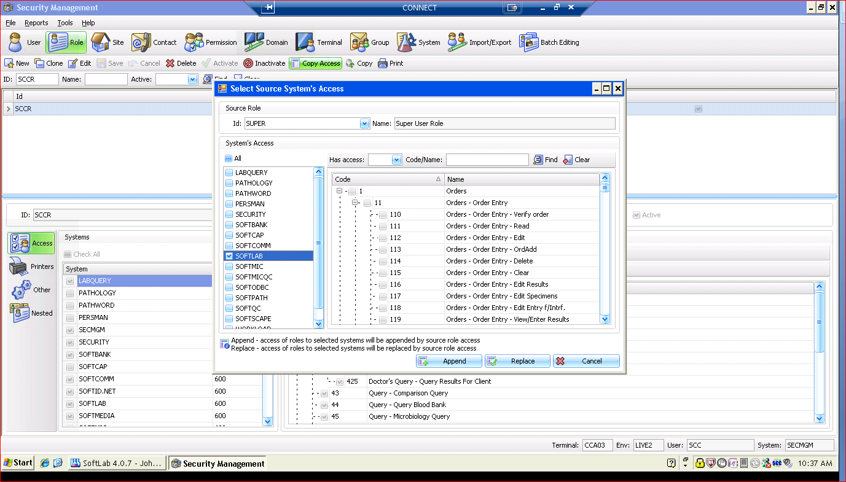
Copy Access Screen
Notes:
1. Append will add the options for selected systems to receiving role
2. Replace will replace the option for the selected systems to the receiving role

Slide 28
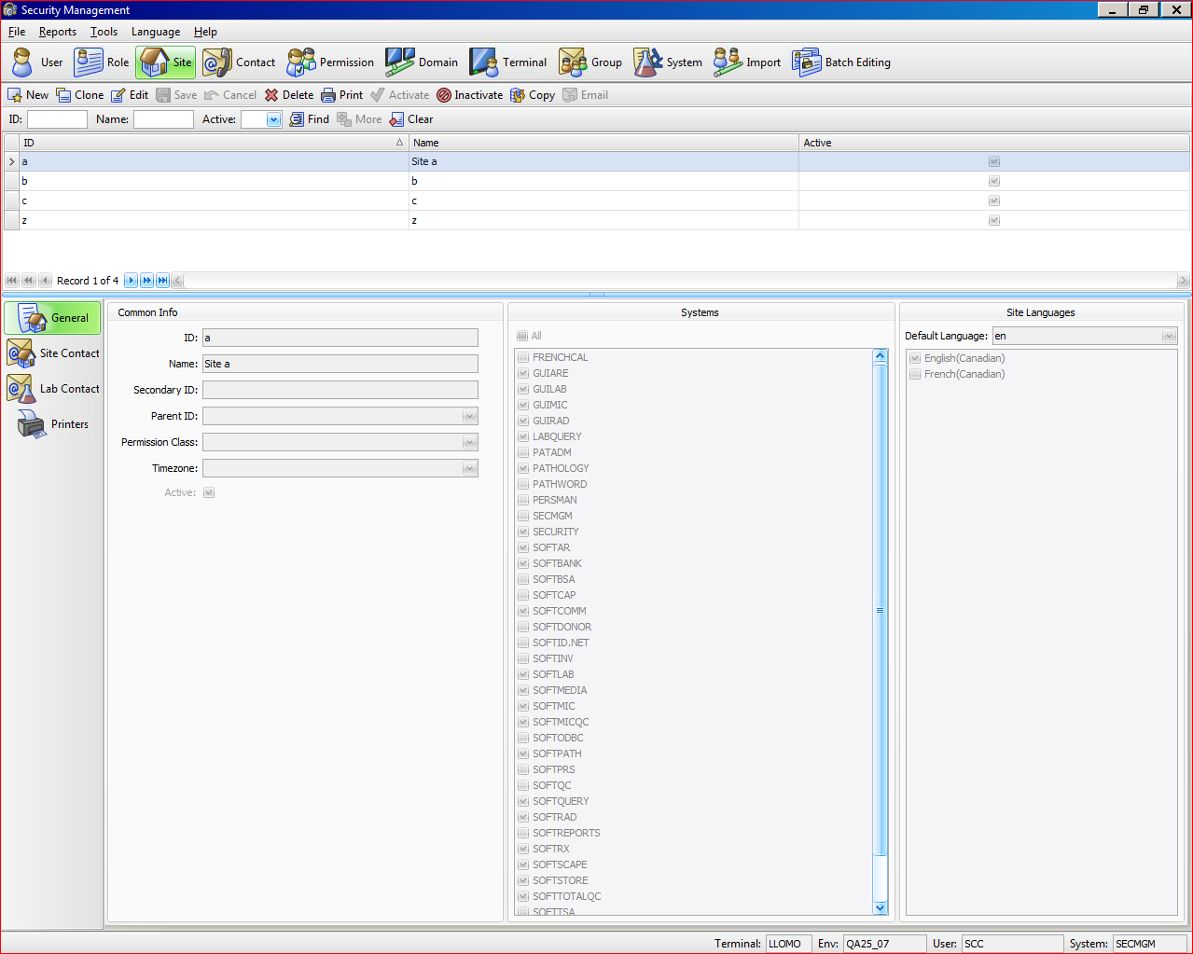
Site – General
Notes:
Sites are edited and created here.

Slide 29
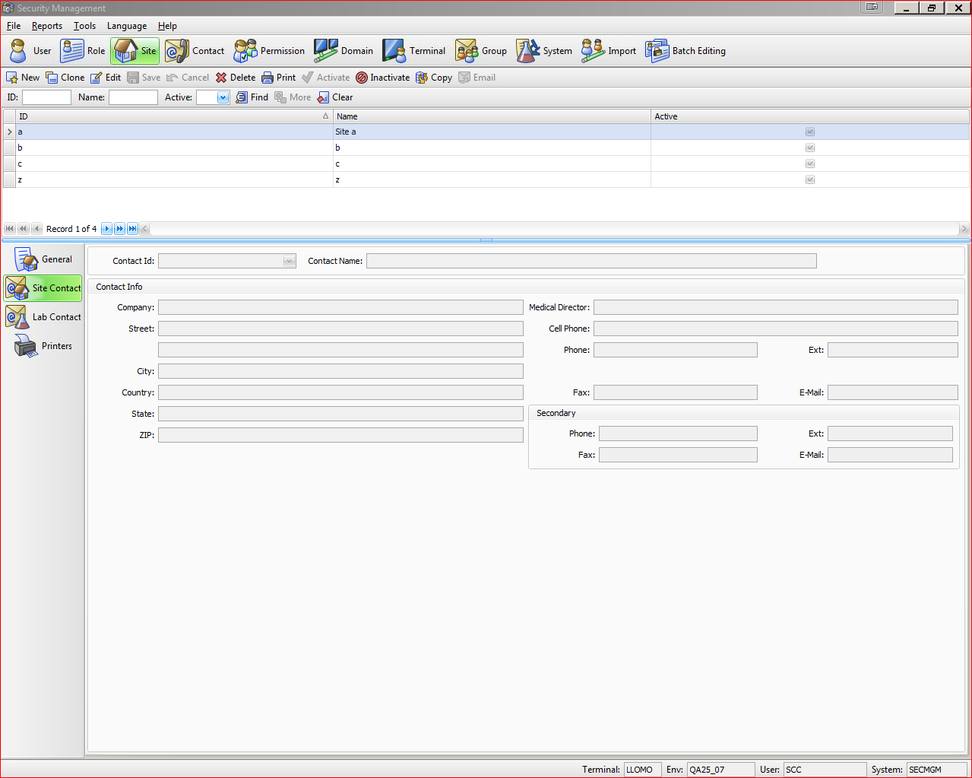
Site – Site Contact
Notes:
Contact Information may be entered here.

Slide 30
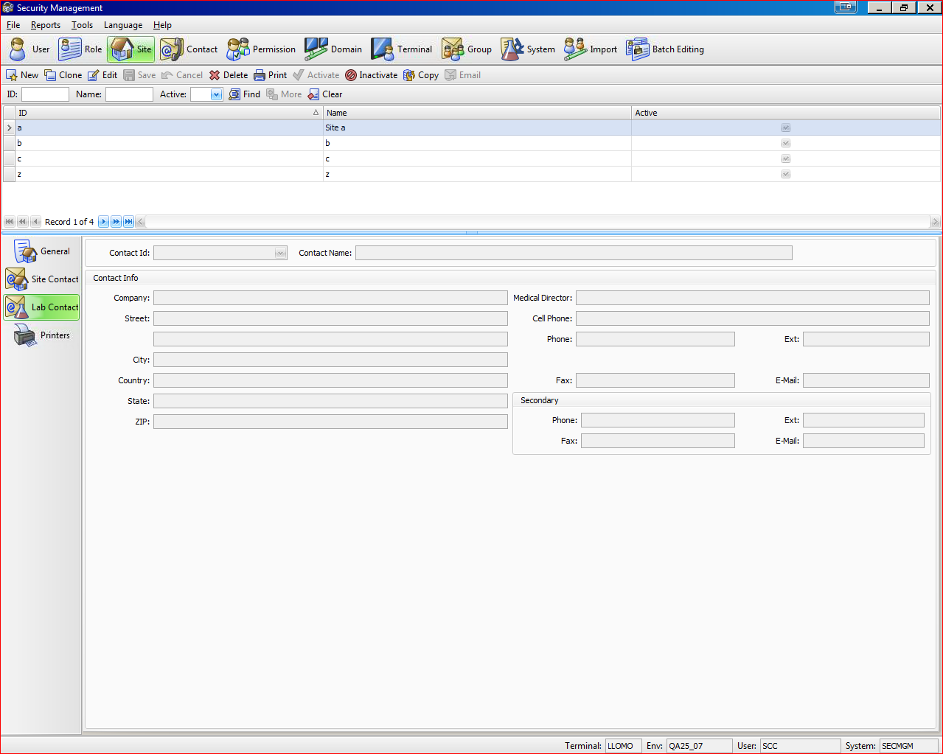
Site – Lab Contact
Notes:
Lab Contact Information may be entered here.

Slide 31
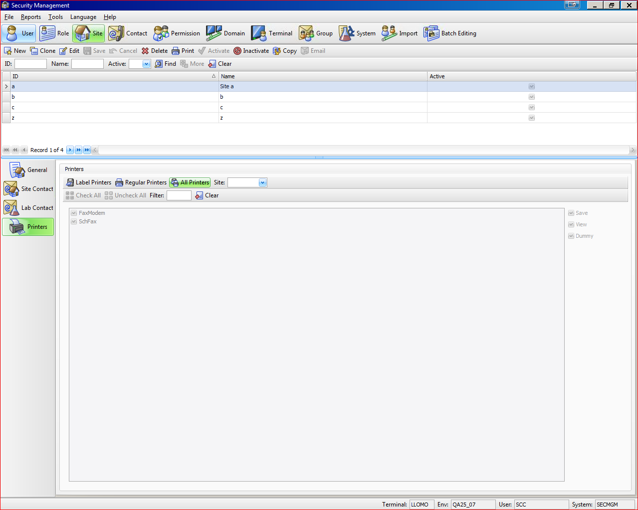
Site - Printers
Notes:
Printers may be added here for Sites.

Slide 32
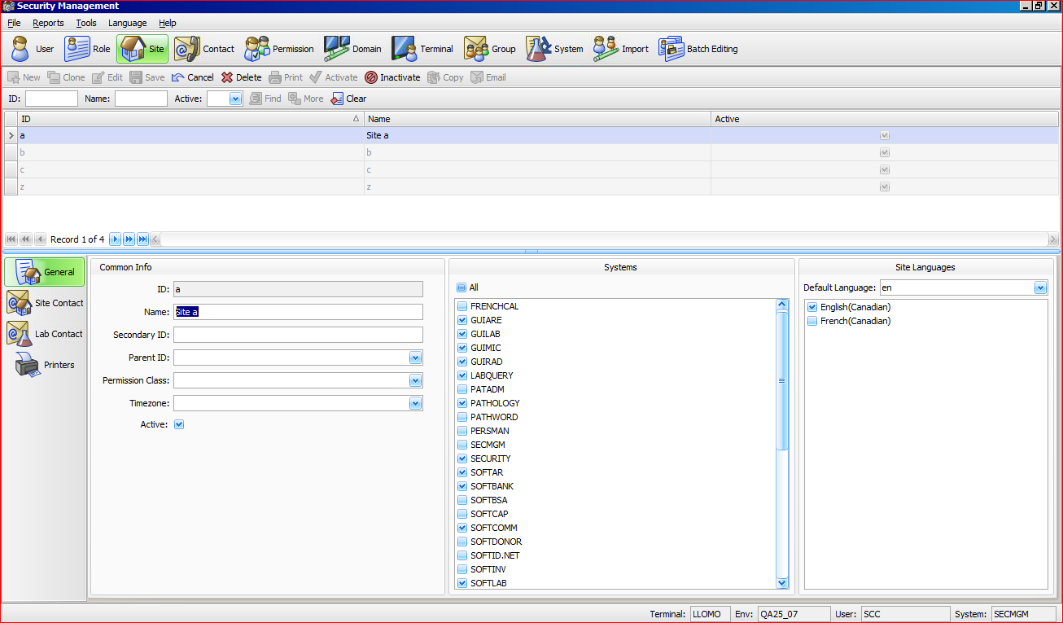
Adding Printers to a Site
Notes:
Select Site.

Slide 33
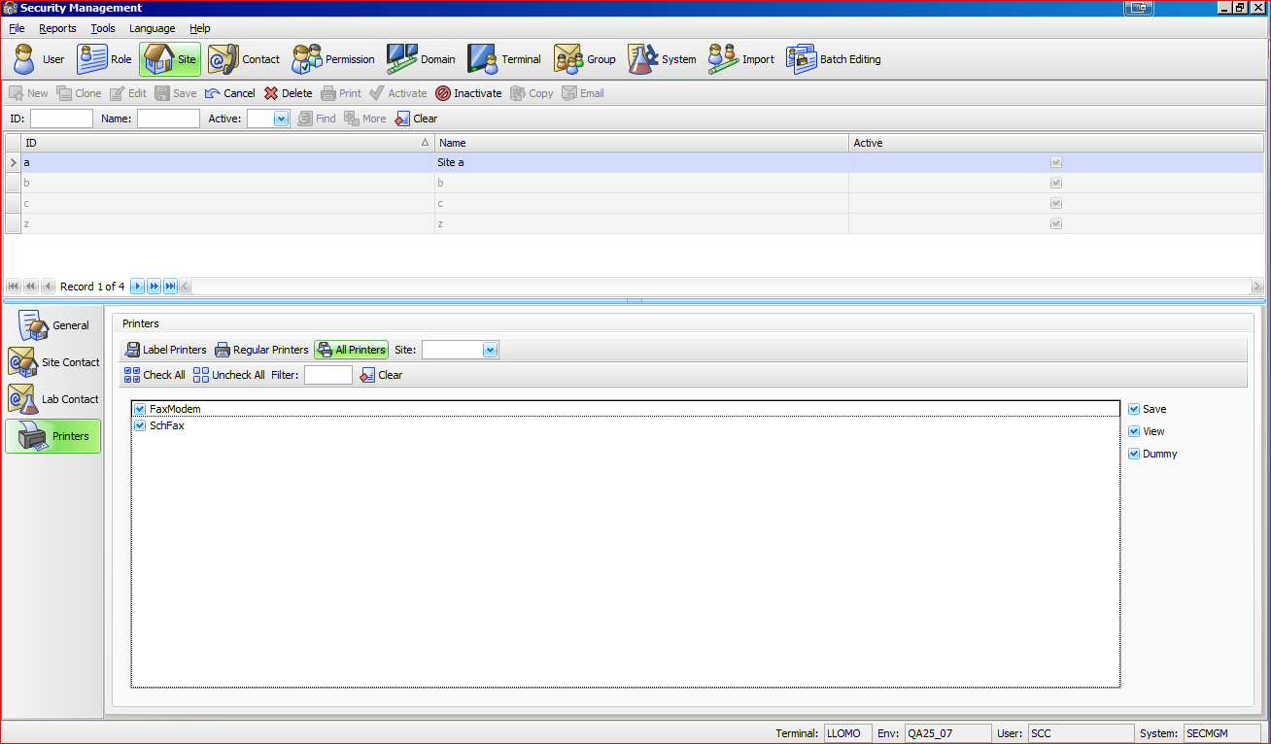
Adding Printers to a Site
Notes:
Select Printer on the left side.

Slide 34
Adding Printers to a Site
Notes:
Then you can add any printer to this site. Label, Regular or All.

Slide 35
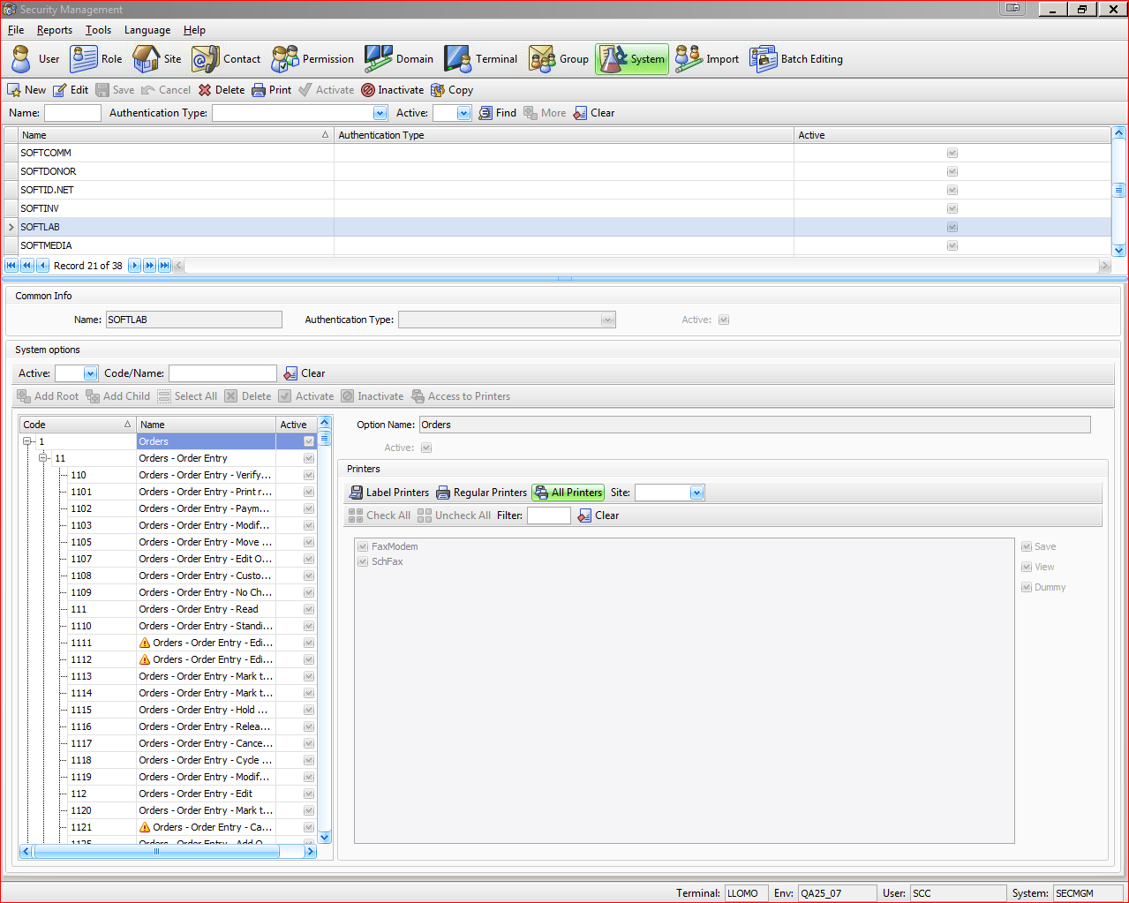
System
Notes:
System. Talk about all of the different fields on this screen.

Slide 36
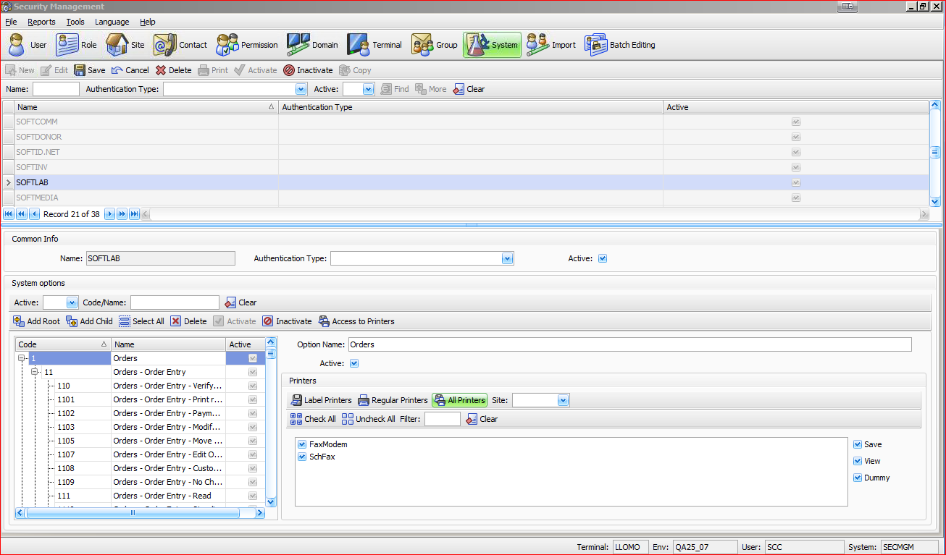
Adding Printers to a System
Notes:
1. Select System from the top Toolbar.

Slide 37
Adding Printers to a System
Notes:
Select your module.

Slide 38
Adding Printers to a System
Notes:
Select which option you would like to add the printer.

Slide 39
Adding Printers to a System
Notes:
You can select Label Printers to show only Label Printers.
Or you can select Regular Printers to show only Regular Printers.
Or you can select All Printers.

Slide 40
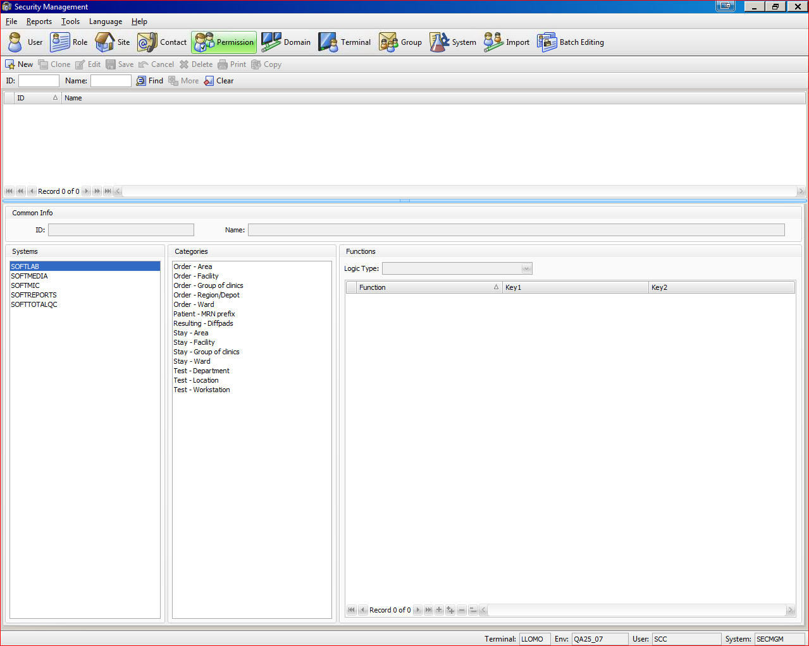
Permission
Notes:
Permission Classes. Now I will build a Permission Class from scratch for the SoftLab module.

Slide 41
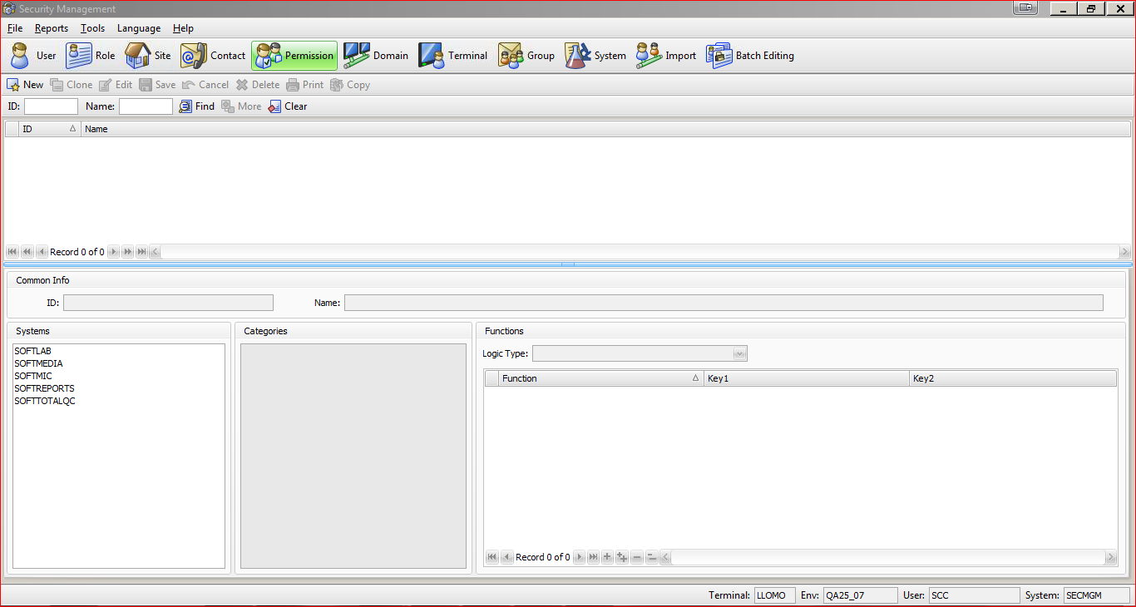
Permission
Notes:
Select New.

Slide 42
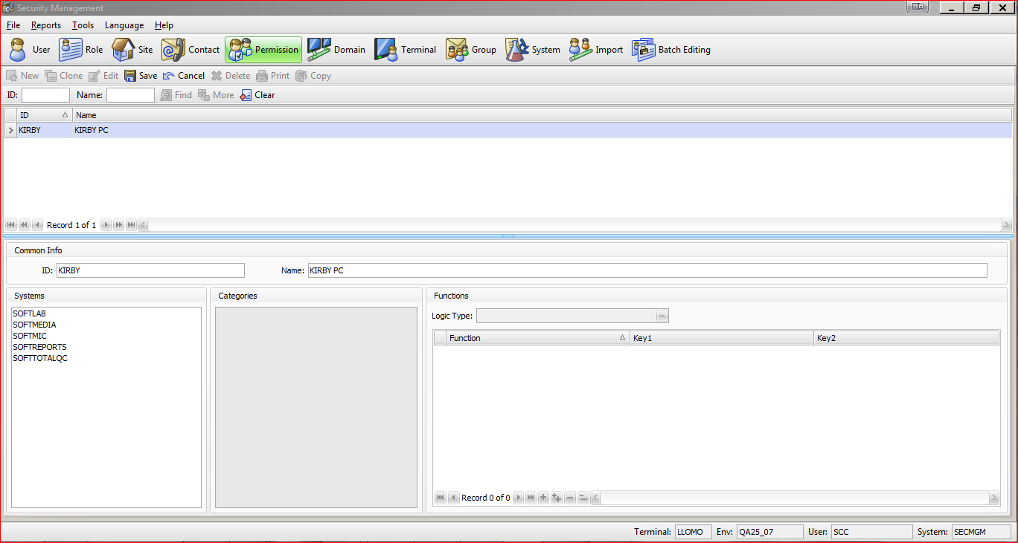
Permission
Notes:
Create your ID and Name. For my example I selected User: Kirby and Name: Kirby PC

Slide 43
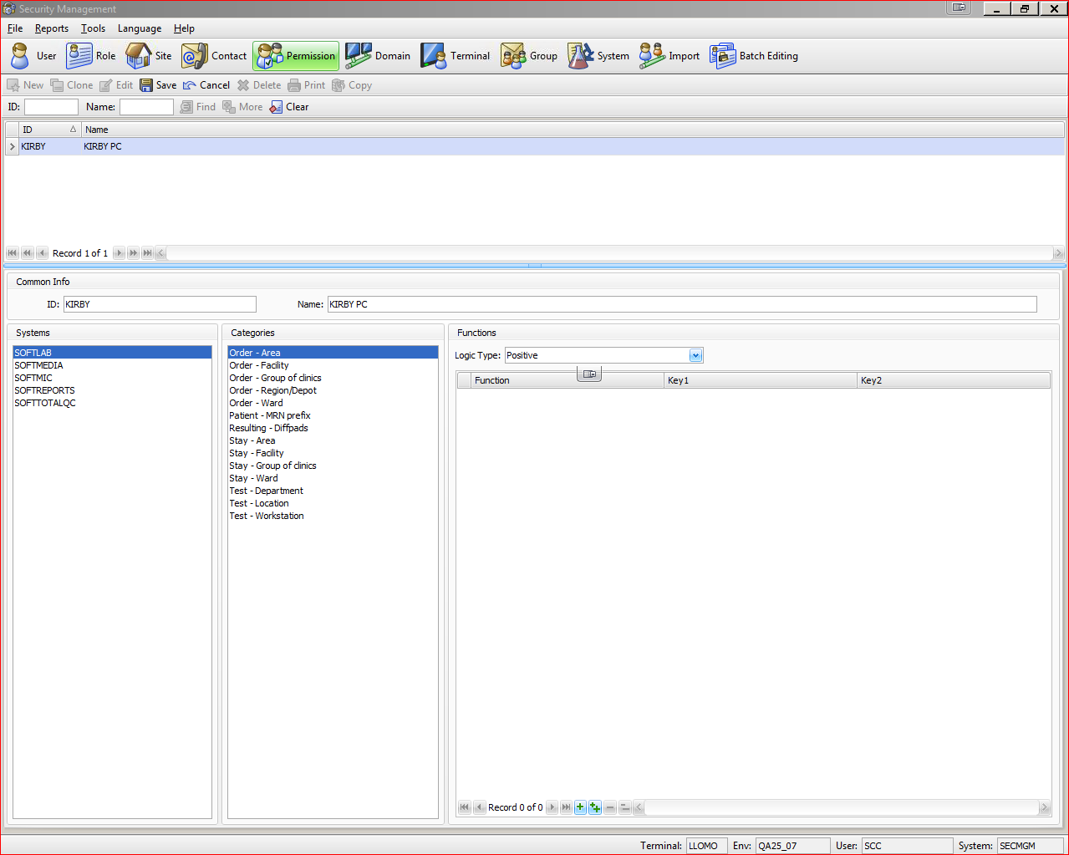
Permission
Notes:
Select your System.
Select your Category.
Under Functions Select your Logic Type.
Select the Positive option to only provide the user with access to the items that
are selected for the permission class. Select the Negative option to provide the
user with access to everything except the selected permission class items.

Slide 44
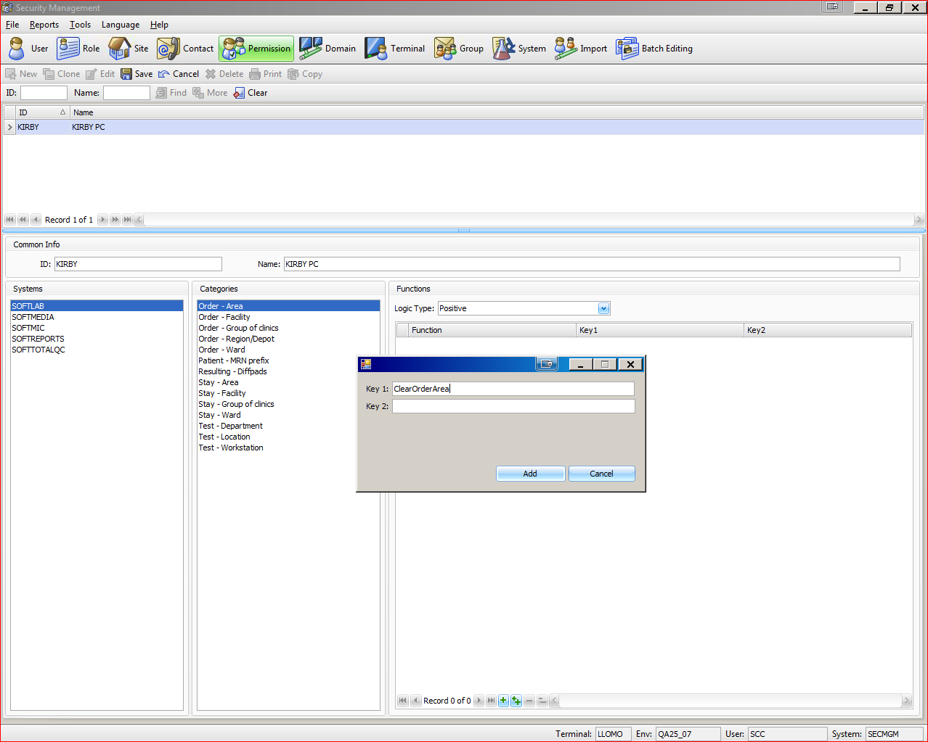
Permission
Notes:
+ - Add One Permission Class
++ - If you want to add several Permission Classes.

Slide 45
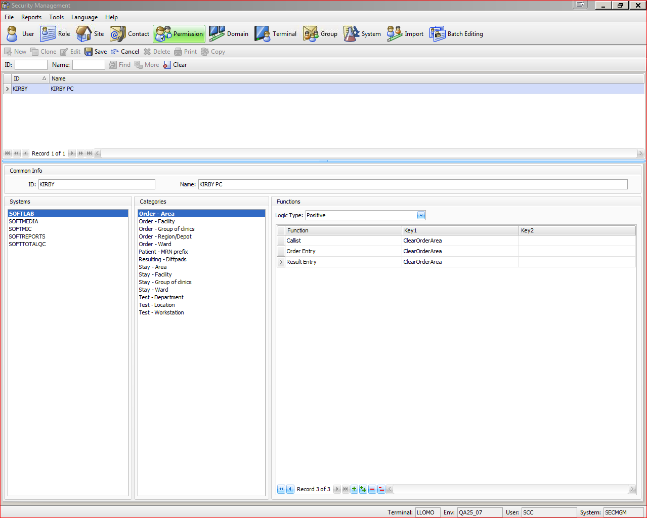
Permission
Notes:
1. After pressing Okay. You will there is a Permission class named KIRBY that has access to SoftLab orders in Order Area ClearOrderArea.
CallList, Order Entry, Result Entry.

Slide 46
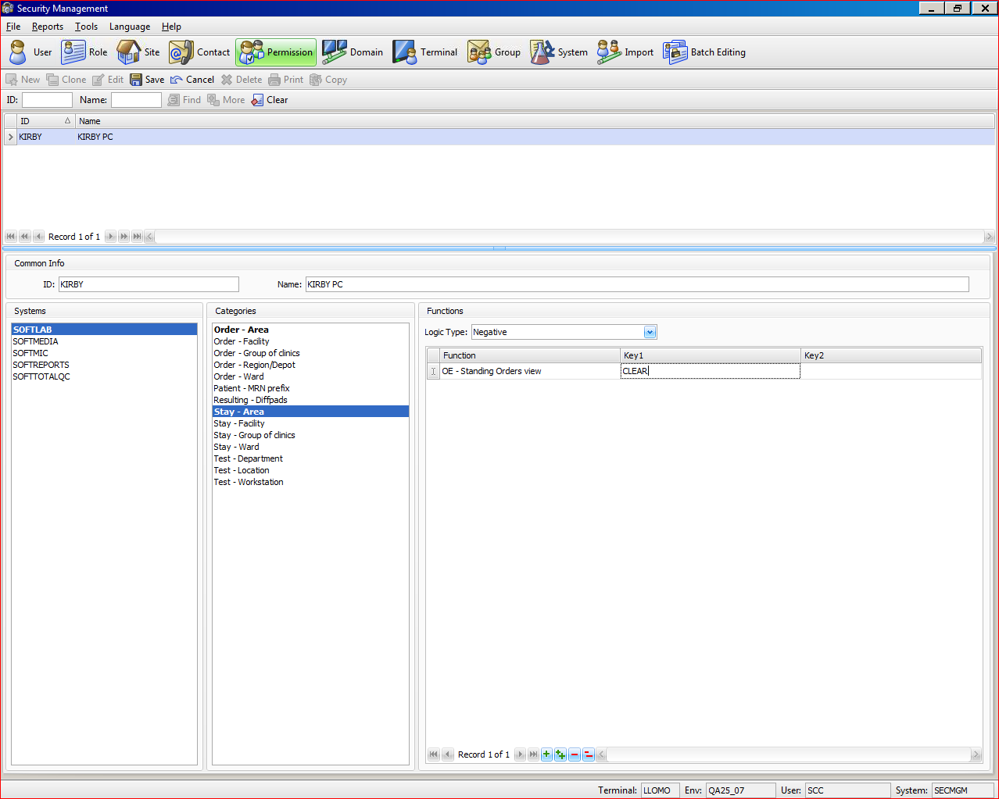
Permission
Notes:
Negative Logic.
I’ve added to my existing Permission Class to not allow access to any Standing Orders in OE with a clinic of CLEAR.

Slide 47
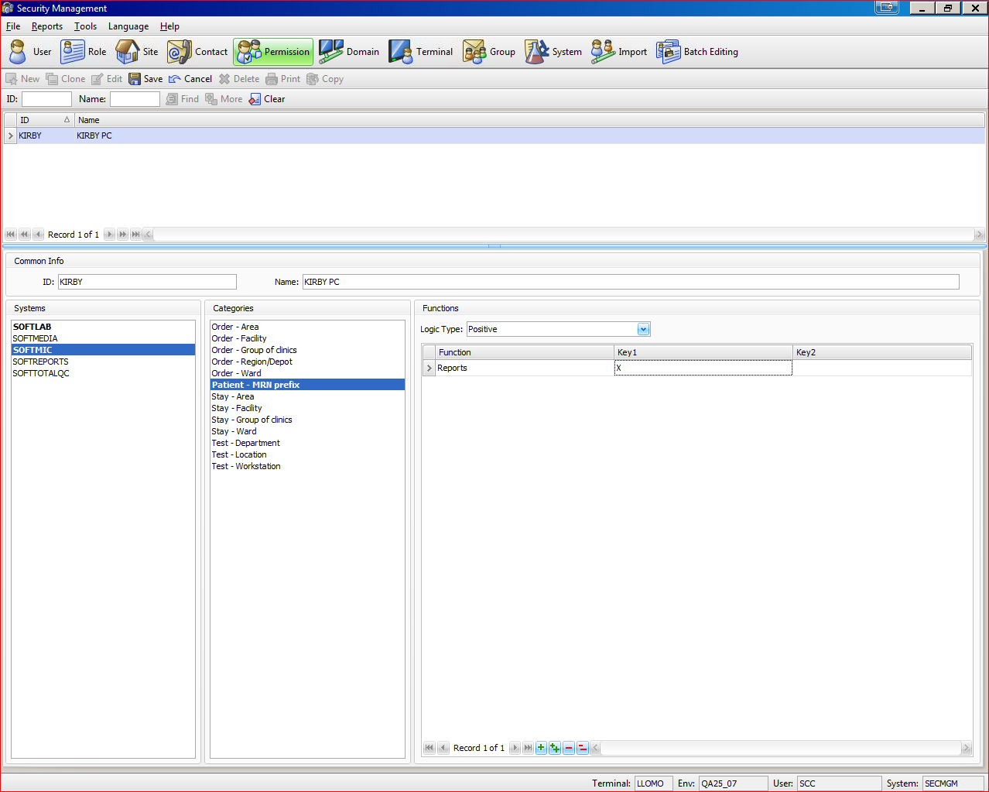
Permission
Notes:
You can have one permission class responsible for several modules. Here I changed my system to SoftMic and Category to Patient MRN Prefix.
Be sure to talk about the Bold Face letters, showing you which Systems you have defined a Positive or Negative Permission Class.

Slide 48
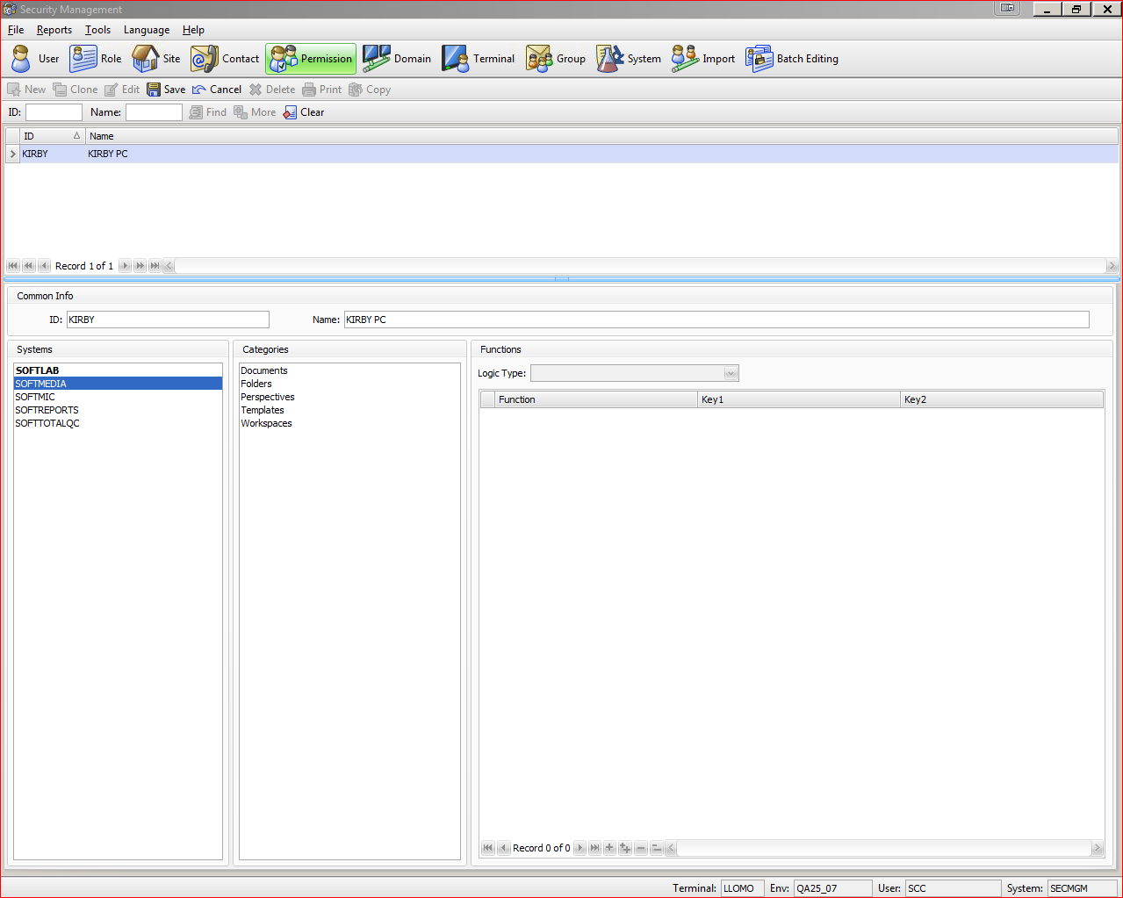
Permission
Notes:
Example Screenshot - SoftMedia Permission Classes

Slide 49
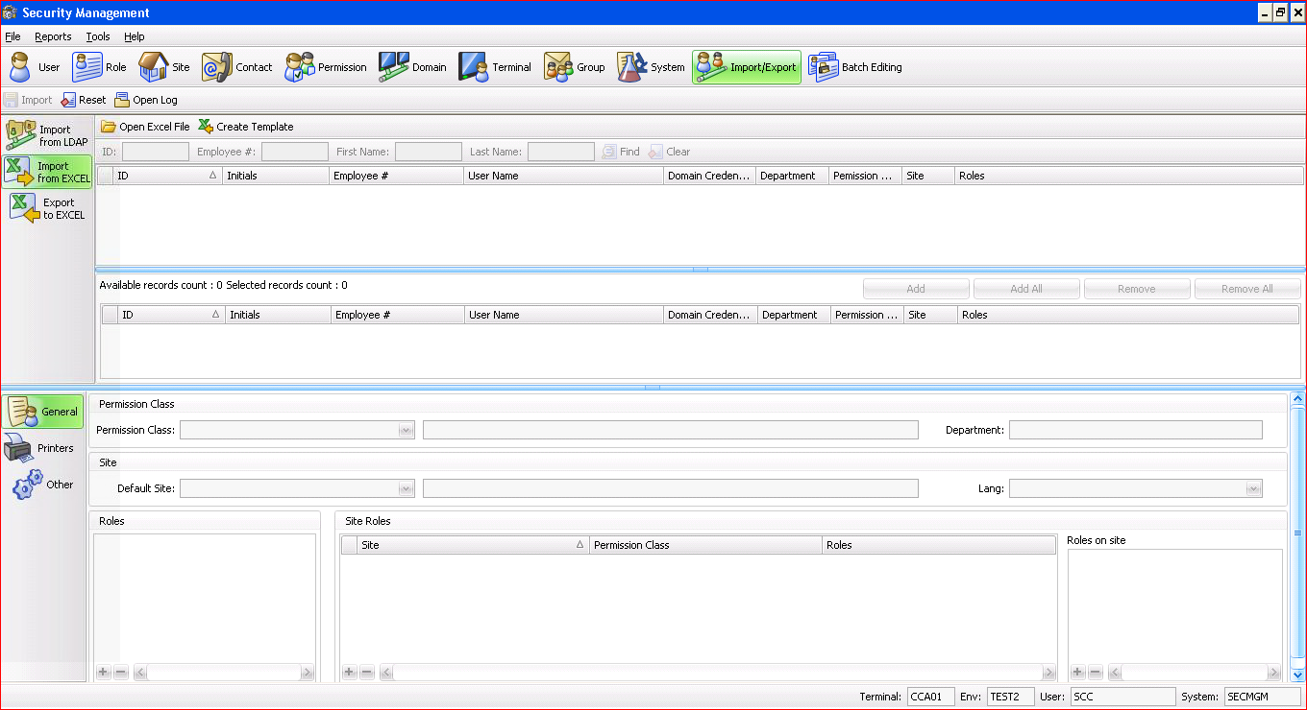
Import Users from Excel
Notes:
Press Create Template

Slide 50
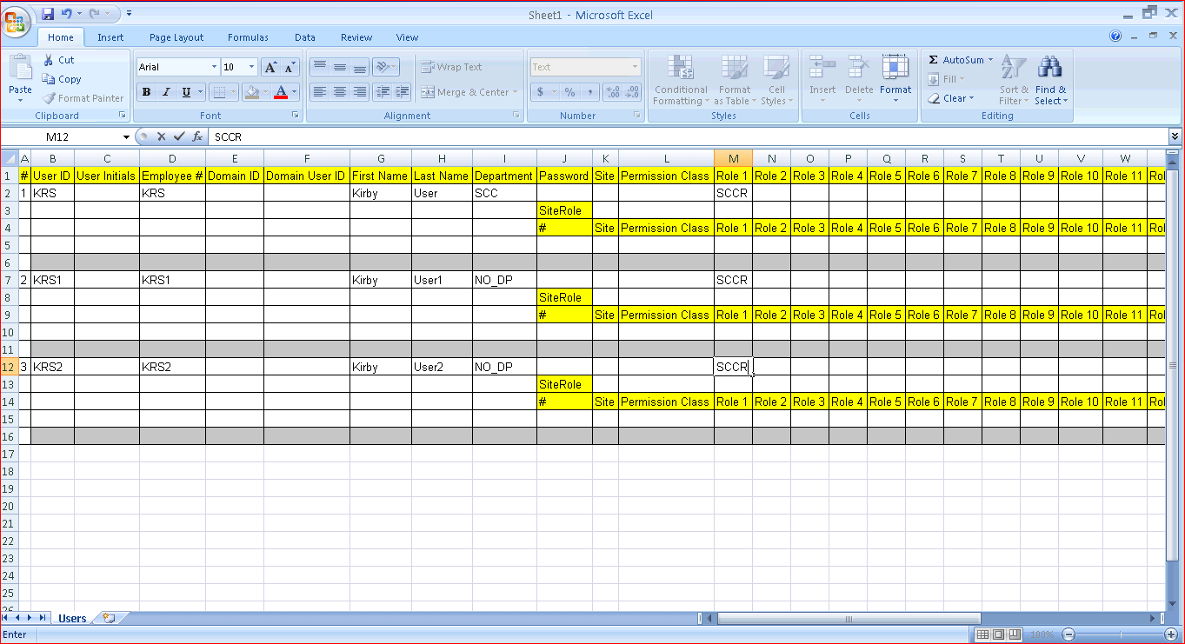
Import Users from Excel
Notes:
Excel Screen will appear. Add your users here. Save your file.
Explain each field.

Slide 51
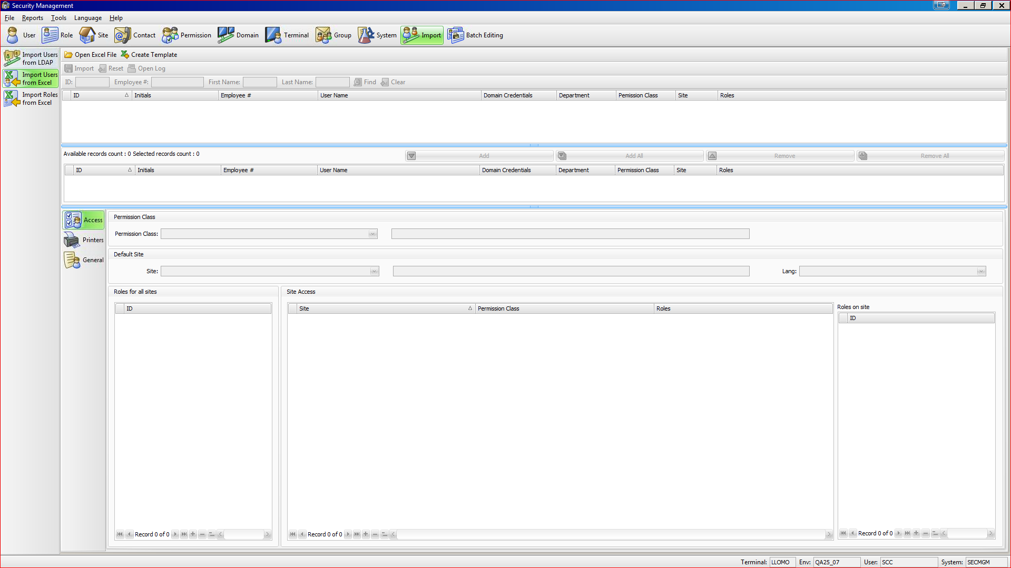
Import - Import Users from Excel
Notes:
Discuss Import Users from Excel

Slide 52
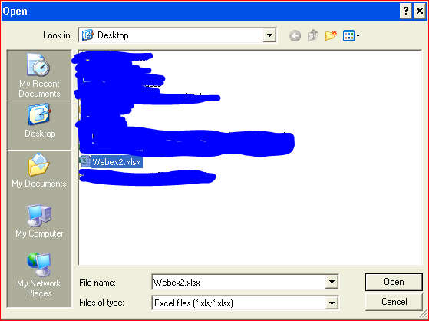
Import Users from Excel
Notes:
Select your document you created.

Slide 53
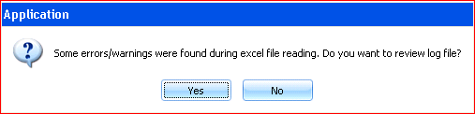
Import - Import Users from Excel
Notes:
Error Log – Something does not matchup with your existing setup.

Slide 54
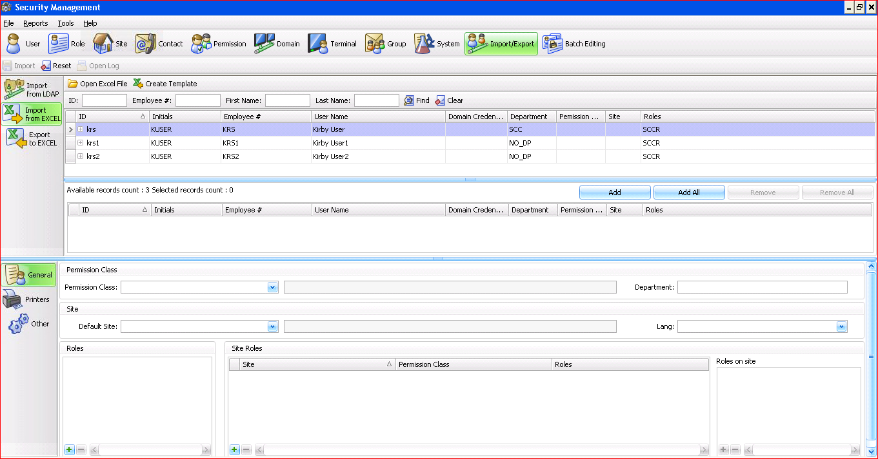
Import - Import Users from Excel
Notes:
Users you will add to the system will be in the top toolbar.
Available records count will show how many records your currently adding.
If everything looks correct press Add to add one at a time or you can press Add All.

Slide 55


