Slide 1

Don’t Touch This!
A quick guide of SoftLab setup files not to edit after go-LIVE.

Slide 2



Editing Rules to follow in LIVE
Don’t Delete ANYTHING!!!
If it has an expiration date,
do NOT Inactivate!
If it’s on a report, BEWARE!

Slide 3
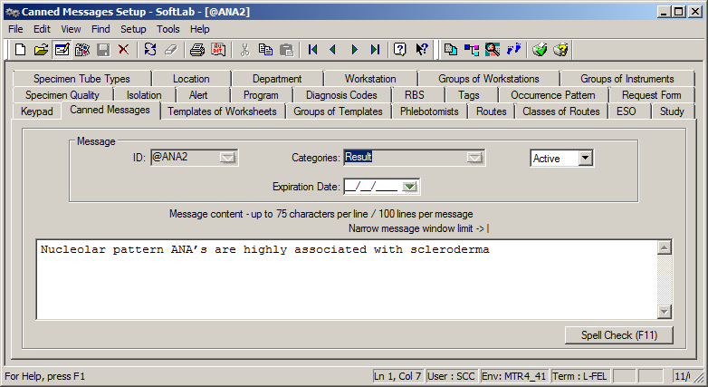
NEVER edit Canned Messages

Slide 4
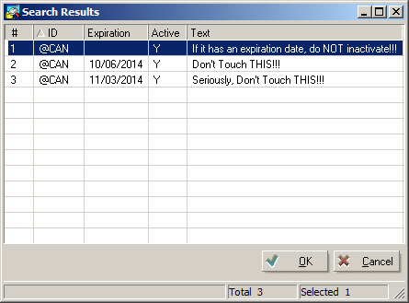
Expire Canned Messages

Slide 5
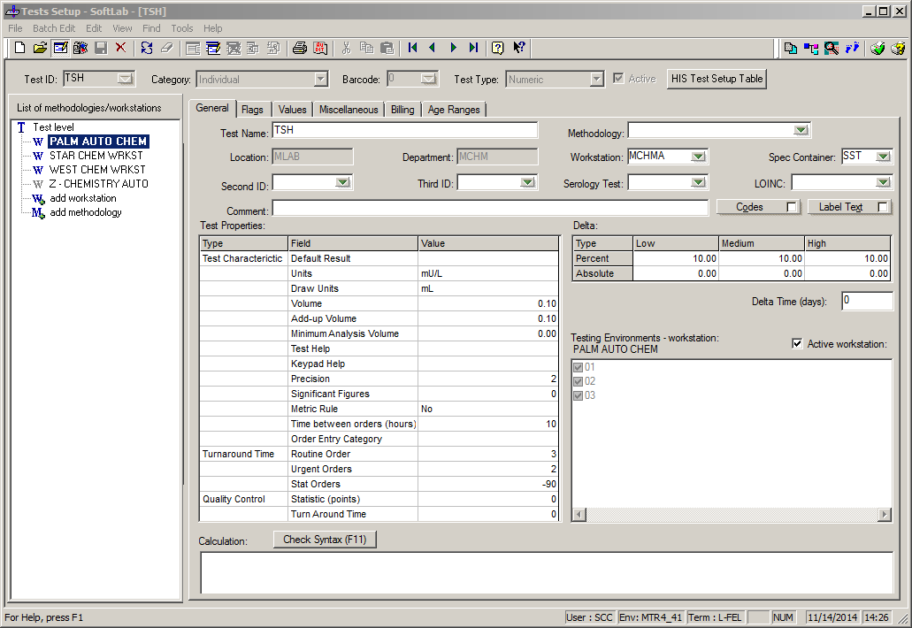
Don’t Touch these Test Maintenance fields

Slide 6
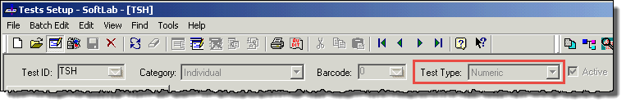
Don’t Touch Test Type
Alphanumeric →Numeric
May have just flagged old results as absurd!
Numeric →Alphanumeric you have just deleted Ranges and Precision.

Slide 7
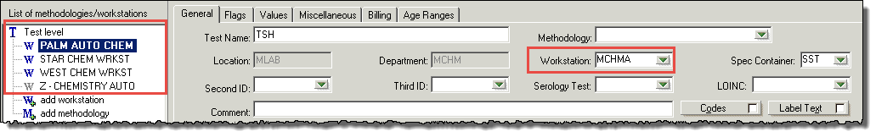
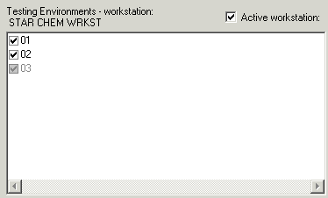
Don’t Touch Workstations
NEVER edit workstation field!
Inactivate, Add New, or Redirect Environments instead.

Slide 8
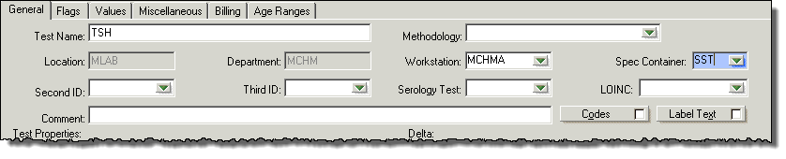
Spec Container
You CAN change the spec container, but all pending tests with the old specimen must be cancelled and re-ordered.

Slide 9
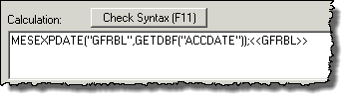
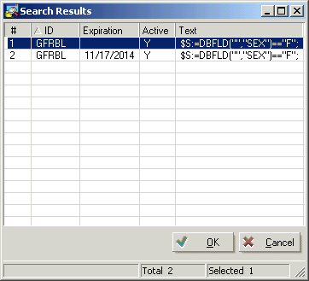
Calculations
Editing Calculations improperly will change historical results!
Refer to the Design II manual for instructions on how to expire them!

Slide 10
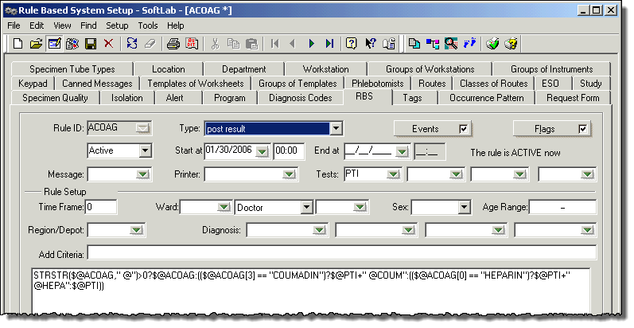
Post Result RBS Rules
Expire the rule or use the same calculation expiration procedure from test setup

Slide 11
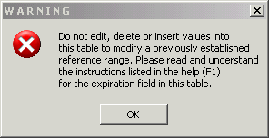
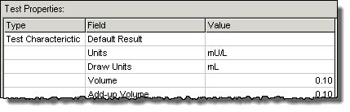
Age Ranges and Units
Age Ranges should be expired, NOT changed!
Units can only be changed in the same edit session that ALL ranges are expired.

Slide 12
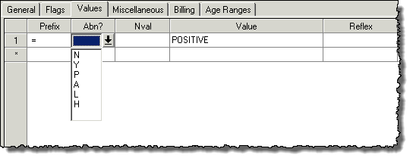
Don’t Touch Values Tab Flagging
If you are using the “Abn?” field, do NOT change the “Value” or “Prefix” field in that row.

Slide 13
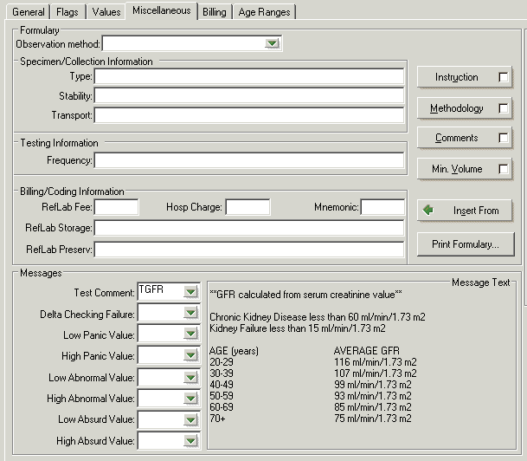
Messages in Miscellaneous Tab
Don’t touch this!!!
Expire the Canned Messages instead

Slide 14
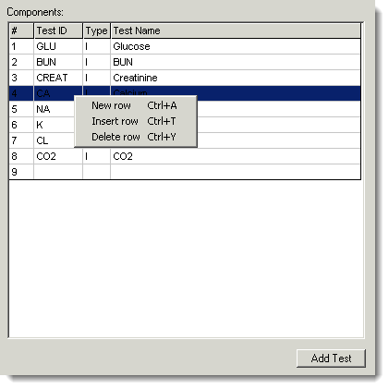
Group Tests
Never delete individual components of Group Tests!
Adding new tests and rearranging tests is OK!

Slide 15
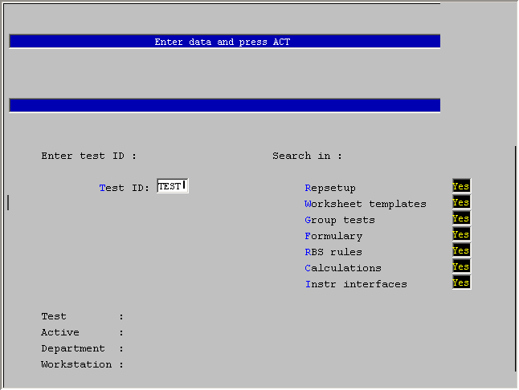
Test Setup Search
The Test Setup Search allows you to search for many setup files that may be affected upon editing of a test!

Slide 16
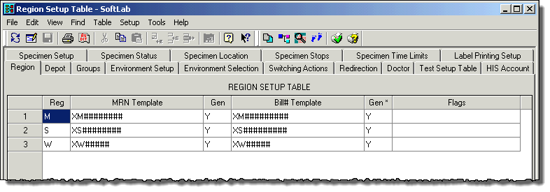
Multisite
ALL multisite tables can be edited without affecting historical values

Slide 17
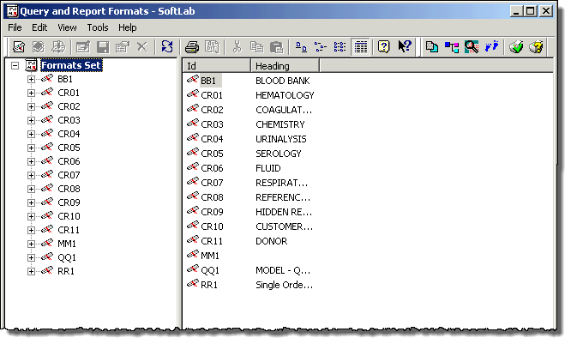
Report Setups
Report Setups including Query and Reports Formats, and Tags can be edited without affecting Hisotrical Data.

Slide 18

Questions? nicholas@softcomputer.com

