Slide 1
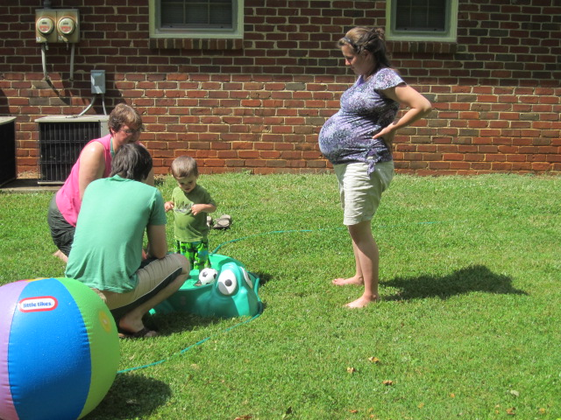
What to Expect When You’re Expanding
Peggy Steele, BSMT (ASCP)
Lab Implementation Specialist
Client Projects
(727)789-0100 x 4583
peggy@softcomputer.com

Slide 2
Congratulations!
When adding an affiliate with a unique physical location, a site needs to be added in Soft in order to uniquely identify the affiliate for reports, billing, patients, and tests.

Slide 3
Preparing for the new arrival
To ensure a smooth implementation, some decisions have to be made up front. The sooner the better!
Files to review in preparation include:
Doctor
Ward/Clinic
Orderable Tests
Individual Tests
Users

Slide 4
Doctor Files
Get the Doctor Master from the new affiliate
Will doctors need to be added to the system?
Will “shared” doctors be identified by the current Soft ID or will two ID’s be needed?
If a second ID, does it need to be prefixed to be unique?

Slide 5
Doctor Files
Can the same doctor have multiple offices? Impact on report delivery?
Is there a Doctor Update Interface? Will the new affiliate use it?
ELR (MU2/CHERT)
NPI
Assigning Authority/Facility (if different HIS)
Contact info (Primary phone and address)

Slide 6
Ward/Clinic
Get a list of patient locations (wards and clinics) from new affiliate
What wards/clinics need to be added?
Are all identifiers unique? If not, consider prefixing the inbound wards in the HIS or engine.

Slide 7
Ward/Clinic
Do orders from the HIS use Salesman ID? Discuss with you’re HIS specialist.
ELR (MU2/CHERT):
Assigning Authority
Contact info (Primary phone and address)
Facility name (Physical building of clinics)

Slide 8
Orderable Tests
Compare the current orderable test menus
What tests are offered in the current Soft system that are not offered by the new affiliate? Vice versa? Make a list of tests that will need to be added.
Will the discrepancies be orderable by all when the new affiliate goes live or will some tests be disallowed?

Slide 9
Orderable Tests
Try to use the HIS Test Table to convert existing and new HIS codes to the SAME Soft code. Try NOT to create two different orderable tests for the same performed test.
Will the HIS ID be the same or different?
ELR (MU2/CHERT):
LOINC codes

Slide 10
Test Setup
Review all the fields in Test Setup for the new affiliate
Collection containers (tube types)
Draw and analytical units
Precision and rounding
Time Between Orders and TAT
Ref ranges/ RFR’s for alphas/ Deltas
Required reflex tests
Billing

Slide 11
Test Setup
Will referred testing be sent to the same reference lab? Will specimens be sent from an existing lab or from the affiliate?
For group tests, will the components be the same?
Notes:
-Add rooms in the order labels should print
-What is put under Room depends on what comes from HIS (301 vs MLD01)
-Use ALL to include all rooms

Slide 12
Users
Get a list of the affiliate’s employees and their job types/descriptions.
Will permission classes be used?
Will users float between facilities?

Slide 13

Questions
About
File Review?

Slide 14

The Process

Slide 15
Process
Build majority of items in Production
Synch to Upgrade/ Build Interfaces
Validate in Upgrade
Copy interfaces/ enable logins in Production

Slide 16
Process
Build in Upgrade
Validate in Upgrade
Build in Production
Copy interfaces/ Enable logins in Production

Slide 17

The Build

Slide 18
Multisite Setup
Region
If the new affiliate will use a different region, start by building the new region. For example, Region F.
To the Region Setup Table add:
Region
MRN and Billing Number Templates
Y to generate (if applicable)

Slide 19
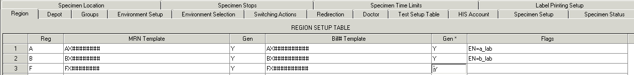
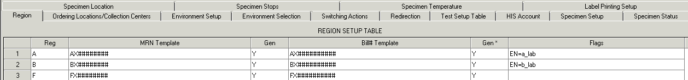
Region
Pink = 4.0 Blue = 4.5

Slide 20
Multisite Setup
Depot (4.0)
Ordering Location/Collection Center (4.5)
Depot/OLCC Setup Table. Assign terminals if necessary.
HIS Account Depot Setup Table
Testing Environment Selection Table

Slide 21
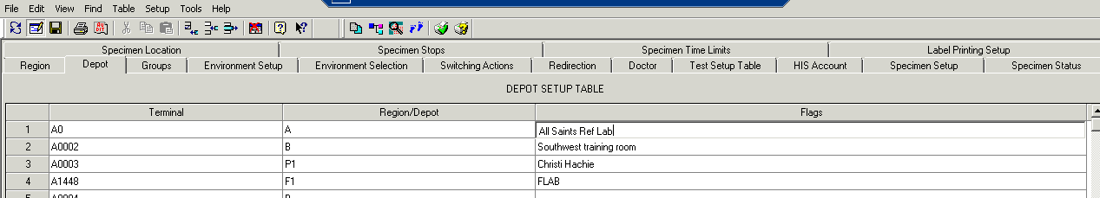
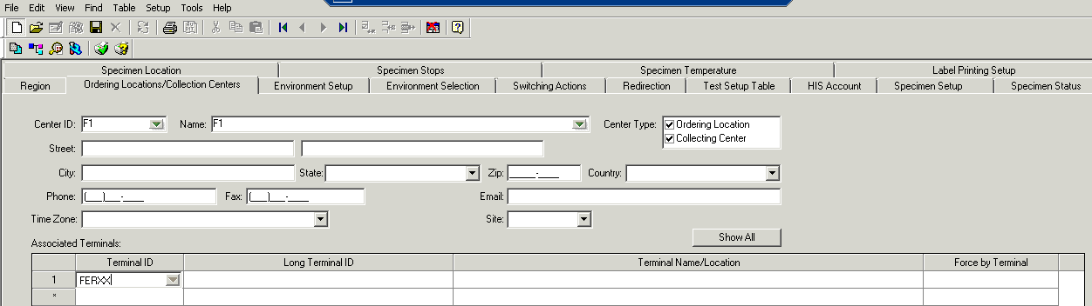
DEPOT
Pink = 4.0 Blue = 4.5

Slide 22
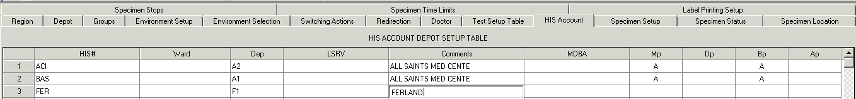
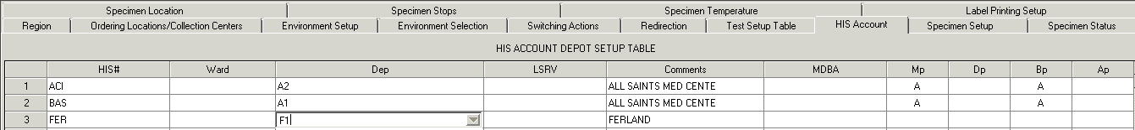
HIS
ACC
Pink = 4.0 Blue = 4.5

Slide 23
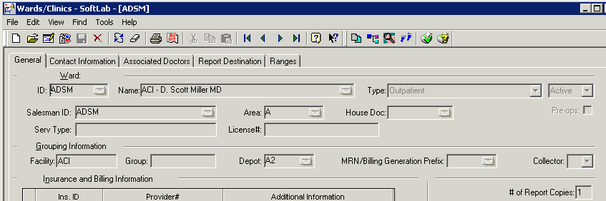
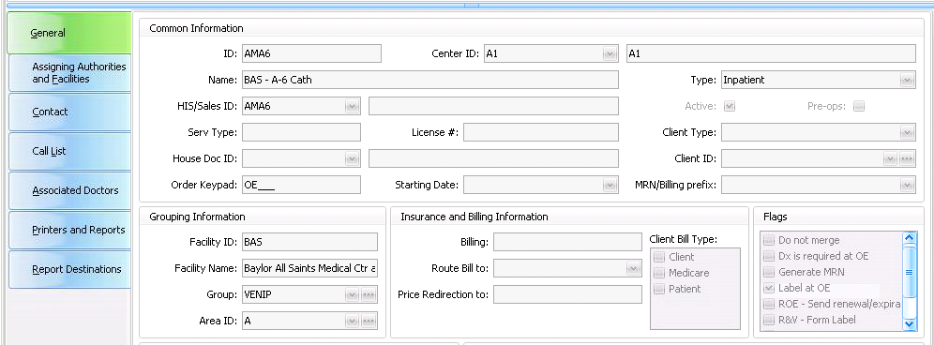
Create Depot/OLCC entries on HIS Account Setup Table
HIS # should be in Facility in Ward/Clinic Setup
Pink = 4.0 Blue = 4.5

Slide 24
Multisite Setup
Environment Selection
Whether you actually need a new environment depends on a number of factors. Please discuss with your implementation specialist.
Advantages to creating a new environment:
Troubleshooting and ongoing changes very “clean”
Instructions easy to write
Locations and environments have a one to one correlation

Slide 25
Multisite Setup
Environment Selection
Disadvantage to creating a new environment:
Every orderable test must be touched to add the new workstation. This includes all referred tests (even if the work is being sent from MLAB). Similarly, POC tests often need to be touched.

Slide 26
Multisite Setup
New Environment Setup
Workstations (4.0)
Workstation Groups Table (4.0)
Testing Environment Setup Table
Testing Environment Selection Table

Slide 27
4.0
Env
After creating workstations, create a group of workstations (optional)
Use the Group of Workstations or just the new workstations to create the new environment
Link new depots to new environment

Slide 28
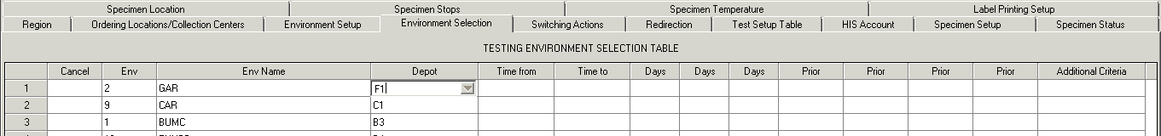
4.5
Env
Create the Environment on the Testing Environment Setup Table
FLAB
Link new depots to new environment
Pink = 4.0 Blue = 4.5

Slide 29
Questions
About
Process or Multisite Setup?

Slide 30
Lab Setup
Create unique LOCATIONS and link them to the new DEPOTS (4.0)
Create unique DEPARTMENTS and link them to the new LOCATIONS
Create unique WORKSTATIONS and link them to the new DEPARTMENTS
Create unique WARDS and link them to the new DEPOTS. Remember to include the HIS # as the facility.
Test Setup
Add the new “F” workstations to existing tests which will be performed at the affiliate site. Remember to check the new environment as you add the workstations.
Add appropriate environment only to appropriate workstation for tests not performed at the new affiliate.
When completed, ALL tests should have ALL environments checked for SOME workstation.
Check with you Implementation Specialist to see if utilities are available to assist in this process.

Slide 31
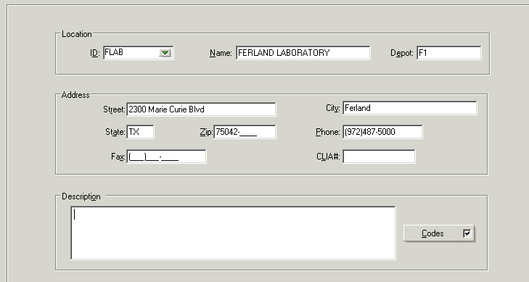
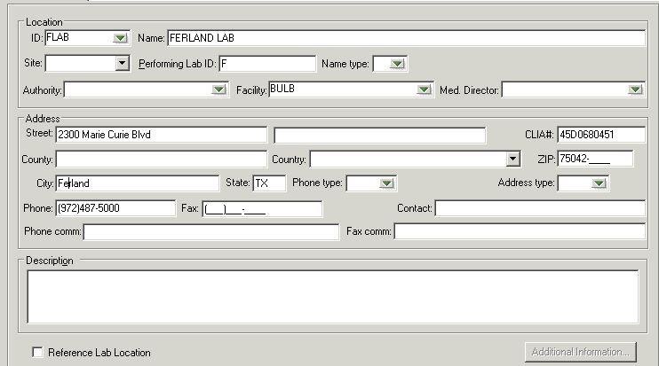
Location
Pink = 4.0 Blue = 4.5

Slide 32
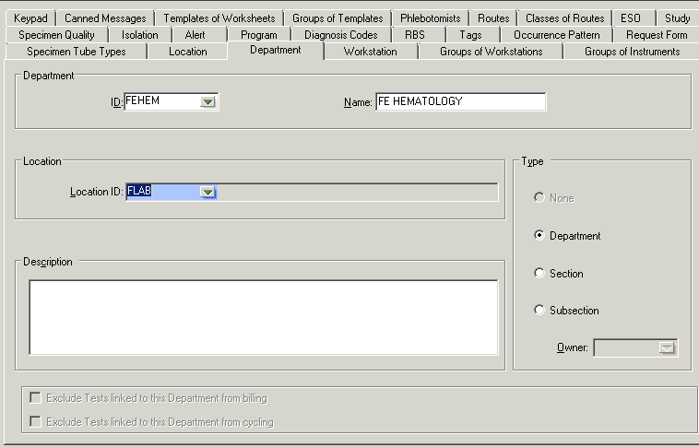
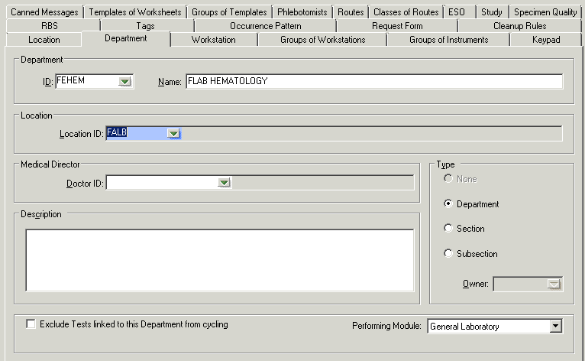
Depart
Pink = 4.0 Blue = 4.5

Slide 33
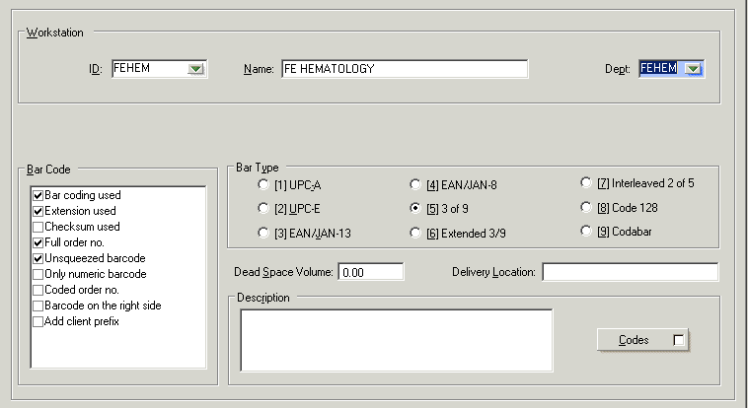
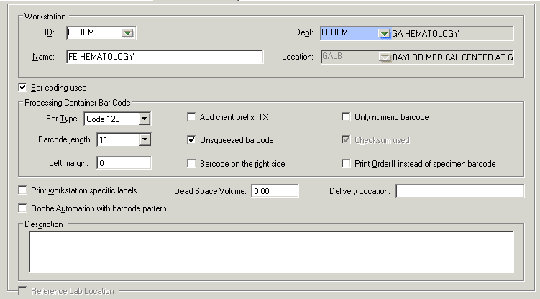
Wrkstn
FLAB FERLAND LAB
Pink = 4.0 Blue = 4.5

Slide 34
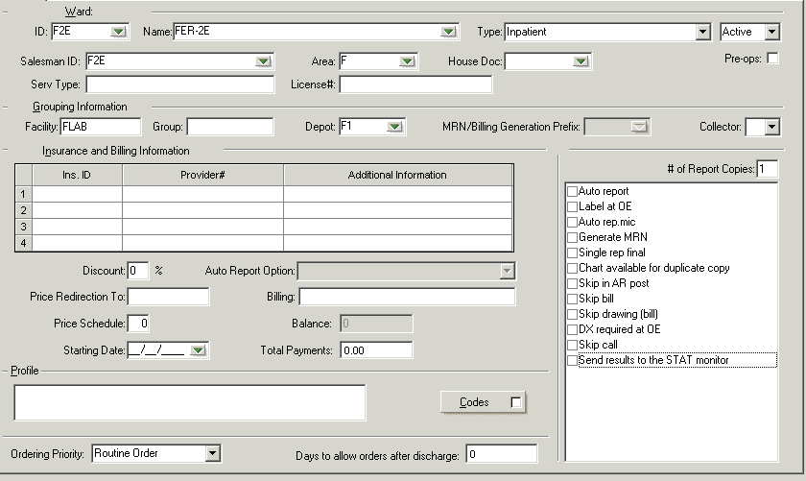
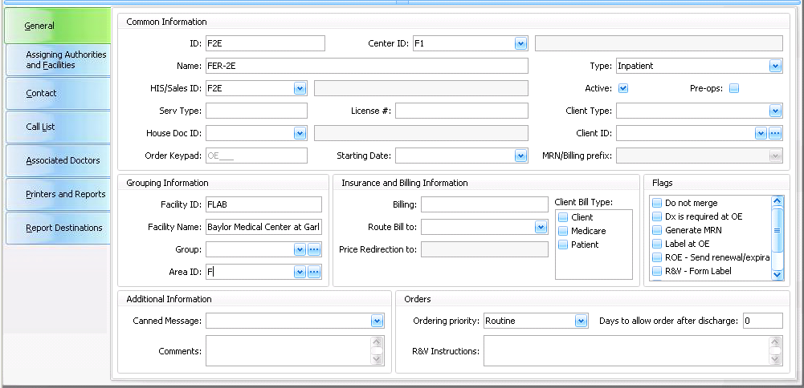
Wards
FERLAND LAB
Ferland Lab
Pink = 4.0 Blue = 4.5

Slide 35
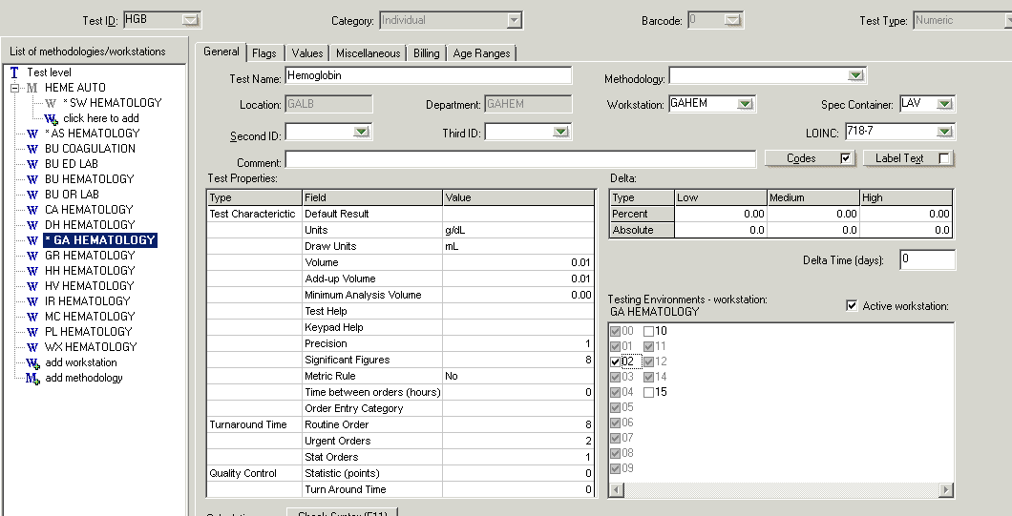
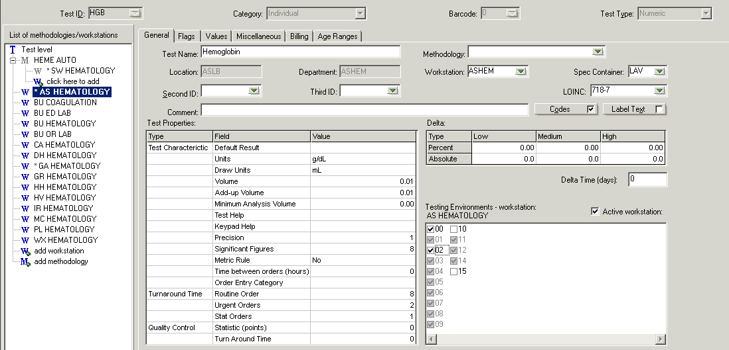
Test
FEHEM
Add new workstation
FEHEM
And check new env if affiliate performs test
Check new env ONLY if another facility will perform the test for the new affiliate
Pink = 4.0 Blue = 4.5

Slide 36
Questions
About
Lab Setup when using a new environment?

Slide 37
Multisite Setup
NO New Environment Setup
Whether you actually need a new environment depends on a number of factors. Please discuss with your implementation specialist.
Advantage- Somewhat less setup
Disadvantage- Cannot redirect again

Slide 38
Lab Setup
Create only new Location/Department/Workstations as previously described (do not create a new environment)
The new Depot/OLCC uses an existing environment (i.e. MLAB, env 0) in the Environment Selection Table.
Add workstations to the tests to be done at other sites
Use the Workstation Redirection Table to push the ordered test from the MLAB workstation to the affiliate’s workstation (FLAB)

Slide 39
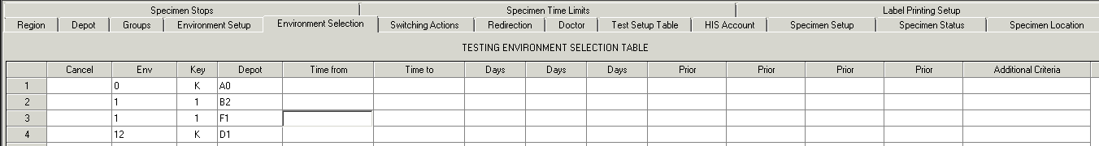
Pink = 4.0 Blue = 4.5 Green = Both

Slide 40
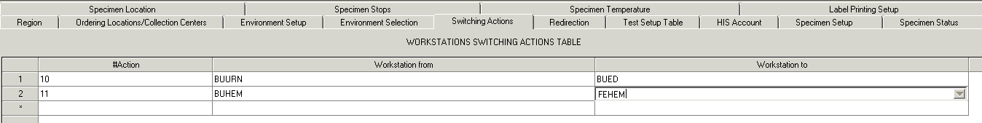
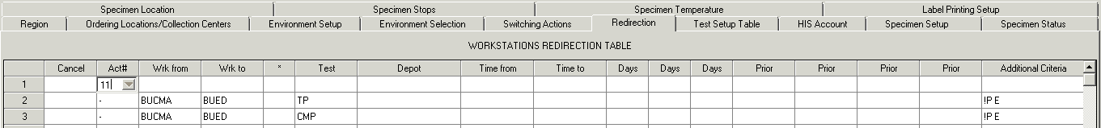
Define a switching action on the Workstations Switching Actions Table
Use it on the Workstations Redirection Table OR enter test by test (either group or individual tests)
Pink = 4.0 Blue = 4.5

Slide 41
Security
Add the new users
For Users who need to see the new site as a choice at log in, add the new site to that user’s role or User Site Role.

Slide 42
Site logins
SCC will add site logins to the upgrade system
Site logins do not need to be added to the live system until Go-Live but they can be added before, if desired. Specify letter(s) to represent the site.

Slide 43
Patient Reports
If new layouts are created for the new affiliate, new report tags will have to be copied and added to the new layouts
If you are using a legend in the footer to indicate the name and address of the performing lab, the new affiliate will need to be added.

Slide 44
Printers
For all new printers to be added, gather the following info
Printer type: label, dot matrix, laser, etc
Printer brand: Zebra, Oki-Data, Intermic, etc.
Printer model: 600, 320, 4000, OptraT, etc.
Serial or network connection
Serial- also get baud rate, flow control, stop bits, parity and character length
Network- also get IP address and type of print server used

Slide 45
Templates/Worklists
New affiliate could have their own or Permission Classes could be used to limit what different affiliates see on the same template/worklist.

Slide 46
Questions
About
Anything?

Slide 47

What to Expect When You’re Expanding
Peggy Steele, BSMT (ASCP)
Lab Implementation Specialist
Client Projects
(727)789-0100 x 4583
peggy@softcomputer.com

